Slide 1


FP=
Information Theoretic Metrics for Multi-Class Predictor Evaluation
2015-04-16
NYC Machine Learning
Sam Steingold, Michal Laclavik

Slide 2
Predictor Evaluation
A predictor is a black box which spits out an estimate of an unknown parameter. E.g.:
will it rain tomorrow?
will this person buy this product?
is this person a terrorist?
is this stock a good investment?

Slide 3
Examples
Perfect – always right
Mislabeled – always the opposite
Random – independent of the actual
San Diego Weather Forecast (a.k.a. SDWF):
Actual: 3 days of rain per 365
Predict: sunshine always!
Coin flip
Actual: true half the time
Predict: true if coin lands Head

Slide 4
Why Evaluate Predictors?
Which one is better?
How much to pay for one?
You can always flip the coin yourself, so the random predictor is the least valuable
When to use this one and not that one?

Slide 5
Confusion Matrix + Cost
predictor |  | Predicted
 |  | Sun | Rain | Hurricane
Actual | Sun | 100 | 10 | 1
 | Rain | 5 | 20 | 6
 | Hurricane | 0 | 3 | 2
cost |  | Predicted
 |  | Sun | Rain | Hurricane
Actual | Sun | 0 | 1 | 3
 | Rain | 2 | 0 | 2
 | Hurricane | 10 | 5 | 0
Total cost (i.e., predictor value)=45

Slide 6
Confusion Matrix - 2
Probability/Cost |  | predicted
 |  | target | non-target
actual | bought | 0.01 / $1 | 0.09 / $0
 | Did not buy | 0.09 / ($0.1) | 0.81 / $0
Expected value of one customer: $0.001 > 0

Slide 7
What if the Cost is Unknown?
 |  | predicted
 |  | True (PT) | False (PF)
actual | True (AT) | TP | FN (type2) | Sensitivity: TP/AT (aka Recall, Hit Rate)
 | False (AF) | FP (type1) | TN | Specificity: TN/AF
 |  | Precision: TP/PT | NPV: TN/PF | Accuracy: (TP+TN) / total
Perfect: FN=FP=0
Mislabeled: TP=TN=0
Random predictor (statistically independent from actual):
TP=PT*AT FN=PF*AT FP=PT*AF TN=PF*AF
Total of 8 partial measures
… and 4 total measures.

Slide 8
Metric Requirements
Meaning: the meaning of the metric should be transparent without resorting to averages of meaningful values
Discrimination:
Weak: its value is 1 for the perfect predictor (and only for it)
Strong: additionally, its value is 0 for a worthless (random with any base rate) predictor (and only for such a predictor)
Universality: the metric should be usable in any setting, whether binary or multi-class, classification (a unique class is assigned to each example) or categorization/community detection (an example can be placed into multiple categories or communities)

Slide 9
Accuracy
Pr(correct)=(tp+tn)/N
1 is perfect
0 is mislabeled
Sucks for SDWF:
Accuracy: 362/365=99.2%
And yet the predictor is actually worthless
Does not detect a random predictor

Slide 10
F1-Score
The harmonic average of Precision and Recall:
1 for a perfect predictor
0 if either Precision or Recall is 0
Correctly handles SDWF (because Recall is 0)…
…But only if we label rain as T!
Otherwise Recall=100%, Precision=99.2%
F1 = 99.6%
F1 is Asymmetric (Positive vs Negative)

Slide 11
Matthews correlation coefficient
AKA Phi coefficient,Pearson correlation coefficient:
Range: [-1 ; 1]
1 for perfect predictor
-1 for mislabeled predictor
0 for the random predictor
Handles SDWF (but not very well)
Hard to generalize to non-binary classifiers.

Slide 12
Uncertainty coefficient
AKA proficiency:
Range: [0;1]
Measures the percentage of bits of information contained in the Actual which is captured by the Predictor.
1 for both perfect and mislabeled predictors
0 for the random predictor
Handles SDWF and all possible quirks – the best.
Easily generalizes to any number of categories.

Slide 13
Comparison
i=0 | TP=20 | FN=0
 | FP=0 | TN=180
i=50 | TP=15 | FN=5
 | FP=45 | TN=135
i=100 | TP=10 | FN=10
 | FP=90 | TN=90
i=150 | TP=5 | FN=15
 | FP=150 | TN=25
i=100 | TP=0 | FN=20
 | FP=180 | TN=0

Slide 14
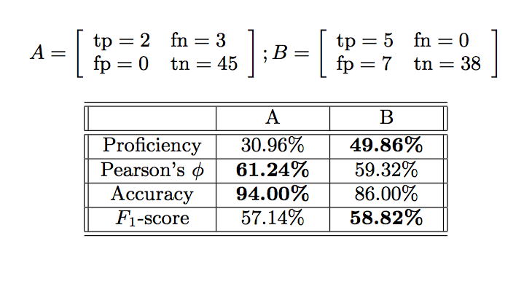
2 Against 2 – take 1

Slide 15
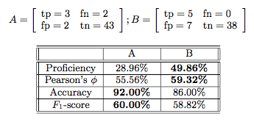
2 Against 2 – take 2

Slide 16
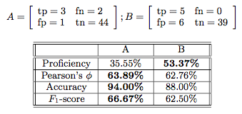
Odd One Out: Proficiency

Slide 17
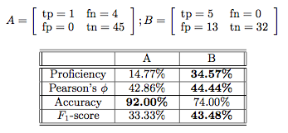
Odd One Out: Accuracy

Slide 18
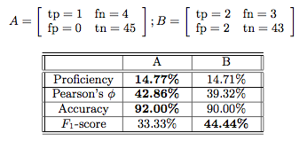
Odd One Out: F1-score

Slide 19
Multi-Class Prediction
Character recognition
Mislabeling is bad
Group detection
Mislabeling is fine
Metrics:
Accuracy = Pr(Actual=Predicted)
No Recall, Precision, F1!

Slide 20


Pearson’s Phi
Define
Where
0 for a worthless (independent) predictor
Perfect predictor: depends on the data

Slide 21
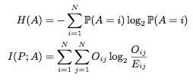
Proficiency
Same as before
with
0 for the worthless predictor
1 for the perfect (and mis-labeled!) predictor

Slide 22
Phi vs Alpha
Phi is to Chi-squared test
Same as
Alpha is to Likelihood-ratio test
Neyman–Pearson lemma: Likelihood-ratio test is the most powerful test!

Slide 23

Example
Vowpal Wabbit:

Slide 24
This Metric is Old! Why is it Ignored?
Tradition: My teacher used it
Inertia: I used it previously
Log was computationally expensive
Not anymore!
Information Theory is unintuitive
Intuition is built up gradually as one learns!
Mislabeled = Perfect
Use the Hungarian algorithm

Slide 25
Multi-Label Categorization
Text Categorization
Mislabeling is bad
But may indicate problems with taxonomy
Community Detection
Mislabeling is fine
Metrics:
No Accuracy
Precision & Recall work again!

Slide 26
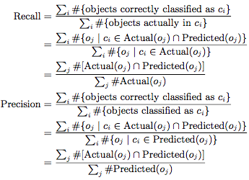
Precision and Recall

Slide 27
Precision & Recall ?
The above is the “macro” P&R (and F1)
Can also define “micro” P&R (and F1!)
There is some confusion as to which is which
Side note: single label per object ➔ Precision=Recall=Accuracy

Slide 28

Proficiency: Definition
Binary variables:
Ac_{i}(o_{j}) = [o_{j} is actually in c_{i}]
Pc_{i}(o_{j}) = [o_{j} is categorized into c_{i}]
Define:
Problem: cannot compute:
KDD Cup 2005 Taxonomy: 67 categories
Cartesian product: 2⁶⁷>10²⁰>>800k examples

Slide 29


Proficiency: Estimate
Numerator: Assume that Ac_{i} is independent of everything but Pc_{i} (similar to Naïve Bayes).
Denominator: Use H(AxB)>=H(A)+H(B).
Define:

Slide 30

Proficiency: Permuted
Recover re-labeling invariance
Let M(c) be the optimal assignment with the cost matrix = pairwise mutual informations
Permuted Proficiency metric:
M is optimal ➔

Slide 31
Properties
Meaning: (an estimate of) the share of the information recovered by the classifier
Strong Discrimination: yes
Universality: the independence assumption above weakens the claim

Slide 32
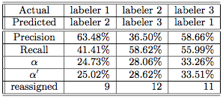
Example: KDD Cap 2005
800 queries
67 categories
3 human labelers

Slide 33

Each Human Against Dice
Pit each of the three human labelers against the random labeler with the same category probability distribution:

Slide 34
Academic Setting
Consider a typical University department:
Every professor serves on 9 administrative committees out of 10 available.
Take the worthless predictor which assigns each professor to 9 random committees
Precision=Recall=90%
Proficiency=0

Slide 35
Numeric Stability
Think of the data as an infinite stream of observations, and view the actually available data as a sample.
How would the metrics change is the sample is different?
All metrics have approximately the same variability (standard deviation):
~1% for 800 observations of KDD Cup 2005
~0.5% for 10,000 observations in the Magnetic data set

Slide 36
Summary
If you know the costs – use the expected value.
If you know what you want (recall/precision &c) – use it
If you want a general metric, use Proficiency instead of F1.

Slide 37
Implementation
Python code in https://github.com/Magnetic/proficiency-metric

