Slide 1
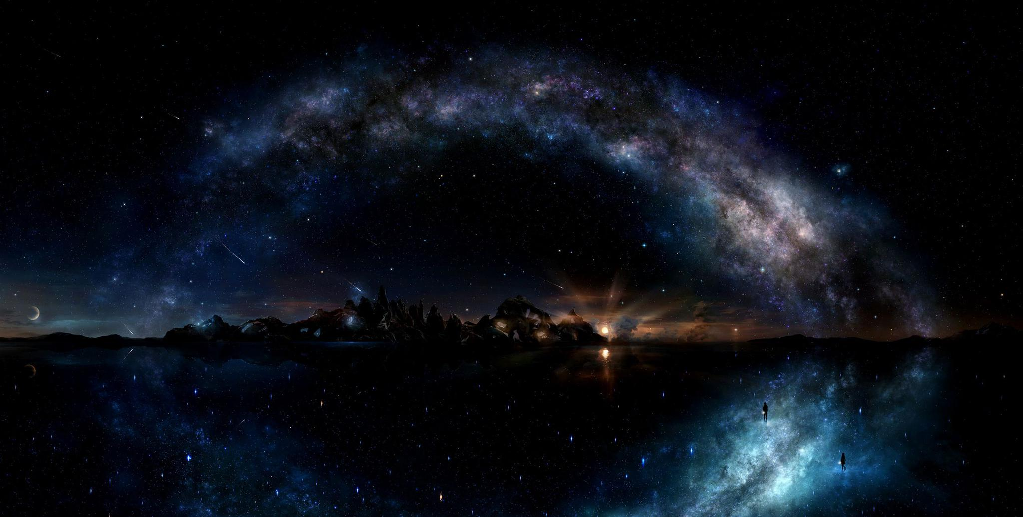
Explore beyond the earth

Slide 2
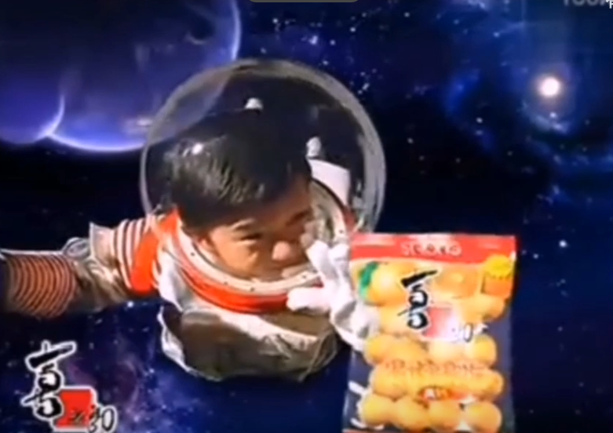

Curiosity
Spirit of adventure
Out of human nature

Slide 3
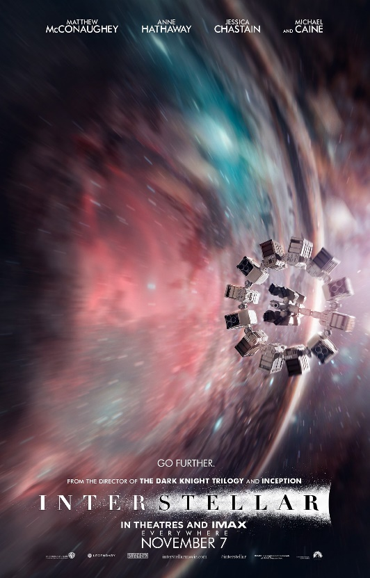
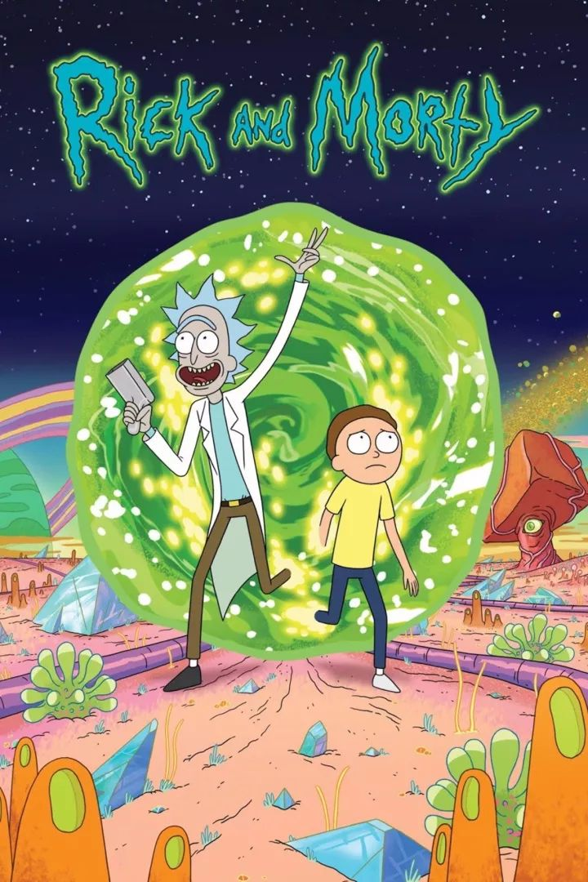
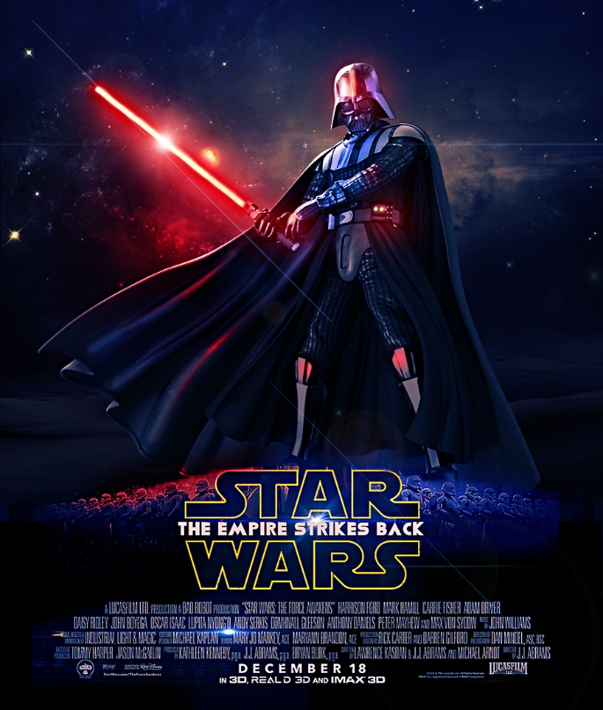
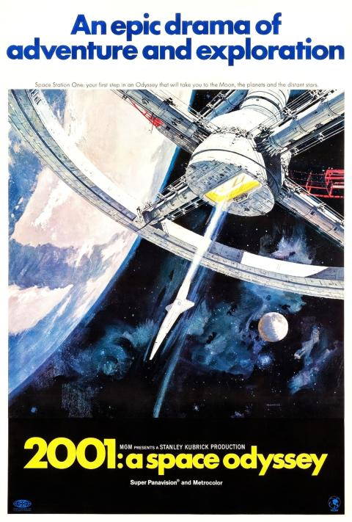
They have lots of fans
In the last few millennia we have made the most astonishing and unexpected discoveries about the Cosmos and our place within it, explorations that are exhilarating to consider.

Slide 4
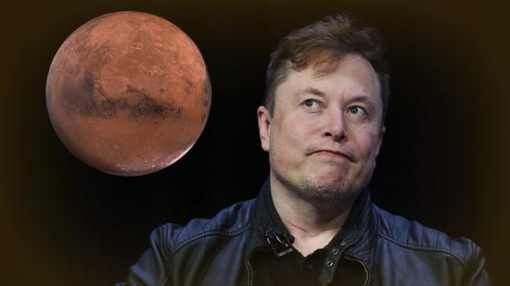
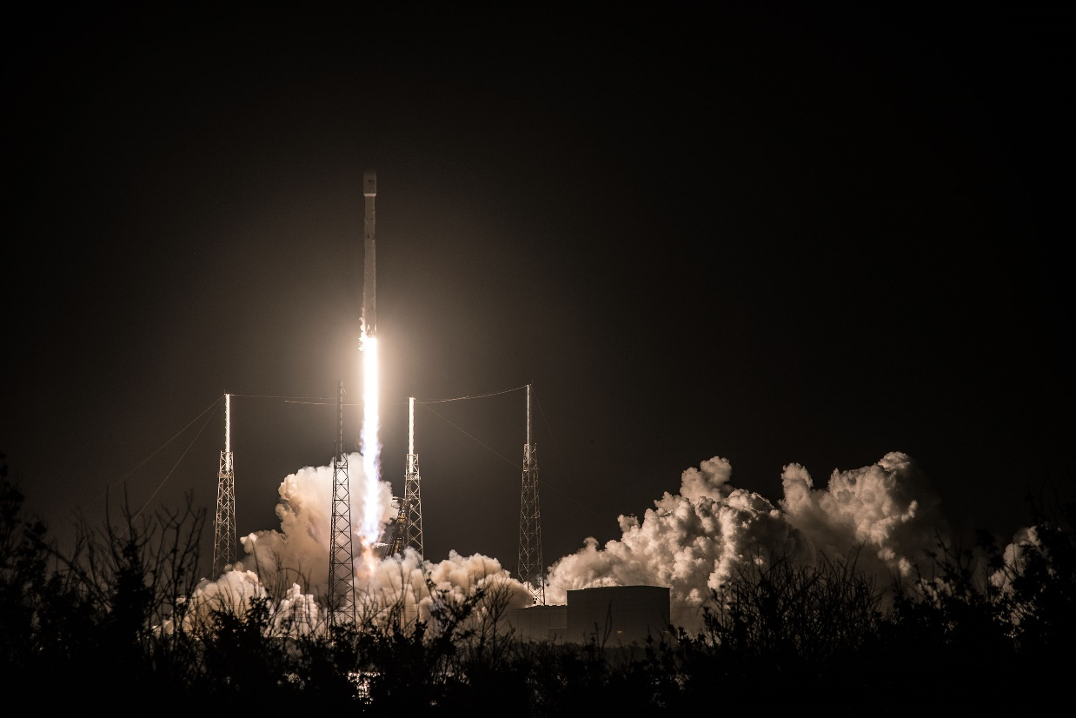
What if…
The known is finite, the unknown infinite; intellectually we stand on an islet in the midst of an illimitable ocean of inexplicability. Our business in every generation is to reclaim a little more land.

Slide 5
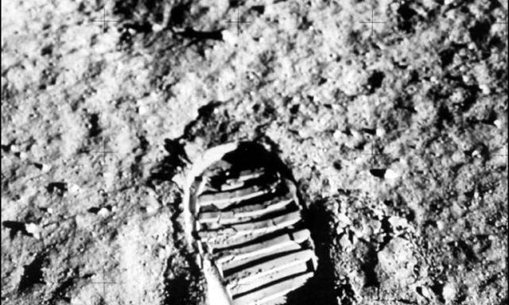
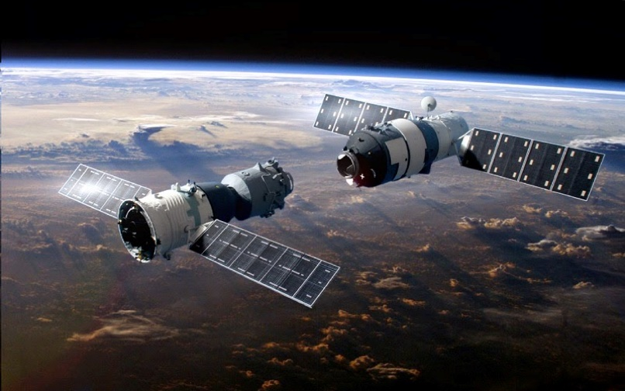
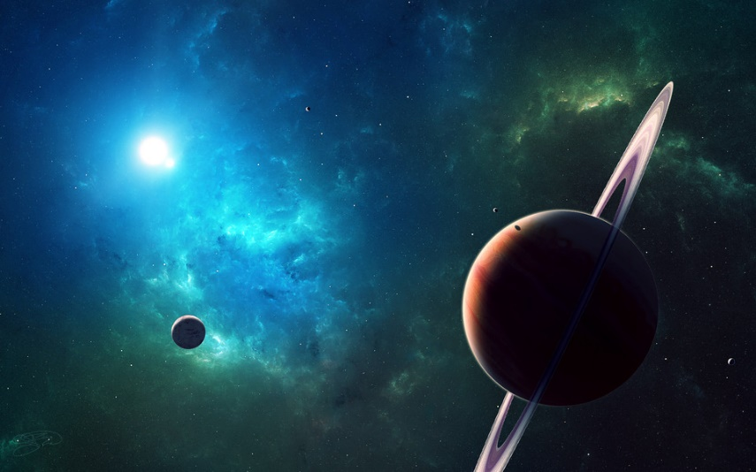
Waiting for us to explore

