Slide 1
FUNDAMENTALS OF PHYSIOLOGY (GAC 183)
B. SEREBOUR,
Dept of Physiology, SMS

Slide 2
Homeostasis And Homeostatic Control Systems

Slide 3
Homeostasis
The term ‘homeostasis’ was coined in 1932 by Walter Cannon from the Greek words homeo (same, like, resembling, similar) and stasis (to stand, posture, stillness, changeless).
This concept was created by Claude Bernard who proposed the principle of the constancy of the milieu interieur in 1878.
The ECF is considered the internal environment.

Slide 4
Key observations
Highlights the body’s ability to regulate its own internal conditions despite the external changes
The glycogenic function of the liver and the concept of ‘internal secretion’
Vasomotor nerves and temperature
The puncture experiment- artificial diabetes
The stability of body fluids
Notes:
The liver stores a starchy substance (glycogen)- to maintain blood sugar levels even in fasting- a self-regulatory mechanism
Cutting certain nerves caused vasodilation and increased heat in that part of the body and stimulating such nerves caused the opposite effect. Realizing those nerves controlled blood flow to regulate body temperature
Injuring the fourth ventricle of the brain cause an immediate increase in blood sugar and in the urine demonstrating neural link in regulating sugar levels
The blood and lymph circulate chemical materials, maintain heat and sugar levels regardless the external environment.

Slide 5
Homeostasis is the maintenance of a constant/relatively stable internal environment in the face of changing external environment.
Homeostasis is continually disturbed by stress
Most diseases results from disruption of homeostasis, a condition known as homeostatic imbalance
Understanding the concept of homeostasis form the basis for clinical diagnostic procedures
Homeostasis allows humans to live and adapt in many habitats

Slide 6
The essential variables of the internal environment that are maintained within limits
acceptable are:
Concentration of oxygen and carbon dioxide
pH of the internal environment
Concentration of nutrients and waste products
Concentration of salt and other electrolytes
Volume and pressure of extracellular fluid
temperature

Slide 7
Homeostasis depends on the action and interaction of a number of body systems to maintain a range of conditions within which the body can best operate.
circulatory system
lymphatic system and immunity
digestive system
nervous system
endocrine system
integumentary system
reproductive system
muscular
skeletal system
respiratory system
excretory system
the nervous system and to some degree the endocrine system are the main control systems of homeostasis

Slide 8
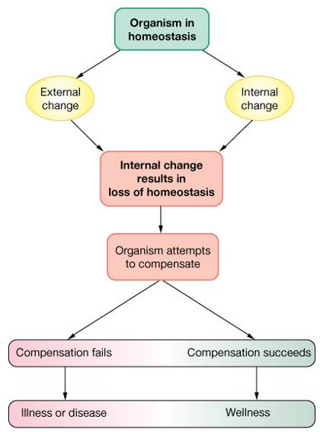
Successful compensation
Homeostasis reestablished
Failure to compensate
Pathophysiology
Illness
Death
When a homeostatic disruption becomes so severe that it is no longer compatible with survival, death results.

Slide 9
Regulation of the Body Functions
Regulation- the ability of an organism to maintain a stable internal conditions in a constantly changing environment
Three types:
1. Chemical (hormonal) Regulation
2. Nervous Regulation
3. Autoregulation

Slide 10
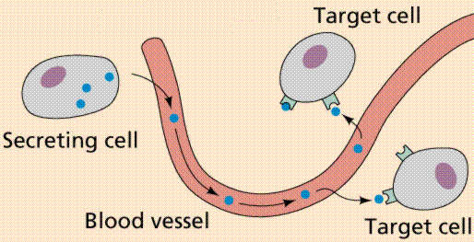
Chemical (hormonal) Regulation
a regulatory process performed by hormone or active chemical substance in blood or tissue.
response slowly
acts extensively
lasts for a long time.

Slide 11
Nervous Regulation
a process in which body functions are controlled by nerve system
Pathway: nerve reflex
Types: unconditioned reflex and conditioned reflex
Example: baroreceptor reflex of arterial blood pressure
Characteristics:
response fast
acts exactly or locally
last for a short time

Slide 12
Autoregulation
a tissue or an organ can directly respond to environmental changes
independent of nervous and hormonal control
Characteristics：
Amplitude of the regulation is smaller than other two types.
Extension of the effects is smaller than other two types.
The three regulations have coordinated and acts as one system, “feedback control system”.

Slide 13
Homeostatic Control Systems
Homeostatic control systems are body components that generate compensatory regulatory responses to maintain relatively stable conditions of the internal environment
they are subject to nervous and endocrine
control
homeostatic control systems have three
components. These are:
detectors/sensors
integrating/control center
effectors

Slide 14
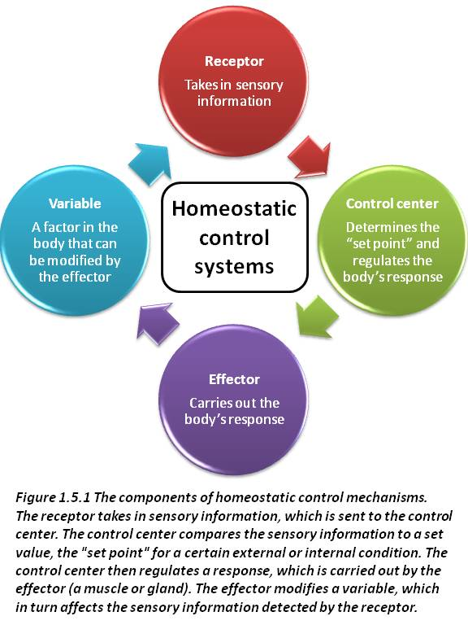

Slide 15
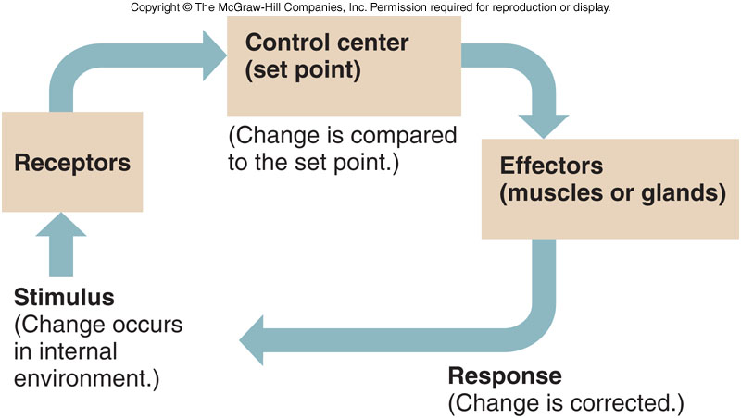

Slide 16
Two basic strategies are used by the body to maintain homeostasis. These are:
Feedback
Feedforward
Feedback Control
The term Feedback refers to responses made after a change has been detected
The course of a reaction is controlled by the activity of some of the products of the reaction ie a mechanism by which the products of a process can act as regulators of that process.
Feedback control can be either negative or positive

Slide 17
Negative Feedback
This occurs when a change in a controlled variable triggers a response that opposes the change
Homeostasis primarily operates on this principle
They are inhibitory
Negative feedback helps to maintain equilibrium
Disruption of negative feedback can lead to undesirable results

Slide 18
Stimulus triggers response to counteract further change in the same direction.
Negative-feedback mechanisms prevent small changes from becoming too large.
Examples?

Slide 19
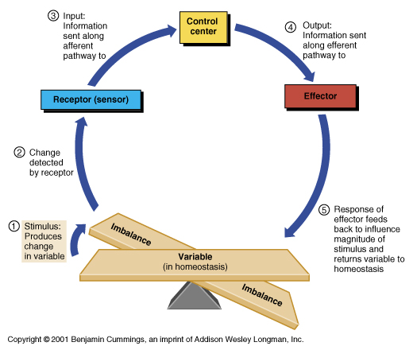

Slide 20
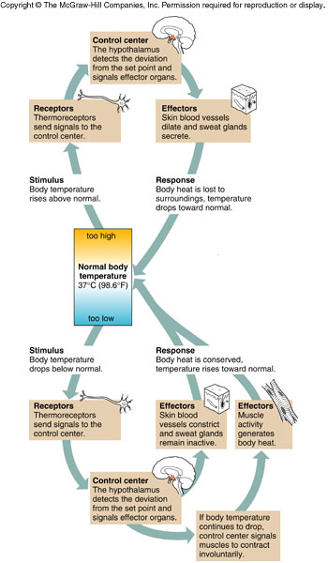

Slide 21
Positive Feedback
This occurs when a change in a controlled variable triggers a response that amplifies the change
It is stimulatory
moves the controlled variable further away from the set point
Brings about disequilibrium
Not involved in homeostasis
At times makes negative feedback more efficient

Slide 22
The feedback signal or output from the controlled system increases the action of the control system
Examples:
Blood clotting
Micturition
Na⁺ inflow in genesis of nerve signals
Contraction of the uterus during childbirth (parturition)
Enhances the action of original stimulus or amplify or reinforce change
promote an activity to finish

Slide 23
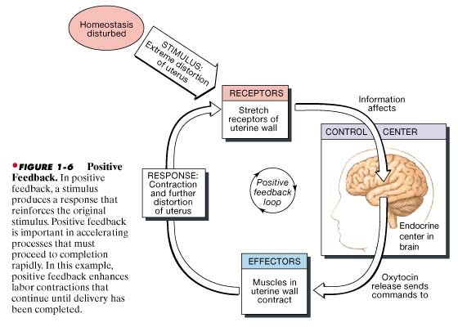
Positive Feedback: Stimulatory.
Stimulus trigger mechanisms that amplify the response and reinforces the stimulus.

Slide 24
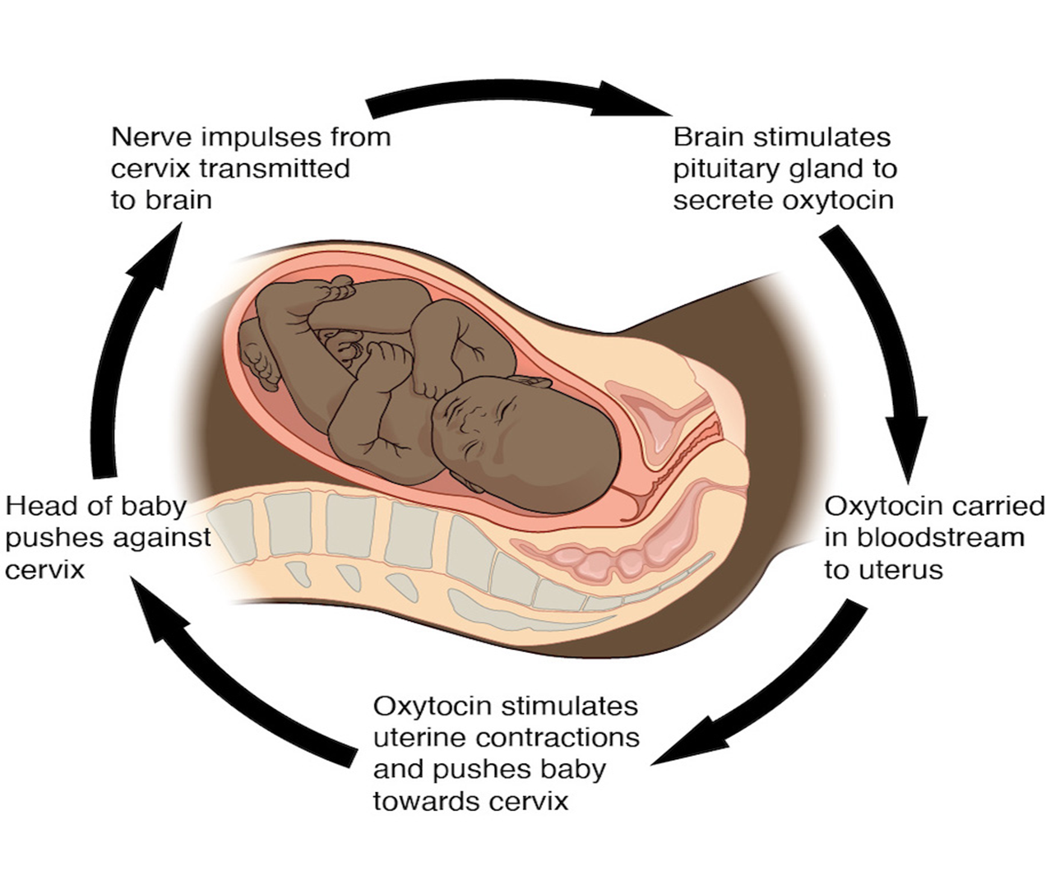

Slide 25
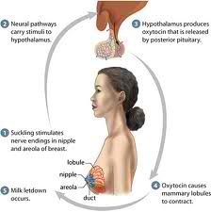

Slide 26
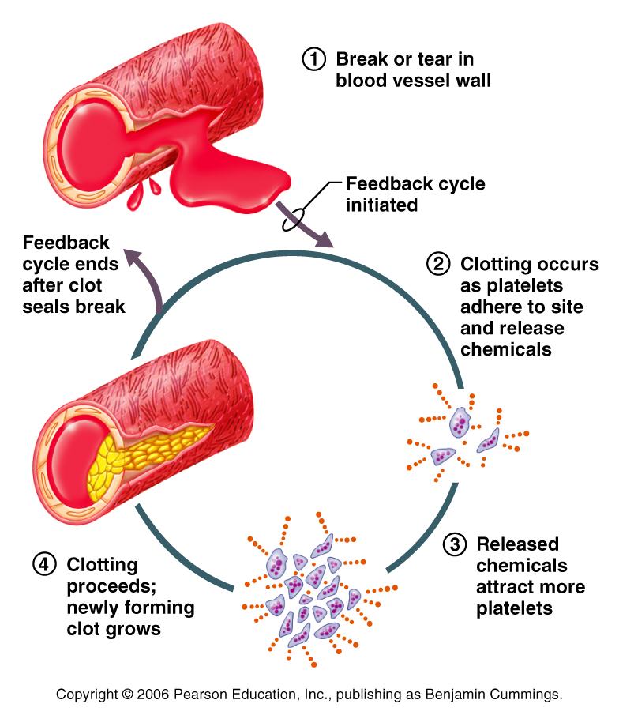
Notes:
Throboxane A2 and ADP are hemostatic mediator (mediators)

Slide 27
Feedforward Control
This is a response in anticipation of a change in a controlled variable. The disturbance is suppressed before it has the chance to affect the system's essential variables
It is not error based
prepares the body for a change
improves the speed of the body’s homeostatic responses
minimizes fluctuations in the level of variable being regulated
such regulation use external detectors or learning

Slide 28
Concept: Direct effect of stimulus on the control system before the action of feedback signal occurs.
Examples
salivation reflex
insulin secretion triggered by food in the gut
penile erection in human males (visual or tactile stimuli)
shivering before dipping in cold water
increase in heart and respiratory rate before an event

Slide 29
Significance of Feedback-forward
adaptive feedback control.
makes the human body to foresee and adapt the environment promptly and exactly
(prepare the body for the change).

Slide 30
END

