Slide 1
Snake Game
Group 1 :
Raihan Farid Erlangga Wahyu Utomo Mohammed Fachry Dwi Handoko

Slide 2
Explanation
We make a platform game called ‘snake game’, the player will be the ‘snake’ that will eat the corresponding ‘target’
We move the snake using ‘arrow’ button
Everytime the snake eat the food, the score increased
The edge of the map will loop back into the platform
The snake died if it eat its own body
We can respawn by pressing button ‘R’

Slide 3
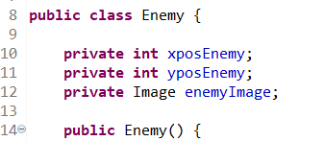
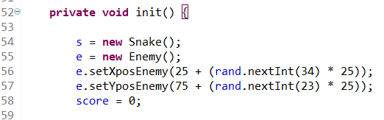
Implementation of Encapsulation
In our code, we implement ‘encapsulation’ almost in every aspect of our game
We ‘encapsulate’ the data and use it in another class to make it easier accessing the data in each class
Example:
We declare class “Enemy”
And call that class in another class called “Gameplay” to change one or another data in class “enemy”, can be seen in the image

Slide 4
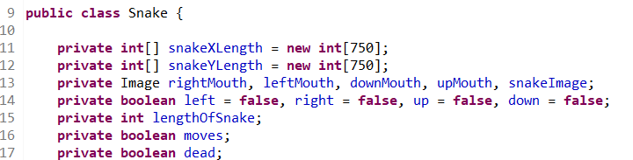
Implementation of Inheritance and Polymorphism
We inherit most of our public class in the gameplay superclass
Example:
We declare a class called snake
And reuse it in the class called ‘gameplay’ to initialize new object

Slide 5
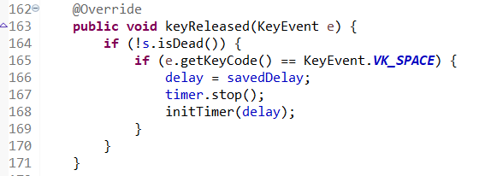
Implementation of Override
We use override to checking the user input if the button is pressed or released
Example:

Slide 6
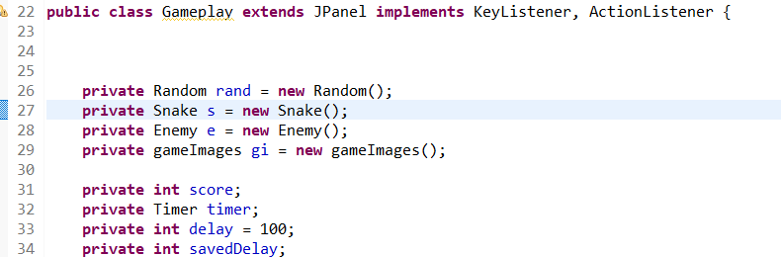
Implementation of Composition
Our code mainly focus in composition because the class ‘gameplay’ cannot run itself without class from ‘snake’ ‘enemy’ or ‘gameImage’
Example:
The class ‘gameplay’ that used ‘snake’, ‘enemy’, and ‘gameImages’

Slide 7

Thank you For your attention

