Slide 1
Argentina Economic and Demographic Analysis
Generated Visualizations

Slide 2
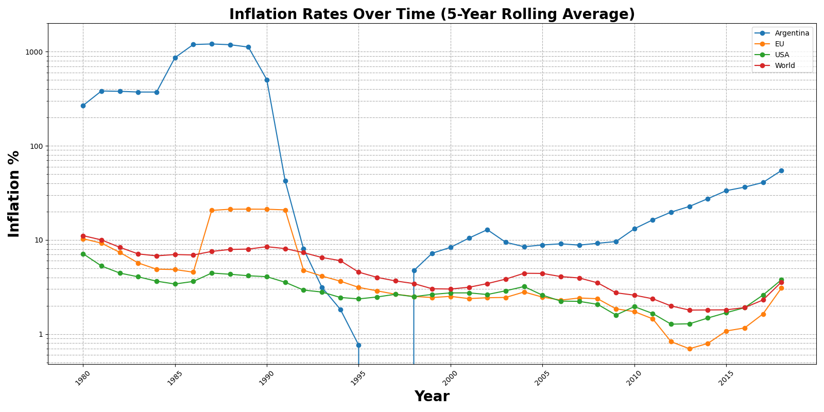
Cpi Display Lineplot

Slide 3
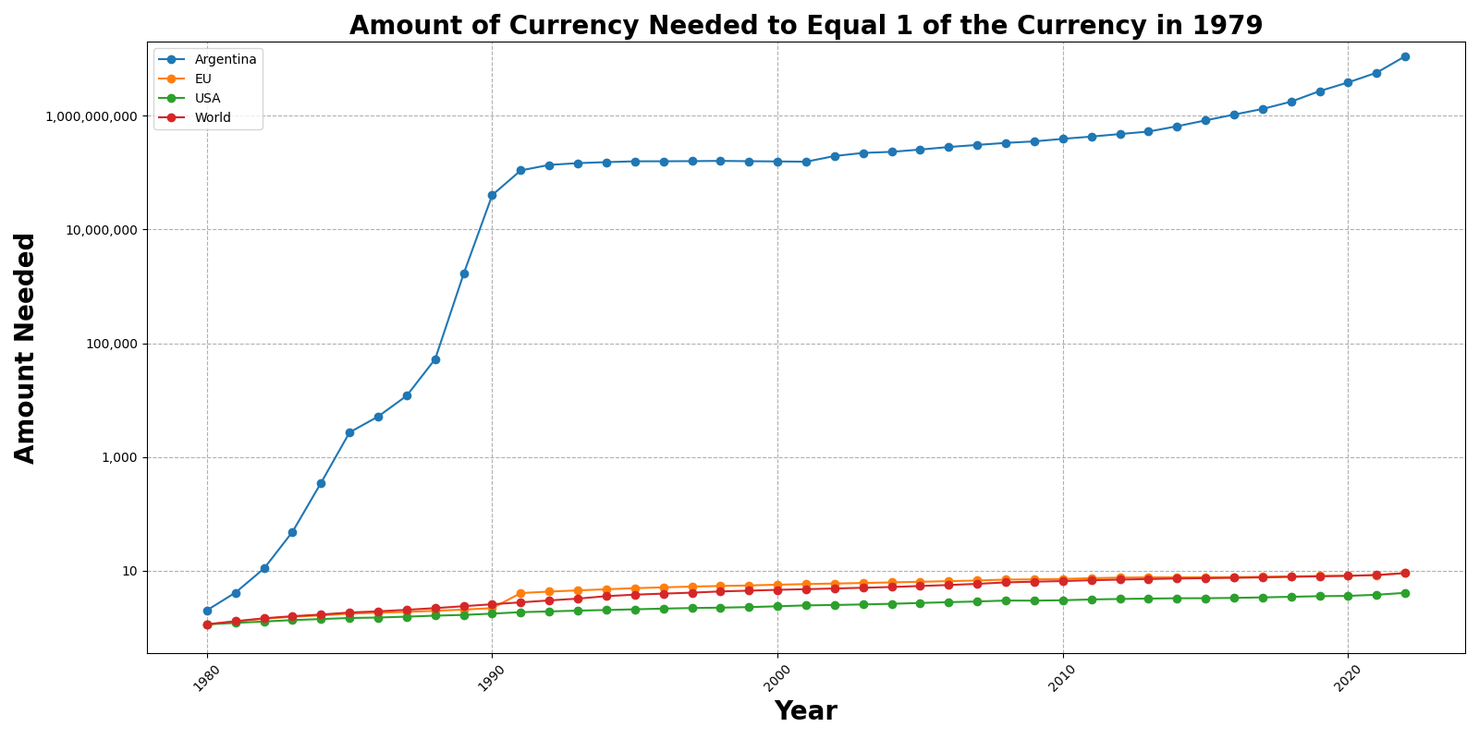
Currency Valuation Over Time

Slide 4
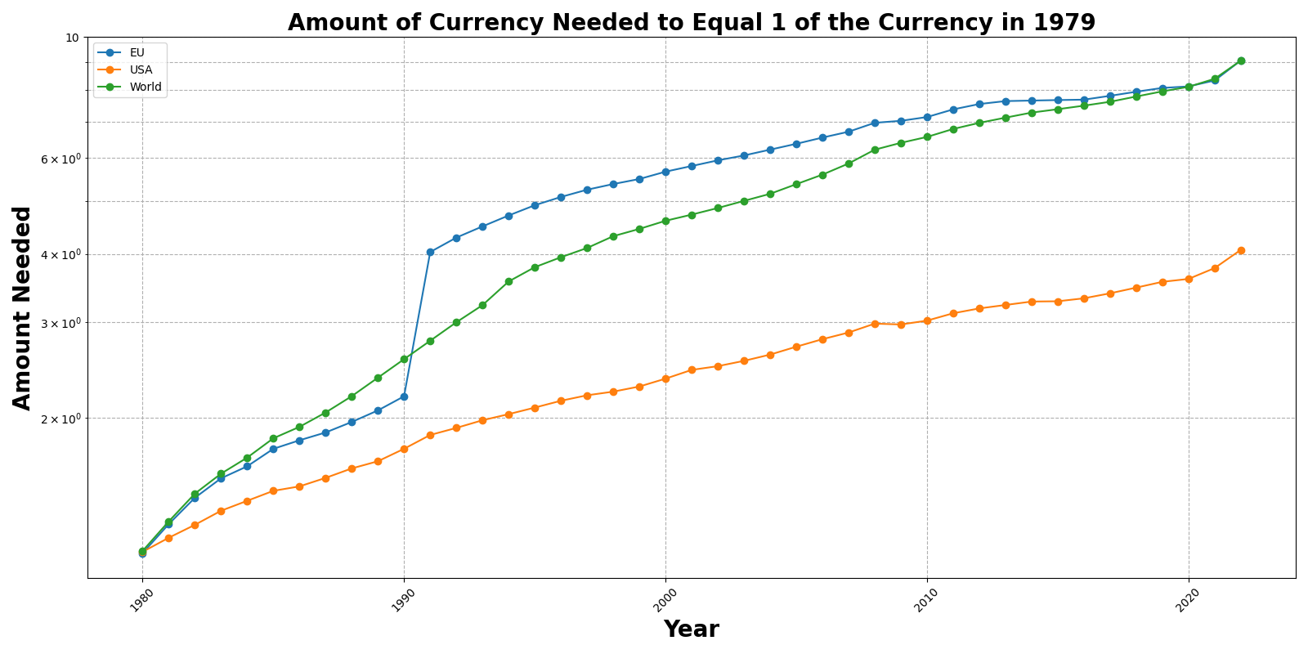
Currency Valuation Over Time Excluding Argentina

Slide 5
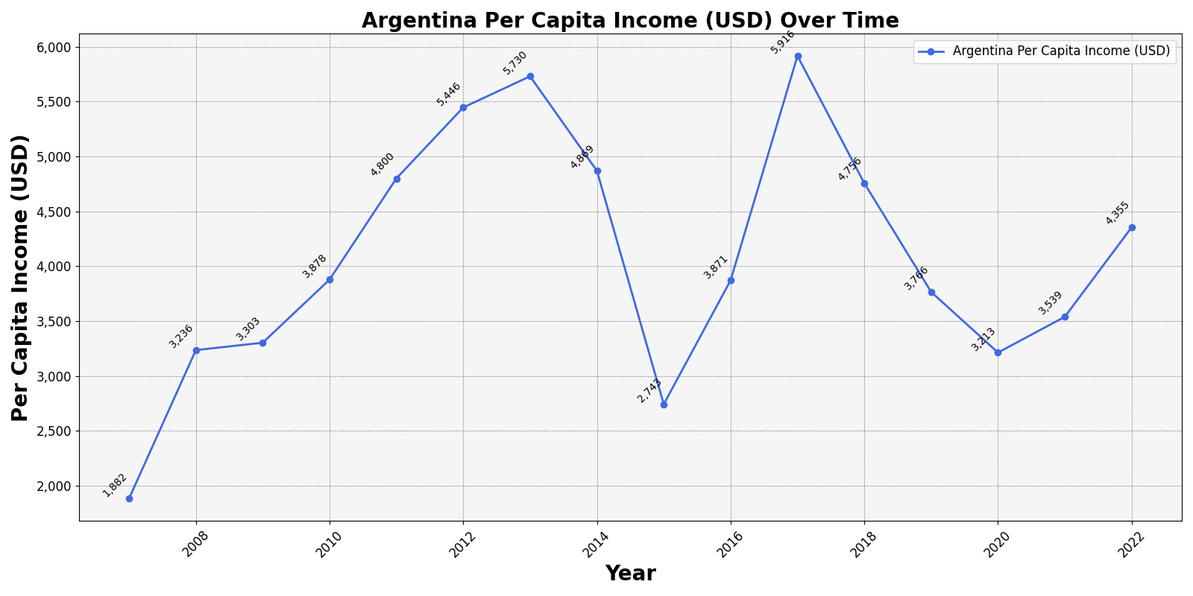
Household Purchasing Power In Argentina

Slide 6
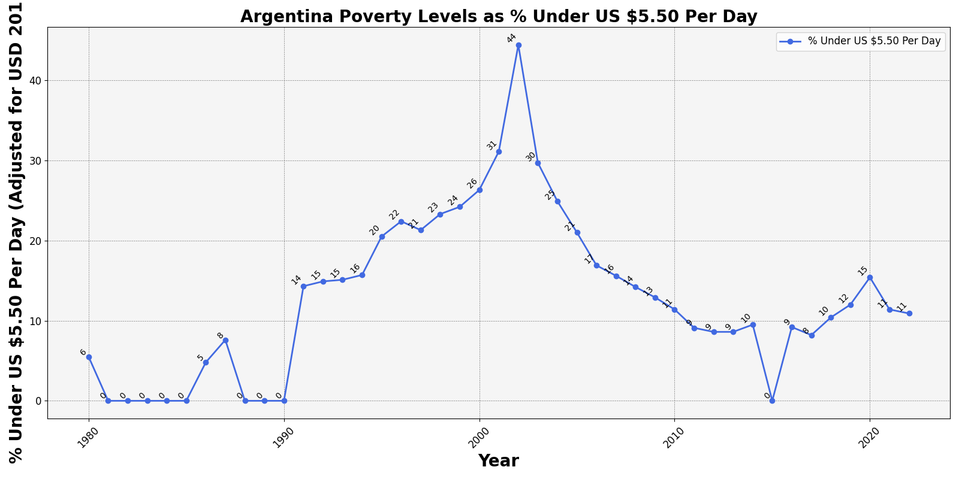
Argentina Poverty Levels

Slide 7
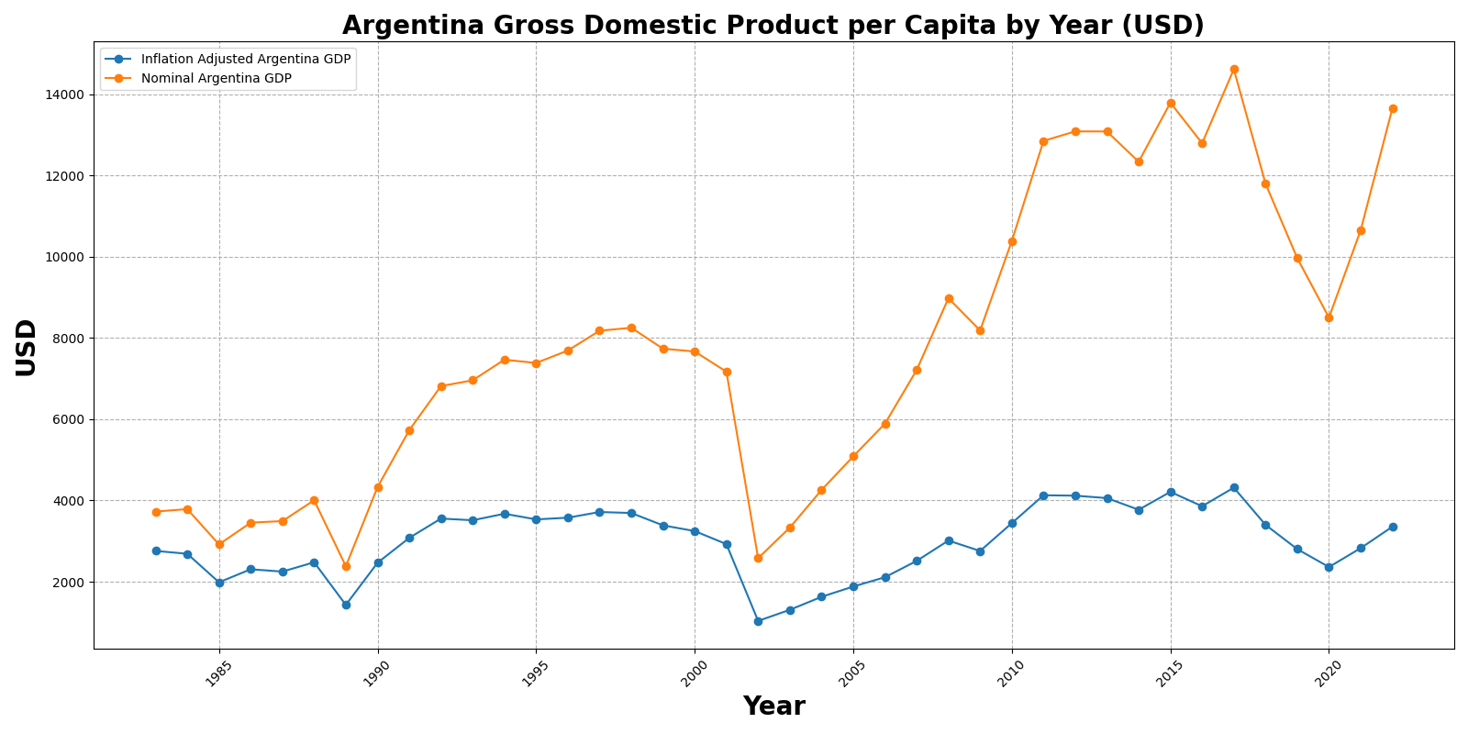
Gross Domestic Weighted Inflation Lineplot

Slide 8
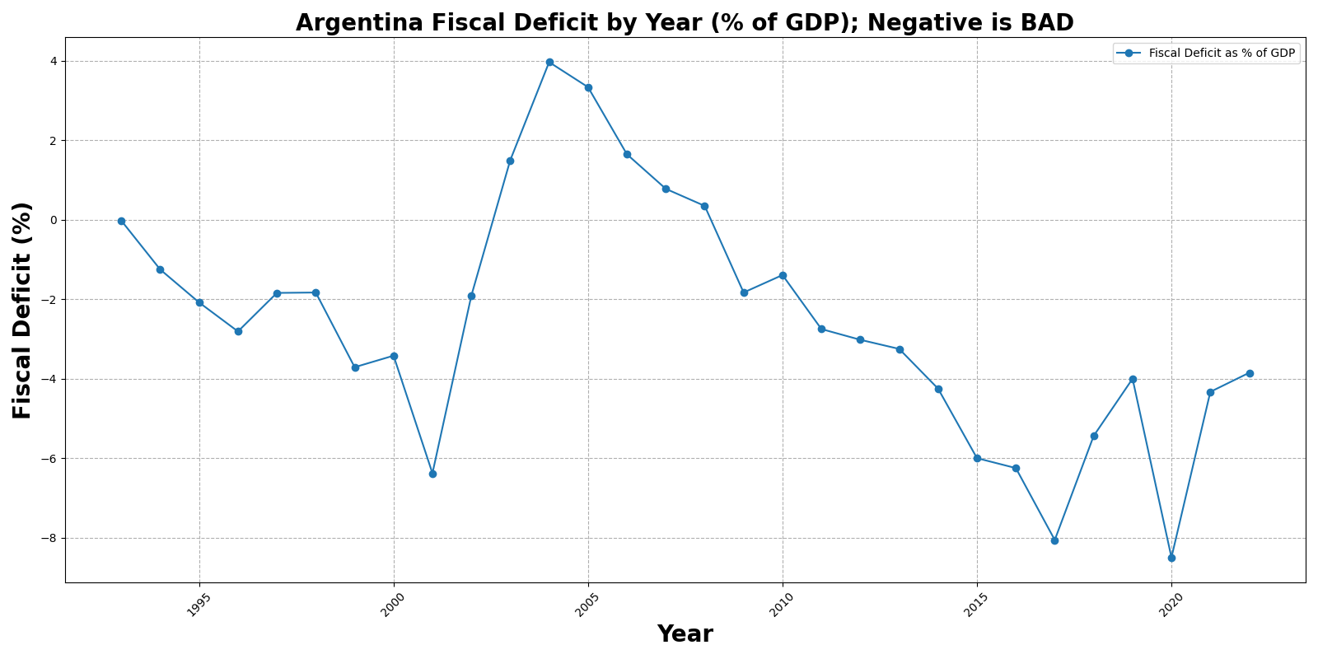
Fiscal Deficit Lineplot

Slide 9
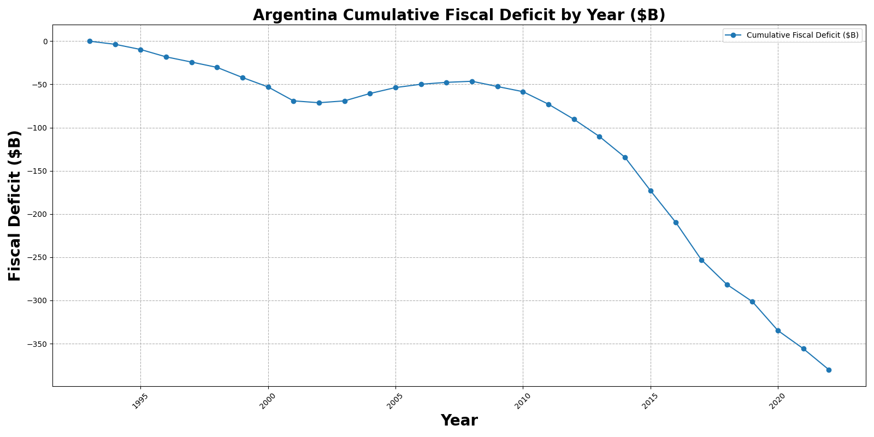
Cumulative Fiscal Deficit Lineplot

Slide 10
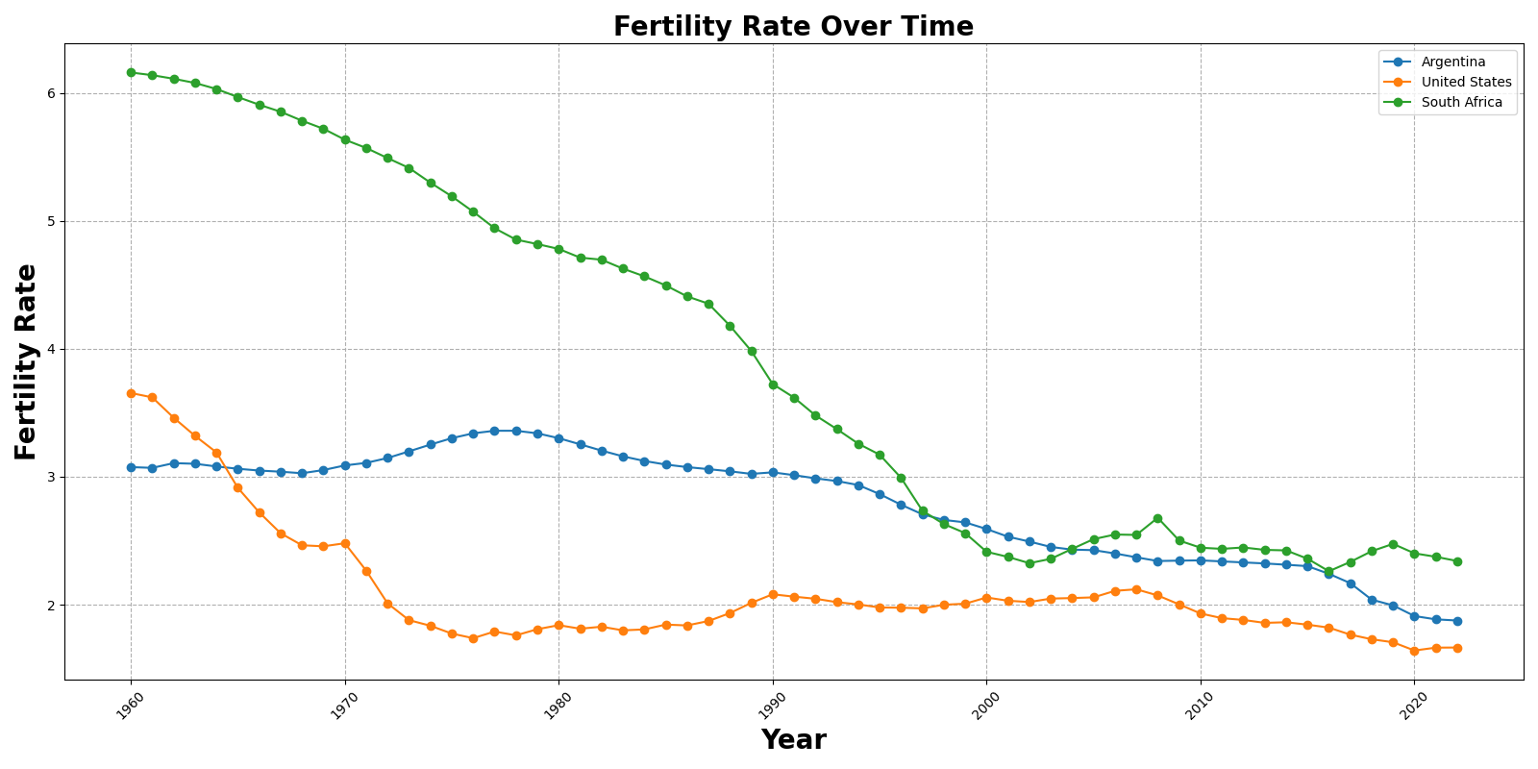
Fertility Rate Over Time

Slide 11
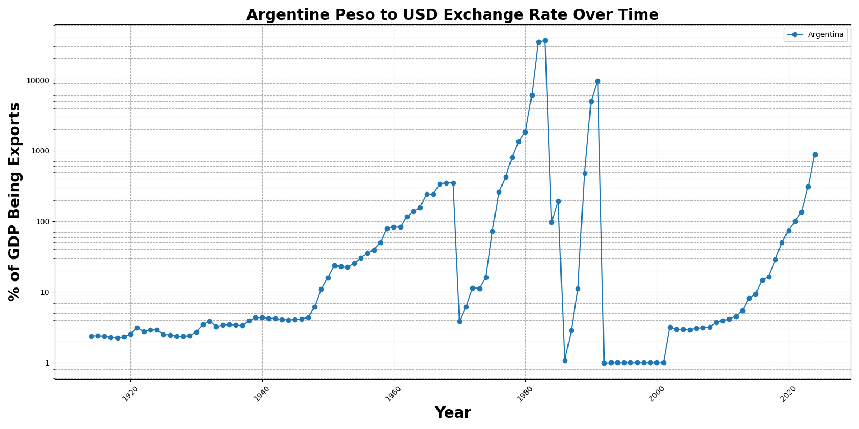
Exchange Rate Over Time

Slide 12
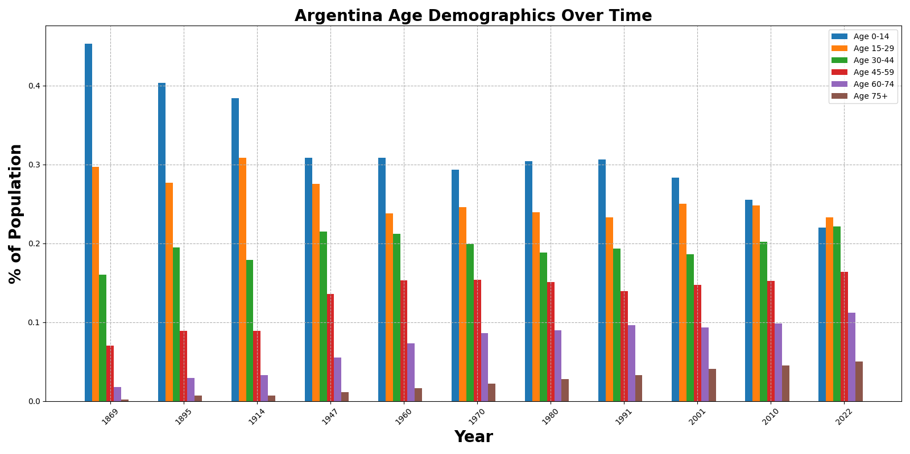
Argentina Age Demographics Over Time

Slide 13
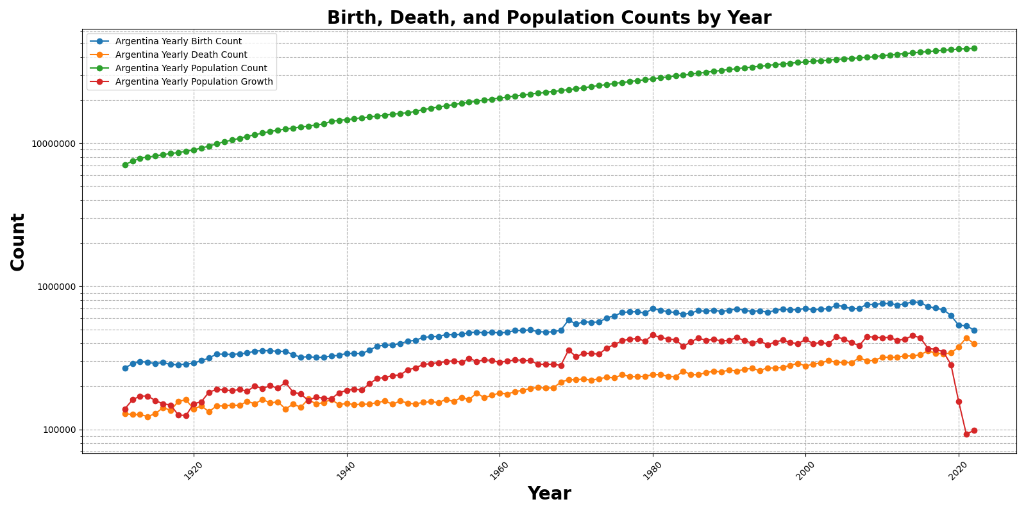
Argentina General Population Data

Slide 14
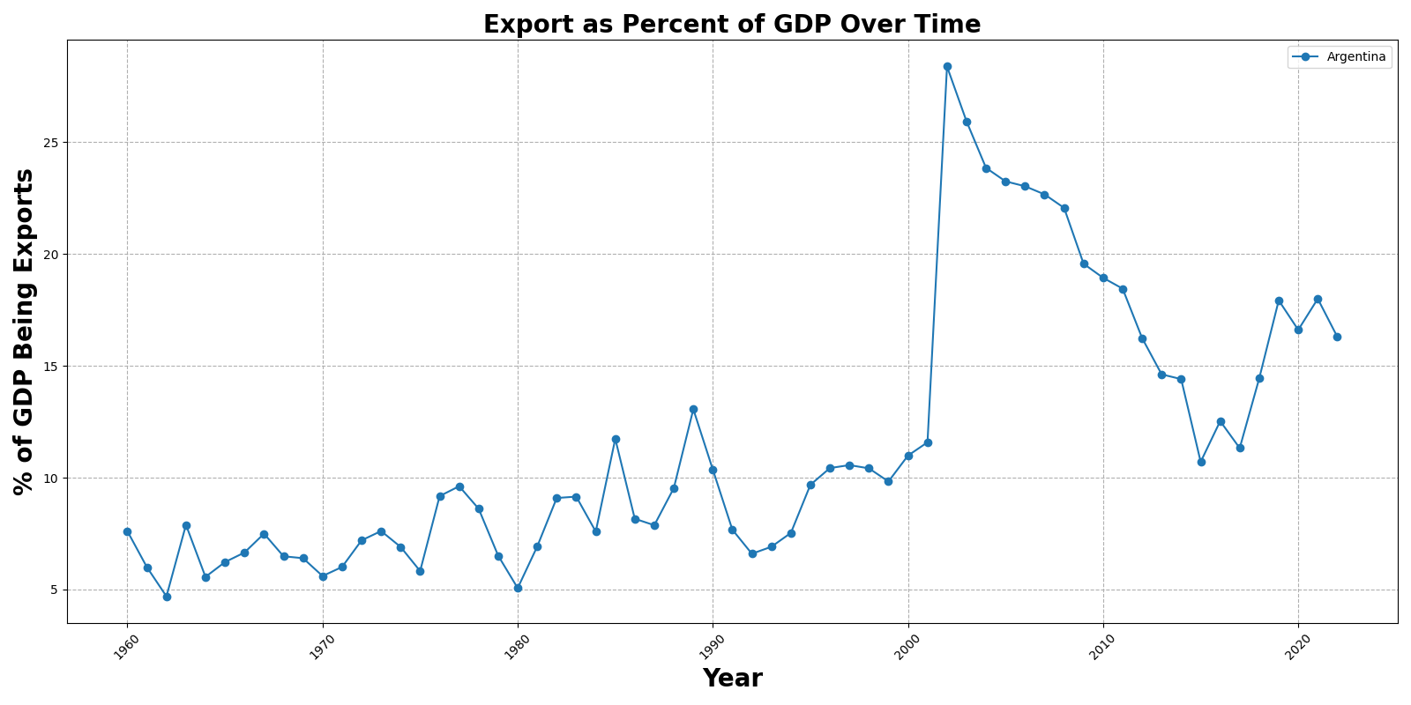
Export Percentage Of Gdp Over Time

