Slide 1
Argentina Economic and Demographic Analysis
Generated Visualizations

Slide 2
For where your treasure is, there your heart will be also.
Matthew 6:21
The rich rule over the poor, and the borrower is slave to the lender.
Proverbs 22:7
Honor the Lord with your wealth, with the firstfruits of all your crops.
Proverbs 3:9

Slide 3
Keep your lives free from the love of money and be content with what you have, because God has said, 'Never will I leave you; never will I forsake you.'
Hebrews 13:5
One person gives freely, yet gains even more; another withholds unduly, but comes to poverty.
Proverbs 11:24
Whoever loves money never has enough; whoever loves wealth is never satisfied with their income. This too is meaningless.
Ecclesiastes 5:10

Slide 4
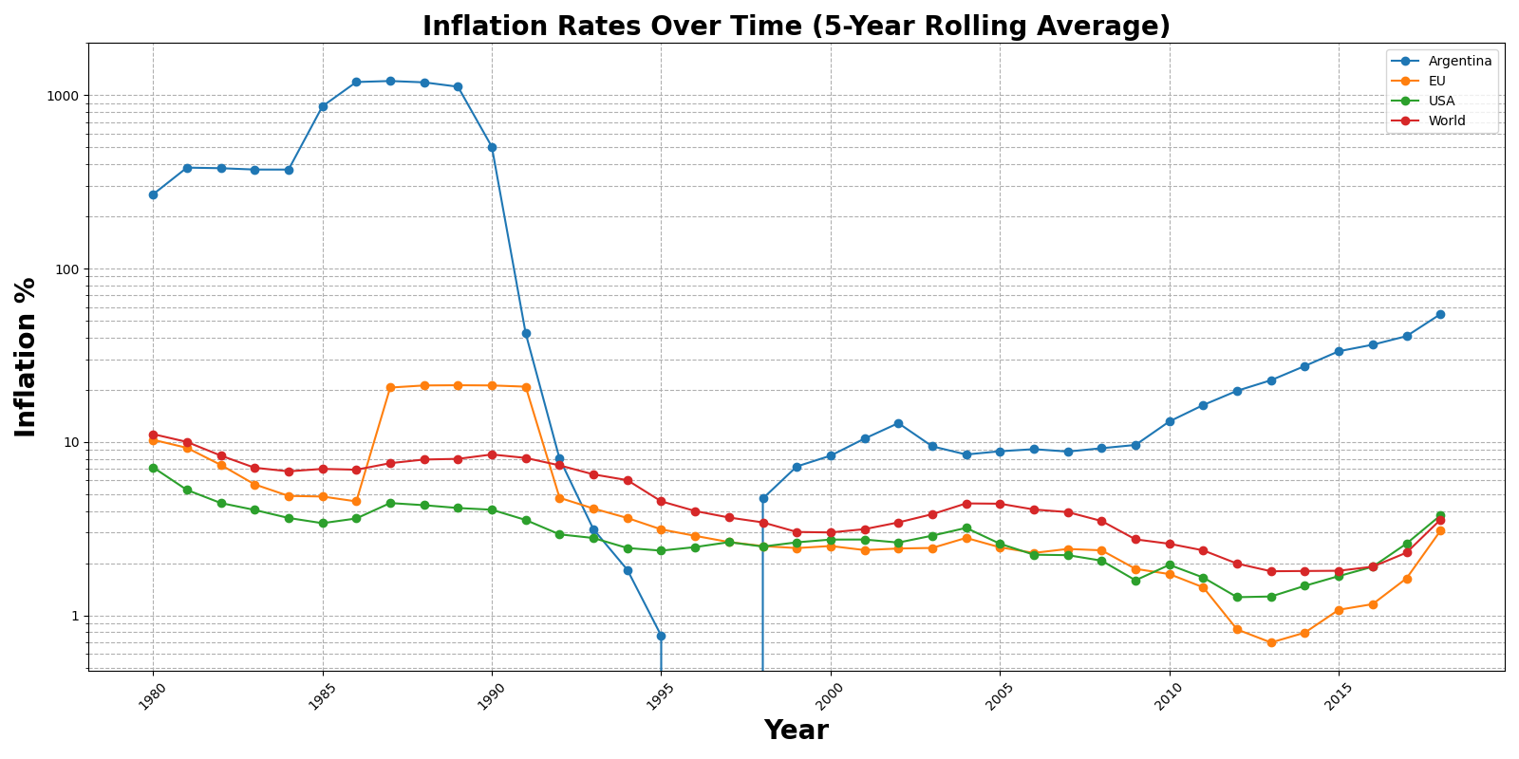
CPI Display Lineplot

Slide 5
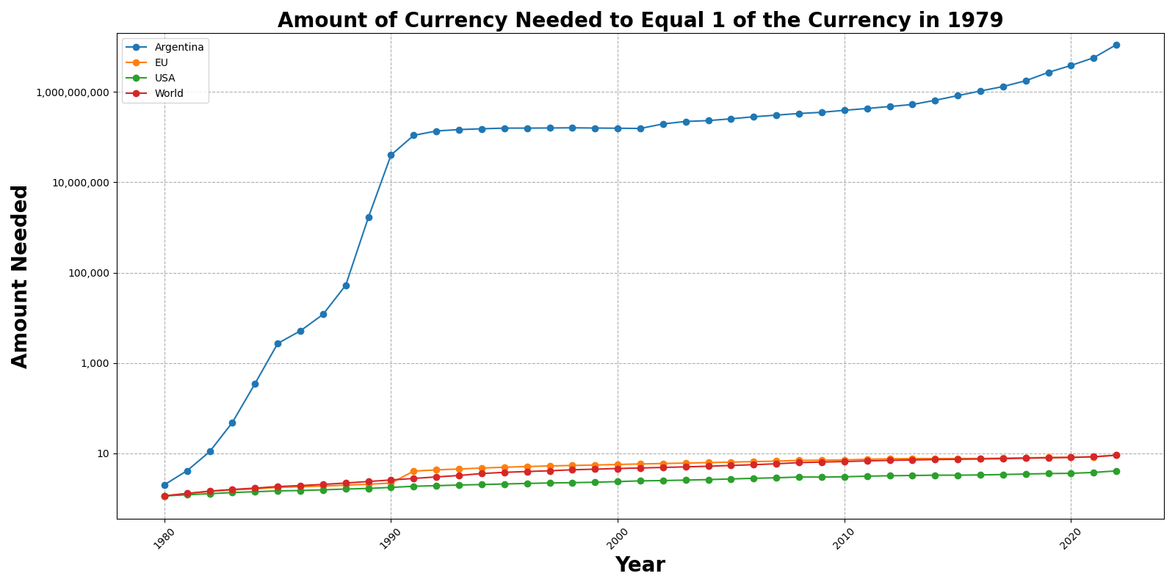
Currency Valuation Over Time

Slide 6
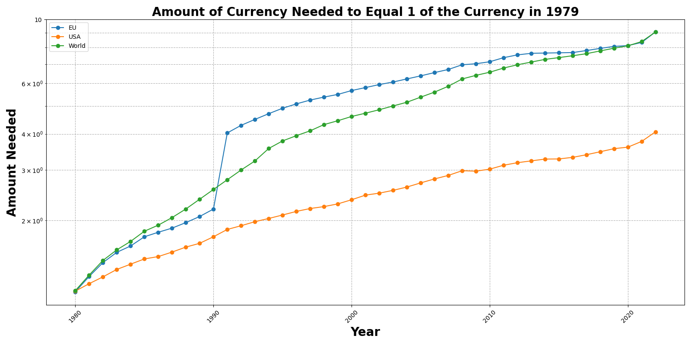
Currency Valuation Over Time Excluding Argentina

Slide 7
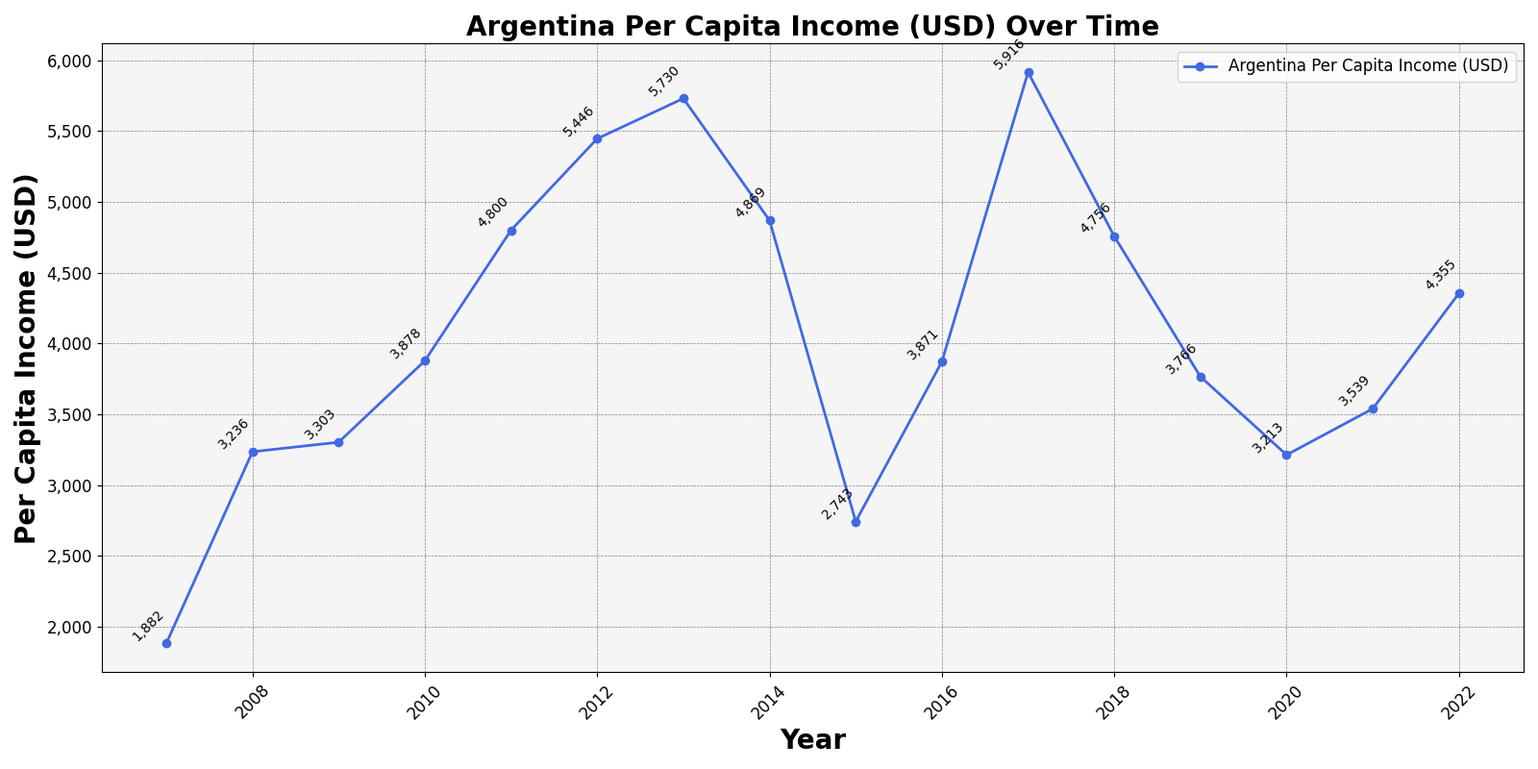
Household Purchasing Power In Argentina

Slide 8
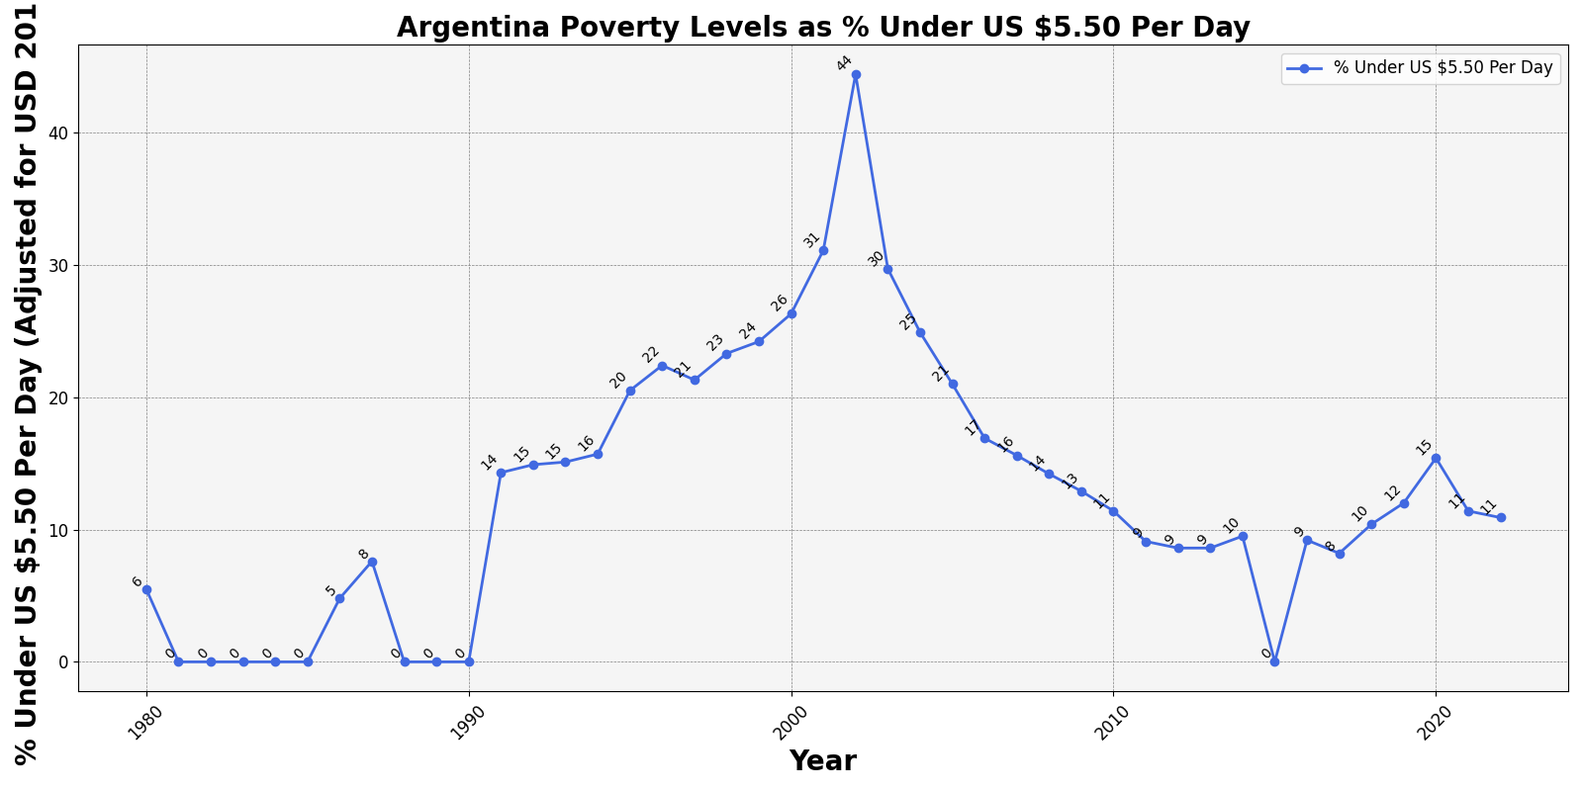
Argentina Poverty Levels

Slide 9
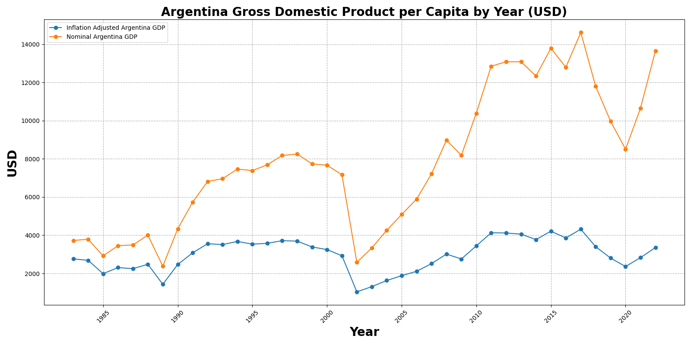
Gross Domestic Weighted Inflation Lineplot

Slide 10
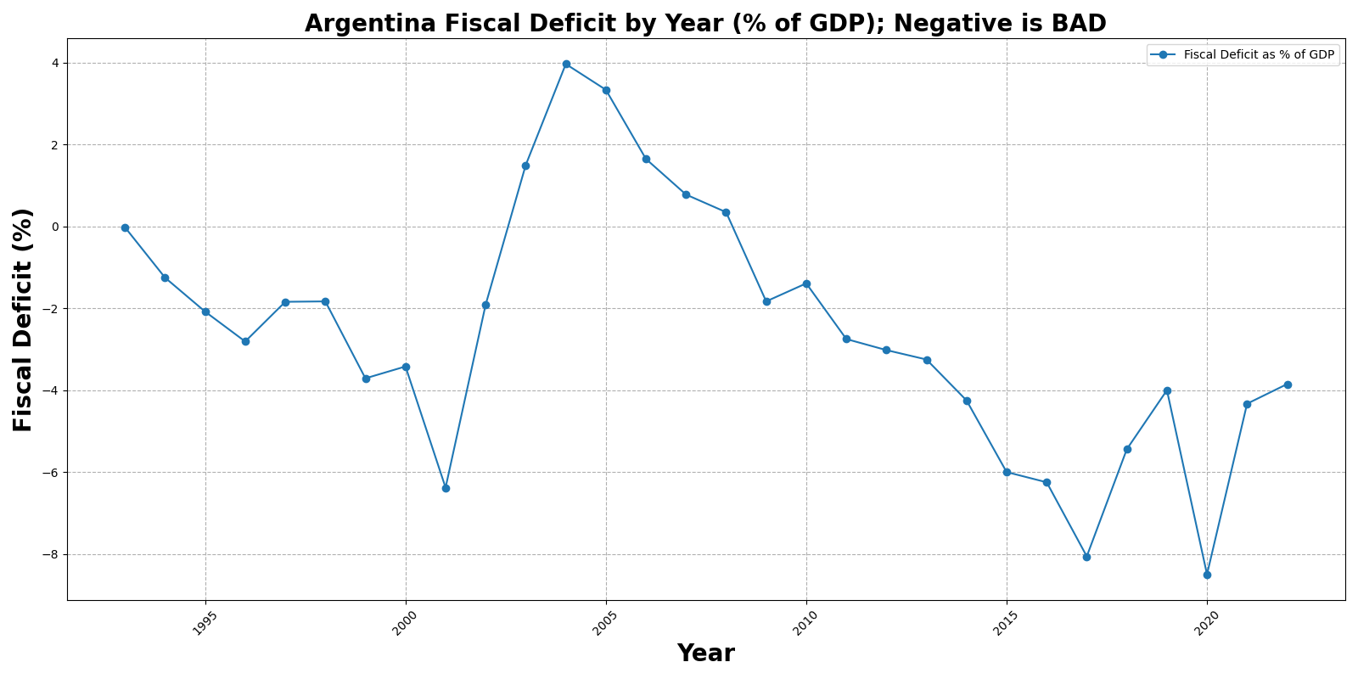
Fiscal Deficit Lineplot

Slide 11
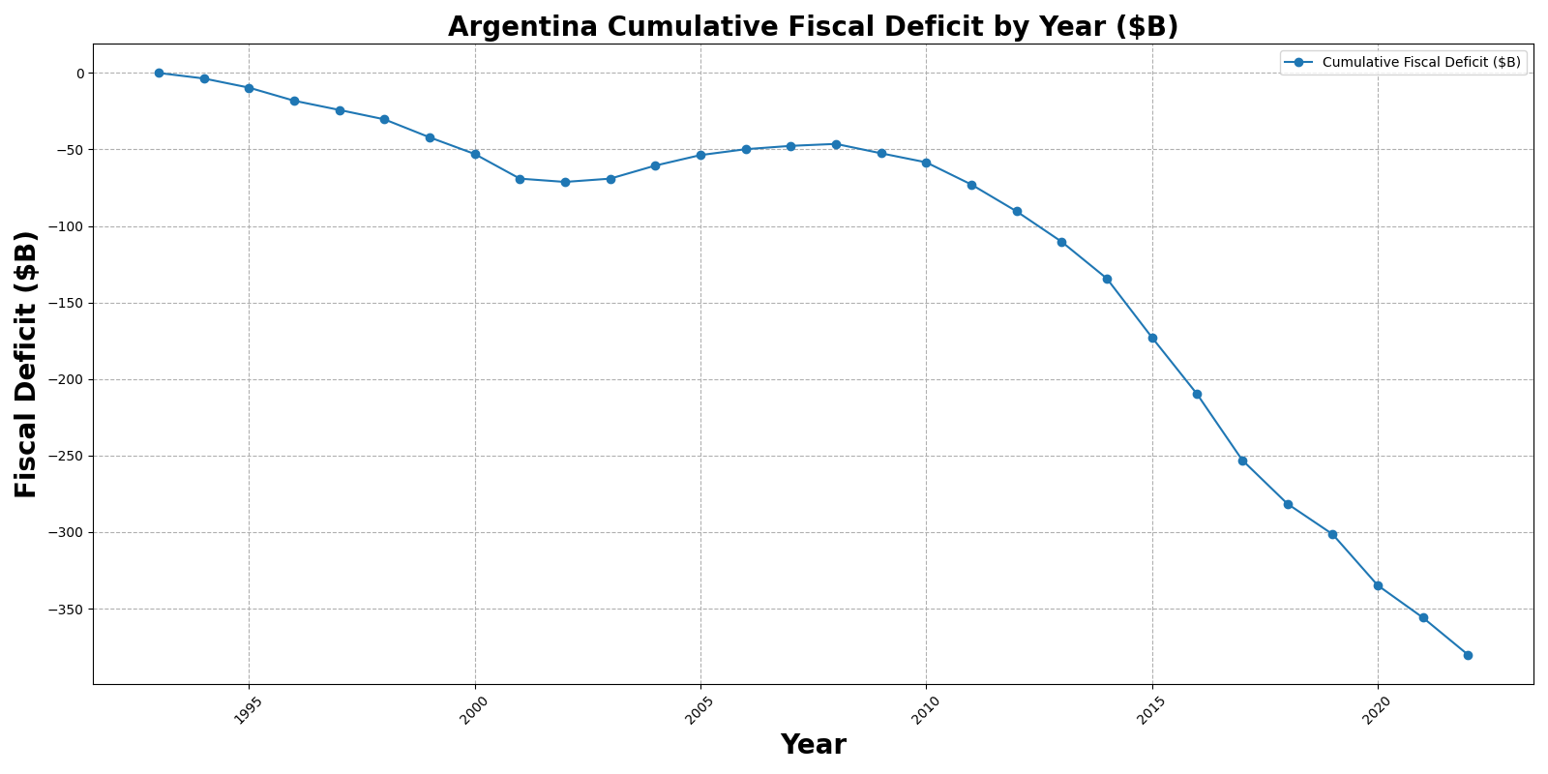
Cumulative Fiscal Deficit Lineplot

Slide 12
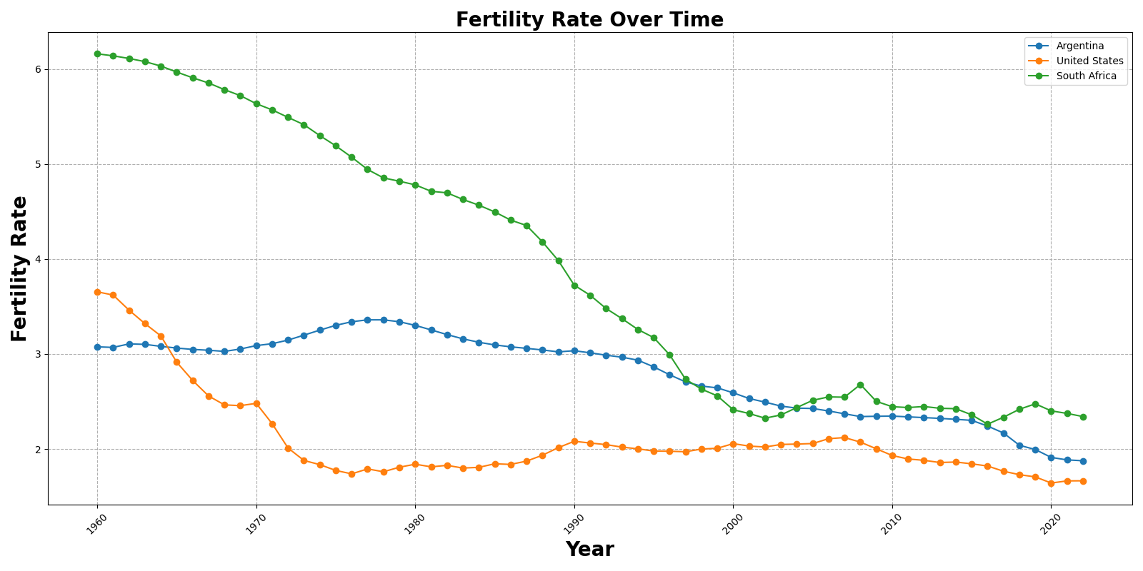
Fertility Rate Over Time

Slide 13
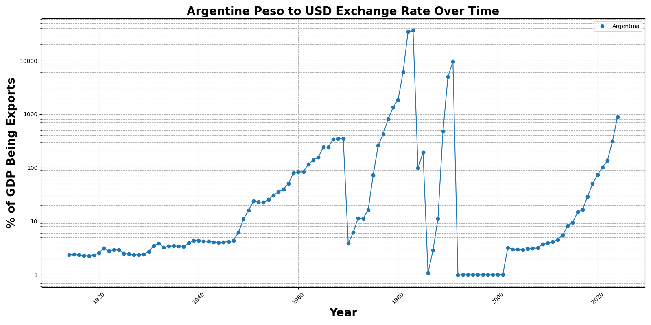
Exchange Rate Over Time

Slide 14
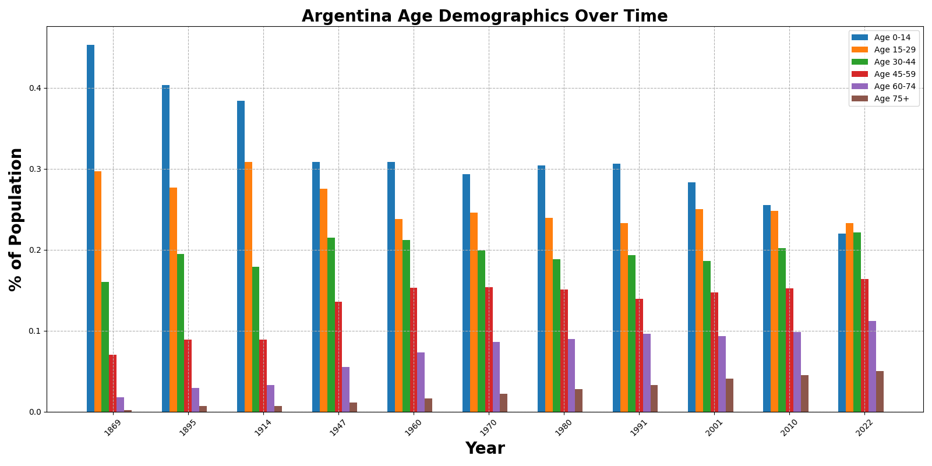
Argentina Age Demographics Over Time

Slide 15
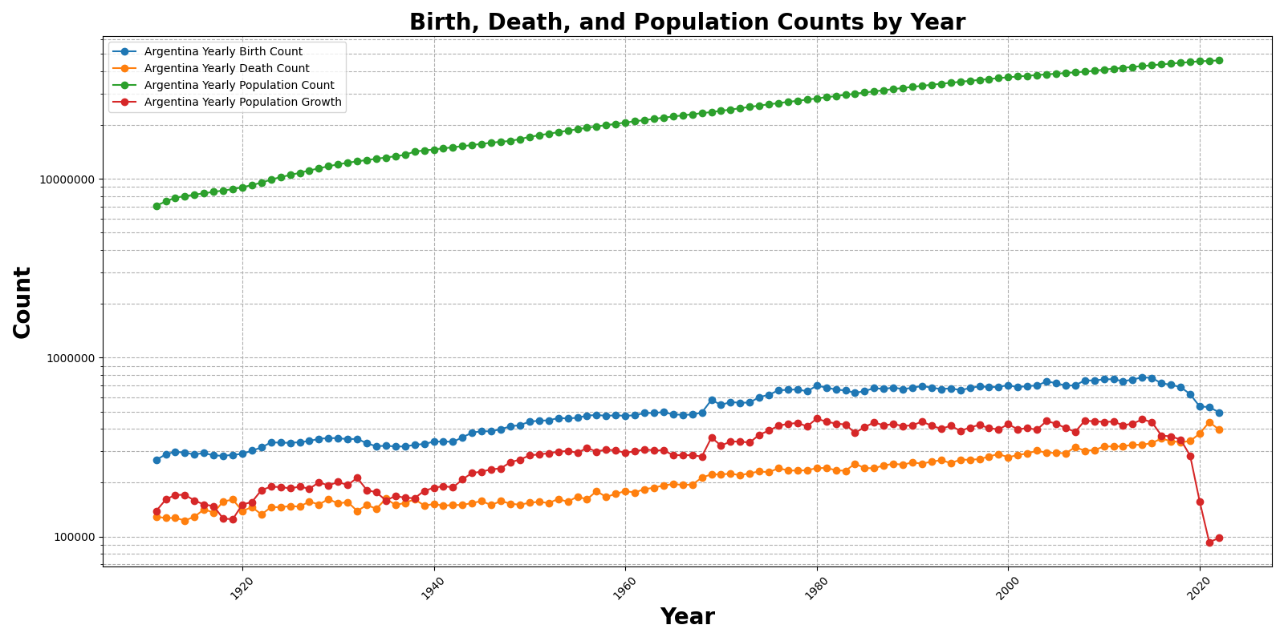
Argentina General Population Data

Slide 16
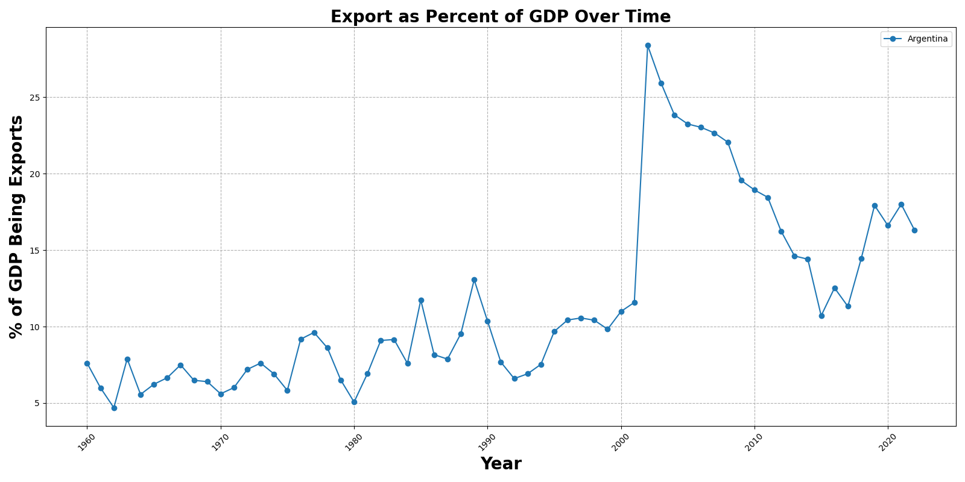
Export Percentage Of GDP Over Time

