Slide 1
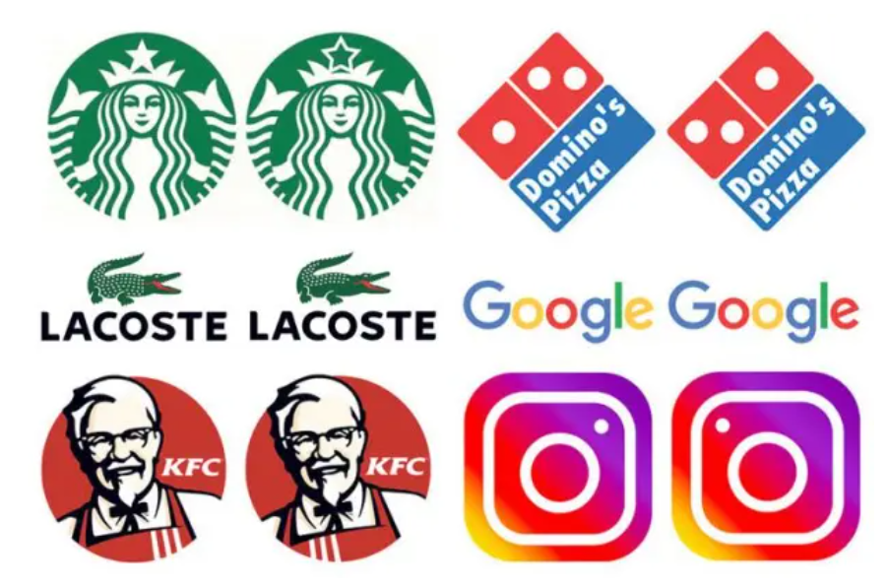
Fake Brand Logo Detection
Group members:
Delphina Dominic Carval
Deelan Joston Monteiro
Akshay Shaji
Sai Kumar Yamasani

Slide 2
INTRODUCTION
Fake brand logos, also known as counterfeit or knockoff logos, are logos that are intentionally designed to look like the logos of well-known brands but are not authorized or produced by the brand owner. These logos are often used to sell fake or low-quality products to unsuspecting consumers, which can harm the reputation of the brand and the safety of the consumer.
The problem of fake brand logos is widespread and can affect a wide range of industries, from fashion and luxury goods to electronics and pharmaceuticals. In fact, the global value of counterfeit goods is estimated to be in the hundreds of billions of dollars annually.

Slide 3
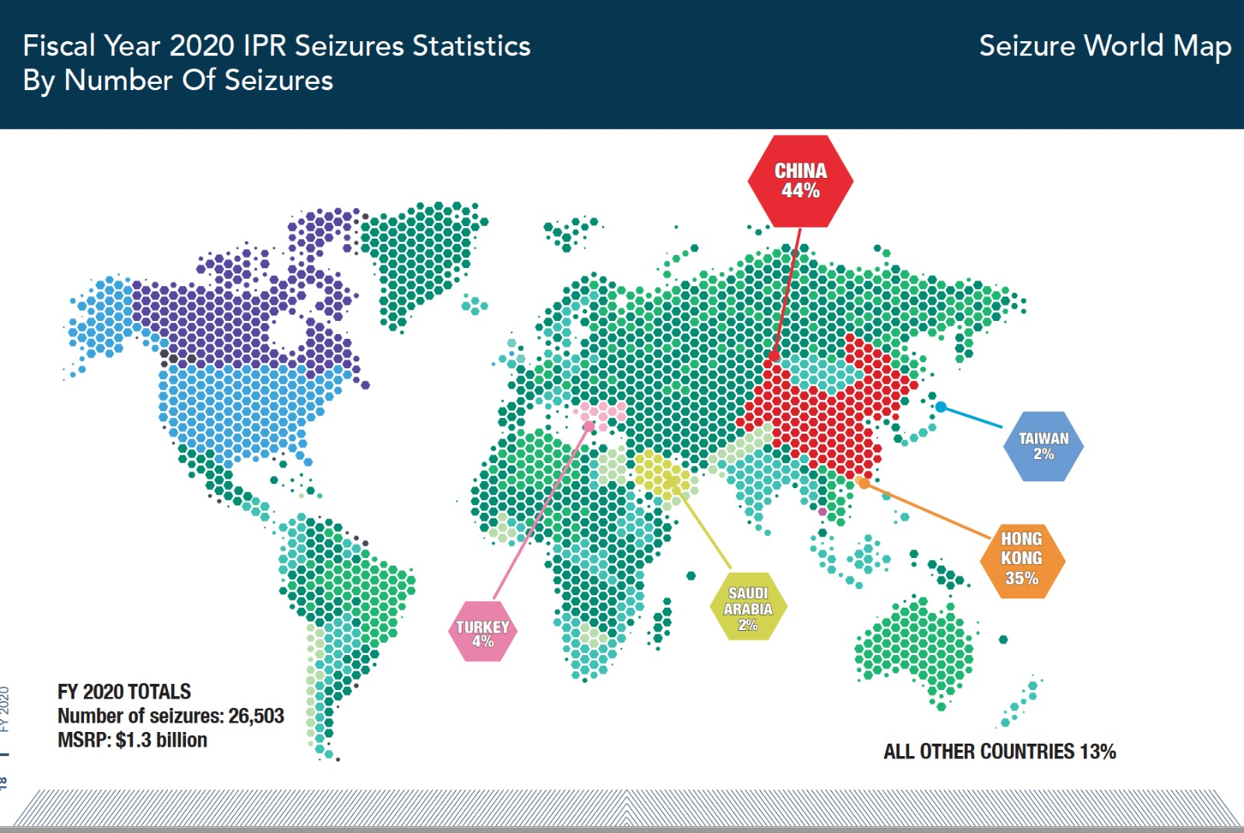
Research showed that most counterfeit products had produced in Asian countries. China and Hong Kong were the leading producers of counterfeit goods than the other countries.

Slide 4
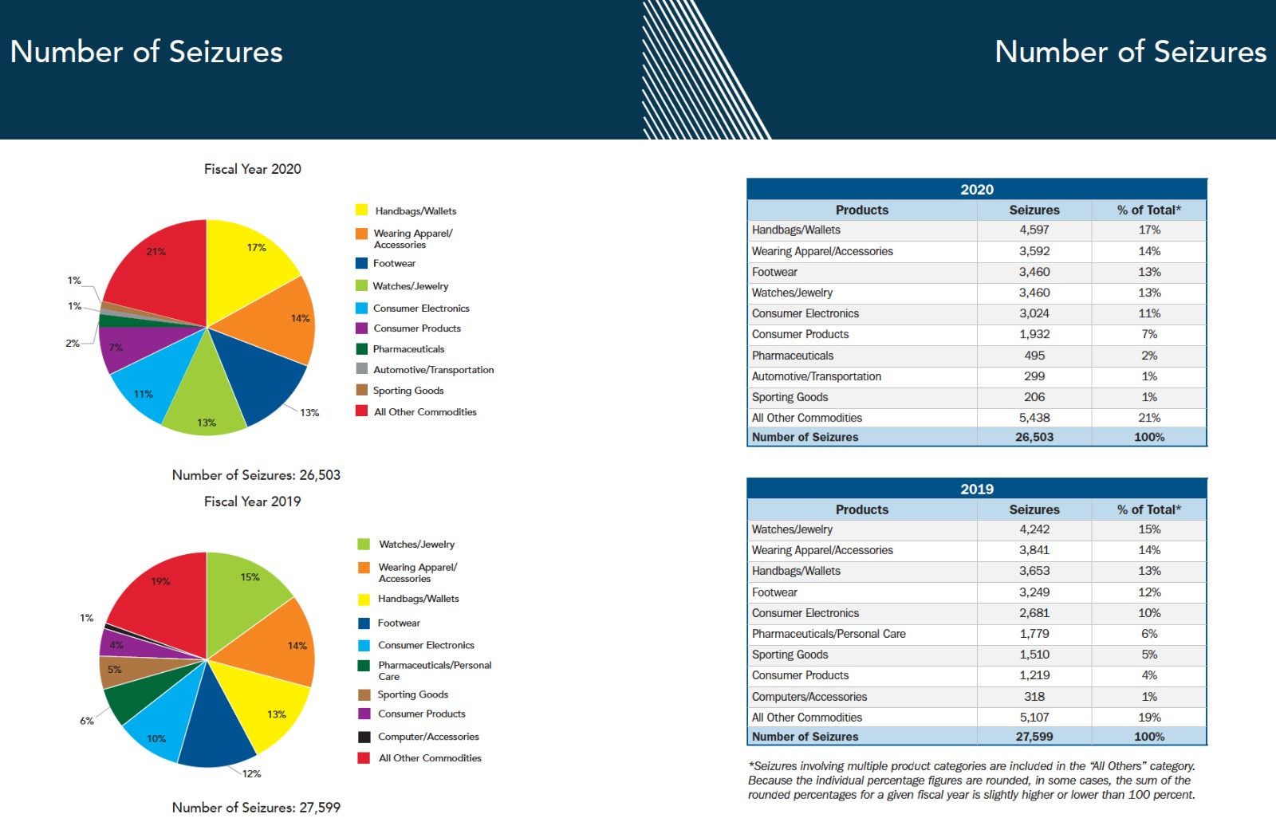
The most counterfeited category was handbags and wallets while the least counterfeiting category was automotive and transportation.

Slide 5
Importance
Detecting fake brand logos is important for several reasons.
Firstly, it helps to protect the brand owner's reputation and revenue by preventing counterfeit products from being sold under their name.
Secondly, it helps to protect consumers from being deceived into purchasing fake or low-quality products that may not meet safety standards.
Finally, it helps to support fair competition by preventing counterfeiters from undercutting legitimate businesses with cheaper, inferior products.

Slide 6
Project Objective
The main objective of this project is to develop a machine learning-based model by using API will connect to the website that can accurately detect fake brand logos and distinguish them from genuine ones, with a focus on copyright infringement.

Slide 7
Tools and technology
Python
Machine Learning
Jupyter Notebook
Data Visualization (Excel, Tableau)
Notepad++ and Php to develop web application

Slide 8
Dataset
We will be using image dataset consisting of 100 brands. The dataset will include images of both original and fake logos and there will be same number of images for all the brands. We already have flickr-32 dataset consisting of original logos of 33 brands .We will be adding more images from internet and social media.

Slide 9
Existing project
There is a research done by SRM Institute of Science and Technology in which they have used correlation method and Tesseract-OCR to detect fake logos. Tesseract-OCR is a tool that can recognize text in images. It works well, but sometimes has trouble with unique fonts due to which they have 80% accuracy .We will be using machine learning algorithms like Random forest,CNN and SVM to increased the accuracy more than 80%.

Slide 10
Ethical Concerns
In our system, we will try to have high accuracy and reliability to avoid causing harm to legitimate brand owners or customers as false detections could result in financial losses or damage to brand reputation.
We will make sure that the collected data is not used for any unintended purpose.

Slide 11
Impact on stakeholders
Our primary stakeholders will be the Brand owners and customers. By detecting fake brand logos, brand owners can protect their reputation, copyright, and financial interests.
Customers can also benefit from being able to identify genuine products and avoid being misled or scammed.
Social media platforms such as Facebook, Instagram, and Twitter are also important stakeholders as they are major channels for advertising and brand promotion.

Slide 12
References:
https://www.researchgate.net/publication/354507140_Logo_Infringement_Detection_using_Machine_Learning
https://medium.com/@meerkat.cv/a-study-on-beer-logo-detection-and-analysis-on-social-media-9ab2dab0014c

