Slide 1

NYPTalk
Group Members:
Nigel Tan (Leader) (181391W) Ivan Che (183641U) Kok Jia Ming (180780E)
Alstin Lau (185399N) Tan Yi Tong (180164S)
Module: 2019S2 - ITP292
APPLICATIONS SECURITY & PROJECT

Slide 2
Overview
Objective 3
Architecture Diagram 4
Prototype UI 5 - 21
Login/Sign up/Friends 5 - 8
Game 9 - 11
Chat/Friend matcher 12 - 14
News feed/Event planner 15 - 18
To-do list 19 - 21
Q&A 22

Slide 3

Objective
Our main objective is to develop a web-application that allows students from various schools to interact with each other, manage their time and entertain themselves.

Slide 4


Architecture diagram
Client side code
.NET web app
Web API
Stream API
Security measures includes
SHA512 for password hashing + salt
Validate requests (deny access to certain pages without proper authentication)
CRUD operation/
Hash password
HTTPS
token
HTTPS POST
token
End User (Student, Admin)
Web Application
Server IIS
(Check what is requested)
DBMS
(SQL server
management studio)
Return result
Stream API
Return response
Return result
Server: Windows 10 VM
Database: MSSQL
Coding language: Code C#
Front-end
Back-end

Slide 5
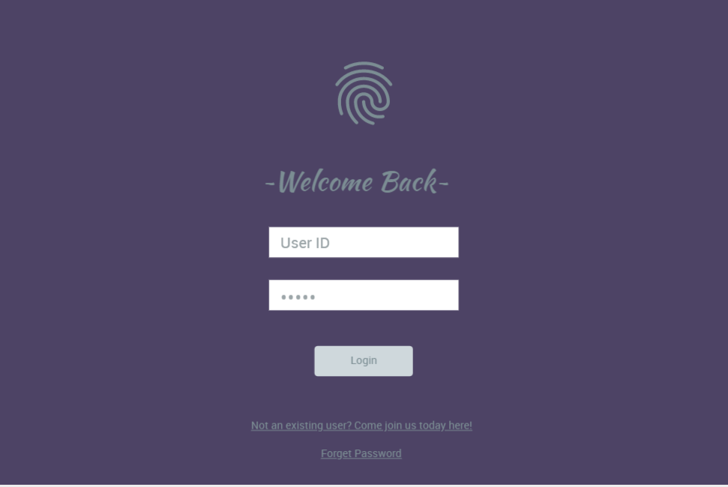
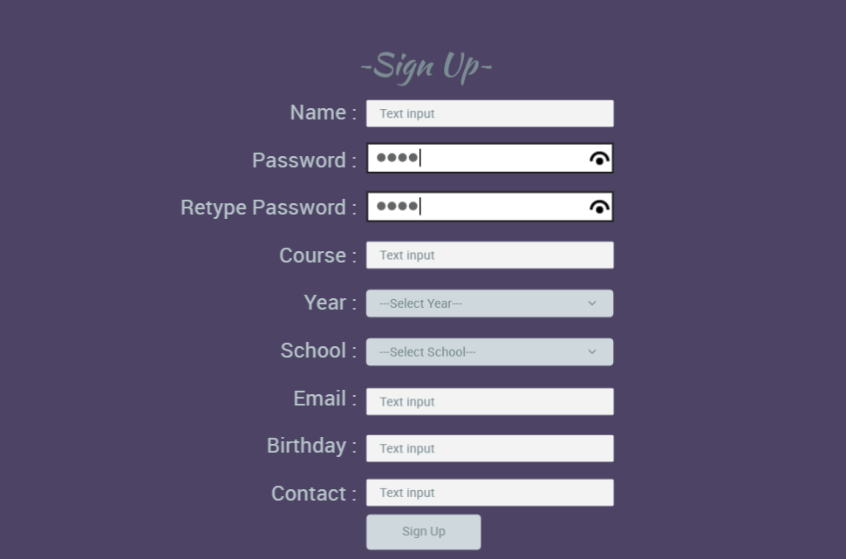
Login page
secure to prevent unauthorised access
Authentication and password management
Password entry should be obscured on the user's screen
Authentication failure responses should not indicate which part of the authentication data was incorrect.
Sign up page
Authentication and password management
Enforce password length
Password entry should be obscured on the user's screen
Enforce password complexity (letters, numbers, symbols)

Slide 6
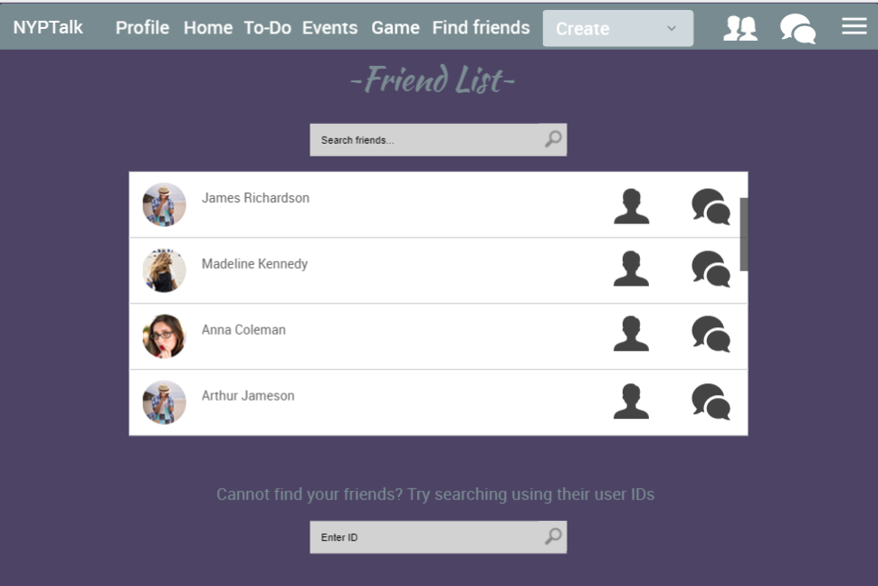
Friend List
Shows the list of user’s existing friends
Allow user to easily chat with them or see their profile
User can find their friends through their friend’s ID

Slide 7
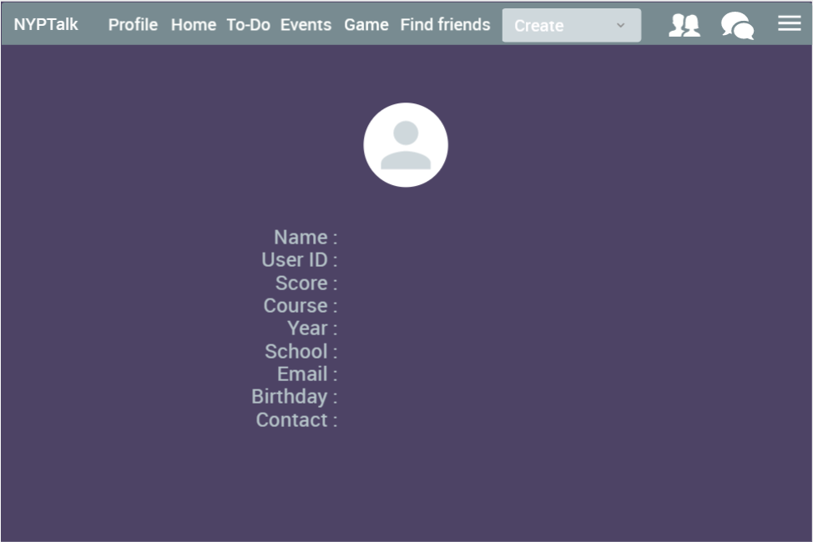
Profile page
Shows the list of user’s own information

Slide 8
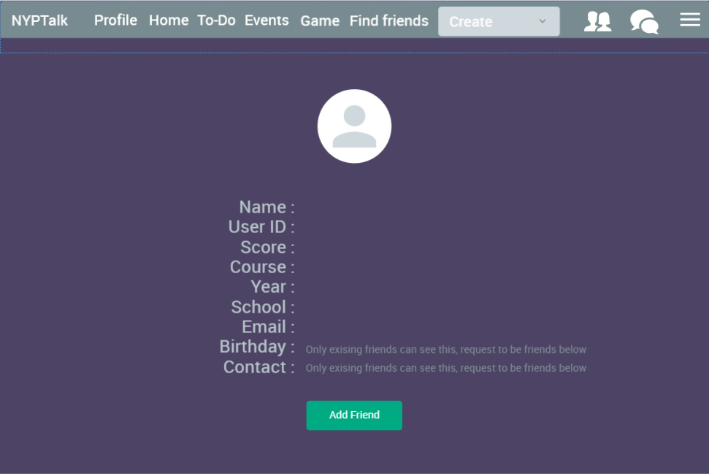
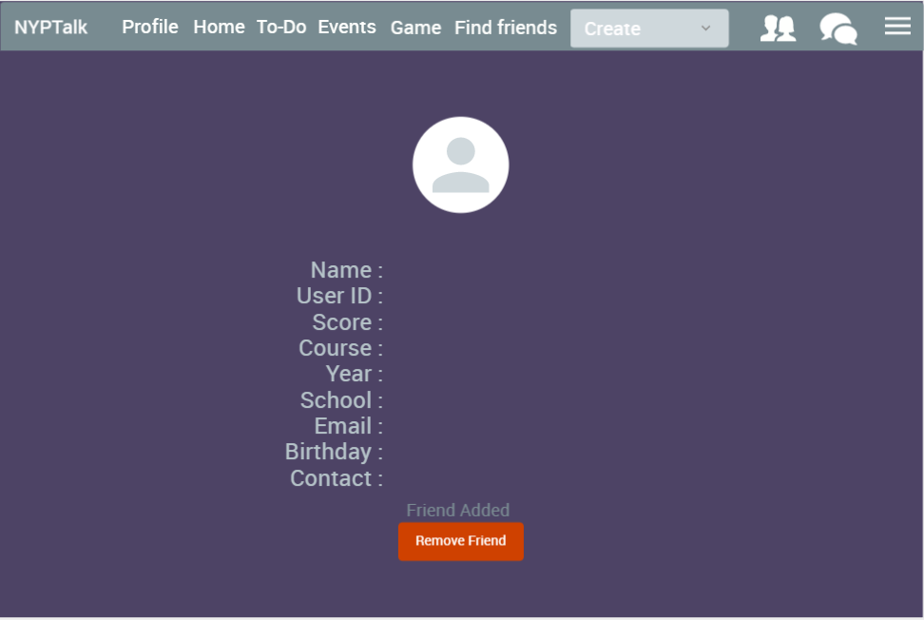
Other people’s profile
Users cannot see private information like birthday and phone numbers
Access Control
Restrict access to protected functions to only authorized users
Restrict access to application data to only authorized users
Existing friend’s profile
Users can see private informations of their friends
Users must accept the friend requests in order to be able to exchange information
Users can advance and talk to their friends on more common social media like whatsapp using their phone numbers

Slide 9
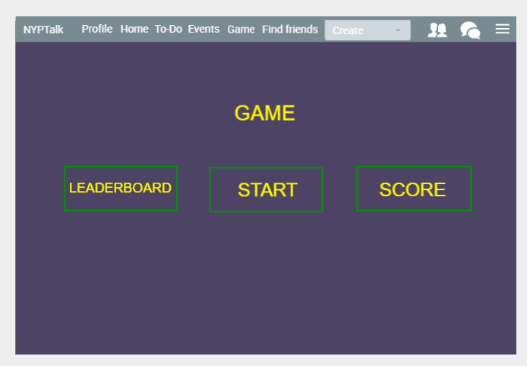
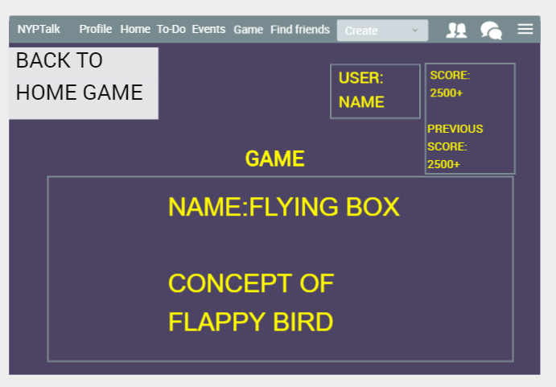
 | Main Page The master page of “Game” Page.
 | Start/Game Page Start page is to start the game On top left have able to back to game master page Right top will be display username, score and previous score Score user hit 1500 able to get 1 point, one month maximum to get 3 point.
https://www.fluidui.com/editor/live/project/p_khwUykQ3zGUeoncNECgFmlL73vwfmzil

Slide 10
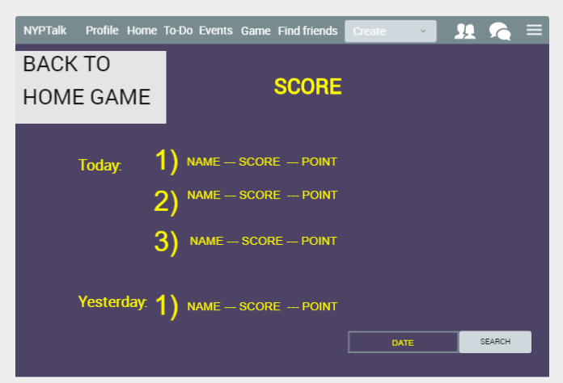
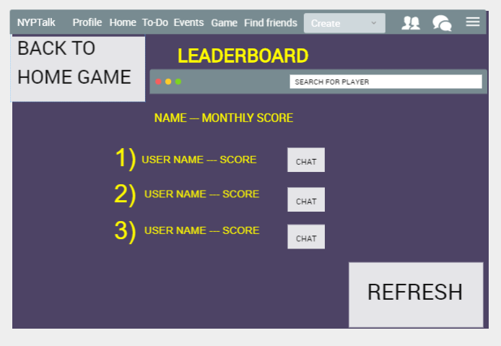
 | Score Able to display the the past user score Left top can be return to the game master page Right bottom user able to search their past date score
 | Leaderboard Able to display ALL NYP student score, and able to find your friend or yourself. Lastly able to chat with random user up to 3 messages/ add friends continue more chat.
https://www.fluidui.com/editor/live/project/p_khwUykQ3zGUeoncNECgFmlL73vwfmzil

Slide 11

Security features
Output Encoding
- Contextually sanitize all output of untrusted data to queries for SQL, XML, and LDAP]
System Configuration - When exceptions occur, fail securely
Error Handling & Logging - The application should handle application errors and not rely on the server configuration
- All logging controls should be implemented on a trusted system (Microsoft SQL Server management studio)
General Coding Practice - Utilise locking to prevent multiple simultaneous request

Slide 12
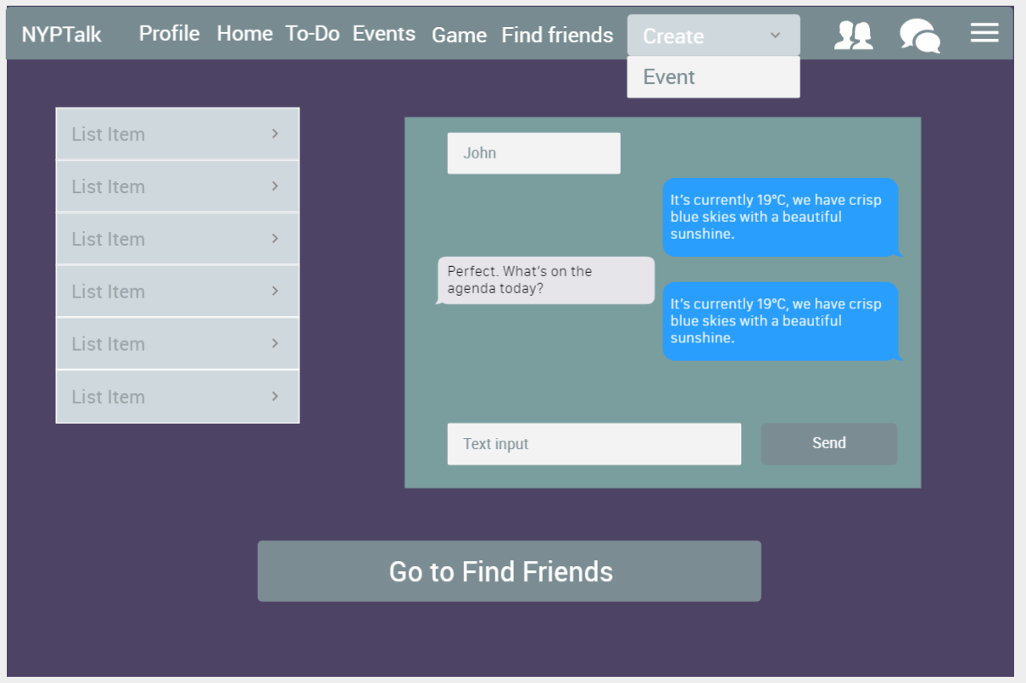
Chat & Friend matcher (Ivan)
Chat
Linked with friend feature
Live chat with added friends
https://www.fluidui.com/editor/live/preview/cF9KUUlWUlBkQ1hWek96S2lSbTVnTFVmQUI5ZjZpTTl4MA==

Slide 13
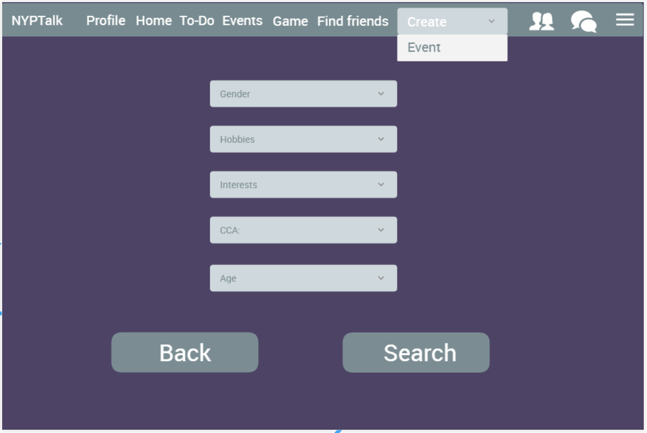
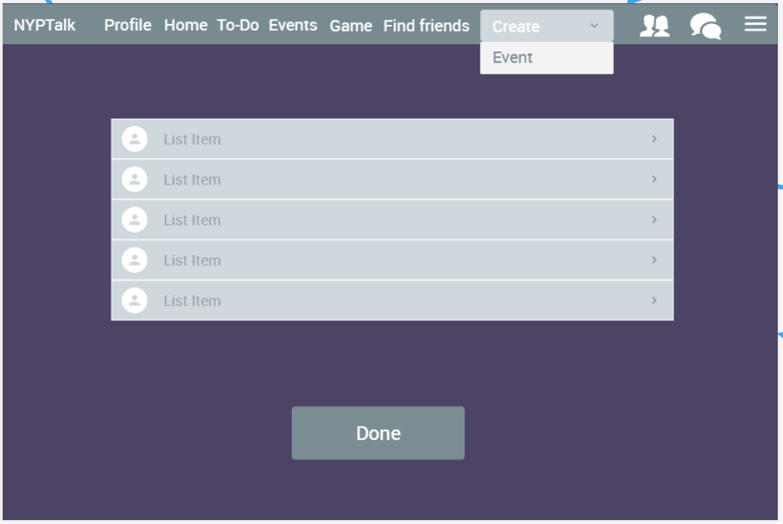
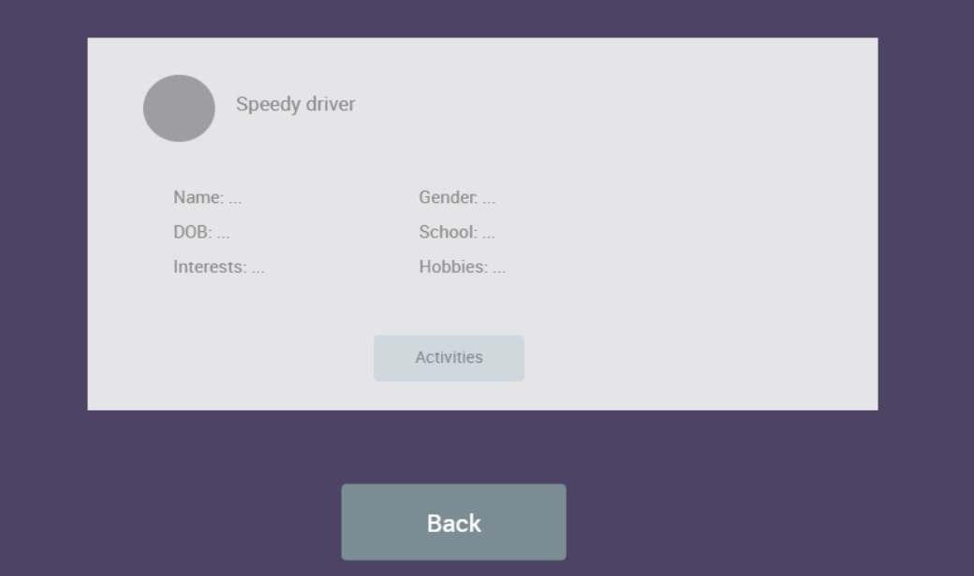
Friend Matcher
Allow users to find their ideal friend by specifying the traits they are looking out for in a person
List of matches displayed

Slide 14
Security features
Input Validation on code-behind( data length, expected data types, check for blacklisted characters like ‘<’ & ‘>’
Restrict access to protected URLS (e.g. api/Chat which will display all chat data from the database)
Use error handlers that do not display debugging or stack trace information
Encrypt connection string

Slide 15
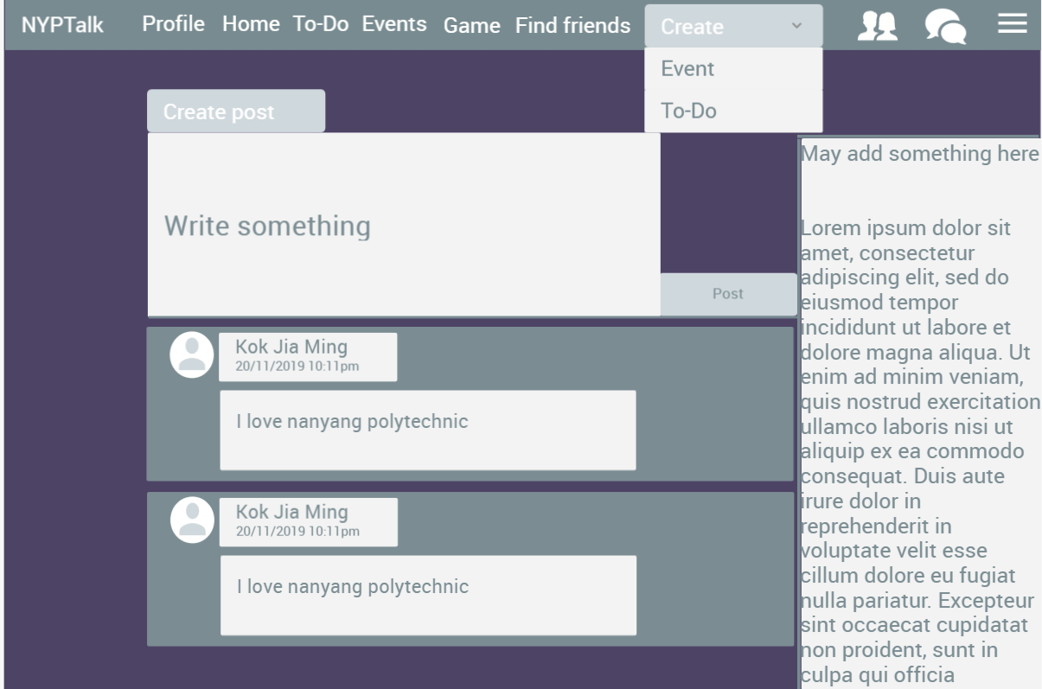
Newsfeed page
Function
User can share information about themselves and also see updates about those in their friend list
FluidUI
https://www.fluidui.com/editor/live/preview/cF96dUFOcW5ERDZpaVJUMGJOY2lFQUVORzZjTEpEdEsyNQ==

Slide 16
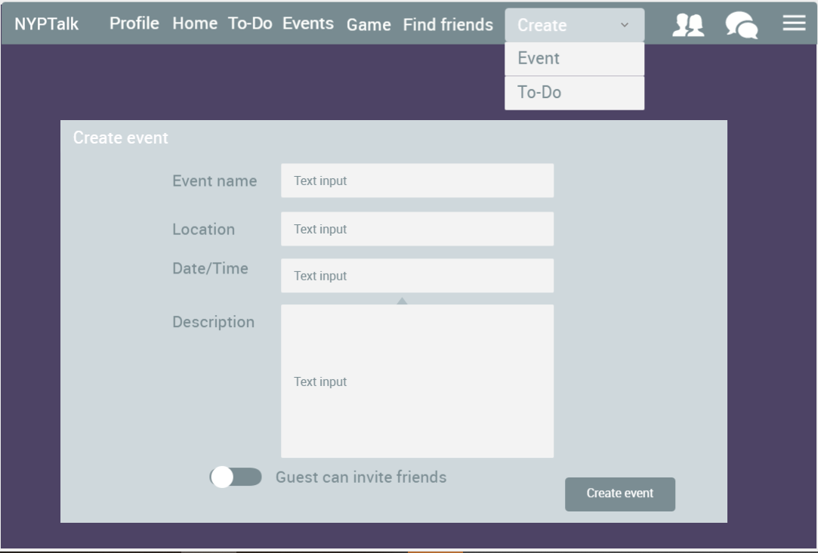
Create event
page
Function:
User fills up create event form fields (Event name, Location, Date/Time and Description)
User can also choose whether this event allows mutual friends to be invited

Slide 17
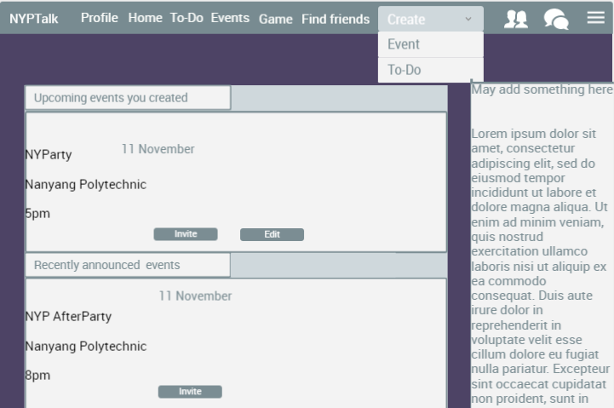
View event page
Function:
Users can view upcoming events from both created by user and other users
Users can invite or edit their own events
OR to other user events

Slide 18
Security features
1.Input validation
- Validate for expected data types
- Validate data range/length
- Validate all input against a “white” list of allowed characters, whenever possible
2.Input validation
- Conduct all data validation on a trusted system.
- Specify proper character sets, such as UTF-8, for all sources of input.
3.Session Management
- Establish a session inactivity timeout that is as short as possible, based on balancing risk and business functional requirements. In most cases it should be no more than several hours
4.Database Security
- Use secure credentials for database access
5.Access control
- Restrict access to protected URLs to only authorized users.
- Restrict direct object references to only authorized users

Slide 19
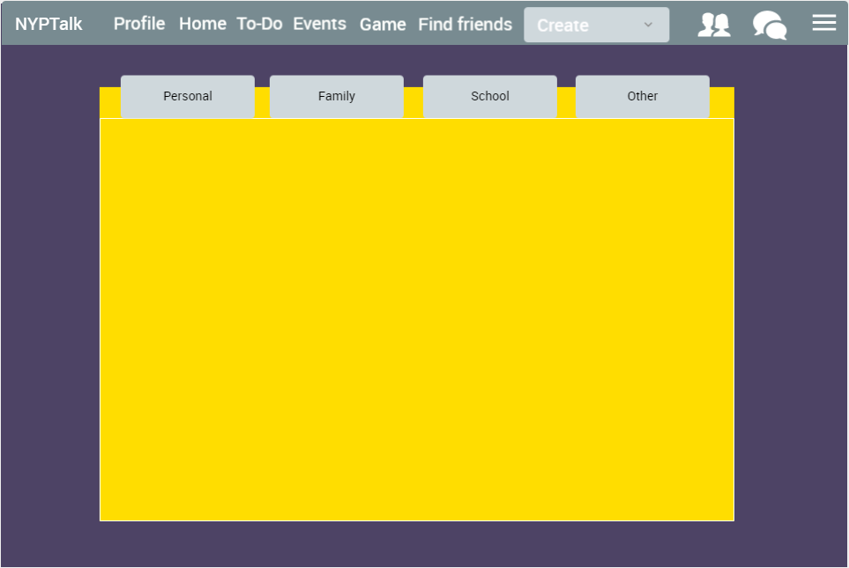

Slide 20
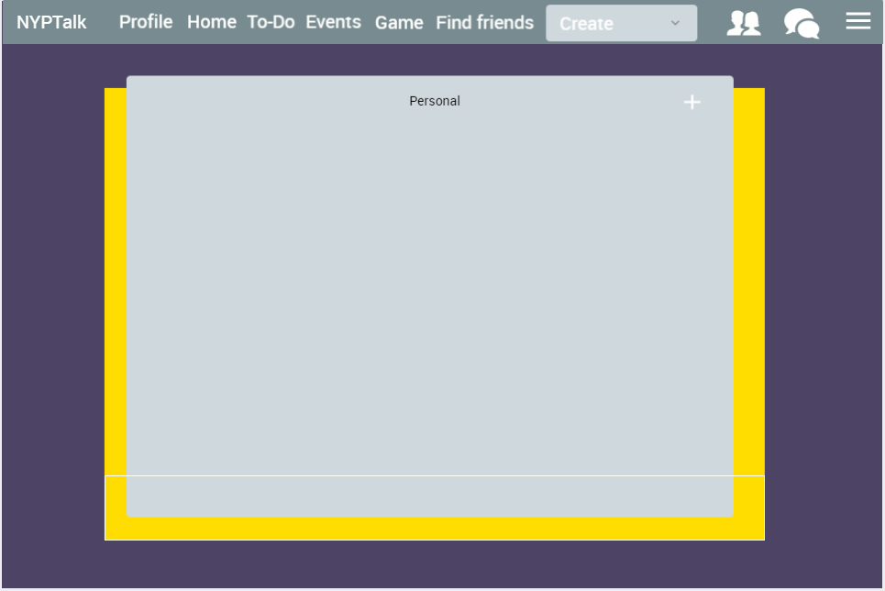
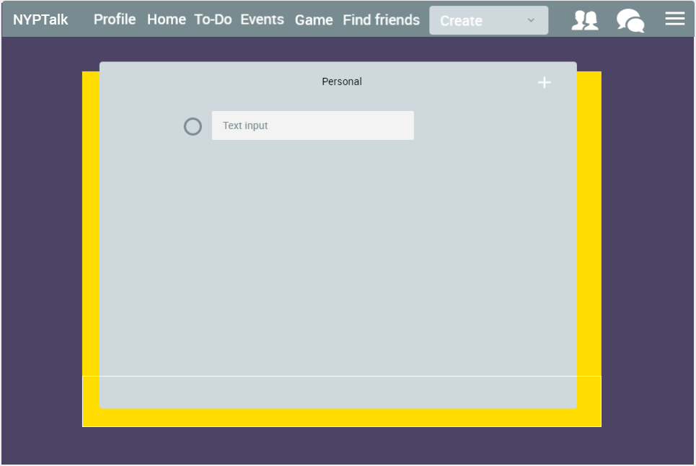
Clicking on the plus icon will add a new task which prompts for user input.
Input will be encoded and validated server-side, if it fails validation, a generic error message will be shown, asking the user to try again.

Slide 21
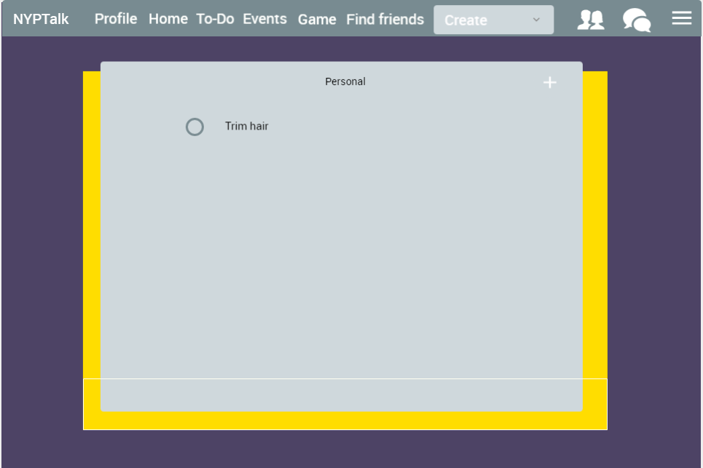
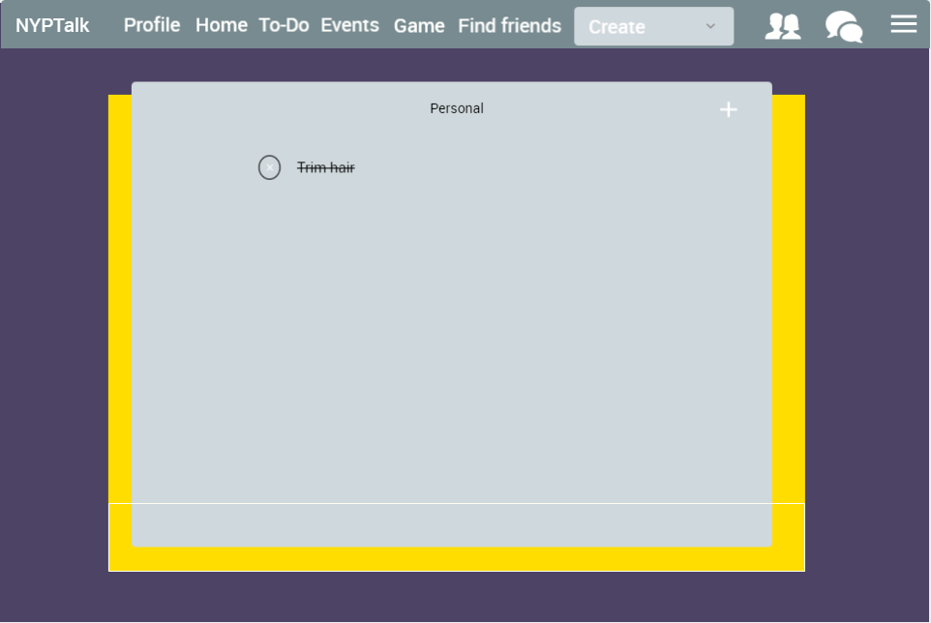
If validation succeeds, the text will be stored inside the database.
Clicking on the text itself will allow users to edit it and is validated again.
Clicking on the circle will strike-through the task, denoting a completed task.
Tasks will auto-delete themselves after each day.

Slide 22
Security features
1.Input validation
- Conduct all data validation on a trusted system.
- Specify proper character sets, such as UTF-8, for all sources of input.
2.Input validation
- Encode data to a common character set before validating.
- Validate data length.
- Validate for expected data types.
3.Error Handling
- Do not disclose sensitive information in error responses, including system details, session or account information.
4.Database Security
- Close the connection as soon as possible.
5.Access control
- Use secure credentials for database access.
- Remove or change all default database administrative passwords.
- Utilize strong passwords/phrases or implement multi-factor authentication.

Slide 23
Questions?

Slide 24
Thank You

