Slide 1

Gitlab CI Workshop
Jack WJ Lu

Slide 2

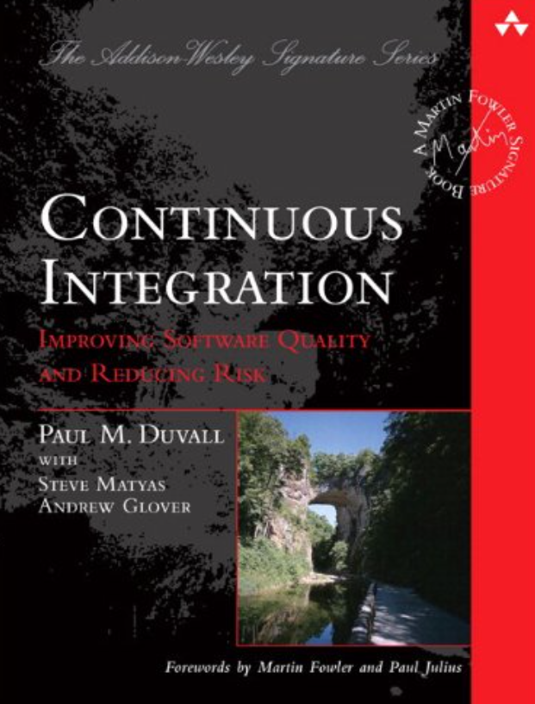
Continuous Integration
- 1994, Grady Booch
Improving Software Quality and Reducing Risk illustrates how to transform integration from a necessary evil into an everyday part of the development process.

Slide 3
Agenda
Gitlab CI structure
Overall CI/CD flow
Stage/job/script
Configuration parameters & Predefined variables
Runner
Basic Syntax
CI lint / pipeline editor
Condition(rules, only, except) / variables…
AVATAR CI YML guide
Initial project
Front-end & Back-end
Advance Syntax(optimize CI pipeline)
Cache / Artifact / dependencies / needs
Default / extends / hidden job / Include
Docker: Multi-Stage Build (why b360 pipeline is fast)
Special Pipeline
Parent-child pipeline (*b360 front-end structure in the future)
Multi-project pipeline (maybe it will used in the new CD flow)

Slide 4

Gitlab CI structure

Slide 5






Overall CI/CD Flow
Continuous Integration
Development
Source Code Management
Test\Build
Package Repository
Continuous Deployment
Deploy
Qas / Staging
Production

Slide 6
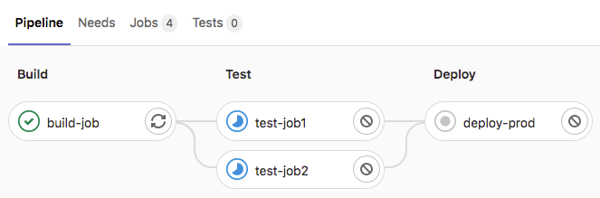
Stage / Job / Script
example
A pipeline may contain many stages
A stage may contain many jobs run in parallel
Run in serial between stages(default)
Stage
Job
Script
(inside)

Slide 7

Stage / Job / Script – ex1
answer
p.10
* 3 stages
* Test stage have 2 jobs
What do we have?

Slide 8
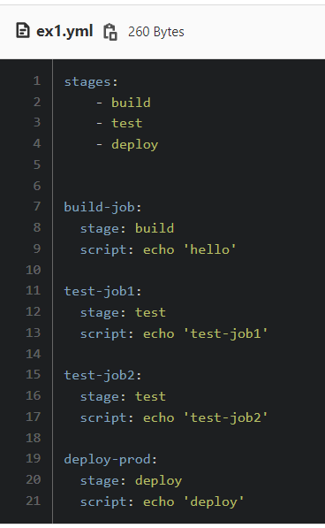
Stage / Job / Script
answer

Slide 9
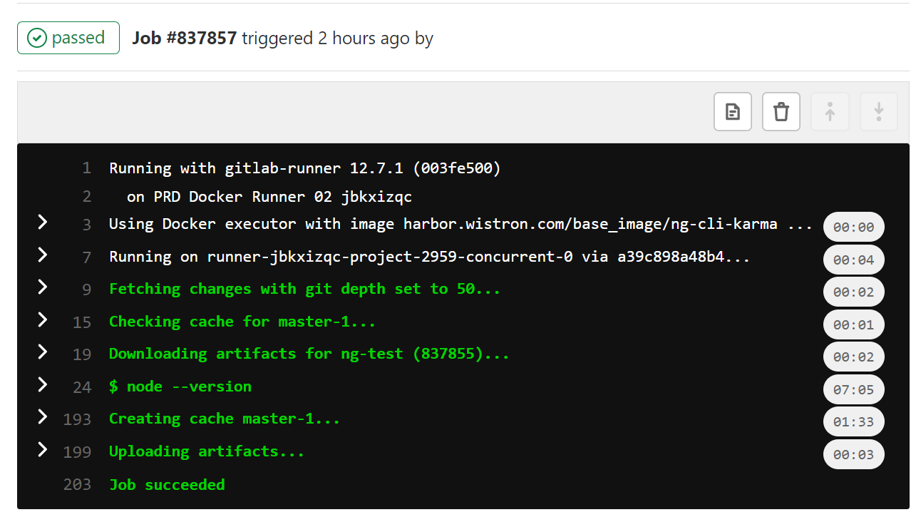
Job
reference
Using docker executor with image....(image)
Running on runner-XXX(tags)
Fetching changes with git depth set to 50
Checking cache for master-1....
Downloading artifacts for xxx(dependencies)
Script(before_script, after_script)
Created cache(cache)
Uploading artifacts(artifact)
Job succeeded (or fail exit code with 1)

Slide 10
Configuration parameters
reference

Slide 11
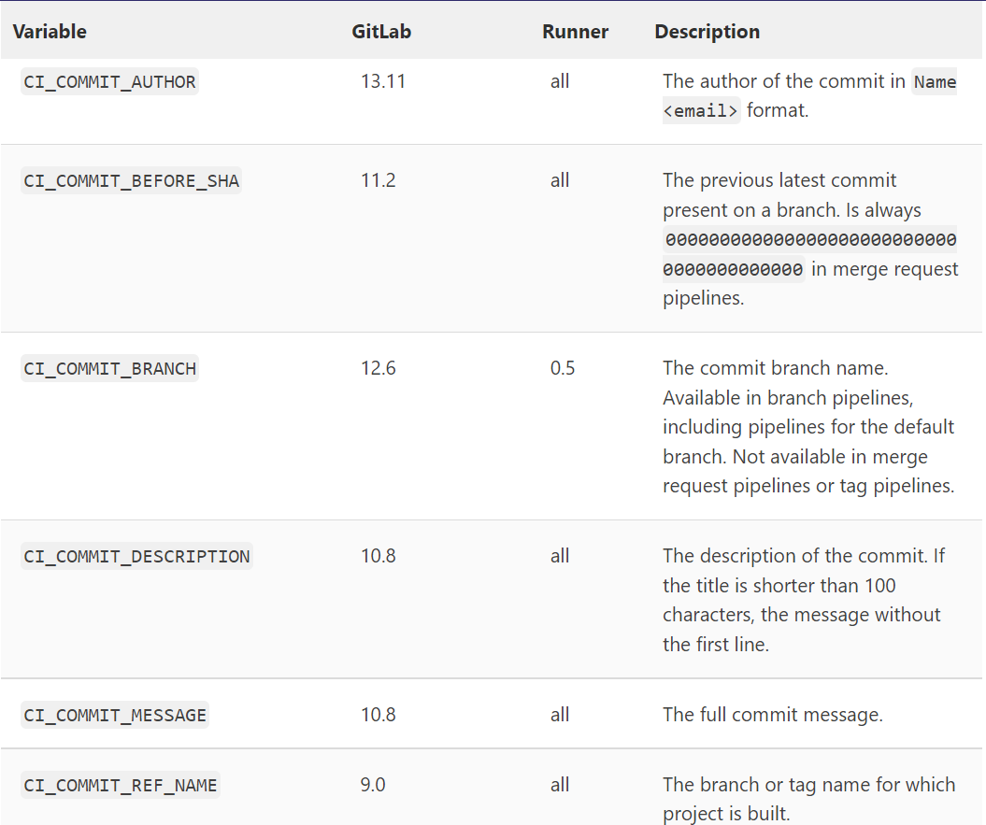
Predefined variables
reference

Slide 12
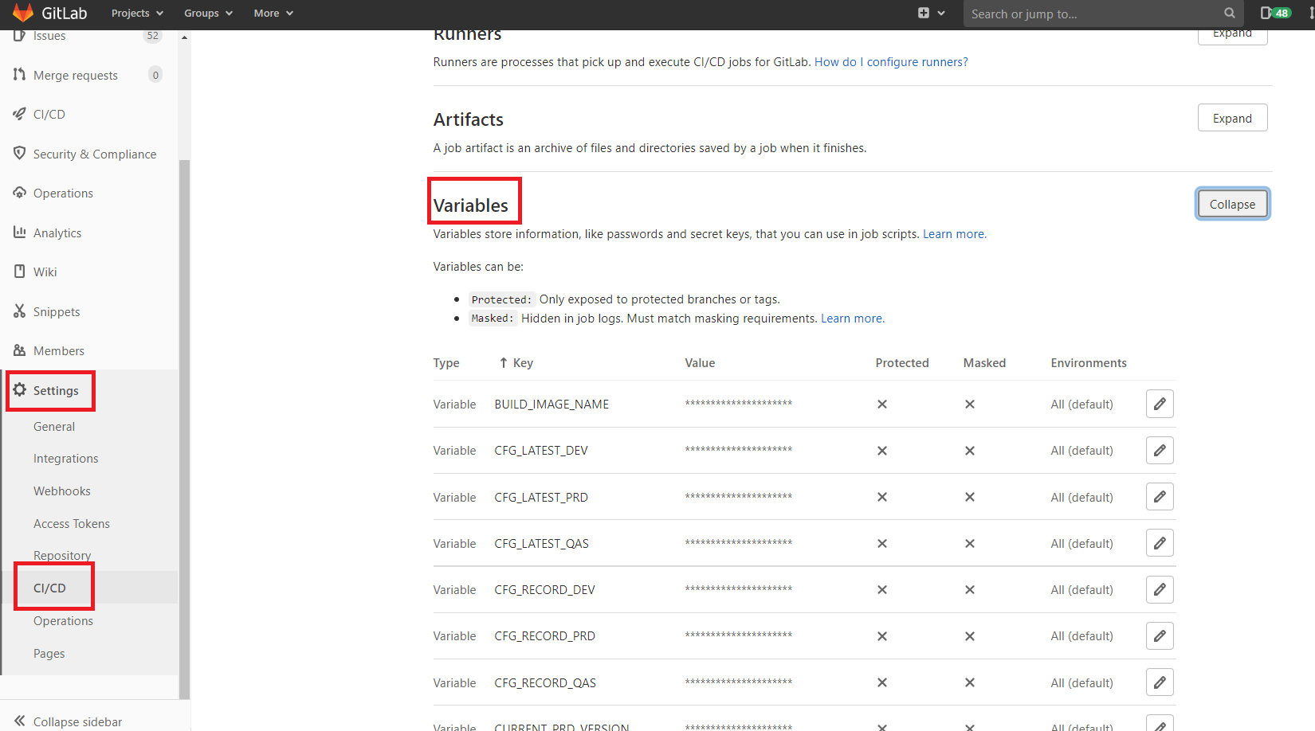
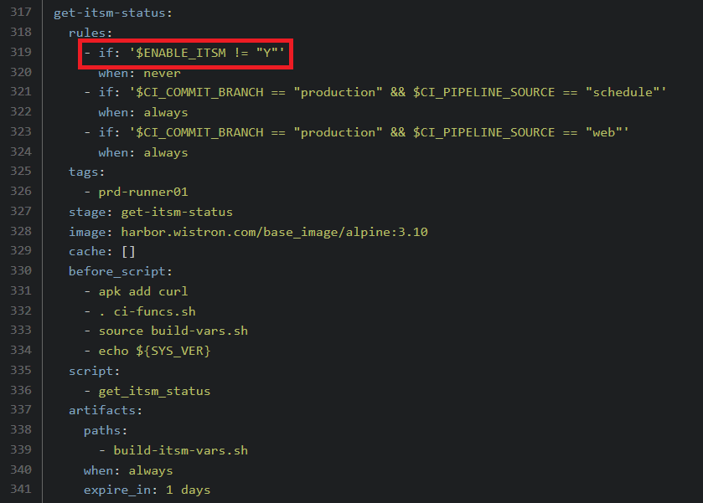
Gitlab variables

Slide 13
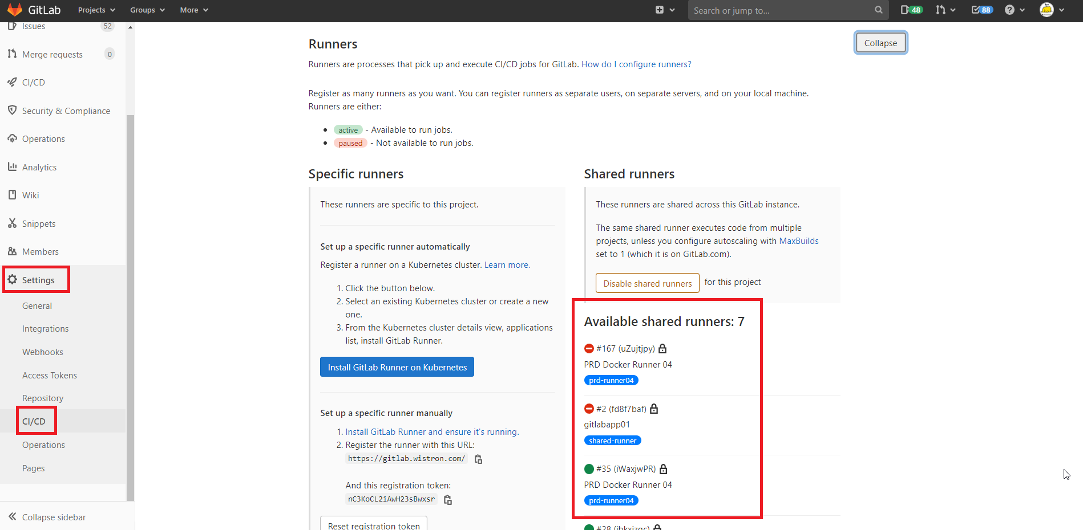
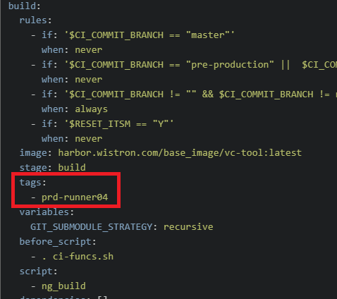
Runner

Slide 14
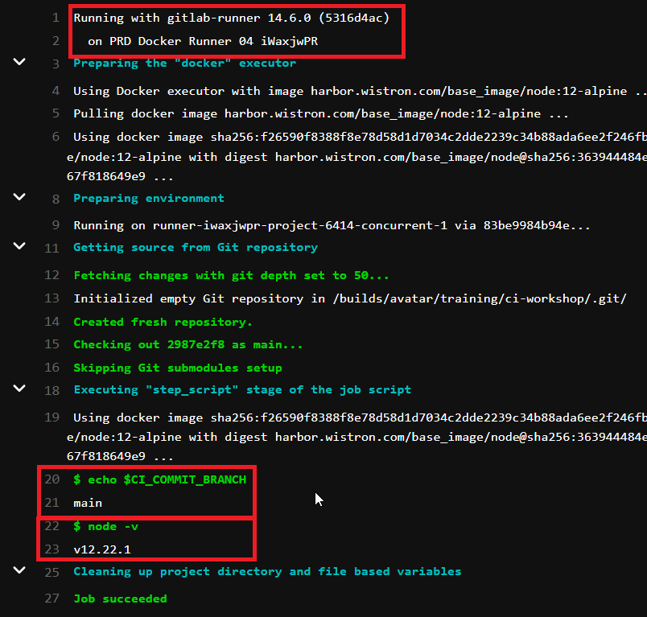
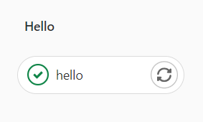
Gitlab CI Structure – ex2
answer
Add one stage “hello”
Add one job “hello”
This job use runner prd-runner04
print current branch name(hint: $CI_COMMIT_BRANCH )
print node.js version
node –v
image: harbor.wistron.com/base_image/node:12-alpine

Slide 15

Basic Syntax

Slide 16
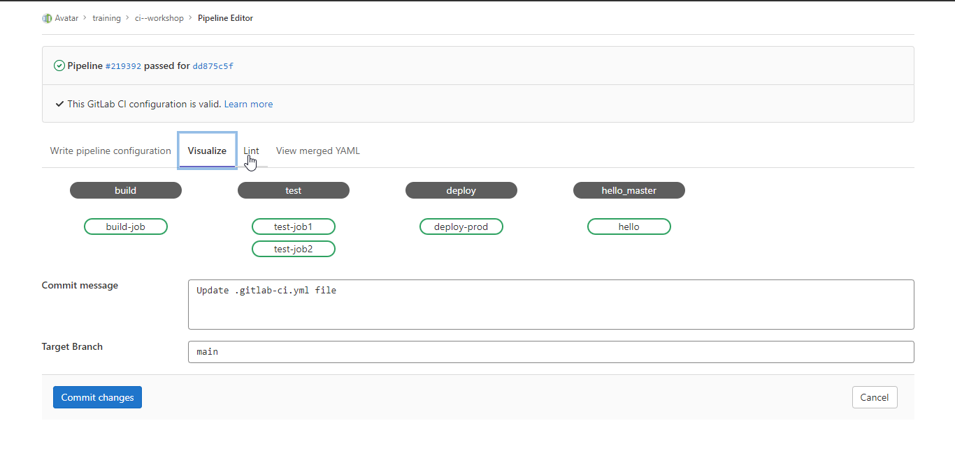
CI lint / pipeline editor

Slide 17
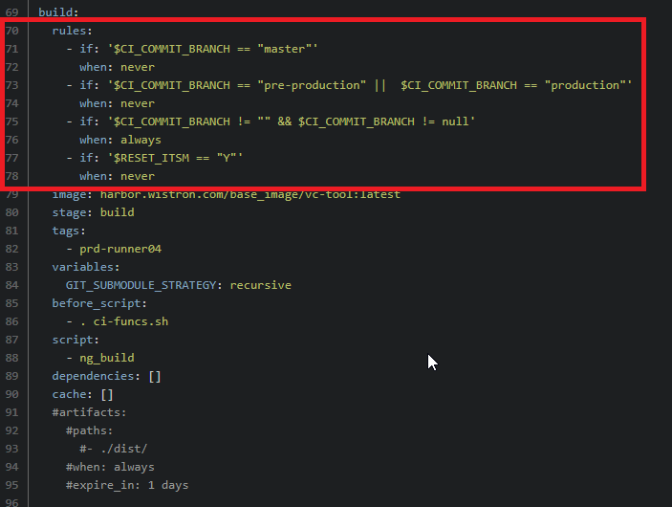
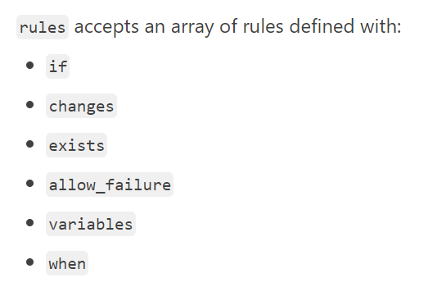
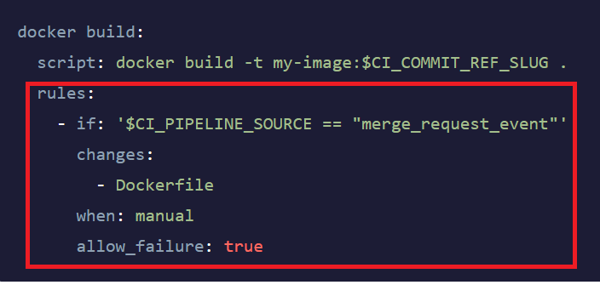
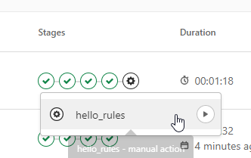
Condition(rules)
reference

Slide 18
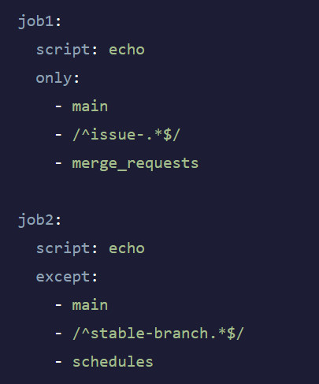
Condition(only, except)
reference
default:
tags:
- prd-runner02
job1:
script: echo
only:
- main
- /^issue-.*$/
- merge_requests
job2:
script: echo
except:
- main
- /^stable-branch.*$/
- schedules

Slide 19
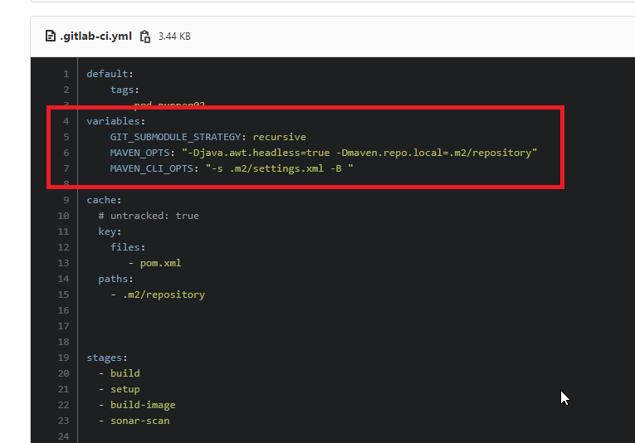

Variables
reference

Slide 20
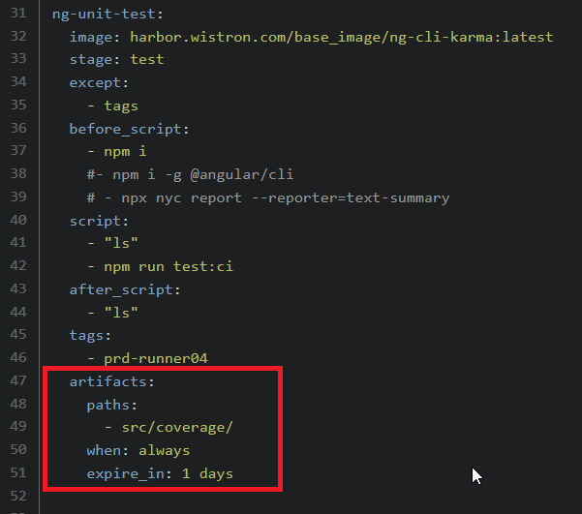
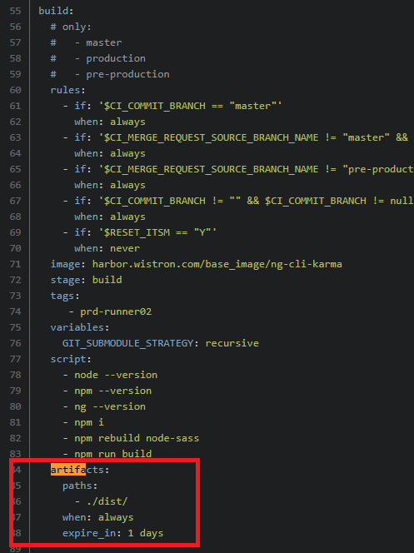
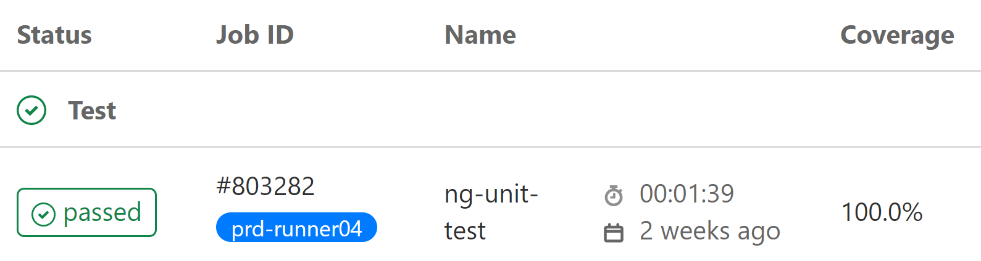
Artifacts
reference

Slide 21
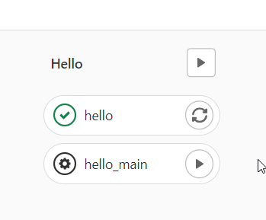
Basic Syntax – ex3
answer
Use stage “hello”
Add one job “hello_main” only run at “main” branch
this job is manual(hint: when: manual)
Add one variable “enable_job = Y”
Use rules identify if branch is main branch and enable_job = Y ? => run job
Create artifact (script : echo 'Hello, world.' >foo.txt)

Slide 22

AVATAR CI YML guide

Slide 23

Initial Project
Welcome Louise~
來賓請掌聲鼓勵

Slide 24
Initial Project – ex4
Fork angular-template to training/{your_name_subgroup}
Check gitlab variable
Jeff got it ?

Slide 25
04:20 繼續下半堂課

Slide 26
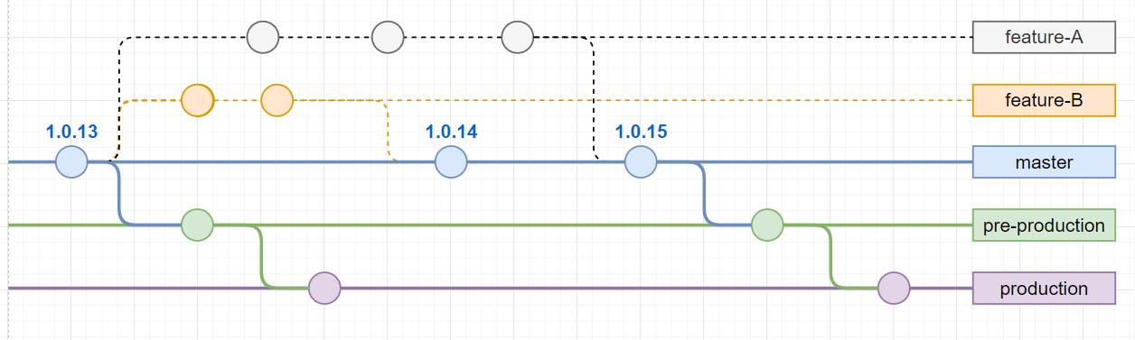
Gitlab flow

Slide 27
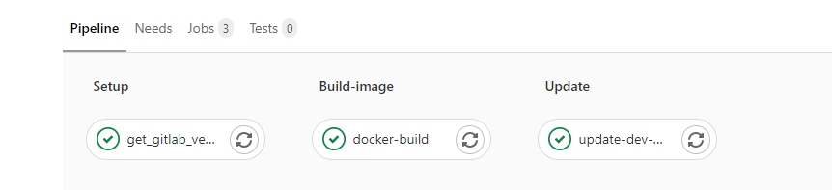
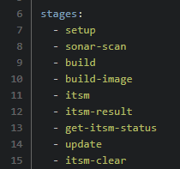
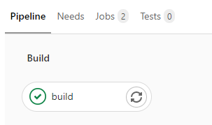
CI flow (front-end)
reference
master
branch
tags

Slide 28
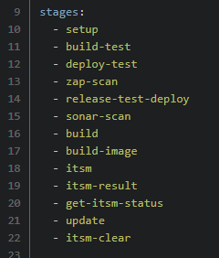
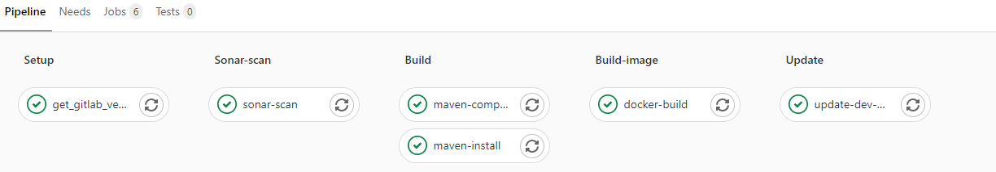
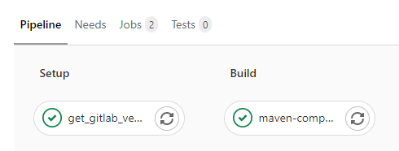
CI flow (back-end)
reference
master
branch

Slide 29
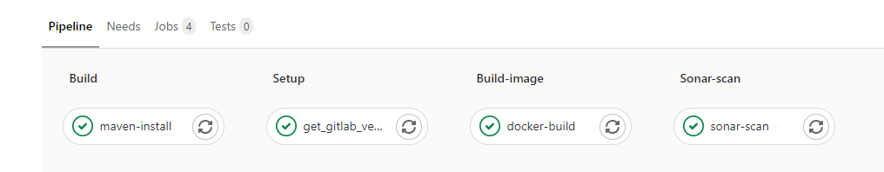
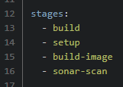
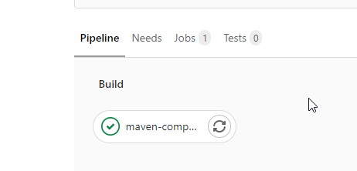
CI flow (back-end) future
reference
master
branch

Slide 30

Advance Syntax (optimize CI pipeline)

Slide 31
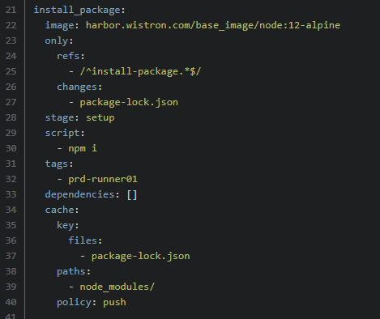

Cache
reference
example
Install package job
Use package job

Slide 32
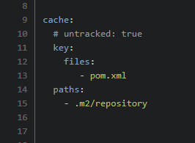
Cache(global)
example

Slide 33
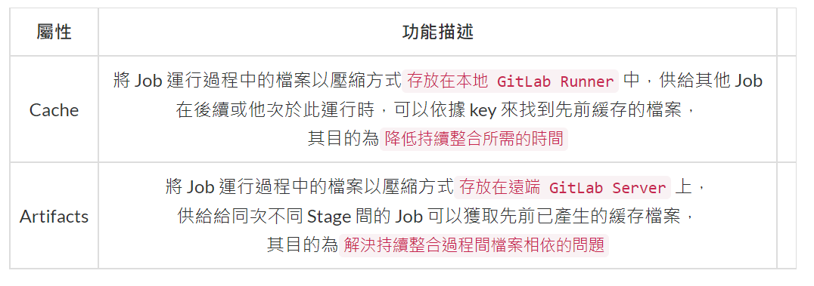
Cache vs Artifact
reference

Slide 34
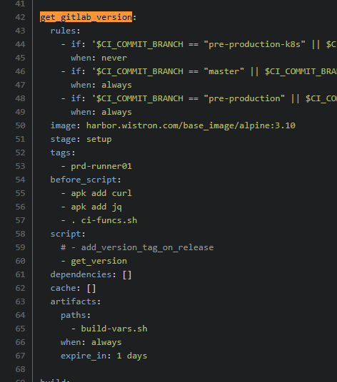
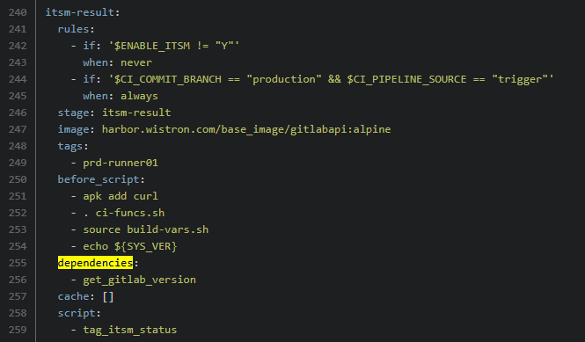

dependencies
reference
example

Slide 35
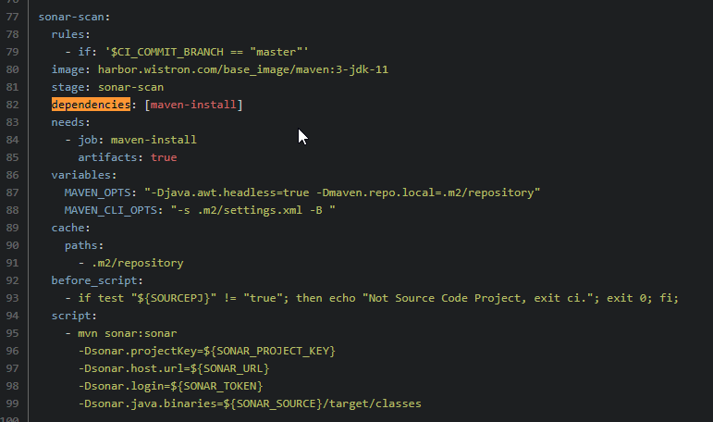
dependencies
reference
example

Slide 36
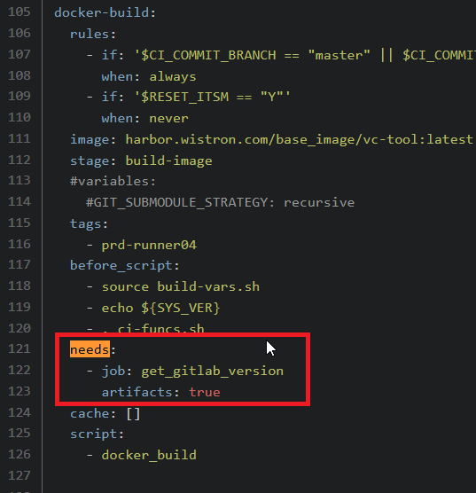
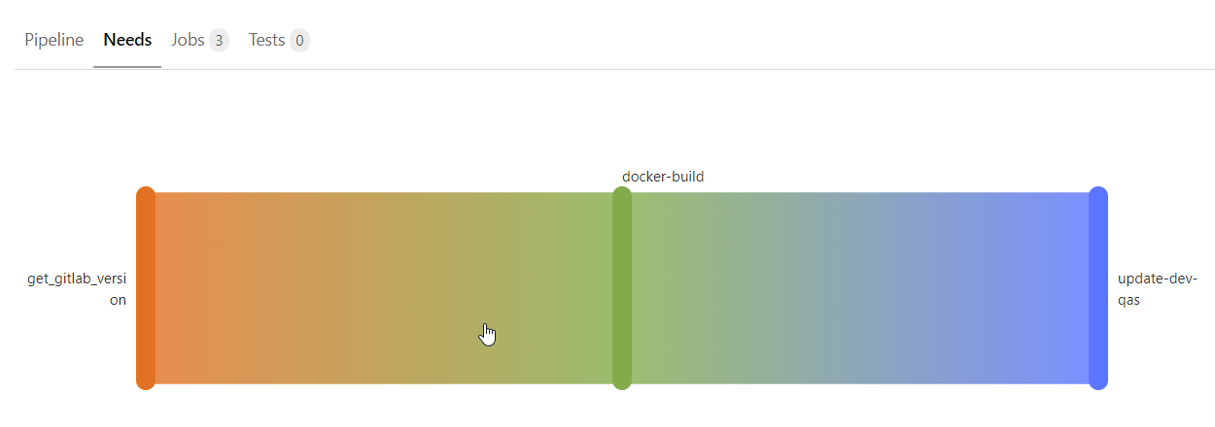
needs
reference
example
example

Slide 37
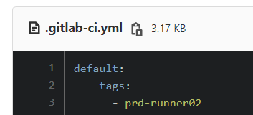
Default
reference

Slide 38
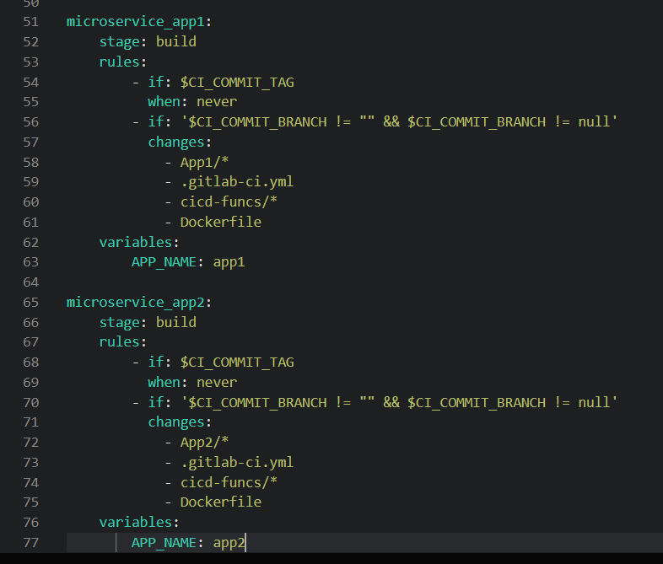
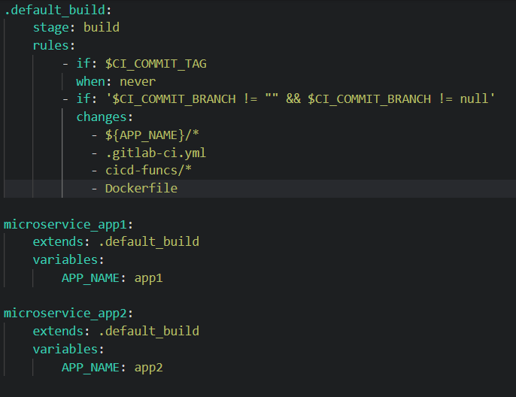
Extends / hidden job
reference

Slide 39
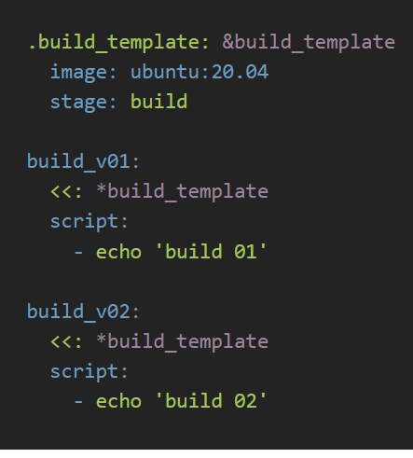
hidden job(anchor)
reference
Anchor

Slide 40

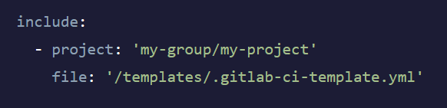
include
reference
example
example

Slide 41
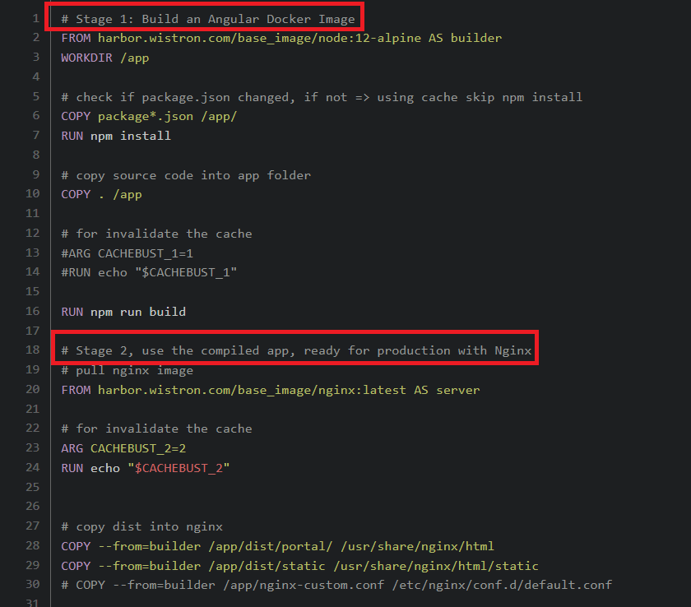
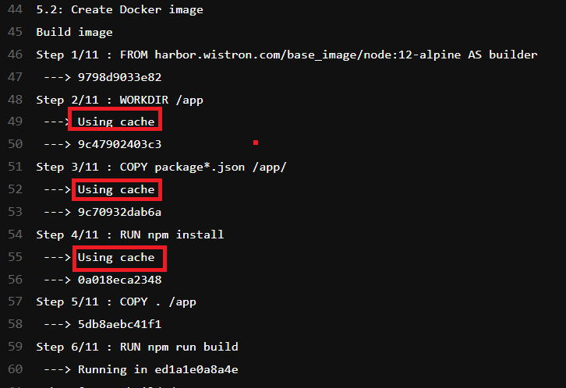
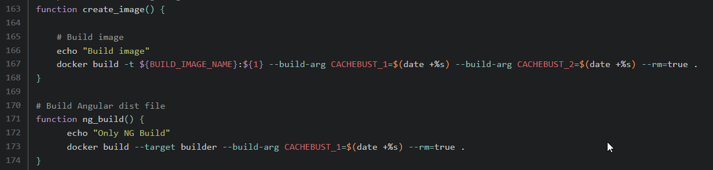
Docker: Multi-Stage Build
reference
example
Dockerfile
Run time log

Slide 42
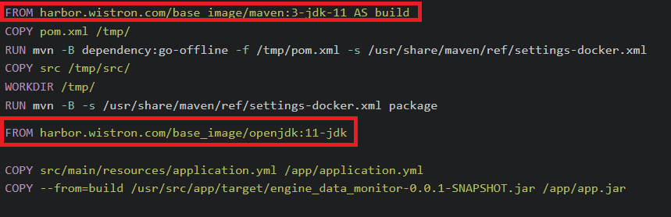
Docker: Multi-Stage Build
reference
example

Slide 43

Special Pipeline

Slide 44
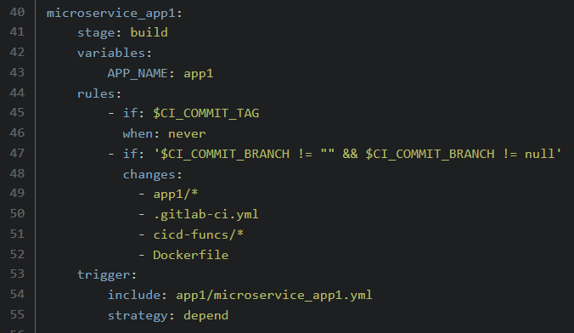

Parent-child pipeline
reference
example

Slide 45

Multi-project pipeline
reference
reference
reference

Slide 46
Reference

