Slide 1
Java Introduction
ML2700, Back-end

Slide 2
Homework
Presentation (9/3)
Output result for all samples (9/3)
Discussion (now ~ 9/3)

Slide 3
What is Java?
Java is an object-oriented programming language with its runtime environment
Java programs are platform independent which means they can be run on any operating system
Java code that runs on one platform does not need to be recompiled to run on another platform
Write once, run anywhere
Types of JAVA Applications
Web, Standalone, Enterprise and Mobile Application

Slide 4





Evolution of Java
Version | Released on
JDK1.0 | 23 Jan 1996
JDK1.1 | 19 Feb 1997
J2SE 1.2 | 8 Dec 1998
J2SE 1.3 | 8 May 2000
J2SE 1.4 | 6 Feb 2002
J2SE 5.0 | 30 Sept 2004
Java SE 6 | 11 Dec 2006
Java SE 7.0 | 28 July 2011
Java SE 8.0 | 18 March 2014
Java SE 9.0 | Sept 2017
Java SE 10 (18.3) | 2018

Slide 5
Java Program Structure
Section | Description
Documentation Section | Comments are beneficial for the programmer because they help them understand the code
Package statement | A package is a group of classes that are defined by a name. That is, if you want to declare many classes within one element, then you can declare it within a package
Import statements | This line indicates that if you want to use a class of another package, then you can do this by importing it directly into your program.
Class Definition | A Java program may contain several class definitions. Classes are the main and essential elements of any Java program.

Slide 6
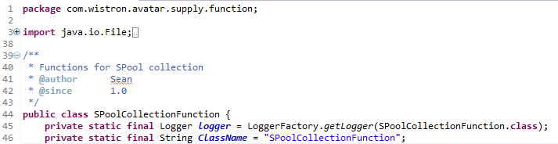
Java Program Structure
Section
Documentation Section
Package statement
Import statements
Class Definition

Slide 7
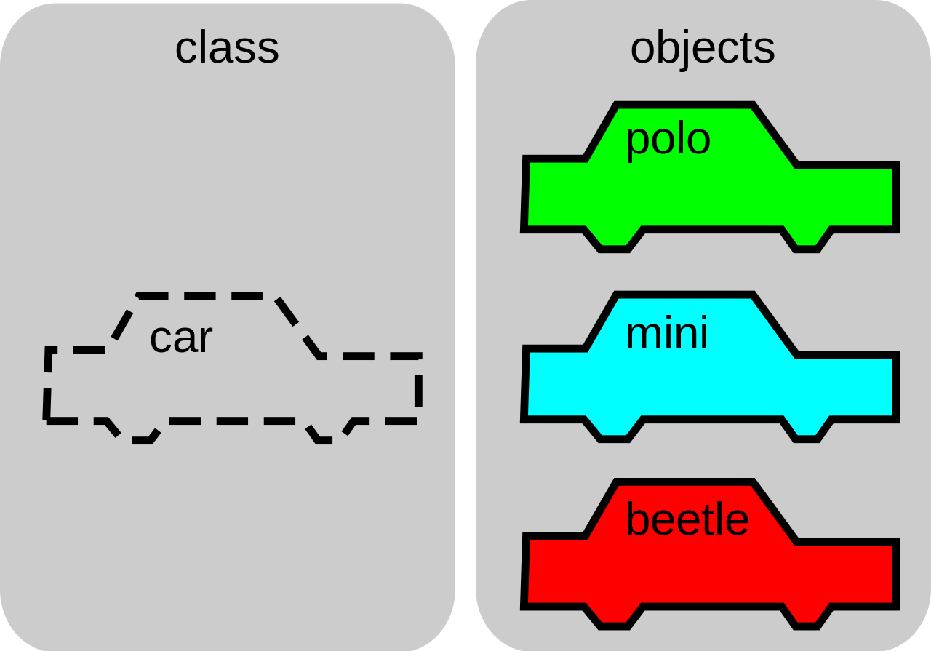
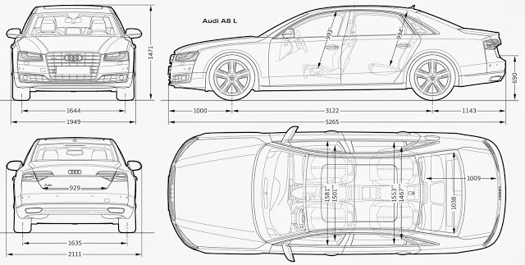
JAVA Class & Object

Slide 8
JAVA Class & Object
Class | Objects
A class is a blueprint from which you can create the instance, i.e., objects. | An object is the instance of the class, which helps programmers to use variables and methods from inside the class.
A class is used to bind data as well as methods together as a single unit. | object acts as a variable of the class.
Classes have logical existence. | Objects have a physical existence.
A class doesn't take any memory spaces when a programmer creates one. | An object takes memory when a programmer creates one.
The class has to be declared only once. | Objects can be declared several times depending on the requirement.

Slide 9
What is JVM?
JVM → Java Virtual Machine.
Java compiler produce Bytecode for a Java Virtual Machine.
JVM is the main component of Java architecture, and it is the part of the JRE (Java Runtime Environment).
A program of JVM is written in C Programming Language, and JVM is Operating System dependent.
JVM is responsible for allocating the necessary memory needed by the Java program.
# JRE stands for Java Runtime Environment which is used to provide an environment at runtime

Slide 10
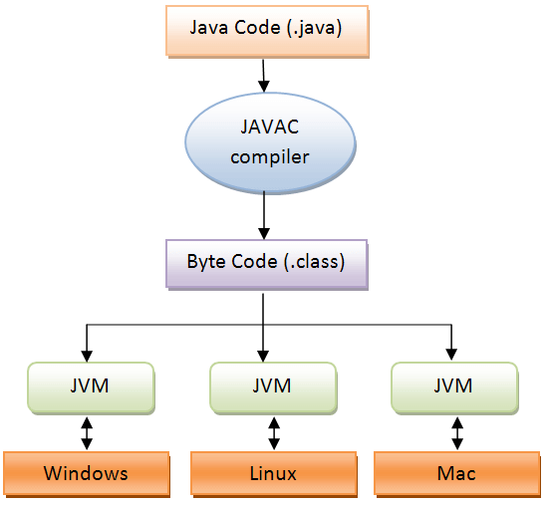
What is JVM?

Slide 11

JDK Installation
https://www.azul.com/downloads/zulu/
Zulu® is a certified build of OpenJDK that is fully compliant with the Java SE standard.

Slide 12
Java SE Development Kit (JDK)
JDK Includes a complete JRE plus tools for developing, debugging, and monitoring Java applications
JRE stands for Java Runtime Environment which is used to provide an environment at runtime
javac is the compiler for the Java; it's used to compile .java file. It creates a class file which can be run by using java command
When a class file has been created, the java (interpreter, 直譯器) command can be used to run the Java program
jar is (manage Java archive) a package file format that contains class, text, images and sound files for a Java application into a single compressed file

Slide 13
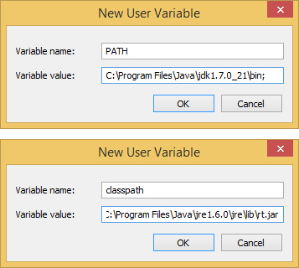
Java SE Development Kit (JDK)
path
path variable is used to set the path for all Java software tools like javac.exe, java.exe, javadoc.exe, and so on.
classpath
classpath variable is used to set the path for java classes.

Slide 14
Declaration & Assignments

Slide 15
Reserved words
abstract | assert | boolean | break
byte | case | catch | char
class | const | continue | default
do | double | else | enum
extends | final | finally | float
for | goto | if | implements
import | instanceof | int | interface
long | native | new | package
private | protected | public | return
short | static | strictfp | super
switch | synchronized | this | throw
throws | transient | try | void
volatile | while | true | false
null

Slide 16
Arithmetic Operators (算術運算子)
Arithop
Operator | Meaning | Work
+ | Addition | To add two operands.
- | Subtraction | To subtract two operands.
* | Multiplication | To multiply two operands.
/ | Division | To divide two operands.
% | Modulus | To get the area of the division of two operands.

Slide 17
Unary Operation (一元運算子)
Unaryop
Example | Description
val = a++; | Store the value of "a" in "val" then increments.
val = a--; | Store the value of "a" in "val" then decrements.
val = ++a; | Increments "a" then store the new value of "a" in "val".
val = --a; | Decrements "a" then store the new value of "a" in "val".
Notes:
a++ 為先取a值使用, "結束後"再將變數a加上1
++a 為先將a加上1,在開始運算

Slide 18
Relational Operators (關係運算子)
Relatiop
Operator | Meaning
== | Is equal to
!= | Is not equal to
> | Greater than
< | Less than
>= | Greater than or equal to
<= | Less than or equal to

Slide 19
Logical Operators (邏輯運算子)
Logicalop
Operator | Meaning | Work
&& | Logical AND | If both operands are true then only "logical AND operator" evaluate true.
|| | Logical OR | The logical OR operator is only evaluated as true when one of its operands evaluates true. If either or both expressions evaluate to true, then the result is true.
! | Logical Not | Logical NOT is a Unary Operator, it operates on single operands. It reverses the value of operands, if the value is true, then it gives false, and if it is false, then it gives true.

Slide 20
Assignment Operators (設定運算子)
Assigns
Operator | Meaning
= | Simple assigns
+= | Increments then assigns
-= | Decrements then assigns
*= | Multiplies then assigns
/= | Divides then assigns
%= | Modulus then assigns

Slide 21
JAVA Data Types (原生型別)
DataTypes
Type | Contains | Default | Size | Range
byte | Signed integer | 0 | 1 byte | -128 to 127
short | Signed integer | 0 | 2 bytes | -32,768 to 32767
int | Signed integer | 0 | 4 bytes | -2147,483,648 to 2147,483,647
long | Signed integer | 0 | 8 bytes | -9223,372,036,854,755,808 to 9223,372,036,854,755,807
float | floating point single-precision | 0.0f | 4 bytes | ±3.40282347E+38F
double | floating point double-precision | 0.0 | 8 bytes | ±1.7976931348623157E+308
Notes:
\u0000 = null,

Slide 22
JAVA Data Types (原生型別)
DataTypes
Type | Contains | Default | Size | Range
char | Unicode character | \u0000 | 2 bytes | \u0000 to \uFFFF
boolean | true or false | false | 1 bit | true or false
array | datatype[] identifier; or datatype identifier[];
Notes:
\u0000 = null,

Slide 23
Variables in JAVA
Local variables
Defined in method or other statements, such as defined and used within the cache block, and outside the block or method, the variable cannot be used
Instance variables
A non-static variable that is declared within the class but not in the method is called instance variable. Instance variables are related to a specific object
Static variables
Implemented a class level variable. Hence variables and methods having the static keyword act as part of the class and not as the class instance

Slide 24
Access Modifiers (存取修飾詞)
AccessModifiers
Access Modifier | Within class | Within package | Outside package by subclass only | Outside package
Private | Y | N | N | N
Default | Y | Y | N | N
Protected | Y | Y | Y | N
Public | Y | Y | Y | Y

Slide 25
Flow Control

Slide 26
If-Else Statements
IfElseStatements
if (test_expression) {
//execute your code
}
else if (test_expression n) {
//execute your code
}
else {
//execute your code
}

Slide 27
Switch Statements
SwitchStatements
switch(variable) {
case 1:
//execute your code break;
case n:
//execute your code
break;
default:
//execute your code
break;
}

Slide 28
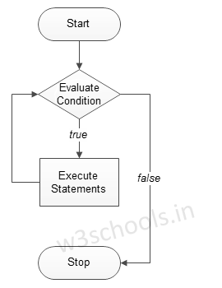
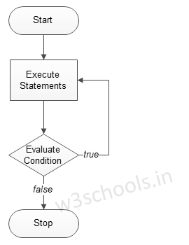
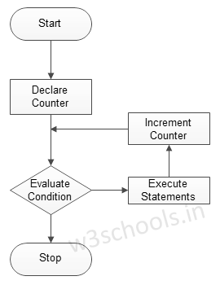
Loop Statements
Loops
While
Do-While
For Loop
true
false

Slide 29
Loop Control Statements
BreakAndContinue
Statement | Syntax | Description
break statement | break; | Is used to terminate loop or switch statements.
continue statement | continue; | Is used to suspend the execution of current loop iteration and transfer control to the loop for the next iteration.

Slide 30
Miscellaneous (哩哩扣扣)

Slide 31
String Object in JAVA
StringObject
A String is a sequence of character, widely used as an object
Declaration: String name = "Alex";
Concatenating Strings
String message = "Hello," + " world" + "!“
String Case
String str1 = "Hello";
System.out.println(str1.toUpperCase());
System.out.println(str1.toLowerCase());

Slide 32
String Object in JAVA
StringObject
Trim String
String str = " Hello ";
System.out.println(str.trim());
String Length
String str = "Cloud";
System.out.println(str.length());
String Comprison
String str = "Cloud";
System.out.println(str.equals("Cloud"));
String Pool: https://openhome.cc/Gossip/JavaGossip-V1/ImmutableString.htm

Slide 33
Date Object in JAVA
DisplayDate
Date contained in a java.util.Date instance
Declaration: Date datetime = new Date();
Date timestamp in milliseconds is accessible by using Date object with getTime() method
date.getTime(); //1444194469602
Current Date Time
date.toString();

Slide 34
Date Object in JAVA
DisplayDate
Date formatting
Date date = new Date( );
SimpleDateFormat dateFormat = new SimpleDateFormat ("E yyyy.MM.dd 'at' hh:mm:ss a zzz"); //Fri 2018.08.17 at 05:48:19 AM UTC
Calendar Object
Date comparison & manipulation
https://openhome.cc/Gossip/JavaGossip-V2/UseCalendar.htm

Slide 35
JAVA Methods
CallMethods
A Java method is a single or a collection of Java statement(s) to carry out a specific task on some data (variables) which may or may not return any end result
You can group Java operations providing a name which will be the name of the method
Java methods must have to be located within a Java class
Java method is defined by the programmer or available and pre-existing in Java's standard library or additional libraries.

Slide 36
JAVA Methods
CallMethods
The syntax for Creating methods in Java
modifier returnType NameofMethod(Parameter List) {
// method body
}
What is the ideal length of a method
Readability and maintainability
Less than 100 – by 假掰Sean
https://martinfowler.com/bliki/FunctionLength.html

Slide 37
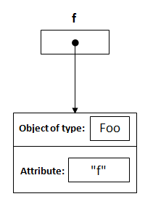
JAVA Methods
CallByValues
Parameters can be passed by value
Declaring a reference named f of type Foo and assign it to a new object of type Foo with an attribute "f".
Foo f = new Foo("f");

Slide 38
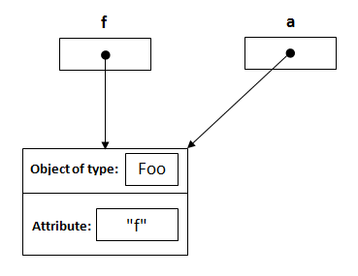
JAVA Methods
CallByValues
Parameters can be passed by value
As you call the method changeReference, the reference a will be assigned to the object which is passed as an argument.
changeReference(f);
public static void changeReference(Foo a)

Slide 39
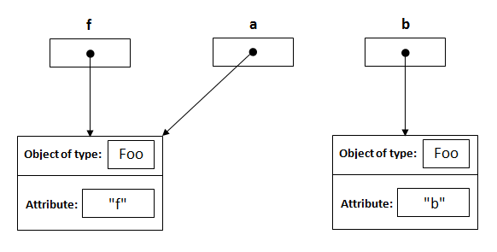
JAVA Methods
CallByValues
Parameters can be passed by value
Declaring a reference named b of type Foo and assign it to a new object of type Foo with an attribute "b"
Foo b = new Foo("b");

Slide 40
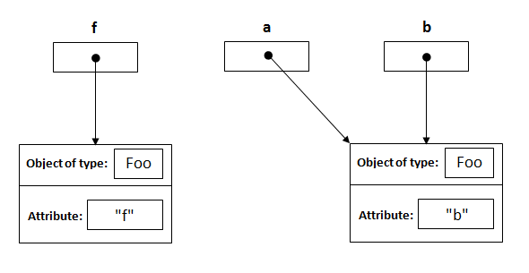
JAVA Methods
CallByValues
Parameters can be passed by value
a = b is re-assigning the reference a NOT f to the object whose its attribute is "b".
a = b

Slide 41
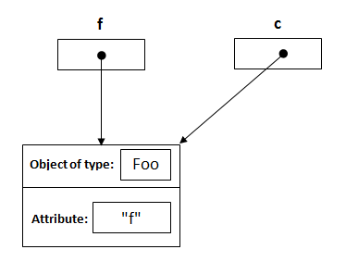
JAVA Methods
CallByValues
Parameters can be passed by value
As you call modifyReference(Foo c) method, a reference c is created and assigned to the object with attribute "f".
modifyReference(f);
modifyReference(Foo c)

Slide 42
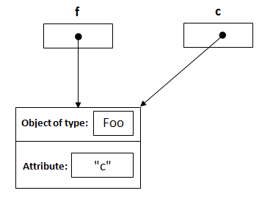
JAVA Methods
CallByValues
Parameters can be passed by value (JAVA has no call by reference)
c.setAttribute("c"); will change the attribute of the object that reference c points to it, and it's same object that reference f points to it.
c.setAttribute("c");

Slide 43
Object-oriented Programming (OOP)

Slide 44



Concept of OOP

Slide 45
Basic Terms and Features that are used and provided by OOP
Classes and Objects
Abstraction
Inheritance
Polymorphism
Data encapsulation

Slide 46
Advantages of OOP
Code reuse.
Wrapping up of data into a single unit.
Easy to partition the work in a project based on objects.
Message passing technique between objects through methods.
Software Complexity can be easily handled and managed.
Possible to map objects in a problem domain within a program.
Data hiding is possible.
Use of inheritance can eliminate redundant codes in a program.

Slide 47
JAVA Class & Object

Slide 48
JAVA Class & Object
Class | Objects
A class is a blueprint from which you can create the instance, i.e., objects. | An object is the instance of the class, which helps programmers to use variables and methods from inside the class.
A class is used to bind data as well as methods together as a single unit. | object acts as a variable of the class.
Classes have logical existence. | Objects have a physical existence.
A class doesn't take any memory spaces when a programmer creates one. | An object takes memory when a programmer creates one.
The class has to be declared only once. | Objects can be declared several times depending on the requirement.

Slide 49
JAVA Constructors
ConstructorSample
Constructors are special method whose task is to initialize the objects of its class
It is treated as a special method because its name is the same as the class name
Java constructors are invoked when their objects are created
Every class has a constructor when we don't explicitly declare a constructor for any java class

Slide 50
Characteristics of Constructor
ConstructorSample
Constructors cannot be private.
A constructor can be overloaded.
Constructors cannot return a value.
Constructors name must be same with the class name.
Constructors are automatically called when an object is instanced.

Slide 51
Rules for using Static Variables/Methods
StaticModifier
Variables or methods belong to class rather than to any particular instance
A static method cannot access a non-static variable of a class nor can directly invoke non-static method
Static members can be applied without creating or referencing an instance of the class
A static variable will be shared by all instances of that class which will result in only one copy

Slide 52
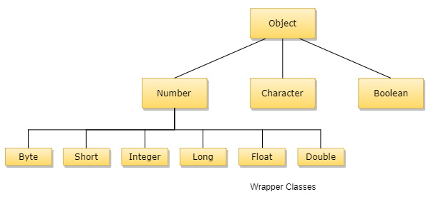
Abstraction & Inheritance (抽象 & 繼承)
Concept
Reduces programmers re-writing effort (code reusability)
Abstract classes and interfaces
https://docs.oracle.com/javase/10/docs/api/java/lang/Double.html
https://openhome.cc/Gossip/JavaEssence/Interface.html

Slide 53
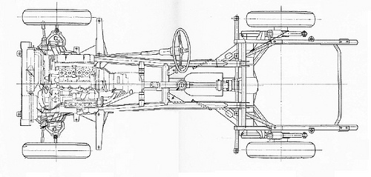
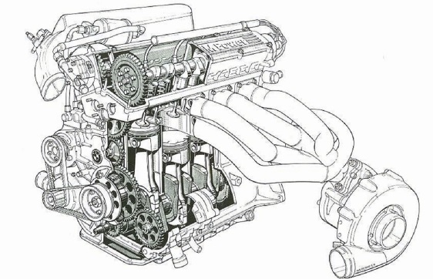

Abstraction & Inheritance (抽象 & 繼承)
Concept
Abstraction Class Car
Interface Chassis
Interface Engine
extends
Implements
Implements
Class A1
Class A3
Class A4
Class A5
Class A6

Slide 54
Polymorphism (多型)
Concept
Single interface with multiple implementations
Important concept in polymorphism:
https://github.com/JustinSDK/JavaSE6Tutorial/blob/master/docs/CH08.md#821-%E5%A4%9A%E5%9E%8B%E5%B0%8E%E8%AB%96
OVERLOADING | OVERRIDING
It is performed at compile time. | It is performed at runtime.
It is carried out within a class. | It is carried out with two classes having an IS-A relationship between them.
Parameters do not remain the same in case of overloading. | The parameter must remain the same in case of overriding.

Slide 55
Encapsulation (封裝)
Concept
Encapsulation can be used to hide non-public variables & methods.
Encapsulation means that the internal representation of an object is generally hidden from view outside of the object's definition.
Data/Information Hiding: The user will have no idea about the inner implementation of the class. He only knows that we are passing the values to a public method and getting responded value.
Reusability: Encapsulation also improves the re-usability and easy to change with new requirements.
Testing code is easy: unit testing.

Slide 56
Collection & Map

Slide 57
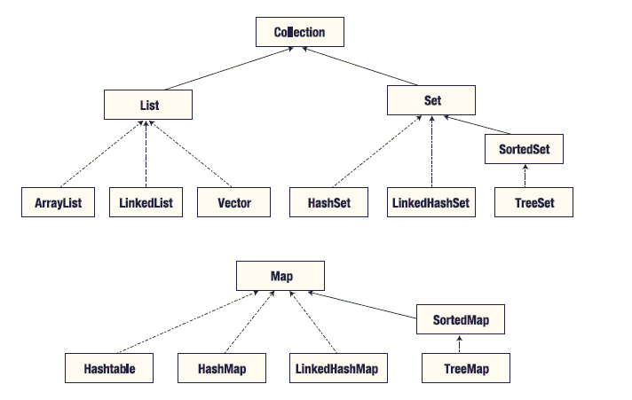
Collection & Map

Slide 58
Collection – List Object
List<T> is an ordered collection of objects in which duplicate values can be stored.
Since List preserves the insertion order, it allows positional access and insertion of elements.
List Interface is implemented by ArrayList, LinkedList, Vector.

Slide 59
Collection – List Object
ArrayListDemo
IteratorDemo
ArrayList
ArrayList is implemented as a resizable array. As more elements are added to ArrayList, its size is increased dynamically.
It's elements can be accessed directly by using the get and set methods, since ArrayList is essentially an array.
LinkedList
LinkedList is implemented as a double linked list.
Its performance on add and remove is better than Arraylist, but worse on get and set methods.

Slide 60
Collection – Set Object
Set<T> is an non-ordered collection of objects in which duplicate values can not be stored.
More formally, sets contain at most one null element.
Set Interface is implemented by EnumSet, HashSet, JobStateReasons, LinkedHashSet, TreeSet classes.

Slide 61
Map
HashMapDemo
HashMapDemo2
Map represents a mapping between a key and a value.
Map cannot contain duplicate keys and each key can map to at most one value.
Some implementations allow null key and null value like the HashMap and LinkedHashMap, but some do not like the TreeMap.
The order of a map depends on specific implementations,
e.g TreeMap and LinkedHashMap have predictable order, while HashMap does not.

Slide 62

OOD
https://dzone.com/articles/ten-commandments-of-object-oriented-design

Slide 63
References..
https://docs.oracle.com/javase/tutorial/index.html
https://www.w3schools.in/java-tutorial/
https://github.com/JustinSDK/JavaSE6Tutorial
https://dzone.com/articles/ten-commandments-of-object-oriented-design

Slide 64
Next Step…
Introduction of
Kafka, Redis, ElasticSearch, MQTT
AVATAR Back-end and Dev.

