Slide 1
MQTT
Jesse Huang

Slide 2
Outline
What is MQTT
MQTT Broker
MQTT over Websocket
Java MQTT Client
homework
Reference

Slide 3
What is MQTT
MQTT (Message Queuing Telemetry Transport) is a machine-to-machine (M2M)/"Internet of Things" connectivity protocol. It works on top of the TCP/IP protocol.
It was designed as an extremely lightweight publish/subscribe messaging transport.

Slide 4
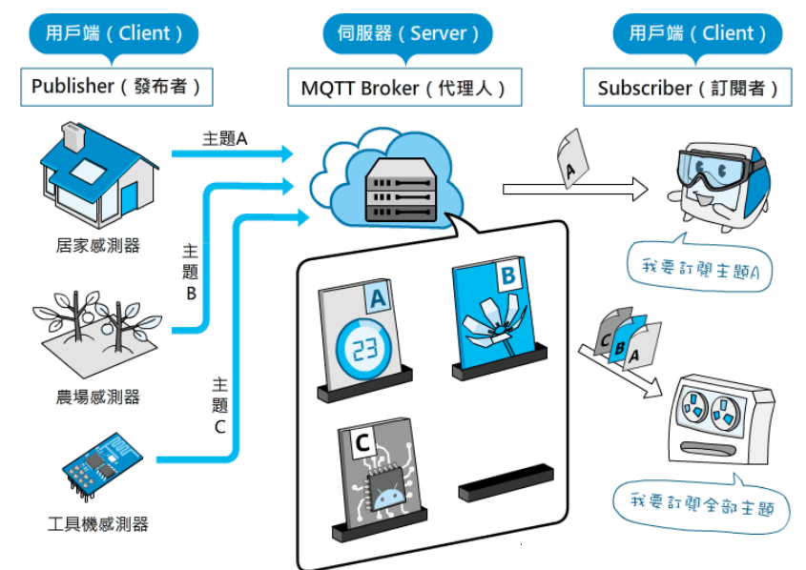
What is MQTT
Publisher, Broker and Subscriber

Slide 5
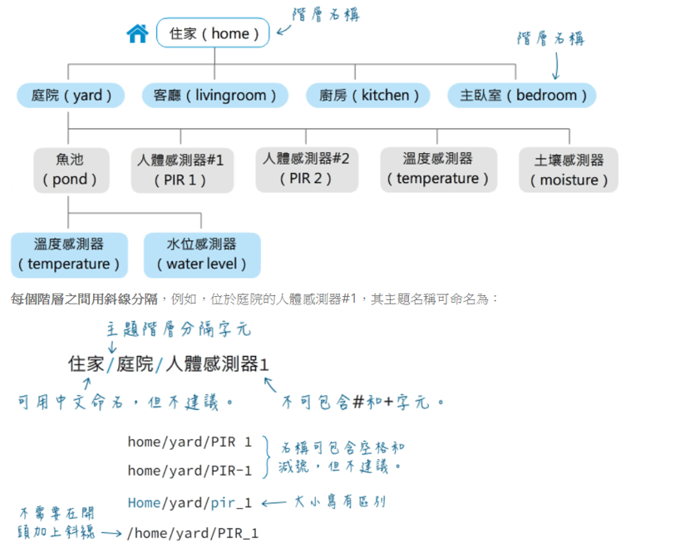
What is MQTT
Topic

Slide 6
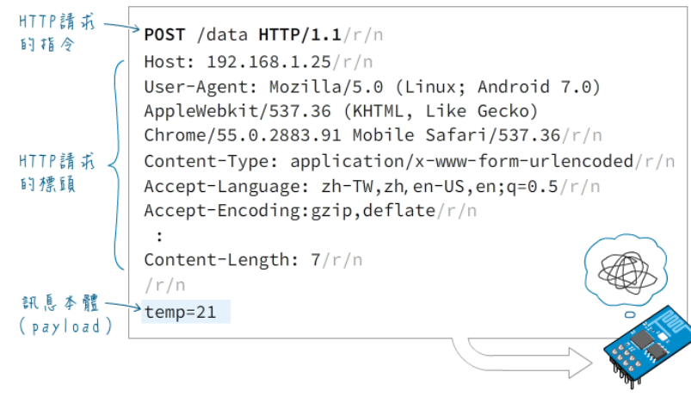
What is MQTT
HTTP message format

Slide 7
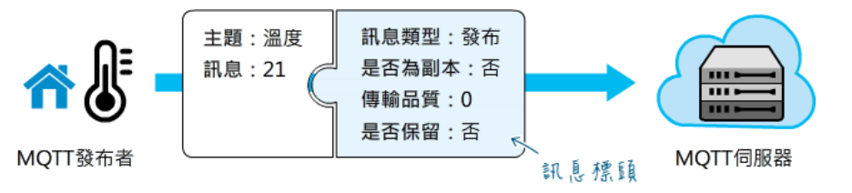
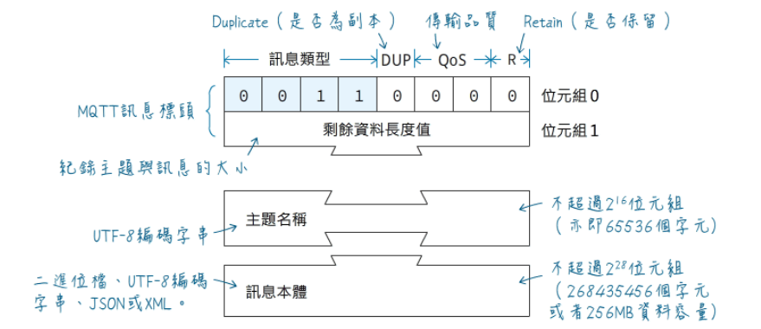
What is MQTT
MQTT message format

Slide 8
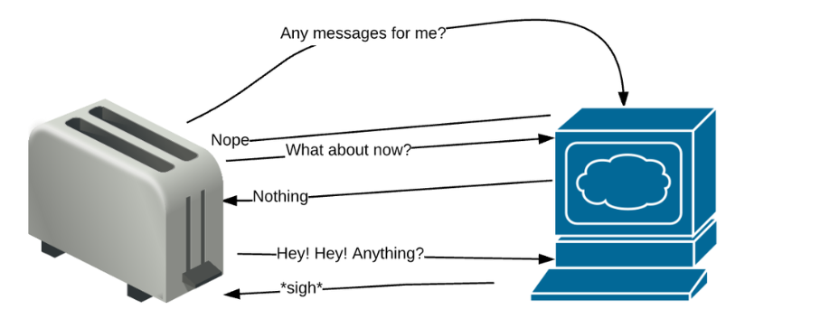
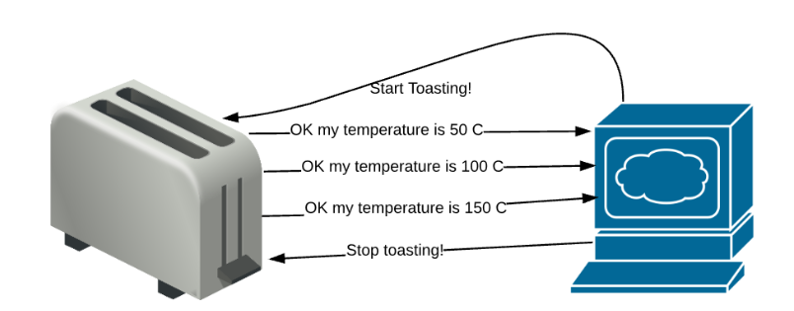
What is MQTT
HTTP vs MQTT

Slide 9
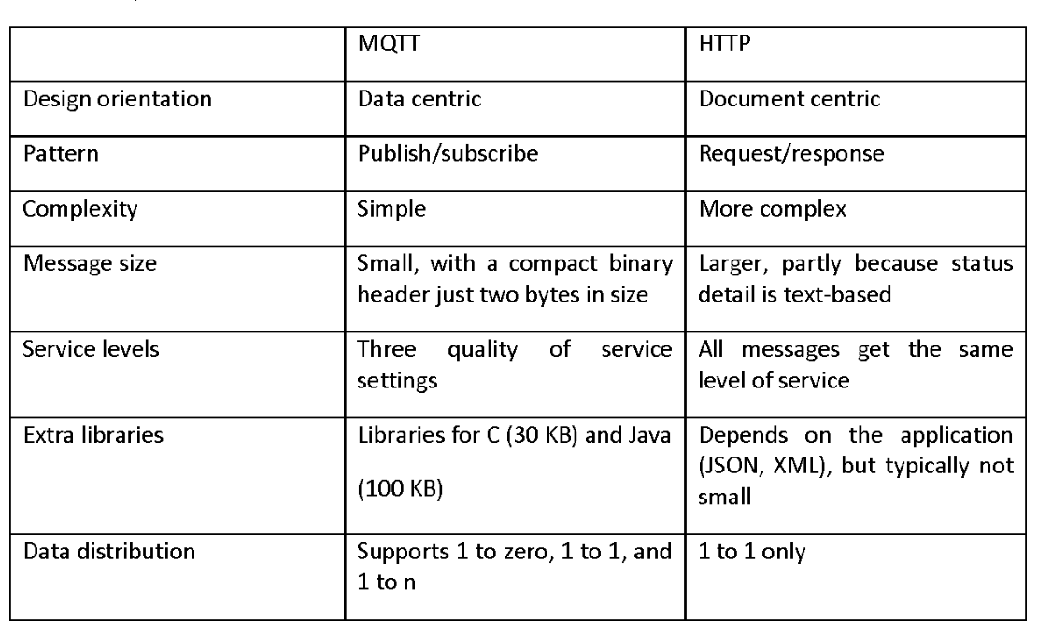
What is MQTT
Comparison between MQTT and HTTP

Slide 10
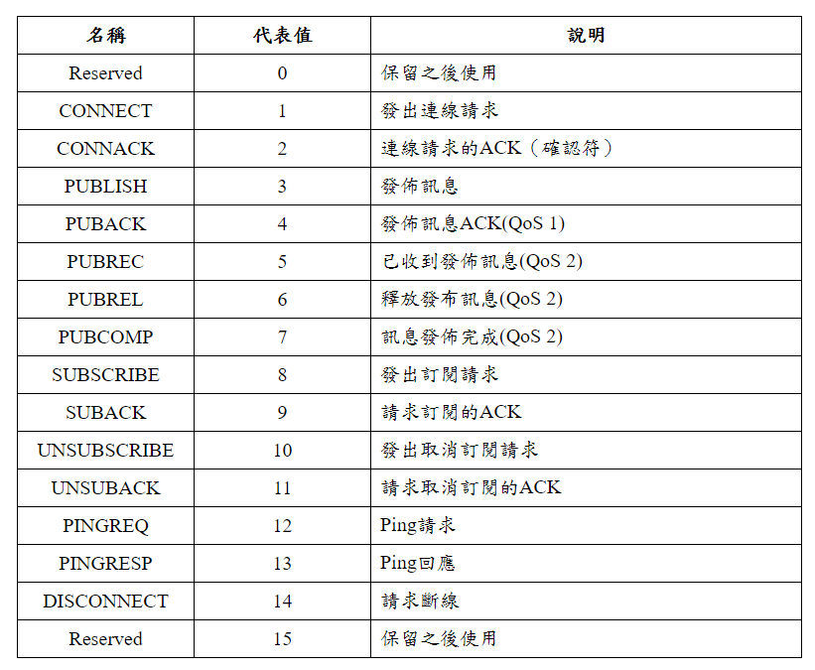
What is MQTT
MQTT message type

Slide 11
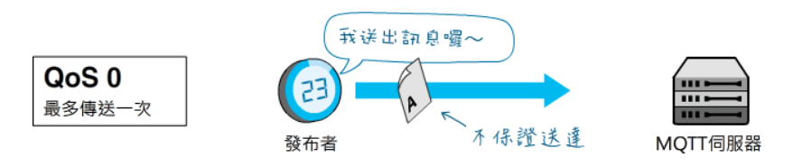
What is MQTT
At most once (0)
There are 3 Quality of service (QoS) levels in MQTT:

Slide 12
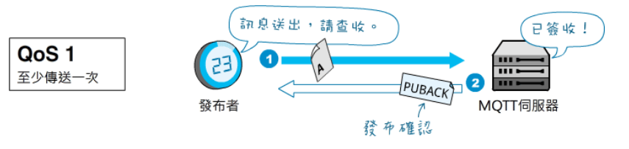
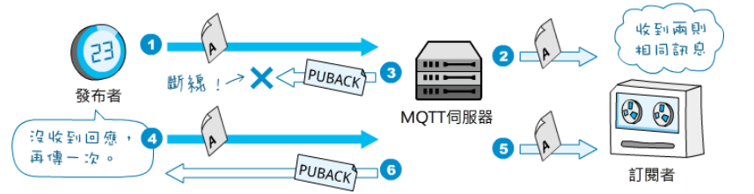
What is MQTT
At least once (1)

Slide 13
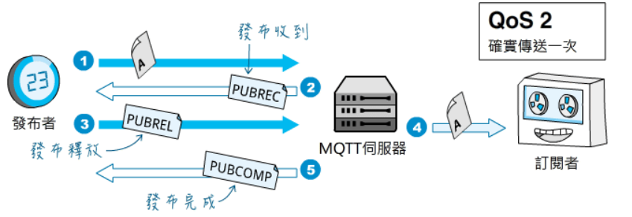
What is MQTT
Exactly once (2)

Slide 14
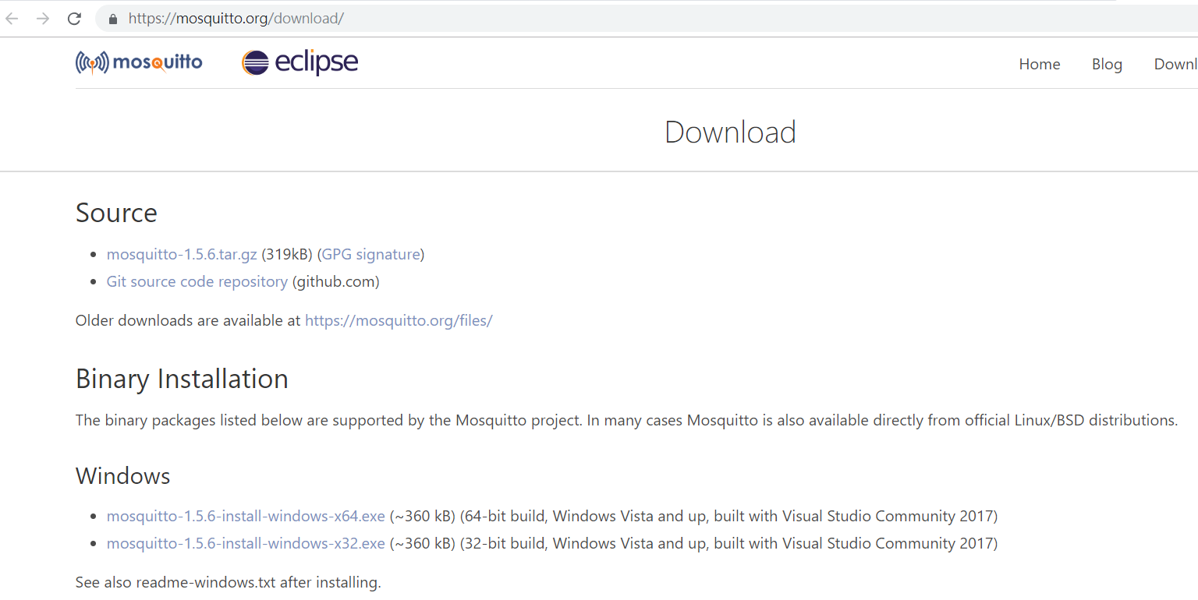
MQTT Broker
Eclipse Mosquitto is an open source (EPL/EDL licensed) message broker that implements the MQTT protocol versions 3.1 and 3.1.1.

Slide 15
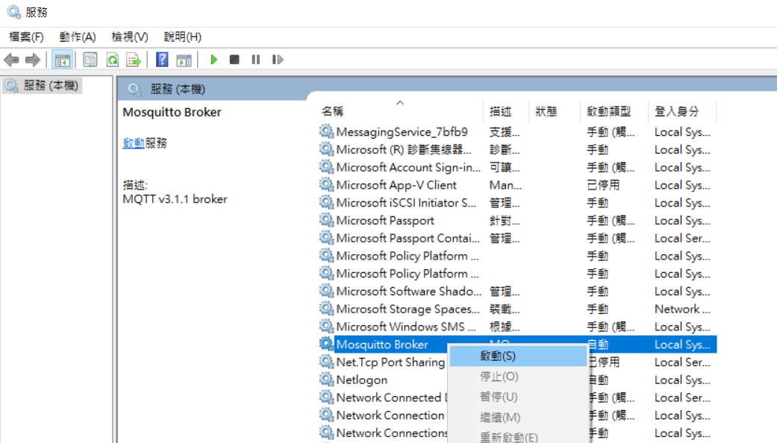
MQTT Broker
Starting Mosquitto service on Windows

Slide 16
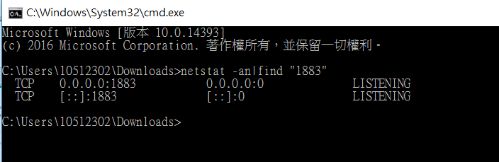
MQTT Broker
Starting Mosquitto
mosquitto.exe -v
publish:
mosquitto_pub.exe -h host -p port -q qos -t topic -m message
subscribe:
mosquitto_sub.exe -h host -p port -q qos -t topic

Slide 17
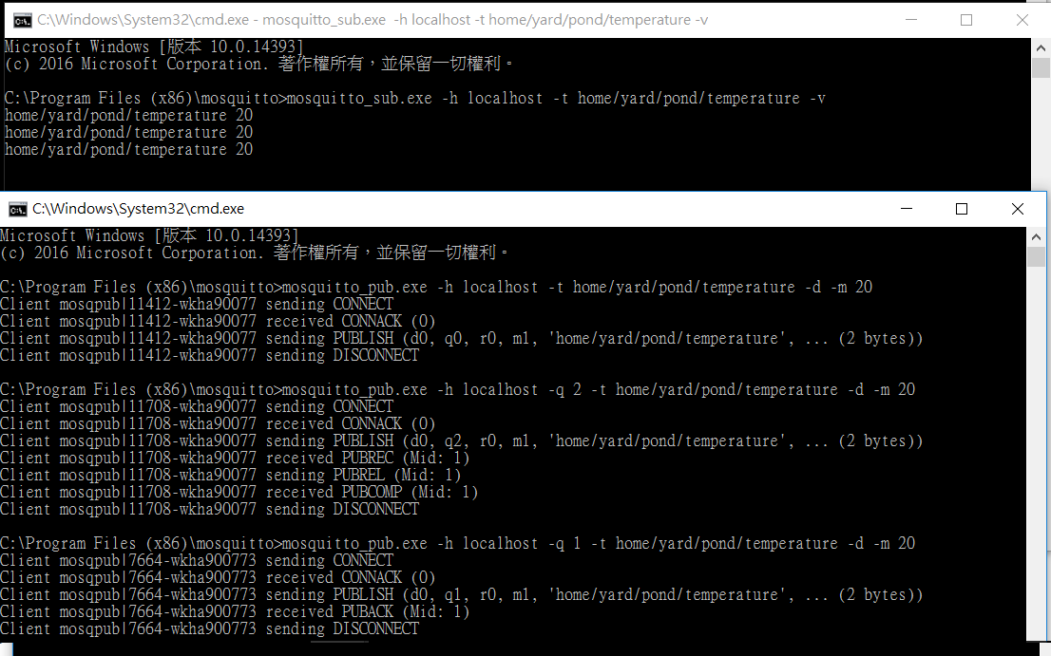
MQTT Broker

Slide 18
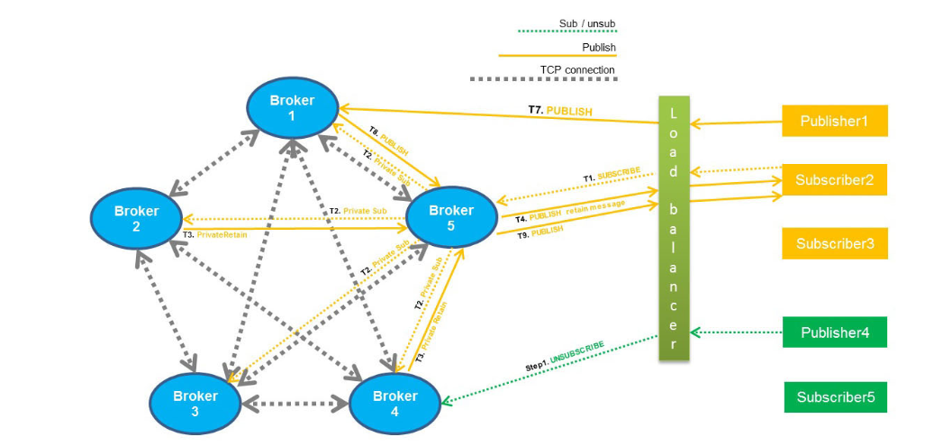
MQTT Broker
Cluster

Slide 19
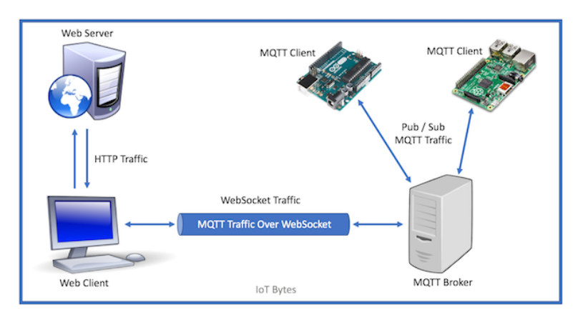
MQTT Over WebSocket
Two main reason to use MQTT over Websocket
Consuming messages in a browser (WebApp)
for firewall reasons

Slide 20
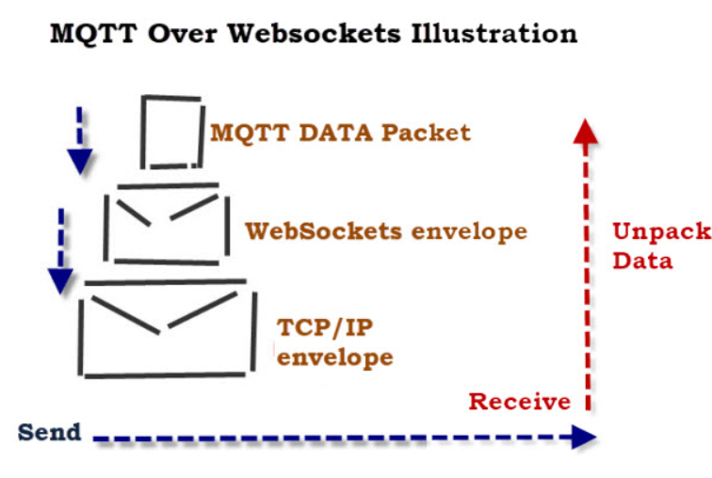
MQTT Over WebSocket

Slide 21
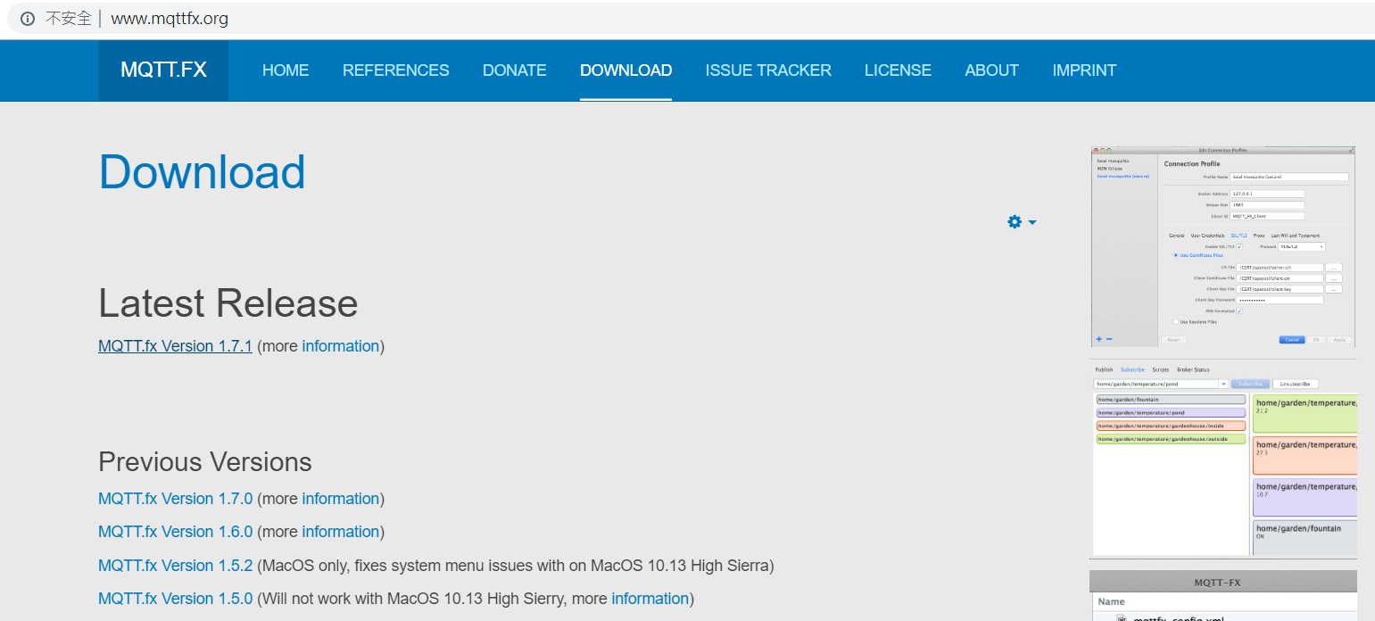
Java MQTT Client
MQTT.fx is a MQTT Client written in Java based on Eclipse Paho.

Slide 22
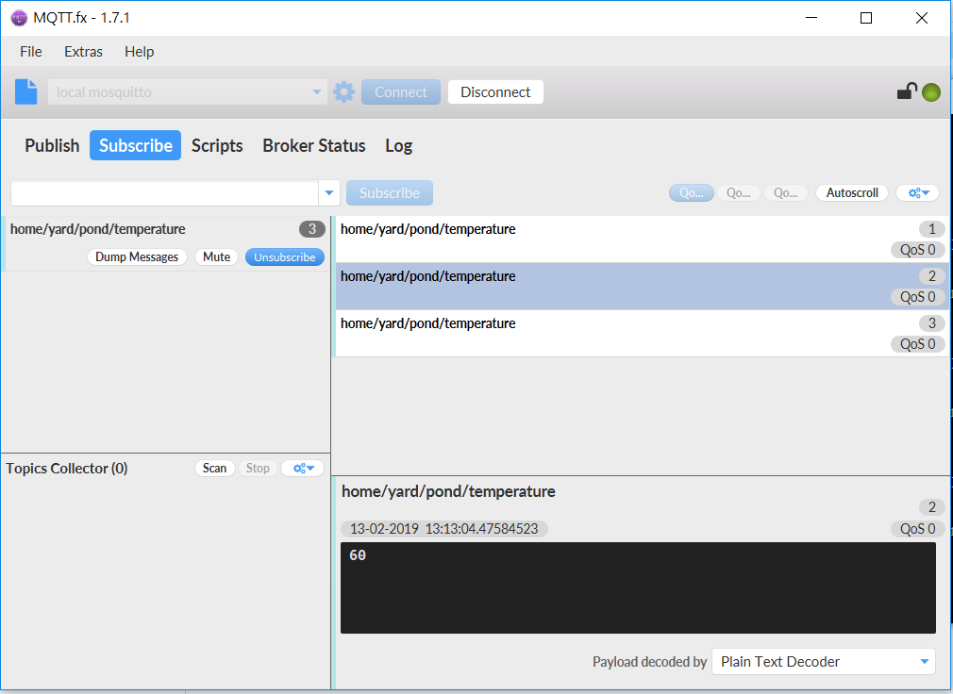
Java MQTT Client

Slide 23
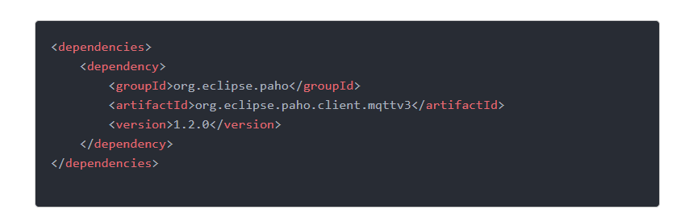
Java MQTT Client
The Paho Java Client is an MQTT client library written in Java for developing applications that run on the JVM or other Java compatible platforms such as Android

Slide 24
Java MQTT Client
Publish
Subscribe

Slide 25
Homework
import com.wistron.avatar.common.util.MqttUtils;
写一个publisher
TOPIC : /AVATAR/AVATARTRING/自己的工号
MESSAGE : AVATAR2019TRAINING
写一个subscriber
收到讯息后将讯息印出来

Slide 26
Reference
MQTT
認識MQTT
Understanding the MQTT Protocol Packet Structure
MQTT Control Packet format
MQTT vs. HTTP: which one is the best for IoT?
HiveMQ公司的MQTT Essentials系列文件
Eclipse Mosquitto
Using The Mosquitto_pub and Mosquitto_sub MQTT Client Tools- Examples

Slide 27


