Slide 1

2019/02

Slide 2
Agenda
What is Redis
Why using Redis
When using Redis
Redis Data Types
Redis Commands
Redis GUI Management Tool
How to operate redis using Java
Demo
Advance

Slide 3
What is Redis
An in-memory key-value store
Redis also support persistent
Support several data type
String
List
Set
Sorted set
Hash table
Support cluster architecture

Slide 4
Why using Redis
High performance
Read 110000/s, Write 81000/s
Support atomic operate
Support transaction
Support several data type
Has pub/sub functionality
Support major languages

Slide 5
When using Redis
Cache
Ranking list
Counter
Pub/Sub message queue
Session sharing

Slide 6
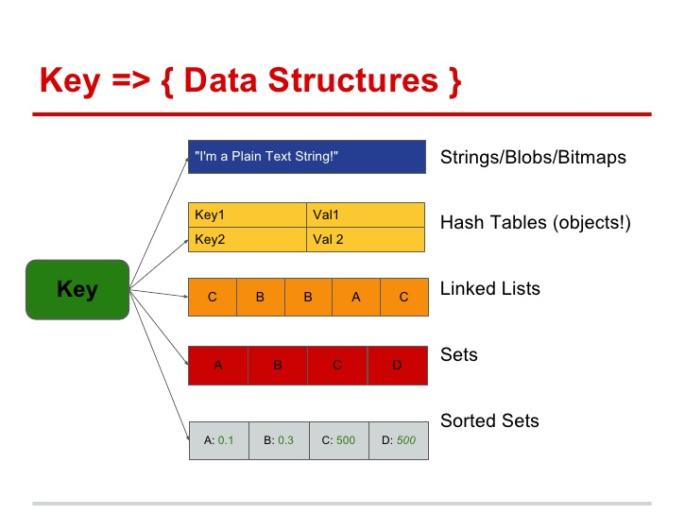
Data Types

Slide 7
Redis - String
Max 512 Megabytes in length
Use Strings as atomic counters using commands in the INCR family: INCR(+1), DECR(-1), INCRBY(+X)
Append to strings with the APPEND command
Encode a lot of data in little space, or create a Redis backed Bloom Filter using GETBIT and SETBIT

Slide 8
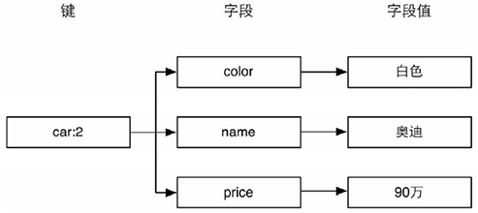
Redis - Hash
Maps between string fields and string values
Perfect data type to represent objects
Store up to 2³² - 1 field-value pairs (more than 4 billion)

Slide 9

Redis – Linked Lists
Lists of strings, sorted by insertion order
Max length of a list is 2³² - 1 elements (4294967295, more than 4 billion of elements per list)
Model a timeline in a social network, using LPUSH in order to add new elements in the user time line, and using LRANGE in order to retrieve a few of recently inserted items
User ID

Slide 10
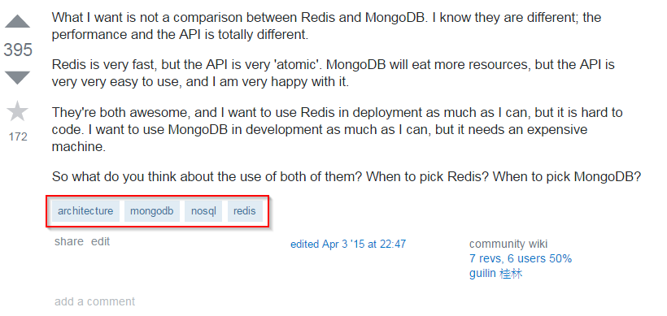
Redis - Sets
An unordered collection of Strings
Max number of members in a set is 2³² - 1 (4294967295, more than 4 billion of members per set)
To know all the unique IP addresses visiting a given blog post
Tag of web page

Slide 11

Redis – Sorted Sets
Similarly to Redis Sets
Every member of a Sorted Set is associated with score, that is used in order to take the sorted set ordered

Slide 12
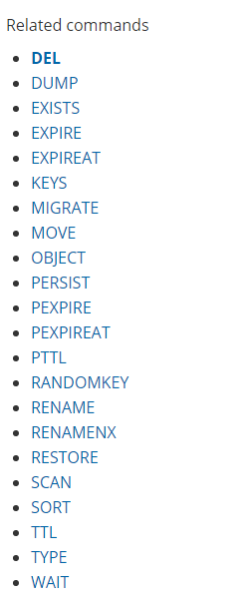
Redis Commands
Key
String
Hash
List
Set
Sorted Set
Transaction
You can find more on http://redis.io/

Slide 13
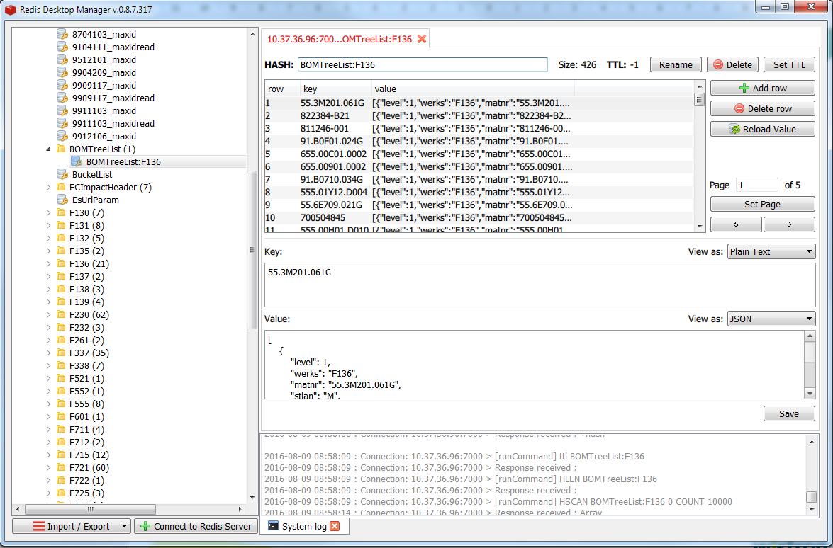
Redis Desktop Manager Open Source Redis GUI Management Tool
https://redisdesktop.com/

Slide 14
How to operate redis using Java
New maven project
Add dependency as follow
<dependencies>
<dependency>
<groupId>redis.clients</groupId>
<artifactId>jedis</artifactId>
<version>2.9.0</version>
</dependency>
</dependencies>
Connect the redis server
Jedis jedis = new Jedis("10.37.35.58", 8000, 3000);
Now, you can operate redis using the connection

Slide 15
Demo

Slide 16
Advance
Redis really has atomic?
For example, key A’s value is 1. Rick and Jess get this key at same time and incr A then update this key’s value. Final result is 2. but we want implement count feature.
Redis really has high performance?
If redis want to achieve high performance, vales need as small as possible
Reduce TCP Round Trip is key point.
Redis really has transaction?
In fact, reids only support Isolation, not ACID
Redis don’t have roll back

Slide 17
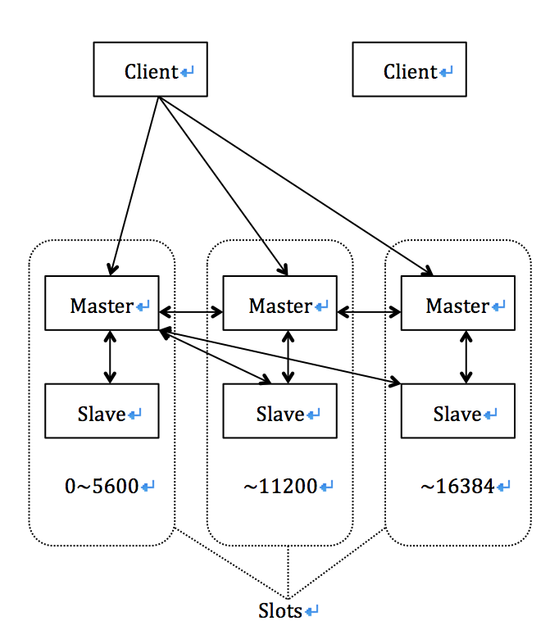
Advance
Redis Cluster
Redis CAP theorem
Using lock to achieve CP
Not lock to achieve AP

Slide 18
Homework
从Oralce取得资料，SQL如下，SELECT group_id, topic, partitions, MAX(OFFSETS) FROM AT_LG_CONSUMER_DUPCHECK where log_idx = '2019021508' group by topic, partitions, group_id order by group_id, topic, partitions
每个group_id会对应到多个topic，每个topic会对应到多个partition，每个partition各自有自己的offset
用group_id当作key在redis取得hashmap，把topic和partition组成field后取得value
比较offset与value，若offset < value，则更新此field的value
比对完全部的oracle资料
加分题
如何防止自己在操作数据时别人也在操作数据，导致数据不一致
如何防止上锁后，该进程卡住时，能够释放资源
符合面向对象的程序设计风格

