Slide 1
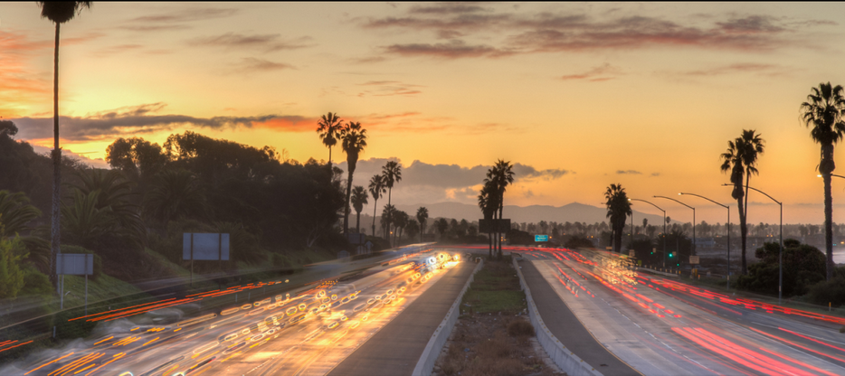
California Car Accidents Analysis (2016-2023)
Analysis of Monthly, Yearly, and Weather-Related Accident Trends in California
Presented by: Oleg Makarovskiy

Slide 2
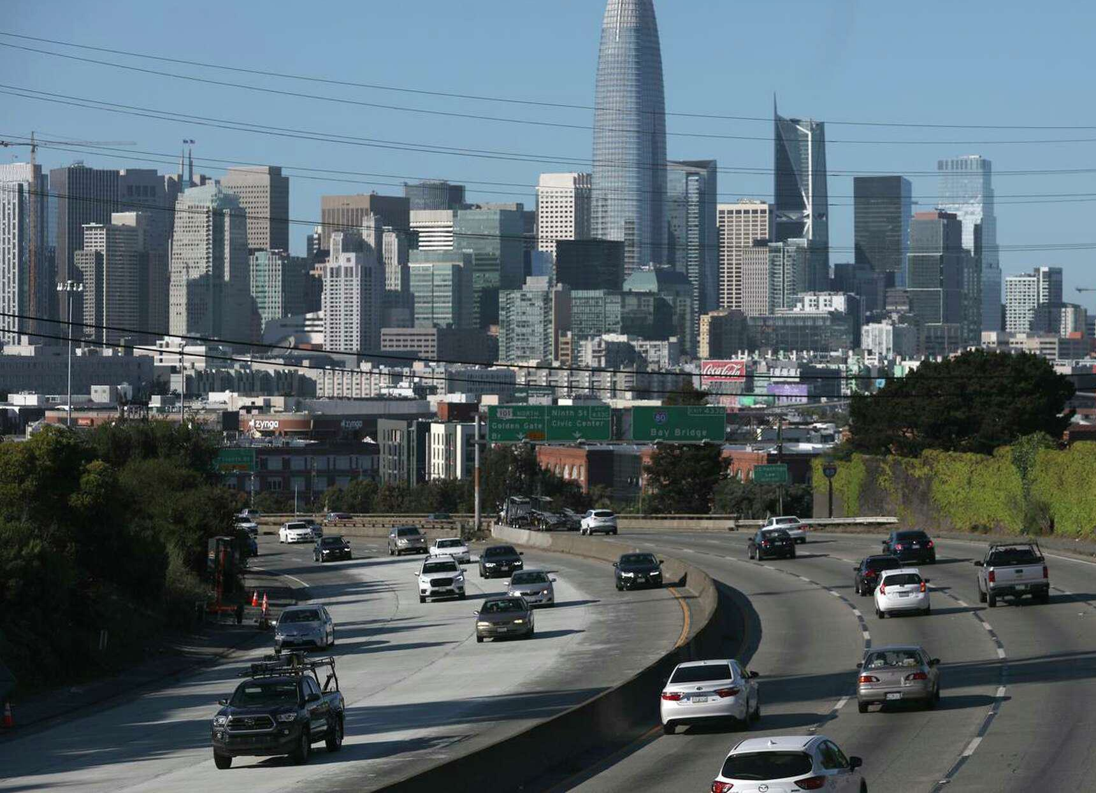
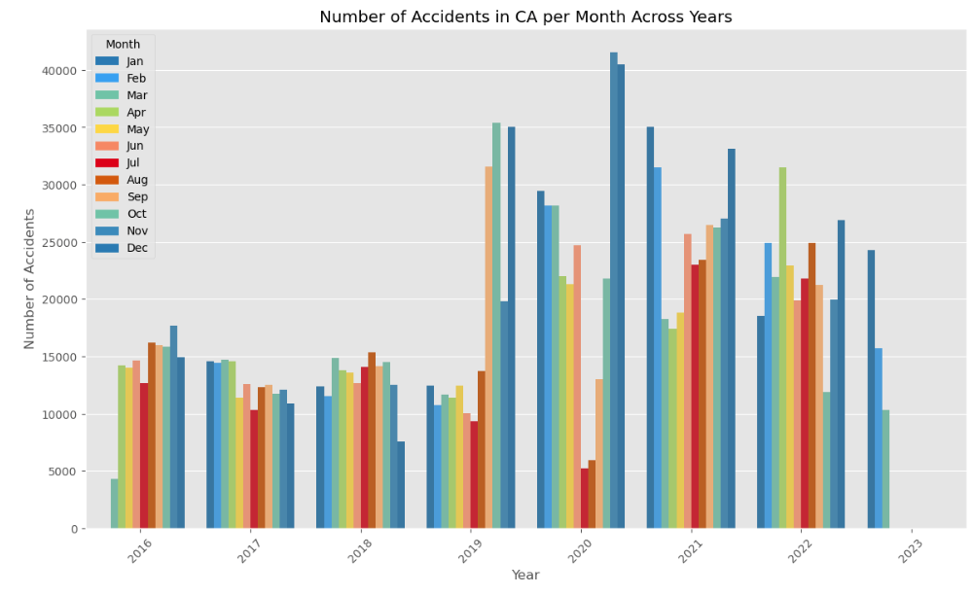
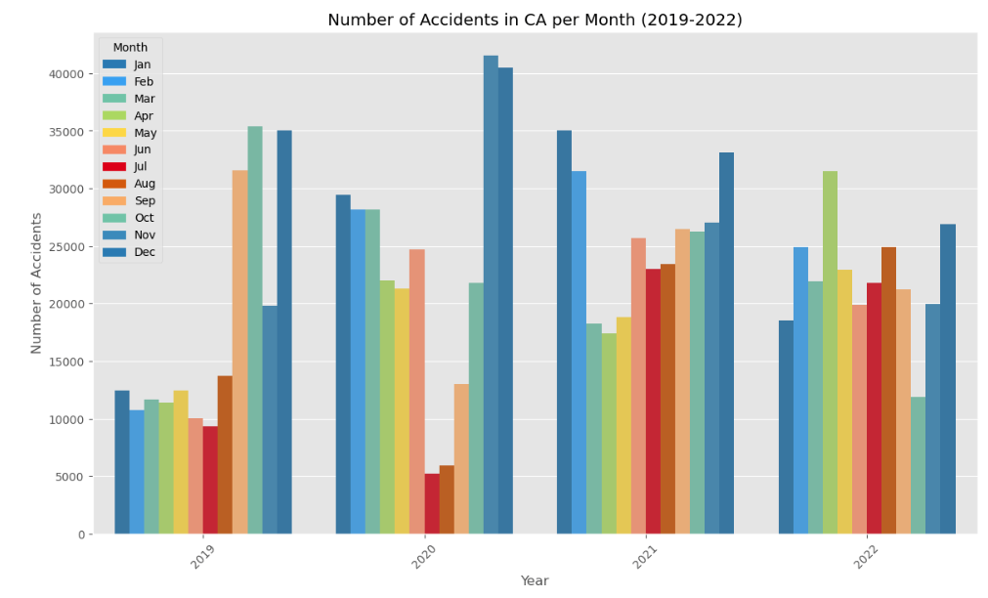
Monthly Trends Overview
Highest accident rates in January and December.
Summer months like July and August see a drop in accidents.
COVID19

Slide 3
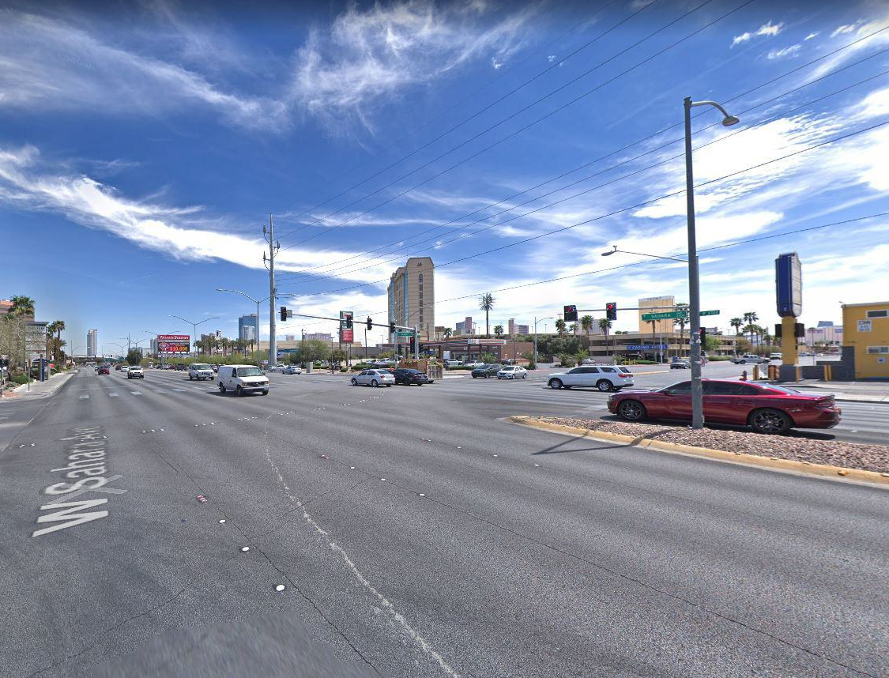
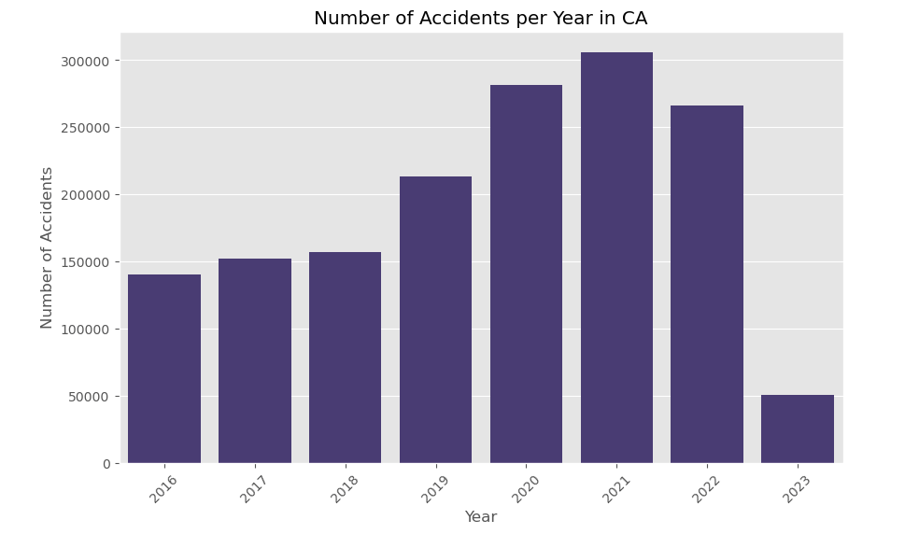
Yearly Trends in Accidents
Accidents have shown a steady growth year after year, with notable peaks in 2020 and 2021.

Slide 4

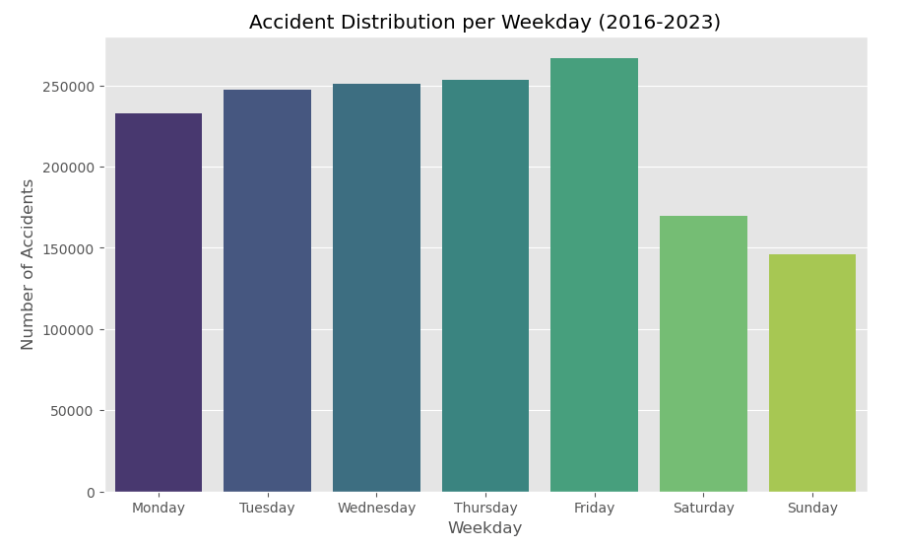
Accidents by Day of the Week
Fridays show the highest accident rates among all workdays
Weekend have the fewest accidents

Slide 5
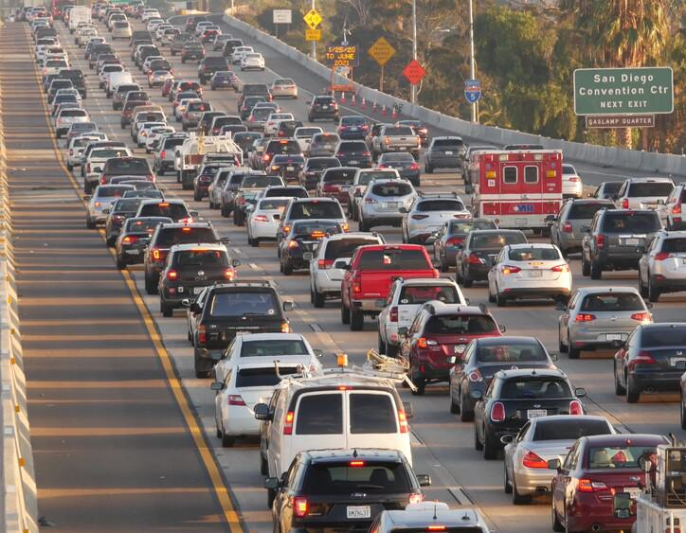
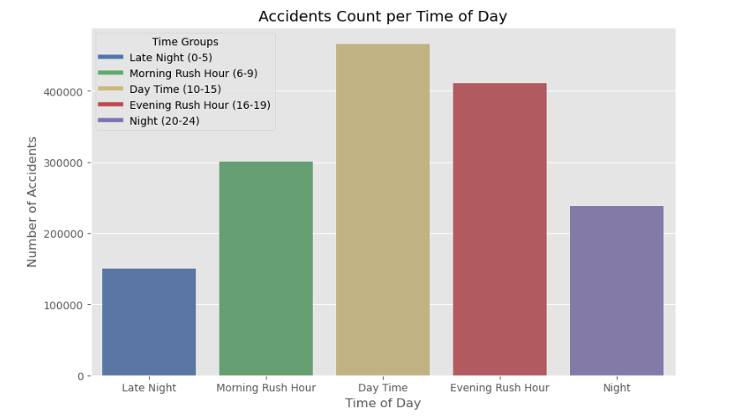
Time of Day Analysis
Morning and evening rush hours have fewer accident rates comparing to Day Time
Fewer accidents occur late at night

Slide 6
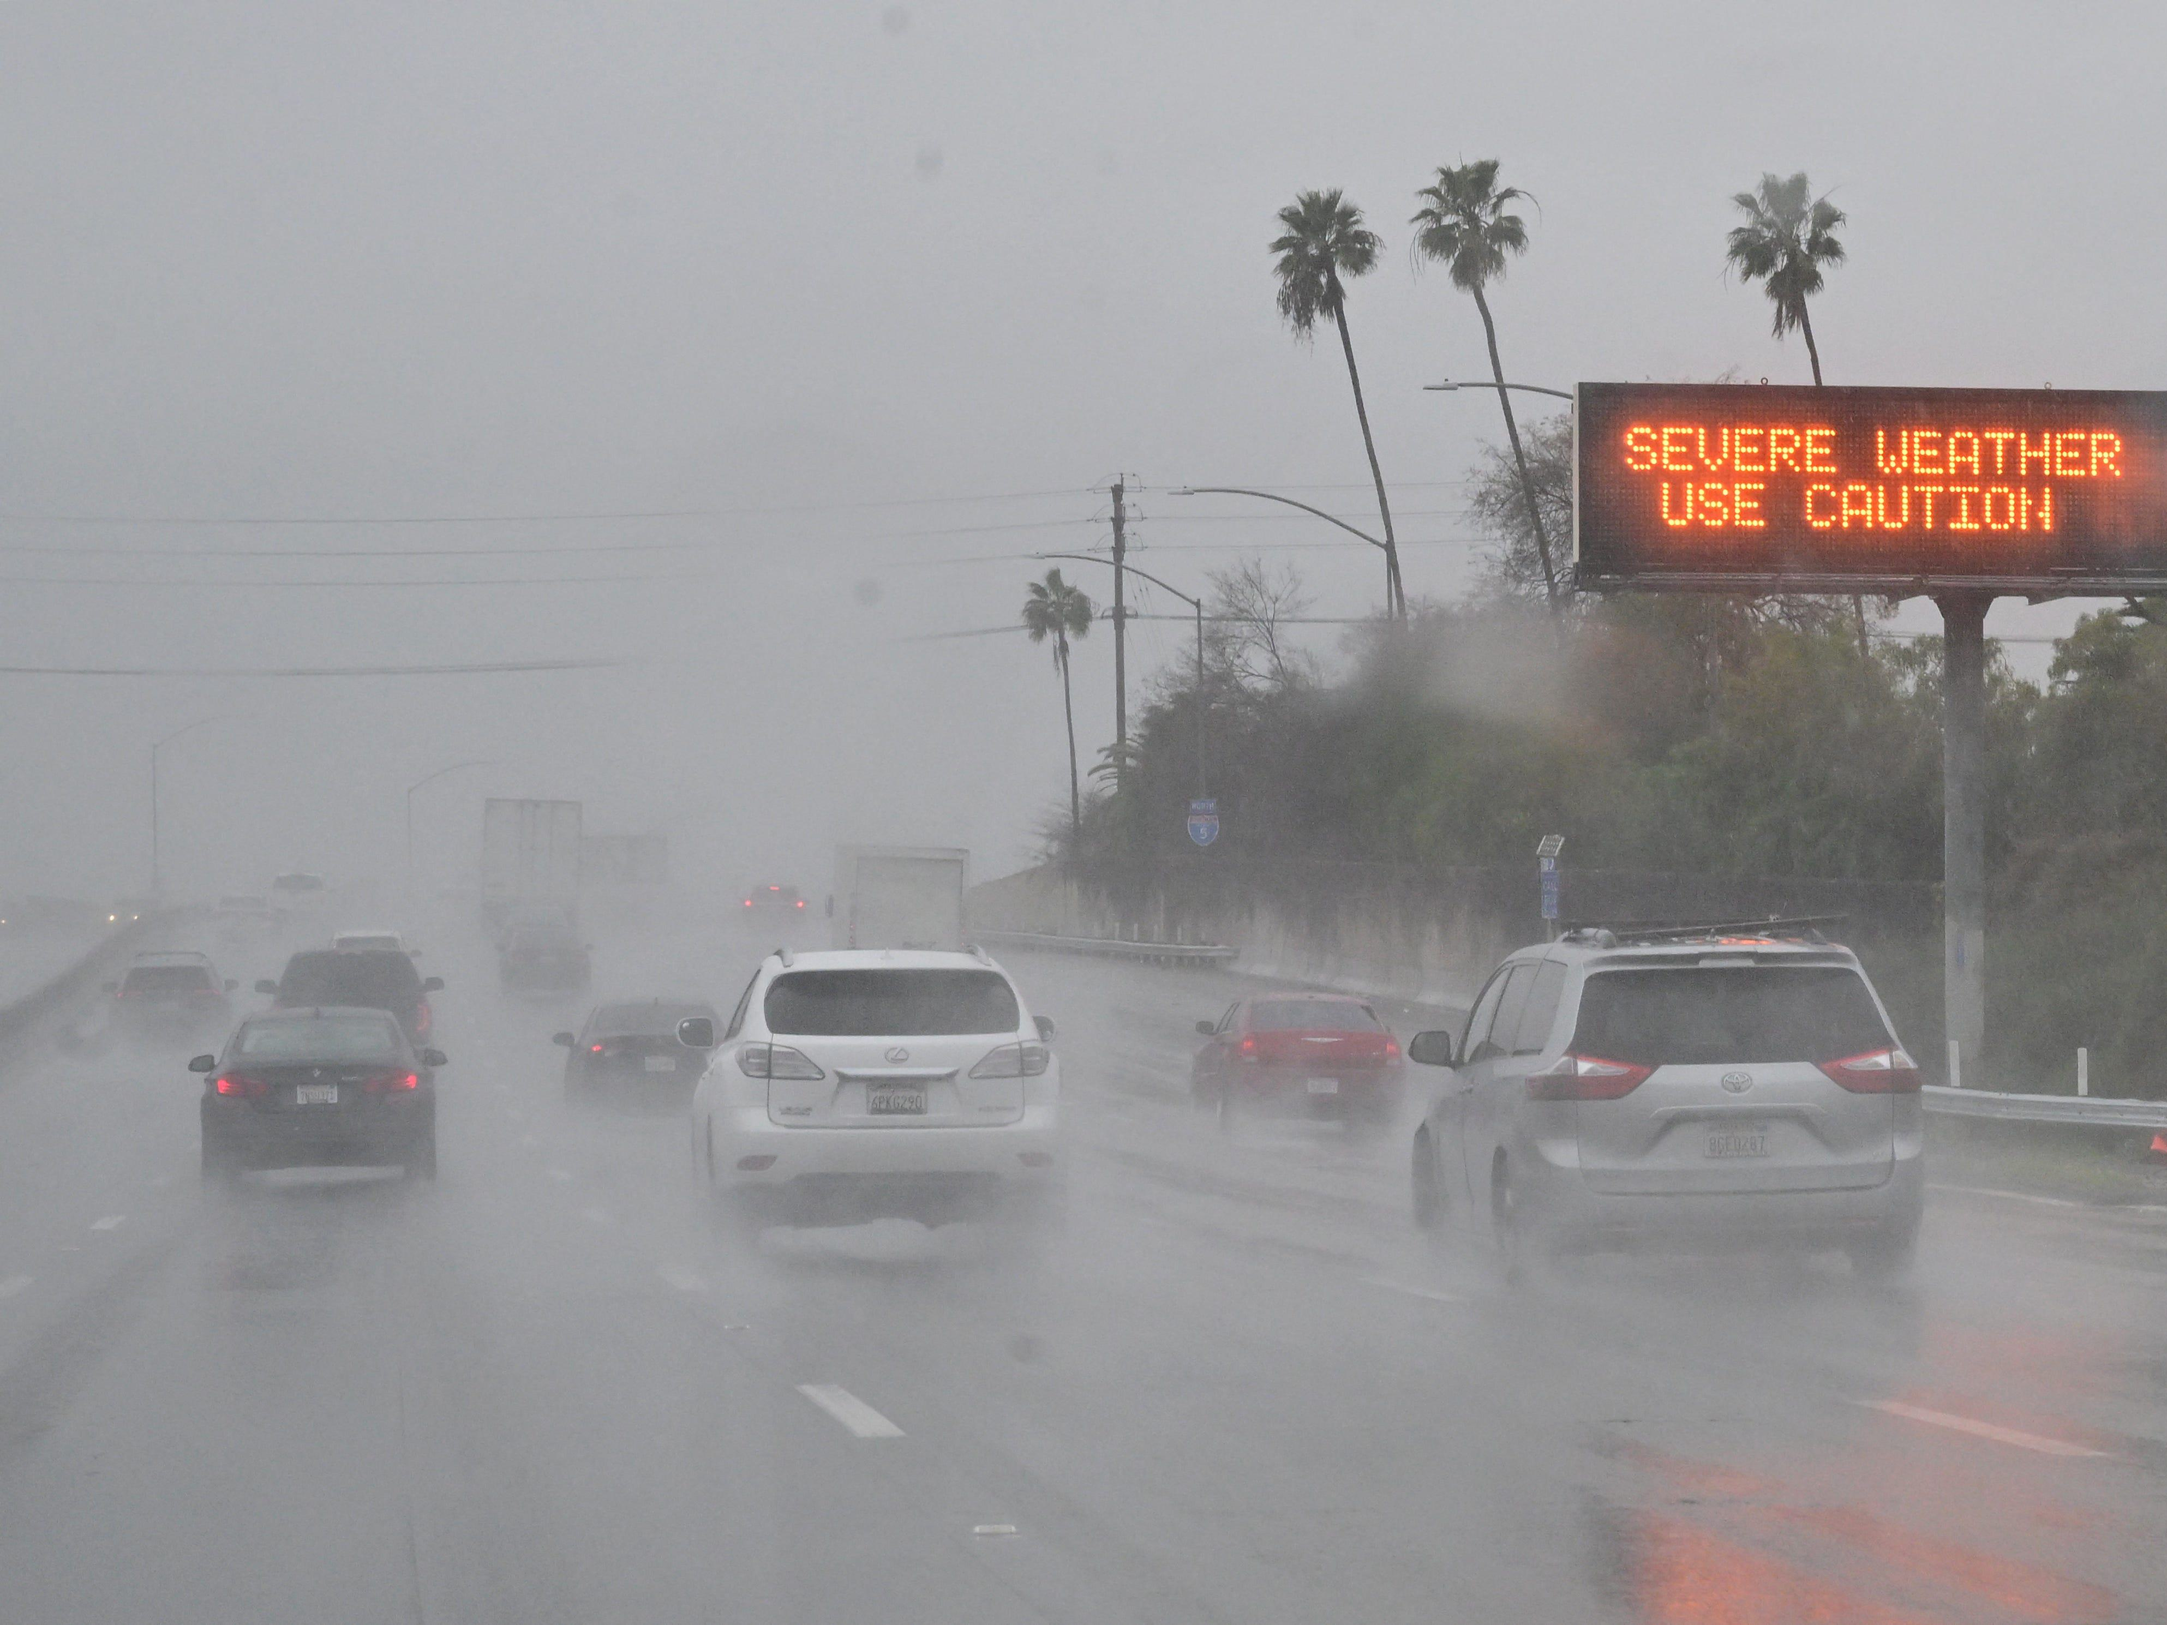
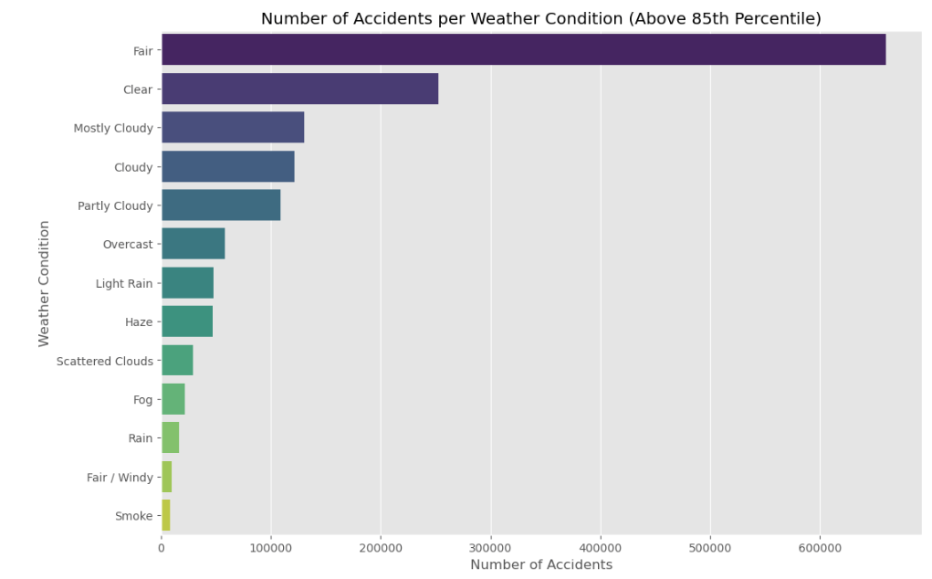
Impact of Weather Conditions on Accidents
Fair & Clear weather conditions show high accident counts.
Rainy days surprisingly have fewer accidents

Slide 7
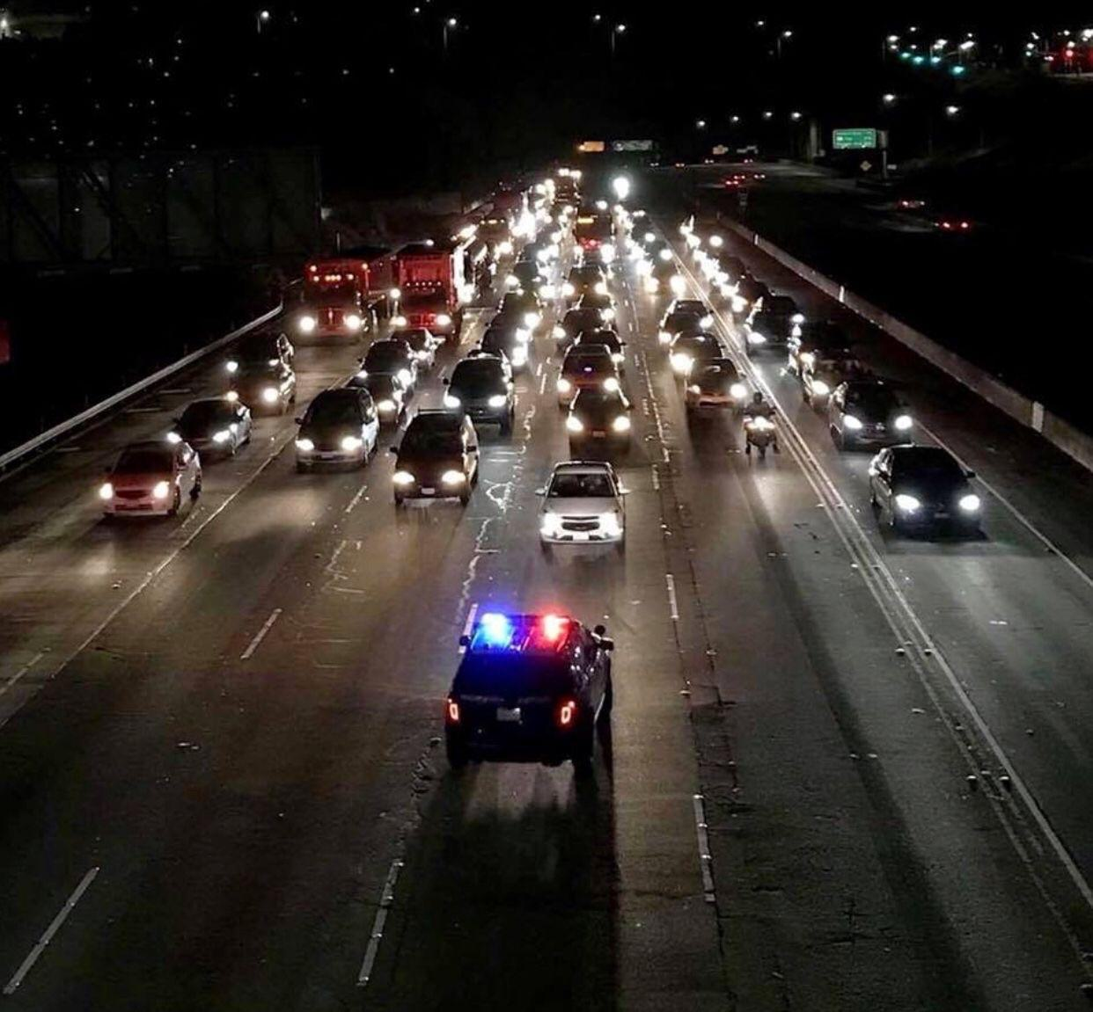
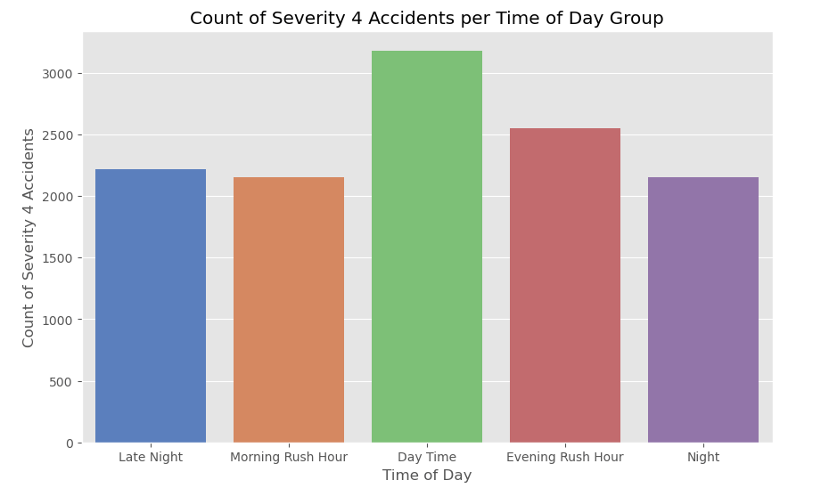
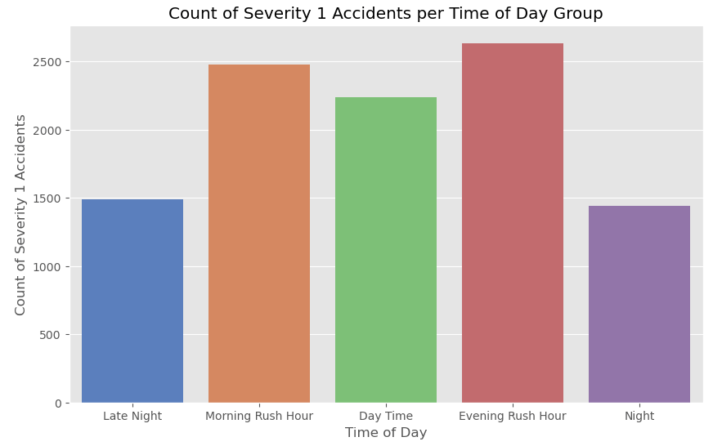
Severity Analysis by Time of Day
Severity levels 1 and 2 are most common for rush hours.
Severity 4 (most severe) appears more frequently during day time.

Slide 8
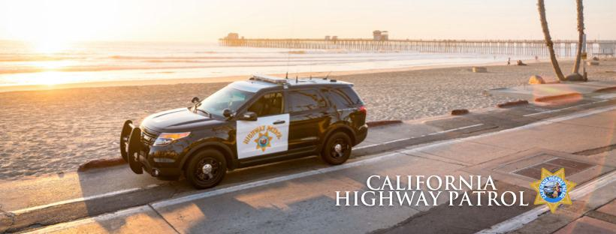
Conclusions & Recommendations
Accidents peak in December and January
Rush hours are high-risk for minor accidents
Surprisingly, there are fewer accidents under poor weather conditions
Deeper analysis can be conducted taking into account more data such as area income rate, population, demographics, etc
Increase awareness and encourage cautious driving.

