Slide 1
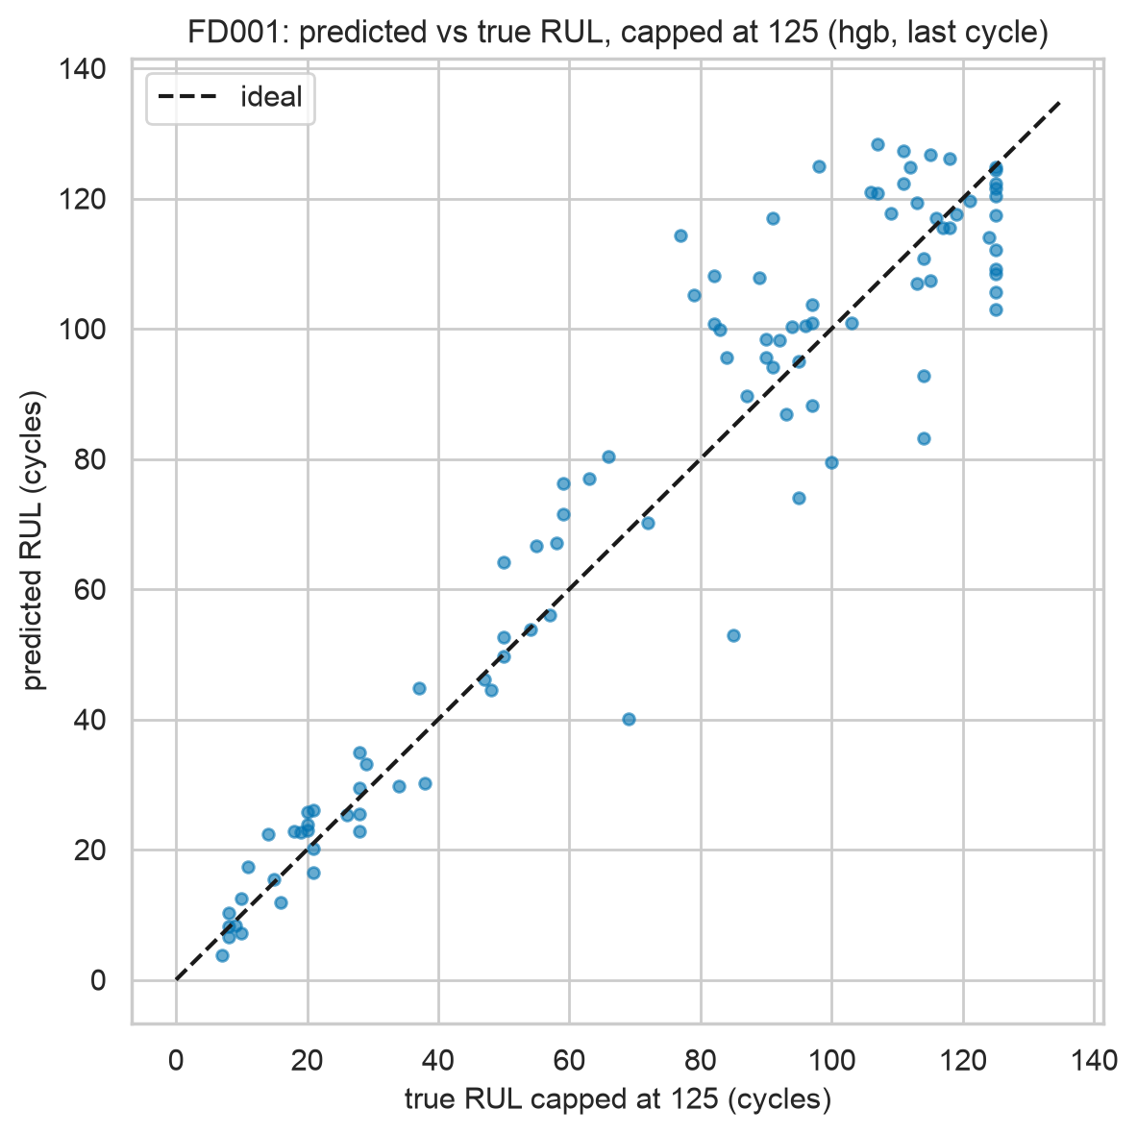
Turbofan RUL & Maintenance Alerts
TE7483 · NASA C-MAPSS (PHM08)
FD001 hgb: RMSE 12.4 (CV 11.6), PHM 241
RUL regression → green/amber/red alert policy, tuned on validation only
Notes:
45s: unscheduled engine removals cost airlines millions; we turn sensor streams into remaining-useful-life estimates plus green-amber-red alerts. Headline numbers are on screen: capped test RMSE with a grouped cross-validation score to match — no test leakage anywhere.

Slide 2
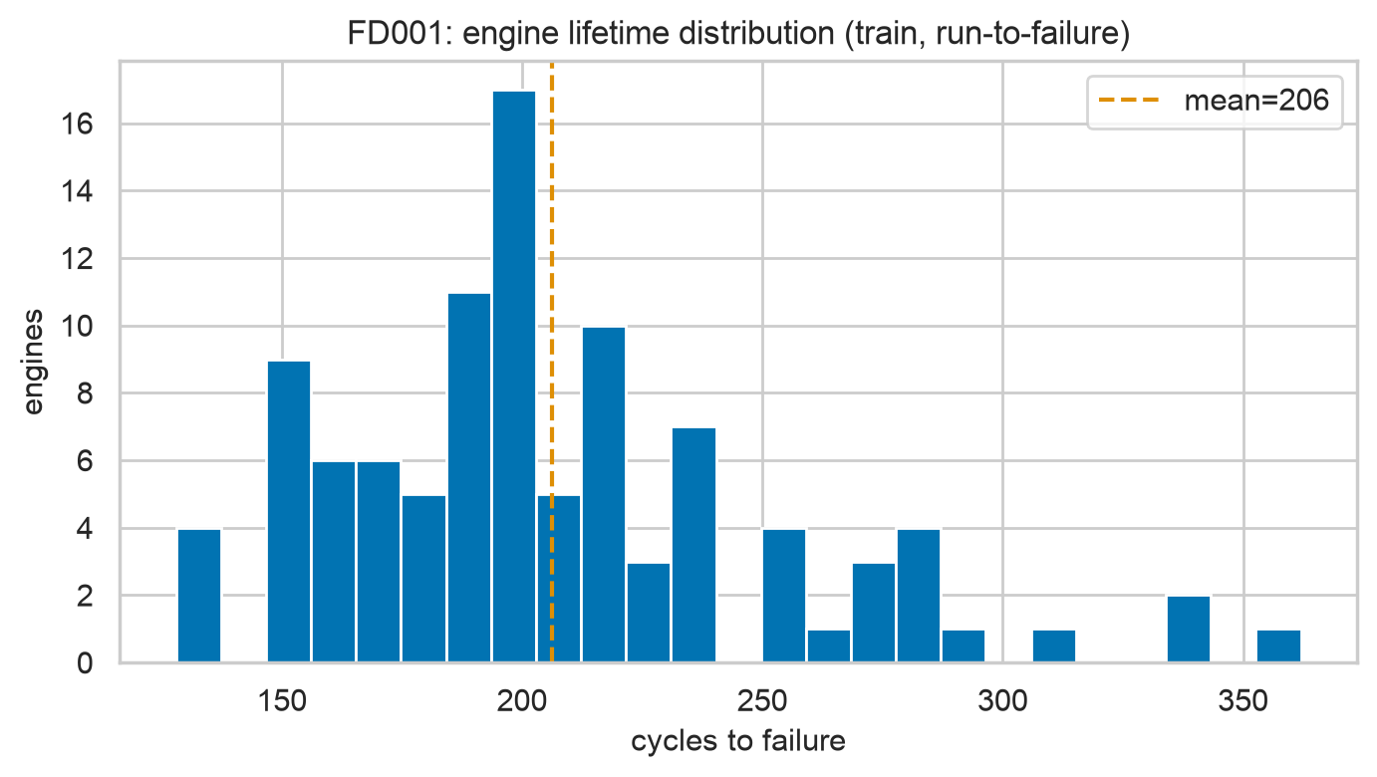
Data: run-to-failure + truncated test
26 cols: unit, cycle, 3 ops, 21 sensors
FD001–FD004: 1/6 conditions × HPC / HPC+Fan faults
Labels: RUL capped @125; safe>50, warn 20–50, crit<20, ≤30 binary
Notes:
45s: train runs to failure so RUL is exact; test is truncated with official RUL labels at the last cycle. Four subsets span operating conditions and fault modes; thresholds sit below the cap so classes are undistorted.

Slide 3
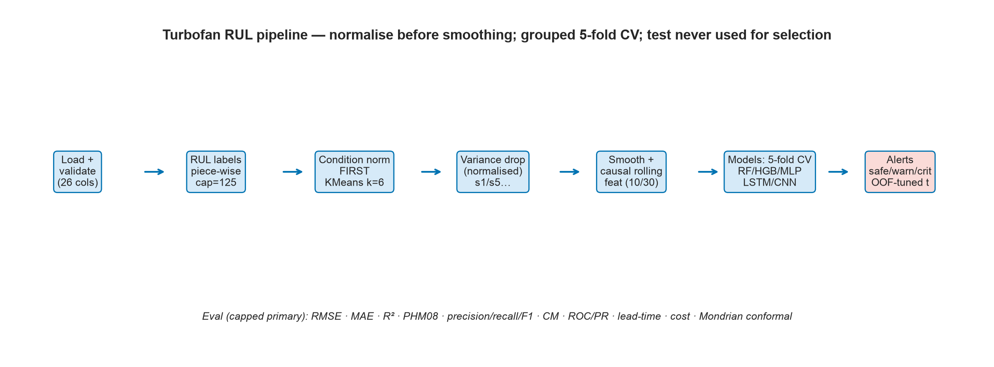
Pipeline: normalise FIRST, then smooth
GroupKFold by engine; train-only scalers/KMeans
Piece-wise cap 125; causal rolling + length-30 windows
Baselines → RF/HGB/MLP → LSTM/CNN; direct vs RUL-threshold
Notes:
45s: every fit happens on train folds only; test features use past data causally. Model selection uses grouped CV only — the test set never picks the model. Two leakage bugs were found and fixed; details on the next-but-one slide.

Slide 4
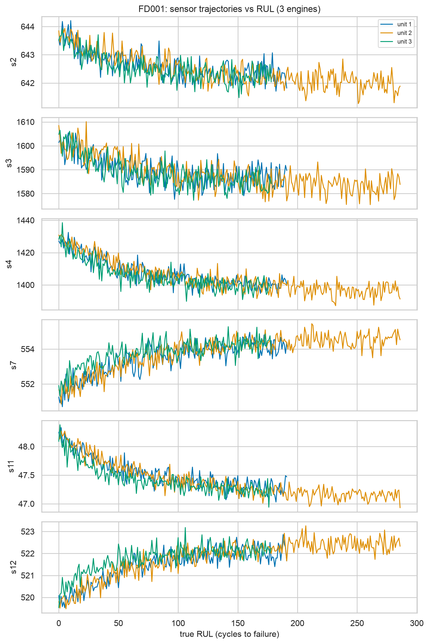
Key EDA insight
Degradation invisible early → the cap is justified
Correlation + monotonicity select sensors
Safe rows dominate: accuracy is the wrong metric
Notes:
45s: sensors sit flat for most of an engine's life then degrade steeply — training on raw RUL of 200-plus cycles would fit noise, hence the cap at 125. And most rows are healthy, so we optimise recall, not accuracy.

Slide 5
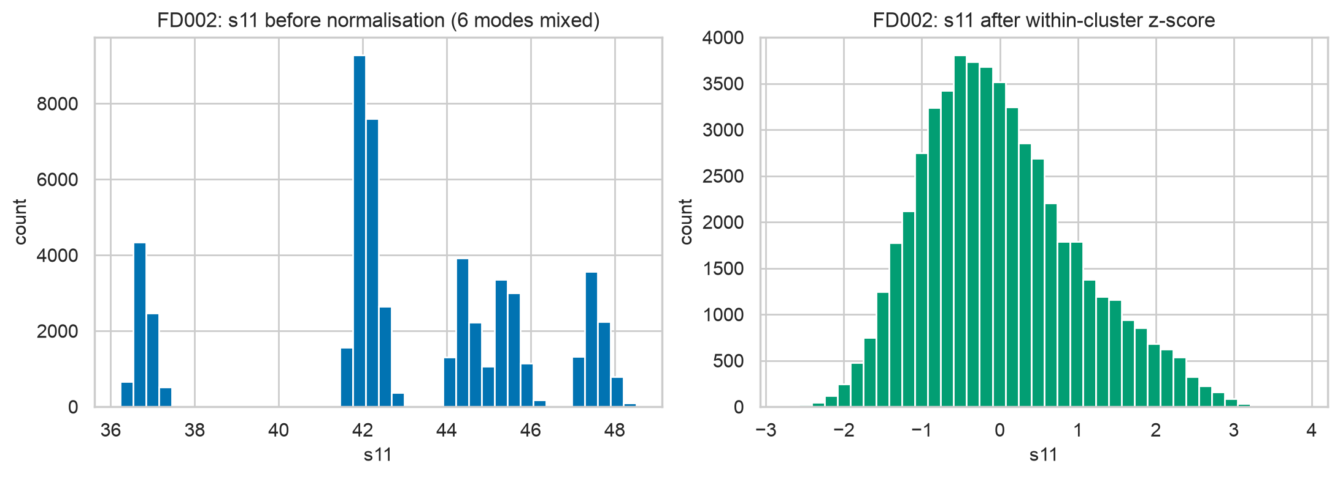
Condition normalisation works
KMeans k=6 on standardised ops: elbow + silhouette
Within-cluster z-score collapses the six modes
s1/s5/s18/s19 drop out (constant within condition)
Notes:
45s: six operating modes shift every sensor; global scaling confuses mode with damage. Within-cluster normalisation removes the modes, and setpoint sensors correctly vanish from the feature set.

Slide 6
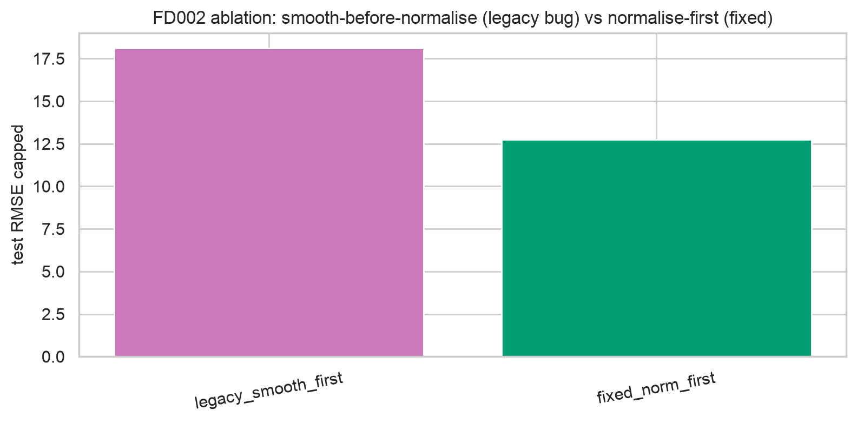
What we found and fixed
FD002 HGB: 18.3 to 12.9 RMSE (see results/before_after.csv)
Bug: smoothing raw sensors blended operating modes
Caught by checking WHAT the model relied on (s1/s5 top)
Notes:
45s: our strongest methods slide: permutation importance showed the model leaning on condition proxies s1 and s5 — sensors that cannot carry damage signal. Tracing why exposed smoothing-before-normalisation; fixing the order gained five RMSE points, now a documented ablation.

Slide 7
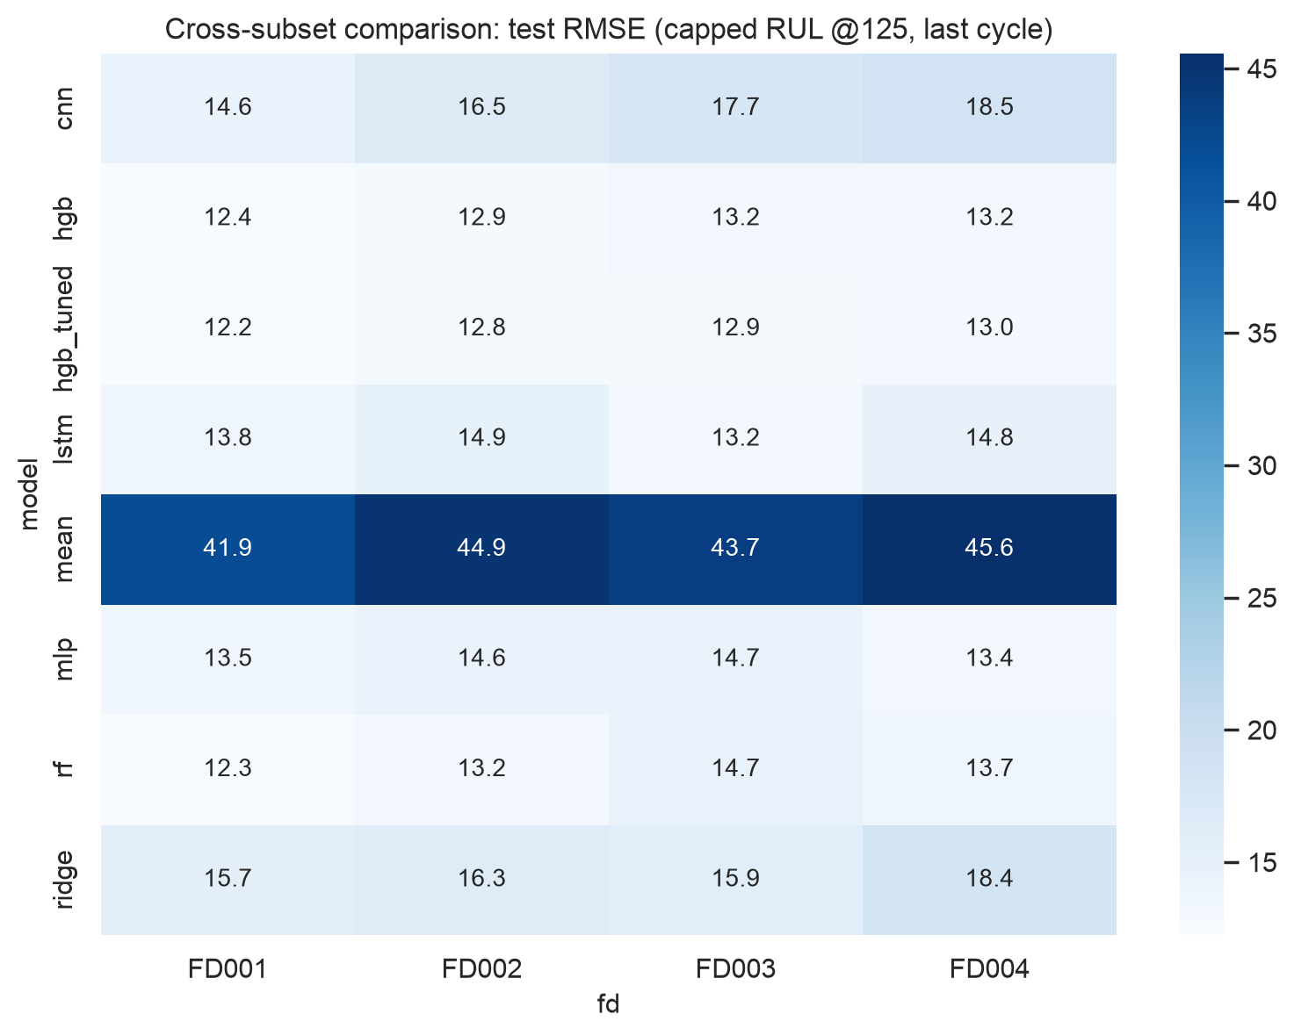
Headline results (capped test RMSE)
fd FD001 FD002 FD003 FD004
model
cnn 14.6 16.5 17.7 18.5
hgb 12.4 12.9 13.2 13.2
hgb_tuned 12.2 12.8 12.9 13.0
lstm 13.8 14.9 13.2 14.8
mlp 13.5 14.6 14.7 13.4
rf 12.3 13.2 14.7 13.7
ridge 15.7 16.3 15.9 18.4
Notes:
45s: HGB is cross-validation-selected on all four subsets; deep models trail by one to four points — reported, not hidden. Multi-condition subsets stay harder, but the gap closed from twofold to under ten percent.

Slide 8
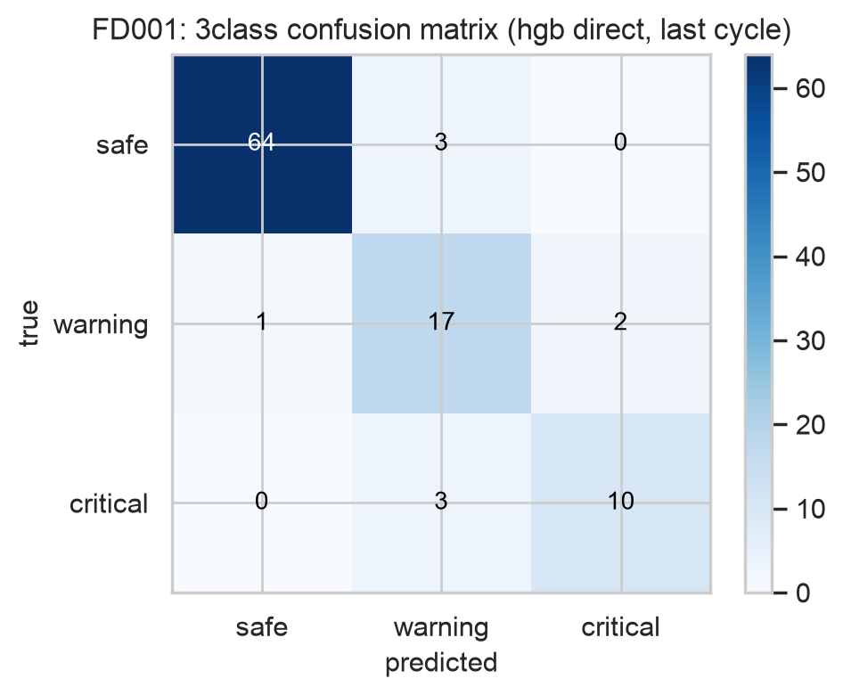
Confusion matrices (FD001)
Critical recall is the safety metric
Errors sit in adjacent classes, not safe↔critical
Headline direct: hgb (CV-selected)
Notes:
45s: read rows as truth, columns as prediction. Warning-adjacent errors still trigger action; the dangerous cell is true-critical predicted safe — rare here, and counted explicitly in the report.

Slide 9
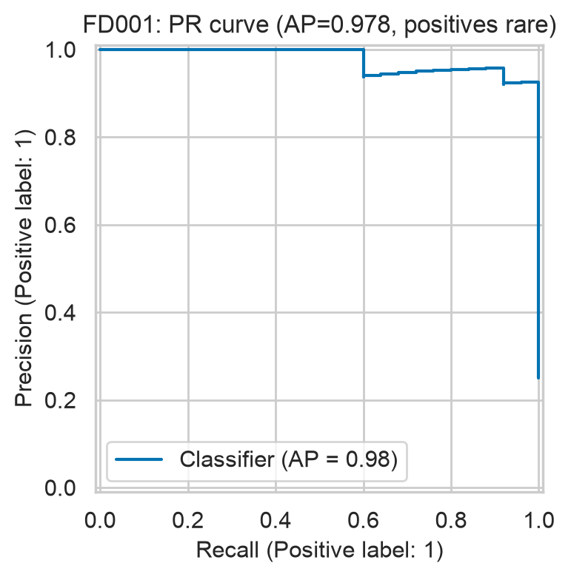
Fails-within-30: ROC/PR + frozen threshold
PR matters: positives are rare
Threshold from out-of-fold preds at truncation points
FD001: recall 1.00 at precision 0.93 (frozen t=40)
Notes:
45s: the alert threshold is tuned on validation folds at realistic truncation points, frozen, then applied once to test. Full recall on all four test sets; FD004 pays the most false alarms under two fault modes (numbers on the slide and in the report).

Slide 10
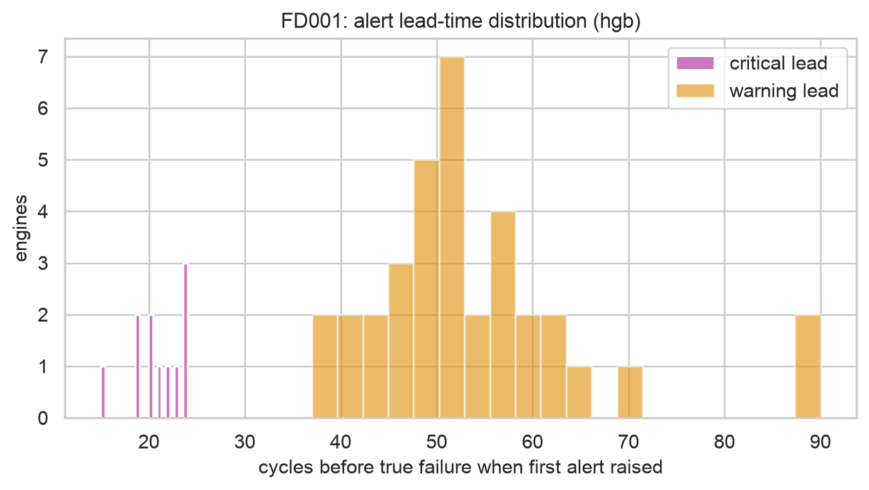
Lead time + cost
Median warning lead 50–53 cycles on every subset
False alarms 0.28–0.96 per 100 cycles
Assumed 10:1 costs; tuned threshold wins everywhere
Notes:
45s: the policy buys roughly fifty cycles of advance warning — comfortably plannable — with under one false alarm per hundred cycles (exact medians in the report). Costs are assumed, stated as such, with a sensitivity table in the report.

Slide 11
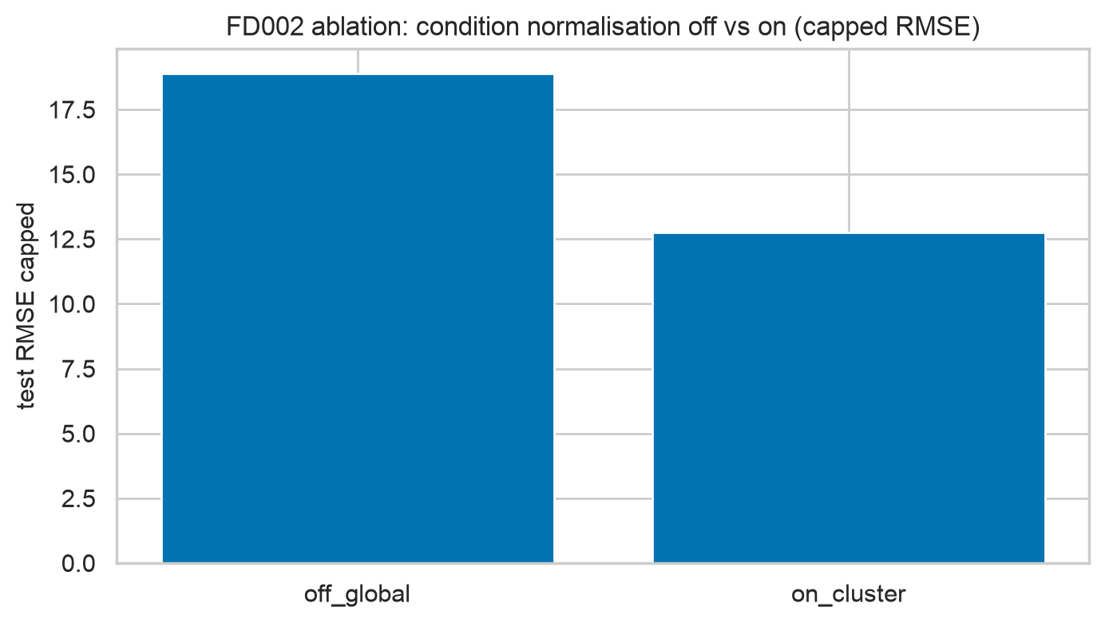
Ablations: what earned its keep
Normalise-first +5.4; condnorm +6.2 (FD002)
Rolling [10,30] beats [10]; window-30 sweet spot for deep
Honest negatives: class-weights hurt; ops add nothing
Notes:
45s: every pipeline choice carries a number, including negative results — class weighting and extra op features do not help, and we say so. Deep window fifty overfits its holdout: ten-point holdout error becomes sixteen on test.

Slide 12
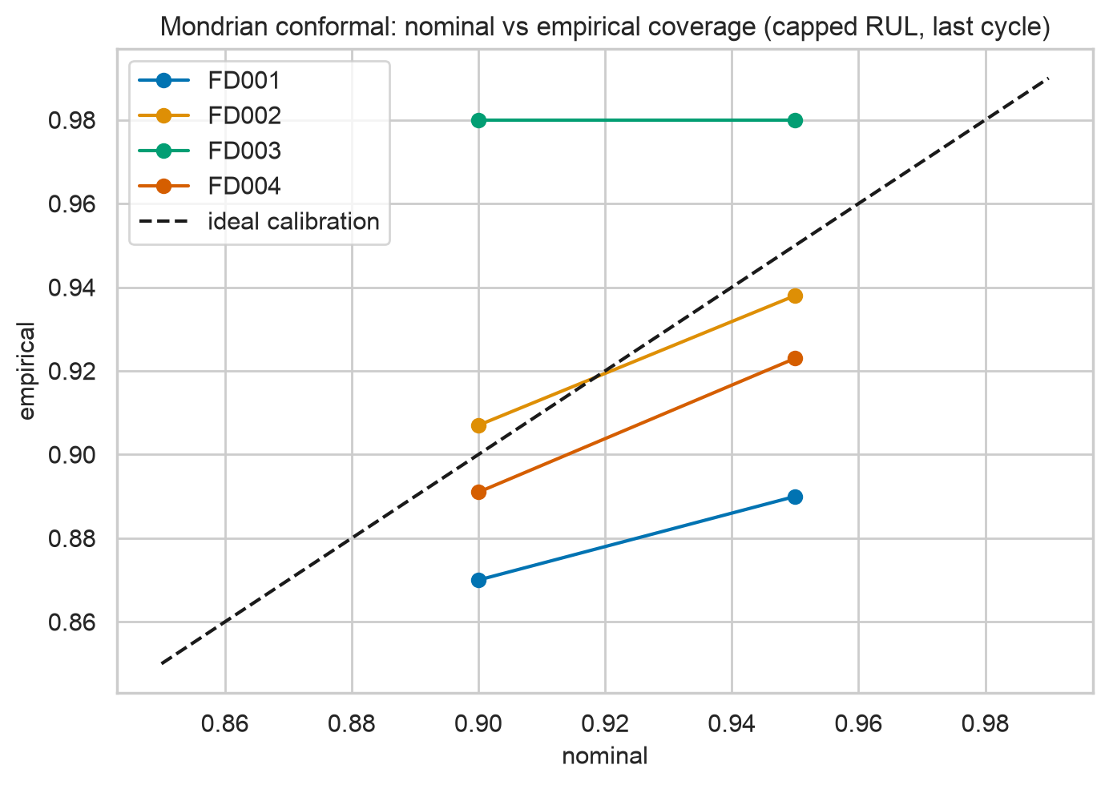
Limitations + uncertainty
Simulated data; 13 critical engines on FD001/FD003
Mondrian conformal: near-nominal, wide when far out
Human signs every red — never autonomous grounding
Notes:
45s: small test sets mean wide confidence intervals — shown, not hidden. Conformal intervals cover near nominally but are wide far from failure. Red alerts advise; engineers decide.

Slide 13
Future + Thank you
Transformers with grouped validation; domain adaptation
Survival heads; adaptive uncertainty; edge + drift
Questions welcome
Notes:
45s: next steps are real-fleet adaptation with drift monitoring and richer uncertainty. Thank you — questions?

