Slide 1
全栈项目架构
浏览器页面
Web层
Dao层
持久层 （数据库）
先建立持久层，也就是先建数据库表等（数据库表可以给整体设计提供一个思路）
然后再写其他代码（代码放在GitHub上—在GitHub上新建一个项目—clone项目到本地）

Slide 2
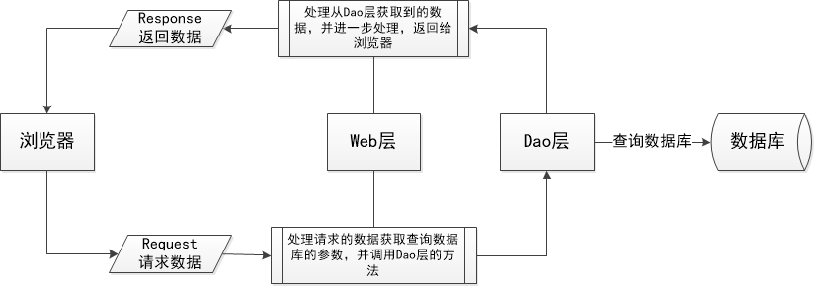
数据流程

Slide 3
Web层：定义接口，接收前端数据
Dao层：链接数据库，插入数据库的方法写在这里
res.writeHead() 和 res.write() 是一组，如果一开始使用res.writeHead() 写响应头，后面如果要传内容需要用res.write()传入，并且需要使用res.end()结束这次响应

Slide 4
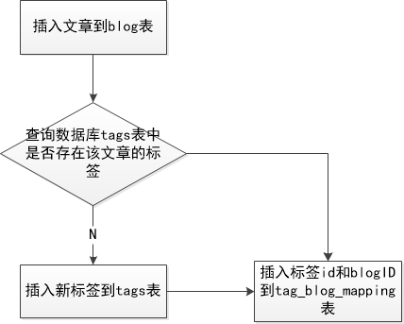
插入文章到数据库的逻辑

Slide 5
代码目录结构
代码文件目录
--node_modules（资源库）
--Page文件夹（存放前端页面文件）
--Web文件夹
--Dao文件夹
--Util文件夹（存放工具文件）
--index.js （服务器启动文件）
--package.json
--package-lock.json

Slide 6
多次提交编辑文章，会出现以下错误
Error [ERR_HTTP_HEADERS_SENT]: Cannot render headers after they are sent to the client
at ServerResponse.writeHead (_http_server.js:236:13)
at D:\xhn\programs\deltaning.com\web\BlogController.js:17:17
at Query.<anonymous> (D:\xhn\programs\deltaning.com\dao\BlogDao.js:18:13)
at Query.<anonymous> (D:\xhn\programs\deltaning.com\node_modules\mysql\lib\Connection.js:526:10)
at Query._callback (D:\xhn\programs\deltaning.com\node_modules\mysql\lib\Connection.js:488:16)
at Query.Sequence.end (D:\xhn\programs\deltaning.com\node_modules\mysql\lib\protocol\sequences\Sequence.js:83:24)
at Query._handleFinalResultPacket (D:\xhn\programs\deltaning.com\node_modules\mysql\lib\protocol\sequences\Query.js:149:8)
at Query.OkPacket (D:\xhn\programs\deltaning.com\node_modules\mysql\lib\protocol\sequences\Query.js:74:10)
at Protocol._parsePacket (D:\xhn\programs\deltaning.com\node_modules\mysql\lib\protocol\Protocol.js:291:23)
at Parser._parsePacket (D:\xhn\programs\deltaning.com\node_modules\mysql\lib\protocol\Parser.js:433:10)

Slide 7
多次查询评论列表
CommentDao Error: { Error: ER_CON_COUNT_ERROR: Too many connections
at Handshake.Sequence._packetToError (D:\xhn\programs\deltaning.com\node_modules\mysql\lib\protocol\sequences\Sequence.js:47:14)
at Handshake.ErrorPacket (D:\xhn\programs\deltaning.com\node_modules\mysql\lib\protocol\sequences\Handshake.js:123:18)
at Protocol._parsePacket (D:\xhn\programs\deltaning.com\node_modules\mysql\lib\protocol\Protocol.js:291:23)
at Parser._parsePacket (D:\xhn\programs\deltaning.com\node_modules\mysql\lib\protocol\Parser.js:433:10)
at Parser.write (D:\xhn\programs\deltaning.com\node_modules\mysql\lib\protocol\Parser.js:43:10)
at Protocol.write (D:\xhn\programs\deltaning.com\node_modules\mysql\lib\protocol\Protocol.js:38:16)
at Socket.<anonymous> (D:\xhn\programs\deltaning.com\node_modules\mysql\lib\Connection.js:88:28)
at Socket.<anonymous> (D:\xhn\programs\deltaning.com\node_modules\mysql\lib\Connection.js:526:10)
at Socket.emit (events.js:182:13)
at addChunk (_stream_readable.js:283:12)
--------------------
at Protocol._enqueue (D:\xhn\programs\deltaning.com\node_modules\mysql\lib\protocol\Protocol.js:144:48)
at Protocol.handshake (D:\xhn\programs\deltaning.com\node_modules\mysql\lib\protocol\Protocol.js:51:23)
at Connection.connect (D:\xhn\programs\deltaning.com\node_modules\mysql\lib\Connection.js:116:18)
at Object.queryNewComments (D:\xhn\programs\deltaning.com\dao\CommentDao.js:89:16)
at queryNewComments (D:\xhn\programs\deltaning.com\web\CommentController.js:10:16)
at Layer.handle [as handle_request] (D:\xhn\programs\deltaning.com\node_modules\express\lib\router\layer.js:95:5)
at next (D:\xhn\programs\deltaning.com\node_modules\express\lib\router\route.js:137:13)
at Route.dispatch (D:\xhn\programs\deltaning.com\node_modules\express\lib\router\route.js:112:3)
at Layer.handle [as handle_request] (D:\xhn\programs\deltaning.com\node_modules\express\lib\router\layer.js:95:5)
at D:\xhn\programs\deltaning.com\node_modules\express\lib\router\index.js:281:22
code: 'ER_CON_COUNT_ERROR',
errno: 1040,
sqlMessage: 'Too many connections',
sqlState: undefined,
fatal: true }

