Slide 1
Machine Learning
Unit4

Slide 2
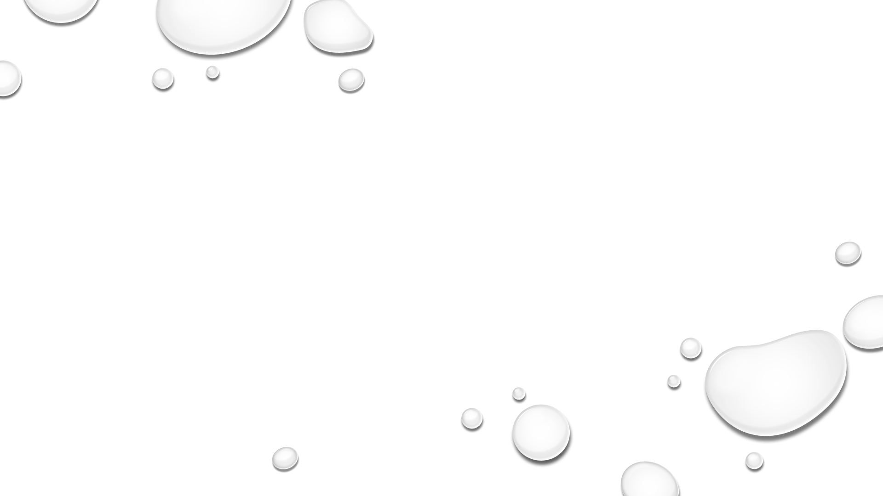
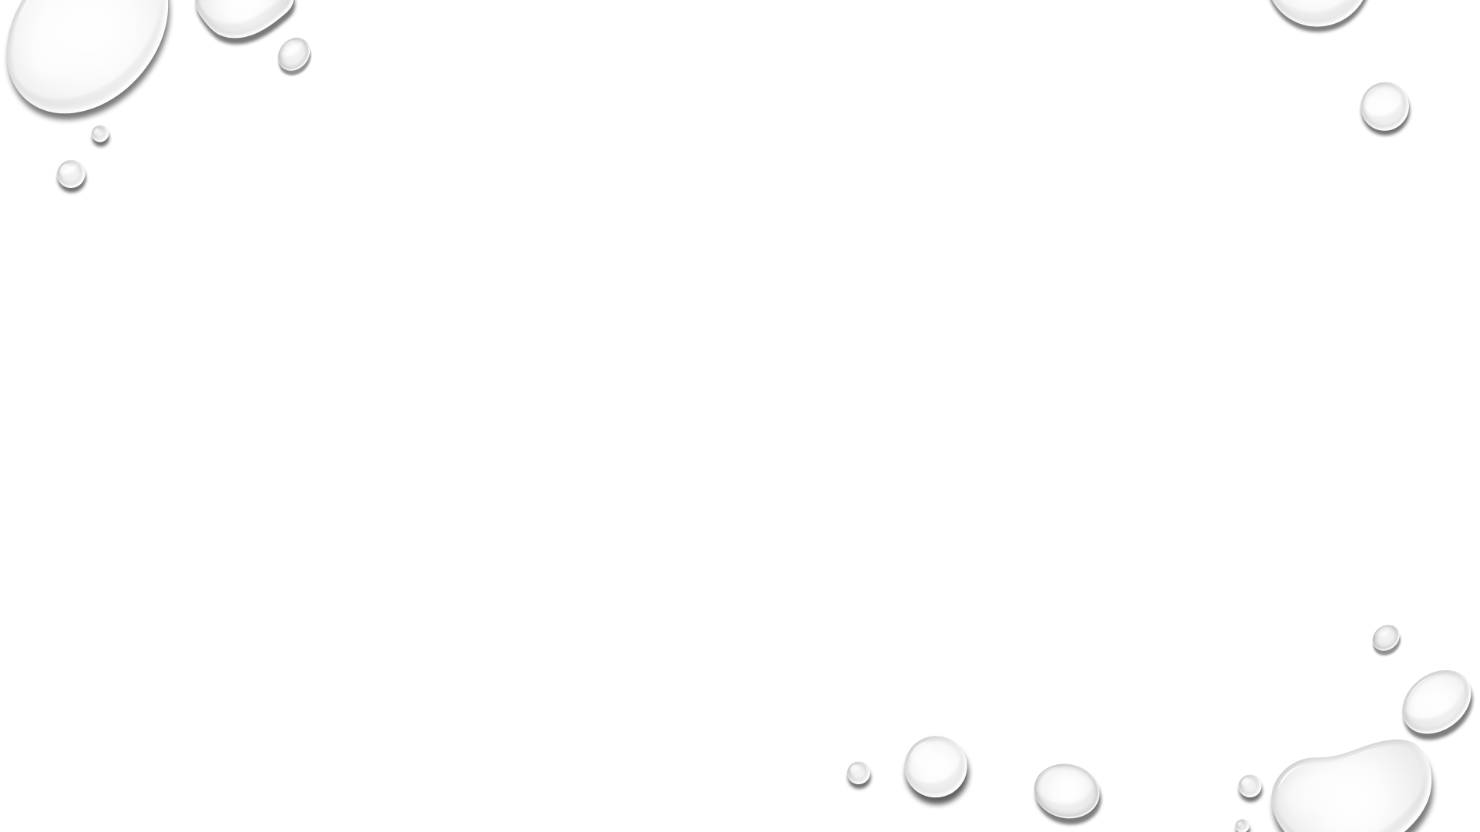
Topics to be Covered…
Distance Based Models: Neighbours and Examples, Nearest Neighbours Classification, Distance based clustering K-means Algorithm, Hierarchical clustering,
Rule Based Models: Association rule mining.
Tree Based Models: Decision Trees, Regression trees, Clustering Trees.
Trends In Machine Learning: Model and Symbols- Bagging and Boosting, Ensemble Learning, Online learning and Sequence Prediction, Deep Learning, Reinforcement Learning

Slide 3
Neighbours and Examples
The ‘Nearest Neighbours’ algorithm is one of the easiest machine learning algorithms to understand mathematically. Despite its simplicity, the algorithm is fairly accurate and models based on it usually generate optimal results.
The algorithm is best understood through its use to perform data classification. In a scenario where we are given a data-point for which we need to determine a predicted label (class).
we would find the closest data-point to the one in question and assume that the label of our data point matches that of the one that it is closest to.

Slide 4
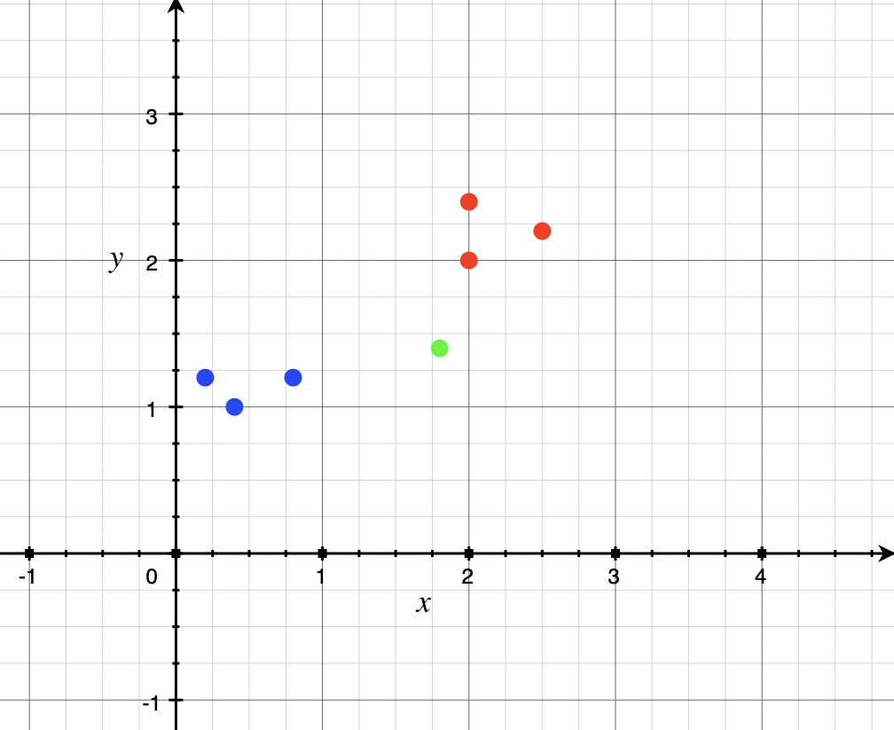
Consider the example in the graph alongside.
We are given a dataset of points that are either red or blue.
These have been plotted on a graph based on some set of parameters.
Now, we are given a new point (plotted in green) and asked to predict whether it should be red or blue.
In the Nearest Neighbours (NN) algorithm, we first plot the green point on the graph based on the same parameters we used to plot the earlier points and then we search for the closest point to the point in question.
In this case, the red point with coordinates (2,2) is the closest to the green point. Since the closest point is red, we predict that this new point is also going to be red.

Slide 5
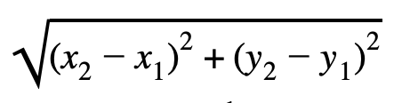
On a simple graph like this one, the distance formula can be used to calculate the distances to find the closest point, i.e. the ‘Nearest Neighbour’.

Slide 6
Nearest Neighbours Classification (KNN)
K-nearest neighbors (KNN) algorithm is a type of supervised ML algorithm which can be used for both classification as well as regression predictive problems. However, it is mainly used for classification predictive problems in industry. The following two properties would define KNN well −
Lazy learning algorithm − KNN is a lazy learning algorithm because it does not have a specialized training phase and uses all the data for training while classification.
Non-parametric learning algorithm − KNN is also a non-parametric learning algorithm because it doesn’t assume anything about the underlying data.

Slide 7
Working of KNN Algorithm:
K-nearest neighbours (KNN) algorithm uses ‘feature similarity’ to predict the values of new datapoints which further means that the new data point will be assigned a value based on how closely it matches the points in the training set. We can understand its working with the help of following steps-
Step 1 − For implementing any algorithm, we need dataset. So during the first step of KNN, we must load the training as well as test data.
Step 2 − Next, we need to choose the value of K (i.e. the nearest data points). K can be any integer.
Step 3 − For each point in the test data do the following −
3.1 − Calculate the distance between test data and each row of training data with the help of any of the method namely: Euclidean, Manhattan or Hamming distance. The most commonly used method to calculate distance is Euclidean.
3.2 − Now, based on the distance value, sort them in ascending order.
3.3 − Next, it will choose the top K rows from the sorted array.
3.4 − Now, it will assign a class to the test point based on most frequent class of these rows.
Step 4 − End

Slide 8
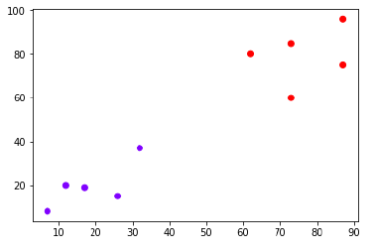
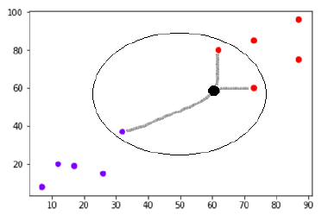
Example
The following is an example to understand the concept of K and working of KNN algorithm −
Suppose we have a dataset which can be plotted as follows −
Now, we need to classify new data point with black dot (at point 60,60) into blue or red class. We are assuming K = 3 i.e. it would find three nearest data points. It is shown in the next diagrams
We can see in the above diagram the three nearest neighbours of the data point with black dot. Among those three, two of them lies in Red class hence the black dot will also be assigned in red class.

Slide 9
Pros and Cons of KNN
Pros
It is very simple algorithm to understand and interpret.
It is very useful for nonlinear data because there is no assumption about data in this algorithm.
It is a versatile algorithm as we can use it for classification as well as regression.
It has relatively high accuracy but there are much better supervised learning models than KNN.
Cons
It is computationally a bit expensive algorithm because it stores all the training data.
High memory storage required as compared to other supervised learning algorithms.
Prediction is slow in case of big N.
It is very sensitive to the scale of data as well as irrelevant features.

Slide 10
Applications of KNN:
The following are some of the areas in which KNN can be applied successfully −
Banking System
KNN can be used in banking system to predict weather an individual is fit for loan approval? Does that individual have the characteristics similar to the defaulters one?
Calculating Credit Ratings
KNN algorithms can be used to find an individual’s credit rating by comparing with the persons having similar traits.
Politics
With the help of KNN algorithms, we can classify a potential voter into various classes like “Will Vote”, “Will not Vote”, “Will Vote to Party ‘Congress’, “Will Vote to Party ‘BJP’.
Other areas in which KNN algorithm can be used are Speech Recognition, Handwriting Detection, Image Recognition and Video Recognition.

Slide 11
Distance based clustering K-means Algorithm
K-means clustering algorithm computes the centroids and iterates until we it finds optimal centroid. It assumes that the number of clusters are already known.
It is also called flat clustering algorithm.
The number of clusters identified from data by algorithm is represented by ‘K’ in K-means.
In this algorithm, the data points are assigned to a cluster in such a manner that the sum of the squared distance between the data points and centroid would be minimum.
It is to be understood that less variation within the clusters will lead to more similar data points within same cluster.

Slide 12
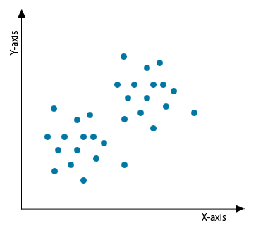
How the K- Means Clustering Algorithm Works?
K- Means Clustering Algorithm needs the following inputs:
K = number of subgroups or clusters
Sample or Training Set = {x₁, x₂, x₃,………x_{n}}
Now let us assume we have a data set that is unlabeled and we need to divide it into clusters.

Slide 13
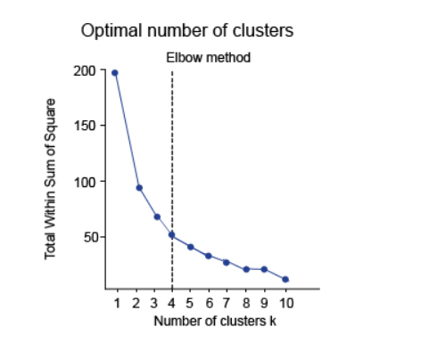
Now we need to find the number of clusters. This can be done by two methods:
Elbow Method.
Purpose Method.
Elbow Method
In this method, a curve is drawn between “within the sum of squares” (WSS) and the number of clusters. The curve plotted resembles a human arm.
It is called the elbow method because the point of elbow in the curve gives us the optimum number of clusters. In the graph or curve, after the elbow point, the value of WSS changes very slowly so elbow point must be considered to give the final value of the number of clusters.
Purpose-Based
In this method, the data is divided based on different metrics and after then it is judged how well it performed for that case. For example, the arrangement of the shirts in the men’s clothing department in a mall is done on the criteria of the sizes. It can be done on the basis of price and the brands also. The best suitable would be chosen to give the optimal number of clusters i.e. the value of K.

Slide 14
Working of K-Means Algorithm
We can understand the working of K-Means clustering algorithm with the help of following steps −
Step 1 − First, we need to specify the number of clusters, K, need to be generated by this algorithm.
Step 2 − Next, randomly select K data points and assign each data point to a cluster. In simple words, classify the data based on the number of data points.
Step 3 − Now it will compute the cluster centroids.
Step 4 − Next, keep iterating the following until we find optimal centroid which is the assignment of data points to the clusters that are not changing any more
4.1 − First, the sum of squared distance between data points and centroids would be computed.
4.2 − Now, we have to assign each data point to the cluster that is closer than other cluster (centroid).
4.3 − At last compute the centroids for the clusters by taking the average of all data points of that cluster.

Slide 15
Advantages of K- Means Clustering Algorithm
It is fast, Robust, Comparatively efficient
If data sets are distinct then gives the best results
Produce tighter clusters, Flexible, Easy to interpret, Better computational cost
Enhances Accuracy, Works better with spherical clusters
disadvantages of K- Means Clustering Algorithm
Needs prior specification for the number of cluster centers
If there are two highly overlapping data then it cannot be distinguished and cannot tell that there are two clusters
With the different representation of the data, the results achieved are also different
Cannot handle outliers and noisy data
Do not work for the non-linear data set
Lacks consistency

Slide 16
Applications of K- Means Clustering Algorithm
Market segmentation
Document clustering
Image segmentation
Image compression
Cluster analysis
Insurance fraud detection
Public transport data analysis

Slide 17
Hierarchical clustering
Also known as Hierarchical cluster analysis or HCA
IT is an unsupervised clustering algorithm which involves creating clusters that have predominant ordering from top to bottom.
For e.g: All files and folders on our hard disk are organized in a hierarchy.
The algorithm groups similar objects into groups called clusters. The endpoint is a set of clusters or groups, where each cluster is distinct from each other cluster, and the objects within each cluster are broadly similar to each other.
This clustering technique is divided into two types:
1. Agglomerative Hierarchical Clustering
2. Divisive Hierarchical Clustering

Slide 18
Agglomerative Hierarchical Clustering
The Agglomerative Hierarchical Clustering is the most common type of hierarchical clustering used to group objects in clusters based on their similarity. It’s also known as AGNES (Agglomerative Nesting). It's a “bottom-up” approach: each observation starts in its own cluster, and pairs of clusters are merged as one moves up the hierarchy.
How does it work?
1. Make each data point a single-point cluster → forms N clusters
2. Take the two closest data points and make them one cluster → forms N-1 clusters
3. Take the two closest clusters and make them one cluster → Forms N-2 clusters.
4. Repeat step-3 until you are left with only one cluster.

Slide 19
Have a look at the visual representation of Agglomerative Hierarchical Clustering for better understanding:

Slide 20
There are several ways to measure the distance between clusters in order to decide the rules for clustering, and they are often called Linkage Methods. Some of the common linkage methods are:
Complete-linkage: the distance between two clusters is defined as the longest distance between two points in each cluster.
Single-linkage: the distance between two clusters is defined as the shortest distance between two points in each cluster. This linkage may be used to detect high values in your dataset which may be outliers as they will be merged at the end.
Average-linkage: the distance between two clusters is defined as the average distance between each point in one cluster to every point in the other cluster.
Centroid-linkage: finds the centroid of cluster 1 and centroid of cluster 2, and then calculates the distance between the two before merging.

Slide 21
The choice of linkage method entirely depends on you and there is no hard and fast method that will always give you good results. Different linkage methods lead to different clusters.
The point of doing all this is to demonstrate the way hierarchical clustering works, it maintains a memory of how we went through this process and that memory is stored in Dendrogram.
What is a Dendrogram?
A Dendrogram is a type of tree diagram showing hierarchical relationships between different sets of data.
As already said a Dendrogram contains the memory of hierarchical clustering algorithm, so just by looking at the Dendrogram you can tell how the cluster is formed.
Note:-
Distance between data points represents dissimilarities.
Height of the blocks represents the distance between clusters.

Slide 22
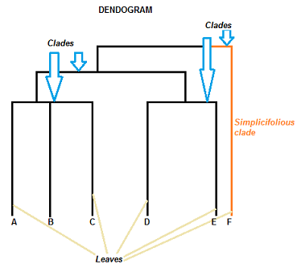
Parts of a Dendrogram
A dendrogram can be a column graph (as in the Given image ) or a row graph.
Some dendrograms are circular or have a fluid-shape, but the software will usually produce a row or column graph. No matter what the shape, the basic graph comprises the same parts:
The Clades are the branch and are arranged according to how similar (or dissimilar) they are.
Clades that are close to the same height are similar to each other;
clades with different heights are dissimilar — the greater the difference in height, the more dissimilarity.
Each clade has one or more leaves.
Leaves A, B, and C are more similar to each other than they are to leaves D, E, or F.
Leaves D and E are more similar to each other than they are to leaves A, B, C, or F.
Leaf F is substantially different from all of the other leaves.

Slide 23
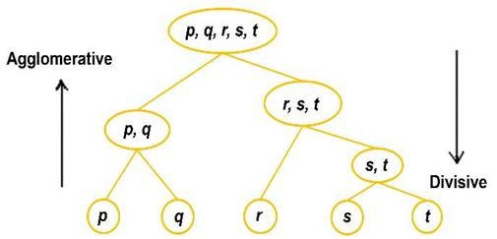
Divisive Hierarchical Clustering
In Divisive or DIANA(DIvisive ANAlysis Clustering) is a top-down clustering method
where we assign all of the observations to a single cluster and then partition the cluster to two least similar clusters.
Finally, we proceed recursively on each cluster until there is one cluster for each observation.
So this clustering approach is exactly opposite to Agglomerative clustering.

Slide 24
Rule Based Models: Association rule mining
Has it ever happened that you’re out to buy something, and you end up buying a lot more than you planned?
It’s a Phenomenon known as Impulsive Buying and Big Retailers take advantage of Machine Learning and Apriori Algorithm and make sure that we tend to buy more.
So let’s understand how the Apriori algorithm works in the following order:
Market Basket Analysis
Association Rule Mining
Apriori Algorithm

Slide 25
Market Basket Analysis
In today’s world, the goal of any organization is to increase revenue. Can this be done by pitching just one product at a time to the customer? The answer is a clear no.
Hence, organizations began mining data related to frequently bought items.
Market Basket Analysis is one of the key techniques used by large retailers to uncover associations between items.
They try to find out associations between different items and products that can be sold together, which gives assisting in right product placement.
Typically, it figures out what products are being bought together and organizations can place products in a similar manner.
Let’s understand this better with an example:

Slide 26
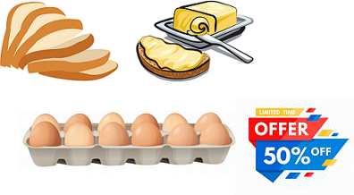
People who buy Bread usually buy Butter too.
The Marketing teams at retail stores should target customers who buy bread and butter and provide an offer to them so that they buy the third item, like eggs.
So if customers buy bread and butter and see a discount or an offer on eggs, they will be encouraged to spend more and buy the eggs.
This is what market basket analysis is all about.
This is just a small example. So, if you take 10000 items data of your Supermart to a Data Scientist, Just imagine the number of insights you can get.
And that is why Association Rule mining is so important.

Slide 27
Association Rule Mining
Association rules can be thought of as an IF-THEN relationship.
Suppose item A is being bought by the customer, then the chances of item B being picked by the customer too under the same Transaction ID is found out.
There are two elements of these rules:
Antecedent (IF): This is an item/group of items that are typically found in the Item sets or Datasets.
Consequent (THEN): This comes along as an item with an Antecedent/group of Antecedents.
But here comes a constraint. Suppose you made a rule about an item, you still have around 9999 items to consider for rule-making.
This is where the Apriori Algorithm comes into play.
So before we understand the Apriori Algorithm, let’s understand the math behind it.

Slide 28

There are 3 ways to measure association:
Support
Confidence
Lift
Support: It gives the fraction of transactions which contains item A and B. Basically Support tells us about the frequently bought items or the combination of items bought frequently.
So with this, we can filter out the items that have a low frequency.

Slide 29

Confidence: It tells us how often the items A and B occur together, given the number times A occurs.
Typically, when you work with the Apriori Algorithm, you define these terms accordingly.
But how do you decide the value?
Honestly, there isn’t a way to define these terms. Suppose you’ve assigned the support value as 2.
What this means is, until and unless the item/s frequency is not 2%, you will not consider that item/s for the Apriori algorithm.
This makes sense as considering items that are bought less frequently is a waste of time.
Now suppose, after filtering you still have around 5000 items left.
Creating association rules for them is a practically impossible task for anyone.
This is where the concept of lift comes into play.

Slide 30

Lift: Lift indicates the strength of a rule over the random occurrence of A and B. It basically tells us the strength of any rule.
Focus on the denominator, it is the probability of the individual support values of A and B and not together. Lift explains the strength of a rule.
More the Lift more is the strength. Let’s say for A -> B, the lift value is 4. It means that if you buy A the chances of buying B is 4 times.
Note:
Apriori Algorithm:
Apriori algorithm uses frequent itemsets to generate association rules.
It is based on the concept that a subset of a frequent itemset must also be a frequent itemset. Frequent Itemset is an itemset whose support value is greater than a threshold value(support).

Slide 31
Tree Based Models: Decision Trees, Regression trees, Clustering Trees
Classification is a two-step process, learning step and prediction step, in machine learning.
In the learning step, the model is developed based on given training data.
In the prediction step, the model is used to predict the response for given data.
Decision Tree is one of the easiest and popular classification algorithms to understand and interpret.
Decision Tree Algorithm
Decision Tree algorithm belongs to the family of supervised learning algorithms. Unlike other supervised learning algorithms, the decision tree algorithm can be used for solving regression and classification problems too.
The goal of using a Decision Tree is to create a training model that can use to predict the class or value of the target variable by learning simple decision rules inferred from prior data(training data).
In Decision Trees, for predicting a class label for a record we start from the root of the tree. We compare the values of the root attribute with the record’s attribute. On the basis of comparison, we follow the branch corresponding to that value and jump to the next node.

Slide 32
Types of Decision Trees
Types of decision trees are based on the type of target variable we have. It can be of two types:
Categorical Variable Decision Tree: Decision Tree which has a categorical target variable then it called a Categorical variable decision tree.
Continuous Variable Decision Tree: Decision Tree has a continuous target variable then it is called Continuous Variable Decision Tree.
Example:- Let’s say we have a problem to predict whether a customer will pay his renewal premium with an insurance company (yes/ no). Here we know that the income of customers is a significant variable but the insurance company does not have income details for all customers. Now, as we know this is an important variable, then we can build a decision tree to predict customer income based on occupation, product, and various other variables. In this case, we are predicting values for the continuous variables.

Slide 33
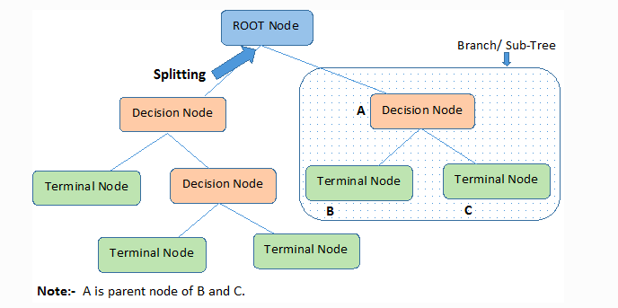
Important Terminology related to Decision Trees
Root Node: It represents the entire population or sample and this further gets divided into two or more homogeneous sets.
Splitting: It is a process of dividing a node into two or more sub-nodes.
Decision Node: When a sub-node splits into further sub-nodes, then it is called the decision node.
Leaf / Terminal Node: Nodes do not split is called Leaf or Terminal node.
Pruning: When we remove sub-nodes of a decision node, this process is called pruning. You can say the opposite process of splitting.
Branch / Sub-Tree: A subsection of the entire tree is called branch or sub-tree.
Parent and Child Node: A node, which is divided into sub-nodes is called a parent node of sub-nodes whereas sub-nodes are the child of a parent node.

Slide 34
Decision trees classify the examples by sorting them down the tree from the root to some leaf/terminal node, with the leaf/terminal node providing the classification of the example.
Each node in the tree acts as a test case for some attribute, and each edge descending from the node corresponds to the possible answers to the test case.
This process is recursive in nature and is repeated for every subtree rooted at the new node.

Slide 35
How do Decision Trees work?
The decision of making strategic splits heavily affects a tree’s accuracy. The decision criteria are different for classification and regression trees.
Decision trees use multiple algorithms to decide to split a node into two or more sub-nodes.
The creation of sub-nodes increases the homogeneity of resultant sub-nodes. In other words, we can say that the purity of the node increases with respect to the target variable.
The decision tree splits the nodes on all available variables and then selects the split which results in most homogeneous sub-nodes.

Slide 36
The algorithm selection is also based on the type of target variables. Let us look at some algorithms used in Decision Trees:
ID3 → (extension of D3) C4.5 → (successor of ID3) CART → (Classification And Regression Tree) CHAID → (Chi-square automatic interaction detection Performs multi-level splits when computing classification trees)
The ID3 algorithm builds decision trees using a top-down greedy search approach through the space of possible branches with no backtracking. A greedy algorithm, as the name suggests, always makes the choice that seems to be the best at that moment.
Steps in ID3 algorithm:
It begins with the original set S as the root node.
On each iteration of the algorithm, it iterates through the very unused attribute of the set S and calculates Entropy(H) and Information gain(IG) of this attribute.
It then selects the attribute which has the smallest Entropy or Largest Information gain.
The set S is then split by the selected attribute to produce a subset of the data.
The algorithm continues to recur on each subset, considering only attributes never selected before.

Slide 37
Attribute Selection Measures
If the dataset consists of N attributes then deciding which attribute to place at the root or at different levels of the tree as internal nodes is a complicated step.
By just randomly selecting any node to be the root can’t solve the issue. If we follow a random approach, it may give us bad results with low accuracy.
For solving this attribute selection problem, researchers worked and devised some solutions. They suggested using some criteria like :
Entropy, Information gain, Gini index, Gain Ratio, Reduction in Variance Chi-Square
These criteria will calculate values for every attribute. The values are sorted, and attributes are placed in the tree by following the order i.e, the attribute with a high value(in case of information gain) is placed at the root. While using Information Gain as a criterion, we assume attributes to be categorical, and for the Gini index, attributes are assumed to be continuous.

Slide 38

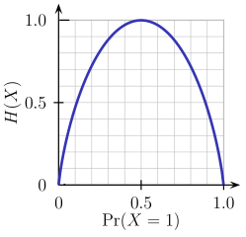
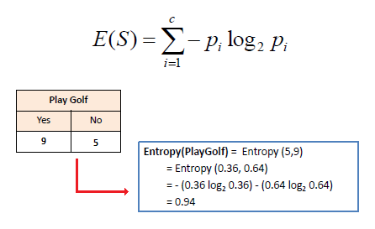
Entropy
Entropy is a measure of the randomness in the information being processed. The higher the entropy, the harder it is to draw any conclusions from that information. Flipping a coin is an example of an action that provides information that is random.
From the graph, it is quite evident that the entropy H(X) is zero when the probability is either 0 or 1. The Entropy is maximum when the probability is 0.5 because it projects perfect randomness in the data and there is no chance if perfectly determining the outcome.
Mathematically Entropy for 1 attribute is represented as:
Where S → Current state, and Pi → Probability of an event i of state S or Percentage of class i in a node of state S.

Slide 39
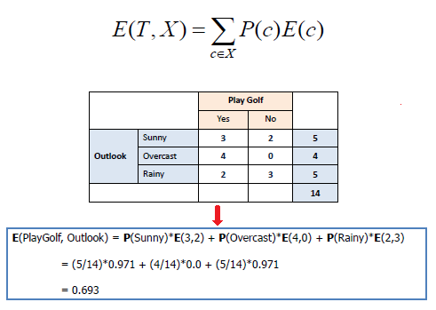
Mathematically Entropy for multiple attributes is represented as:
where T→ Current state and X → Selected attribute

Slide 40
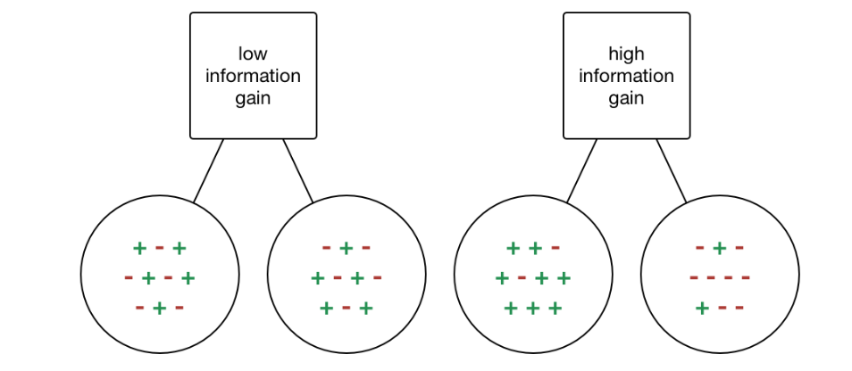
Information Gain
Information gain or IG is a statistical property that measures how well a given attribute separates the training examples according to their target classification. Constructing a decision tree is all about finding an attribute that returns the highest information gain and the smallest entropy.

Slide 41
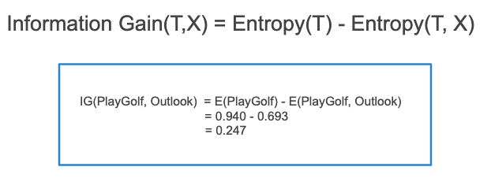

Information gain is a decrease in entropy. It computes the difference between entropy before split and average entropy after split of the dataset based on given attribute values. ID3 (Iterative Dichotomiser) decision tree algorithm uses information gain.
Mathematically, IG is represented as:
In a much simpler way, we can conclude that:
Where “before” is the dataset before the split, K is the number of subsets generated by the split, and (j, after) is subset j after the split.

Slide 42
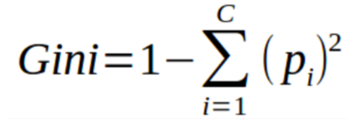
Gini Index
You can understand the Gini index as a cost function used to evaluate splits in the dataset. It is calculated by subtracting the sum of the squared probabilities of each class from one. It favors larger partitions and easy to implement whereas information gain favors smaller partitions with distinct values.
Gini Index works with the categorical target variable “Success” or “Failure”. It performs only Binary splits.
Steps to Calculate Gini index for a split
Calculate Gini for sub-nodes, using the above formula for success(p) and failure(q) (p²+q²).
Calculate the Gini index for split using the weighted Gini score of each node of that split.
CART (Classification and Regression Tree) uses the Gini index method to create split points.

Slide 43
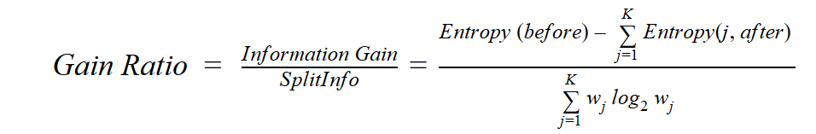
Gain ratio
Information gain is biased towards choosing attributes with a large number of values as root nodes. It means it prefers the attribute with a large number of distinct values.
C4.5, an improvement of ID3, uses Gain ratio which is a modification of Information gain that reduces its bias and is usually the best option. Gain ratio overcomes the problem with information gain by taking into account the number of branches that would result before making the split. It corrects information gain by taking the intrinsic information of a split into account.
Where “before” is the dataset before the split, K is the number of subsets generated by the split, and (j, after) is subset j after the split.

Slide 44

Reduction in Variance
Reduction in variance is an algorithm used for continuous target variables (regression problems). This algorithm uses the standard formula of variance to choose the best split. The split with lower variance is selected as the criteria to split the population:
Above X-bar is the mean of the values, X is actual and n is the number of values.
Steps to calculate Variance:
Calculate variance for each node.
Calculate variance for each split as the weighted average of each node variance.

Slide 45
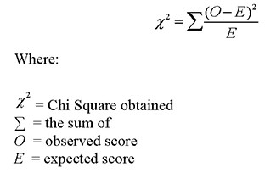
Chi-Square
The acronym CHAID stands for Chi-squared Automatic Interaction Detector. It is one of the oldest tree classification methods. It finds out the statistical significance between the differences between sub-nodes and parent node. We measure it by the sum of squares of standardized differences between observed and expected frequencies of the target variable.
It works with the categorical target variable “Success” or “Failure”. It can perform two or more splits. Higher the value of Chi-Square higher the statistical significance of differences between sub-node and Parent node.
It generates a tree called CHAID (Chi-square Automatic Interaction Detector).
Mathematically, Chi-squared is represented as:

Slide 46
Steps to Calculate Chi-square for a split:
Calculate Chi-square for an individual node by calculating the deviation for Success and Failure both
Calculated Chi-square of Split using Sum of all Chi-square of success and Failure of each node of the split

Slide 47
How to avoid/counter Overfitting in Decision Trees?
The common problem with Decision trees, especially having a table full of columns, they fit a lot. Sometimes it looks like the tree memorized the training data set. If there is no limit set on a decision tree, it will give you 100% accuracy on the training data set because in the worse case it will end up making 1 leaf for each observation. Thus this affects the accuracy when predicting samples that are not part of the training set.
Here are two ways to remove overfitting:
Pruning Decision Trees.
Random Forest

Slide 48
Pruning Decision Trees
The splitting process results in fully grown trees until the stopping criteria are reached. But, the fully grown tree is likely to overfit the data, leading to poor accuracy on unseen data.

Slide 49
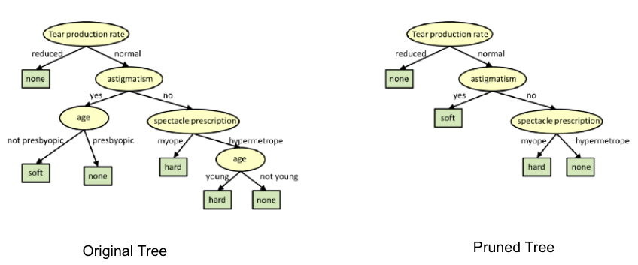
In pruning, you trim off the branches of the tree, i.e., remove the decision nodes starting from the leaf node such that the overall accuracy is not disturbed.
This is done by segregating the actual training set into two sets: training data set, D and validation data set, V.
Prepare the decision tree using the segregated training data set, D. Then continue trimming the tree accordingly to optimize the accuracy of the validation data set, V.
In the above diagram, the ‘Age’ attribute in the left-hand side of the tree has been pruned as it has more importance on the right-hand side of the tree, hence removing overfitting.

Slide 50
Random Forest
Random Forest is an example of ensemble learning, in which we combine multiple machine learning algorithms to obtain better predictive performance.
Why the name “Random”?
Two key concepts that give it the name random:
A random sampling of training data set when building trees.
Random subsets of features considered when splitting nodes.
A technique known as bagging is used to create an ensemble of trees where multiple training sets are generated with replacement.
In the bagging technique, a data set is divided into N samples using randomized sampling. Then, using a single learning algorithm a model is built on all samples. Later, the resultant predictions are combined using voting or averaging in parallel.

Slide 51
Which is better Linear or tree-based models?
Well, it depends on the kind of problem you are solving.
If the relationship between dependent & independent variables is well approximated by a linear model, linear regression will outperform the tree-based model.
If there is a high non-linearity & complex relationship between dependent & independent variables, a tree model will outperform a classical regression method.
If you need to build a model that is easy to explain to people, a decision tree model will always do better than a linear model. Decision tree models are even simpler to interpret than linear regression!

Slide 52
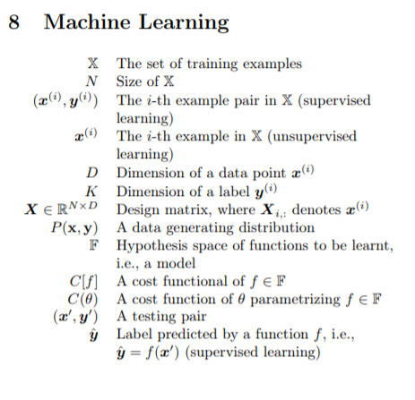
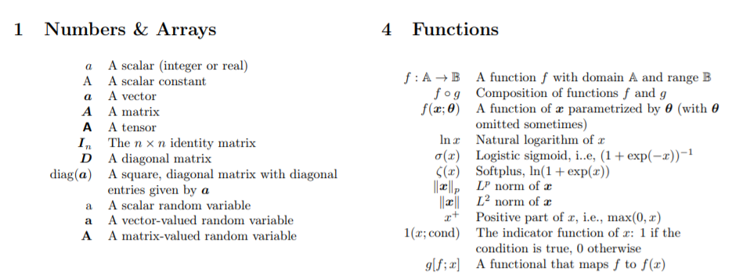
model and symbols

Slide 53
Bagging and Boosting
Bagging and boosting are both ensemble learning methods in machine learning.
Bagging and boosting are similar in that they are both ensemble techniques, where a set of weak learners are combined to create a strong learner that obtains better performance than a single one.
Ensemble learning helps to improve machine learning model performance by combining several models. This approach allows the production of better predictive performance compared to a single model.
The basic idea behind ensemble learning is to learn a set of classifiers (experts) and to allow them to vote.
This diversification in Machine Learning is achieved by a technique called ensemble learning.
The idea here is to train multiple models, each with the objective to predict or classify a set of results.
Bagging and boosting are two types of ensemble learning techniques. These two decrease the variance of single estimate as they combine several estimates from different models.
So the result may be a model with higher stability.
The main causes of error in learning are due to noise, bias and variance.
Ensemble helps to minimize these factors. By using ensemble methods, we’re able to increase the stability of the final model and reduce the errors mentioned previously.

Slide 54
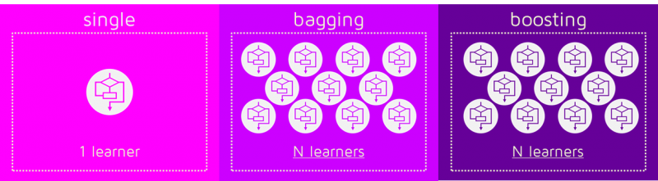
Bagging helps to decrease the model’s variance.
Boosting helps to decrease the model’s bias.
These methods are designed to improve the stability and the accuracy of Machine Learning algorithms.
Combinations of multiple classifiers decrease variance, especially in the case of unstable classifiers, and may produce a more reliable classification than a single classifier.
To use Bagging or Boosting you must select a base learner algorithm.
For example, if we choose a classification tree, Bagging and Boosting would consist of a pool of trees as big as we want as shown in the following diagram:

Slide 55
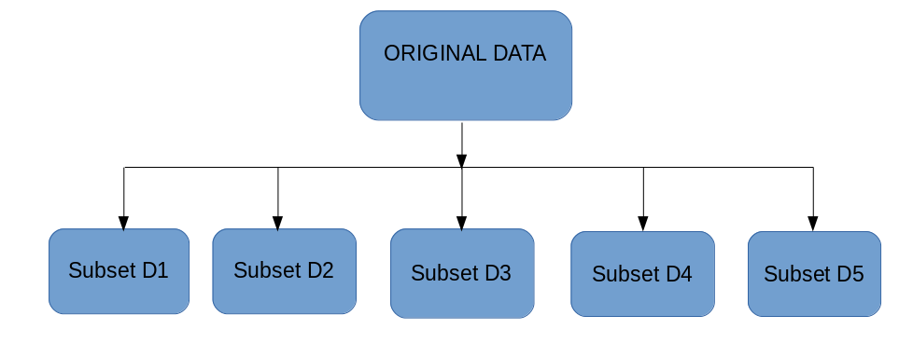
Bagging
Bagging ( or Bootstrap Aggregation), is a simple and very powerful ensemble method. Bagging is the application of the Bootstrap procedure to a high-variance machine learning algorithm, typically decision trees.
The idea behind bagging is combining the results of multiple models (for instance, all decision trees) to get a generalized result. Now, bootstrapping comes into picture.
Bagging (or Bootstrap Aggregating) technique uses these subsets (bags) to get a fair idea of the distribution (complete set). The size of subsets created for bagging may be less than the original set.
It can be represented as follows:

Slide 56
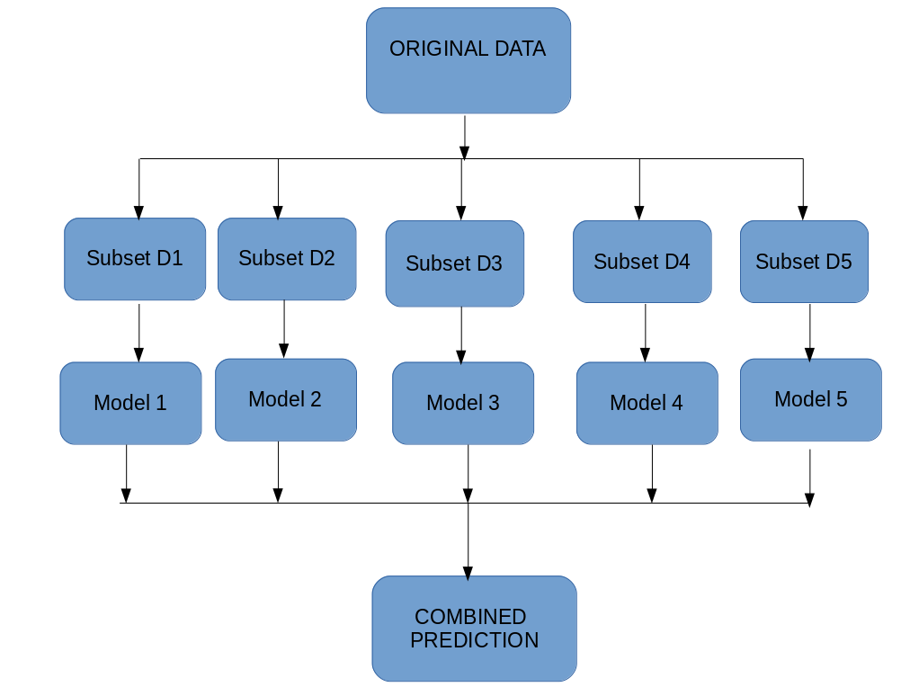
Bagging works as follows:-
Multiple subsets are created from the original dataset, selecting observations with replacement.
A base model (weak model) is created on each of these subsets.
The models run in parallel and are independent of each other.
The final predictions are determined by combining the predictions from all the models.
Now, bagging can be represented diagrammatically as follows:

Slide 57
Boosting
Boosting is a sequential process, where each subsequent model attempts to correct the errors of the previous model. The succeeding models are dependent on the previous model.
In this technique, learners are learned sequentially with early learners fitting simple models to the data and then analyzing data for errors. In other words, we fit consecutive trees (random sample) and at every step, the goal is to solve for net error from the prior tree.
When an input is misclassified by a hypothesis, its weight is increased so that next hypothesis is more likely to classify it correctly. By combining the whole set at the end converts weak learners into better performing model.

Slide 58
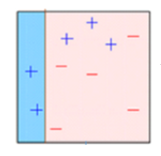
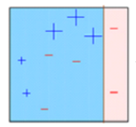
Let’s understand the way boosting works in the below steps.
A subset is created from the original dataset.
Initially, all data points are given equal weights.
A base model is created on this subset.
This model is used to make predictions on the whole dataset.
Errors are calculated using the actual values and predicted values.
The observations which are incorrectly predicted, are given higher weights. (Here, the three misclassified blue-plus points will be given higher weights)
Another model is created and predictions are made on the dataset. (This model tries to correct the errors from the previous model)

Slide 59
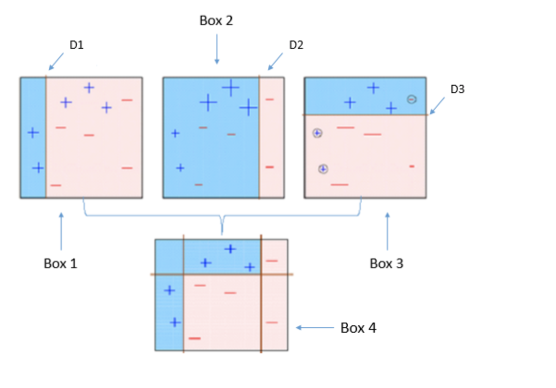
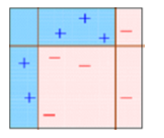
Similarly, multiple models are created, each correcting the errors of the previous model.
The final model (strong learner) is the weighted mean of all the models (weak learners).
Thus, the boosting algorithm combines a number of weak learners to form a strong learner.
The individual models would not perform well on the entire dataset, but they work well for some part of the dataset.
Thus, each model actually boosts the performance of the ensemble.

Slide 60
Ensemble Learning
Let’s understand the concept of ensemble learning with an example.
Suppose you are a movie director and you have created a short movie on a very important and interesting topic.
Now, you want to take preliminary feedback (ratings) on the movie before making it public.
What are the possible ways by which you can do that?
A: You may ask one of your friends to rate the movie for you. Now it’s entirely possible that the person you have chosen loves you very much and doesn’t want to break your heart by providing a 1-star rating to the horrible work you have created.
B: Another way could be by asking 5 colleagues of yours to rate the movie. This should provide a better idea of the movie. This method may provide honest ratings for your movie. But a problem still exists. These 5 people may not be “Subject Matter Experts” on the topic of your movie. Sure, they might understand the cinematography, the shots, or the audio, but at the same time may not be the best judges of dark humour.

Slide 61
C: How about asking 50 people to rate the movie? Some of which can be your friends, some of them can be your colleagues and some may even be total strangers.
The responses, in this case, would be more generalized and diversified since now you have people with different sets of skills.
With these examples, you can infer that a diverse group of people are likely to make better decisions as compared to individuals.
Similar is true for a diverse set of models in comparison to single models.
This diversification in Machine Learning is achieved by a technique called Ensemble Learning.

Slide 62
Simple Ensemble Techniques:
In this section, we will look at a few simple but powerful techniques, namely:
Max Voting.
Averaging.
Weighted Averaging.
Max Voting:
The max voting method is generally used for classification problems.
In this technique, multiple models are used to make predictions for each data point.
The predictions by each model are considered as a ‘vote’.
The predictions which we get from the majority of the models are used as the final prediction.

Slide 63
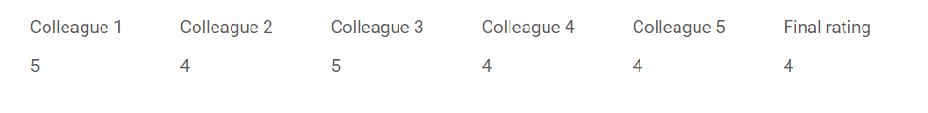
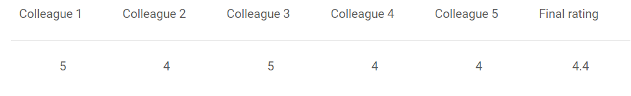
For example, when you asked 5 of your colleagues to rate your movie (out of 5); we’ll assume three of them rated it as 4 while two of them gave it a 5. Since the majority gave a rating of 4, the final rating will be taken as 4. You can consider this as taking the mode of all the predictions.
The result of max voting would be something like this:
Averaging
Similar to the max voting technique, multiple predictions are made for each data point in averaging. In this method, we take an average of predictions from all the models and use it to make the final prediction. Averaging can be used for making predictions in regression problems or while calculating probabilities for classification problems.
For example, in the below case, the averaging method would take the average of all the values.
i.e. (5+4+5+4+4)/5 = 4.4

Slide 64
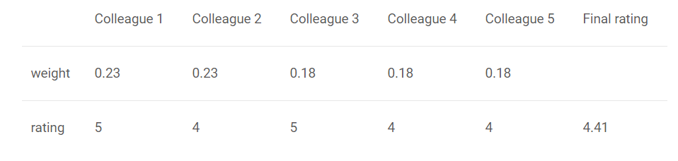
Weighted Average:
This is an extension of the averaging method. All models are assigned different weights defining the importance of each model for prediction. For instance, if two of your colleagues are critics, while others have no prior experience in this field, then the answers by these two friends are given more importance as compared to the other people.
The result is calculated as :
[(5*0.23) + (4*0.23) + (5*0.18) + (4*0.18) + (4*0.18)] = 4.41.

Slide 65
Advanced Ensemble techniques
Now that we have covered the basic ensemble techniques, let’s move on to understanding the advanced techniques.
Stacking.
Blending.
Bagging.
Boosting.

Slide 66
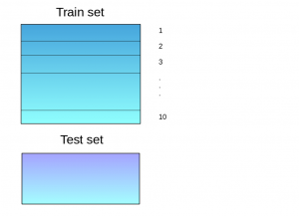
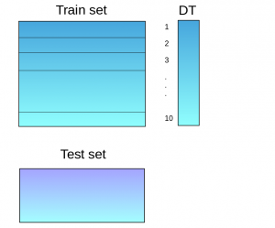
Stacking
Stacking is an ensemble learning technique that uses predictions from multiple models (for example decision tree, knn or svm) to build a new model.
This model is used for making predictions on the test set. Below is a step-wise explanation for a simple stacked ensemble:
1 The train set is split into 10 parts:
2 A base model (suppose a decision tree) is fitted on 9 parts and predictions are made for the 10th part. This is done for each part of the train set.

Slide 67
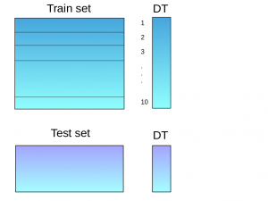
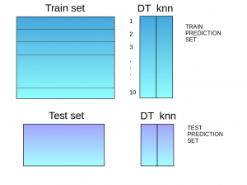
3. The base model (in this case, decision tree) is then fitted on the whole train dataset.
4. Using this model, predictions are made on the test set
5. Steps 2 to 4 are repeated for another base model (say knn) resulting in another set of predictions for the train set and test set.

Slide 68
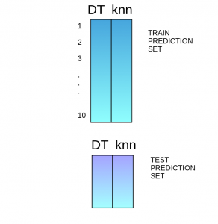
6. The predictions from the train set are used as features to build a new model.
7. This model is used to make final predictions on the test prediction set.

Slide 69
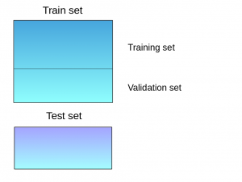
Blending:
Blending follows the same approach as stacking but uses only a holdout (validation) set from the train set to make predictions.
In other words, unlike stacking, the predictions are made on the holdout set only. The holdout set and the predictions are used to build a model which is run on the test set. Here is a detailed explanation of the blending process:
1. The train set is split into training and validation sets.

Slide 70
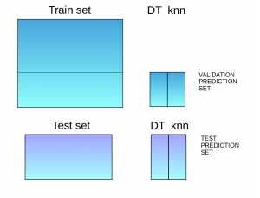
2. Model(s) are fitted on the training set.
3. The predictions are made on the validation set and the test set.
4. The validation set and its predictions are used as features to build a new model.
5. This model is used to make final predictions on the test and meta-features.

Slide 71
Bagging & Boosting: Covered Ahead in the slides
Algorithms based on Bagging and Boosting
Bagging and Boosting are two of the most commonly used techniques in machine learning. In this section, we will look at them in detail. Following are the algorithms we will be focusing on:
Bagging algorithms:
Bagging meta-estimator
Random forest
Boosting algorithms:
AdaBoost
GBM
XGBM
Light GBM
CatBoost

Slide 72
Online learning and Sequence Prediction
online machine learning is a method of machine learning in which data becomes available in a sequential order and is used to update the best predictor for future data at each step, as opposed to batch learning techniques which generate the best predictor by learning on the entire training data set at once.
Online learning is a common technique used in areas of machine learning where it is computationally infeasible to train over the entire dataset, requiring the need of out-of-core algorithms.
It is also used in situations where it is necessary for the algorithm to dynamically adapt to new patterns in the data, or when the data itself is generated as a function of time, e.g., stock price prediction

Slide 73
Sequence prediction is a popular machine learning task, which consists of predicting the next symbol(s) based on the previously observed sequence of symbols. These symbols could be a number, an alphabet, a word, an event, or an object like a webpage or product. For example:
A sequence of words or characters in a text.
A sequence of products bought by a customer.
A sequence of events observed on logs.
Sequence prediction is different from other types of supervised learning problems, as it imposes that the order in the data must be preserved when training models and making predictions.
Sequence prediction is a common problem which finds real-life applications in various industries. We will introduce you three types of sequence prediction problems:
Predicting the next value.
Predicting a class label.
Predicting a sequence.

Slide 74
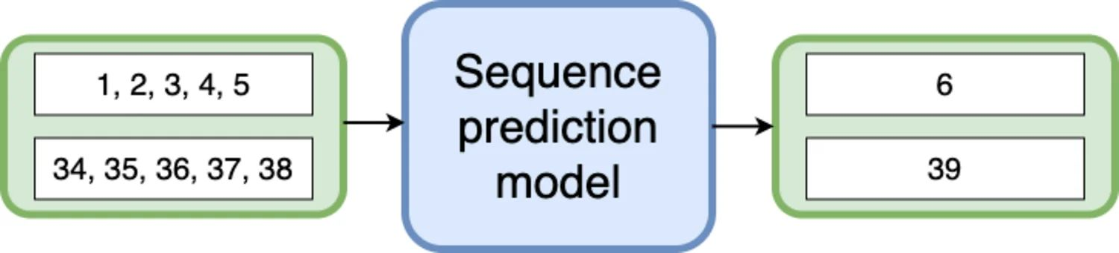
Predicting the next value
Being able to guess the next element of a sequence is an important question in many applications.
A sequence prediction model learns to identify the pattern in the sequential input data and predict the next value.

Slide 75
Deep learning
Deep learning is a machine learning technique that teaches computers to do what comes naturally to humans: learn by example. Deep learning is a key technology behind driverless cars, enabling them to recognize a stop sign.
It is the key to voice control in consumer devices like phones, tablets, TVs, and hands-free speakers.
Deep learning is getting lots of attention lately and for good reason.
It’s achieving results that were not possible before.
In deep learning, a computer model learns to perform classification tasks directly from images, text, or sound.
Deep learning models can achieve state-of-the-art accuracy, sometimes exceeding human-level performance.
Models are trained by using a large set of labeled data and neural network architectures that contain many layers.

Slide 76
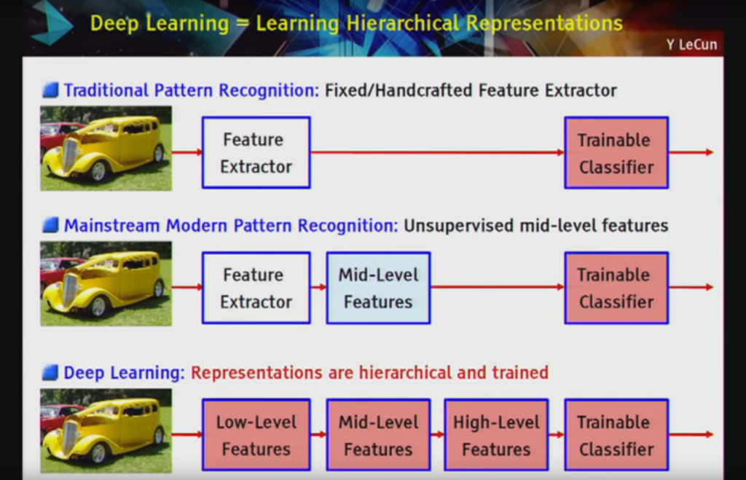

Slide 77
Most deep learning methods use neural network architectures, which is why deep learning models are often referred to as deep neural networks.
The term “deep” usually refers to the number of hidden layers in the neural network. Traditional neural networks only contain 2-3 hidden layers, while deep networks can have as many as 150.
Deep learning models are trained by using large sets of labeled data and neural network architectures that learn features directly from the data without the need for manual feature extraction.

Slide 78
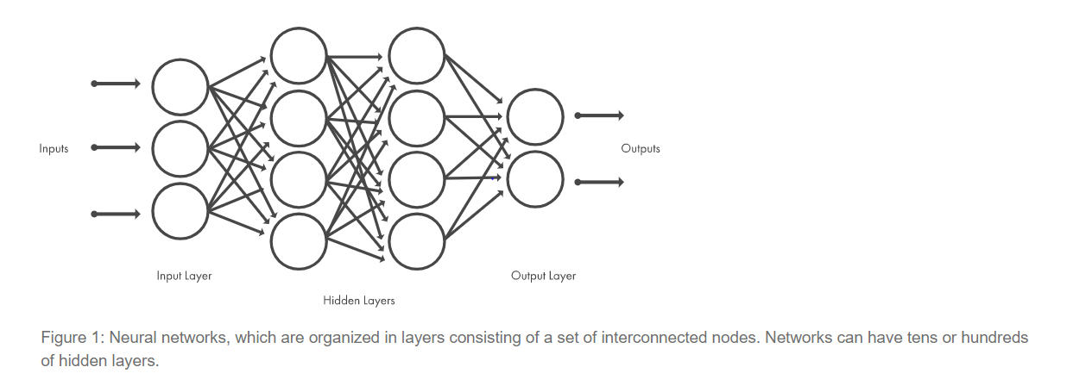

Slide 79
Examples of Deep learning
As we know deep learning and machine learning are subsets of artificial intelligence but deep learning technology represents the next evolution of machine learning.
As machine learning will work based on algorithms and programs developed by humans whereas deep learning learns through a neural network model which acts like similar to humans and allows machine or computer to analyze the data in a similar way as humans do. This becomes possible as we train the neural network models with a huge amount of data as data is the fuel or food for neural network models.
Below are some of the examples in the real world:
Computer Vision: Computer vision deals with algorithms for computers to understand the world using an image and video data and tasks such as image recognition, image classification, object detection, image segmentation, image restoration etc.

Slide 80
Speech and Natural Language Processing: Natural language processing deals with algorithms for computers to understand, interpret, and manipulate in human language. NLP algorithms work with text and audio data and transform them into audio or text output. Using NLP we can do tasks such as sentiment analysis, speech recognition, language transition, and natural language generation etc.
Autonomous vehicles: Deep learning models are trained with a huge amount of data for identifying street signs; some models specialize in identifying pedestrians, identifying humans etc. for driverless cars while driving.
Image filtering: By using deep learning models such as adding color to black-and-white images can be done by deep learning models which will take more time if we do manually.

Slide 81
Application of Deep Learning
Applications of deep learning are vast, but we would try to cover the most used application of deep learning techniques. Here are some of the deep learning applications, which are now changing the world around us very rapidly.
Toxicity detection for different chemical structures
Here deep learning method is very efficient, where experts used to take decades of time to determine the toxicity of a specific structure, but with deep learning model it is possible to determine toxicity in very less amount of time (depends on complexity could be hours or days).
Mitosis detection/ Radiology
Determining cancer detection deep learning model has 6000 factors which could help in predicting the survival of a patient. For Breast cancer diagnosis deep learning model has been proven efficient and effective. CNN model of deep learning is now able to detect as well as classify mitosis inpatient. Deep neural networks help in the investigation of the cell life cycle

Slide 82
Text Extraction and Text recognition
Text extraction itself has a lot of applications in the real world. For example, automatic translation from one language to other, sentimental analysis of different reviews. This widely is known as natural language processing. When writing an email we see auto-suggestion to complete the sentence is also the application of deep learning.
Market Prediction
Deep learning models can predict buy and sell calls for traders, depending on the dataset how the model has been trained, it is useful for both short term trading game as well as long term investment based on the available features.
Fraud Detection
A deep learning model uses multiple data sources to flag a decision as a fraud in real-time. With deep learning models, it is also possible to find out which product and which markets are most susceptible to fraud and provide or extra care in such cases.

Slide 83
Reinforcement Learning
Reinforcement is the field of machine learning that involves learning without the involvement of any human interaction as it has an agent that learns how to behave in an environment by performing actions and then learn based upon the outcome of these actions to obtain the required goal that is set by the system two accomplish.
Based upon the type of goals it is classified as Positive and Negative learning methods with there application in the field of Healthcare, Education, Computer Vision, Games, NLP, Transportation, etc.

Slide 84
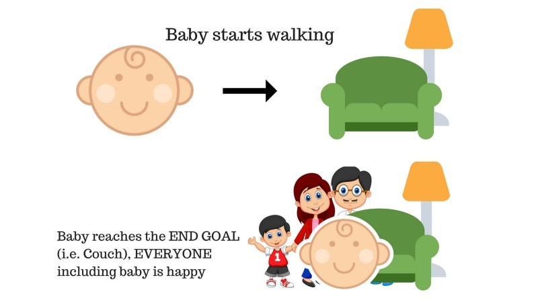
Understand Reinforcement Learning
Let us try to under the working of reinforcement learning with the help of 2 simple use cases:
Case #1
There is a baby in the family and she has just started walking and everyone is quite happy about it. One day, the parents try to set a goal, let us baby reach the couch, and see if the baby is able to do so.
Result of Case 1: The baby successfully reaches the settee and thus everyone in the family is very happy to see this. The chosen path now comes with a positive reward.
Points: Reward + (+n) → Positive reward.

Slide 85
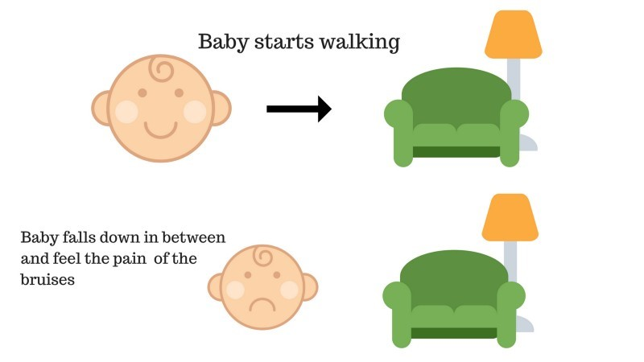
Case #2
The baby was not able to reach the couch and the baby has fallen.
It hurts! What possibly could be the reason?
There might be some obstacles in the path to the couch and the baby had fallen to obstacles.
Result of Case 2: The baby falls to some obstacles and she cries! Oh, that was bad, she learned, not to fall in the trap of obstacle the next time. The chosen path now comes with a negative reward.
Points: Rewards + (-n) →Negative reward.

Slide 86
Types of Reinforcement Learning
Below are the two types of reinforcement learning with their advantages and disadvantages:
1. Positive
When the strength and frequency of the behavior are increased due to the occurrence of some particular behavior, it is known as Positive Reinforcement Learning.
Advantages: The performance is maximized and the change remains for a longer time.
Disadvantages: Results can be diminished if we have too much reinforcement.
2. Negative
It is the strengthening of behavior, mostly because of the negative term vanishes.
Advantages: Behavior is increased.
Disadvantages: Only the minimum behavior of the model can be reached with the help of negative reinforcement learning.

Slide 87
Thank You…!!

