Slide 1
Unit 5 ML Idol MU
Part 1
Machine Learning

Slide 2
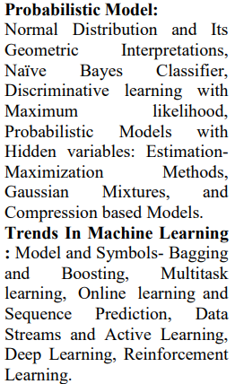
Unit 5 ML Idol MU
Table Of Contents

Slide 3
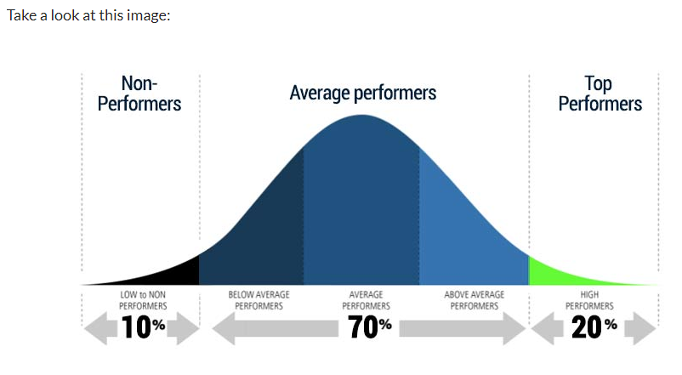

Normal Distribution and Its Geometric Interpretations

Slide 4

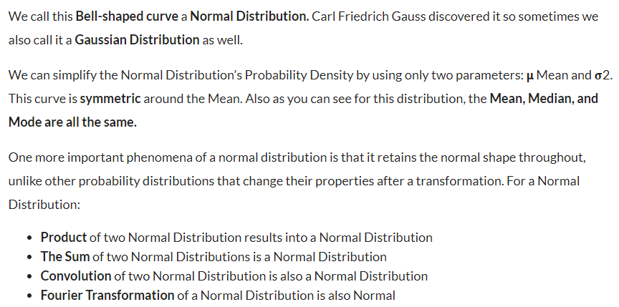
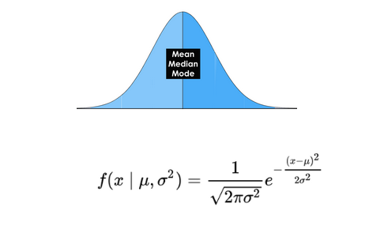

Slide 5
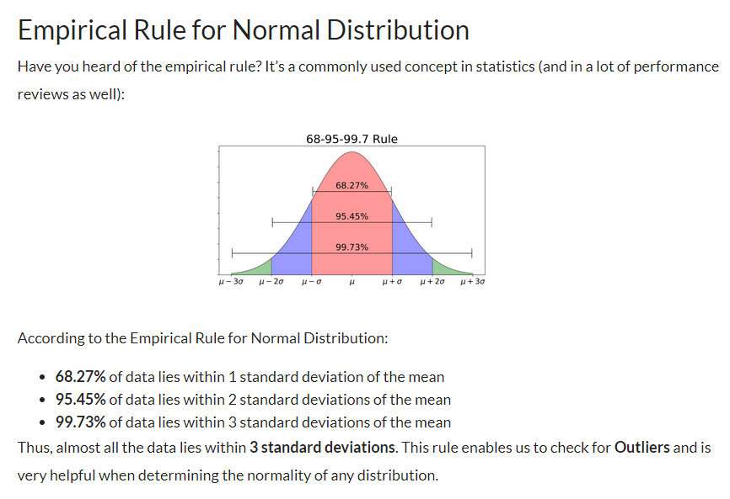

Slide 6
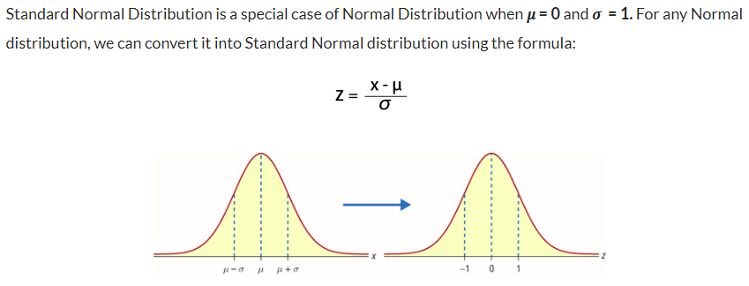



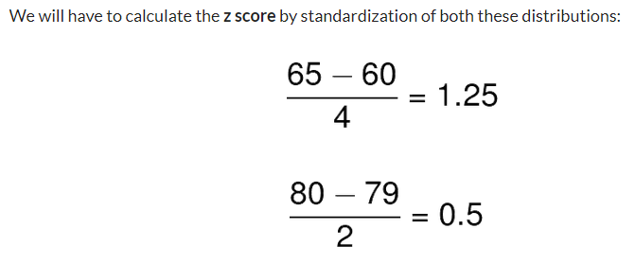

Slide 7
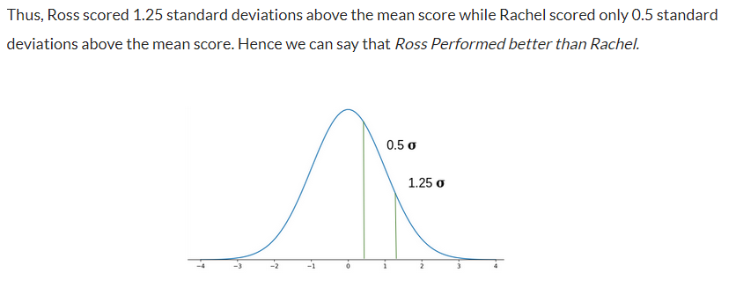

Slide 8
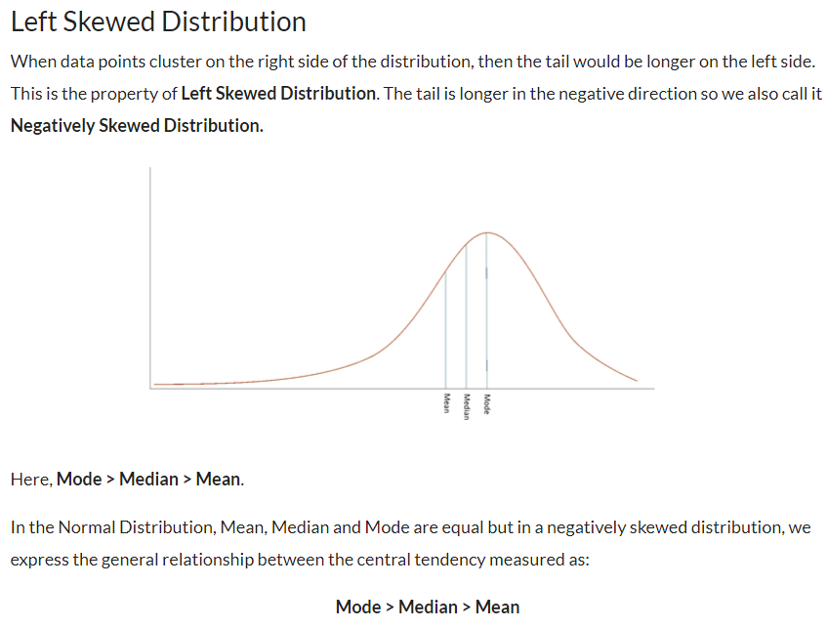

Slide 9
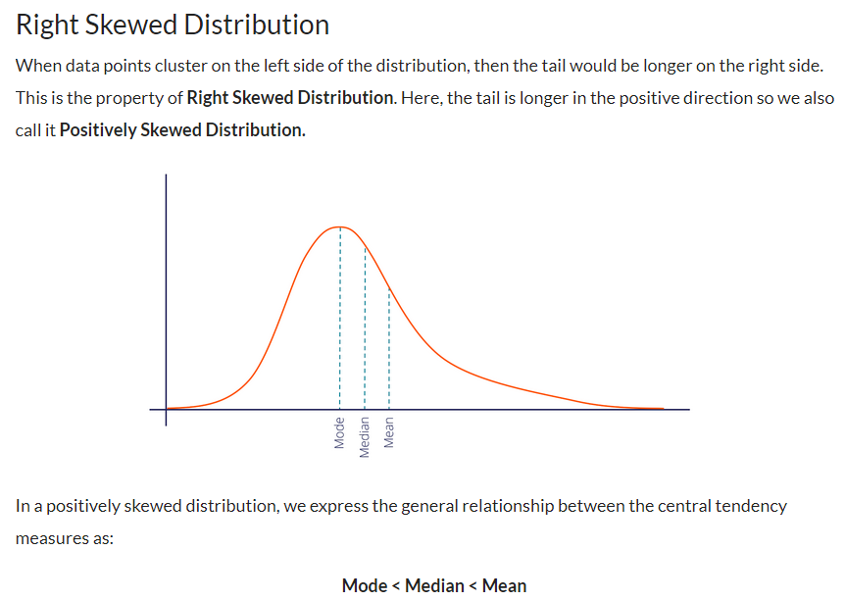

Slide 10


Naïve Bayes Classifier

Slide 11
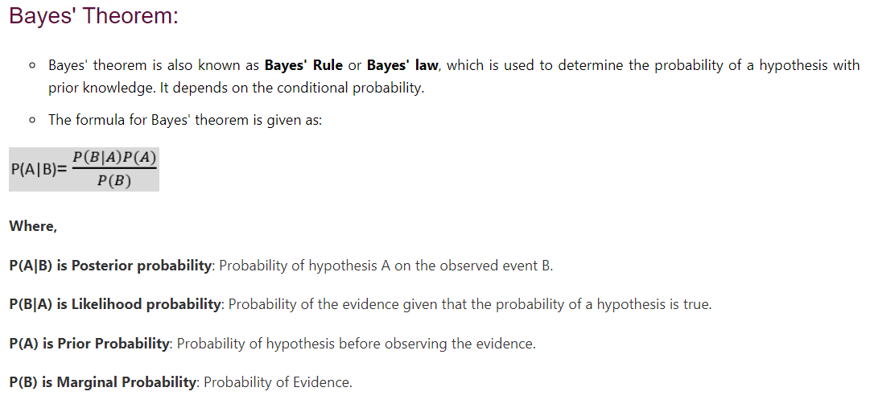

Slide 12





Slide 13

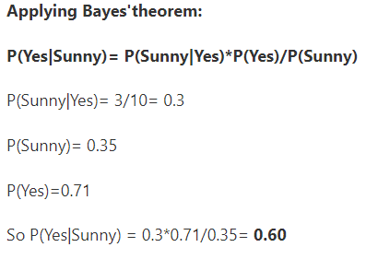
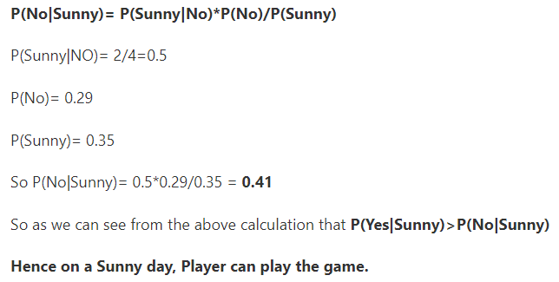

Slide 14
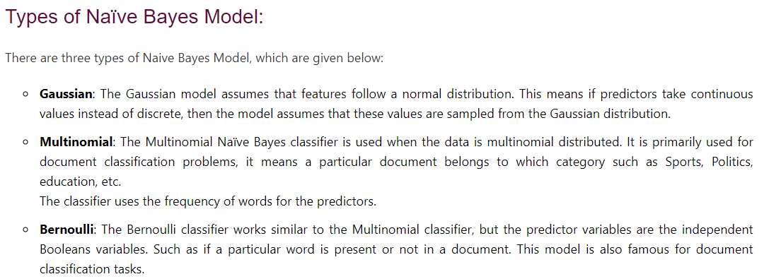

Slide 15
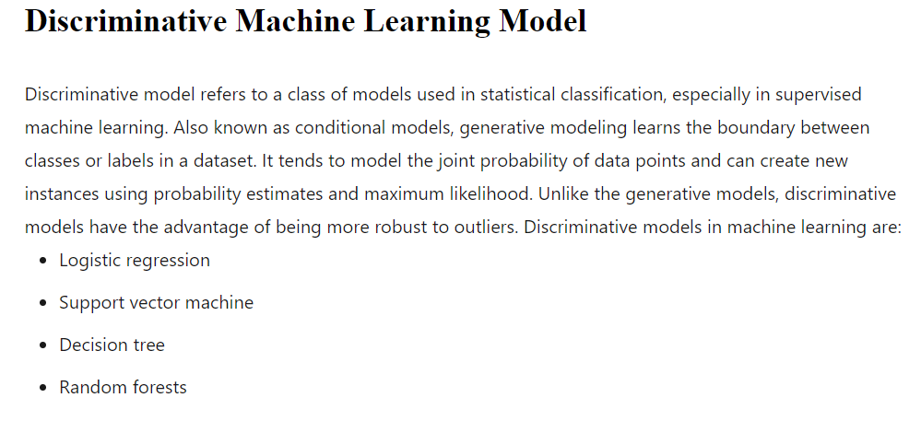
Discriminative learning with Maximum likelihood

Slide 16




Slide 17

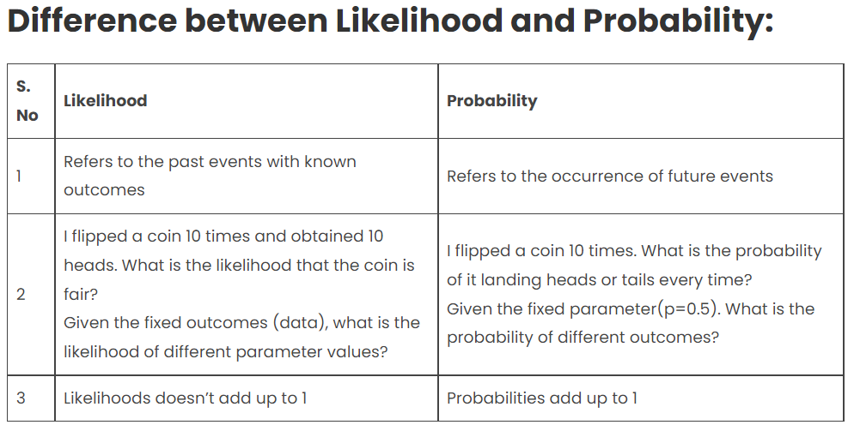

Slide 18




Slide 19





Slide 20



Slide 21



Slide 22



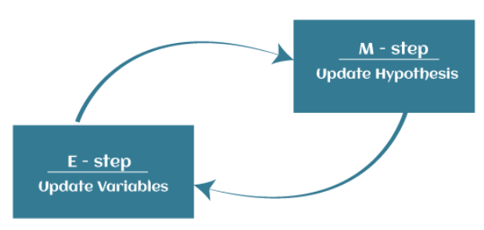

Slide 23



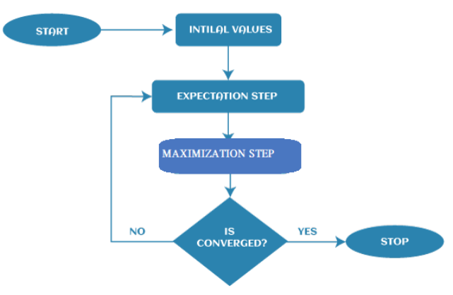

Slide 24
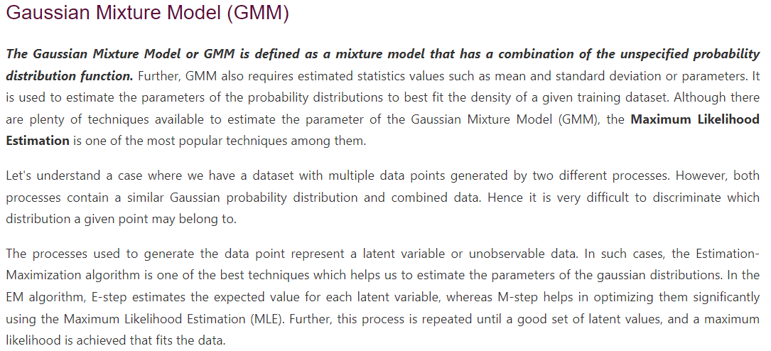

Slide 25
Compression based Models
Important Links:
https://towardsdatascience.com/three-model-compression-methods-you-need-to-know-in-2021-1adee49cc35a
https://xailient.com/blog/4-popular-model-compression-techniques-explained/

