Slide 1
Neural Evidence of Cross-domain
Structural Interaction between
Language and Arithmetic
Bihan Wang, Mengting Jiang, Yixuan Zhu, Zhiyi Chen, Zhekun Zou

Slide 2
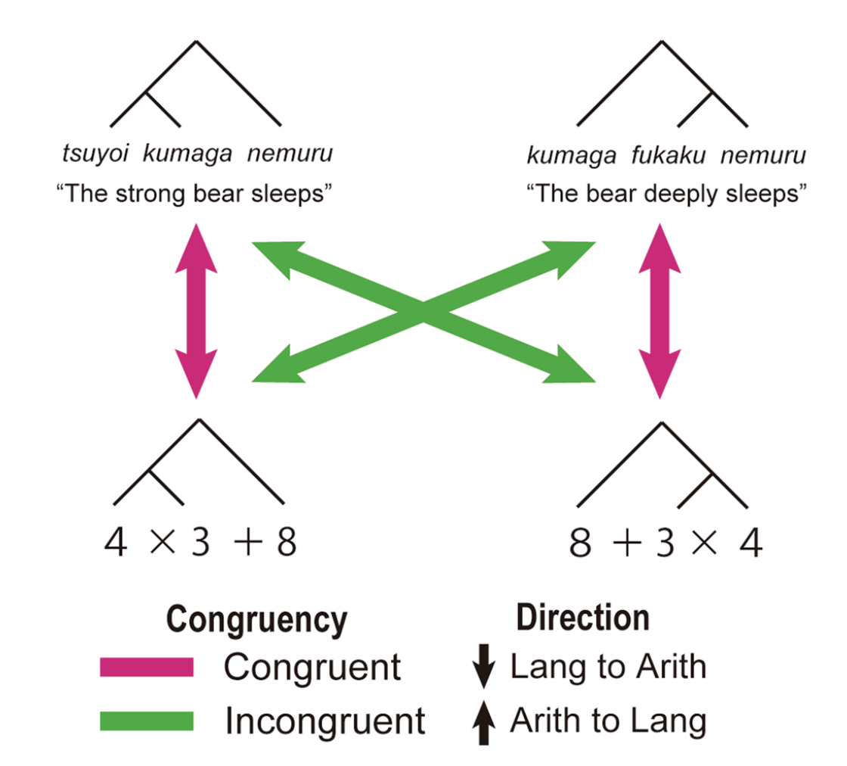
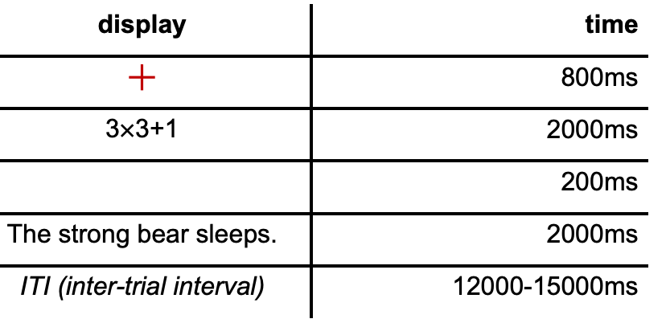
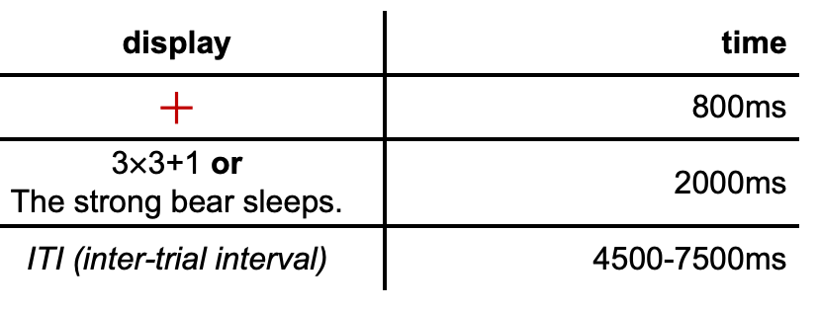
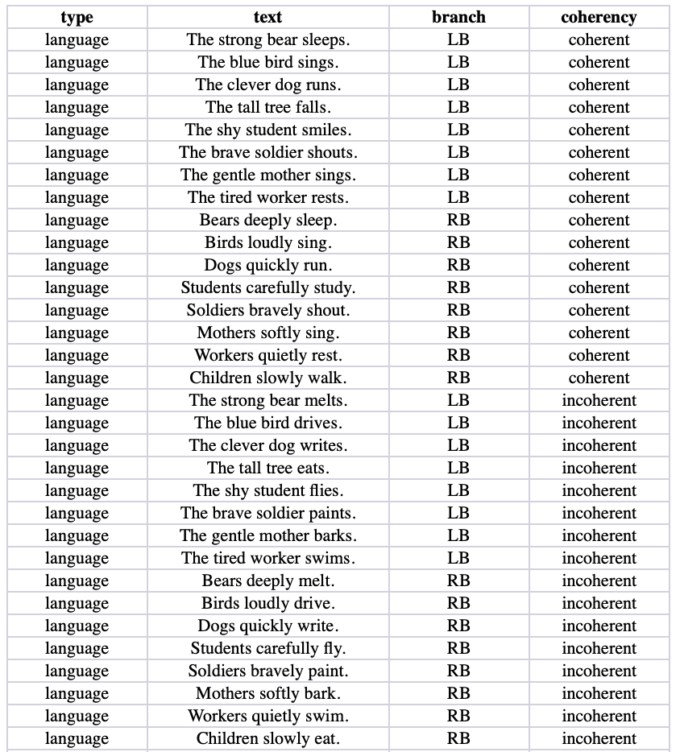
1 Introduction
Repetition Suppression
LB/ RB
32 Language
LB: left branches, [adv., n., vi.]
RB: right branches, [n., adv, vi.]
8 LB √, 8 LB ×
8 RB √, 8 RB ×
standard/ deviant (coherency)
32 Arithmetic
standard:multiplies of 10
deviant: +1/ -1 to standard
Functional Localizer
8 LB √, 8 LB ×
8 RB √, 8 RB ×
congruency
congruent: LB→LB, RB→RB
incongruent: LB→RB, RB→ LB
source: Nakai & Okanoya, 2018
8 L√
8 R√
8 L×
8 R×

Slide 3
2.1 Functions for pairing stimulus
------derangement of repetition suppression and functional localizer------
def derangements_RS(df):
def derangements_FL(df):
------Presenting functions------
def present_instructions(text, key=K_SPACE):
def timed_draw(*stims):
def present_for(*stims, t=1000):
def present_for_wait_key(*stims, t=1000):
# check keyboard while present stimuli
def present_blank(t=200):
def present_ITI(iti_win, text = ''):

Slide 4
2.2 def derangements_RS
split groups
sent_df = df[df.type=='language'].copy()
arith_df = df[df.type=='arithmetic'].copy()
def split_groups(df):
return {
'Lcoh': df[(df.branch=='LB') & (df.coherency=='coherent')].copy(),
'Lincoh': df[(df.branch=='LB') & (df.coherency=='incoherent')].copy(),
'Rcoh': df[(df.branch=='RB') & (df.coherency=='coherent')].copy(),
'Rincoh': df[(df.branch=='RB') & (df.coherency=='incoherent')].copy(),
}
sent_groups = split_groups(sent_df)
arith_groups = split_groups(arith_df)
language to arithmetic
pairs_LangArith = []
a_available = {k: list(v.to_dict('records')) for k,v in arith_groups.items()}
for s_group_name, s_group in sent_groups.items():
s_list = s_group.to_dict('records')
for i, s in enumerate(s_list):
a_group_name = a_group_order[(i // 2) % len(a_group_order)]

Slide 5
32 sentences
--------------------------
32 A-expressions
--------------------------
8 L√
1
8 L√
1
2
3
4
2
3
4
5
6
7
5
6
7
8
8
8 L X
1
8 L X
1
2
3
4
2
3
4
5
6
7
5
6
7
8
8
8 R√
8 R√
1
2
3
1
2
3
4
5
6
4
5
6
7
8
7
8
8 R X
8 R X
1
2
3
1
2
3
4
5
6
4
5
6
7
8
7
8

Slide 6
3 trial: def run_trial_RS
present process
present_for(FIXATION, t=FIXATION_DURATION)
key_1, rt_1 = present_for_wait_key(stim1, t=STIMULUS_DURATION)
present_blank(t=BLANK_DURATION)
key_2, rt_2 = present_for_wait_key(stim2, t=STIMULUS_DURATION)
present_for_wait_key:
record the pressed key and reaction time of participants
record the keys
if direction == 'Lang->Arith':
lang_RT = rt_1
arith_RT = rt_2
lang_key = 'none'
arith_key = 'none'
if key_1:
lang_key = key_map[key_1]
if key_2:
arith_key = key_map[key_2]
else:
......
record data
exp.data.add([session, trial, direction, congruency,'language', language_text, language_branch, language_coherency, lang_RT, lang_key,'arithmetic', arithmetic_text, arithmetic_branch, arithmetic_coherency, arith_RT, arith_key])

Slide 7
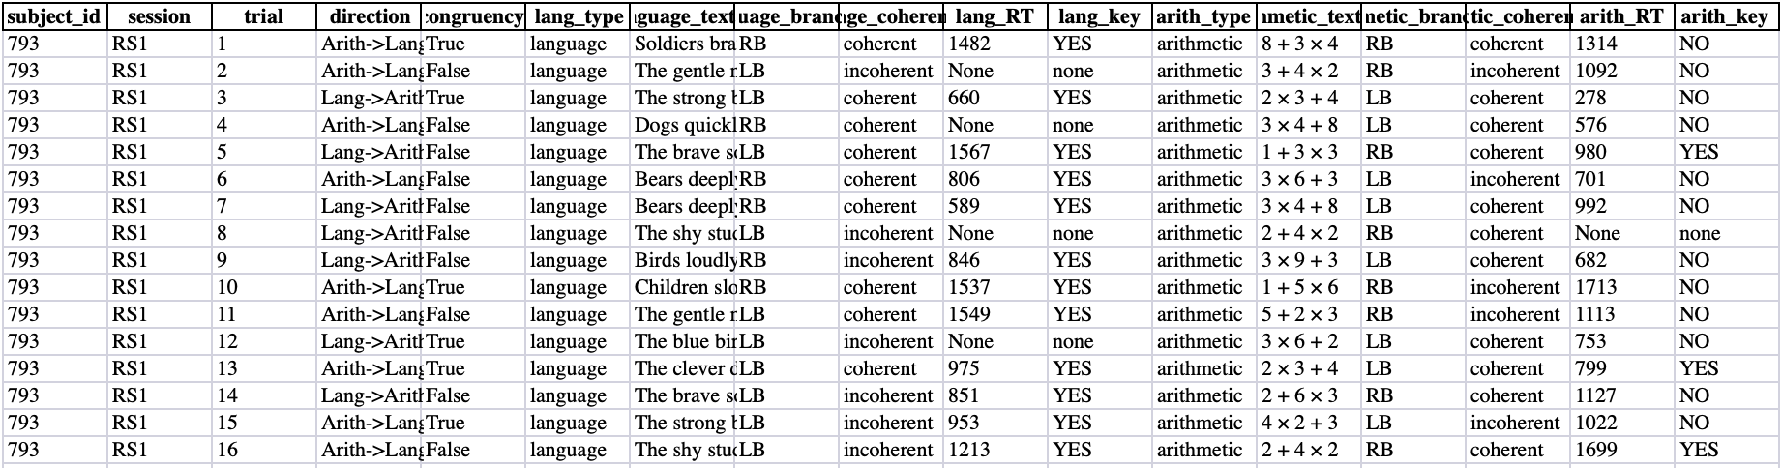
4 Main Experiment: result

