Slide 1
Variable Prediction: K-Nearest Neighbours algorithm
One of the methods we used for the predictions is the K-Nearest Neighbour algorithm. In order to predict an arbitrary variable, the other six are used. Implementation:
Analysing the nearest neighbours of the six-dimentional points (corresponding to the six known variables) from the traning set of dimention T
Applying these indeces and distances to the seventh variable

Slide 2
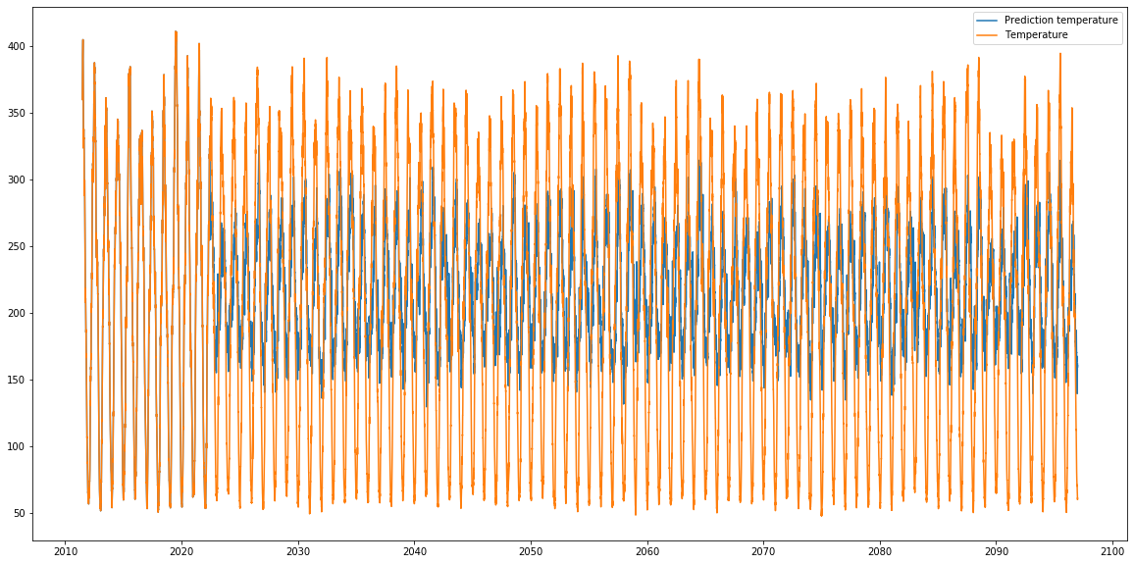
Variable Prediction: K-Nearest Neighbours algorithm
Best performance the variables:
Temperature (figure below)
Surface Radiation

Slide 3
Model Prediction: K-Nearest Neighbours algorithm
Purpose: given all of the variables in one model, predict them for another model
Same procedure as before, this time applied to two seven-dimentional vectors
Low Performance: it seems that this method is not very accurate in model prediction

