Slide 2

Deep-dive in pre- and post-processing HYDROLIB-core
DSD-INT 2024
Prisca van der Sluis
Naam Achternaam

Slide 3
This breakout session
Introduction to HYDROLIB-core
Simple demo
Exercises: modelling Magdalena

Slide 4





What does HYDROLIB-core offer?
Functionality
Reading, writing, manipulating and validating D-HYDRO input files
Basis for pre- and postprocessing tools for (automated) modelling workflows
Specifications
Written in Python
Installable via pip
Runs on Windows and Linux
Hosted on GitHub
https://github.com/Deltares/HYDROLIB-core

Slide 5
Hydrolib-core acts as a wrapper around kernel files
Supported D-HYDRO kernels:
Flow FM (1D2D3D)
Rainfall runoff
Each file has one corresponding class.
Each file class contains several attributes that collectively represent the content of the file.

Slide 6

Kernel files hierarchy
Hydrolib-core hierarchy
Model definition file
Root model object
Model
file
A
Model
file
B
Model
file
C
Model
object
A
Model
object
B
Model object
C
…
…
…
…
…
…
Property X
Property Y
Property Z
class ModelObjectC:
X
Y
Z

Slide 7
Flow FM Kernel files
Hydrolib-core Flow FM representation
MDU file
Flow FM model
External
forcing file (EXT)
Network file
(NC)
Structure file
(INI)
Ext
model
Network
model
Structure
model
BC
BC
BC
Forcing
model
Forcing
model
Forcing model
[General]
fileVersion = … fileType = …
[Structure]
id = …
name = …
branchId = …
chainage = …
type = …
…
class StructureModel:
general:
StructureGeneral
structure:
List[Structure]
class StructureGeneral:
fileversion: str
filetype: str
class Structure:
id: str
name: str
branchid: str
chainage: float
type: str
…

Slide 8
Hydrolib-core Flow FM representation
Flow FM model
Save
Load
Show tree
Ext
model
Network
model
Structure
model
Forcing
model
Forcing
model
Forcing model
class StructureModel:
general:
StructureGeneral
structure:
List[Structure]
class StructureGeneral:
fileversion: str
filetype: str
class Structure:
id: str
name: str
branchid: str
chainage: float
type: str
…

Slide 9
Demo time

Slide 10
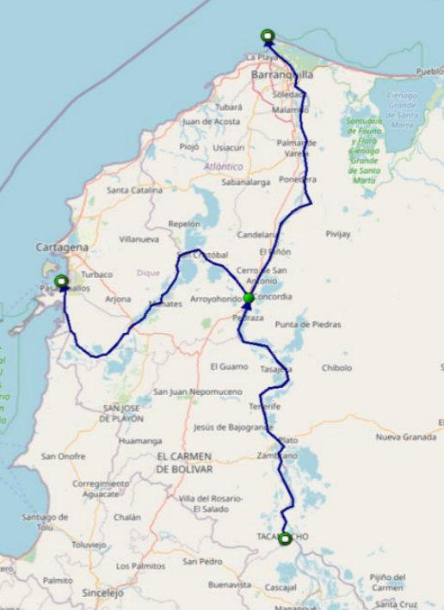
Modelling the Magdalena river
Longest river in Columbia, South America
949 miles/1528 km
Canal del Dique: artificial canal
Workbook:
magdalena_workbook_exercises.ipynb

