Slide 1
MeshKernel

Slide 2
MeshKernel in C++: Outline
Motivation
  Gridgeom in Fortran
  Why re-writing?
  Why using C++?
    Several examples from a developer perspective.
Results:
  Performance of mesh administration
  Performance of mesh orthogonalization.
  Code metrics.
Conclusions
Demo
  Orthogonalize a mesh in the Grid Editor using Gridgeom++ and interactor.
  Renaming a method using ReSharper.
<number> of 9

Slide 3
Motivation
Making a library of the interactor mesh editing functionalities:
  Orthogonalization/ smoothing.
  Generation of curvilinear meshes.
  Making unstructured and structured meshes in polygons.
  Manual editing of edges/nodes.
  Visualization of mesh quality.
  …
For some of the algorithms interactivity is required:
  Show the progress of mesh generation and stop when needed.
  Visualize problematic nodes during algorithm execution.
With the current Fortran code it is difficult to make a library which can be consumed by the Grid Editor and meet the following requirements:
  Interactivity and clean algorithms. In the current state, visualization code is embedded into the numerical code.
  Supporting multiple mesh instances: interactor data modules are not designed for it.
<number> of 9

Slide 4
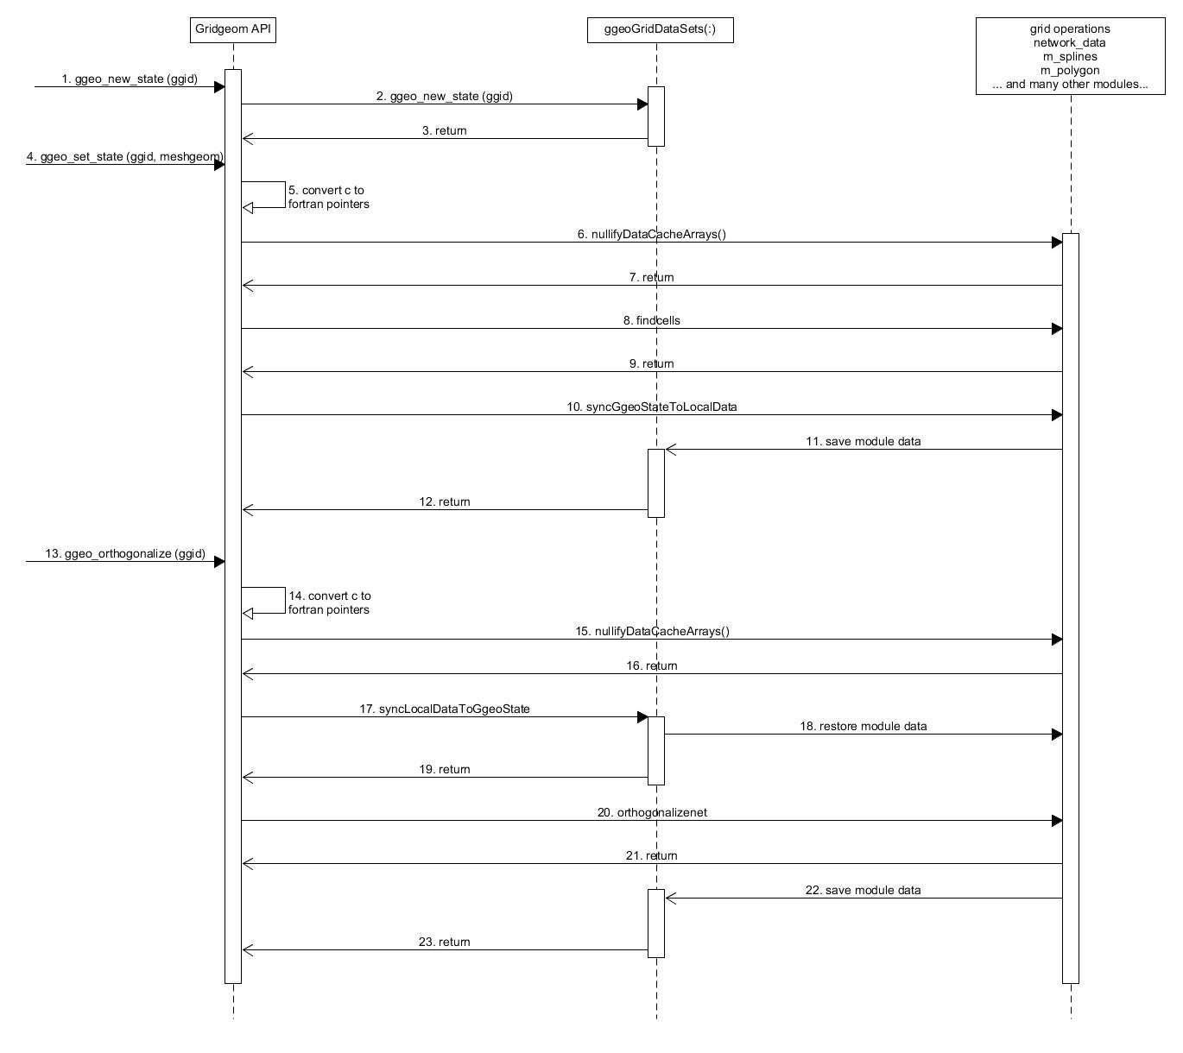
Gridgeom in Fortran
Snapshots of the module variables are saved when exiting every function in a separate container.
The snapshot is restored when entering a function to re-create the needed variables.
Visualization of the mesh during its generation is not possible, only when the algorithm has finished.
<number> of 9

Slide 5
Motivation: why re-writing?
For building a proper library of the interactor mesh editing functionalities:
  Computational code should not contain calls to interactor GUI.
  Algorithms can be split into parts, so any client can support interactivity, not just interactor.
For improving the code quality:
  Self-explanatory variable names.
  Consistent naming conventions and capitalizations.
  Improve modularity without sacrificing performance (object oriented design).
  Reduce compilation time by splitting large files.
  Introduce cross-platform unit tests (Google tests).
  Introduce a cross-platform building system (CMake).
<number> of 9

Slide 6
Motivation: why using C++
Performance-wise C++ is not inferior to Fortran:
  Writing performant C++ code does not require pointers, use std::vectors and references instead!
Better communication with C based languages (such as C#)
  No need to convert C pointers to Fortran pointers.
C++ supports things we typically re-write ourselves:
  Data structures
    Vector and related methods (e.g. vector re-allocation)
    Strings and related methods
    Hash tables and hash functions
  Algorithms
    Sorting (quick sort, hash sort, etc..)
    Finding
  Templates (no python scripting required to generate code)
    Avoid code repetition for different data types
Algorithms in C++ are more concise than Fortran: variables are declared where used, no need for a separate definition part.
C++ support for code productivity tools is much better than Fortran:
  ReSharper: renaming of variables in all source files is a matter of seconds.
  Visual Studio natively supports C++ intellisense and autocompletion (no need for Fortran Navigator).
Short-circuit evaluation.
It is easier to write header files to reduce compilation time.
<number> of 9

Slide 7
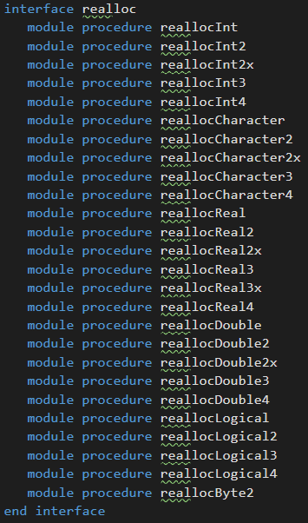
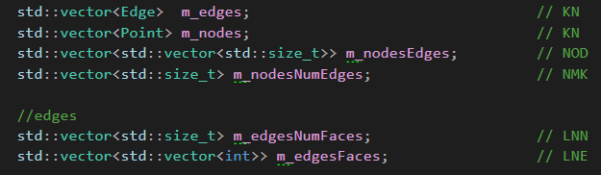
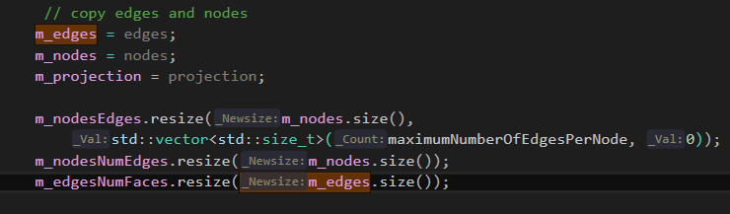
Motivation for C++: realloc and vector<T>::resize()
Fortran:
malloc.f90 : 46 procedures to reallocate arrays of different sizes and types written by ourselves.
3400 lines of code to maintain.
C++:
vector<T>, where T is any type.
0 lines of code (LOC) to maintain, rely on vector<T>::resize() method.
Any dimensionality is supported.
“If n is greater than the current container size, the content is expanded by inserting at the end as many elements as needed to reach a size of n.”
<number> of 9
Notes:
If keepexisting=false, std::clear() can be used before!

Slide 8
Motivation for C++: many useful algorithms are part of the language
Functionality | Fortran (loc = lines of code) | C++
String manipulations | string_module.f90 (853 loc) | string class and algorithms transform(s.begin(), s.end(), sl.begin(), ::tolower);
sorting algorithms | sorting_algorithms.f90 (200 loc) | quicksort sort(s.begin(), s.end());
linear search | about 5 loc | find(s.begin(), s.end(), element)
binary search | xbeach_interp.f90 (50 loc) | binary_search(s.begin(), s.end(), element)
hash tables | hash_search.f90 (384 loc) | unordered_map<T, T>
trees | tree_struct.f90 (800 loc) | map<T, T>
“C++ was designed so that every language feature is usable in code under severe time and space constraints” (Stroustrup, 1994)
<number> of 9
Notes:
If keepexisting=false, std::clear() can be used before!

Slide 9
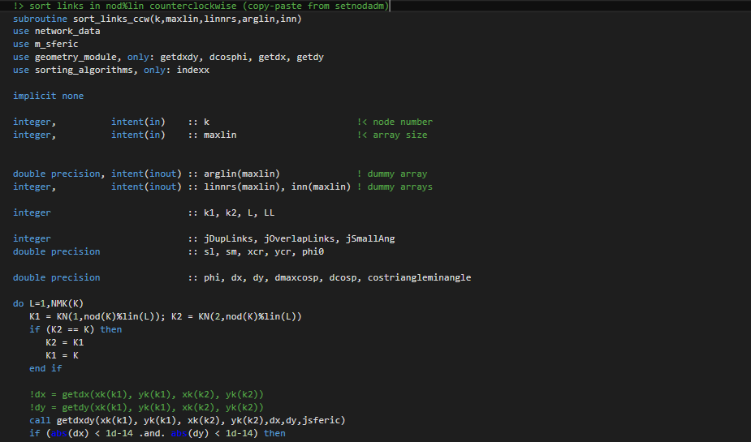
Motivation for C++: DFlow-FM style
All names are clear only after years of experience.
The scope of the variables is the entire function body and beyond.
Mixed-use of upper/lower cases.
The code is longer.
Sometimes code is dead or commented.
<number> of 9

Slide 10
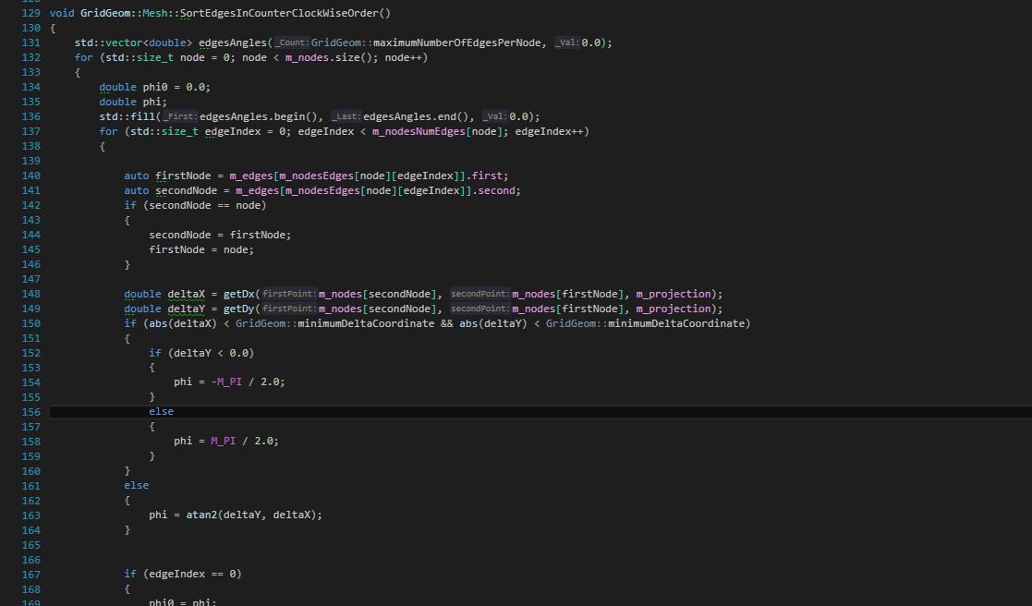
Motivation: Gridgeom++ style
Meaningful names.
Scope of variables as limited as possible, unless expensive memory reallocation is required.
Better coding style.
<number> of 9

Slide 11
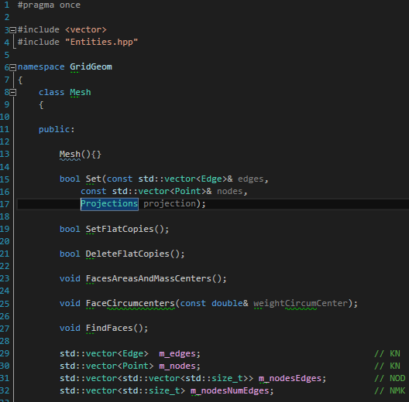
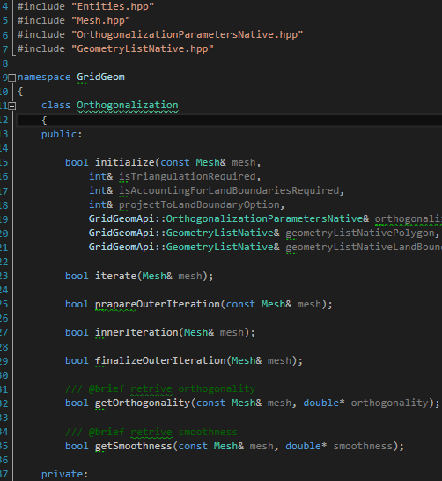
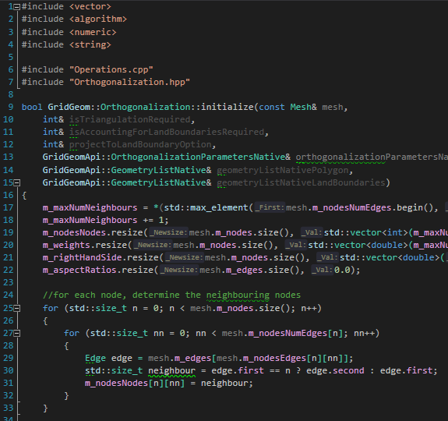
Motivation: in C++ it is easier to write interfaces!
Reducing compilation time for large code-base.
Interactor: De-couple data from methods. Drawbacks: it is difficult to group all functions that change the data (no encapsulation).
C++ standards: Couple data and methods in modules/objects. Method signatures are declared in header files (.hpp), implementations in separate .cpp files. Dependent code only includes the header files, not .cpp files!
Mesh.hpp
Orthogonalization.hpp
Orthogonalization.cpp
<number> of 9
Notes:
If keepexisting=false, std::clear() can be used before!

Slide 12
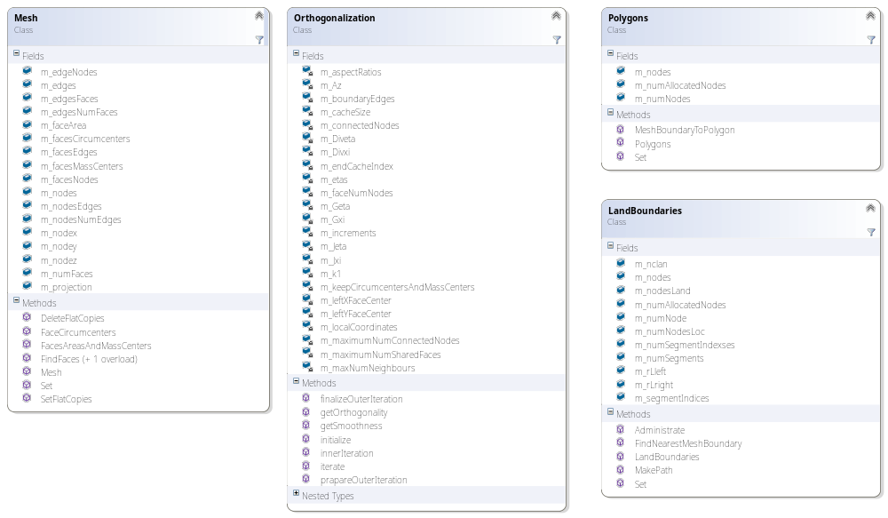
Motivation for re-writing: separate the responsibilities in classes
<number> of 9

Slide 13
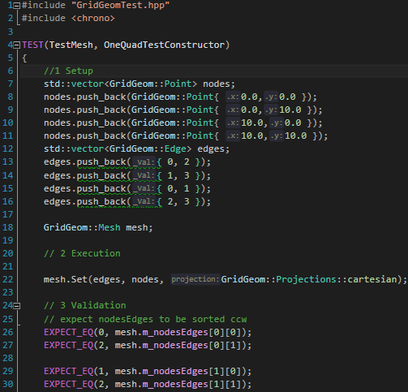
Motivation for re-writing: introduce unit-tests (1)
Test suite, Test name
Test setup
Function/method to test (node admin and find cells)
Check if internal mesh data is correct
<number> of 9

Slide 14
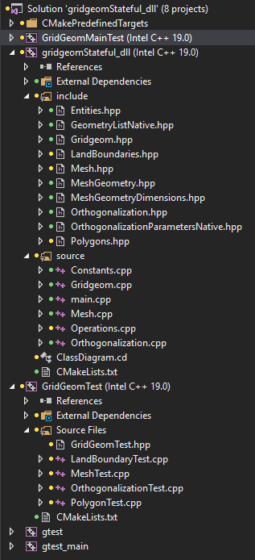
Motivation for re-writing: introduce unit-tests (2)
Application (.exe) project
Library project
Header files
Implementation files
Unit test project
Unit test files, one for each class
<number> of 9

Slide 15
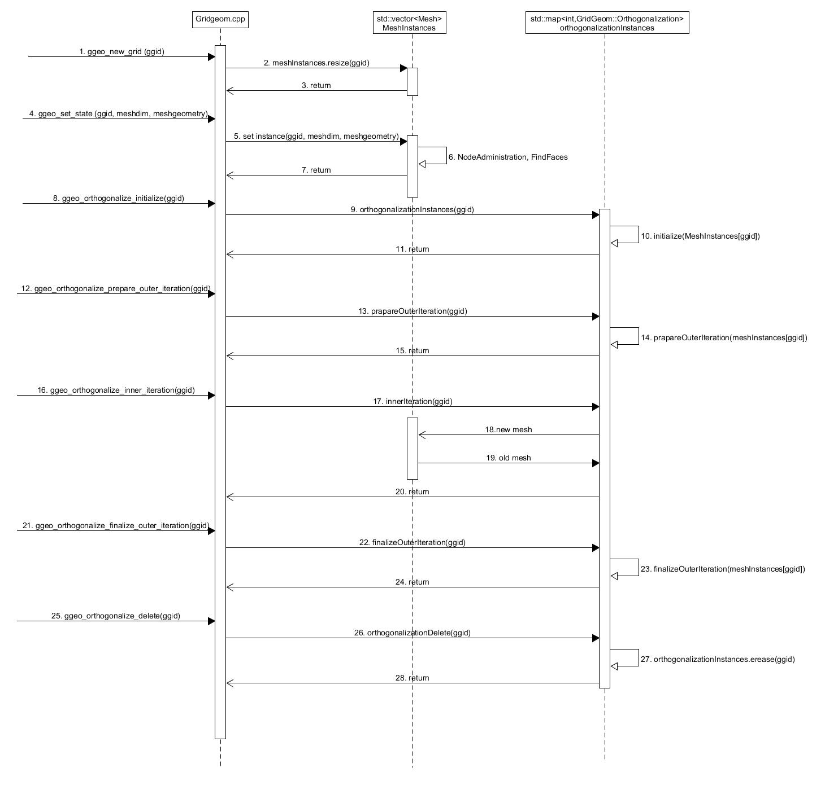
Gridgeom++
The library stores a vector of meshes.
No need for synchronization of module variables, everything we need is encapsulated in the mesh class!
The orthogonalization algorithm is split into parts, so clients can retrieve the mesh state during the iterations.
<number> of 9

Slide 16
Gridgeom++
Results: mesh administration and orthogonalization++
<number> of 9

Slide 17
Mesh administration test, finding a million of squared faces on a regular mesh.
1000 x 1000 mesh | Single thread | Settings
DFlowFM interactor | 1,58 s | Intel Fortran (timing measured by Sander)
Gridgeom++ | 1,21 s | Visual C++ compiler
Gridgeom++ | 1,11 s | Intel C++ compiler
Timings are calculated averaging a set of three runs.
Remark: folded cells and isolated edges are not yet accounted for in Gridgeom++!
<number> of 9

Slide 18
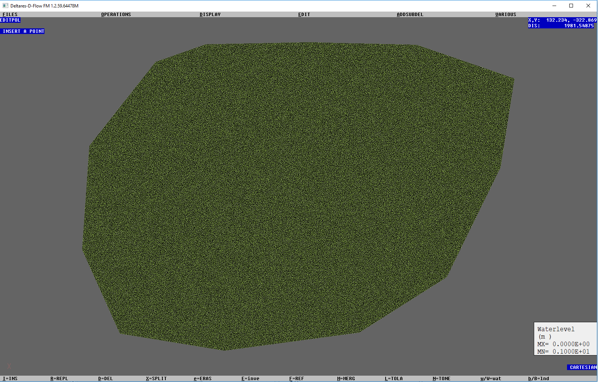

Orthogonalization test
185 939 nodes
370 681 triangular faces
Snapping to the original mesh boundary
Gridgeom++
Interactor
<number> of 9

Slide 19
Orthogonalization test: 370 681 triangles
370 681 triangular faces, unstructured mesh | Single thread | Multithreading (8 OMP threads) | Settings
DFlowFM interactor, disabled rendering | 17,32 s | 10,19 s | Intel Fortran
Gridgeom++ | 19,59 s | 8,91 s | Visual C++ compiler, algorithm not changed
Gridgeom++ | 18,45 s | 8,78 s | Intel C++ compiler, algorithm not changed
Gridgeom++ | 8,14 s | 5,25 s | Intel C++ compiler, improved memory access
Multithreading is applied to the inner-most orthogonalization loop over the nodes.
Timings are calculated averaging a set of three runs.
Intel compiler brings between 2 to 6% speedup (do we need Intel?).
Unit tests are used to check the validity of the results after refactoring (e.g. in last row code was refactored)
<number> of 9

Slide 20
How long do I need to wait to re-compile when a line is changed?
Scenario | dflowfm.exe | GridgeomMainTest.exe
A line in the orthogonalization code is changed | 50 s (ORTHOGONALISENET) | 3 s (orthogonalization.cpp)
DFlowFM project recompiles a long net.f90 file!
Long compilation times tend to make developers unfocused.
<number> of 9

Slide 21
Code metrics: line of code
Functionality | Interactor | Gridgeom++
Mesh administration | 1497 (Setnodeadmin + findcells with findtris, findquads, etc…) | 542 (mesh.cpp + mesh.hpp)
Orthogonalization | 3387 (ORTHOGONALISENET and related functions) | 1918 (Orthogonalization.hpp + Orthogonalization.cpp)
<number> of 9

Slide 22
Conclusions
General:
  C++ is as efficient as Fortran for mesh editing (and can be better with multithreading):
    Maybe for other computational problems as well.
  In C++ it is easier to write code that can be unit tested.
    Unit tests increase confidence in the functional behavior of the code.
    Code refactoring is backed up by unit tests.
  In C++ we can rely on robust libraries for data structures and algorithms.
    Less code to maintain.
  C++ implementations are usually more concise than Fortran implementations.
For developers:
  Easier to separate definitions from implementations and decouple large codebases = faster compilation time, even with objects.
  Easy to make class diagrams from code.
  Better productivity tools to write code
    ReSharper C++: code renaming, searching and more.
    Intellisense and automatic code completion is supported natively by Visual Studio.
<number> of 9

Slide 23
Demo
Orthogonalize a mesh in the Grid Editor using Gridgeom++:
  Speed
  Interactivity
Rename a method in all files using ReSharper.
<number> of 9

Slide 24
How I ported Fortran code to C++: architectural choices
Setting up a unit test environment to debug the functions one by one
  Check correctness
  Measuring speed
Conceptual separation of the code in classes:
  Mesh (e.g. FindFaces, FacesAreasAndMassCenters..)
  Polygons (e.g. MeshBoundaryToPolygon)
  Land boundaries (IsMeshEdgeCloseToLandBoundaries, MakePath, etc…)
  Splines
Separation of class definition from class implementation: reduce compile time dependency.
Built an API layer on top of the classes. Static dictionaries are used to map each view instance to the appropriate class instance (high level operation, no measurable performance loss).
Used the same simple programming paradigm of DFlowFM: flat and contiguous arrays:
  Allocatable arrays -> std::vector : dynamic arrays that do not expose pointers directly (no need for malloc/free or new/delete), contiguous memory
  Preallocation as in Fortran code
<number> of 9

Slide 25
C++, improvements
Algorithms on containers:
  Example SortEdgesInCounterClockWiseOrder/Sort_links_ccw
  Array reallocation: GridGeom::Mesh::Set/ INCREASENETW
Templates:
  Code reusability: GOLDDIS is a root finder algorithm with an hard-coded spline function. In GridGeom the generic part is separated from the spline part. Compiler injects the function when making the executable to avoid function calls.
Meaningful names
Removing of dead code:
  get_heights
Removing of code repetition:
  comp_gridheights
  Find cells: FINDTRIS, FINDQUADS, FINDPENTAS, FINDHEXAS, etc…
<number> of 9

Slide 26
Pictures
n + 1
n
n-1
<number> of 9

Slide 27
Pictures
n + 1
n
n-1
<number> of 9

Slide 28
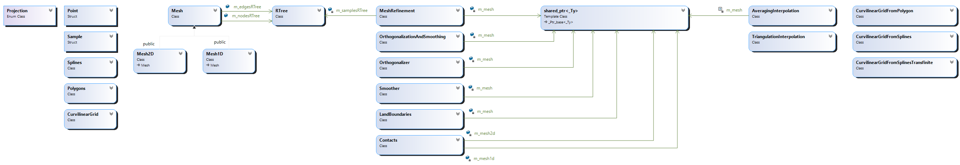
Class diagram
Enumerations
Base geometrical types
Meshes
Spatial trees
Mesh modifiers
Reference to mesh (as shared pointers)
Interpolators
Curvilinear grids
<number> of 9

Slide 29
Land boundary algorithm
1. Segmentation of the land boundary by selecting the nodes inside the polygon and close to the mesh boundary.
<number> of 9

Slide 30
Land boundary algorithm
2. Flag the nodes and the edges close to the segmented land boundary.
<number> of 9

Slide 31
Land boundary algorithm
3. Identify the start and the end mesh nodes representing the land boundary on the mesh.
<number> of 9

Slide 32
Land boundary algorithm
4. Connect the start mesh node to the end mesh node for representing the land boundary on the mesh (using Dijkstra’s algorithm).
<number> of 9

Slide 33
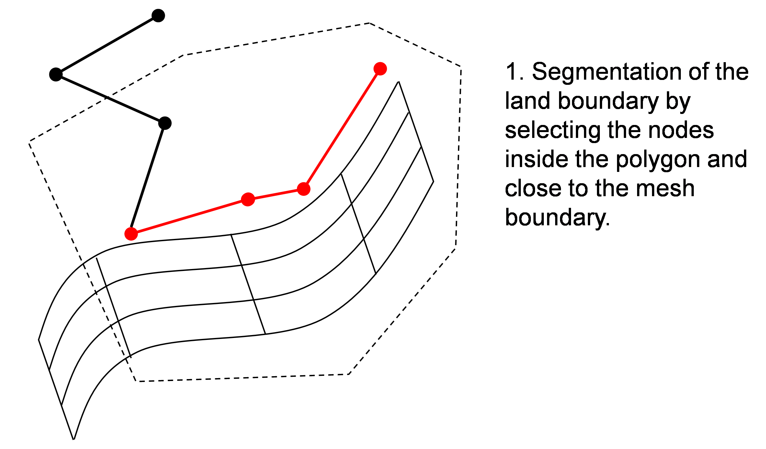
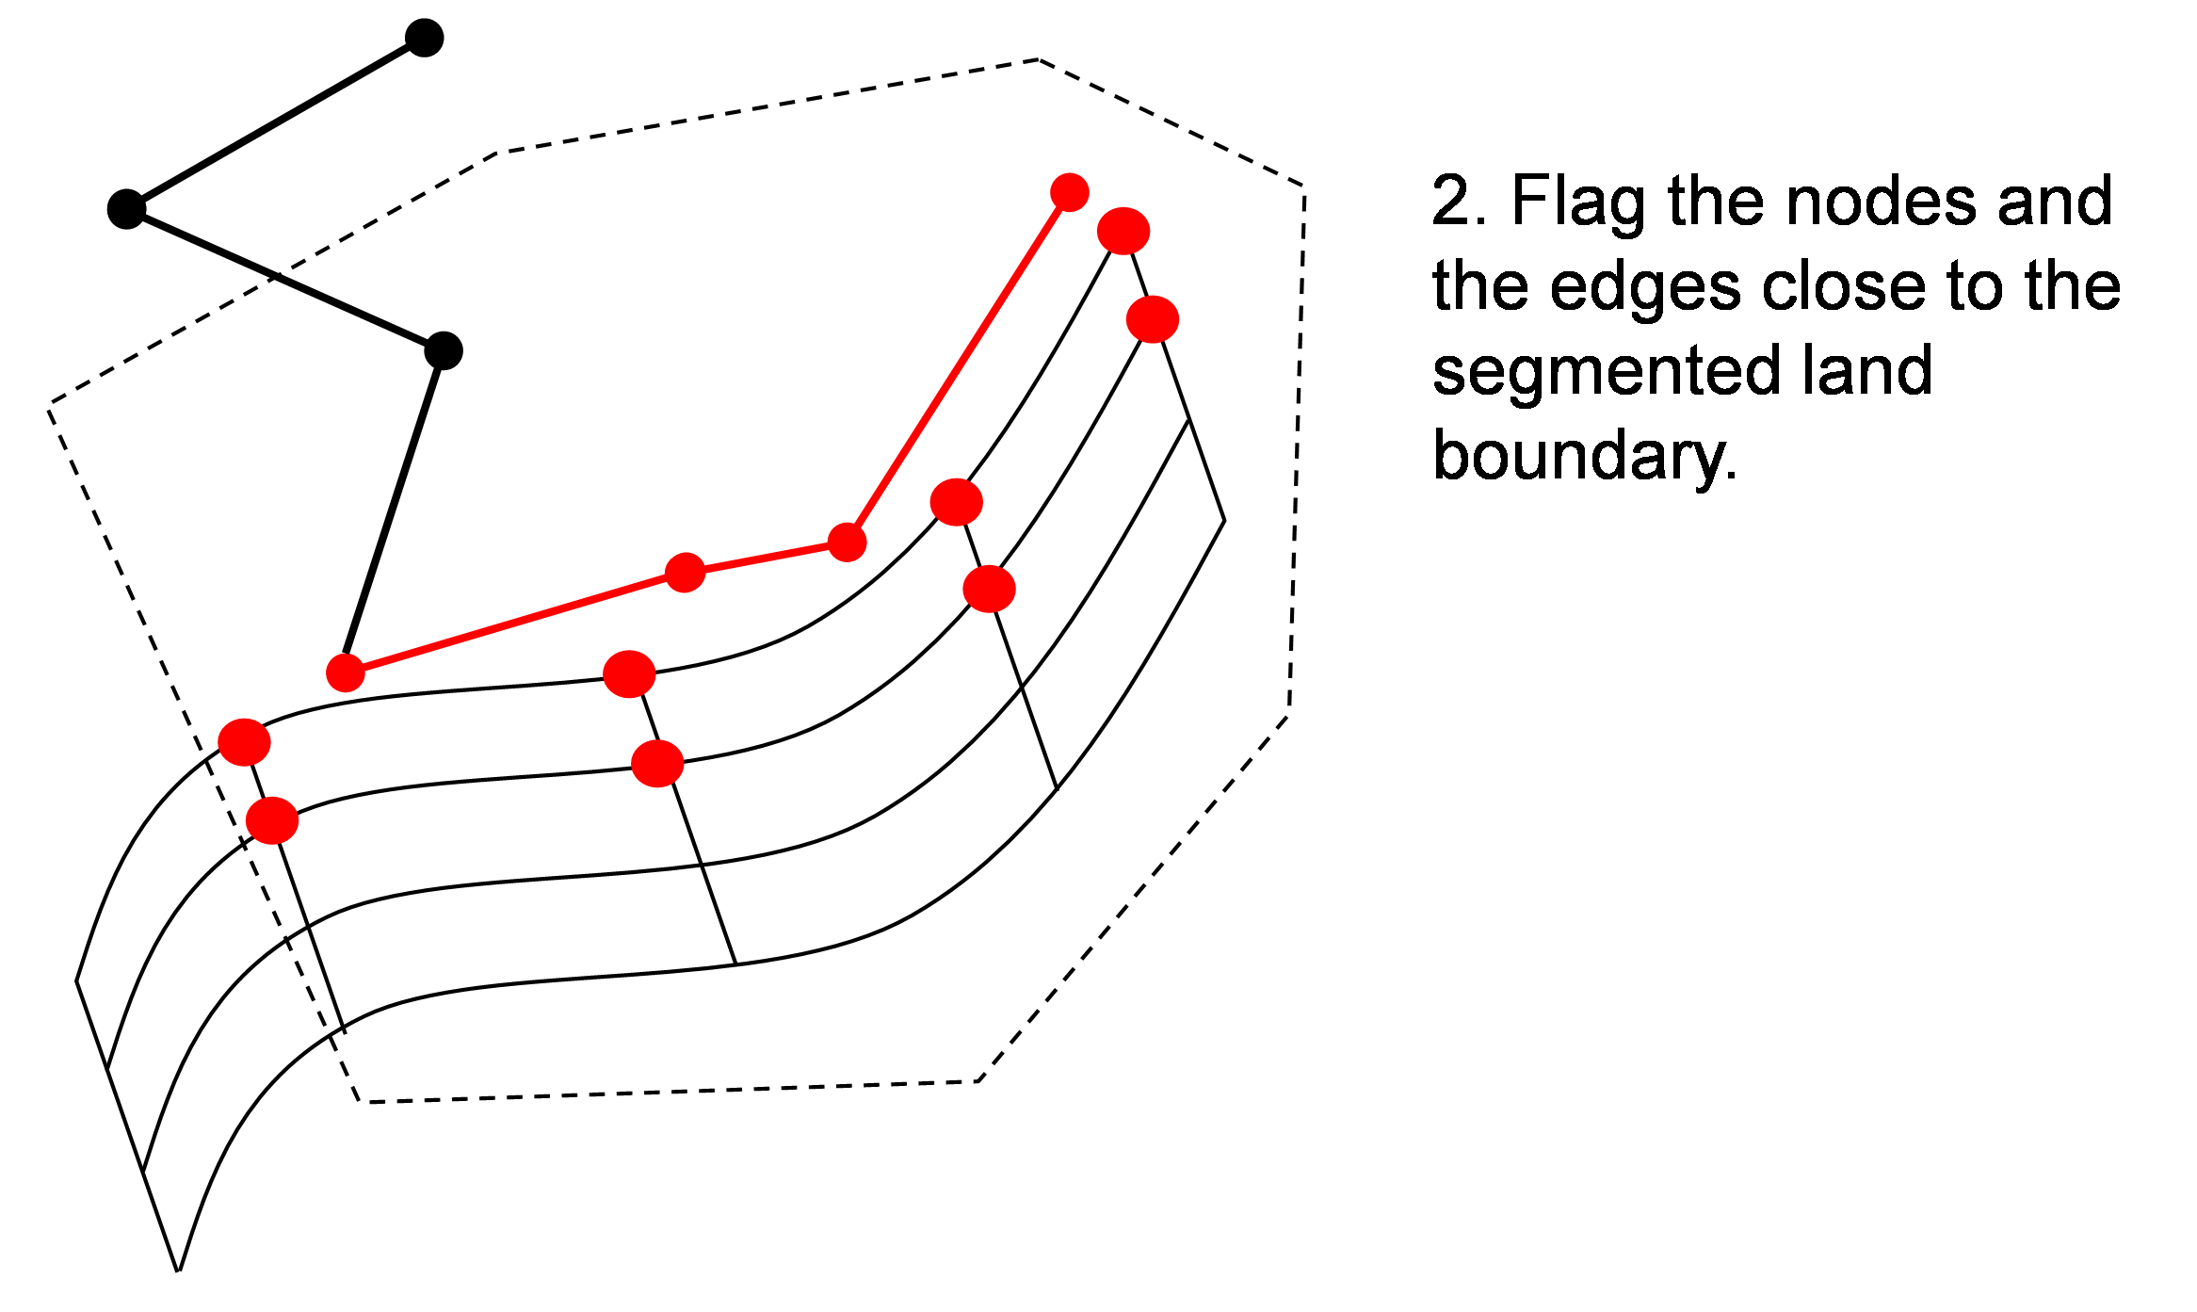
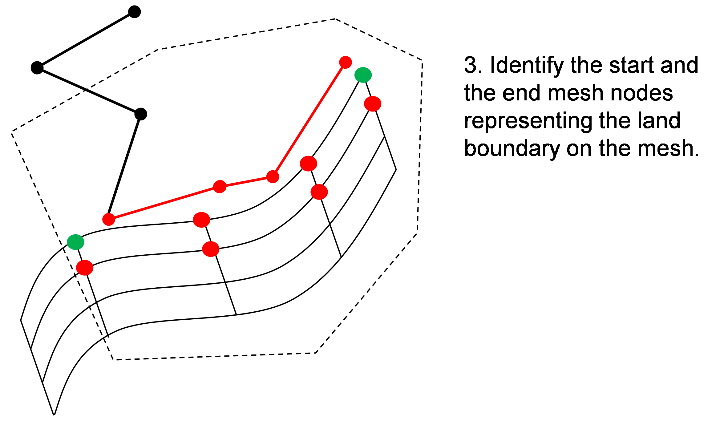
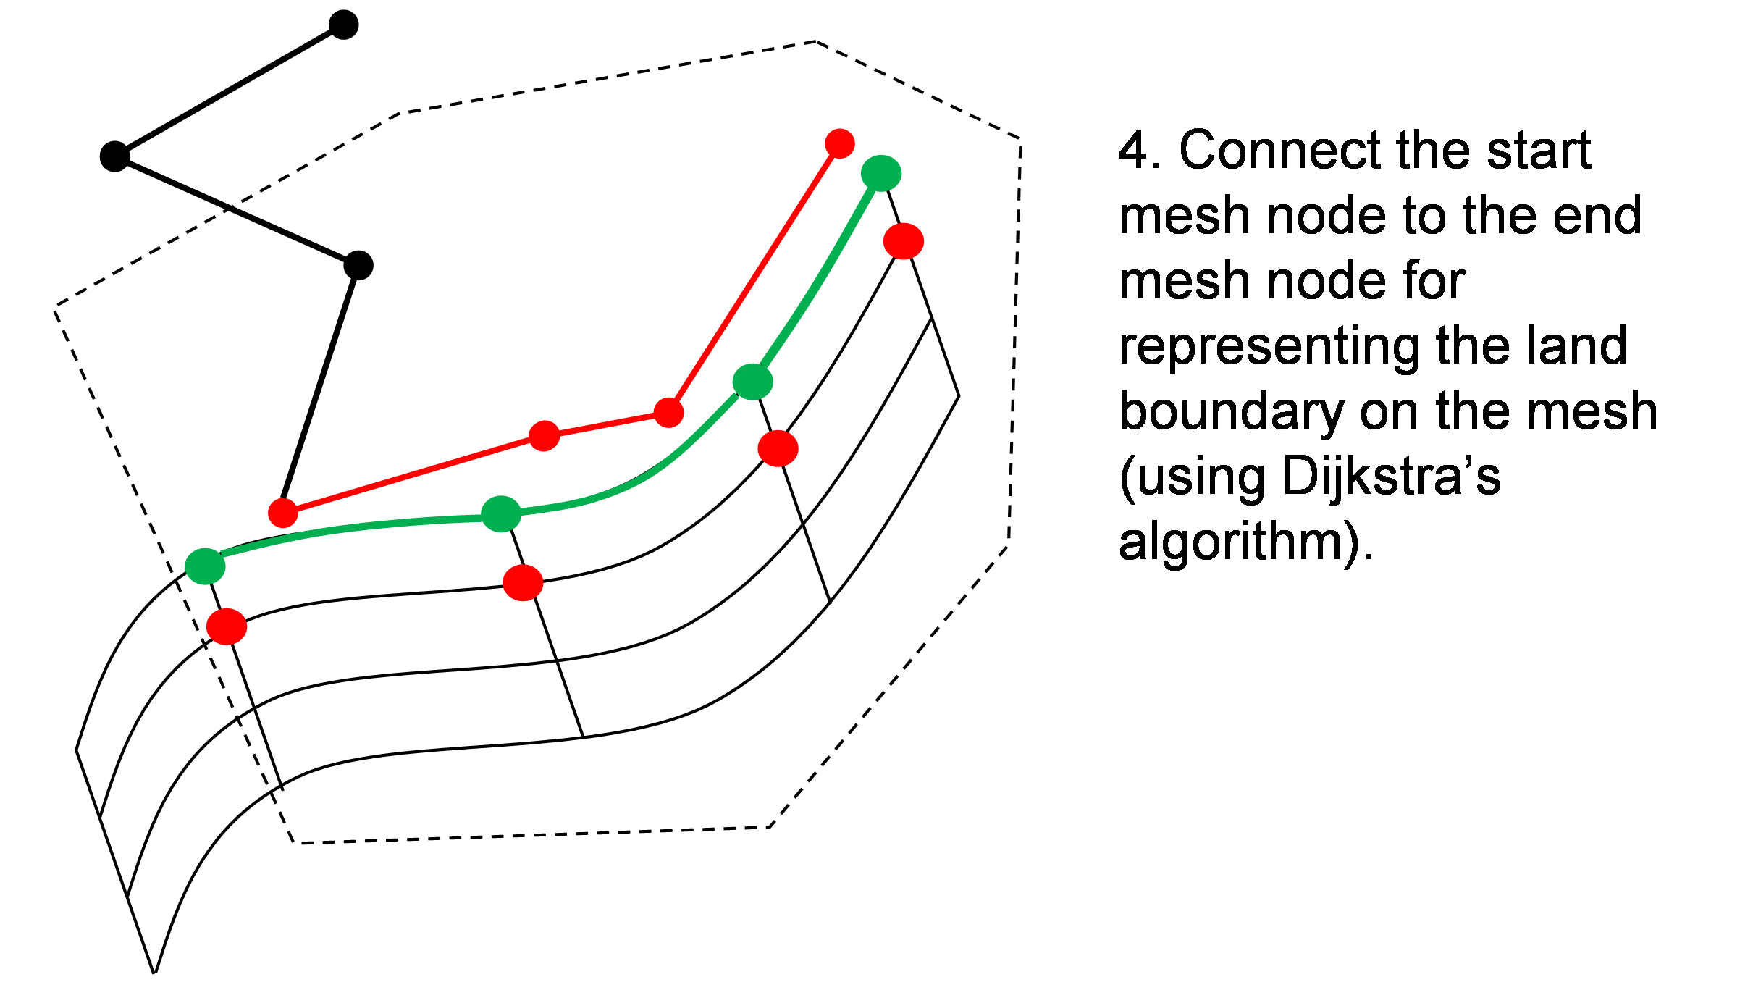
Land boundary algorithm (summary)
<number> of 9

Slide 34
ComputeConnectionsWithPoints
<number> of 9

