Slide 1

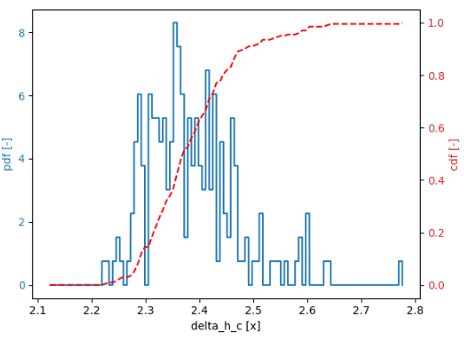
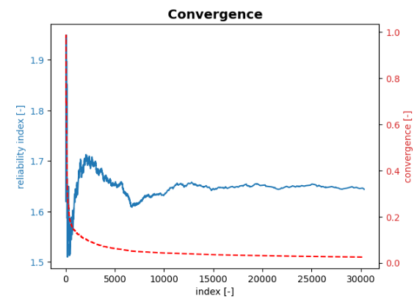
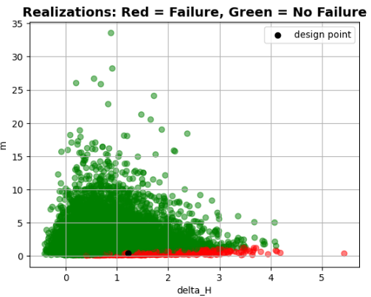
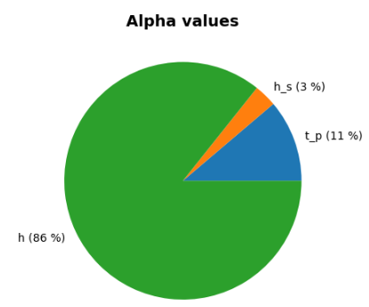
Pizza course: Probabilistic Library in Python

Slide 2
Program

Slide 3
Theory explained

Slide 4
Background information
Two probabilistic libraries at Deltares:
  Fortran library, used in the BOI project (safety assessment of primary flood defences in the NL)
  C# library, used in the Probabilistic Toolkit and D-Stability
In 2024, it was decided to merge these two libraries into a new library written in C++
At this moment the new library is used in the Probabilistic Toolkit. The goal is to use it in D-Stability and the BOI project, and to stop supporting the old libraries
A Python wrapper and .Net wrapper are available for the C++ library

Slide 5
Advantages
Less code duplication at Deltares
The new library is thoroughly validated. Its algorithms are used for the safety assessment of primary flood defences in the Netherlands and within the Probabilistic Toolkit
Thanks to the Python wrapper, the library is more accessible compared to the previous Fortran and C# libraries
Different applications, same answer, because the same probabilistic library is used

Slide 6
Application
Input A
Input B
Input C
Model
Output

Slide 7
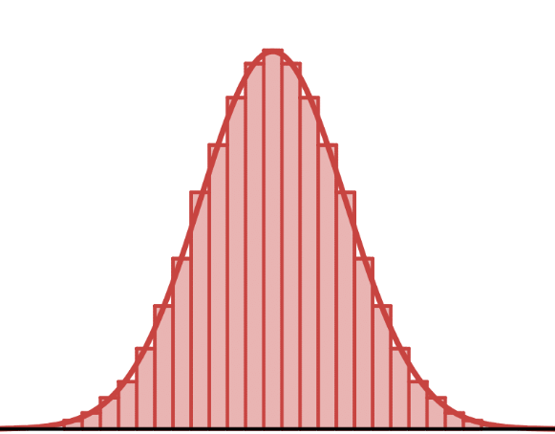
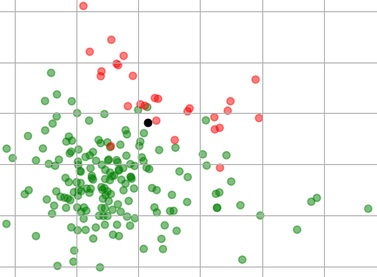
Application
Correlation
Distribution type
Distribution fitting
Input A
Input B
Input C
Model
Reliability analysis
Uncertainty analysis
Interpret output value as failing
or non failing and calculate
probability of failure:
P_{fail} = N_{fail} / N_{total}
Output
Distribution of the output values

Slide 8
Application
Correlation
Input A
Input B
Input C
Input D
Input E
Model 1
Model 2
Output 1
Output 2
P(Output 1 > critical value AND Output 2 > critical value)

Slide 9
Functionality
Distribution functions
Reliability analysis
Uncertainty analysis
Sensitivity analysis
Connection of models

Slide 10
Functionality
Distribution functions
Reliability analysis → probability of exceeding a critical value
Uncertainty analysis → uncertainty of the model output
Sensitivity analysis → effect of model input parameters on the model result
Connection of models

Slide 11
Distribution functions

Slide 12
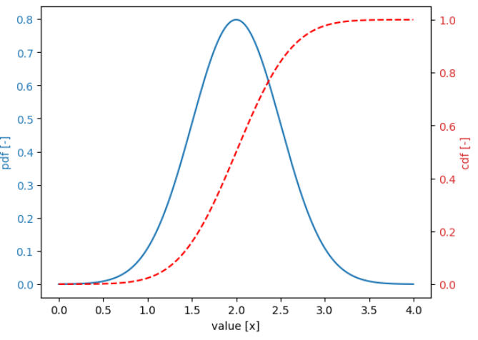
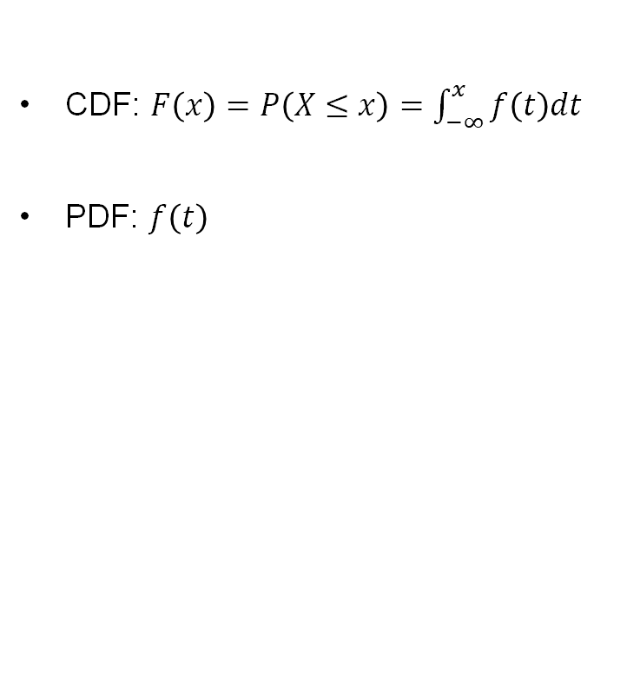
Distribution functions
CDF: $F\left(x\right)=P\left(X≤x\right)=\int_{−∞}^{x}{f\left(t\right)dt}$
PDF: $f\left(t\right)$

Slide 13
Distribution functions
The library supports many `standard` distribution functions: deterministic, normal, log_normal, uniform, triangular, trapezoidal, exponential, gumbel, weibull, conditional_weibull, frechet, generalized_extreme_value, rayleigh, rayleigh_n, pareto, generalized_pareto, student_t, gamma, beta, poisson, discrete, bernoulli
But also special distributions as:
  Cdf curve → user defined probabilities and interpolation in-between
  Histogram → bins
  Conditional distribution → the parameters of the distribution change depending on a value of other variable
  Composite distribution → the weighted average of distribution functions

Slide 14
Operations on distribution functions
Properties derived from the distribution: mean, deviation, variation
Getting CDF and PDF values
Quantiles: value of a random variable that belongs to a probability
Design value: quantile divided by a design factor (used in the Eurocode)

Slide 15
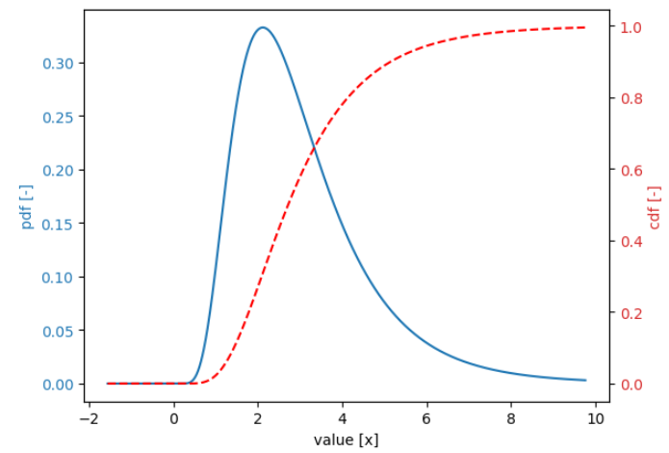
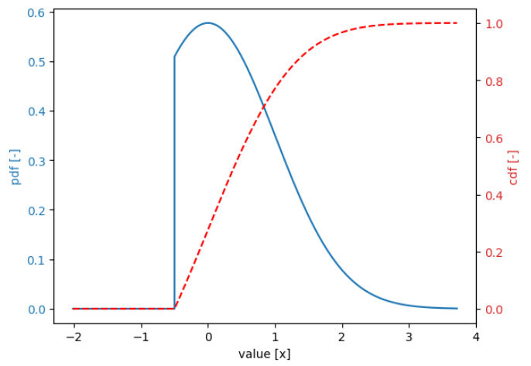
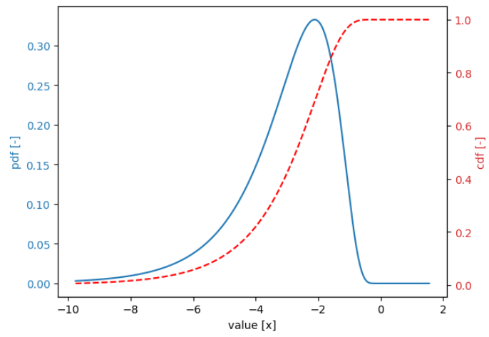
Operations on distribution functions
Truncated distribution: when a random variable is limited to a certain interval
Inverted distribution: symmetry with respect to the shift

Slide 16
Distribution fitting
Given a data set (a set of observations) estimate the parameters of the chosen distribution function
The library uses the Maximum Likelihood Method
The goodness-of-fit can be assessed using the Kolmogorov-Smirnov test

Slide 17
Reliability analysis of a single component

Slide 18
Reliability analysis
Model as a limit state function (Z-function)
Z = Strength – Load
Examples:
  dike height – water level
  safety factor – 1.0
The goal is to find: P(Z < 0) = P(Strength < Load)

Slide 19
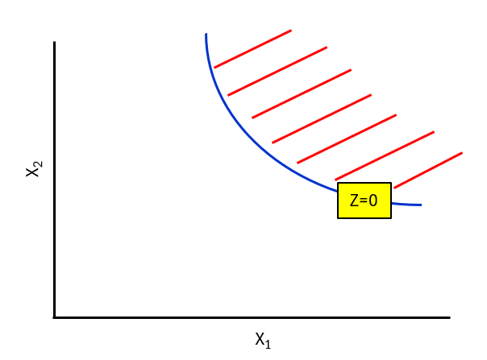
Reliability analysis
Reliability methods in the library:
  Numerical integration
  Numerical bisection
  Crude Monte Carlo
  Importance Sampling
  Adaptive Importance Sampling
  Subset simulation
  Directional Sampling
  Latin Hypercube
  Cobyla
  FORM (First Order Reliability Method)

Slide 20
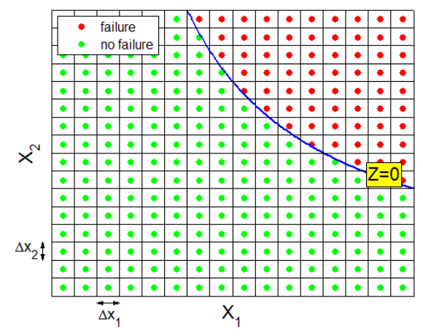
Numerical integration
Domain divided into intervals/cells
The smaller the step size, the more accurate the result will be
Long computation time, if many random variables are considered
Calculation speed improved with Numerical Bisection
Notes:
The grid is uniform in u space, not always in x

Slide 21
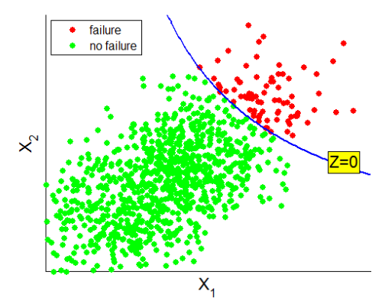
Crude Monte Carlo
The method uses samples of the input variables
The more samples taken, the more accurate the result
A large number of samples is required when estimating very low probabilities

Slide 22
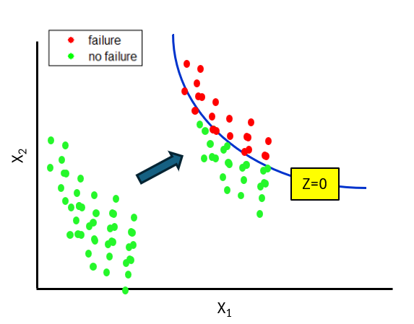
Importance Sampling
Uses samples of the input variables, but requires fewer samples than Crude Monte Carlo
Based on shifting the sample to the area of interest
Results are then weighted to account for the shift

Slide 23
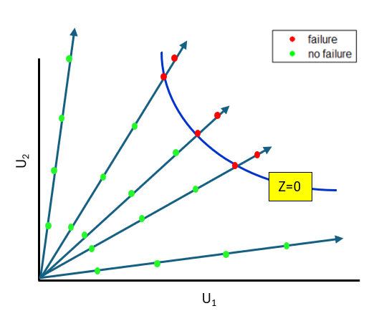
Directional Sampling
Based on sampling of directions
Per direction: the goal is to find `Z = 0`
The method identifies which directions lead to failure
These directions are then used to determine the failure probability

Slide 24
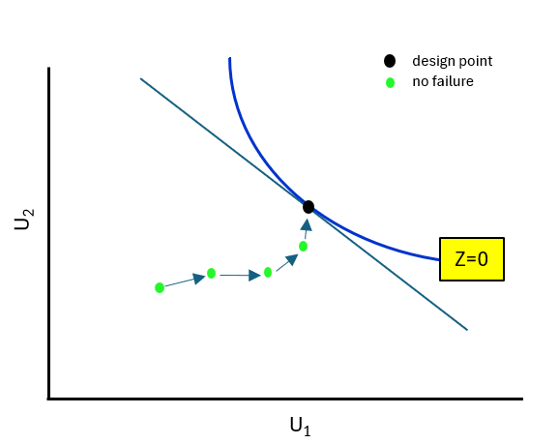
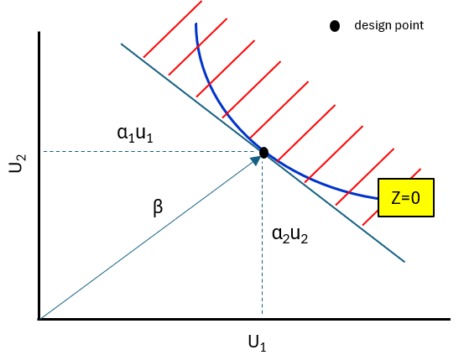
FORM
An iterative method performed in the standard normal space, which uses linearization of the Z-function
Searches for the point closest to the origin (0, 0) → design point
The method approximates the failure probability
Different methods are available to find the starting point
It is a fast method, but it can converge to a local minimum

Slide 25
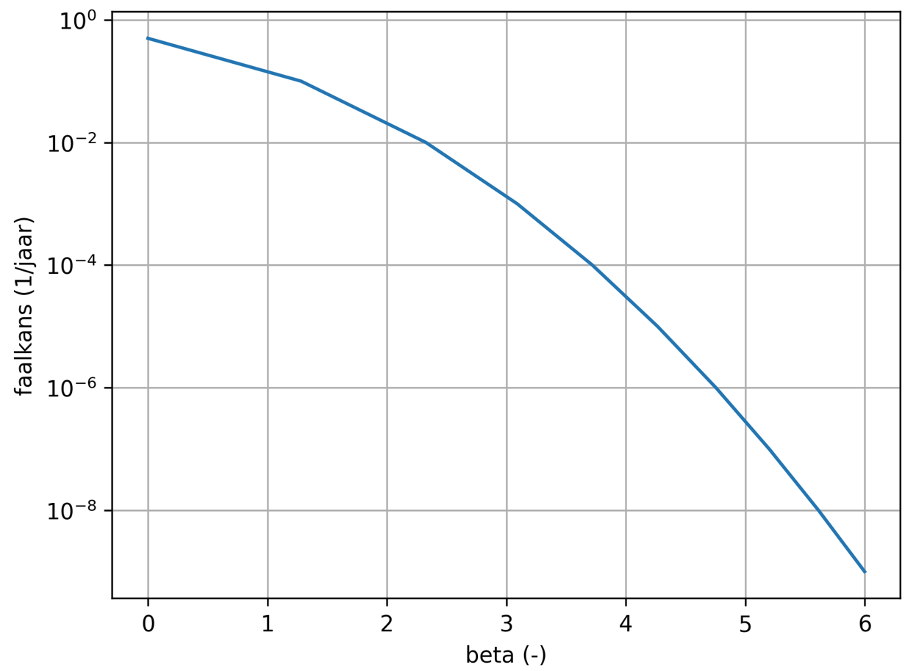
Results of all methods
Reliability index (β)
Alpha value per variable (influence coefficients)
Design point (the most probable combination of input values that leads to failure)

Slide 26
Reliability analysis of a system

Slide 27
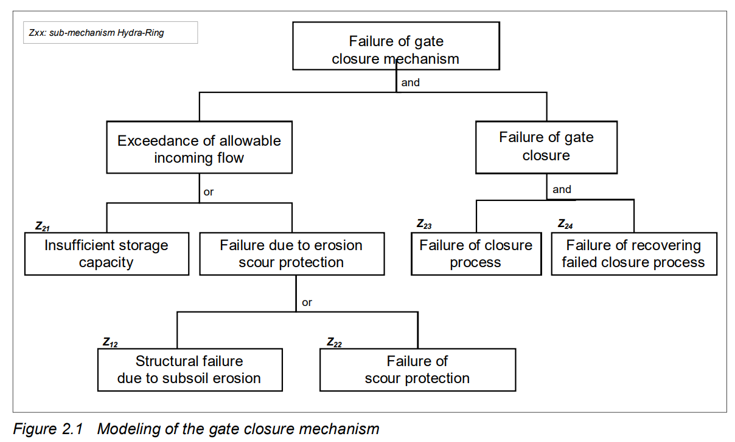
When it is applied?
Failure trees
Combination of elements such as dike sections and failure mechanisms
Length-effect: combining of the same elements multiple times
(but with varying correlation)

Slide 28
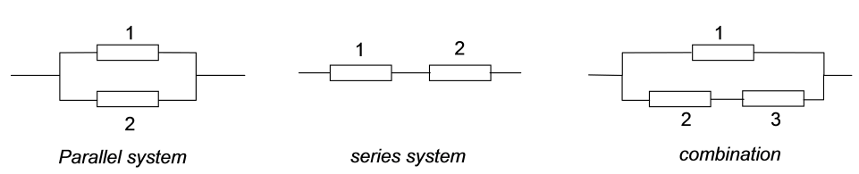
Series and parallel systems
1 fails AND 2 fails
1 fails OR 2 fails
Reliability analysis is applied first for each component in the system
The individual results are combined including correlations between the variables
Different methods available in the library: hohenbichler, hohenbichler_form, importance_sampling, directional_sampling

Slide 29
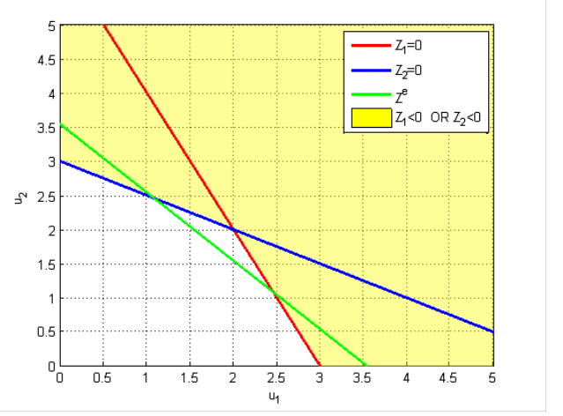
Series and parallel systems
Simulate individual design points with hyperplanes as the limit state function
Hohenbichler:
  First combine 2 elements (OR, AND)
  Then combine the result with the next element
Importance Sampling:
  Sample near the design points, starting with the 2 most likely design points
  Add next design point
Directional sampling:
  Create the limit state function as a combination of all hyperplanes

Slide 30
Uncertainty analysis and sensitivity analysis

Slide 31
Uncertainty analysis
The models themselves are deterministic, but input parameters may be uncertain
As a result, the model output becomes a distribution rather than a single value
Useful for decision making (as it provides insight into the range and likelihood of possible outcomes)
Different methods available in the library: crude_monte_carlo, numerical_integration, fosm, form, importance_sampling, directional_samping
Input A
Input B
Input C
Model
Output

Slide 32
Sensitivity analysis
It is a special case of the uncertainty analysis
Assesses how changes in input parameters affect the model output
Helps identify which parameters have the most influence on the results
Simple sensitivity analyses can be conducted with the library
More advanced (SOBOL indices) with the Probabilistic Toolkit
change in value
Input A
Input B
Input C
Model
Output
change in output

Slide 33
Connection of models

Slide 34
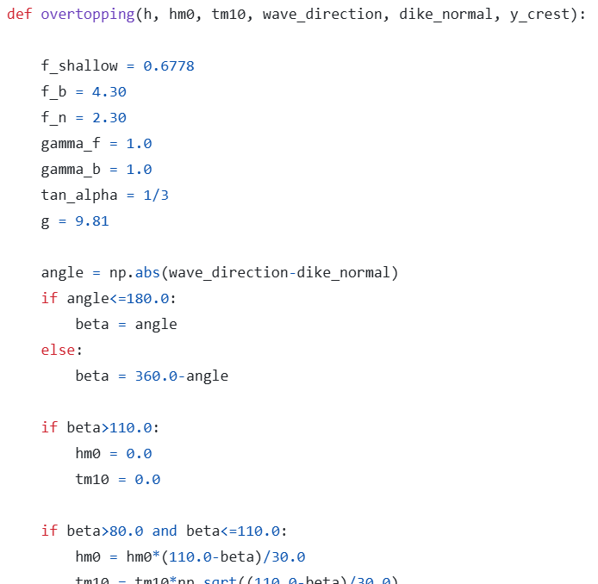
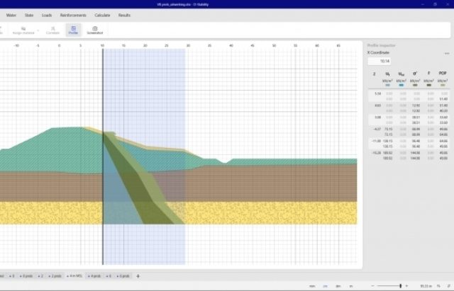
Connection of models
Model described with a python script
Also as a class (enables initialization step)
Model in exe (use ptk-wheel)
Identify random variables in input files
Delft3D, D-Stability, RTCTools, Plaxis, Kratos and other

Slide 35
DEMO: simple example

Slide 36
DEMO: simple example
Jupyter notebook: demo_simple.ipynb
Goal:
  Defining a random variable
  Uncertainty analysis of a simple model
  Reliability analysis, P(Z<0) and P(h>3)
  Combining probabilities

Slide 37
Exercise 1

Slide 38
Exercise 1
Jupyter notebook: case1_py_model.ipynb

Slide 39
DEMO: connection of a model (exe)

Slide 40
DEMO: model as exe
Input
Text file
runOvertopping.exe
Output text file
(wave run-up)

Slide 41
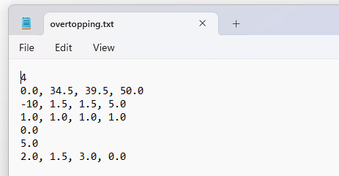
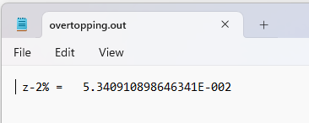
DEMO: model as exe
Row 1: number of dike points
Row 2: x-coordinates
Row 3: z-coordinates
Row 4: roughness
Row 5: dike orientation
Row 6: dike height
Row 7: water level, Hs, Tm-1,0, wave direction
z-2% = wave run-up

Slide 42
DEMO: model as exe
Running from Command Prompt
runOvertopping.exe input.txt > output.out
How to connect to the library?
  Write a python wrapper around “runOvertopping.exe input.txt > output.out”
  Or use the wrapper of the Probabilistic Toolkit: ptk

Slide 43
DEMO: model as exe
Jupyter notebook: demo_overtopping.ipynb

Slide 44
Discussion

Slide 45
Discussion
How can the probabilistic library assist you in your projects?
How could the library be further developed to better meet your needs?
What opportunities do you see for your clients to use the library?
Do you have any general remarks or suggestions so far?

Slide 46
Exercise 2

Slide 47
Exercise 2
Jupyter notebook: case2_dstability.ipynb

