Slide 1

Hendrik Kok
Coupling Ribasim & Wflow: Enabling Land Processes and Irrigation
Hendrik Kok specializes in coupling hydrological models. He is one of the main developers of iMOD Coupler, which runs MODFLOW 6 groundwater models together with the unsaturated zone model MetaSWAP and surface water models. There he built the coupling of Ribasim with MetaSWAP and MODFLOW 6, including sprinkling from surface water. He also contributes to iMOD Python, xugrid and Ribasim-NL, where he uses results of the national groundwater model as forcing for Ribasim.
Photo of presenter
Senior Advisor / Researcher, Deltares

Slide 2
Bart de Koning
Coupling Ribasim & Wflow: Enabling Land Processes and Irrigation
Bart de Koning has a background in applied mathematics and has been one of the core developers of Ribasim since 2023. He built much of its control and allocation: PID, discrete and continuous control, the demand nodes, and the optimization that distributes water over users by priority. He also works on making Ribasim fast and robust for large models. Besides Ribasim he has contributed to Wflow.jl. In the coupling of Ribasim and Wflow he focuses on irrigation.
Photo of presenter
Advanced Engineer, Deltares

Slide 3
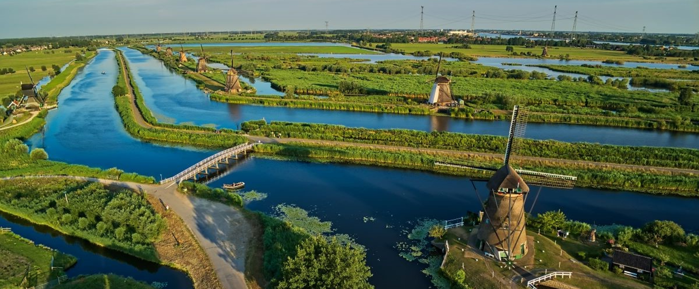
Coupling Ribasim & Wflow
Enabling Land Processes and Irrigation
Hendrik Kok & Bart de Koning - 17 November 2026 - Delft
Notes:
We are Deltares. A world-leading, mission-driven Dutch knowledge institute for water and the subsurface. We work throughout the world, and we are guided by the major societal issues, for which Deltares' knowledge is indispensable.
PICTURED: Kinderdijk, the Netherlands

Slide 4
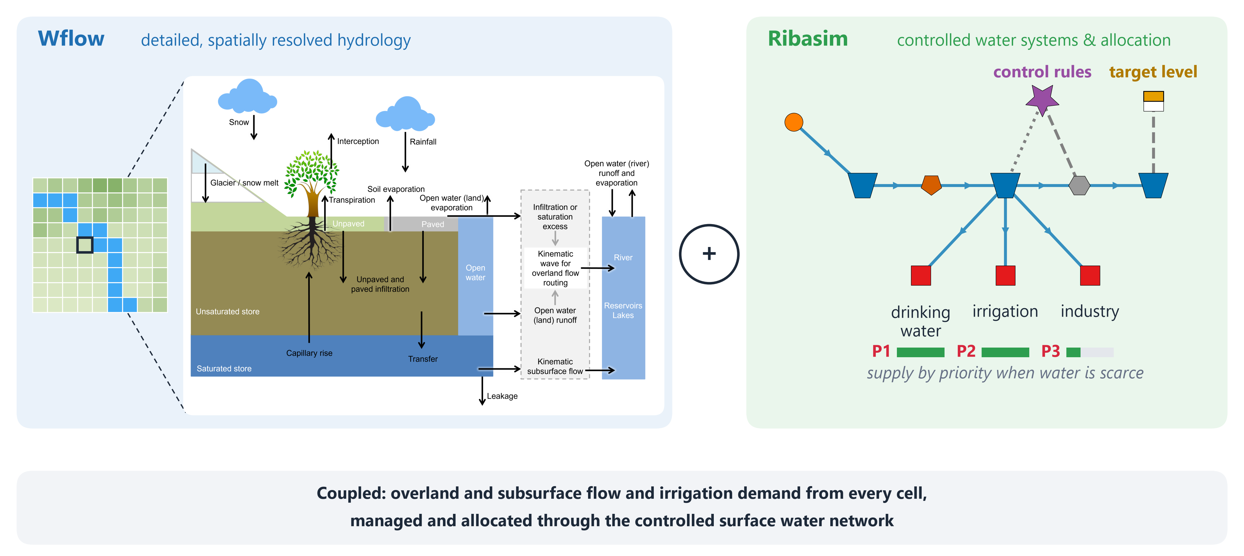
Two strengths, one coupled model
Wflow describes how water moves through the landscape; Ribasim how people store, steer and share it

Slide 5
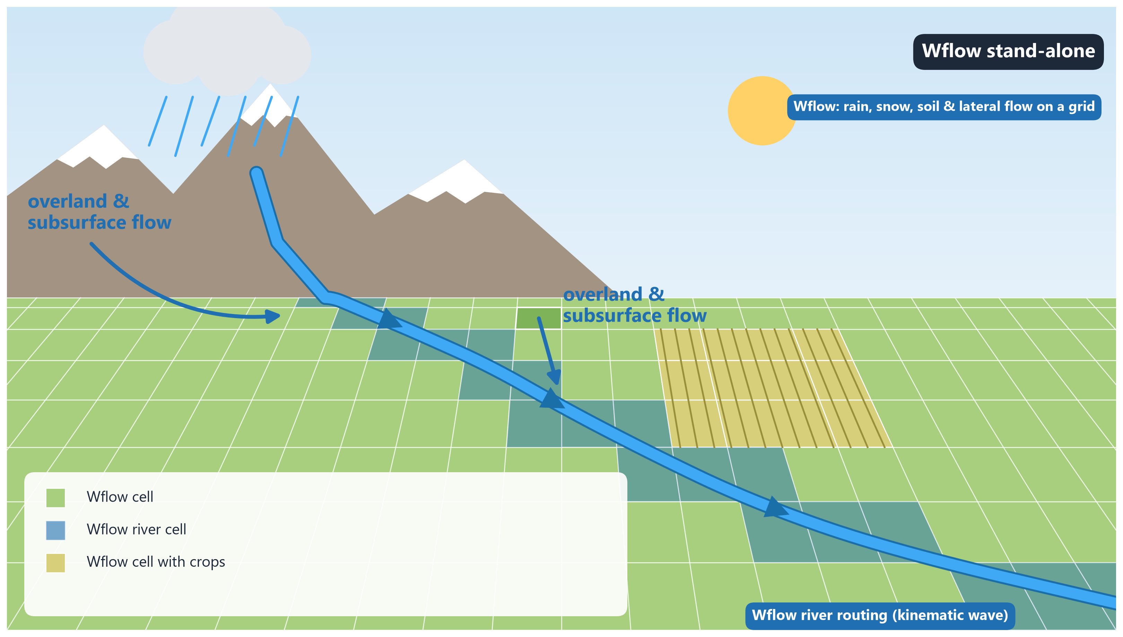

Slide 6
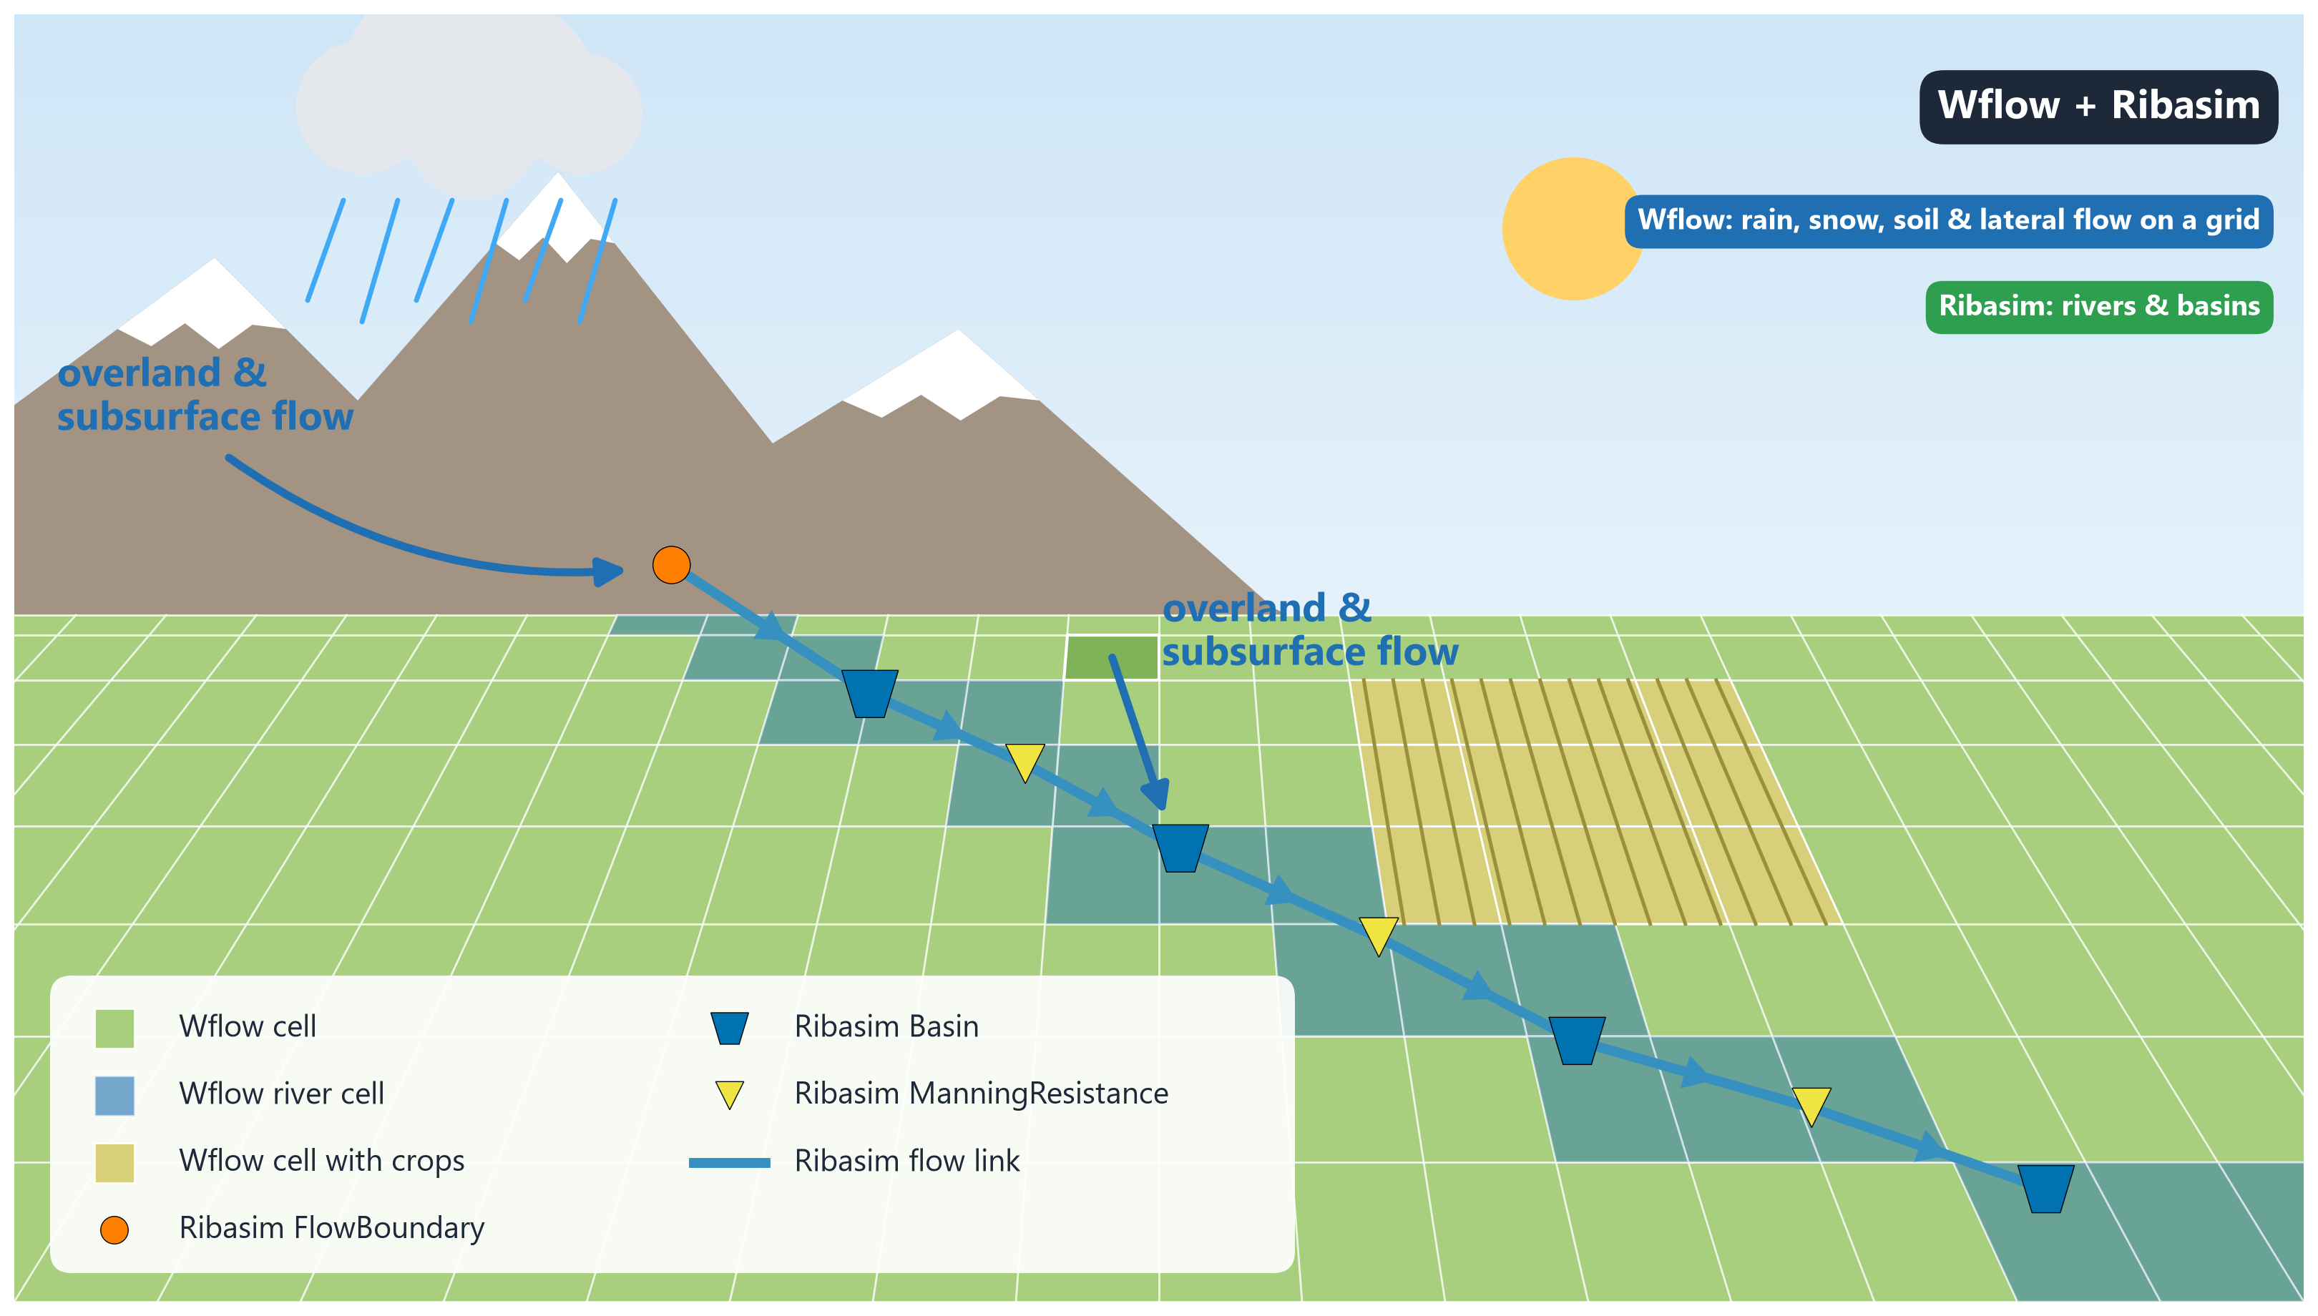

Slide 7
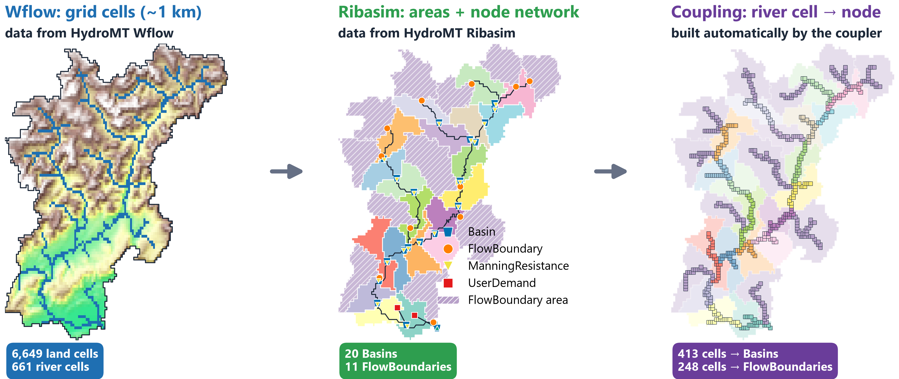
From grid to network: the Piave catchment
Every Wflow river cell delivers its inflow to exactly one Ribasim node

Slide 8
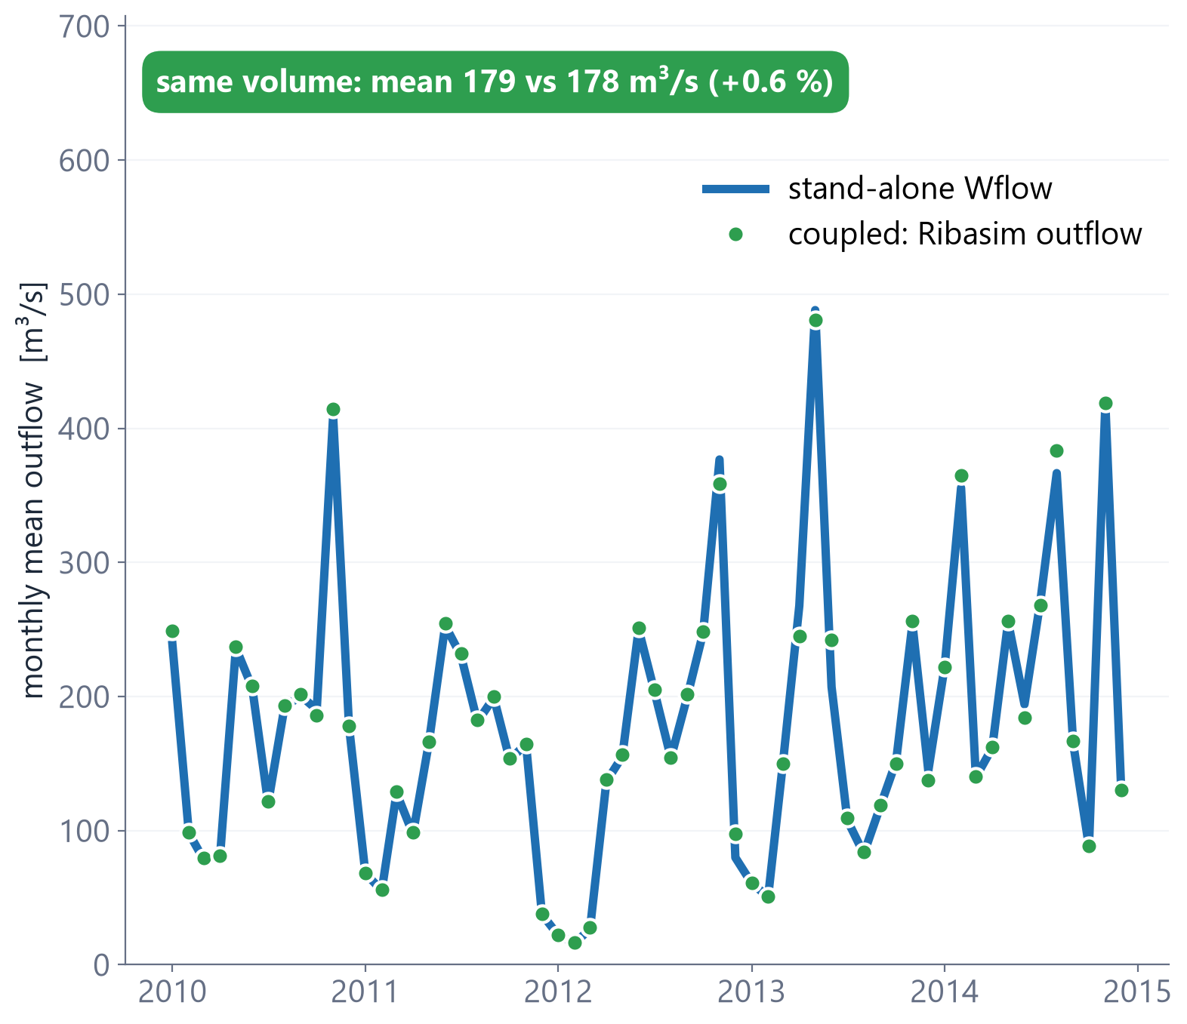
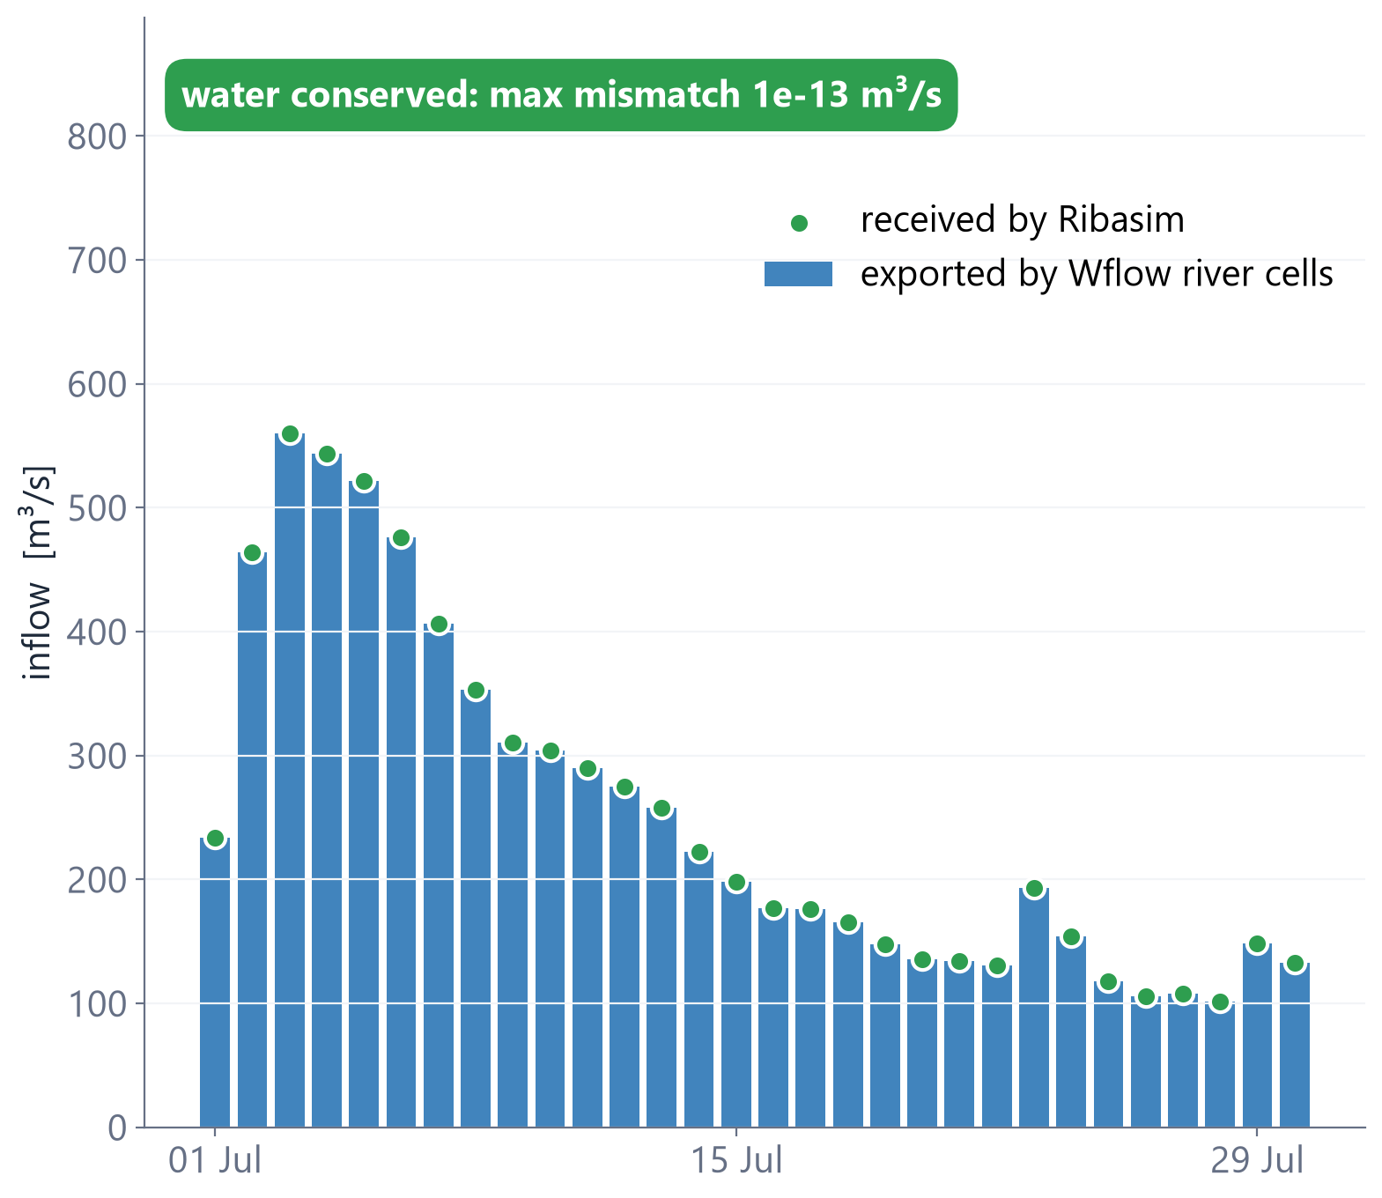
The river coupling works
Left: monthly outflow at the Piave outlet, 2010-2014. Right: daily exchange Wflow to Ribasim, July 2010

Slide 9
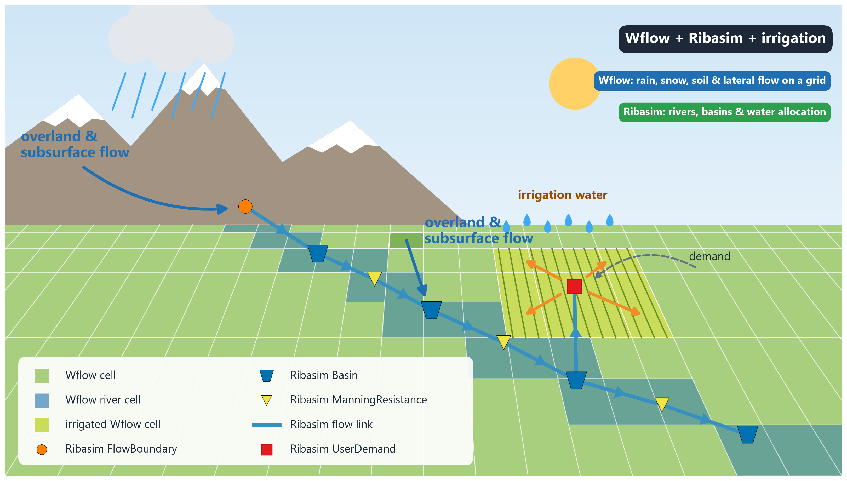

Slide 10
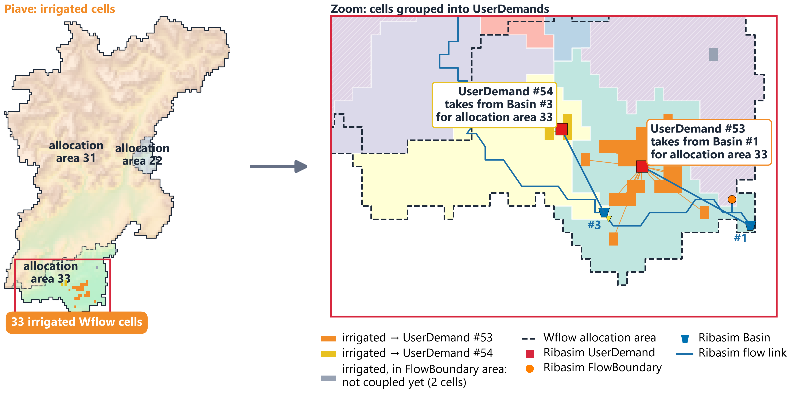
Irrigated cells become Ribasim UserDemands
Irrigated Wflow cells are grouped per Basin and allocation area; each group gets one UserDemand

Slide 11
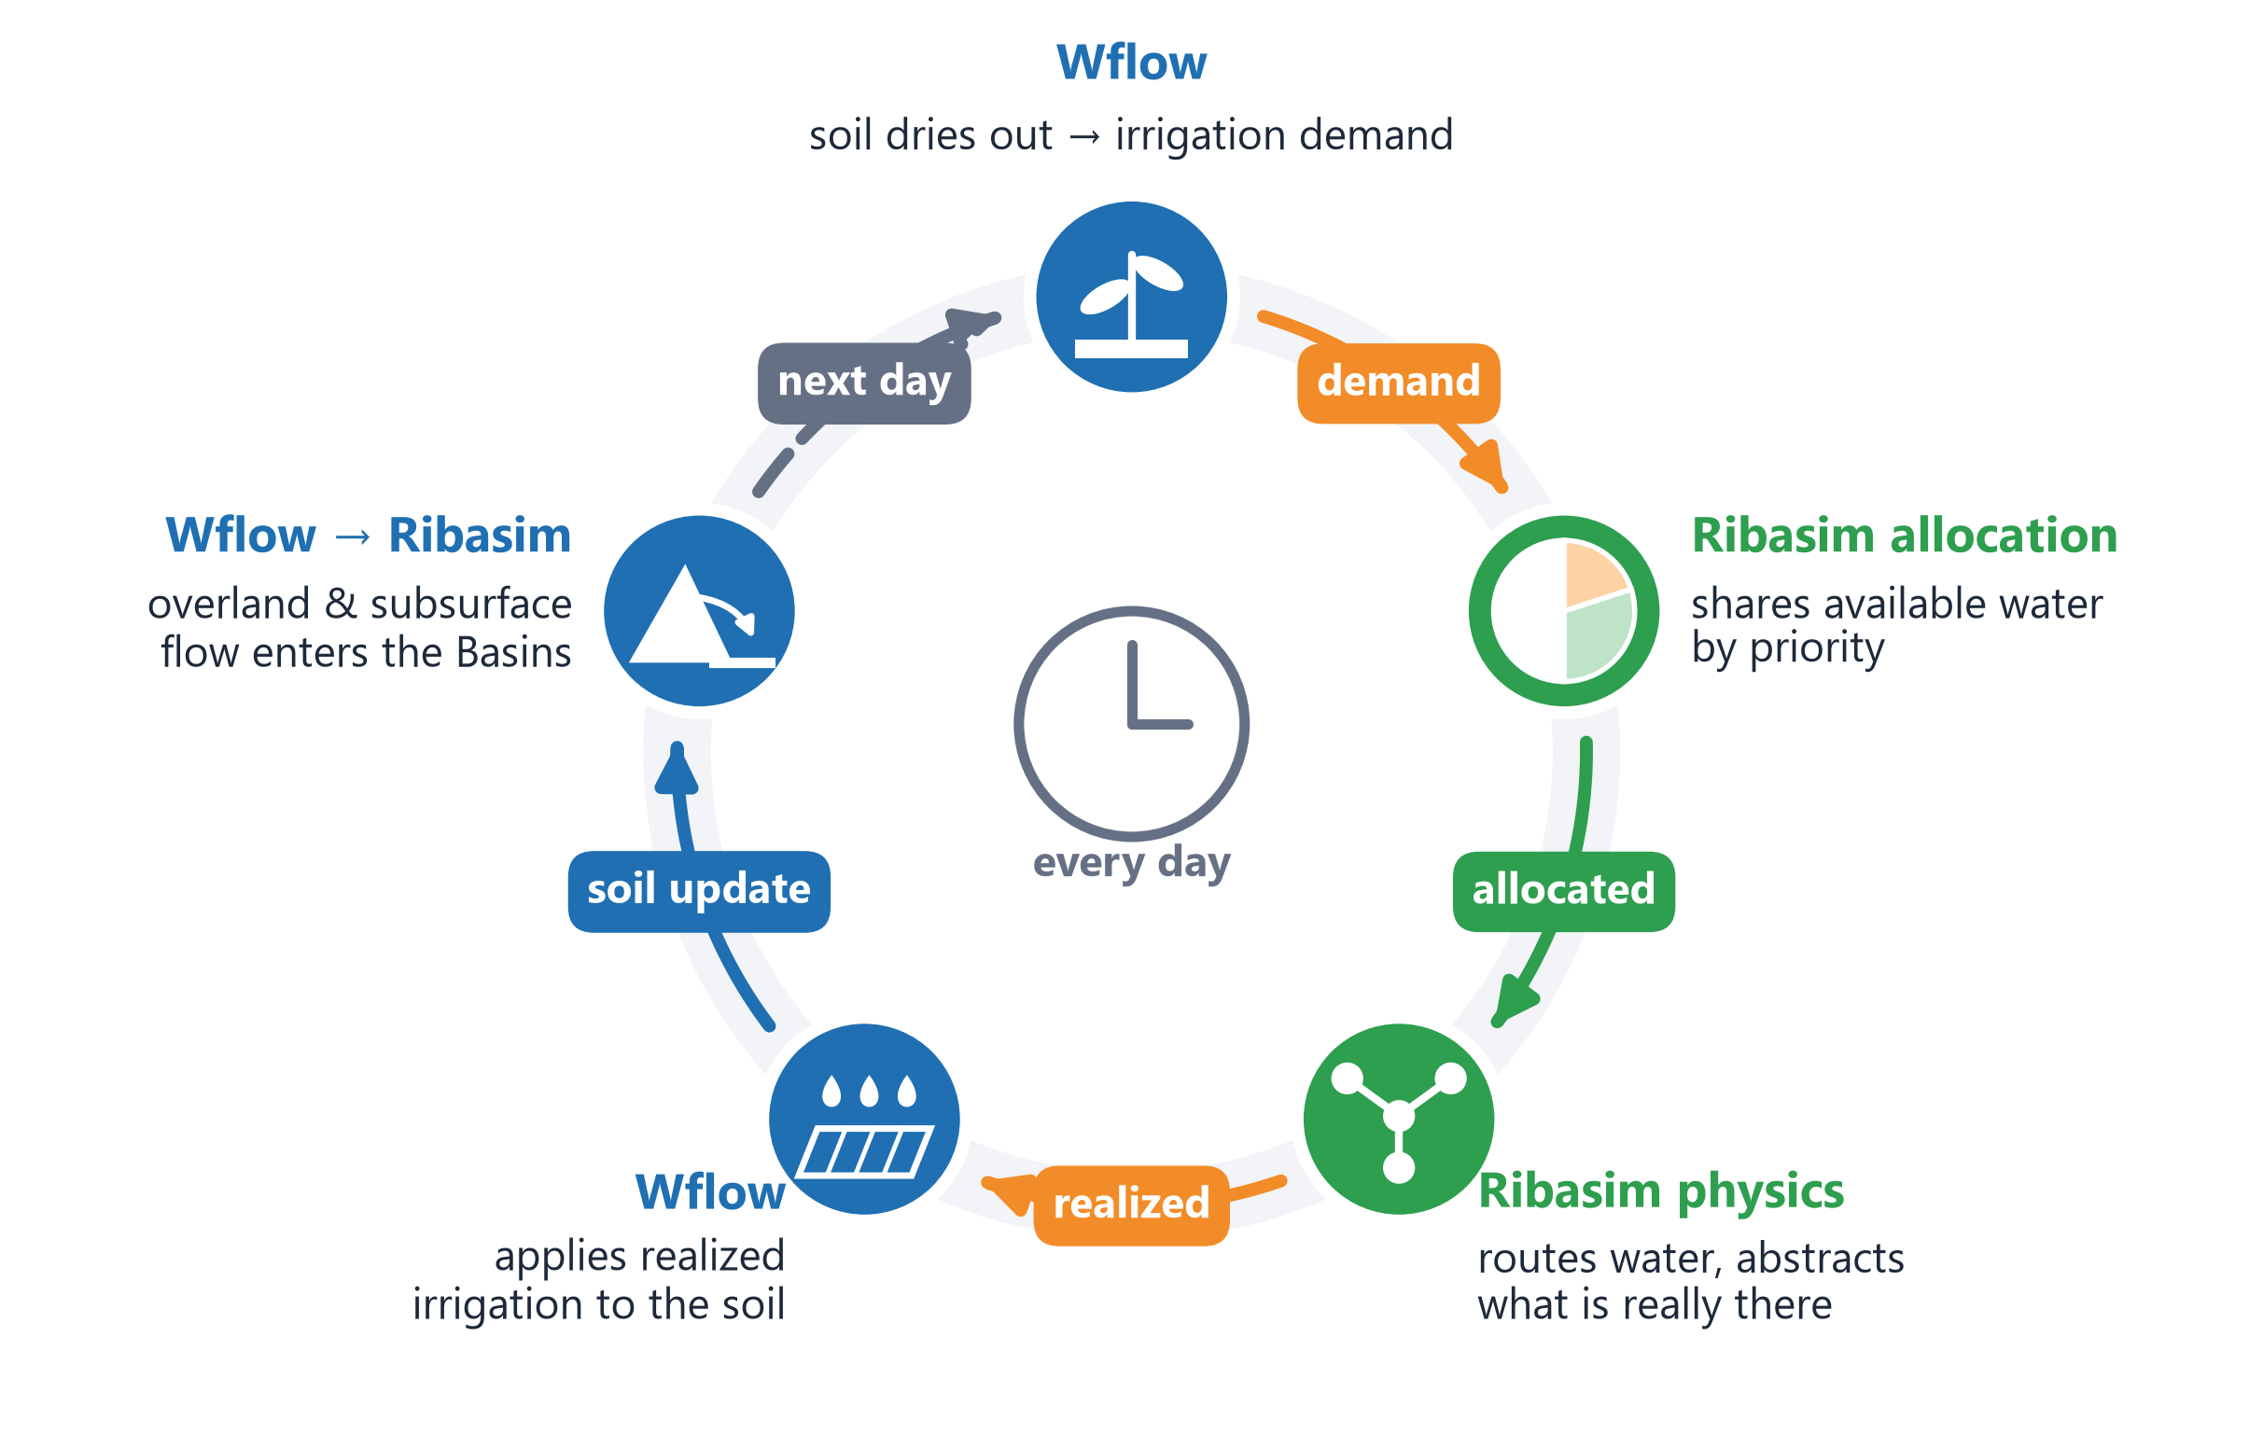
One coupled day
Wflow and Ribasim take turns; only data is exchanged, each model keeps its own state

Slide 12
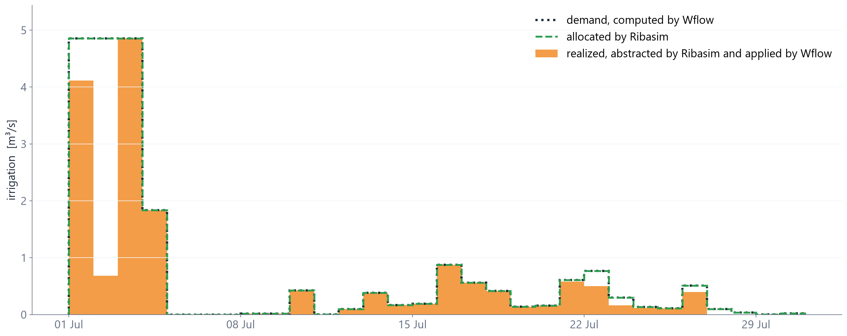
The irrigation loop works
Irrigation of UserDemand #53, Piave, July 2010: every day from Wflow to Ribasim and back

Slide 13
Take-home messages
Proof of concept on the Piave catchment
1
2
Each model does its part
Water is conserved
Wflow computes overland and subsurface flow and irrigation demand per grid cell. Ribasim routes, manages and allocates the water.
Everything Wflow hands over arrives in Ribasim, every day.

Slide 14
Anything else you’d like to ask?
Hendrik Kok & Bart de Koning - 17 November 2026 - Delft

Slide 15
Backup

Slide 16
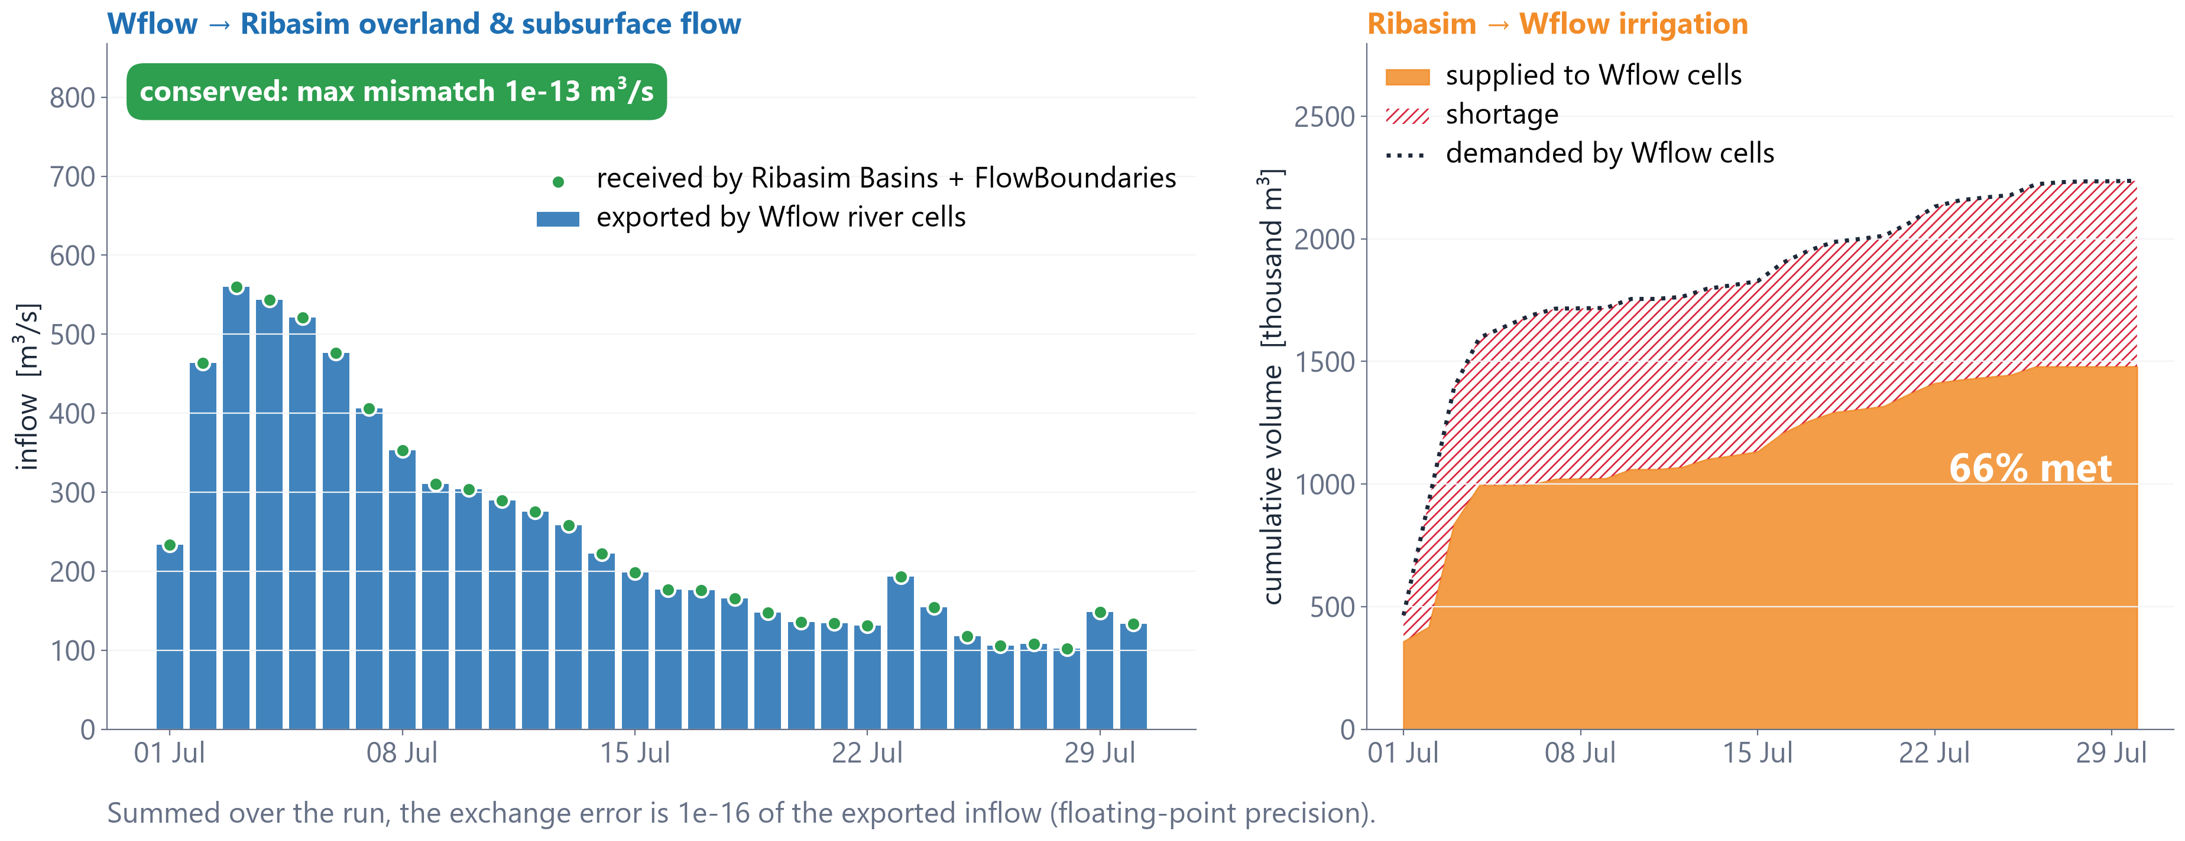
Is water conserved across the coupling?
Daily exchange in the Piave run (July 2010)

Slide 17
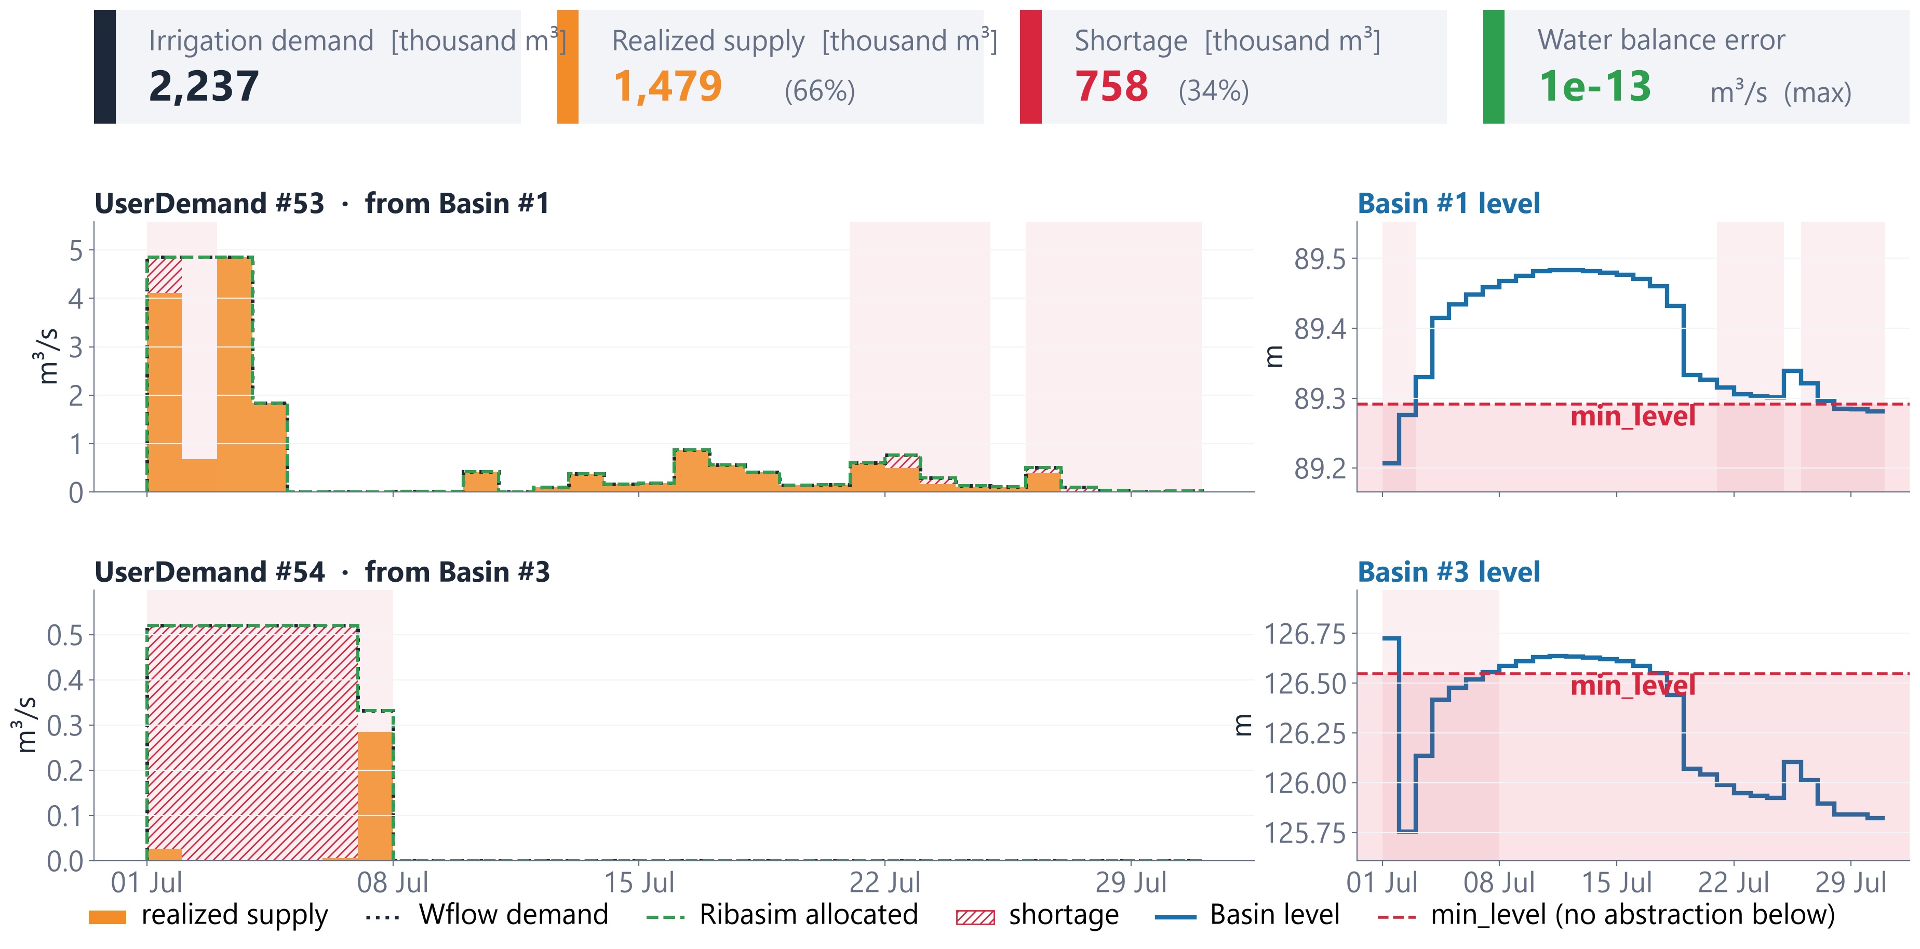
Irrigation results per UserDemand
Piave, July 2010: Ribasim allocates the Wflow demand, but physics decides what is really abstracted

Slide 18
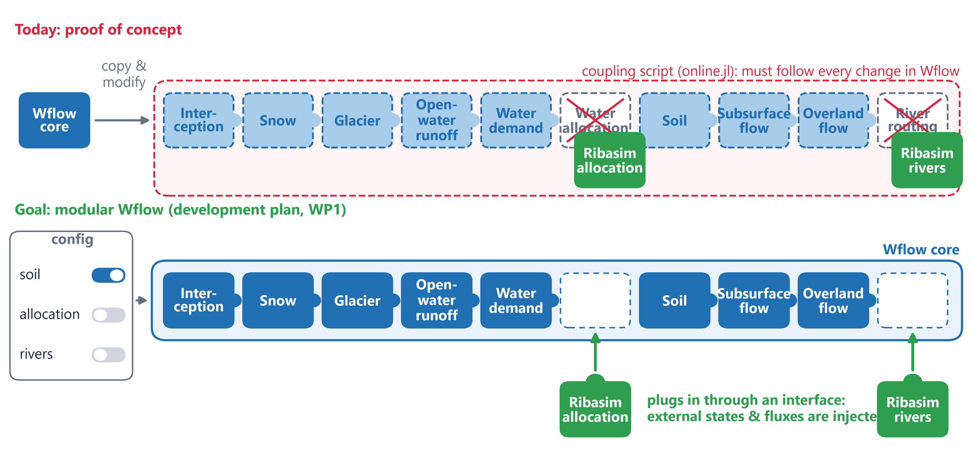
Next step: a modular Wflow
Ribasim should plug into Wflow components instead of the coupler copying Wflow code

Slide 19
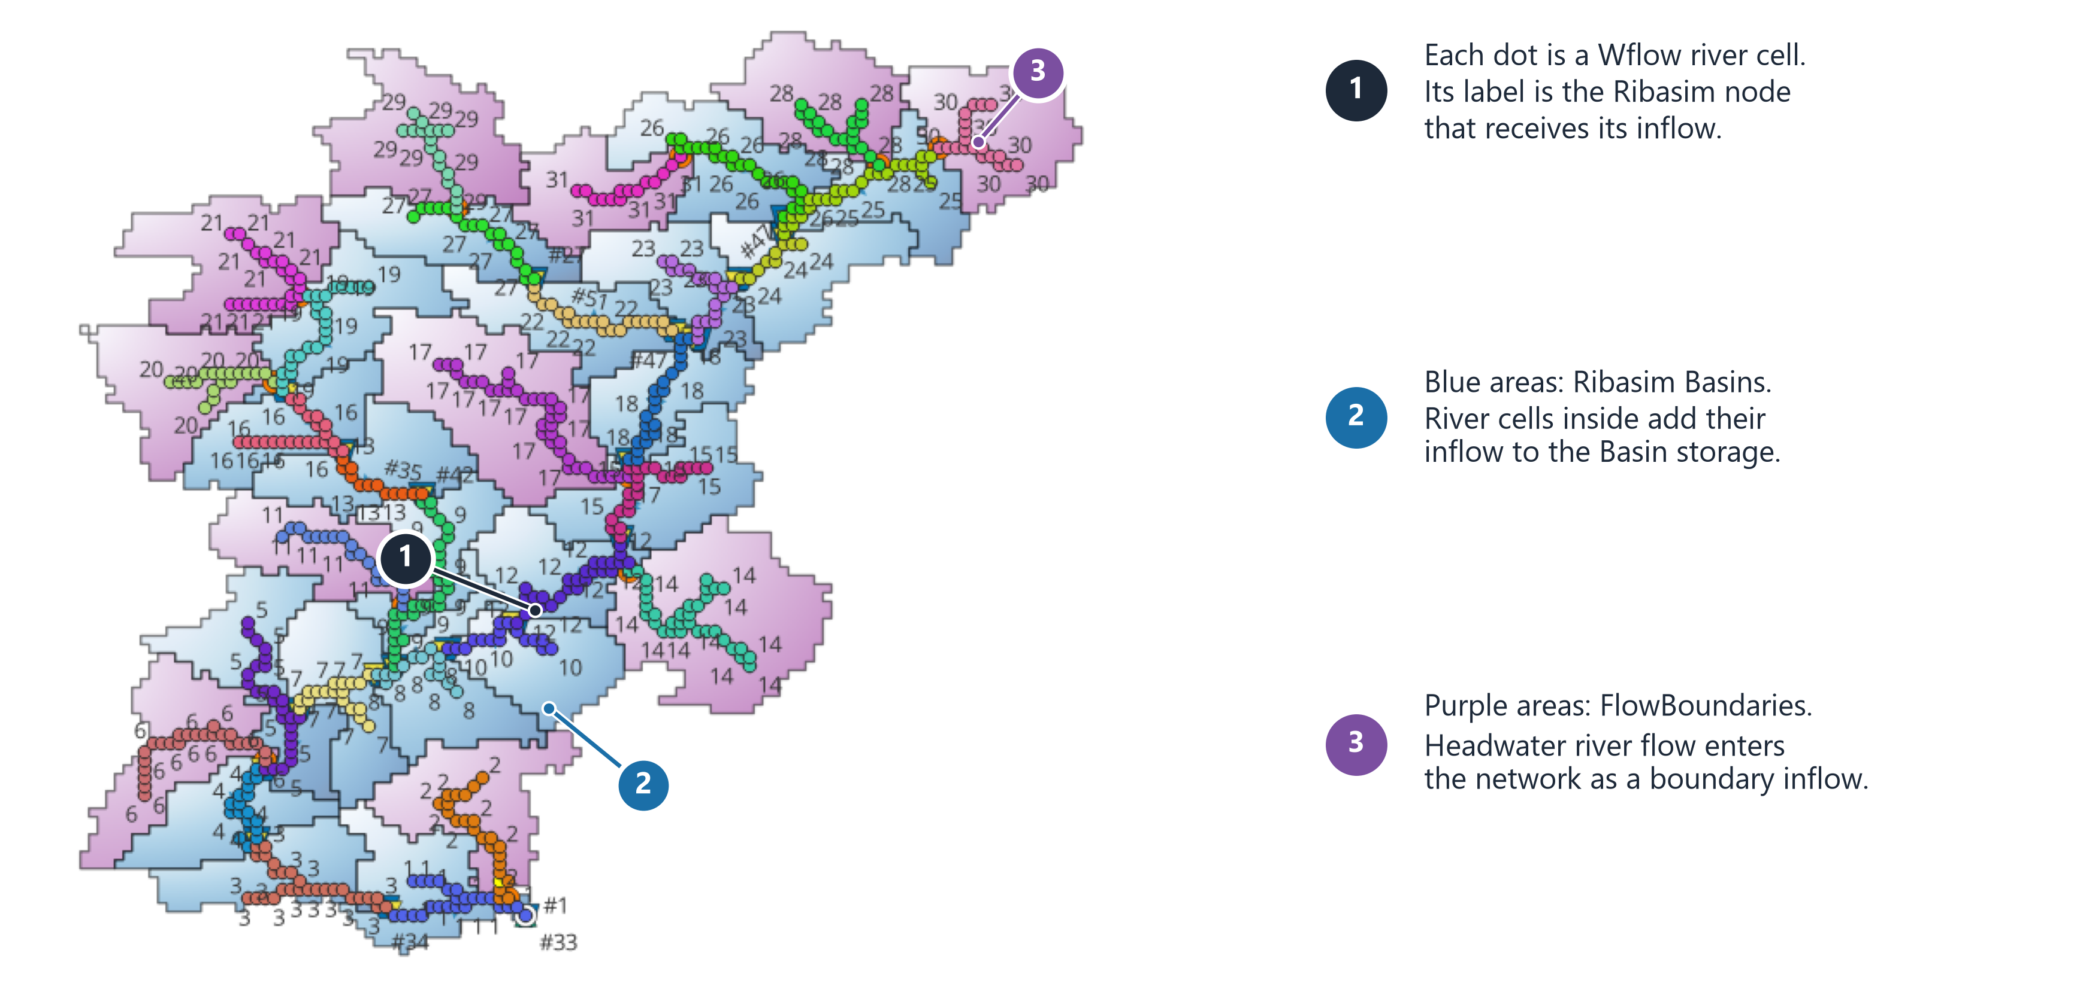
Mapping Wflow river cells to Ribasim
QGIS view of the Piave proof of concept (PR #3324)

Slide 20
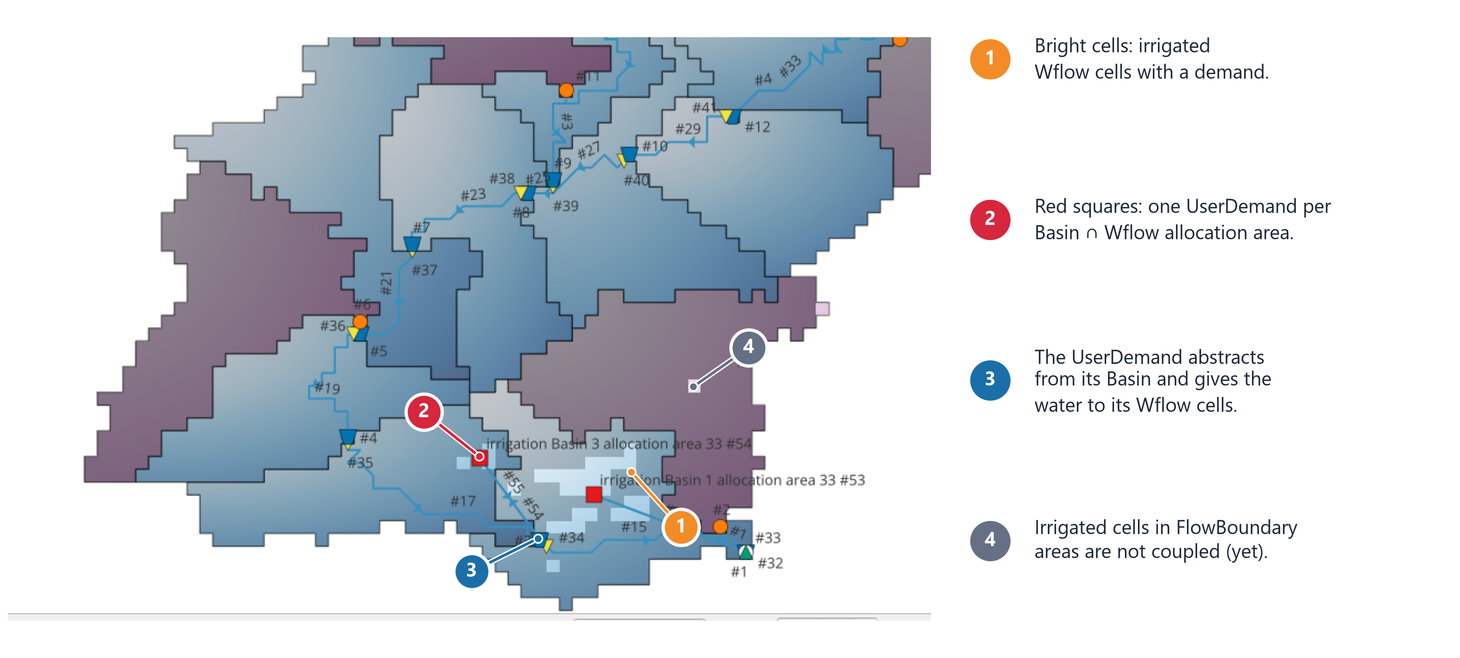
Irrigation in the coupled model
Test schematization in Ribasim's QGIS plugin (PR #3333)

