Slide 1

Model Comparison For Handwritten Digit Recognition
Team 1:
Jacob Partin
Nicholas Acuncius
Sakar Joshi

Slide 2
Recap of the handwritten digit recognition
Machines get and recognize digits from some type of written media
Two types: online and offline
Online is the newer type that involves directly writing onto the computer
Offline involves photos of digits.

Slide 3
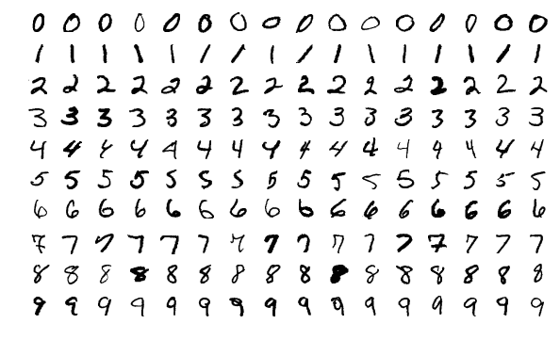
Data
MNIST (Modified National Institue of Science and Technology) database
Two sets: 60000 Training and 10000 Testing
https://en.wikipedia.org/wiki/MNIST_database#/media/File:MnistExamples.png

Slide 4
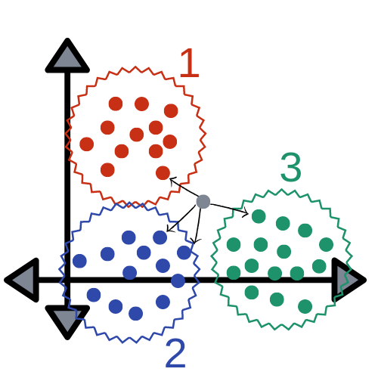
KNN
Stands for k-Nearest Neighbor.
Supervised algorithm.
Generally used to classify a data point.
Memory-based learning method.
Hyperparameters:
k value
distance metric

Slide 5
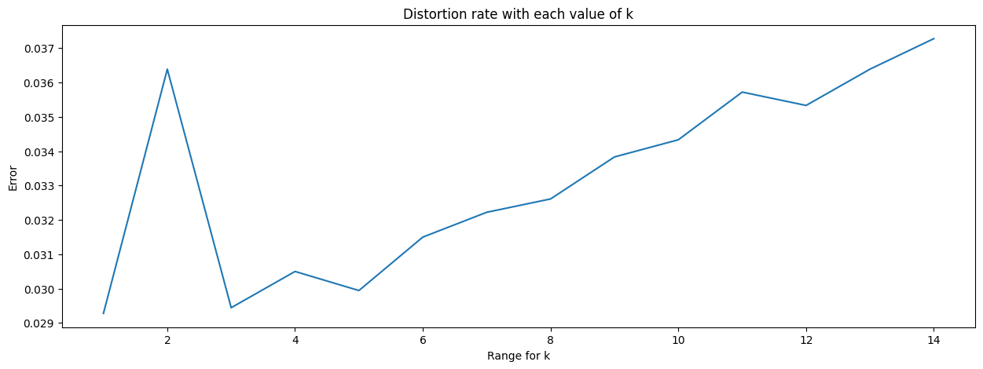

Slide 6
Decision Tree
Binary Tree that branches based on conditions with a feature
Hyperparameters:
Criterion
Max_depth
Min_sample_leaf
Min_samples_split
Max_leaf_nodes

Slide 7

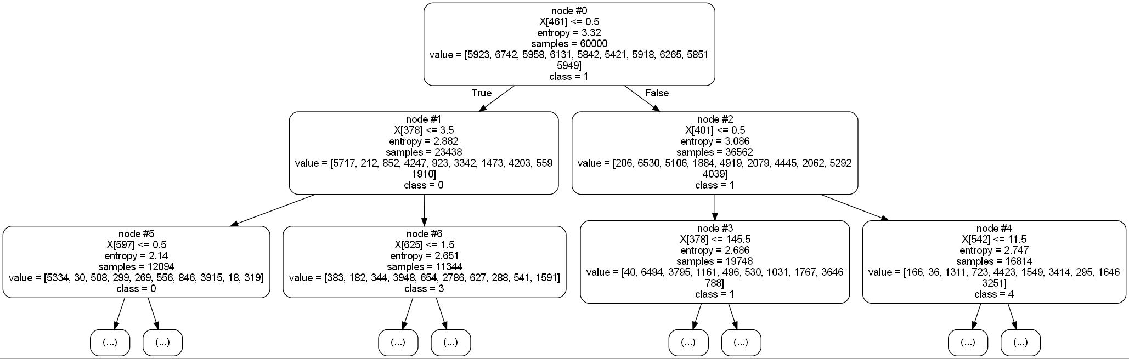
[Full Image]​

Slide 8
CNN
Pre-processing
Convert X to 1D vector
Convert y to categorical with "one-hot" vector
Ex: 3 -> [0, 0, 0, 1, 0, 0, 0, 0, 0, 0]
32 Node hidden layer
Sigmoid activation function
Dropout layer
Can prevent overfitting
Output layer
Softmax activation function
Mini-batch Gradient Descent
Cross-entropy loss

Slide 9
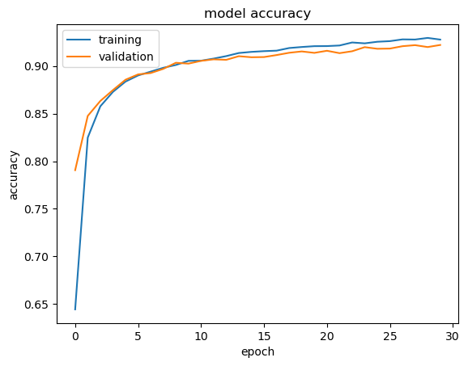
Tuned hyperparameters
Batch size
# of samples to use before updating internal weights/parameters
16, 32, 64, 128, 256, 1024
Dropout
% of random nodes to drop from hidden layer (can reduce overfit)
0.0, 0.10, 0.20, 0.30
Epochs
# of times the entire dataset passes through the network (all batches is one epoch)
5, 10, 30
Bests
Batch size: 128
Dropout: 0.0
Epochs: 30

Slide 10
comparisons
Model | SLOC | Best Accuracy | Model Creation Time (s) | Tuning Time (s)
KNN | 50 | 98% | 20.12 | 150942.29
Decision Tree | 30 | < 90% | 30.96 | ~138977.03
CNN | 77 | 92.5% | 48.35 | 3301.51
SLOC: source lines of code

Slide 11
References
https://en.wikipedia.org/wiki/Handwriting_recognition
https://en.wikipedia.org/wiki/MNIST_database
https://escholarship.org/content/qt0505d532/qt0505d532.pdf
https://medium.com/@nikhilanandikam/handwritten-digit-recognition-hdr-using-k-nearest-neighbors-knn-f4c794a0282a
https://docs.aws.amazon.com/sagemaker/latest/dg/kNN-tuning.html
Image credit: https://medium.com/capital-one-tech/k-nearest-neighbors-knn-algorithm-for-machine-learning-e883219c8f26

Slide 12
References
References for Decision Tree:
https://towardsdatascience.com/how-to-tune-a-decision-tree-f03721801680
https://medium.com/analytics-vidhya/knn-vs-decision-tree-vs-random-forest-for-handwritten-digit-recognition-470e864c75bc
References for CNN model:
https://towardsdatascience.com/mnist-handwritten-digits-classification-using-a-convolutional-neural-network-cnn-af5fafbc35e9
https://machinelearningmastery.com/how-to-develop-a-convolutional-neural-network-from-scratch-for-mnist-handwritten-digit-classification/
https://www.kaggle.com/code/cedricb/mnist-cnn-grid-search-data-augmentation
Images:
https://en.wikipedia.org/wiki/MNIST_database#/media/File:MnistExamples.png

