Slide 1
Predictive Analysis of Patient Health Conditions Using Data Mining Techniques
B9DA 110
Lecturer : Terry hoare
Submitted By : Delvin vallooran jose
: Eldhose thelakkattu
:

Slide 2
Overview
This project utilizes data mining and machine learning to classify patients as "Normal" or "Not Normal" using a real-world healthcare dataset containing over 55,000 records and 10+ features. Following the CRISP-DM framework, it addresses class imbalance through SMOTE and class weighting.
Three classification models—Decision Tree, Random Forest, and Logistic Regression—were built and evaluated, with performance compared against automated tools like RapidMiner and AI Studio. Insights were effectively visualized using Tableau and SSRS.
Business Impact:
The project highlights how early detection of abnormal health conditions can enable timely interventions, optimize healthcare prioritization, and showcase the value of interpretable AI in medical data analysis.

Slide 3
DataSet Overview
Publicly available healthcare dataset (CSV format) with 55,500 rows and 15 features was used, loaded and cleaned in Python via Google Colab. The target variable, Test Results, was binarized (0 = Normal, 1 = Not Normal).
Key Feature Categories:
Demographics: Age, Gender
Medical Data: Condition, Medication, Blood Type, Admission Type
Administrative Info: Billing Amount, Hospital, Room Number

Slide 4
CRISP-DM Phase 1 – Business Understanding
Predict whether a patient's test result will be Normal or Not Normal
Stakeholders:
Healthcare providers and hospital staff
Clinical analysts
Medical support systems
Problem Statement:
Medical institutions often deal with large patient datasets that are underutilizedEarly detection of health risk patterns can help prioritize attention and improve resource allocation
Business Constraints :
Data comes from anonymized public records (no real-time updates)
Only structured features are included (no images, text, or sensor data)
Predictions must be interpretable for practical use
Business Success Criteria:
Build a model that achieves good recall (especially for "Not Normal" cases)
Allow medical teams to act quickly based on automated predictions
Deliver results in a format that supports dashboard reporting and decision-making

Slide 5

Data Cleaning

Slide 6
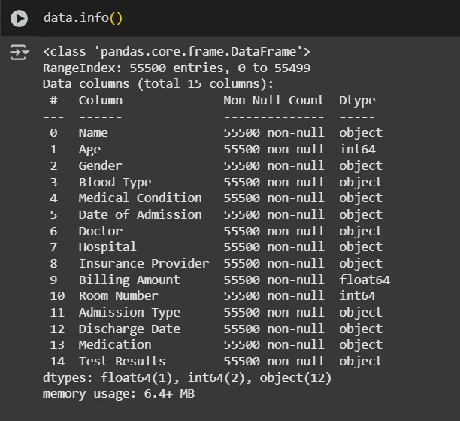

Slide 7
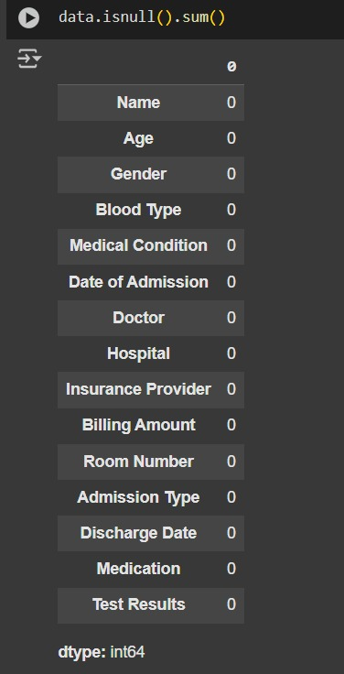

Slide 8
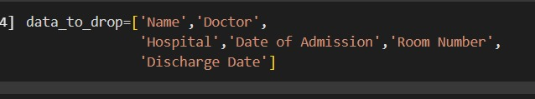

Slide 9


Slide 10
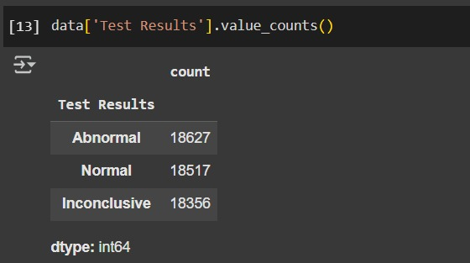

Slide 13
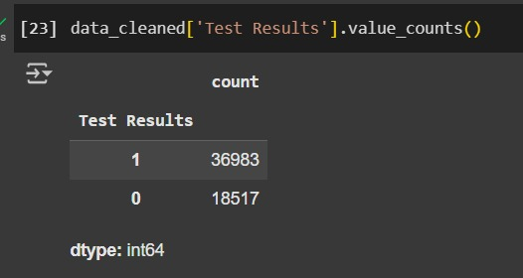

Slide 14
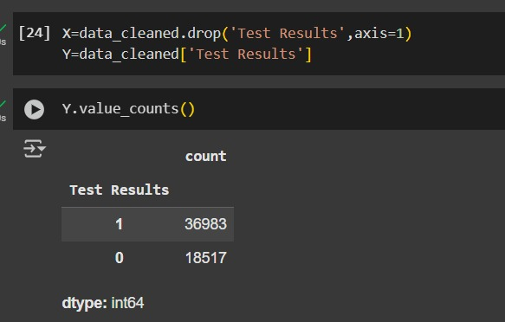

Slide 15
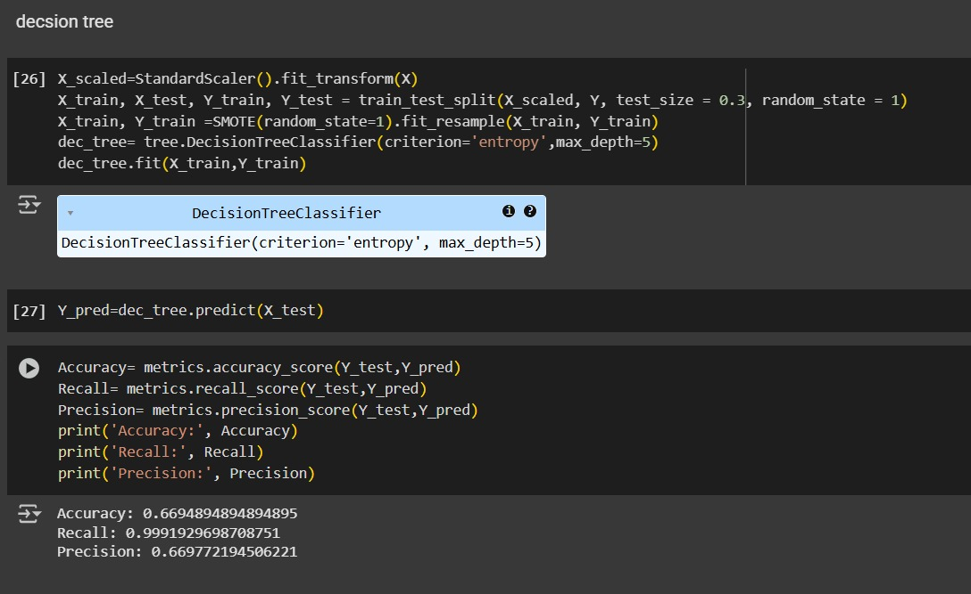
Decesion Tree

Slide 16
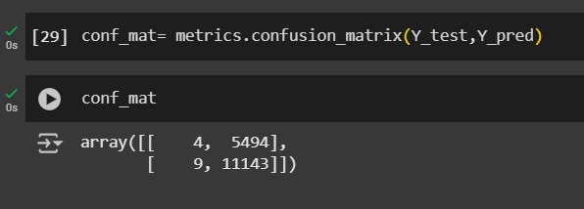

Slide 17
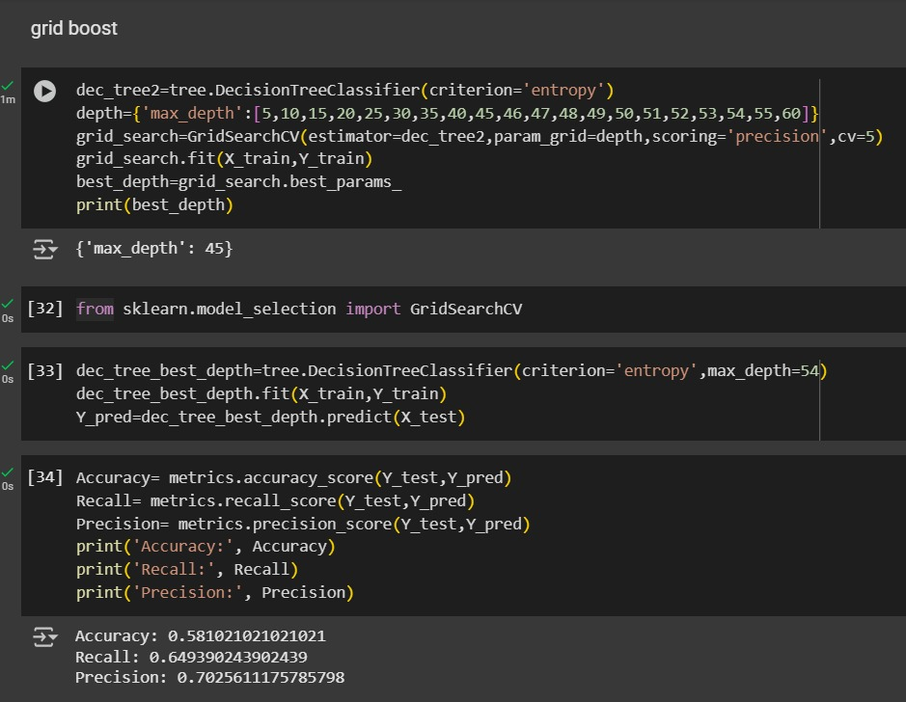

Slide 18
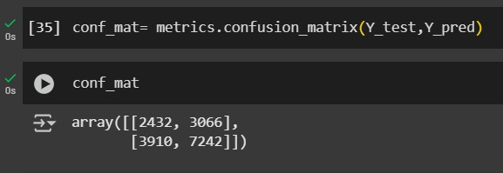

Slide 19
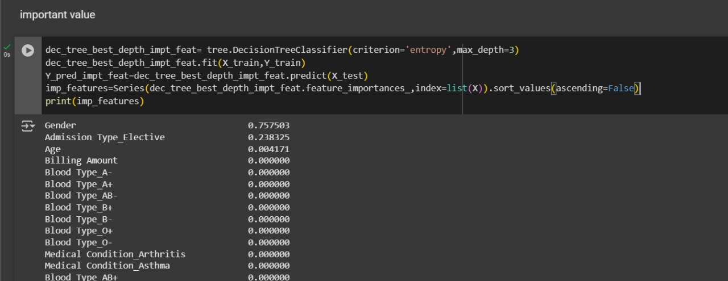

Slide 20
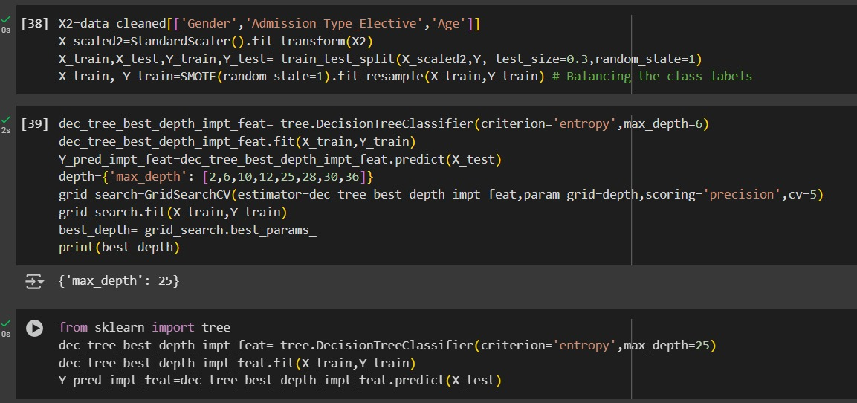

Slide 21
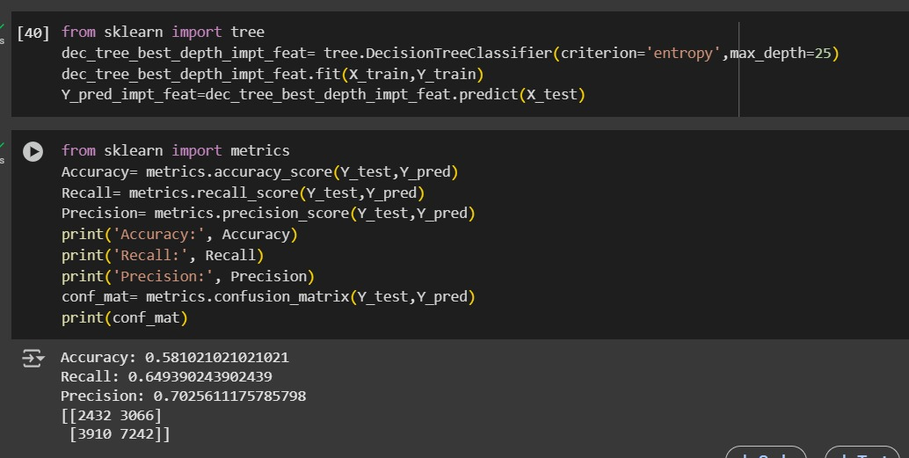

Slide 22
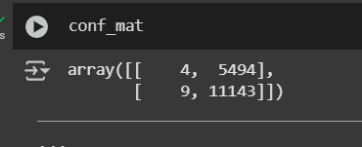

Comparison
Interpretation:
Outstanding recall: almost all abnormal cases detected
Precision moderately affected by high false positives
Strong choice for risk-sensitive environments

Slide 23
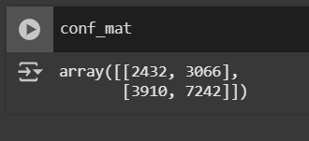
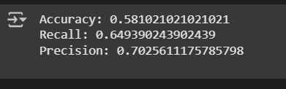
Comparison
Interpretation:
Balanced precision but lower recall
Misses a significant portion of abnormal cases
Tuning may have caused underfitting in this case

Slide 24
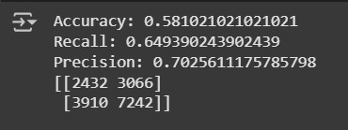
Interpretation:
Identical performance to the tuned model
Feature selection did not improve model outcome significantly
Could simplify model without major performance trade-off

Slide 25
Comparison
Standard Decision Tree with SMOTE provided the best recall, which is crucial in medical diagnosis
Both tuning and feature selection did not improve performance — in fact, recall dropped
SMOTE was essential to improve model sensitivity, but false positives increased

Slide 26
Add a Slide Title - 4

Slide 27
Add a Slide Title - 5

