Slide 1
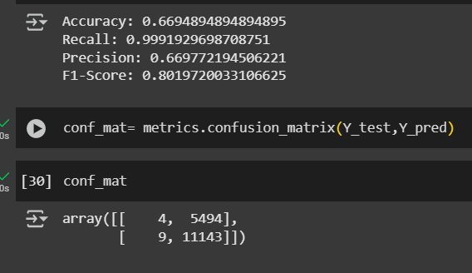
Decesion Tree It was fast and easy to run.But the results showed it wasn’t the best.It gave 66.9% accuracy, very high recall of nearly 1.0, but low precision. This means the model was great at catching abnormal cases, but also labeled many normal ones as abnormal — which is not ideal in healthcare.”

Slide 2
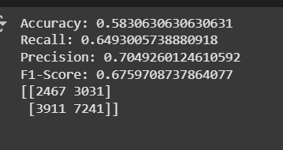
Tuned Decision Tree (GridSearch)
After tuning, the tree became more balanced.The recall dropped a bit, but the precision improved.Accuracy was around 58%, with better F1-score compared to before

Slide 3
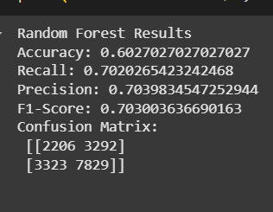
Random Forest
It performs better by combining the results of many small trees.The accuracy jumped to 60%, with balanced precision and recall.Feature importance again showed similar results — billing amount and age were top contributors. It already performed better than the basic decision tree

Slide 4
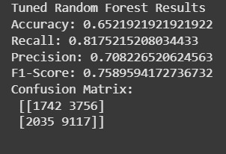
Tuned Random Forest (GridSearch)
This improved the model even more.Accuracy rose to 65.2%,Recall improved to 81.8%,And the F1-score was around 0.76 — which was the best among all models

Slide 5
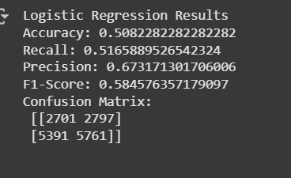
Logistic Regression
Accuracy was the lowest — only around 50.8%,But precision was still decent at 67%.It struggled with recall and F1-score

Slide 6
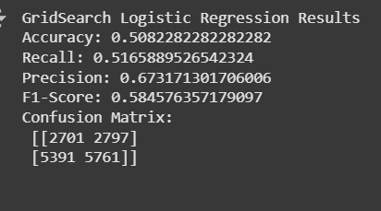
Tuned Logistic Regression
The values stayed almost the same as the basic logistic regression

Slide 7
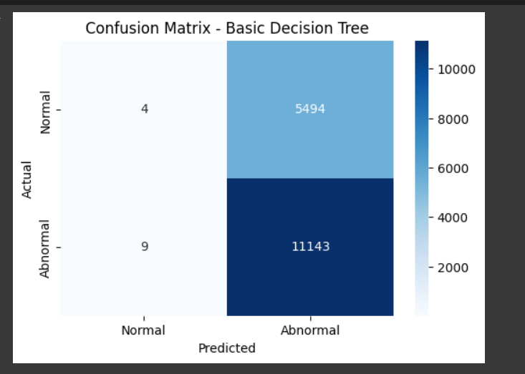

Slide 8
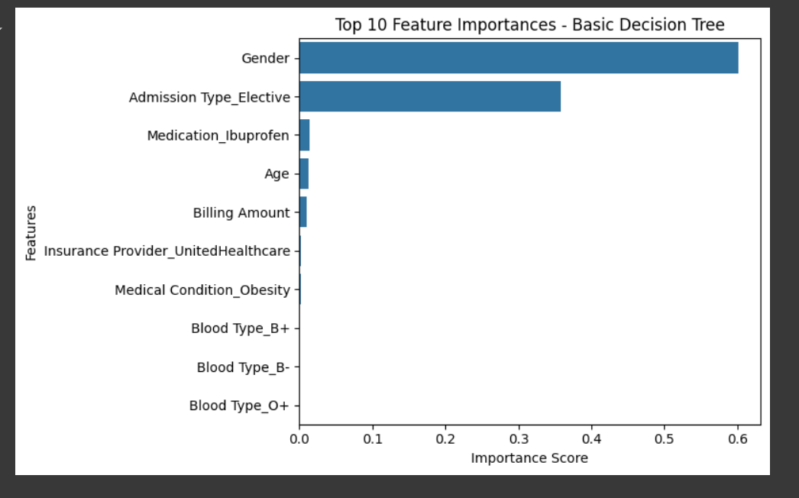
Good starting point with excellent recall but weak precision Tends to over-predict "Abnormal“ Needs tuning or different model to balance precision/recall

Slide 9
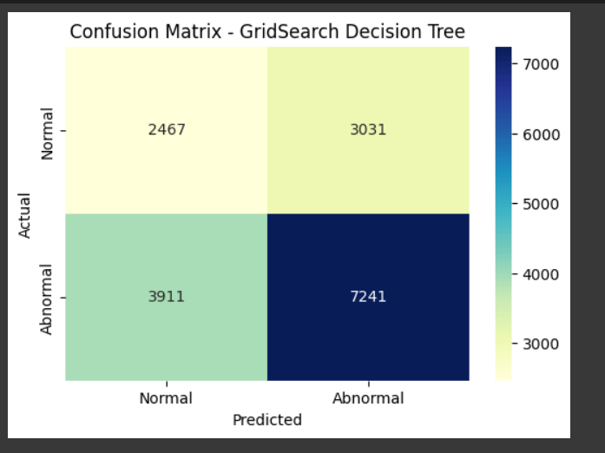

Slide 10
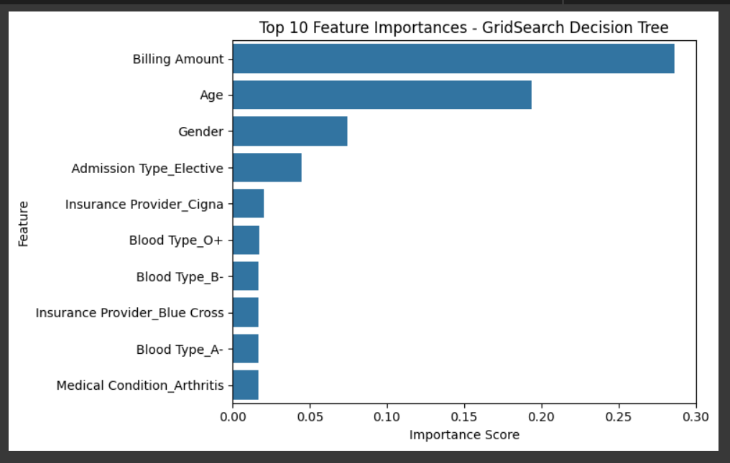
GridSearch tuning improved precision Recall dropped, but now predictions are more confident Great trade-off if false positives are a concern Could benefit from ensemble models next (like RF)

Slide 11
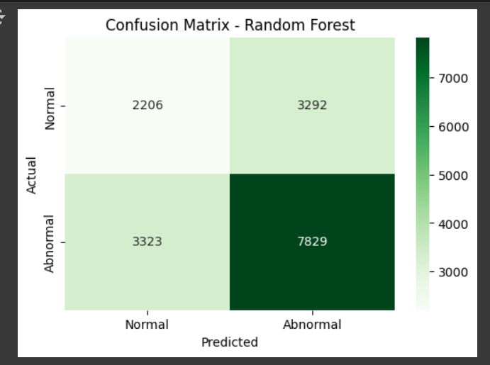

Slide 12
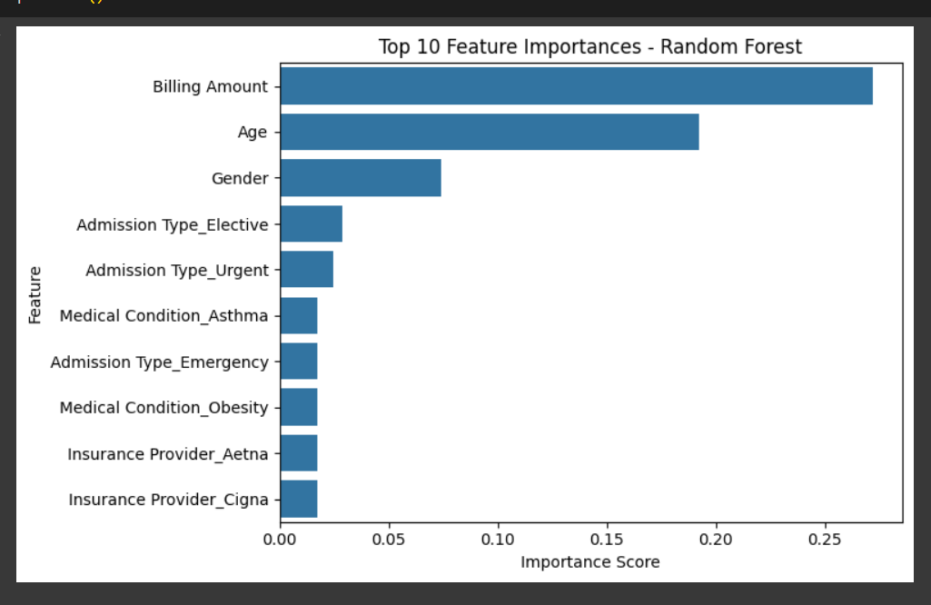
Strong all-around performance Handles class imbalance better than single DTGreat option for noisy or imbalanced datasets You’ll likely get even better results with hyperparameter tuning

Slide 13
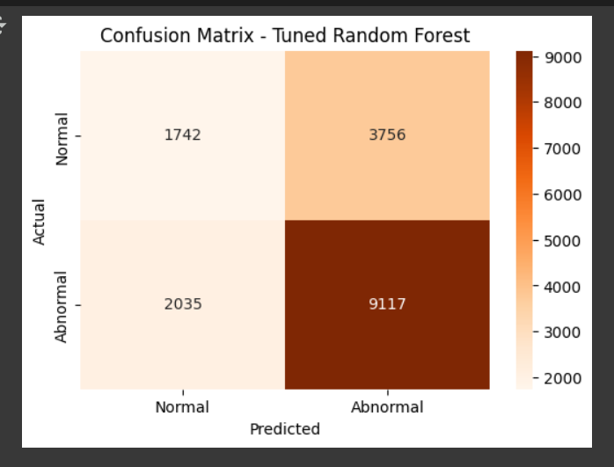
Graphical Representation

Slide 14
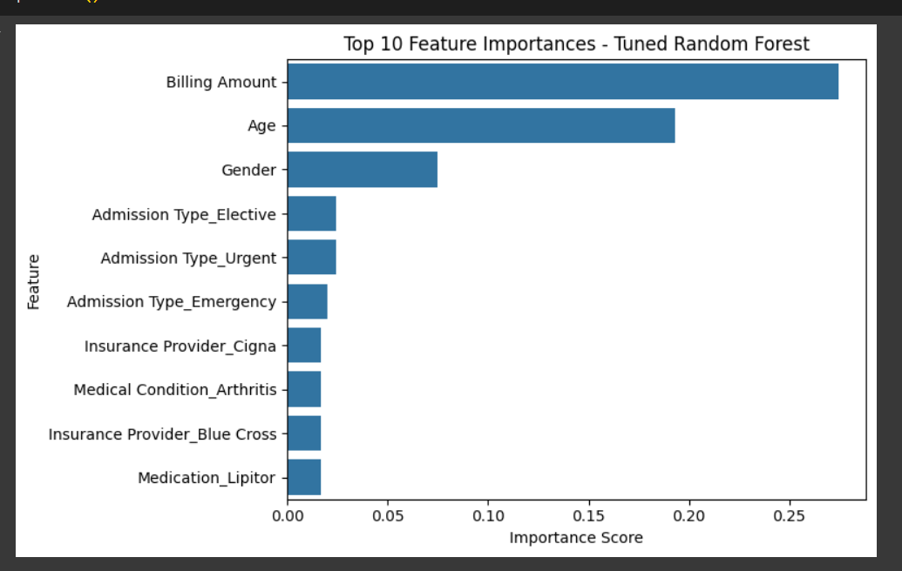
Best-performing model across all core metrics Handles class imbalance better than Decision Trees Robust, stable, and reliable — highly suited for healthcare risk prediction

Slide 15
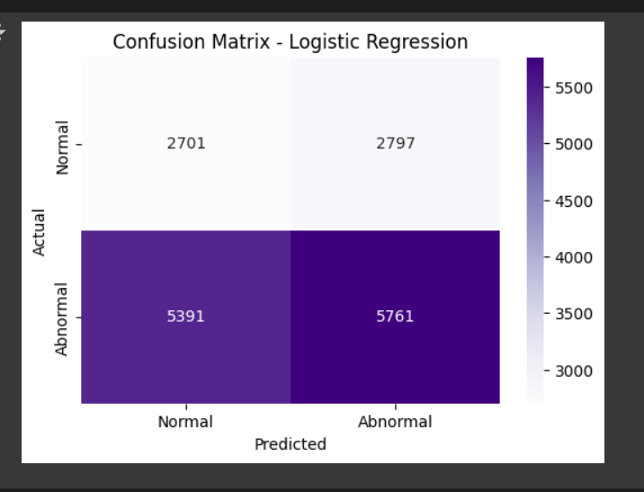

Slide 16
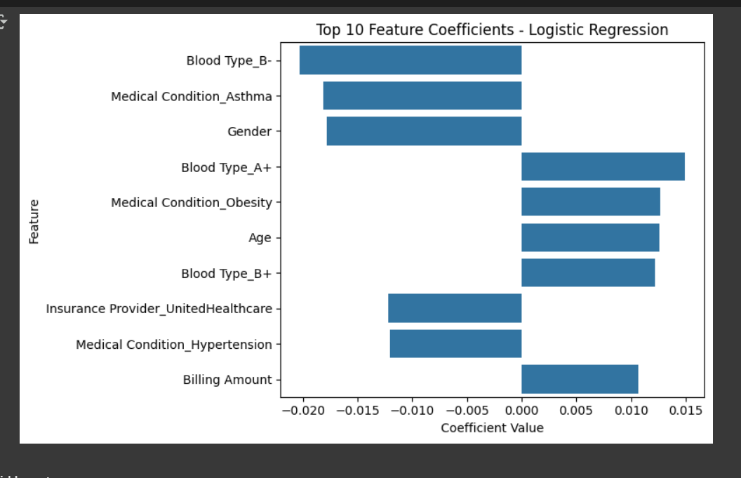
Best-performing model across all core metrics Handles class imbalance better than Decision Trees Robust, stable, and reliable — highly suited for healthcare risk prediction

Slide 17
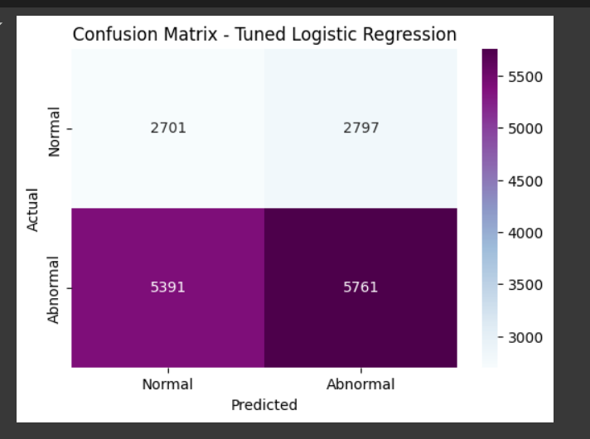

Slide 18
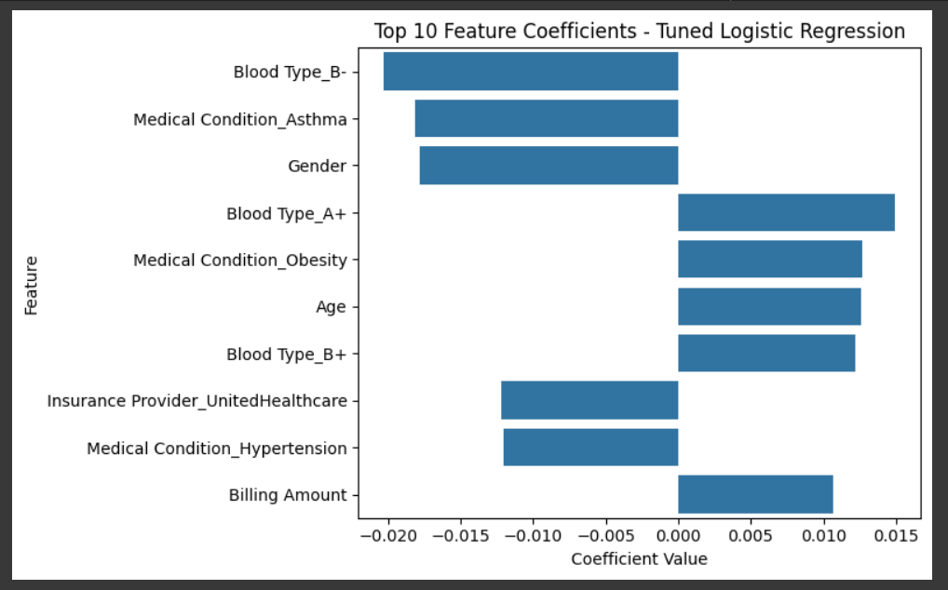
Model remains underwhelming even after tuning Best used for simple, explainable tasks For this healthcare dataset, not suitable as a final model

Slide 19
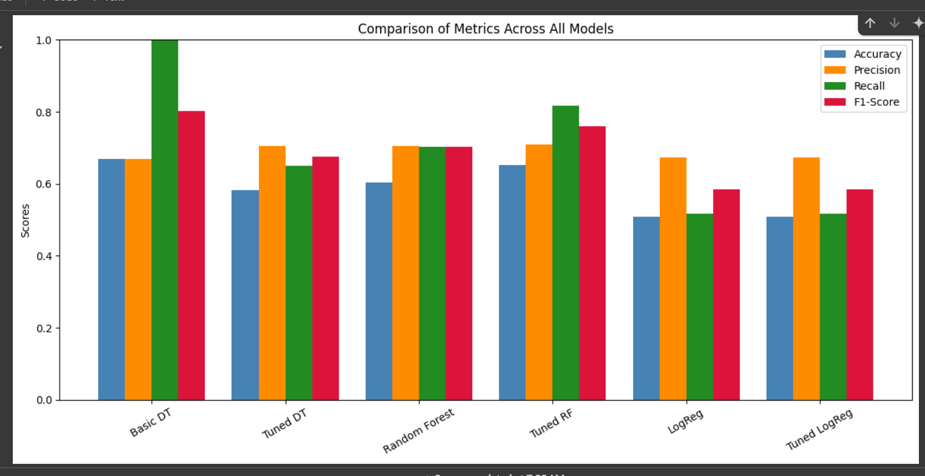

Slide 20
Tuned Random Forest leads in Recall and F1-Score, making it the best overall model Basic DT had the highest recall, but at the cost of precision Tuned DT improved precision slightly but lost a bit of recall Logistic Regression (both versions) had the weakest performance overall Random Forest (even untuned) outperformed basic and tuned DT models in F1-Score Tuned Random Forest is the top performer due to: Balanced precision and recall Best F1-score Solid accuracy without overfitting

Slide 21
