Slide 1
Introduction

Slide 2
What is Performance testing
In software quality assurance
performance testing is in general a testing practice performed to determine how a system performs in terms of responsiveness and stability under a particular workload.

Slide 3
What is agile?
A project management / product development philosophy
It is a set of values and principles
The Agile process consists of short, time-boxed iterations known as sprints. Each sprint results in a working product.
It creates opportunities to assess a project's direction during the development cycle
Agile emphasizes on producing results and optimizing performance

Slide 4
What are the Benefits?
Superior quality product
testing is an integrated part
Customer satisfaction
The client remains involved in the development process and can ask for changes depending on the market realities
Reduced risks
Agile works in small sprints that focus on continuous delivery
Continuous improvement
Working on self-reflection and striving for continuous improvement
The methodology works in iterations which means that each sprint will be better than the last one and previous mistakes will not be repeated

Slide 6
Increased flexibility
Teams work in smaller bursts and are supplemented by the constant feedback and involvement of the product owner
changes usually are time-consuming and costly
Agile divides the project in short sprints that are both manageable and flexible enough to allow the team to implement changes on short notice
Better control
Agile allows managers to have better control over the project due to its transparency, feedback integration, and quality-control features
More relevant metrics
The metrics used by Agile teams in estimating time and cost, measuring project performance are more accurate and relevant than the ones used in traditional methodologies
Agile produces important metrics like lead time, cycle time, and throughput that helps measure the team’s performance, identify bottlenecks and make data-driven decisions to correct them.

Slide 7
what are the 4 core principles of Agile
individuals and interactions over processes and tools
working software over comprehensive documentation
customer collaboration over contract negotiation
responding to change over following a plan

Slide 8
What is Scrum?
Scrum is a specific Agile methodology
an agile project management framework
With scrum, a product is built in a series of iterations called sprints that break down big, complex projects into bite-sized pieces
can use a framework like scrum to help you start thinking that way and to practice building agile principles into your everyday communication and work.
scrum describes a set of meetings, tools, and roles that work in concert to help teams structure and manage their work
Scrum is structured to help teams naturally adapt to changing conditions and user requirements, with re-prioritization built into the process and short release cycles so your team can constantly learn and improve

Slide 9
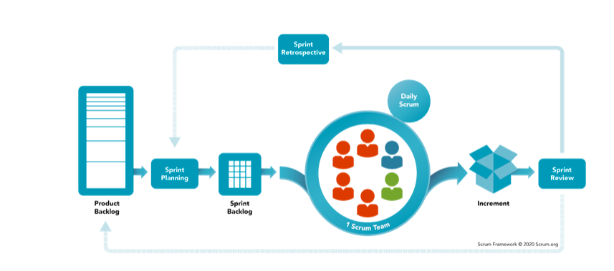
The Scrum Work Flow:

Slide 10
Scrum Backlogs:
Product backlog
This is the ultimate to-do list for the project/product
A product backlog item (PBI) is a single element of work in the product backlog
a PBI is an individual task that needs to be taken care of to improve the project or fix an issue
If every PBI is completed it means project is completed
The list of tasks(PBI’s) are continuously monitored and prioritized
New tasks(PBI’s) can be added to reflect any change
product backlog refers to a prioritized list of functionality which a product should contain. It is sometimes referred to as a to-do list, and is considered an 'artifact' within the scrum software development framework.

Slide 11
Sprint planning
Sprint planning is an event in scrum that kicks off the sprint
The purpose of sprint planning is to define what can be delivered in the sprint and how that work will be achieved
Sprint planning is done in collaboration with the whole scrum team
before you can leap into action you have to set up the sprint:
The What – The product owner describes the objective(or goal) of the sprint and what backlog items contribute to that goal
The How – The development team plans the work necessary to deliver the sprint goal
Ultimately, the resulting sprint plan is a negotiation between the development team and product owner based on value and effort.

Slide 12
Sprint Backlog:
the Sprint Backlog is composed of the Sprint Goal (why), the set of Product Backlog items selected for the Sprint (what), as well as an actionable plan for delivering the Increment (how)
The main purpose of the Sprint Backlog is to provide the Scrum Team (and other stakeholders) with full transparency of the work being done during the Sprint.
The sprint backlog is a list of tasks identified by the Scrum team to be completed during the Scrum sprint. During the sprint planning meeting, the team selects some number of product backlog items, usually in the form of user stories, and identifies the tasks necessary to complete each user story
A sprint backlog is the subset of product backlog that a team targets to deliver during a sprint in order to accomplish the sprint goal and make progress toward a desired outcome.
The sprint backlog consists of product backlog items that the team agreed with their product owner to include during sprint planning

Slide 13
The Actual sprint
A sprint is a short, time-boxed period when a scrum team works to complete a set amount of work
Sprints are at the very heart of scrum
Make sure the team sets and understands the sprint goal and how success will be measured. This is the key to keeping everyone aligned and moving forward toward a common destination
Optimize your sprints with automation

Slide 14
Scrum Ceremony(meetings):
Sprint Planning Meeting
Daily Scrum Meeting
Sprint Review Meeting
sprint review is about the product
in a Sprint Review meeting, the Scrum Team and stakeholders discuss the work done during the Sprint. After assessing the work done along with changes made to the Product Backlog, the group collaborates on what steps should be taken next to optimize the value of the software
Sprint Retrospective Meeting
sprint retrospective is about the team
The Scrum sprint retrospective is a timeboxed meeting that takes place after the sprint review and before sprint planning
The sprint retrospective is focused on how the team worked together during the sprint
goal of a sprint retrospective is to improve the development process
Backlog Refinement Meeting

Slide 15
Presentation start from here
Introductions:

Slide 16
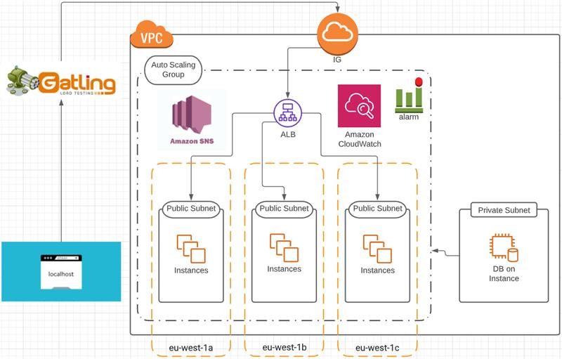
Project Diagram:

Slide 17
Autoscaling Group

Slide 18
Application Load Balancer

Slide 19
What is gatling
Gatling is an open-source load- and performance-testing framework based on Scala, Akka and Netty.
What is Performance testing:
performance testing is in general a testing practice performed to determine how a system performs in terms of responsiveness and stability under a particular workload

Slide 20
Why performance testing:
If you’re a developer or QA engineer or if you work in DevOps, you know you need to conduct different types of performance tests in order to make sure each code change or feature addition (a) doesn’t break the system
Performance testing examines responsiveness, stability, scalability, reliability, speed and resource usage of your software and infrastructure
Before performance testing, it’s important to determine your system’s business goals, so you can tell if your system behaves satisfactorily or not according to your customers’ needs

Slide 21
Types of performance Testing (will be performed)
Load testing
the test measures how systems handle heavy load volumes
Stress testing
Stress tests examine how the system behaves under intense loads and how it recovers when going back to normal usage
Spike Testing
If your stress test includes a sudden, high ramp-up in the number of virtual users, it is called a Spike Test
Soal Testing
If you stress test for a long period of time to check the system’s sustainability over time with a slow ramp-up, it’s called a Soak Test

Slide 22
Load Testing
Load testing is the process of putting demand on a system and measuring its response.
A load test is a type of performance test that checks how systems function under a heavy number of concurrent virtual users performing transactions over a certain period of time
Load test when you want to determine how many users your system can actually handle

Slide 23
Stress testing:
A stress test is a type of performance test that checks the upper limits of your system by testing it under extreme loads
Stress tests examine how the system behaves under intense loads and how it recovers when going back to normal usage
Stress testing can be conducted through load testing tools by defining a test case with a very high number of concurrent virtual users
Run stress tests against your website or app before major events, like Black Friday, ticket selling for a popular concert with high demand, or elections

Slide 24
Spike Testing:
If your stress test includes a sudden, high ramp-up in the number of virtual users, it is called a Spike Test
The goal of spike testing is to determine the behavior of a software application when it receives extreme variations in traffic.
Spike testing addresses more than just an application's maximum load; it also verifies an application's recovery time between activity spikes.

Slide 25
Soak Testing:
Soak testing is a type of load testing.
Soak tests are similar to spike tests, except they test the system over time
Soak testing involves testing a system with a typical production load, over a continuous availability period, to validate system behavior under production use
Soak tests are used primarily to check the reaction of a subject under test under a possible simulated environment for a given duration and for a given threshold.

Slide 26
What is Agile
A project management / product development philosophy
The Agile process consists of short, time-boxed iterations known as sprints. Each sprint results in a working product.
4 core principles of Agile:
individuals and interactions over processes and tools
working software over comprehensive documentation
customer collaboration over contract negotiation
responding to change over following a plan

Slide 27
What is Scrum?
Scrum is a framework to implement agile way of development

Slide 28
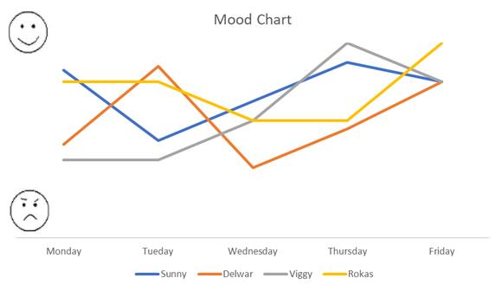
Mood Board

Slide 29
Our project content
Yet to be filled
Trello
Mood board

