Slide 1
CUHKSZ-Overflow -an online forum database design
119010010 ChenBoyi 119010167 LiZihan
119010185 LinghuHan 119010108 HuangPengxiang

Slide 2

Contents
ER-diagram & Relational Schema & Normalization
1
2
3
Introduction
SQL Queries
4
5
6
Improve with Index
Web Demo
Data Mining

Slide 3
1. Introduction
A forum database designed for CUHKSZ programmers as a problem-solving tool

Slide 4
MAIN FUNCTION
Link the question to its correct answer
User
Login, Register, Upload profile…
Blog
Post, Like, Follow, Answer…

Slide 5
2. ER-diagram & Relational Schema & Normalization

Slide 6
E-R diagram

Slide 7
Schema
user(id, email, username, password, photo, major, grade, create_time, update_time)
group(id, group_name, description, create_time, update_time, amount_of_follows)
..

Slide 8
Normalization

Slide 9
3. Sample Queries

Slide 10
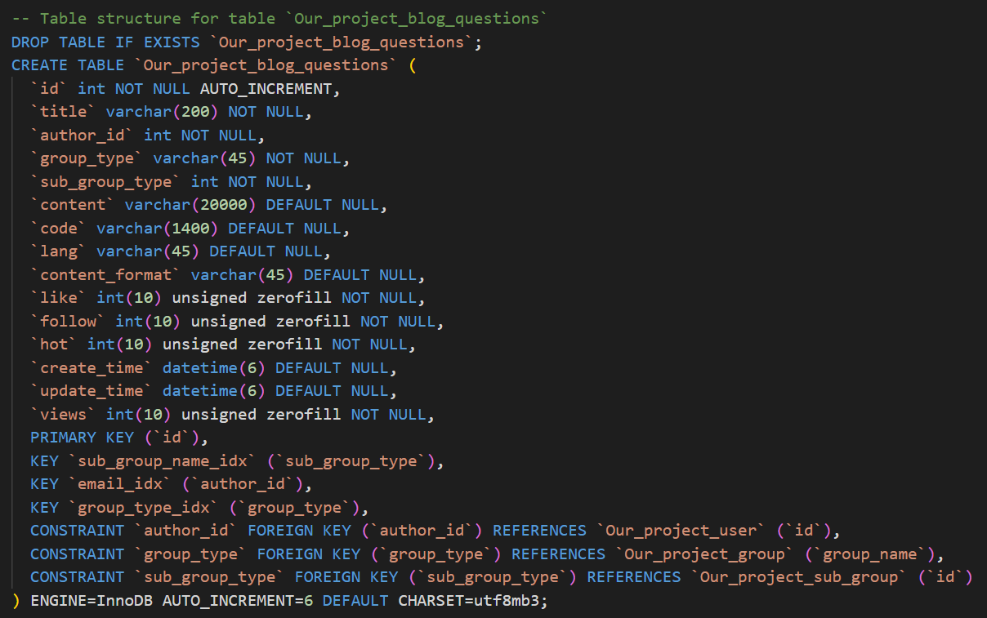
# Query 1: Definition with intergrity constraints

Slide 11
# Query 2: directly interacts with database

Slide 12
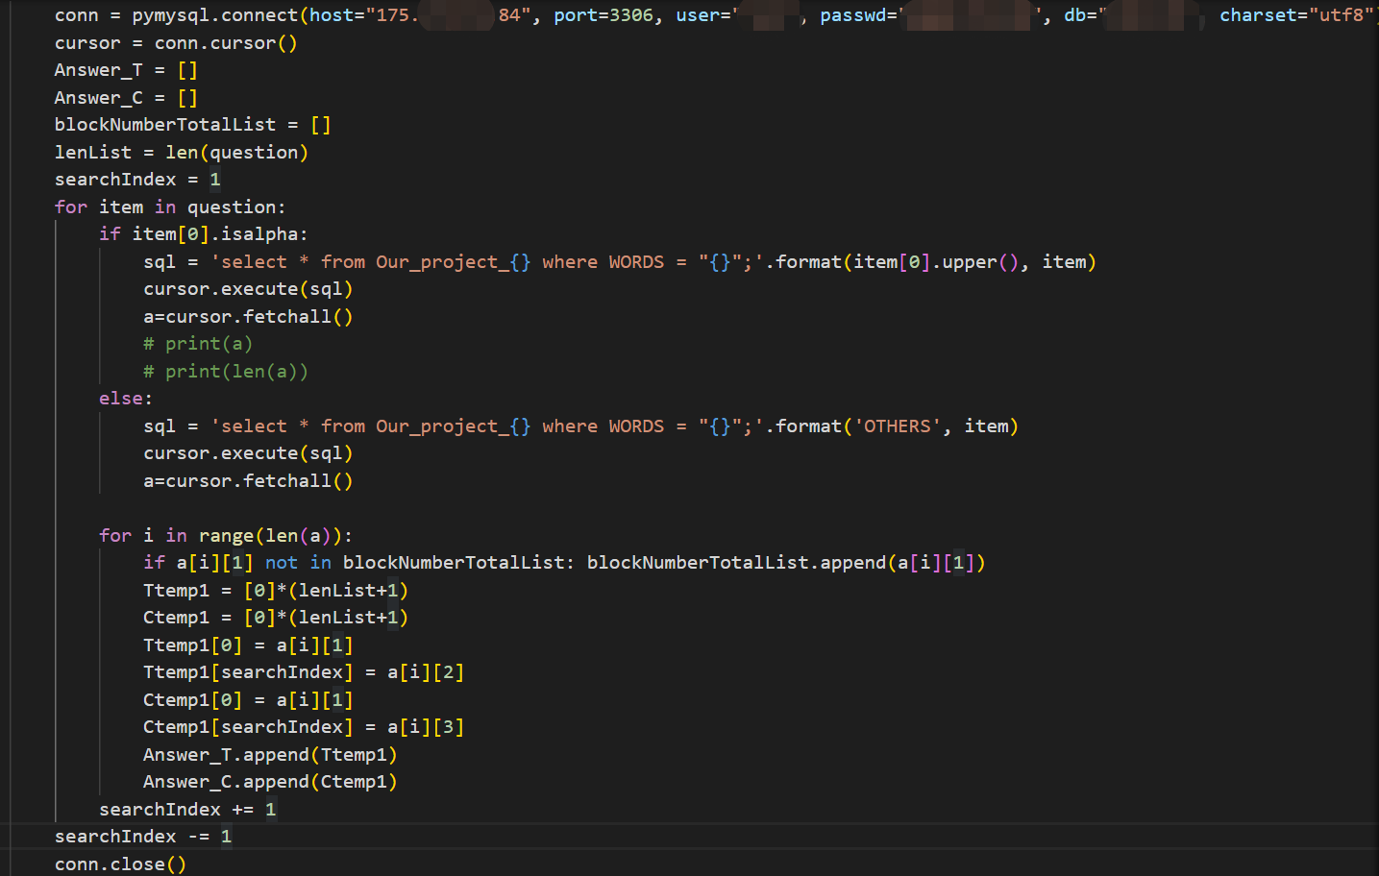
# Query 3: Query within host language

Slide 13
4. Improve with index

Slide 14
Hash Index
Advantage: faster when searching for a specific row (e.g. user id,)
Disadvantage: Use “memory” engine, volatile, not secure (are gone when dataset restart)

Slide 15
B-Tree Index
Advantage: can improve speed on searching for a range of values
Examples:
sub_group_name
username
question_id

Slide 16
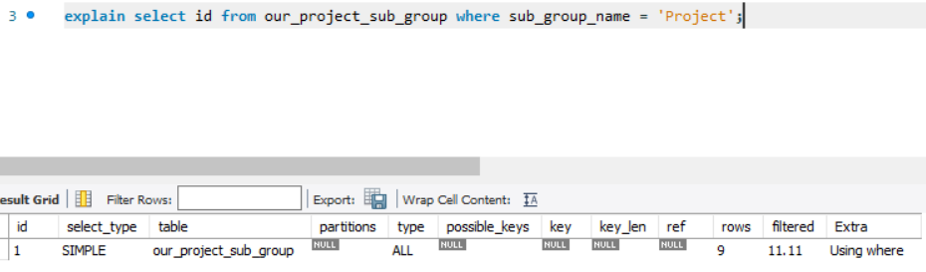
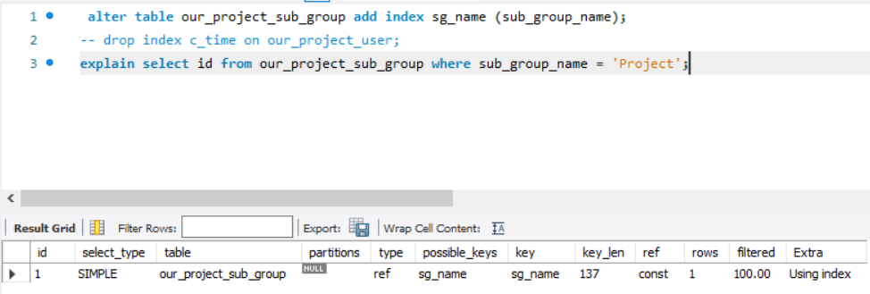
Sub-group name
before
after

Slide 17
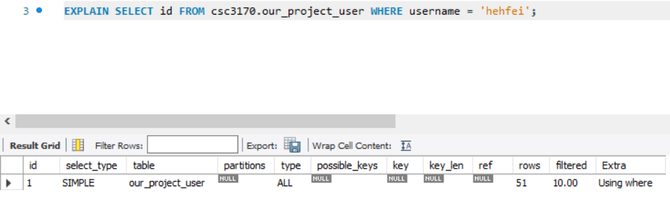
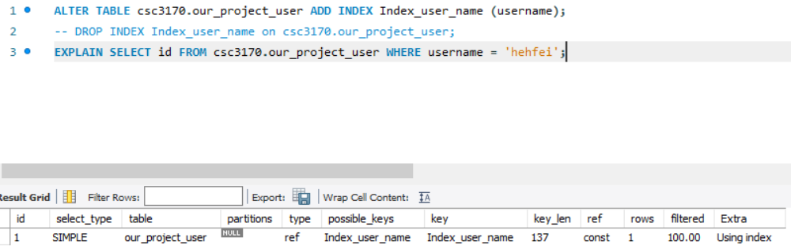
username
before
after

Slide 18
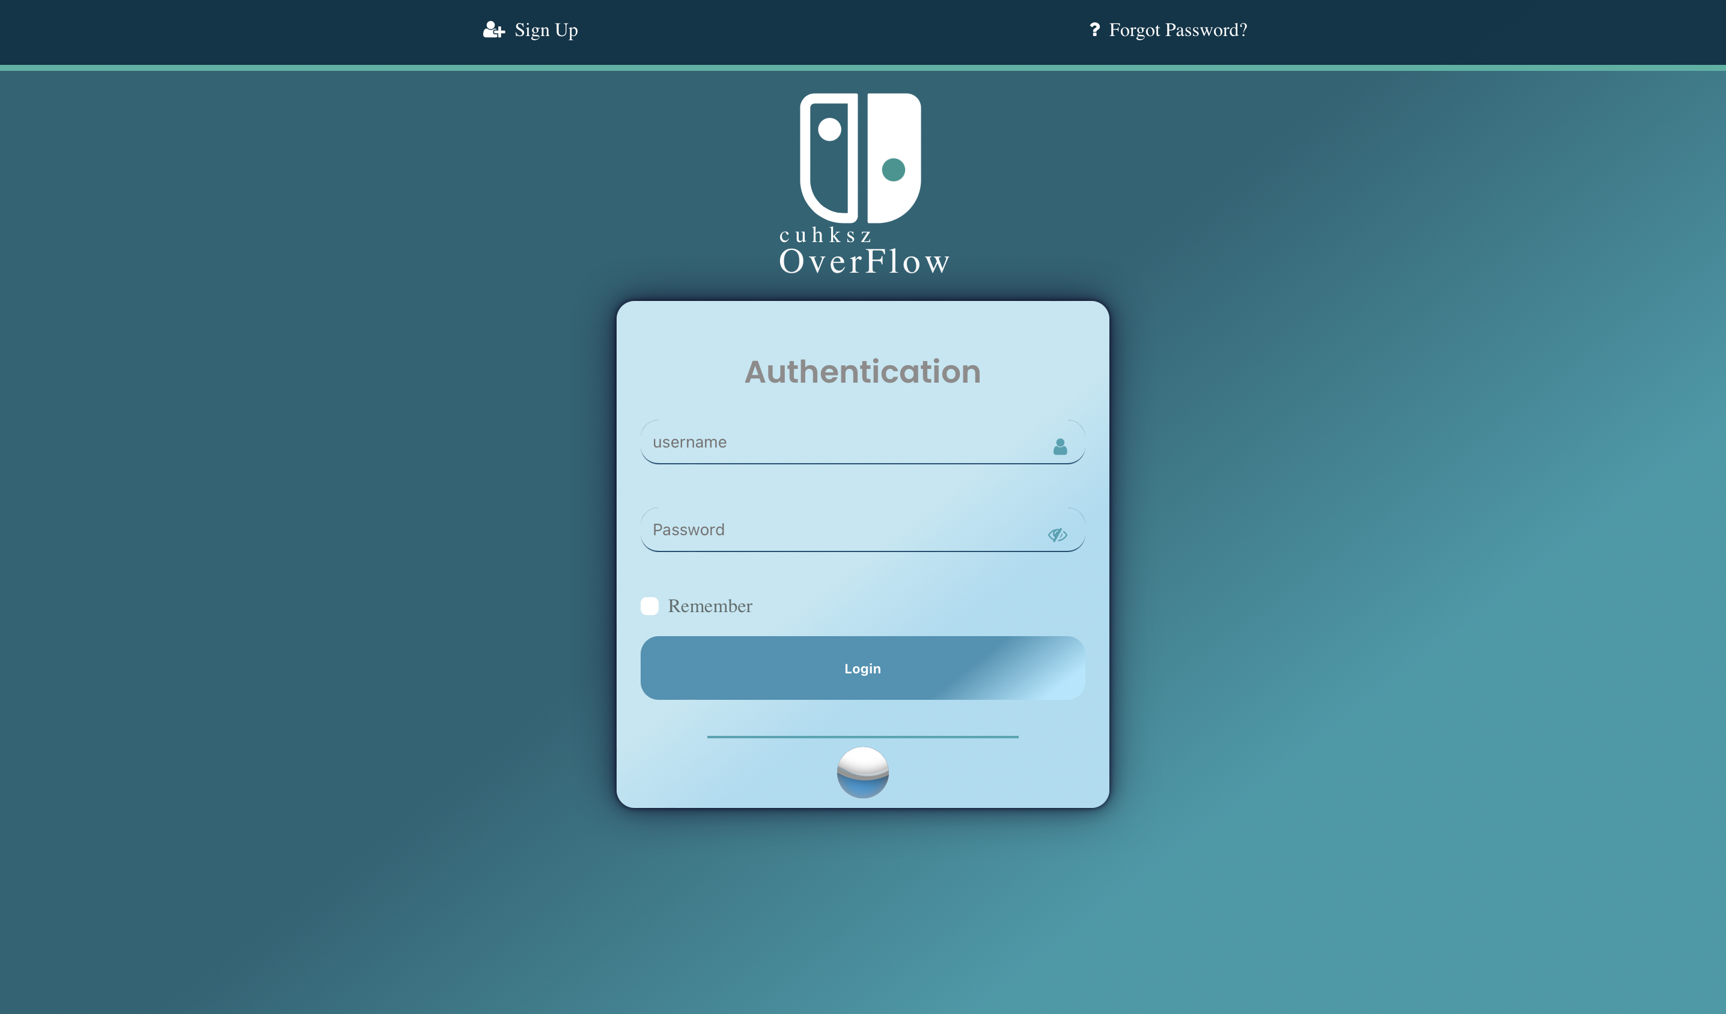
5. Web Demo

Slide 19
Quotations are commonly printed as a means of inspiration and to invoke philosophical thoughts from the reader.

Slide 20
Our process is easy
last
first
second

Slide 21
Thanks!
Any questions?
You can find me at:
@username & user@mail.me

