Slide 1
CSC3100 tutorial 3
Yueyao Yu

Slide 2
Jump Game
You are given an integer array nums.
You are initially positioned at the array's first index, and each element in the array represents your maximum jump length at that position.
Return true if you can reach the last index, or false otherwise
(hint: using Greedy Algorithm)

Slide 3
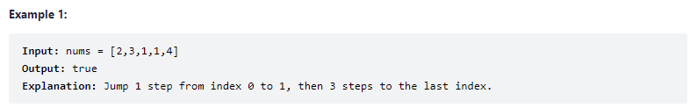
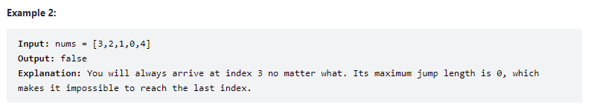
Example :

Slide 4

Solution: Greedy Algorithm
Assume we want to arrive the position y, if there existes a position x, and x+nums(x) $≥$ y, then we can arrive y.
Further, if the current position is x, then we can arrive these positions x+1,… ,x+nums(x).

Slide 5
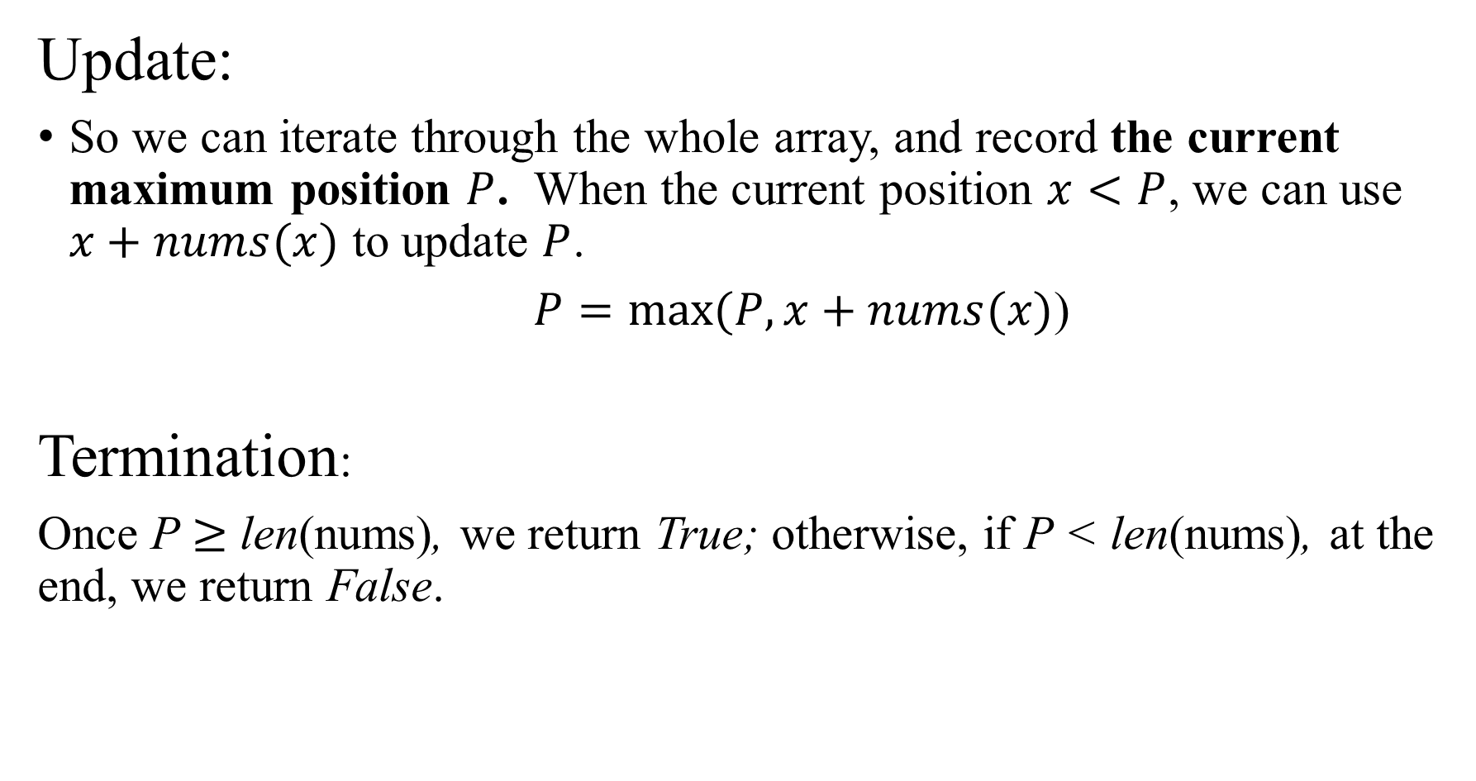
Update:
So we can iterate through the whole array, and record the current maximum position $P$. When the current position $x<P$, we can use $x+nums(x)$ to update $P$.
$P=\max{(P,}x+nums(x)$)
Termination:
Once P $≥$ len(nums), we return True; otherwise, if P < len(nums), at the end, we return False.

Slide 6
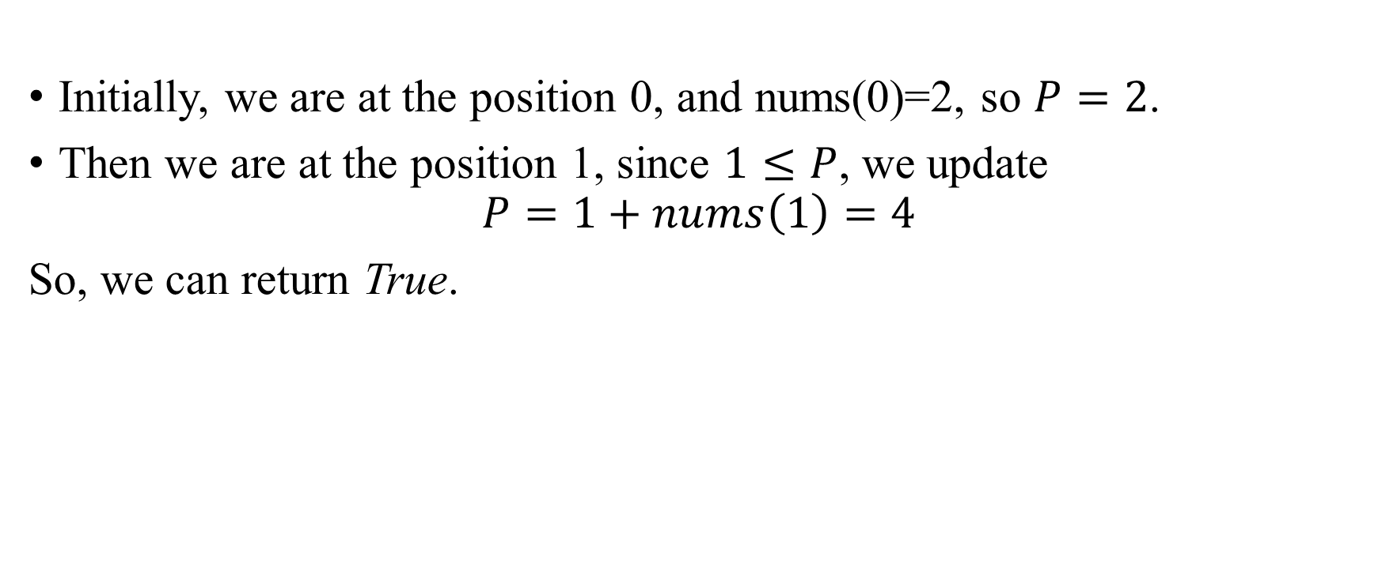
Initially, we are at the position 0, and nums(0)=2, so $P=2$.
Then we are at the position 1, since $1≤P$, we update
$$P=1+nums\left(1\right)=4$$
So, we can return True.

Slide 7
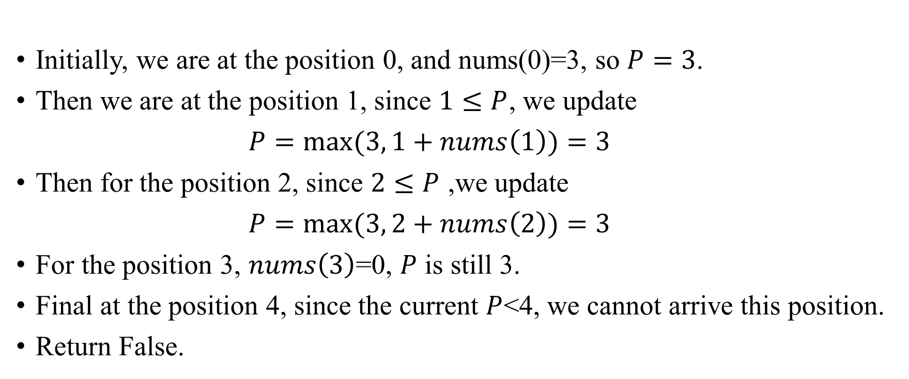
Initially, we are at the position 0, and nums(0)=3, so $P=3$.
Then we are at the position 1, since $1≤P$, we update
$P=\max{(3,}1+nums\left(1\right))=3$
Then for the position 2, since $2≤P$ ,we update
$P=\max{(3,}2+nums\left(2\right))=3$
For the position 3, $nums\left(3\right)$=0, $P$ is still 3.
Final at the position 4, since the current $P$<4, we cannot arrive this position.
Return False.

Slide 8
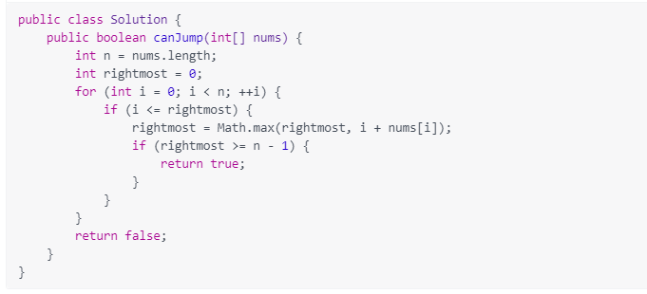
Code
iterate through the array
update the P
Termination condition

Slide 9
Complexity
Time complexity: O(n), we only use one single loop.
Space complexity: O(1), no extra cost.

Slide 10
Jump Game 2
Given an array of non-negative integers nums, you are initially positioned at the first index of the array.
Each element in the array represents your maximum jump length at that position.
Your goal is to reach the last index in the minimum number of jumps.
You can assume that you can always reach the last index.
(hint: still using Greedy Algorithm)

Slide 11
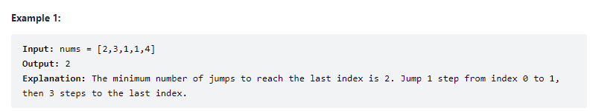
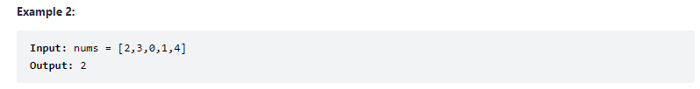
Example :
we can use either forward lookup or reverse lookup.

Slide 12
Solution 1: reverse lookup
Our target is to arrive the last position in the array, so we consider the last step, where we can jeep to the end position.
If there exists multiple eligible positions, we select the furthest one, which is the first eligible one.
Then we select the second to last position.

Slide 13
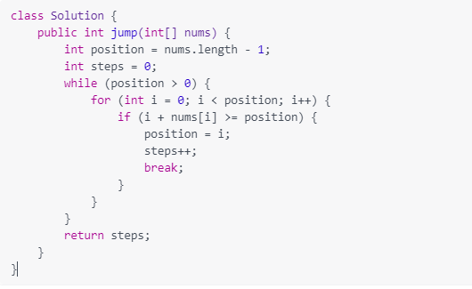
Code
Define the end position
Iterate the array
Find the stasified position

Slide 14
Complexity
Time complexity: O(n^2), we use two loops, in the worst case, it is n^2.

Slide 15
Solution 2: forward lookup
Main idea: We search forward and find the furthest position in each point. Then the time complexity will be O(n).

Slide 16
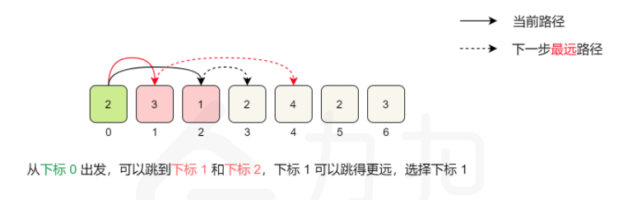
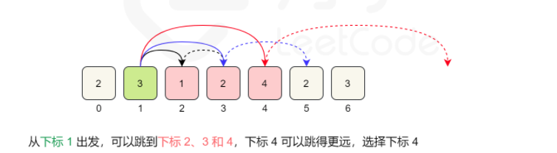
Example
given [2,3,1,2,4,2,3]

Slide 17
Implementation
We iterate the array forward and maintain the current furthest position which we can arrived, called Margin.
At each time, when we arrive the margin, we need to add the jump step.
Please do not access the last item, since before we access the last one, our margin must large than its position, otherwise we cannot jump to the end. If we access this item and the margin is exactly equal to it, we will add a ‘unnecessary step’.

Slide 18
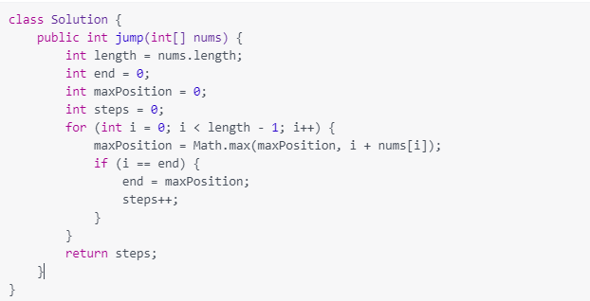
Code
Define the end position
Iterate the array
Update the margin
The margin of the current step position.
Update the step

Slide 19
Complexity
Time complexity: O(n), we only use one loop.

