Slide 1

CUHKSZ Overflow
Huang Pengxiang Qin Peiran
Li Zihan Linghu Han

Slide 2
CONTENTS
1. Overview
2. Functions
3. Testing
4. References

Slide 3
PART 01
Overview

Slide 4
Our project, CUHKSZ-Overflow mainly aims to provide a Q&A platform for CUHKSZ programmers who have technical questions about their Computer Science courses' projects or assignments in CUHK(SZ). It also offers a social channel where some of students, especially senior students, could share their programming and working experience, provide the guidance in CS learning, and give the specific suggestions to the other younger students who may encounter the same problem or situation. We hope to create an environment where students could bravely post their programming problems while other students or teachers would willingly to see and reply those questions.
Hopefully this kind of communication will help students fully understand their homework, also improve their programming skill and accumulate programming experience. Those communication and connection eventually could save much time for students learning CS also reduce the teaching load for TA at the same time, which definable will enhance both learning and teaching quality in Computer Science courses.
You can run our code by git clone https://github.com/Demario-Huang/CSC4001_Project.git
Or you can directly test our code on website: http://175.178.34.84/index/#/

Slide 5
PART 02
Functions

Slide 6
List of functions
10. Raise questions
1. Registration
10.1 Basic information
2. Log in
10.2 Text edition
3. Log out
4. Forget Password
10.3 Online compiling
5. Edit profile
10.4 Uploading
6. Home page
11. Admin
7. Search & Return
12. Apply to server
8. Answer
13. Privacy & Safety
9. Like & Follow & Favorite
14. Frontend optimization

Slide 7
1. Registration
To create a user account, users have to go to the sign-up stage and provide the username, email, and code (with double-check). The backend will check whether there is any duplicate username in the database and give corresponding hints. If no error, users will receive the verification code at the input email address. After users input the right verification code, the account will be created.

Slide 8
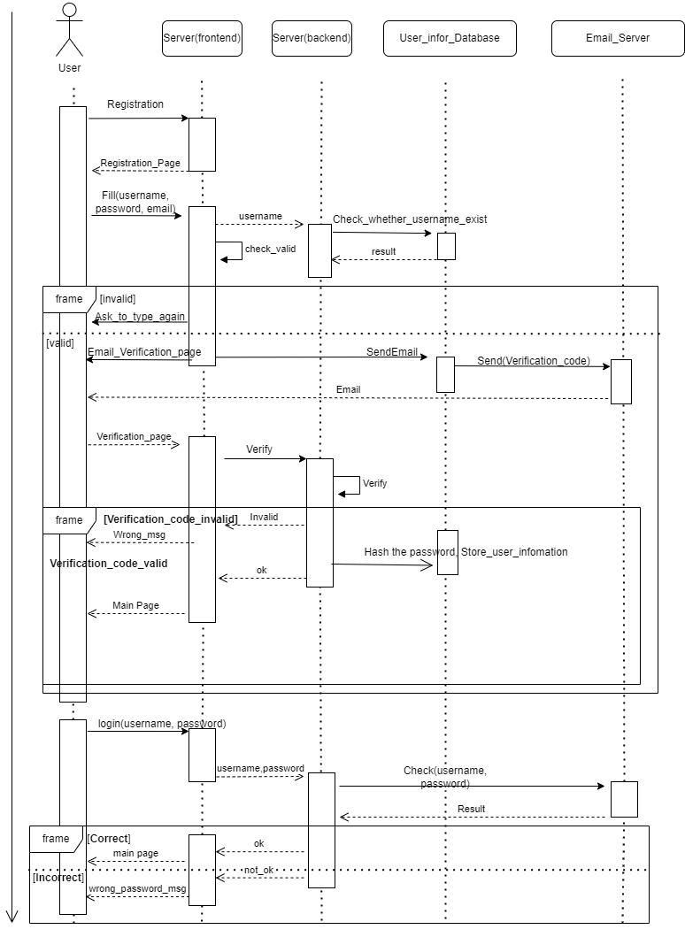
UML sequence diagram

Slide 9
Video Demo

Slide 10
Functions:
Backend: register(), verify(), sendEmail(), encode()
Frontend: register.vue, design.vue

Slide 11
2. Log in
The authentication process is about inputting the username and password. Then the backend will check the validation of the information and choose to accept or reject the request. If the password is forgotten, there is a reset process to help change the password for the users and log-in process.

Slide 12
Video Demo

Slide 13
Functions:
Backend: login()
Frontend: login.vue

Slide 14
3. Log out
Log out of the account and return to the log-in stage.

Slide 15
Video Demo

Slide 16
Functions:
Backend: logout()
Frontend: logout() in home.vue

Slide 17
4. Forget Password
Help users reset Password via Email if he/she forgets the password.

Slide 18
Video Demo

Slide 19
Functions:
Backend: update(), sendEmail()
Frontend: forget.vue

Slide 20
4. Edit Profile
Users can change the password and username. This process is similar to registration. The backend will check the validation of the username. Because the changing process follows the log-in process, changing the password do not require email verification anymore. Also, users can upload or update their own profile pictures.

Slide 21
Video Demo – Reset Username

Slide 22
Video Demo – Reset Password

Slide 23
Video Demo – Upload Profile

Slide 24
Functions:
Backend: update(), uploadProfile()
Frontend: beforeAvatarUpload(), uploadProfile(), handleAvatarSuccess() in home.vue

Slide 25
5. Home page
After the successful log-in process, users will get into the home page. Users can choose to view the Main page, where there are different partitions like Hot Blogs, Followed Blogs, etc. Also, users can get into the Partitions page, and there are different specific partitions inside the Partition page.

Slide 26
Video Demo

Slide 27
Screen shot
Functions:
Backend: main_page(), my_follow(), my_group,
unAnswered(), like(), follow(),
change_amount_of_like_or_follow(),
gerGroup(), followGroup(), groups(), MyGroups(),
MyBlogs(), Addviews()
Frontend: home.vue

Slide 28
6. Search & Return
On the main page, users are also able to search for a specific topic. There is a search box at the top of the website. Just type the information and click the search button, and corresponding blogs will return if they exist. Users can also choose the range of the search. That is, there choose to search within all topics, in particular partitions, or even in certain sub-partitions.

Slide 29
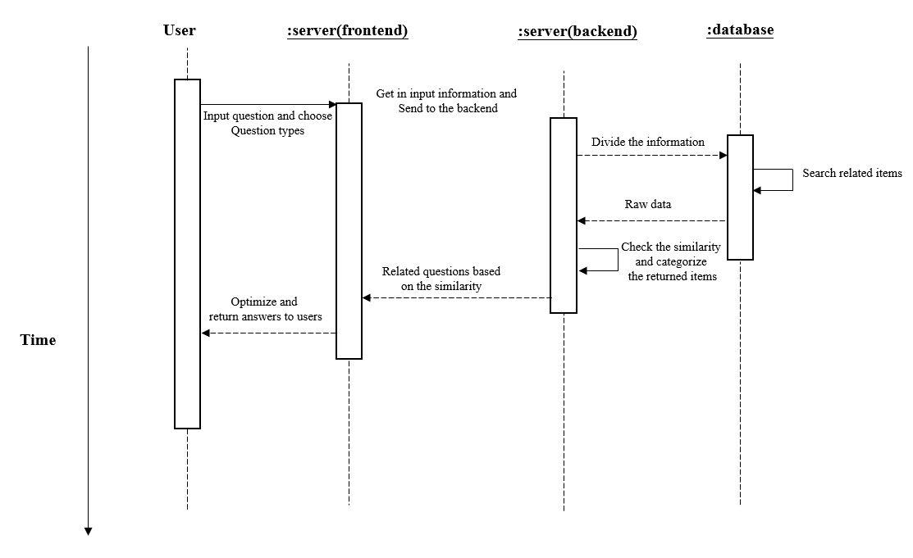
UML sequence diagram

Slide 30
Demo Video

Slide 31
Functions:
Backend: searchQuestion()
Frontend: search() in home.vue

Slide 32
7. Answer
If you are skilled in some questions, you are welcome to get involved in the discussion. Click particular questions, and you can start to help others!

Slide 33
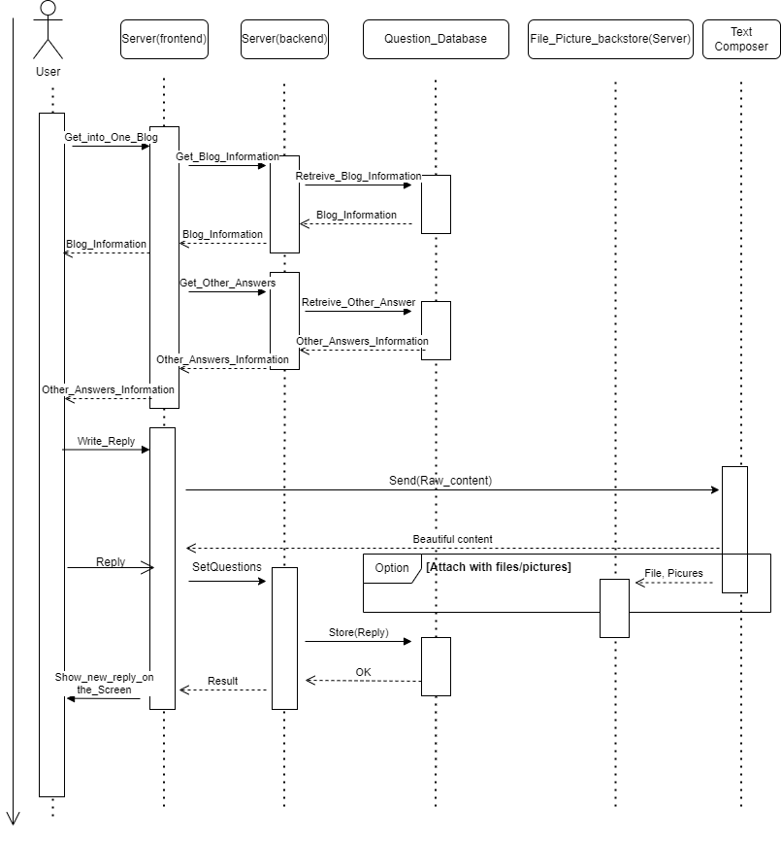
UML sequence diagram

Slide 34
Video Demo

Slide 35
Screen shot
Functions:
Backend:GetQuestions(), get_HTML(), get_raw(),
GetAnswers(), follow(), like(), Reply(), get_file()
Frontend: answer in blog.vue

Slide 36
8. Like & Follow & Favorite
Users interested in some questions can click different buttons under the question titles to like, follow, or favorite them.

Slide 37
Video Demo

Slide 38
Screen shot
Functions:
Backend: like(), follow(), followGroup()
Frontend: like(), follow(), followGroup() in home.vue and blog.vue

Slide 39
9. Raise questions
If there is no discussion about specific topics, users can then choose to post and start a new discussion. Click the post button, and they are able to get into the posting page. And there are different detailed functions in the post-stage.

Slide 40
Overview demo

Slide 41
Screen shot
Functions:
Backend: run_code(), setQuestion()
Frontend: post.vue

Slide 42
9.1 Basic information
Users have to input essential information like title, blog content, partition, and sub-partition.

Slide 43
9.2 Text edition
Users can edit the content of the text online. For instance, they can bord ,align different parts of the content. They can also insert pictures in their text.。

Slide 44
UML sequence diagram

Slide 45
Video demo

Slide 46
Functions:
Backend: null
Frontend: Froala components in post.vue

Slide 47
9.3 Online compiling
We also provide an online compiling interface for the posting page. Users can program online with different programming languages. After clicking the Run button, they are supposed to see the outcome of the program.

Slide 48
Demo

Slide 49
Functions:
Backend: run_code
Frontend: PrismEditor components in post.vue

Slide 50
9.4 Uploading
Users can upload different kinds of files to their blogs. For instance, they may upload their program files for others to download.

Slide 51
Screen shot

Slide 52
Screen shot
Functions:
Backend: get_file()
Frontend: Froala components in post.vue

Slide 53
10. Admin
We also create an administrator account. And in the admin account, we can almost monitor and control everything on the website with the highest right.

Slide 54
demo

Slide 55
Screen shot
Functions:
Backend: admin.site.register()
Frontend: null

Slide 56


11. Apply to server
We have successfully applied our project on a cloud server, and users can view our website anytime.
+
Click here to have a fun!: http://175.178.34.84/index/

Slide 57
Screen shot

Slide 58
12. Privacy & Safety
We try our best to protect the privacy and safety of the website and different users. For instance, we encode all the passwords in the databases, and we also use website storage to restrict strangers' access.

Slide 59
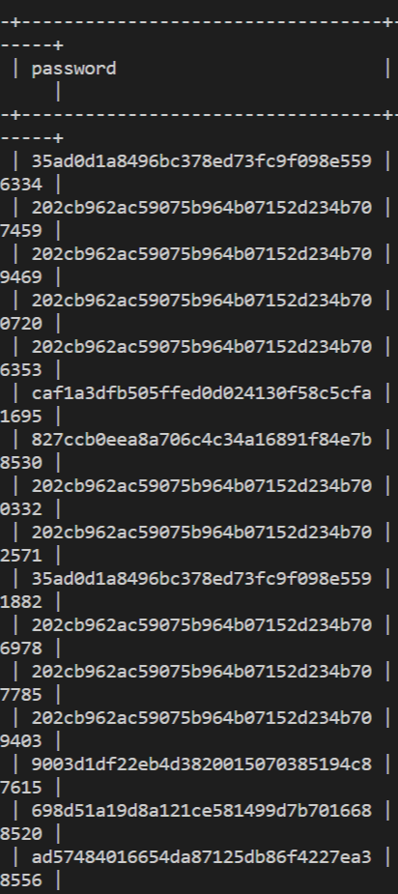
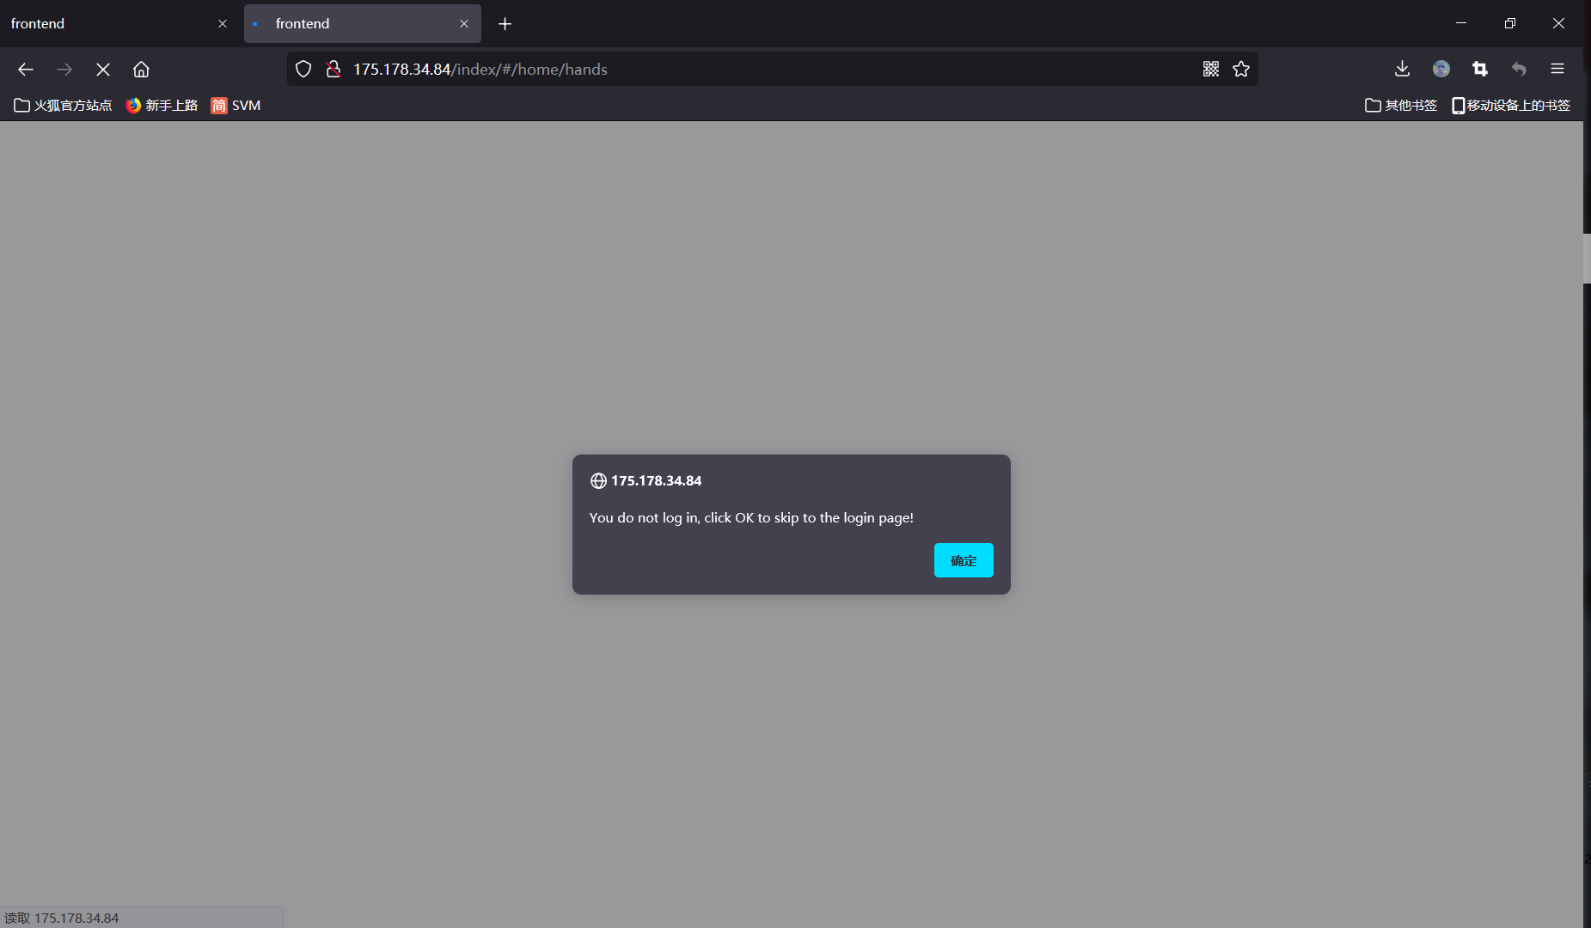
Screen shot

Slide 60
Functions:
Backend: Login()
Frontend: sessionStorage

Slide 61
13. Frontend Optimization
To enhance the usage experience, we spent a lot on optimizing the interface.
For example, we have designed the powerful and elegant text editor and code editor. It supports and encourage users to write their comment and code on our front-end webpage without a local complier. So Users could edit their idea and encode their program even in an Ipad or a phone.

Slide 62
PART 03
Testing

Slide 63
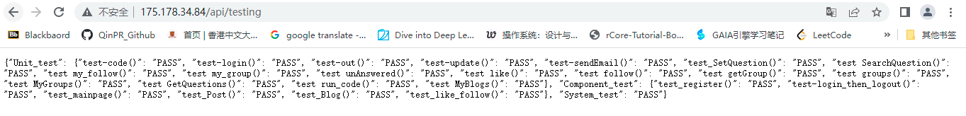
Testing
To ensure the correctness of our website, we conduct
Unit-testing,
Component testing
System-testing.
For the submitted version of code, our program pass all the suites.
run http://175.178.34.84/api/testing, wait for its automatic testing, and the test result will be returned

Slide 64
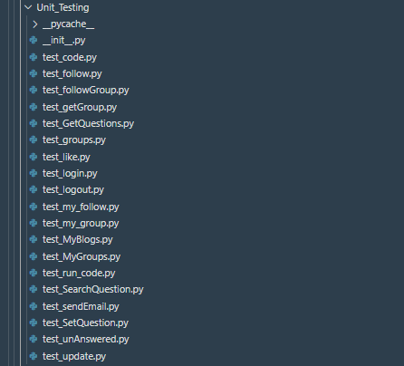
Testing – Unit Testing
We test our program via the
test suite composed of 19
test files with overall
70+ test cases.
Click here to refer our test suit:
http://175.178.34.84/fs/Unit_Testing.zip

Slide 65
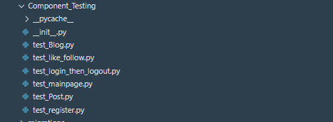
Testing – Component Testing
Test suite is composed of 6 test files with 10+ test cases.
Click here to refer our test suit:
http://175.178.34.84/fs/Component_Testing.zip
Testing – System Testing
An overall testing of the whole functions of our website.
Click here to refer our test suit:
http://175.178.34.84/fs/System_Test.py

Slide 67
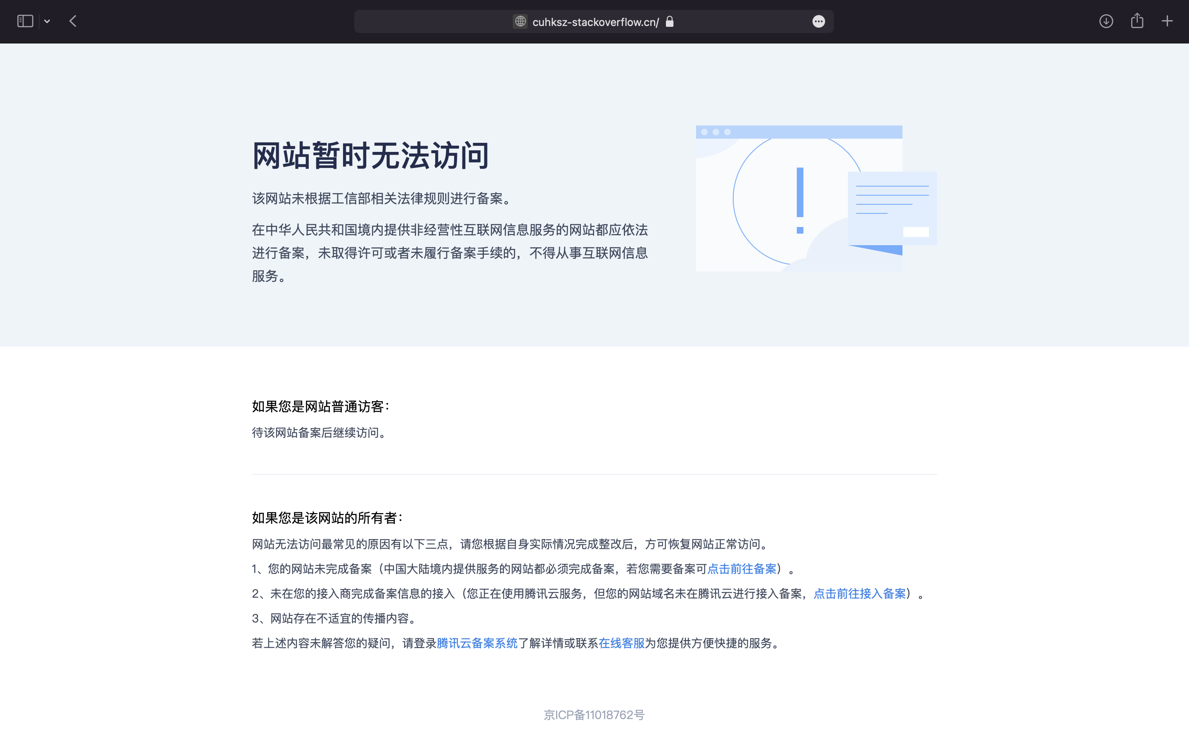
Domain name under checking

Slide 68
PART 04
References

Slide 69
Froala (editor):
https://froala.com
Sphere engine(online compiler api):
https://sphere-engine.com

