Slide 1
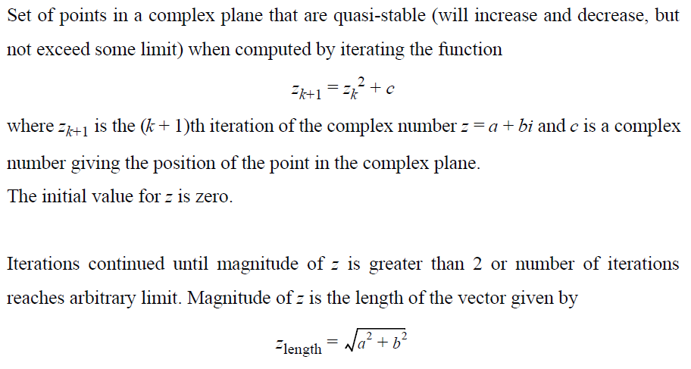
Mandelbrot Set Computation (1)

Slide 2
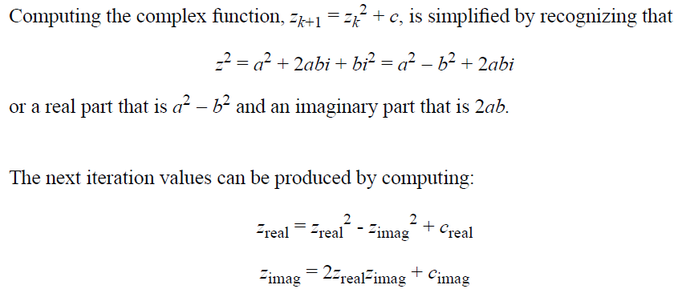
Mandelbrot Set Computation (2)

Slide 3

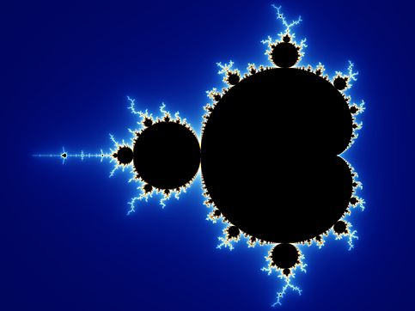
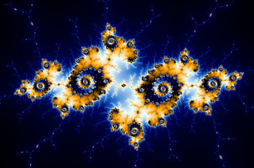
Mandelbrot Set Computation (3)

