Slide 1
Shopped
Team 4
Greg, Dan and Andy

Slide 2
What we did in two weeks
Opening and Saving of image
Resize
Zoom
Rotate
Enabling/Disabling Features

Slide 3
Opening and Saving of image
We can open just about anything (.jpg, .jpeg, .bmp, .ppm, .gif)
We currently save JPEG format. We will add more save formats later.

Slide 4
Resize
Can be done arbitrarily
User enters a percentage in dialog box

Slide 5
Zoom
Can be done arbitrarily
User enters a percentage in dialog box

Slide 6
Rotate
Can be done arbitrarily
User enters a percentage in dialog box

Slide 7
Enabling/Disabling Features
If no picture is loaded, obviously we do not want to resize/zoom/rotate a null picture.
These features get enabled once a picture is loaded into Shopped.

Slide 8
For the next two weeks…
Undo/Redo (Using our ideas :P )
Basic filters (saturation, grayscale)
Enhance GUI features (toolbar, user-friendliness)
Testing, testing, testing
Creation of unit & integration tests

Slide 9
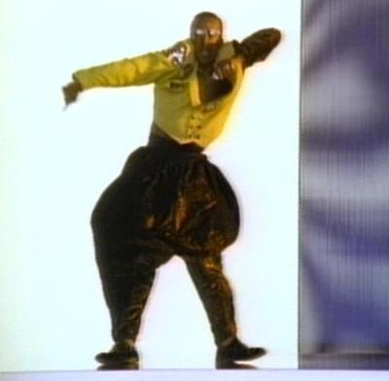
Shopped Itself
Stop. Demo time!

