Slide 1
Shopped Presentation
Team 4, Capstone Fall 2009

Slide 2
Image Rotation
Our algorithm uses basic trigonometry to calculate the new height and width of the rotated image.
Width = arcsin(rotateAngle)*origHeight + arccos(rotateAngle)*origWidth
Height = arcsin(rotateAngle)*origWidth + arccos(rotateAngle)*origHeight

Slide 3
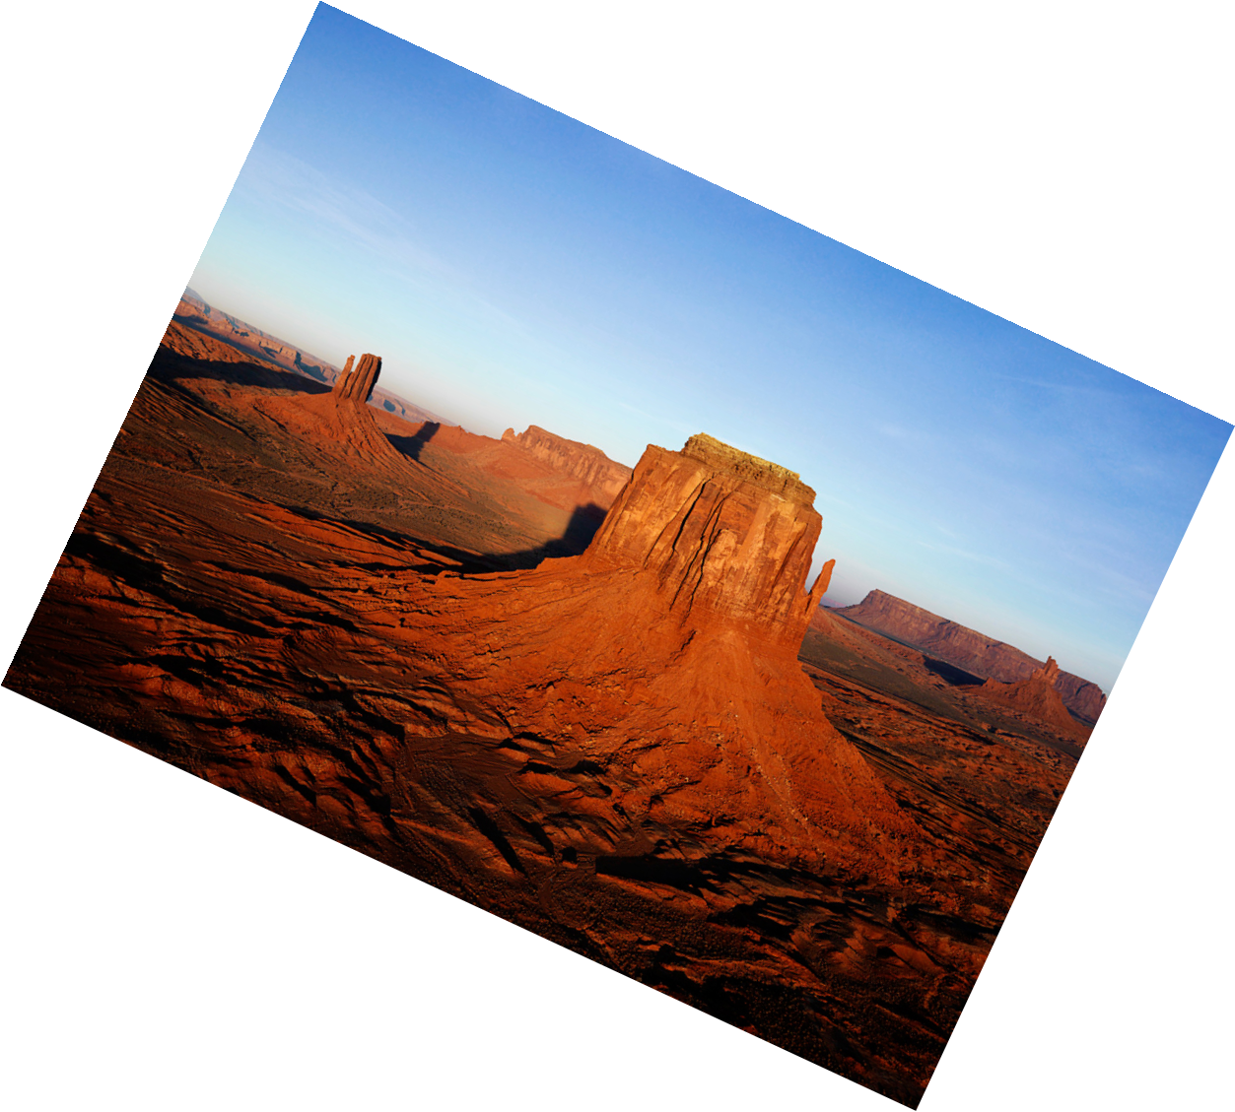
Image Rotation
Ex: Rotate Image 25º
Width = arcsin(25º)*origHeight + arccos(25º)*origWidth
25º
Height = …
25º
25º
25º

Slide 4
Image Rotate
A new bitmap is created of this size and every pixel is made transparent
(alpha = 0).
The Graphics object in ImageRotate then performs the transformation of the original image onto this new image.

Slide 5
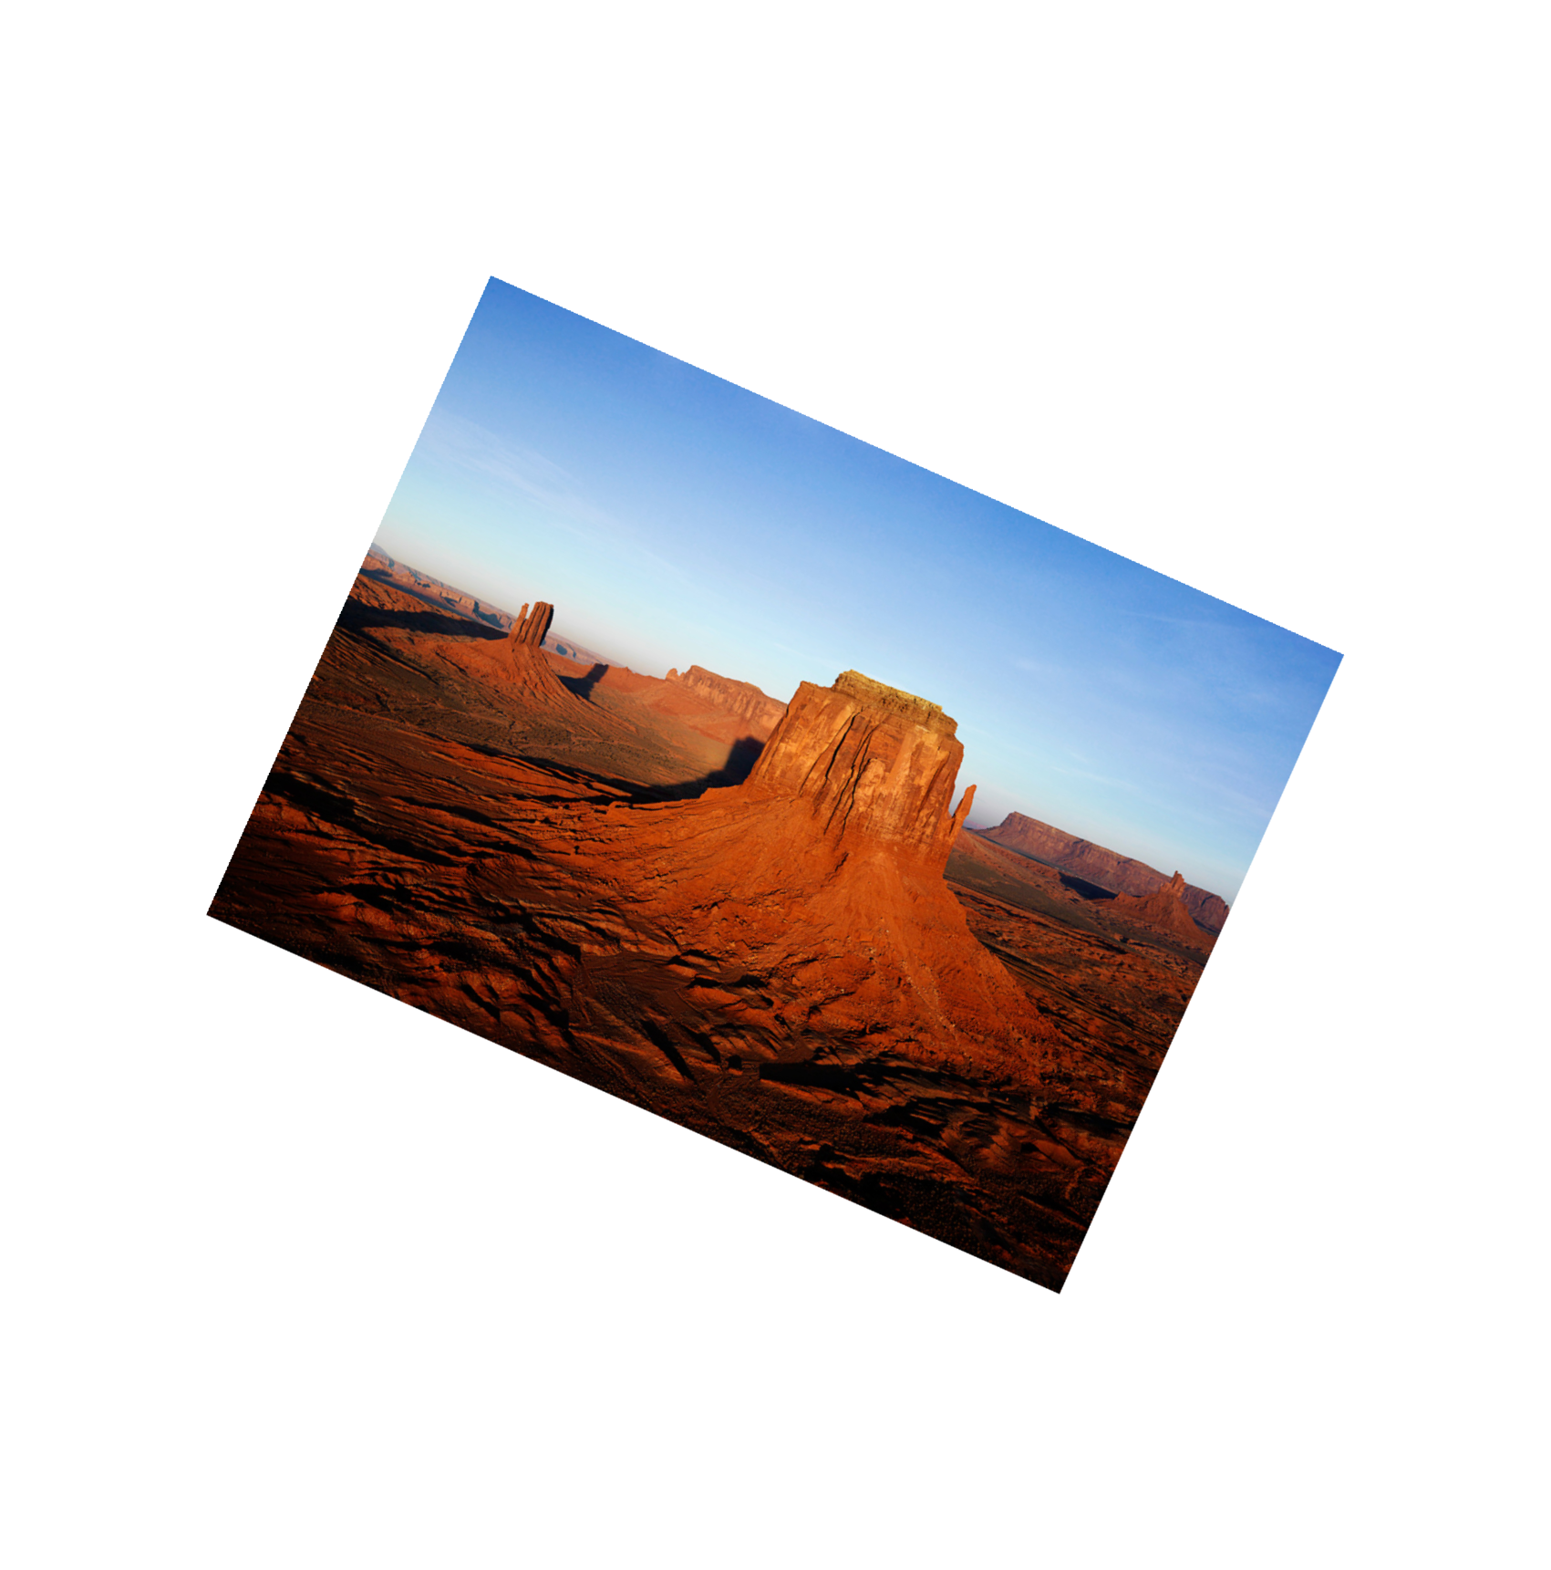
Image Trim
After the image is rotated, we check to see if there is any excess whitespace left over from the rotation. Example:

Slide 6
Image Trim
Our algorithm works by starting at the edge of the picture (top, left, etc.) and goes row by row of pixels and checks its alpha value. If the entire row has alpha = 0 then we can trim that row.
As soon as a pixel with a non-zero alpha is found, we have gotten to an edge of the actual image and we save which row we were in.
The operation for columns is identical.

Slide 7
Selection Box
For the selection box to work in any direction (i.e. you don’t have to start at the top-left corner and drag down and to the right), our algorithm uses ternary operators to determine which point is closer to the origin (the top-left corner of the image).
Any time the GUI requests the selection box to be drawn, the SelectionBox class determines the ordering of the two points (upper-left and lower-right of the box) and returns the correct values.

Slide 8
Selection Box
It also checks to make sure that the selection box does not exceed the bounds of the image.
  This is done by a simple check each time the point is set in memory.
This ensures that the user can only select contents within the image.

