Slide 1

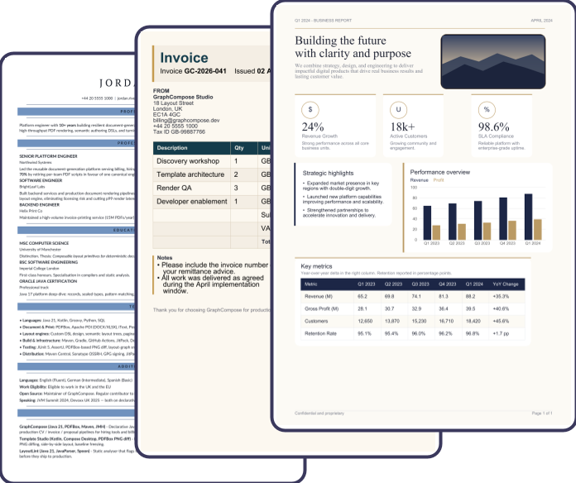
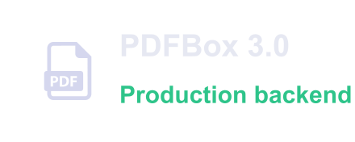







Open-source Java library for generating structured business documents with a declarative DSL — print-ready PDF and
an editable PowerPoint deck from one composition.
1
Java
·
Declarative
DSL
2
GraphCompose
Engine
3
Output
4
Real
PDF
Output
Semantic graph · deterministic layout
Backends
var out = Path.of("deck.pdf");
try (var doc = GraphCompose
.document(out)
.pageSize(DocumentPageSize.A4)
Layout
Components
.create()) {
doc.pageFlow(page -> page
>
>
>
.addParagraph("GraphCompose")
PPTX
.addParagraph("Cinematic."));
Pagination
doc.buildPdf();
Editable deck · Beta
}
You describe the document intent — the engine
Themes
DSL
DOCX export
resolves the rest.
Semantic export
CVs, invoices, reports — every one rendered by
the engine in this repo.
Open Source
Maven Central
Java 17+
MIT License
GraphCompose · “twinned”
Page 1 of 4

Slide 2


HOW IT WORKS
From one Java file to a designed document
You describe the document semantically — sections, rows, tables, charts, shapes, layers — and the engine resolves the rest: it
measures every node twice, paginates the flow row-by-row, and renders the resolved layout through an isolated backend —
PDFBox for PDF, Apache POI for the deck. No manual coordinates, no XML templates.
1
2
3
4
>
>
>
AUTHOR
MEASURE
PAGINATE
RENDER
Fluent DSL describes intent.
Two-pass geometry, every node.
Split the flow across pages.
A backend writes the bytes.
Deterministic
Regression-tested
Production-ready
The same input renders the same bytes on every
layoutSnapshot() diffs the geometry and
An isolated PDFBox backend streams straight to an
machine — layout is reproducible, not best-effort.
PdfVisualRegression pixel-tests fonts and colour,
HTTP response — no temp files, no manual
right in your pull requests.
coordinates.
GraphCompose · “twinned”
Page 2 of 4

Slide 3
BENCHMARKED
GraphCompose vs. the field
The same documents through three engines — render time and peak heap, measured by this repository's own harness. The table and charts below are drawn by GraphCompose straight
from the result file.
Report size
GraphCompose
iText 9
JasperReports
1 page · 3 lines
2.0 ms · 0.2 MB
2.1 ms · 0.2 MB
4.2 ms · 0.2 MB
40 rows
4.1 ms · 1.0 MB
10.0 ms · 3.0 MB
8.3 ms · 2.5 MB
200 rows
10.9 ms · 4.0 MB
36.6 ms · 13.6 MB
13.5 ms · 10.8 MB
1000 rows
42.8 ms · 19.3 MB
189.1 ms · 67.3 MB
43.7 ms · 52.5 MB
Render time at 1000 rows — ms (lower is faster)
Peak heap at 1000 rows — MB (lower is lighter)
200.0 ms
189.1 ms
80.0 MB
67.3 MB
150.0 ms
60.0 MB
52.5 MB
100.0 ms
40.0 MB
50.0 ms
42.8 ms
43.7 ms
20.0 MB
19.3 MB
0.0 ms
1000-row report
0.0 MB
1000-row report
GraphCompose
iText 9
JasperReports
GraphCompose
iText 9
JasperReports
Measured 2026-08-04 22:16:04 · 50 warmup / 100 measurement iterations, single machine — numbers vary by hardware and document. Reproduce: scripts/run-benchmarks.ps1 · see docs/operations/benchmarks.md.
GraphCompose · “twinned”
Page 3 of 4

Slide 4
SCALING
How GraphCompose scales
As the report grows from 40 to 1000 rows, the time lead over iText widens; JasperReports closes to roughly the same render time at 1000 rows, yet GraphCompose stays markedly lighter on
memory than both rivals throughout — every series below reads from the same benchmark file.
Render time vs. report size — ms
Peak heap vs. report size — MB
200 ms
80 MB
150 ms
60 MB
100 ms
40 MB
50 ms
20 MB
0 ms
40
200
1000
0 MB
40
200
1000
GraphCompose
iText 9
JasperReports
GraphCompose
iText 9
JasperReports
Memory at 1000 rows — share of total
Throughput at 1000 rows — docs/sec (higher is better)
13.9%
30.0
23.4
22.9
37.7%
20.0
1000 rows
10.0
5.3
48.4%
0.0
GraphCompose
iText 9
JasperReports
GraphCompose
docs / sec
iText 9
JasperReports
GraphCompose · “twinned”
Page 4 of 4

