Slide 1
COMP433 Project 4
Thaddeus Krawczyk and Demetrios Bairaktaris

Slide 2
Domain Design
Four Modules
Partner
Customer
Order
Product
Façade Interface Pattern

Slide 3
Service Design
Resource API Pattern
Five separate resources
Login
Partners
Products
Orders
Customers

Slide 4
Web Service Details
Database
PostgreSQL hosted on Heroku
Dependencies
Apache CXF
Apache Tomcat
Spring Core
Maven
Jackson

Slide 5
Web Client Details
Pure CSS modules
jQuery AJAX API calls
Basic password authentication
Simulated API key appended as query parameter to URI

Slide 6
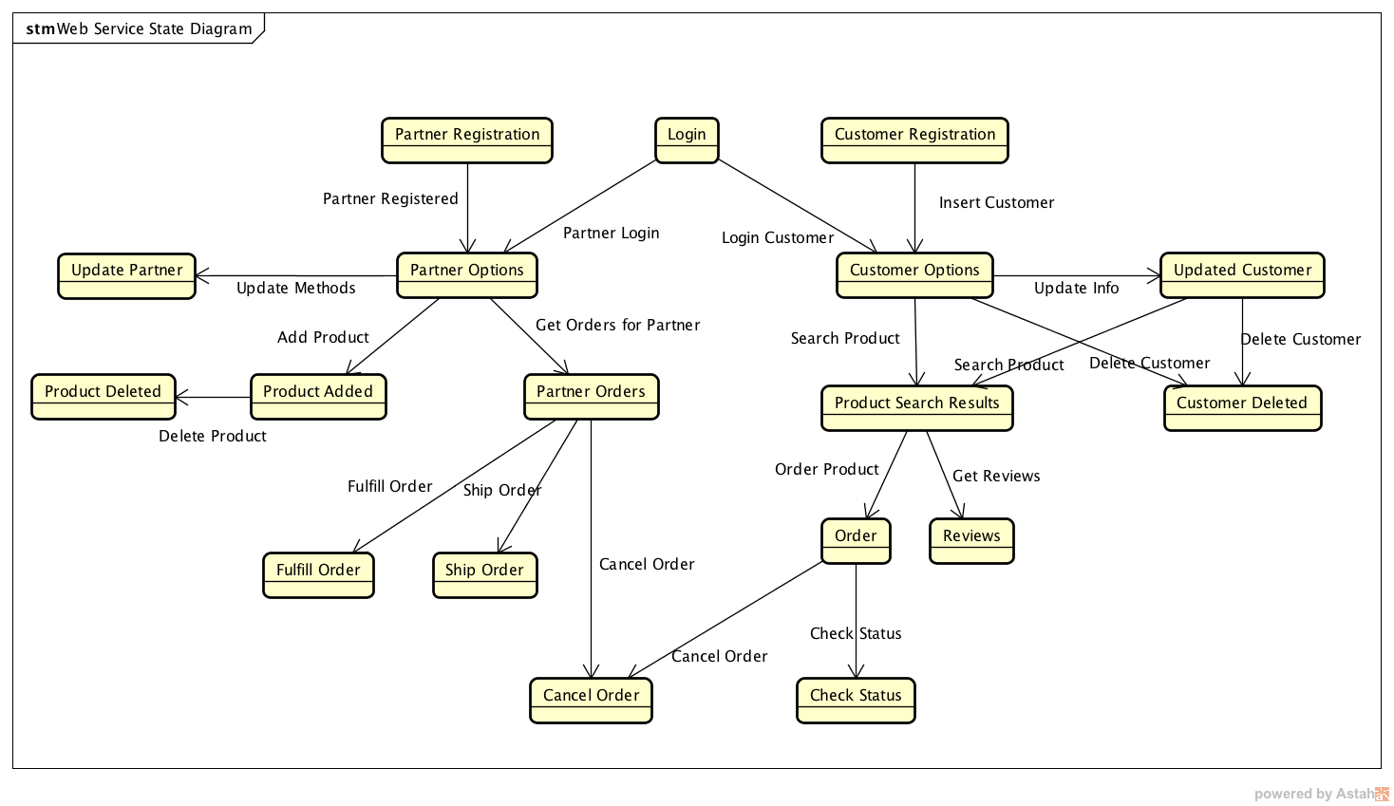
State Diagram

Slide 7
Demonstration

