Slide 1

Medicare Provider Fraud Detection Using Machine Learning
Team: Demiana Yakoob, Fatma Abdelhadi, Mohammed Abdelsattar, Mohammed Yasser
Date: October 26, 2023

Slide 2

The Alarming Scope of Medicare Fraud
What is Medicare Fraud?
Intentional deception by healthcare providers to receive improper payments from Medicare.
Financial Impact
Billions lost annually (estimated $60-90B).
Higher premiums and reduced services for beneficiaries.
Threatens the sustainability of the healthcare system.

Slide 3

Why Fraud Detection Matters: Our Objective
Safeguard Public Funds
Maintain System Integrity
Proactive Identification
Protect taxpayer money and ensure proper allocation of healthcare resources.
Preserve trust in the Medicare program and uphold ethical standards.
Develop a robust ML model to identify fraudulent claims and providers early.

Slide 4

Dataset Overview: Core Components
Provider
Inpatient Claims
Demographic and historical data for each healthcare provider.
Records for services provided during hospital stays.
Outpatient Claims
Beneficiary
Records for services provided in clinics or other non-inpatient settings.
Demographic and health information of Medicare recipients.

Slide 5
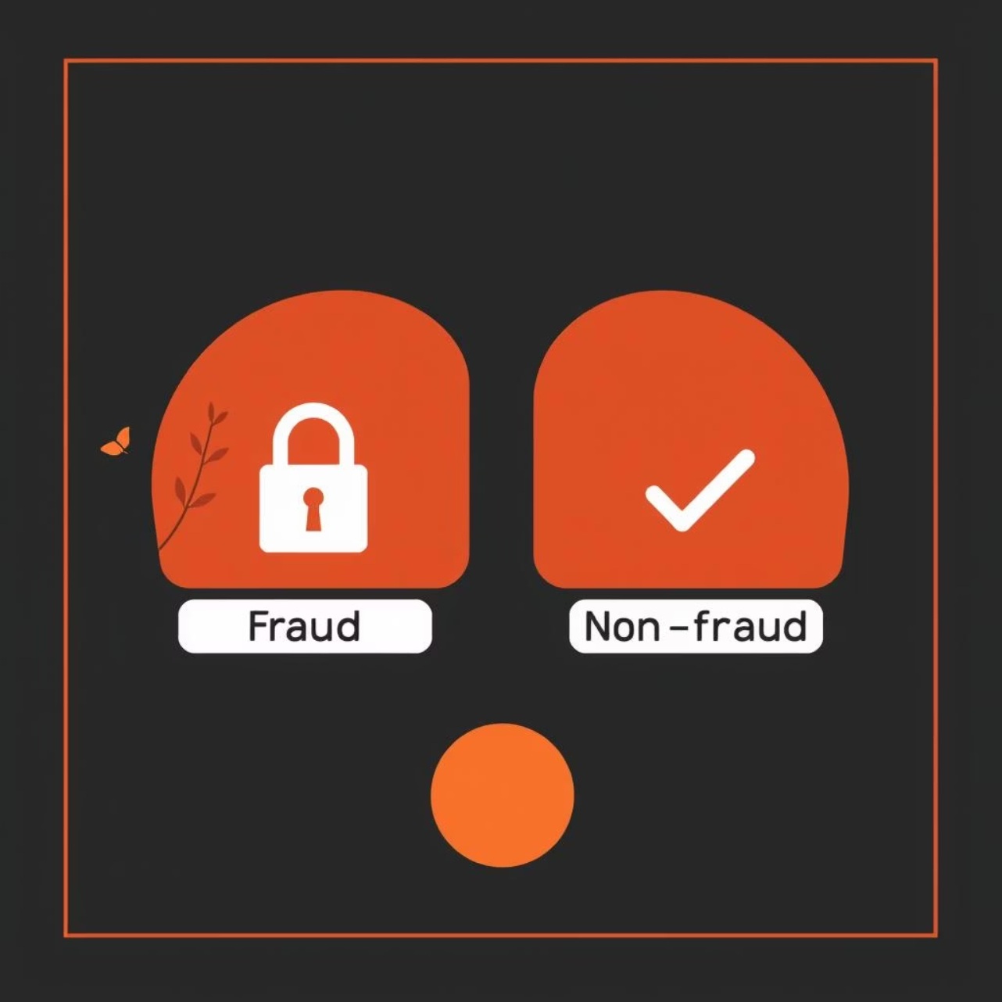
Defining the Target: Fraudulent Providers
Label Generation
Providers were labeled as 'Fraud' if they submitted at least one fraudulent claim, based on historical investigations.
Legitimate Provider
0 (Non-Fraud)
Fraudulent Provider
1 (Fraud)
This binary classification allows us to train models to distinguish between these two categories.

Slide 6
Data Preprocessing: Building a Unified View
01
02
03
Data Merging
Cleaning & Missing Values
Encoding Categorical Data
Consolidated claims (inpatient, outpatient) and beneficiary data with provider records.
Addressed inconsistent entries, duplicates, and imputed missing values using domain-specific strategies.
Converted categorical variables (e.g., medical specialities, states) into numerical formats.
04
05
Outlier Handling
Feature Aggregation
Identified and managed extreme values in numerical features to prevent model distortion.
Summarized claim-level data to provider-level metrics (e.g., total claim amount, number of claims).

Slide 7
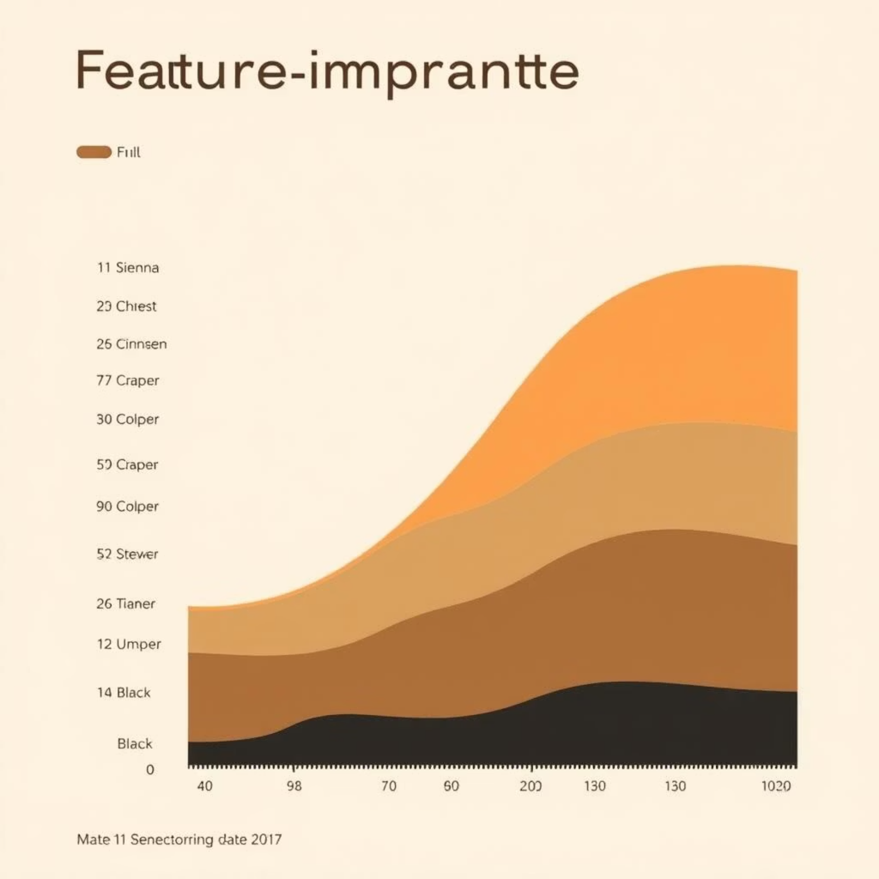
Feature Engineering & EDA: Revealing Patterns
Key Engineered Features
Claim Counts & Amounts: Total claims, average claim amount per provider.
Chronic Conditions: Number of unique chronic conditions treated.
Procedure Codes: Frequency of specific procedure codes.
Beneficiary Data: Patient age distribution, previous claims history.
Exploratory Data Analysis (EDA) Insights
Fraudulent providers often exhibit unusual billing patterns.
Higher volume of claims for specific, lucrative procedures.
Associations between certain chronic conditions and fraud flags.

Slide 8

Addressing Class Imbalance: A Critical Step
The Challenge
Medicare fraud is rare, leading to a highly imbalanced dataset (very few 'Fraud' labels).
Strategies Implemented
Class Weights: Assigned higher weights to minority class during model training to emphasize fraud instances.
SMOTE (Synthetic Minority Over-sampling Technique): Generated synthetic samples for the minority class to balance the dataset.
Evaluation Metrics
Accuracy alone is misleading. Focused on Precision, Recall, F1-score, and AUC to evaluate performance effectively on imbalanced data.

Slide 9
Modeling Approach: From Baselines to Ensemble
Logistic Regression
Random Forest
XGBoost
Linear model for baseline performance and interpretability.
Ensemble method to capture non-linear relationships and reduce overfitting.
Gradient boosting for high performance and handling complex data patterns.
Key Considerations
Train-Test Split: 80% for training, 20% for testing to evaluate generalization.
Hyperparameter Tuning: Used GridSearchCV/RandomizedSearchCV to optimize model parameters for best performance.

Slide 10
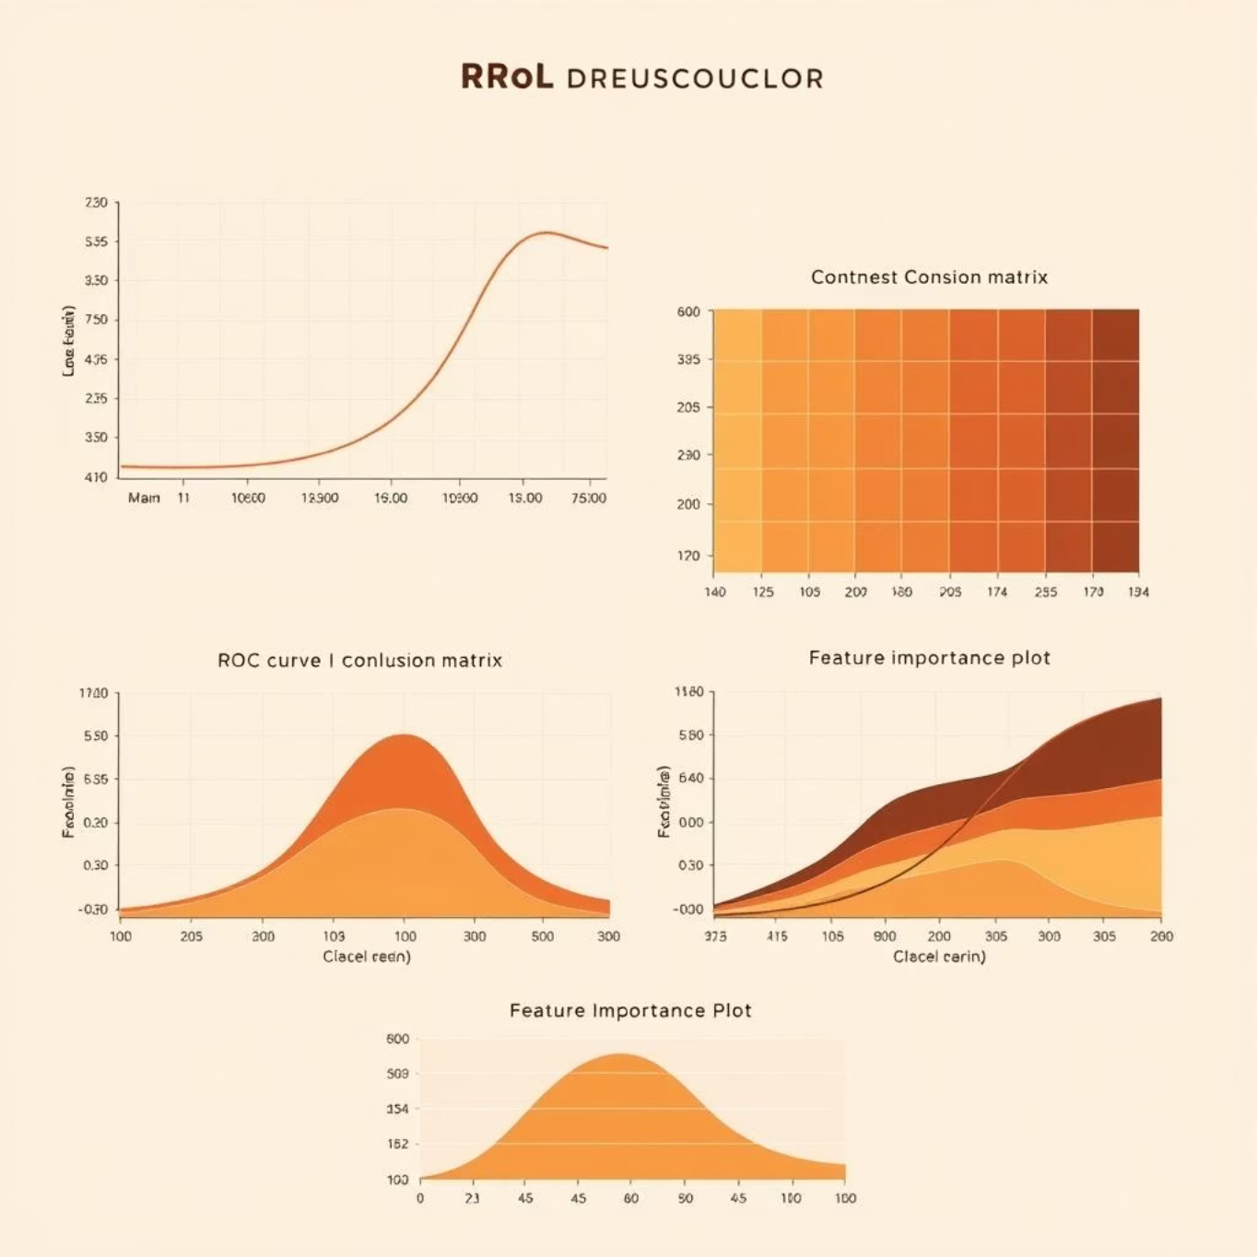
Results Summary: Performance at a Glance
Model Performance Metrics
Logistic Regression
0.65
0.58
0.61
0.72
Random Forest
0.78
0.72
0.75
0.85
XGBoost
0.82
0.79
0.80
0.89
XGBoost consistently outperformed other models, achieving the highest AUC and F1-score, indicating superior balance between precision and recall.
Visualizing Model Effectiveness
ROC Curves: Show trade-off between true positive rate and false positive rate.
Confusion Matrix: Detailed breakdown of true positives, negatives, false positives, and false negatives.
Feature Importance: Ranks features by their contribution to model predictions.

