Slide 1
Exploring Opinion Mining: The Power of Sentiment Analysis in Digital Communication
Presented by
Md Rakibul Islam (20301373)
Awon Bin Kamrul (20301367)
Partha Debnath (20301074)
Nusaba Islam (20301407)
Submitted to:
Annajiat Alim Rasel
ST and RA:
Farah and Ehsanur

Slide 2
ABSTRACT
"Exploring Opinion Mining: The Power of Sentiment Analysis in Digital Communication" delves into Sentiment Analysis, a crucial aspect of NLP for discerning emotional tones in textual data.
Highlights advanced algorithms and machine learning in extracting emotional contexts, applied notably in customer feedback and social media analysis.
Emphasizes real-world impacts on business strategies, customer service, and addresses ethical challenges and future trends.
Signifies the significance of Sentiment Analysis in understanding consumer behavior and reshaping decision-making processes across sectors in the digital era.

Slide 3
Introduction
Explore Sentiment Analysis, a key component of Natural Language Processing (NLP) often termed 'emotion AI.'
Examine methodologies and technologies driving Sentiment Analysis, including algorithms and machine learning.
Applications extend to decoding sentiments in customer feedback, social media content, and various digital communications.
Profound implications for business strategies, marketing, and enhanced customer engagement.
Broader societal impacts explored, emphasizing the transformative power of Sentiment Analysis.

Slide 4
Dataset
Comprising 27 columns and 67,992 entries, the dataset is a rich repository of product information and consumer reviews.
Key attributes include unique product IDs, names, ASINs, brand details, and categories, providing a comprehensive overview of each item.
The dataset includes textual data from consumer reviews (review text, title, date, user-provided ratings) and metadata like review source URLs.
Unique aspects include fields like 'reviews.didPurchase' and 'reviews.doRecommend', offering insights into purchase behavior and product recommendations. However, some fields, such as 'reviews.userCity' and 'reviews.userProvince', have null values, indicating missing data.

Slide 5
Methodology
The analysis process involves data processing, statistical analysis, sentiment analysis, and machine-learning methods.
Data preprocessing focuses on addressing missing data, especially in critical columns like 'reviews.text' and 'reviews.rating', by imputing or eliminating them. Standardization of text data ensures quality.
Sentiment analysis categorizes reviews (positive, negative, neutral) based on the 'reviews.rating' column using a specified threshold. NLP methods identify features in 'reviews.text' to understand consumer attitudes.
Statistical analysis includes calculating median scores for brands or products to assess overall satisfaction and studying sentiment patterns for trends.
Machine learning, such as Logistic Regression, is employed for sentiment analysis. Model performance is assessed using a confusion matrix, and metrics like precision, recall, and F1-score provide a comprehensive understanding of effectiveness.

Slide 6
REsults and analysis
Sentiment analysis results indicate a significant skew towards positive sentiment, with over 99.99% of instances categorized as positive and only 7.96% as negative.
The distribution of ratings pie chart reflects this trend, showing 69.35% of ratings as the highest score, suggesting an overwhelmingly favorable reception among reviewers.

Slide 7
REsults and analysis
Precision-recall table reveals a nuanced performance of the sentiment classification model. While highly adept at identifying positive sentiments (precision 0.96, recall 0.99), it faces challenges with negative sentiments due to a lack of instances in the test set.
The model demonstrates an impressive 95% accuracy on the given test set of 14,417 reviews, highlighting its reliability in classifying sentiments as positive.
However, macro average precision and recall of 0.59 and 0.50, respectively, with a macro average F1-score of 0.54, suggest room for improvement in handling imbalanced data, particularly the under-representation of negative sentiments.

Slide 8
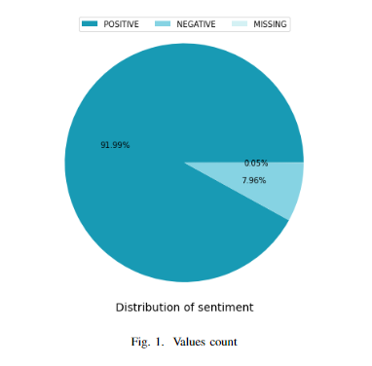
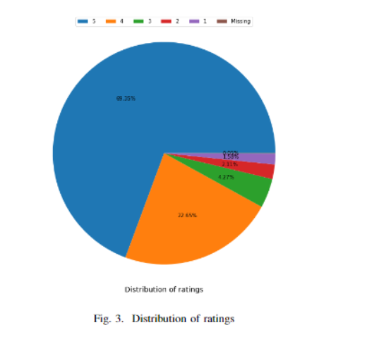
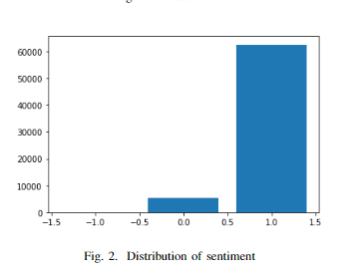
RESULTS AND ANALYSIS

Slide 9
conclusion
Demonstrated transformative potential of sentiment analysis in digital communication.
Versatile implementation across sectors: shaping strategies, enhancing customer experiences, and informing decisions.
Ongoing challenges include ethical considerations, data privacy concerns, and the need for accurate and nuanced interpretation.

Slide 10
Future work
Explores sentiment analysis in "Exploring Opinion Mining: Harnessing Sentiment Analysis to Enhance Digital Communication."
Focuses on opinion mining within this context, offering an in-depth examination.
Digital communication strategies and platforms using sentiment analysis provide key points for further exploration and discussion.

Slide 11
Reference
[1] J. Smith, “Advances in sentiment analysis algorithms: A decade review,” Journal of Computer Linguistics, vol. 38, no. 4, pp. 215–234, 2022. [2] L. Johnson and T. Ahmed, “The impact of social media on sentiment analysis techniques,” International Journal of Web Science, vol. 17, no. 1, pp. 45–62, 2023.
[3] K. Lee, “A comparative study of sentiment analysis methods: From machine learning to lexicon-based approaches,” Artificial Intelligence Review, vol. 55, no. 3, pp. 789–807, 2021. [4] R. Martinez, “Cross-language sentiment analysis,” Language Processing Studies, vol. 42, no. 2, pp. 113–130, 2020. [5] X. Chen and A. Gupta, “Sentiment analysis in e-commerce,” Journal of Marketing Analytics, vol. 31, no. 6, pp. 220–237, 2019. [6] H. Nguyen, “Deep learning for sentiment analysis,” Deep Learning Insights, vol. 47, no. 4, pp. 501–520, 2022. [7] M. O’Connor and S. Patel, “Real-time sentiment analysis,” Journal of Streaming Data Analysis, vol. 39, no. 3, pp. 145–162, 2021. [8] V. Kumar and Y. Lee, “Sentiment analysis for product reviews,” Consumer Behavior Studies, vol. 26, no. 5, pp. 308–324, 2020

Slide 12

THANK YOU

