Slide 1
Exploring Opinion Mining: The Power of Sentiment Analysis in Digital Communication
Presented by
Md Rakibul Islam (20301373)
Awon Bin Kamrul (20301367)
Partha Debnath (20301074)
Nusaba Islam (20301407)
Submitted to:
Annajiat Alim Rasel
ST and RA:
Farah and Ehsanur

Slide 2
ABSTRACT
"Exploring Opinion Mining: The Power of Sentiment Analysis in Digital Communication" delves into Sentiment Analysis, a crucial aspect of NLP for discerning emotional tones in textual data.
Highlights advanced algorithms and machine learning in extracting emotional contexts, applied notably in customer feedback and social media analysis.
Emphasizes real-world impacts on business strategies, customer service, and addresses ethical challenges and future trends.
Emphasizes the importance of Sentiment Analysis in comprehending consumer behavior and influencing decision-making processes across various industries in the digital age.

Slide 3
Introduction
Explore Sentiment Analysis, a key component of Natural Language Processing (NLP) often termed 'emotion AI.'
Examine methodologies and technologies driving Sentiment Analysis, including algorithms and machine learning.
Applications extend to decoding sentiments in customer feedback, social media content, and various digital communications.
Broader societal impacts explored, emphasizing the transformative power of Sentiment Analysis.

Slide 4
Dataset
With 27 columns and 67,992 entries, the dataset serves as a comprehensive repository of product details and customer reviews.
The dataset includes textual data from consumer reviews (review text, title, date, user-provided ratings) and metadata like review source URLs.

Slide 5
Methodology
The analysis process involves data processing, statistical analysis, sentiment analysis, and machine-learning methods.
Data preprocessing concentrates on handling missing data, particularly in vital columns such as 'reviews.text' and 'reviews.rating,' through imputation or removal. Standardizing text data is essential for ensuring its quality.
Sentiment analysis involves classifying reviews (positive, negative, neutral) by evaluating the 'reviews.rating' column with a defined threshold. Natural Language Processing (NLP) techniques are employed to identify key elements in 'reviews.text' for gaining insights into consumer sentiments.
Machine learning, such as Logistic Regression, is employed for sentiment analysis. Model performance is assessed using a confusion matrix, and metrics like precision, recall, and F1-score provide a comprehensive understanding of effectiveness.

Slide 6
REsults and analysis
Sentiment analysis results indicate a significant skew towards positive sentiment, with over 99.99% of instances categorized as positive and only 7.96% as negative.
The distribution of ratings pie chart reflects this trend, showing 69.35% of ratings as the highest score, suggesting an overwhelmingly favorable reception among reviewers.

Slide 7
REsults and analysis
The precision-recall table provides insight into the nuanced performance of the sentiment classification model. Although it excels in accurately identifying positive sentiments (precision 0.96, recall 0.99), it encounters difficulties in recognizing negative sentiments, primarily attributed to the limited occurrences of negative instances in the test set.
Yet, the macro average precision and recall, standing at 0.59 and 0.50, respectively, along with a macro average F1-score of 0.54, indicate the need for enhancements in addressing imbalanced data, especially the underrepresentation of negative sentiments.

Slide 8
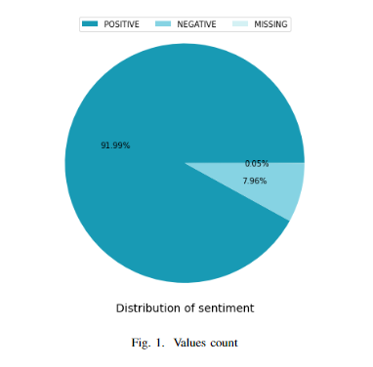
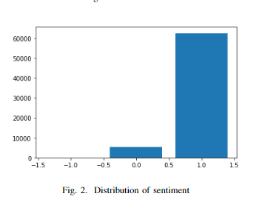
RESULTS AND ANALYSIS

Slide 9
conclusion
Demonstrated transformative potential of sentiment analysis in digital communication.
Ongoing challenges include ethical considerations, data privacy concerns, and the need for accurate and nuanced interpretation.

Slide 10
Future work
Explores sentiment analysis in "Exploring Opinion Mining: Harnessing Sentiment Analysis to Enhance Digital Communication."
Exploring and discussing digital communication strategies and platforms that leverage sentiment analysis offer valuable insights for further investigation.

Slide 11
Reference
[1] J. Smith, “Advances in sentiment analysis algorithms: A decade review,” Journal of Computer Linguistics, vol. 38, no. 4, pp. 215–234, 2022. [2] L. Johnson and T. Ahmed, “The impact of social media on sentiment analysis techniques,” International Journal of Web Science, vol. 17, no. 1, pp. 45–62, 2023.
[3] K. Lee, “A comparative study of sentiment analysis methods: From machine learning to lexicon-based approaches,” Artificial Intelligence Review, vol. 55, no. 3, pp. 789–807, 2021. [4] R. Martinez, “Cross-language sentiment analysis,” Language Processing Studies, vol. 42, no. 2, pp. 113–130, 2020. [5] X. Chen and A. Gupta, “Sentiment analysis in e-commerce,” Journal of Marketing Analytics, vol. 31, no. 6, pp. 220–237, 2019. [6] H. Nguyen, “Deep learning for sentiment analysis,” Deep Learning Insights, vol. 47, no. 4, pp. 501–520, 2022. [7] M. O’Connor and S. Patel, “Real-time sentiment analysis,” Journal of Streaming Data Analysis, vol. 39, no. 3, pp. 145–162, 2021. [8] V. Kumar and Y. Lee, “Sentiment analysis for product reviews,” Consumer Behavior Studies, vol. 26, no. 5, pp. 308–324, 2020

Slide 12

THANK YOU

