Slide 1
Collections

Slide 2
Collections
Without Collections
With Collections
int[] hpEnemyList
int hpEnemy1: 100
[0]: 100
int hpEnemy2: 25
[1]: 25
int hpEnemy3 : 35
[2]: 35
int hpEnemy4: 44
[3]: 44
int hpEnemy5: 12
[4]: 12
int hpEnemy6: 77
[5]: 77
int hpEnemy7: 11
[6]: 11
7 Variables with one value each
1 Variable with 7 values

Slide 3
Set the value of 7 variables
Without Collections
int hpEnemy1 = 100;
int hpEnemy2 = 100;
int hpEnemy3 = 100;
int hpEnemy4 = 100;
int hpEnemy5 = 100;
int hpEnemy6 = 100;
int hpEnemy7 = 100;
With Collections
for (int i = 0; i < hpEnemyList.Length; i++)
{
hpEnemyList[i] = 100;
}
int[] hpEnemyList = new int[7];

Slide 4
Set the value of 20 Variables
Without Collections
int hpEnemy1 = 100;
int hpEnemy2 = 100;
int hpEnemy3 = 100;
int hpEnemy4 = 100;
int hpEnemy5 = 100;
int hpEnemy6 = 100;
int hpEnemy7 = 100;
int hpEnemy8 = 100;
int hpEnemy9 = 100;
int hpEnemy10 = 100;
int hpEnemy11 = 100;
int hpEnemy12 = 100;
int hpEnemy13 = 100;
int hpEnemy14 = 100;
int hpEnemy15 = 100;
int hpEnemy16 = 100;
int hpEnemy17 = 100;
int hpEnemy18 = 100;
int hpEnemy19 = 100;
int hpEnemy20 = 100;
With Collections
for (int i = 0; i < hpEnemyList.Length; i++)
{
hpEnemyList[i] = 100;
}
int[] hpEnemyList = new int[20];

Slide 5
Benefits of Collections
Can be iterated with loops
When dealing with bigger datasets you need far less Code

Slide 6
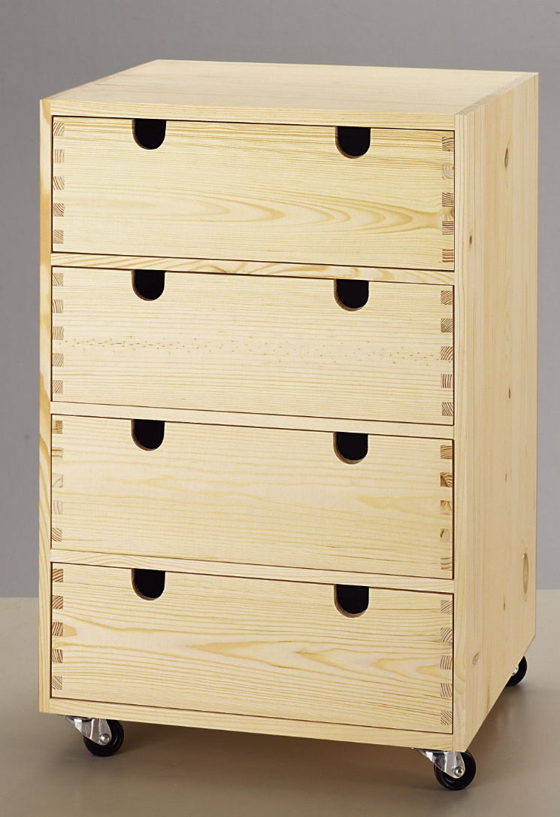
Arrays

Slide 7

Arrays
A List of Values
Works like a drawer Each slot contains a value

Slide 8
Arrays
[0]
[1]
[2]
[3]

Slide 9
Arrays
Indexbased: i.e.:
Save the value 17 into drawer [0]
Save the value 18 into drawer [1]
Save the value 32 into drawer [2]
Save the value 1234 into drawer [3]
[0]
[1]
[2]
[3]

Slide 10
Declaration of an Array
int[] integerArray = new int[4];
Datatype of the array
[0]
[1]
[2]
[3]

Slide 11
Declaration of an Array
int[] integerArray = new int[4];
This is not a normal Integer but an Integer-Array. This means, that it is an array, that can store Integer-Values.
[0]
[1]
[2]
[3]

Slide 12
Declaration of an Arrays
int[] integerArray = new int[4];
Name of the Array
[0]
[1]
[2]
[3]

Slide 13
Declaration of an Arrays
int[] integerArray = new int[4];
Creates new array for integers with place for 4 values.
[0]
[1]
[2]
[3]

Slide 14
Accessing Array-Elements
int[] integerArray = new int[4];
integerArray[2] = 32;
[0]
Access the Value at the index [2]
[1]
[2]
[3]

Slide 15
Usage of Arrays
Declares int-Array with 4 values at max
int[] integerArray = new int[4];
integerArray[0] = 17;
integerArray[1] = 18;
integerArray[2] = 150;
integerArray[3] = 12345; Console.WriteLine(integerArray[2]);
[0]
Sets the Element at index 0 to 17
[1]
[2]
Prints the value which is stores in index [2]
[3]

Slide 16
Advanced: Shorter Declaration of Arrays
int[] enemyHP = new int[] { 10, 13, 18, 19, 16};
Declares an Array with 5 elements.
enemyHP[0] has the value 10
enemyHP[1] has the value 13
etc.

Slide 17
Pass through an Array with a loop
int[] hpEnemyList = new int[7];
for (int i = 0; i < hpEnemyList.Length; i++)
{
hpEnemyList[i] = 100;
}
Length of the array, in this case 7

Slide 18
Problems of Arrays
Fixed size
No Functionalities like sorting, inserting, etc.

Slide 19

Common Pitfall:
int[] myArray = new int[3];
myArray = 17;
[0]
Which of the three Array-Slots will have the value “17”?
The Computer can’t decide that for you -> Error!!!
Please save my life by not doing this!

