Slide 1

Conflict-based search for optimal multi-agent pathfinding
Demir Doruk Dilek
Guni Sharon, Roni Sterm, Ariel Feiner, Nathen Sturtevent

Slide 2
Index
A*
CBS (Conflict-based Search)
  High-level
  Low-level
  Comparison of A* and CBS
  Theorical Analysis of CBS
  Experimental results
MA-CBS (Meta-agent Conflict-based Search)
  Merge policy
  Merging constraints
  Low-level
  Experimental results
References

Slide 3
A*
Pop the Node with lowest f value in OPEN List
Generate all successor
If it is on the goal
Return the optimal path
else
Calculate f value
In
Add successor to OPEN List
Check if it is in OPEN or CLOSE list
Not in

Slide 4
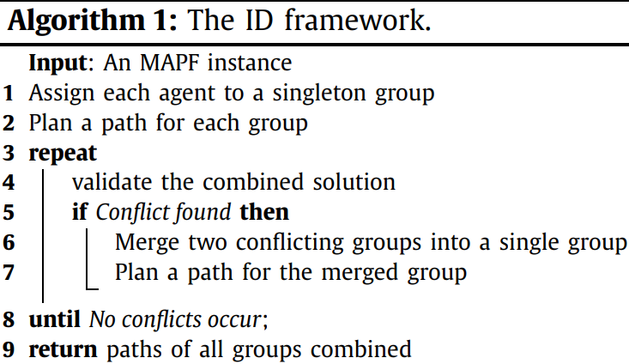

A*
The problem is exponential growth of state space in the number of agent
  For 1 agent b, for 2 agent b², branching factor = O($b^{k}$)
Independence Detection(ID) framework
  With ID, 2 agents state space may reduce to b

Slide 5
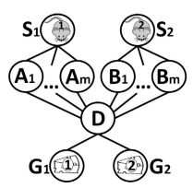
CBS (Conflict-based Search)
CBS solve agents independently with adding constraint to prevent exponential explosion

Slide 6
Two Level of CBS
High level
  Conflict detection
  Constraint management
Low level
  Optimal path finding under constraints

Slide 7
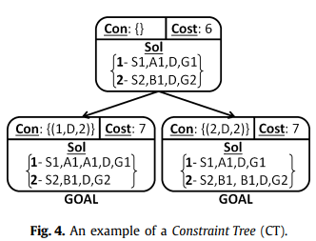
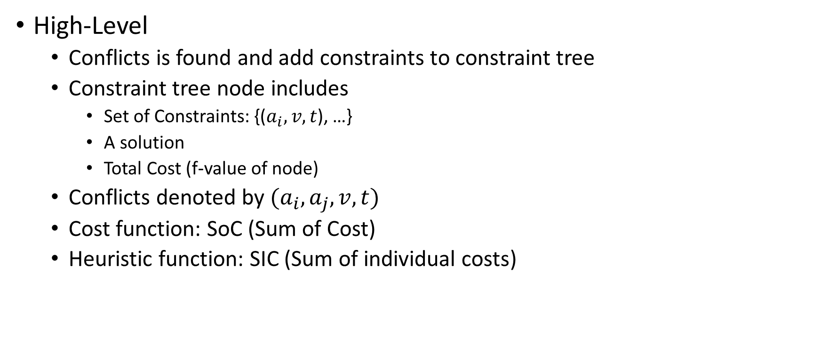
CBS
High-Level
  Conflicts is found and add constraints to constraint tree
  Constraint tree node includes
    Set of Constraints: {($a_{i},v,t$), …}
    A solution
    Total Cost (f-value of node)
  Conflicts denoted by $(a_{i},a_{j},v,t)$
  Cost function: SoC (Sum of Cost)
  Heuristic function: SIC (Sum of individual costs)

Slide 8
CBS
Low-Level: any optimal single agent pathfinding algorithm which can satisfies all the constraint such as A*, can be used

Slide 9
CBS

Slide 10

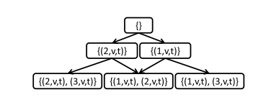
CBS
Conflict of k > 2 agent:
  k-way branching
  Binary CT

Slide 11



CBS
Edge conflict:
$(a_{i},a_{j},v_{1}, v_{2},t)$
$$(a_{1},v_{1}, v_{2},t)$$

Slide 12
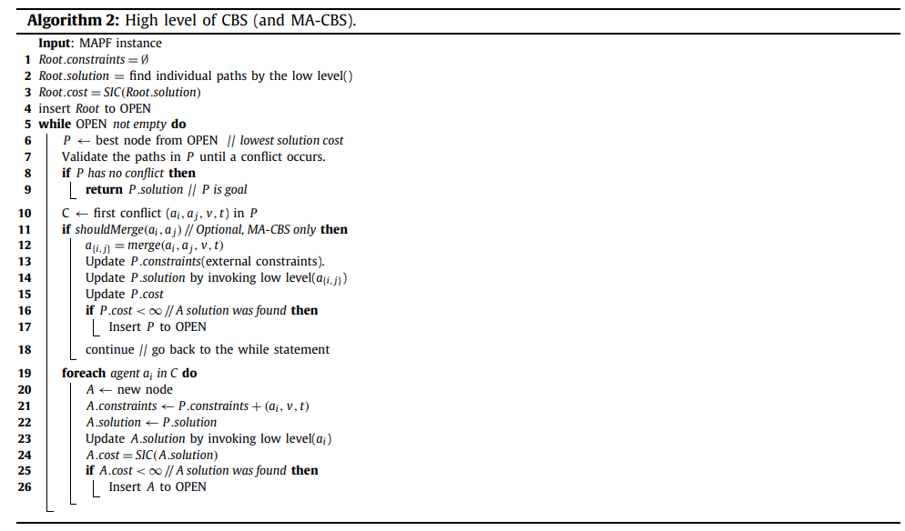
CBS

Slide 13

Theorical Analysis of CBS
A* must expand X = $|χ|$ which $χ$ is set of nodes with f $≤$ $C^{∗}$
CBS must expand $\overline{Y}$ = O($2^{\left|V\right|xC^{∗}}x\left|V\right|xC^{∗}$) low level nodes
CBS outperform A* when $\overline{Y}$ << X
C* is cost of optimal solution

Slide 14
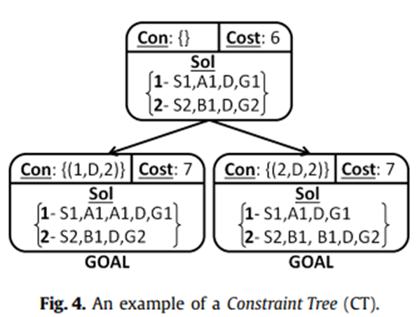


Comparison of A* and CBS
CBS will expand $2m+14$ low level nodes
A* will expand $m^{2}+3$ nodes

Slide 15
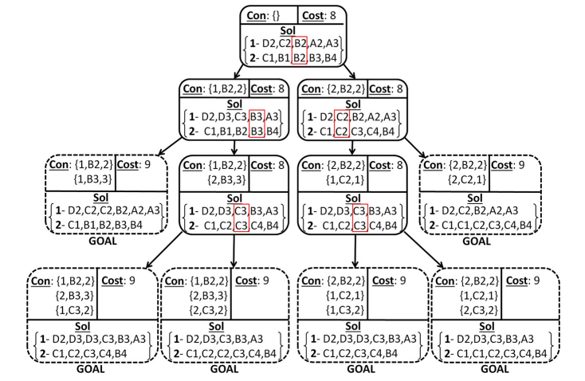
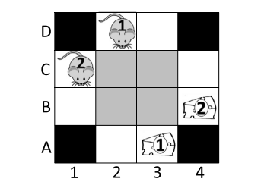
Comparison of A* and CBS
CBS will expand 8 + 4 · 4 + 6 · 5 = 54 low level nodes
A* will expand 5 + 3 = 8 nodes

Slide 16
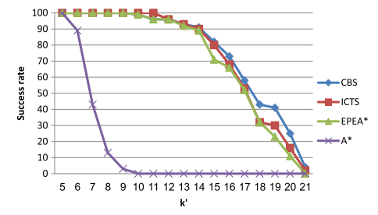
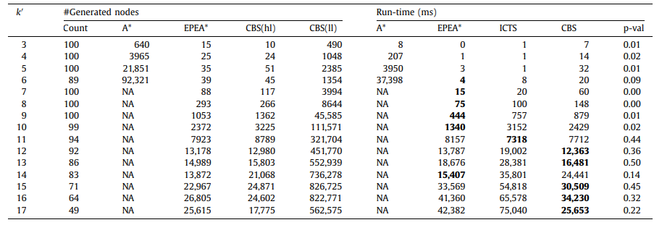
8x8 Grid

Slide 17
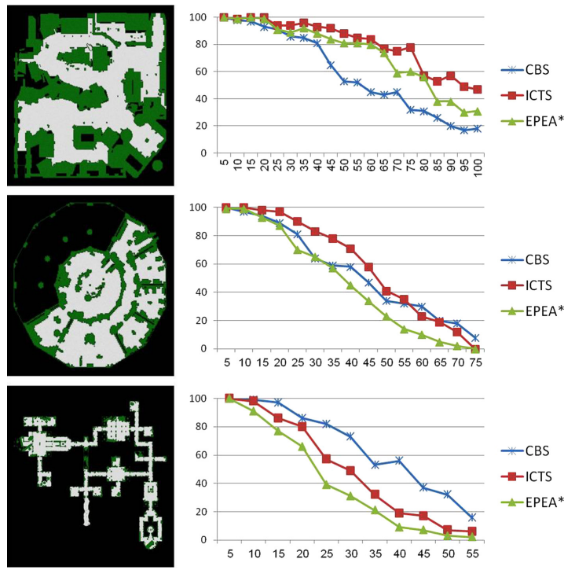
DAO Maps

Slide 18
MA-CBS (Meta-agent Conflict-based Search)
Remedies poor behavior of CBS when a set of agents is frequently conflicting by automatically merging those agent into a meta agent
Therefore prevent the exponential growth of constraint tree
Important Concepts with this:
  Merge policy
  Merging constraints

Slide 19
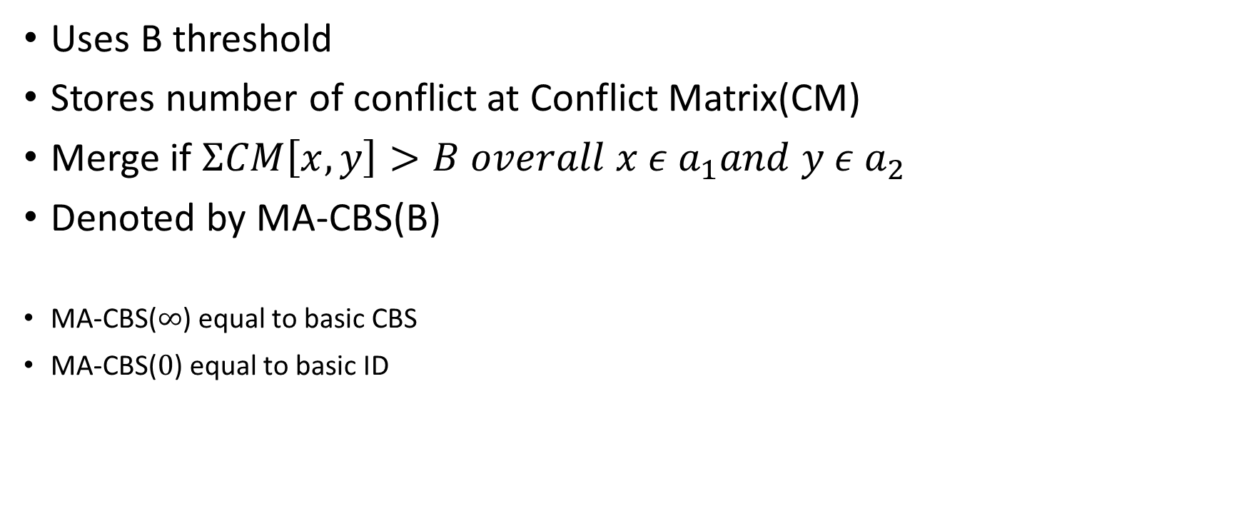
Merge policy
Uses B threshold
Stores number of conflict at Conflict Matrix(CM)
Merge if $ΣCM\left[x,y\right]>B overall x ε a_{1}and y ε a_{2}$
Denoted by MA-CBS(B)
MA-CBS($∞$) equal to basic CBS
MA-CBS($0$) equal to basic ID

Slide 20
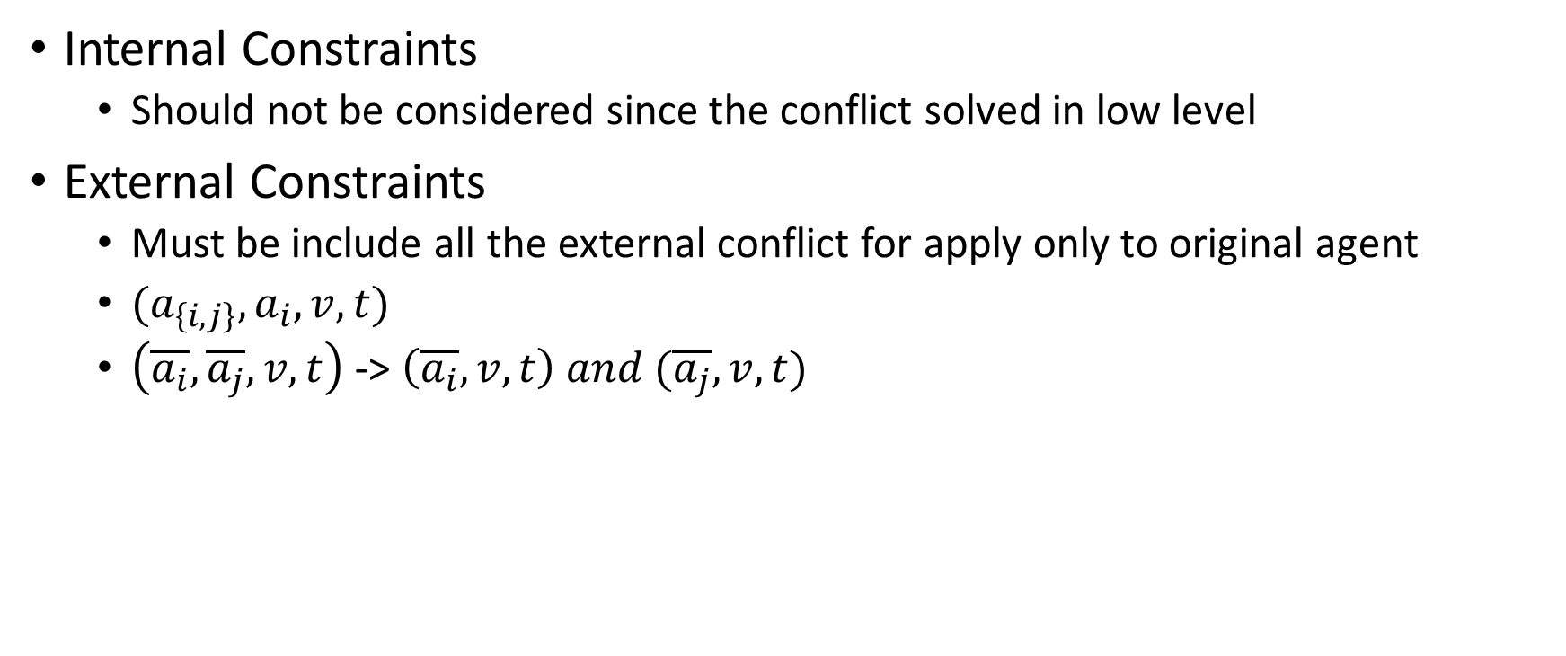
Merging constraints
Internal Constraints
  Should not be considered since the conflict solved in low level
External Constraints
  Must be include all the external conflict for apply only to original agent
  $(a_{\left\{i,j\right\}},a_{i}, v,t)$
  $\left(\overline{a_{i}},\overline{a_{j}},v,t\right)$ -> $\left(\overline{a_{i}},v,t\right) and (\overline{a_{j}},v,t)$

Slide 21
Low Level of MA-CBS
Low Level solver must be
  Complete
  Constraint handling
  Optimal
EPEA*, M*, MA-CBS with lower merging bound can be used as low level solver

Slide 22
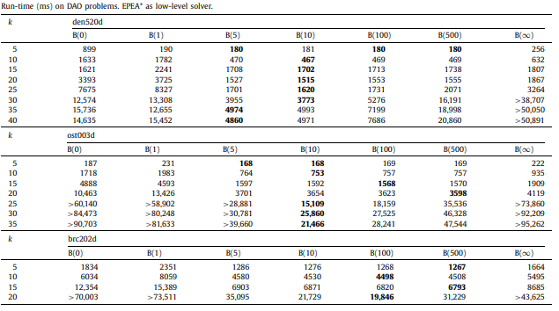
Run-time on DAO maps with EPEA* as low level

Slide 23
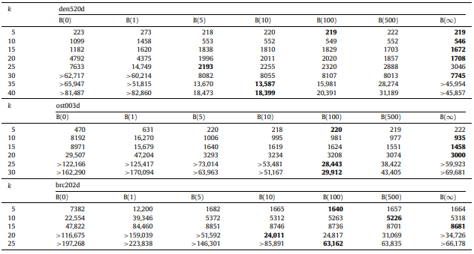
Run-time on DAO maps with A* as low level

Slide 24
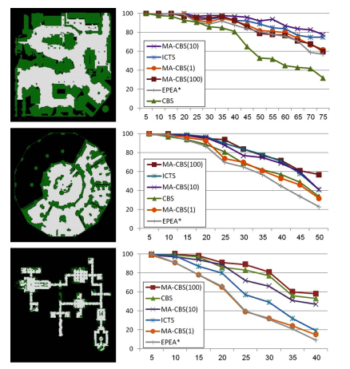
DAO maps

Slide 25
References
Jingjin Yu, Daniela Rus, Pebble motion on graphs with rotations: efficient feasibility tests and planning algorithms, in: Eleventh Workshop on the Algorithmic Foundations of Robotics, 2014
Trevor S. Standley, Finding optimal solutions to cooperative pathfinding problems, in: AAAI, 2010
Nathan R. Sturtevant, Benchmarks for grid-based pathfinding, Comput. Intell. AI Games 4 (2) (2012) 144–148.
Rina Dechter, Judea Pearl, Generalized best-first search strategies and the optimality of A*, J. ACM 32 (3) (1985) 505–536.
Guni Sharon, Roni Stern, Meir Goldenberg, Ariel Felner, The increasing cost tree search for optimal multi-agent pathfinding, in: IJCAI, 2011, pp. 662–667.
Guni Sharon, Roni Stern, Meir Goldenberg, Ariel Felner, The increasing cost tree search for optimal multi-agent pathfinding, Artif. Intell. 195 (2013) 470–495.
Meir Goldenberg, Ariel Felner, Roni Stern, Guni Sharon, Nathan R. Sturtevant, Robert C. Holte, Jonathan Schaeffer, Enhanced partial expansion A*, J. Artif. Intell. Res. 50 (2014) 141–187

Slide 26
Any Questions?

