Slide 1
Cloud Services 2
Amazon Web Services

Slide 2


AWS Container Services

Slide 3
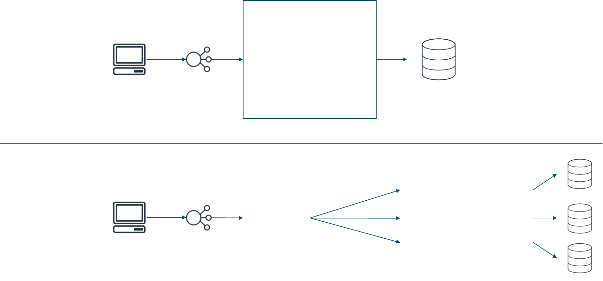
Comparing monolithic and microservice architectures
Monolithic
Storefront UI
Account service
Cart service
Browser
Load balancer
Shipping service
Database
Data access service
Microservices
Account service (Node.js)
Storefront UI (Node.js)
Cart service (Python)
Browser
Load balancer
Shipping service (Java)
Notes:
One of the strongest factors that drive the growth of containers is the rise of microservice architectures. Microservices are an architectural and organizational approach to software development that is designed to speed up deployment cycles. The microservices approach fosters innovation and ownership, and improves the maintainability and scalability of software applications.
Consider this example of a traditional monolithic architecture. For this shopping application, all of the processes are tightly coupled. With tightly coupled processes, if one process of an application experiences a spike in demand, the entire architecture must be scaled. Adding or improving features becomes more complex as the code base grows, which limits experimentation and complicates the implementation of new ideas or technology stacks. Monolithic architectures also add risk for application availability because having many dependent and tightly coupled processes increases the impact of a single process failure.
Now, consider having the same applications run in a microservice architecture. Each service is built as an independent component that communicates by using lightweight API operations. Each service performs a single function that could support multiple applications. Because the services run independently, they can be updated, deployed, and scaled to meet the demand for specific functions of an application.

Slide 4
Characteristics of microservices
Decentralized
Polyglot
Independent
Specialized
Black boxes
You build it, you run it
Notes:
Microservices share some common characteristics:
Decentralized – Microservice architectures are distributed systems with decentralized data management. They don’t rely on a unifying schema in a central database. Each microservice has its own view about data models. Microservices are also decentralized in the way they are developed, deployed, managed, and operated.
Independent – Each component service in a microservice architecture can be changed, upgraded, or replaced independently without affecting the function of other services. Services do not need to share any of their code or implementation with other services. Similarly, the teams responsible for different microservices can act independently from each other.
Specialized – Each component service is designed for a set of capabilities and focuses on a specific domain. If the code for a particular component service reaches a certain level of complexity, then the service can be split into two or more services.
Polyglot – Microservices don’t follow a single approach. Teams have the freedom to choose the best tool for their specific problem. As a consequence, microservice architectures take a heterogeneous approach to operating systems, programming languages, data stores, and tools. This approach is called polyglot persistence and programming.
Black boxes – Individual component services are designed as black boxes, which mean that the details of their complexity are hidden from other components. Any communication between services happens through well-defined APIs to prevent implicit and hidden dependencies.
You build it, you run it – DevOps is a key organizational principle for microservices, where the team responsible for building a service is also responsible for operating and maintaining it in production.

Slide 5
Microservices and containers
Microservices design | Container characteristics
Decentralized, evolutionary design Smart endpoints, dumb pipes | Each container uses the language and technology that are best suited for the service. Each component or system in the architecture can be isolated, and can evolve separately, instead of updating the system in a monolithic style.
Independent products, not projects | You can use containers to package all of your dependencies and libraries into a single, immutable object.
Designed for failure Disposable | You can gracefully shut down a container when something goes wrong and create a new instance. You start fast, fail fast, and release any file handlers. The development pattern is like a circuit breaker. Containers are added and removed, workloads change, and resources are temporary because they constantly change.
Development and production parity | Containers can make development, testing, and production environments consistent. This consistency facilitates DevOps, in which a containerized application that works on a developer's system will work the same way on a production system.
Notes:
When you consider the characteristics of a well-designed microservice architecture, containers are well matched to support microservices. For this reason, containers are the underlying technology that powers many modern microservice architectures. Likewise, with microservice architectures, developers can take full advantage of containers.

Slide 6

Challenges of managing containers at scale
State of containers
Scheduling of starts and stops
Resources available on each server
Maximizing availability, resilience, and performance
Notes:
Recall the shipping container analogy. Suppose that you have one ship and a half dozen containers. Keeping track of what's being shipped on which transport, the schedule of starts and stops, and the state of the containers is manageable. However, consider what happens when you scale up the number and type of transportation methods, along with the number of containers you are working with. Scheduling and managing which are loaded, where, and when requires a lot more logistical effort.
Likewise with software containers, running one or two containers on a single host is simple. But things get complex when you move into environments where you have tens of hosts with possibly hundreds of containers. Or you might have a full production environment with hundreds of hosts and maybe thousands of containers. You now must manage an enterprise-scale, clustered environment.
You must know the state of everything in your system. For example, you need to know which containers aren't working, and which are starting and stopping. You need to know where you have enough room and memory to add new containers. Finally, you need a way to place your containers intelligently on instances to maximize availability, resilience, and performance.

Slide 7

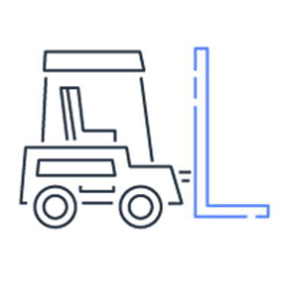

Container orchestration platforms
Scheduling
Placement
Service integration
Notes:
This situation is where container orchestration platforms become useful. They handle the scheduling and placement of containers based on the underlying hardware infrastructure and needs of the application. Container orchestration platforms integrate with other services, such as services for networking, persistent storage, security, monitoring, and logging.
Many options exist, including native tools like Docker Swarm, open-source platforms like Kubernetes, and Amazon Elastic Container Service (Amazon ECS). The orchestration platform is arguably the most important choice that you will make when you architect a container-based workload.

Slide 8

Amazon ECS
Fully managed container orchestration service
  Scales rapidly to thousands of containers with no additional complexity
  Schedules placement across managed clusters
  Integrates with third-party schedulers and other AWS services
Amazon Elastic Container Service (Amazon ECS)
Notes:
Amazon ECS is a highly scalable, highly performing container orchestration service that supports Docker containers. You can use the service to run and scale containerized applications on AWS. You can use Amazon ECS to schedule the placement of containers across a managed cluster of EC2 instances. Amazon ECS provides its own schedulers, but it can also integrate with third-party schedulers to meet business or application-specific requirements. Amazon ECS is also tightly integrated with other AWS services, such as AWS Identity and Access Management (IAM), Amazon CloudWatch, and Amazon Route 53.
For more information about Amazon ECS, see the product page at https://aws.amazon.com/ecs/.

Slide 9

Amazon ECR
Fully managed container registry that you can use to easily store, run, and manage container images for applications that run on Amazon ECS
  Scalable and highly available
  Integrated with Amazon ECS and Docker CLI
  Secure:
    Encryption at rest
    Integration with the AWS Identity and Access Management Service (IAM)
Amazon Elastic Container Registry (Amazon ECR)
Notes:
Amazon ECR is a fully managed, cloud-based Docker image registry that makes it easy for you to store, manage, and deploy Docker container images. Amazon ECR integrates with Amazon ECS and the Docker CLI, which simplifies your development and production workflows. You can push your container images to Amazon ECR by using the Docker CLI from your development machine. Then, Amazon ECS can pull them directly for production deployments.
Amazon ECR reduces the need to operate your own container repositories or be concerned about scaling the underlying infrastructure. Amazon ECR hosts your images in a highly available and scalable architecture, which enables you to reliably deploy containers for your applications. Amazon ECR is also secure. Amazon ECR transfers your container images over HTTPS, and it automatically encrypts your images at rest. You can configure policies to manage permissions for each repository and restrict access to IAM users, roles, or other AWS accounts.
For more information about Amazon ECR, see the product page at https://aws.amazon.com/ecr/.

Slide 10
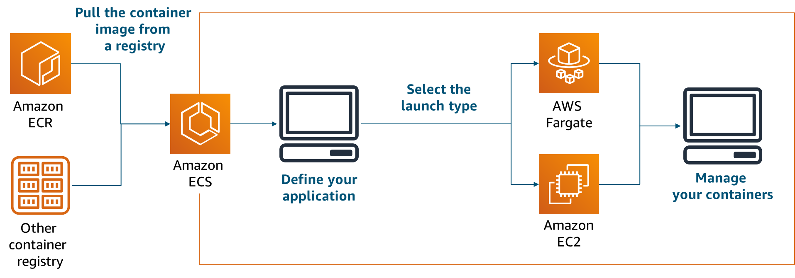
Amazon ECS solution architecture
Notes:
The following procedure is a high-level overview of Amazon ECS.
First, container images are pulled from a registry. This registry can be Amazon ECR—which is one of many AWS services that integrate with Amazon ECS—or a third-party or private registry.
Next, you define your application. Customize the container images with the necessary code and resources, and then create the appropriate configuration files to group. Then, define your containers as short-running tasks or long-running services within Amazon ECS.
When you are ready to bring your services online, you select one of two launch types: AWS Fargate or Amazon EC2. You can mix and match the two launch types as needed within your application. The next slide highlights distinctions between these two launch types.
Finally, you can use Amazon ECS to manage your containers. Amazon ECS scales your application and manages your containers for availability.

Slide 11

AWS Fargate
  Is a fully managed container service
  Works with Amazon Elastic Container Service (Amazon ECS) and Amazon Elastic Kubernetes Service (Amazon EKS)
  Provisions, manages, and scales your container clusters
  Manages runtime environment
  Provides automatic scaling
AWS Fargate
Notes:
In this section, you have learned that Amazon ECS offers two launch types: EC2 and Fargate.
AWS Fargate is a fully managed container service that works with both Amazon ECS and Amazon Elastic Kubernetes Service (Amazon EKS). It enables you to run containers without needing to manage servers or clusters. With AWS Fargate, you no longer need to provision, configure, and scale clusters of virtual machines to run containers. As a result, you don’t need to choose server types, decide when to scale your clusters, or optimize cluster packing. AWS Fargate reduces the need for you to interact with or think about servers or clusters. Fargate enables you to focus on designing and building your applications instead of managing the infrastructure that runs them.

Slide 12
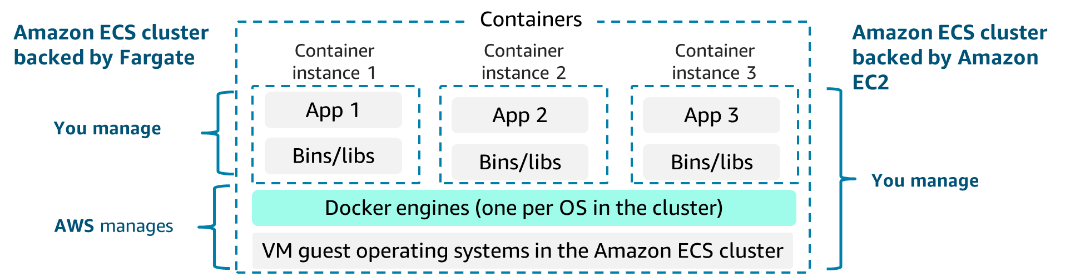
Amazon ECS with Fargate or Amazon EC2
Choose Fargate:
Services subject to wide swings in demand
Large workloads that are optimized for low overhead
Small test environments
Batch workloads that run on a schedule
Choose Amazon EC2:
More predictable resource requirements, or the option of using reserved instances to reduce costs
Large workloads that are optimized for price
Compliance with organizational security requirements
Excess Amazon EC2 capacity
Notes:
The Fargate launch type provides a near-serverless experience, where AWS completely manages the infrastructure that supports your containers. AWS manages the placement of your tasks on instances, and makes sure that each task has the appropriate amount of CPU and memory. With Fargate, you can focus on the tasks and the application architecture, instead of worrying about the infrastructure.
The Amazon EC2 launch type is useful when you want more control over the infrastructure that supports your tasks. When you use the Amazon EC2 launch type, you create and manage clusters of EC2 instances to support your containers. You also define the placement of containers across your cluster based on your resource needs, isolation policies, and availability requirements. You have more granular control over your environment without operating your own cluster management and configuration management systems, or worrying about scaling your management infrastructure.
For example, you can use EC2 to launch services that have more predictable resource requirements. You can use Fargate to launch other services that are subject to wide swings in demand. Regardless of the launch type that you use, Amazon ECS manages your containers for availability, and it scales your application as necessary to meet demand.
For more information about AWS Fargate, see the product page at https://aws.amazon.com/fargate/.
For more information about the Fargate and EC2 launch types, see https://docs.aws.amazon.com/AmazonECS/latest/developerguide/launch_types.html.

Slide 13
Creating an Amazon ECR repository and pushing an image
# Create a repository called hello-world
> aws ecr create-repository \
--repository-name hello-world \
--region us-east-1
# Build and tag an image
> docker build -t hello-world .
> docker tag hello-world:latest aws_account_id.dkr.ecr.us-east-1.amazonaws.com/hello-world:latest
# Authenticate Docker to your Amazon ECR registry
# You can skip the `docker login` step if you have amazon-ecr-credential-helper set up
> aws ecr get-login-password --region region | docker login --username AWS --password-stdin aws_account_id.dkr.ecr.region.amazonaws.com
# Push an image to your repository
> docker push aws_account_id.dkr.ecr.us-east-1.amazonaws.com/hello-world:latest
Notes:
You can programmatically access Amazon ECR from the AWS Command Line Interface (AWS CLI) and by using the APIs. You can use the AWS CLI and APIs to create, monitor, and delete repositories and set repository permissions. You can perform these same actions in the Amazon ECR console, which you can access from the Amazon ECS console. Amazon ECR integrates with the Docker CLI, which allows you to push, pull, and tag images on your development machine.
This example shows how to create a repository that is called hello-world with Amazon ECR. The example uses Docker CLI commands to build and tag an image, and then push it into the repository. To push an image into Amazon ECR, you must first authenticate the Docker client to your Amazon ECR registry.
For more information, see the following resources:
Using Amazon ECR with the AWS CLI: https://docs.aws.amazon.com/AmazonECR/latest/userguide/getting-started-cli.html.
Authenticating Amazon ECR Repositories for Docker CLI with Credential Helper: https://aws.amazon.com/blogs/compute/authenticating-amazon-ecr-repositories-for-docker-cli-with-credential-helper/.

Slide 14

Amazon EKS
Managed service that runs Kubernetes on the AWS Cloud
  Built with the Kubernetes community
  Conformant and compatible
  Secure by default
Amazon Elastic Kubernetes Service (Amazon EKS)
Notes:
Kubernetes is an open-source container management platform that you can use to deploy and manage containerized applications at scale. Kubernetes manages clusters of EC2 instances, and it runs containers on those instances with processes for deployment, maintenance, and scaling. By using Kubernetes, you can run any type of containerized application by using the same toolset on premises and in the cloud.
You can use AWS services to run Kubernetes in the cloud. These services include scalable and highly available VM infrastructure, community created service integrations, and Amazon Elastic Kubernetes Service (Amazon EKS). Amazon EKS is a managed service that runs the Kubernetes management infrastructure across multiple Availability Zones to reduce the chance of a single point of failure.
Amazon EKS is certified Kubernetes conformant, so you can use existing tools and plugins from partners and the Kubernetes community. Applications that run on any standard Kubernetes environment are fully compatible, and they can be migrated to Amazon EKS. Amazon EKS automatically sets up secure and encrypted channels to your worker nodes, which makes your infrastructure that runs on Amazon EKS secure by default. AWS actively works with the Kubernetes community by contributing to the Kubernetes code base, which helps Amazon EKS users employ AWS services and features.
For more information about Amazon EKS, see the product page at https://aws.amazon.com/eks/.

Slide 15
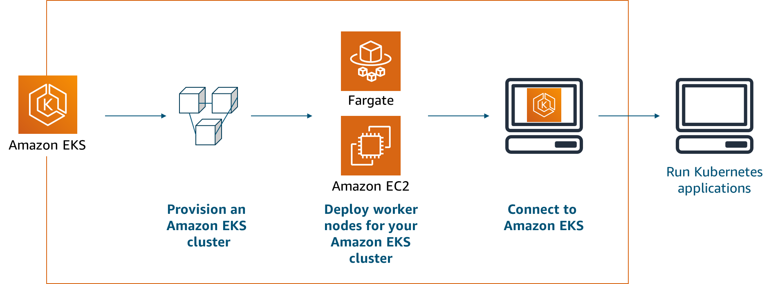
Amazon EKS
Notes:
When you select Amazon EKS as your container management service, you provision an Amazon EKS cluster and deploy Amazon EC2 or Fargate worker nodes (that is, worker machines) for your Amazon EKS cluster. You then connect to Amazon EKS and run your Kubernetes applications.

Slide 16

Elastic Beanstalk
Service for deploying and scaling web applications and services
  Automatically handles deployment details like capacity provisioning, load balancing, automatic scaling, and application health monitoring
  Provides a variety of platforms on which to build your applications
  Use to manage all of the resources that run your application as an environment
AWS Elastic Beanstalk
Notes:
Elastic Beanstalk is a service for deploying and scaling web applications and services. It automatically handles deployment details like capacity provisioning, load balancing, auto scaling, and application health monitoring.

Slide 17
Elastic Beanstalk components
Command | Description
Application | Logical collection of Elastic Beanstalk components. Conceptually similar to a folder.
Application version | Specific, labeled iteration of deployable code for a web application.
Environment | Collection of AWS resources that run an application version.
Environment tier | Designation of the type of application that the environment runs. Determines what resources Elastic Beanstalk provisions to support it.
Environment configuration | Collection of parameters and settings that define how an environment and its associated resources behave.
Saved configuration | Template that you can use as a starting point for creating unique environment configurations.
Platform | Combination of an OS, programming language runtime, web server, application server, and Elastic Beanstalk components. You design and target your web application to a platform.
Elastic Beanstalk CLI | CLI for Elastic Beanstalk. Provides interactive commands that simplify creating, updating, and monitoring environments from a local repository.
Notes:
AWS Elastic Beanstalk enables you to manage all of the resources that run your application as environments. This slide lists key Elastic Beanstalk components.

Slide 18
IAM permissions in Elastic Beanstalk environments
IAM roles assigned during environment creation
Service Role
Assigned during creation
﻿Elastic Beanstalk assumes that it uses other services on your behalf
Default service role:
  aws-elasticbeanstalk-service-role
Instance profile
Assigned during creation
﻿Applied to instances that are launched in your environment
Default instance profile:
  aws-elasticbeanstalk-ec2-role
User policies
Optionally assigned
Can be attached to users or groups who create and manage Elastic Beanstalk applications and environments
Two managed user policies are available to grant either full administrative access or read-only access
Notes:
The Elastic Beanstalk permissions model requires you to assign two roles when creating an environment: the service role and the instance profile.
Service role:
Elastic Beanstalk assumes the service role to use other AWS services on your behalf.
Suppose that you create an environment with the eb create command in the Elastic Beanstalk CLI. If you don't specify a service role through the
--service-role option, Elastic Beanstalk creates the default service role, aws-elasticbeanstalk-service-role. If the default service role already exists, Elastic Beanstalk uses it for the new environment.
Instance profile:
An instance profile is a container for an IAM role that can pass role information to an EC2 instance when the instance starts.
The instance profile is applied to the instances in your environment. The instances retrieve application versions from Amazon Simple Storage Service (Amazon S3), upload logs to Amazon S3, and perform other tasks. The tasks vary depending on the environment type and platform. In multicontainer Docker environments, the instance profile coordinates container deployments with Amazon ECS.
When you launch an environment by using the Elastic Beanstalk console or the CLI, Elastic Beanstalk creates a default instance profile, called aws-elasticbeanstalk-ec2-role. Managed policies are assigned to the role with default permissions.
Elastic Beanstalk provides three managed policies that are assigned to your environment by default. The policies consist of one for the web server tier, one for the worker tier, and one with additional permissions necessary for multicontainer Docker environments:
AWSElasticBeanstalkWebTier grants permissions to instances in your environment to upload logs to Amazon S3 and send debugging information to AWS X-Ray.
AWSElasticBeanstalkWorkerTier grants permissions for log uploads, debugging, metric publication, and worker instance tasks, including queue management, leader election, and periodic tasks.
AWSElasticBeanstalkMulticontainerDocker grants permissions for Amazon ECS to coordinate cluster tasks.
User policies:
User policies enable users to create and manage environments. Elastic Beanstalk provides managed policies for full access and read-only access:
AdministratorAccess-AWSElasticBeanstalk
AWSElasticBeanstalkReadOnly

Slide 19
AWS Managed policy example
{
"Version" : "2012-10-17",
"Statement" : [
{
"Effect" : "Allow",
"Action" : "ec2:Describe*",
"Resource" : "*"
},
{
"Effect" : "Allow",
"Action" : "elasticloadbalancing:Describe*",
"Resource" : "*"
},
… }
truncated for brevity
Excerpt of
AmazonEC2ReadOnlyAccess
Notes:
This slide shows an excerpt of the AmazonEC2ReadOnlyAccess policy.

Slide 20
Elastic Beanstalk simplifies container deployment
Getting started with
Amazon ECS
  Create a task definition
  Create and configure a cluster including:
    EC2 instances
    VPC settings
    IAM role definition
  Create a service to run and maintain a specified number of instances of a task
Getting started with
Elastic Beanstalk
  Write a Dockerrun.aws.json file and provide your zipped code
  Select the platform for your language
  Launch your application
Notes:
Elastic Beanstalk uses Amazon ECS to coordinate container deployments to multicontainer Docker environments. This coordination simplifies the task of getting up and running with containers. Elastic Beanstalk takes care of Amazon ECS tasks, including cluster creation, task definition, and running tasks.
You can also continue to customize your Elastic Beanstalk environment as you experiment and learn more about working with containers. When you create an Elastic Beanstalk environment, Elastic Beanstalk provisions and configures all of the AWS resources necessary to run and support your application. In addition to configuring your environment's metadata and update behavior, you can customize these resources by providing values for configuration options.
Elastic Beanstalk uses AWS CloudFormation to launch the resources in your environment and propagate configuration changes. The resources are defined in a template that you can view in the CloudFormation console.

Slide 21
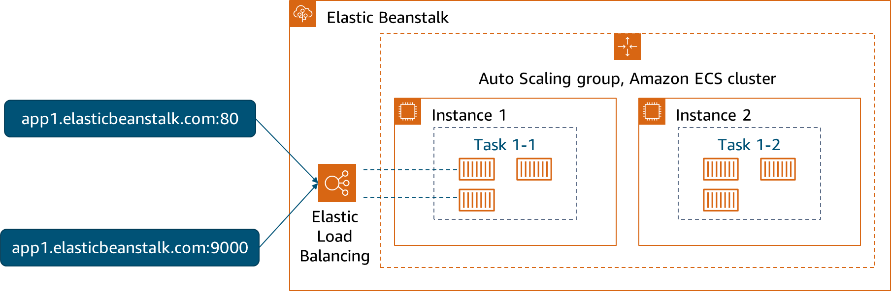
Multicontainer Docker platform
Notes:
You can use Elastic Beanstalk to create an environment where your EC2 instances run multiple Docker containers side by side.
This diagram shows an example Elastic Beanstalk environment that is configured with three Docker containers running on each EC2 instance in an Auto Scaling group.
The multicontainer Docker platform for Elastic Beanstalk requires images to be prebuilt and stored in a public or private online image repository.
When you create an environment by using the multicontainer Docker platform, Elastic Beanstalk automatically creates and configures several Amazon ECS resources. At the same time, it is building the environment to create the necessary containers on each EC2 instance.
Here are the components that Elastic Beanstalk creates:
Amazon ECS cluster: Container instances in Amazon ECS are organized into clusters. When they are used with Elastic Beanstalk, one cluster is always created for each multicontainer Docker environment.
Amazon ECS task definition: Elastic Beanstalk uses the Dockerrun.aws.json file in your project to generate the Amazon ECS task definition that configures container instances in the environment.
Amazon ECS task: Elastic Beanstalk communicates with Amazon ECS to run a task on every instance in the environment to coordinate container deployment. In a scalable environment, Elastic Beanstalk initiates a new task whenever an instance is added to the cluster. In rare cases, you might need to increase the amount of space that is reserved for containers and images.
Amazon ECS container agent: The agent runs in a Docker container on the instances in your environment. The agent polls the Amazon ECS service and waits for a task to run.
Amazon ECS data volumes: Elastic Beanstalk inserts volume definitions (in addition to the volumes that you define in Dockerrun.aws.json) into the task definition to facilitate log collection.
Elastic Beanstalk creates log volumes on the container instance, one for each container, at /var/log/containers/containername. These volumes are named awseb-logs-containername and are provided for containers to mount.

Slide 22
Deployment option namespaces
aws:elasticbeanstalk:command
Choose the deployment policy
Set a timeout
Choose options for size and type of batches to use
Choose whether to cancel deployment on a failed health check
aws:elasticbeanstalk:trafficsplitting
Choose the percentage of traffic to go to new instances
Choose how long to wait before continuing to shift more traffic
Notes:
Elastic Beanstalk defines a large number of configuration options that you can use to configure your environment's behavior and the resources that it contains. Configuration options are organized into namespaces.
You can use the configuration options in the aws:elasticbeanstalk:command namespace to configure your deployments.
If you choose the traffic-splitting policy, additional options for this policy are available in the aws:elasticbeanstalk:trafficsplitting namespace.
These deployment options can be set by using configuration files (.ebextensions).

Slide 23
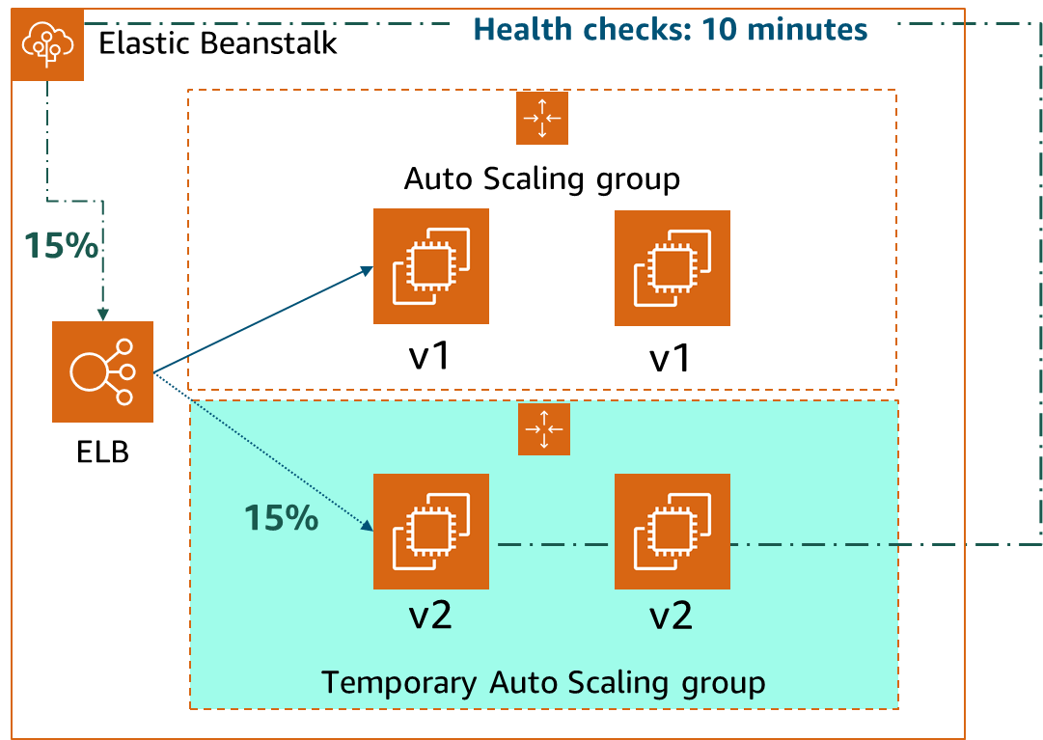
Example of traffic splitting (canary testing)
Example deployment configurations
option_settings:
aws:elasticbeanstalk:command:
DeploymentPolicy: TrafficSplitting
aws:elasticbeanstalk:trafficsplitting:
NewVersionPercent: "15"
EvaluationTime: "10"
Notes:
You can use traffic-splitting deployments to perform canary testing. You direct some incoming client traffic to your new application version to verify the application's health. As soon as the application’s health is verified, you can commit to the new version and direct all traffic to it.
During a traffic-splitting deployment, Elastic Beanstalk creates a new set of instances in a separate temporary Auto Scaling group. Elastic Beanstalk instructs the load balancer to direct a certain percentage of your environment's incoming traffic (NewVersionPercent) to the new instances. The decision is based on the configuration values in the aws:elasticbeanstalk:trafficsplitting namespace of your configuration file.
Then, for the configured amount of time (EvaluationTime), Elastic Beanstalk tracks the health of the new set of instances. If all is well, Elastic Beanstalk shifts remaining traffic to the new instances and attaches them to the environment's original Auto Scaling group. They replace the old instances. Then, Elastic Beanstalk cleans up—it terminates the old instances and removes the temporary Auto Scaling group.

Slide 24
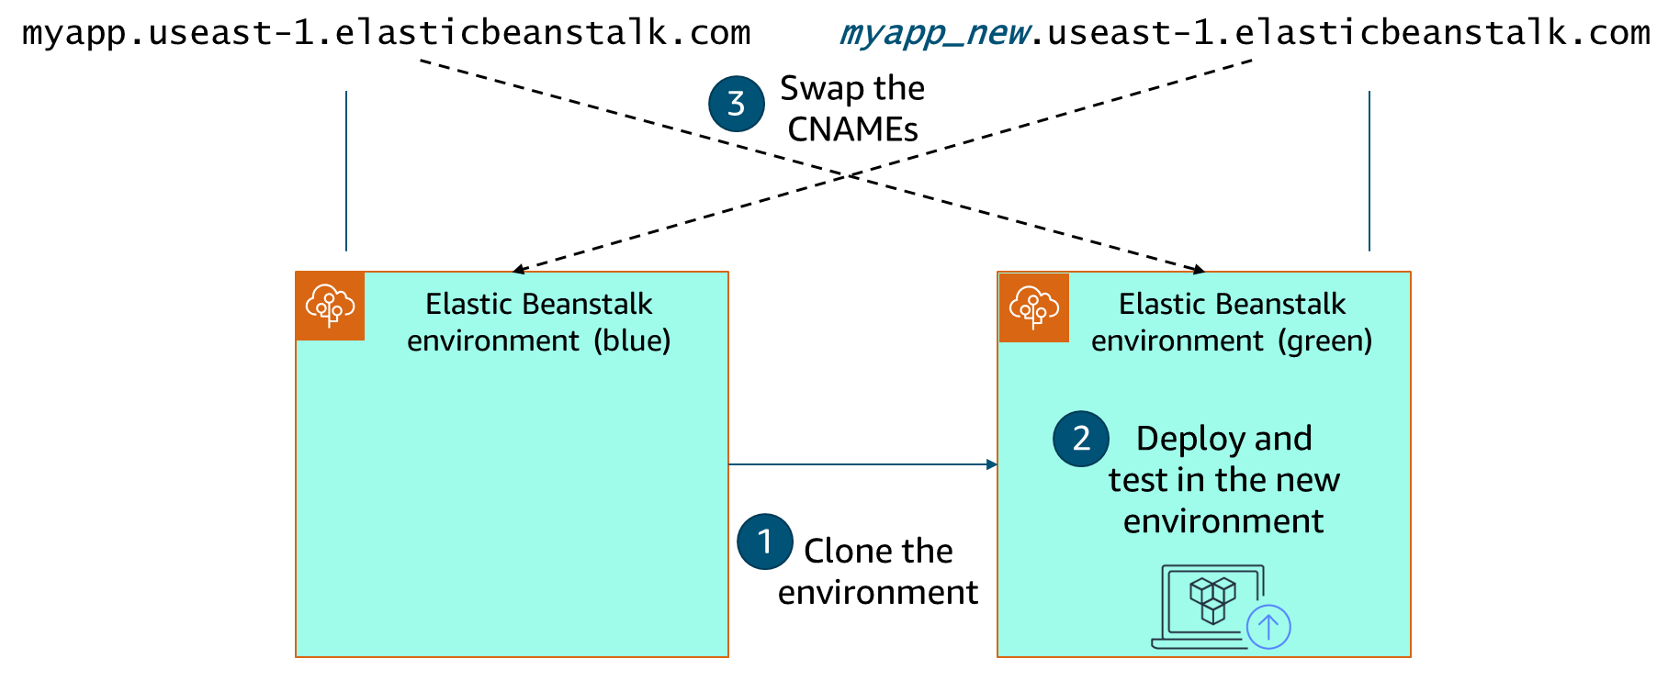
Blue/green deployments on Elastic Beanstalk
Notes:
Blue/green deployments are similar to immutable deployments because you create an entirely new environment and then move your application to that environment.
With a blue/green deployment, you deploy the new version to a separate environment. You then swap CNAMEs of the two environments to redirect traffic to the new version instantly.
Elastic Beanstalk gives you the option to clone an environment. Then, you can deploy your updates and test the new version in the clone. After completing all verification and testing, use the swap URL option in the original environment (blue) to redirect all traffic to your newly deployed version.
Blue/green deployment is required when you want to update an environment to an incompatible platform version.

Slide 25

Extra leermaterialen & labs
Documentatie:
  https://docs.aws.amazon.com/ecs/
  https://docs.aws.amazon.com/ecr/

