Slide 1


Thermodynamics 2 ENG2037
Laboratory Briefing
Dr C. White
craig.white.2@glasgow.ac.uk

Slide 2
Academic Details
Senior Lecturer in Aerospace Engineering
Email: craig.white.2@glasgow.ac.uk

Slide 3
Lab Aims
Learn how the pressure distribution around an aerofoil changes will angle of attack
Understand the relationship between various aerodynamic parameters, i.e. lift and drag, with angle of attack

Slide 4
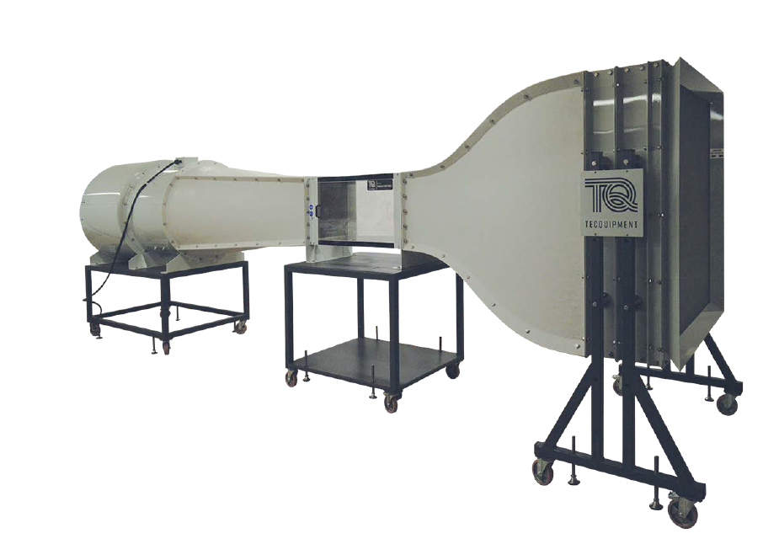
Windtunnel
Tecquipment AF1450 subsonic wind tunnel
450 mm x 450 mm x 1000 mm working section
Air drawn through the working section by a fan at the discharge end of the tunnel

Slide 5
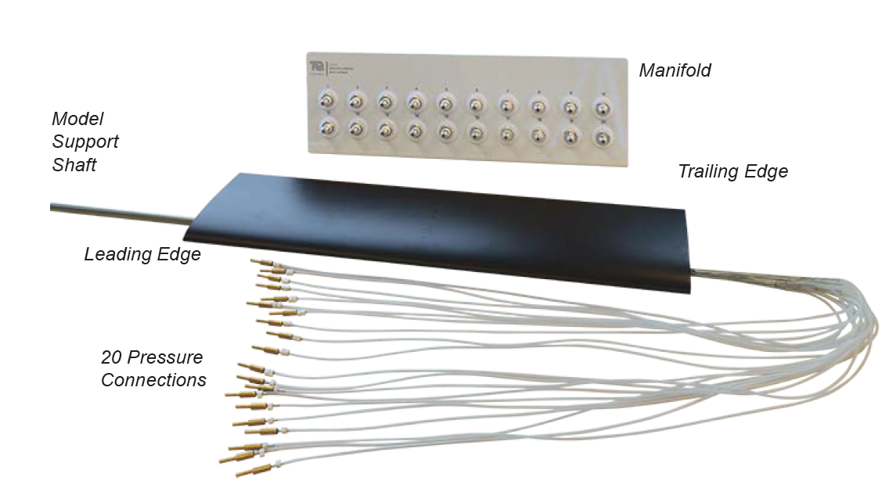
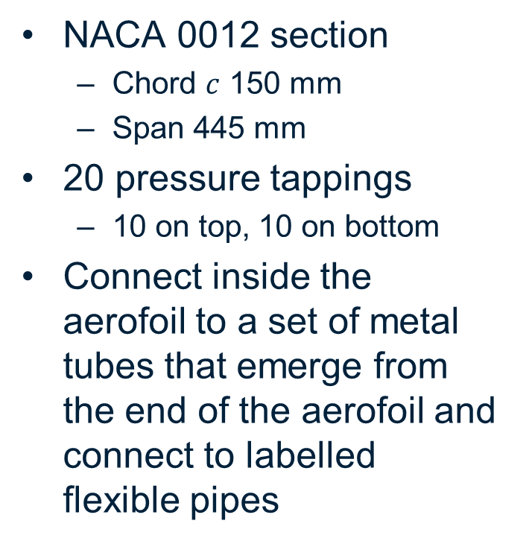
Pressure Tapped Aerofoil
NACA 0012 section
Chord $c$ 150 mm
Span 445 mm
20 pressure tappings
10 on top, 10 on bottom
Connect inside the aerofoil to a set of metal tubes that emerge from the end of the aerofoil and connect to labelled flexible pipes

Slide 6
Pressure Tapped Aerofoil
Flexible tubing connected to data acquisition board
Wall static pressures also connected to data acquisition
Angle of attack adjusted by rotating the mounting rod

Slide 7
Tapping Positions
Lower Surface Tapping | Distance From Leading Edge (mm) | Upper Surface Tapping | Distance From Leading Edge (mm)
1 | 0.76 | 2 | 1.52
3 | 3.81 | 4 | 7.62
5 | 11.43 | 6 | 15.24
7 | 19.05 | 8 | 22.86
9 | 38.00 | 10 | 41.15
11 | 62.0 | 12 | 59.44
13 | 80.77 | 14 | 77.73
15 | 101.35 | 16 | 96.02
17 | 121.92 | 18 | 114.30
19 | 137.16 | 20 | 129.54
Tapping numbers correspond to the channel numbers on the data acquisition
pressure tapping 1 is connected to channel 1, pressure tapping 2 is connected to channel 2, and so on

Slide 8
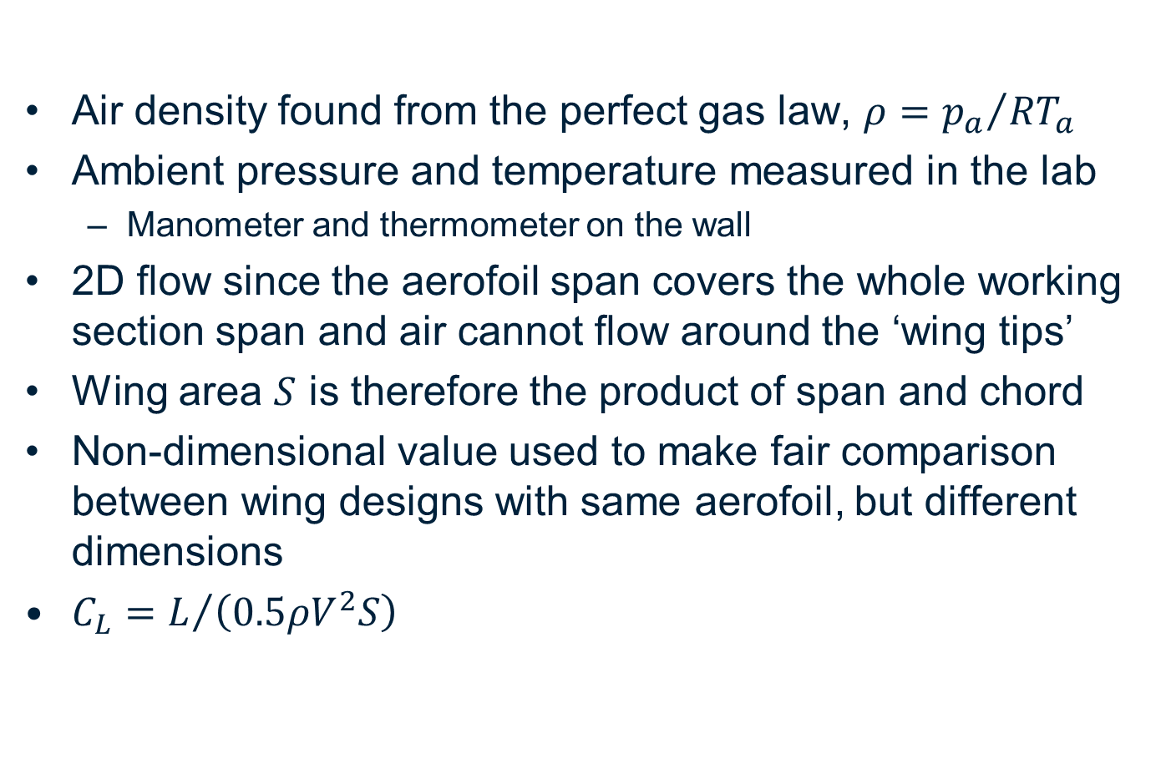
Theory
Air density found from the perfect gas law, $ρ={p_{a}}/{RT_{a}}$
Ambient pressure and temperature measured in the lab
Manometer and thermometer on the wall
2D flow since the aerofoil span covers the whole working section span and air cannot flow around the ‘wing tips’
Wing area $S$ is therefore the product of span and chord
Non-dimensional value used to make fair comparison between wing designs with same aerofoil, but different dimensions
$C_{L}=L/{\left(0.5ρV^{2}S\right)}$

Slide 9
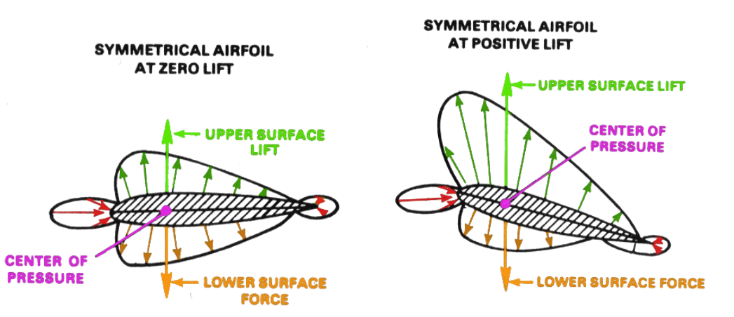
Theory
Aerofoil lift relies on relative differences between undisturbed atmospheric pressure and local pressures on the aerofoil surface

Slide 10
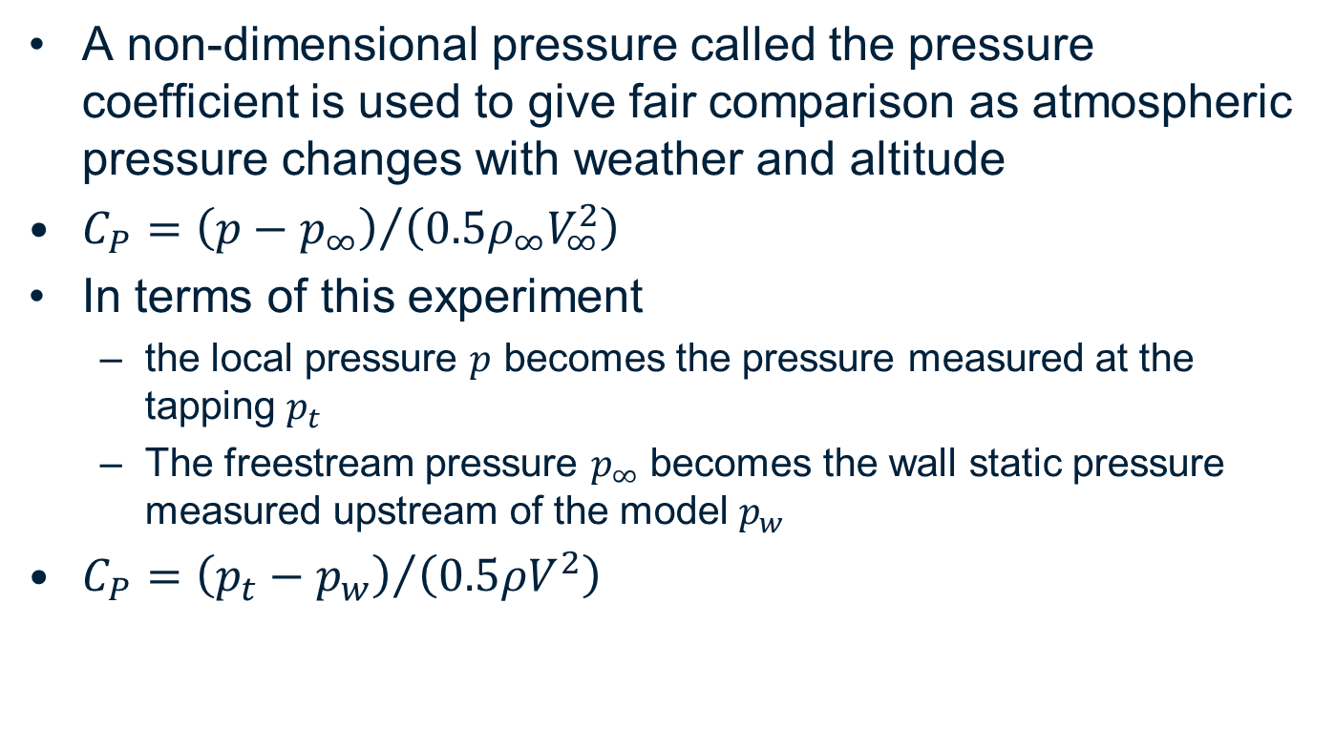
Theory
A non-dimensional pressure called the pressure coefficient is used to give fair comparison as atmospheric pressure changes with weather and altitude
$C_{P}={\left(p−p_{∞}\right)}/{\left(0.5ρ_{∞}V_{∞}^{2}\right)}$
In terms of this experiment
the local pressure $p$ becomes the pressure measured at the tapping $p_{t}$
The freestream pressure $p_{∞}$ becomes the wall static pressure measured upstream of the model $p_{w}$
$C_{P}={\left(p_{t}−p_{w}\right)}/{\left(0.5ρV^{2}\right)}$

Slide 11
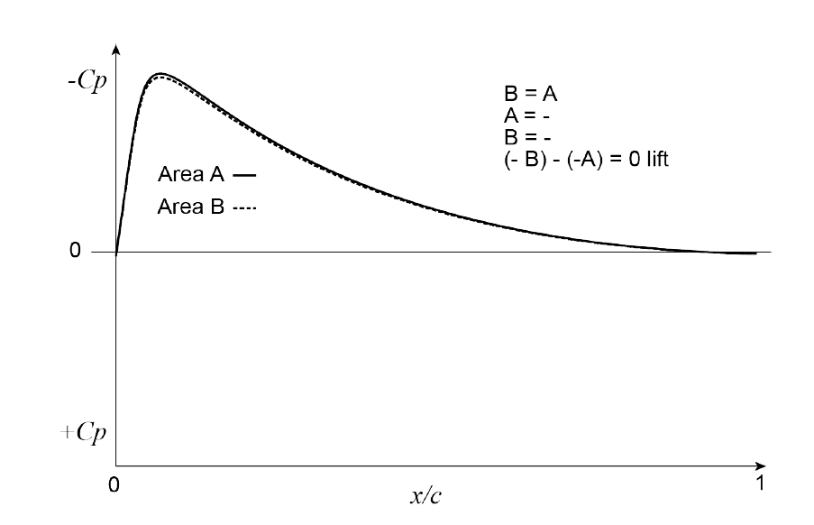
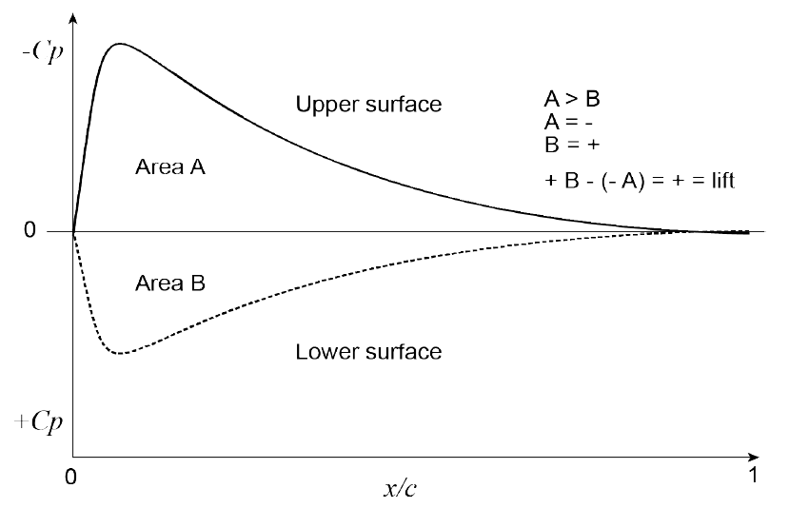

Theory
$C_{L}$is found from the area under a chart of $C_{p}$ against non-dimensional distance $x/c$ along the aerofoil
Zero degrees angle of attack
Positive angle of attack

Slide 12
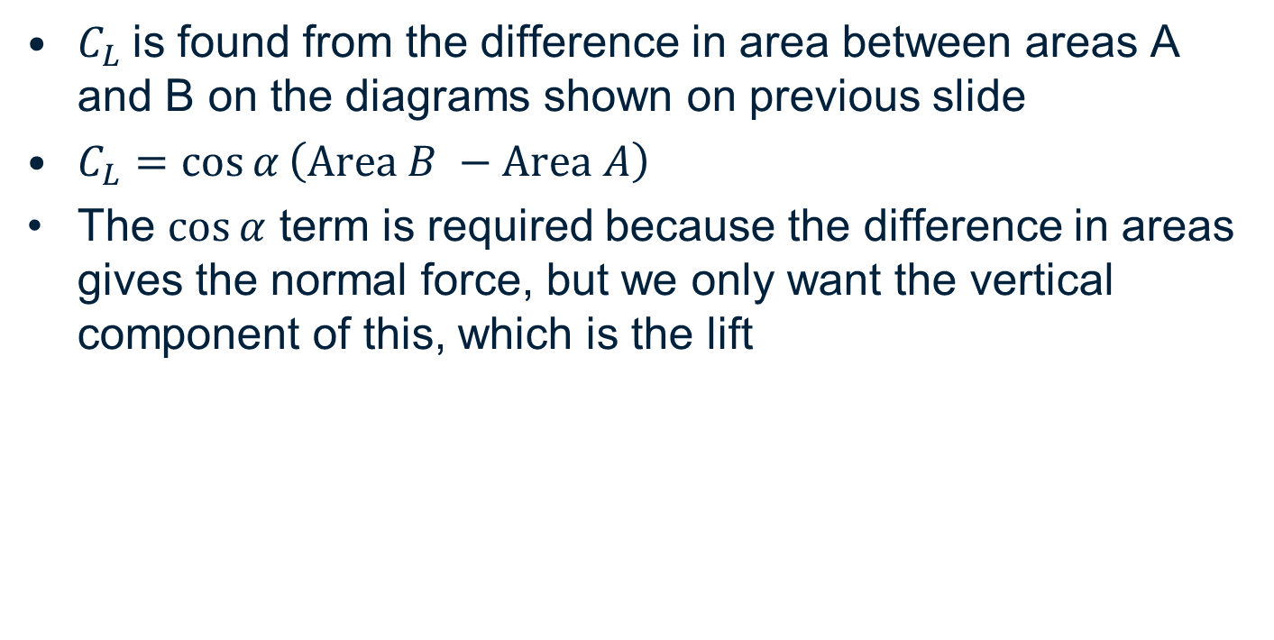
Theory
$C_{L}$is found from the difference in area between areas A and B on the diagrams shown on previous slide
$C_{L}=\cos{α}\left(Area B −Area A\right)$
The $\cos{α}$ term is required because the difference in areas gives the normal force, but we only want the vertical component of this, which is the lift

Slide 13
Lab Description
Record the ambient temperature and pressure from the thermometer and barometer in the lab.
Open the VDAS software on the PC connected to the wind tunnel’s data acquisition system (DAQ). Update the temperature to that measured in step 1.
Hit the ‘play’ button on the menu bar to start real time communication. The pressures and wind tunnel velocity will now be updated in real time on the screen.
Click Data -> Display Data Table to open a table, which will be empty for now.
Start the wind tunnel at a velocity of 20 m/s or higher. The model will initially be at an angle of attack of -6 degrees.

Slide 14
Lab Description
Hit F4 on the VDAS software to take the first reading. The surface static pressures at the locations in Table 1 will be recorded in Pressures 1-20 of the AFA6 Multi-Channel Pressure System section of the table (location 1 in Table 1 corresponds to channel 1, location 2 to channel 2, and so on). The upstream wall static pressure, which is also required to convert to pressure coefficient, is recorded in channel 31. Note that these are gauge pressures in units of kPa.
Repeat the experiment at different angles of attack, e.g. -6 degrees to 16 degrees in increments of 2 degrees, hitting F4 in the VDAS software to add a reading at each AoA.
Export the results to an Excel spreadsheet using File -> Export to Excel XLSX. Save the file. The demonstrator will upload it to Moodle, where it can be downloaded to begin the data analysis.

Slide 15
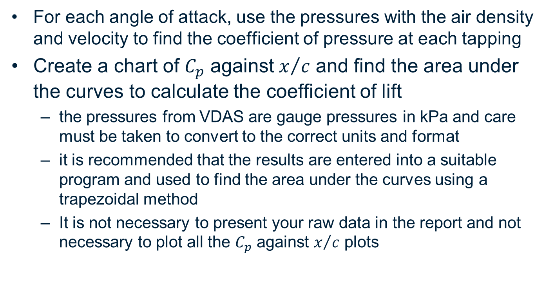
Hints for Processing the Data
For each angle of attack, use the pressures with the air density and velocity to find the coefficient of pressure at each tapping
Create a chart of $C_{p}$ against $x/c$ and find the area under the curves to calculate the coefficient of lift
the pressures from VDAS are gauge pressures in kPa and care must be taken to convert to the correct units and format
it is recommended that the results are entered into a suitable program and used to find the area under the curves using a trapezoidal method
It is not necessary to present your raw data in the report and not necessary to plot all the $C_{p}$ against $x/c$ plots

Slide 16
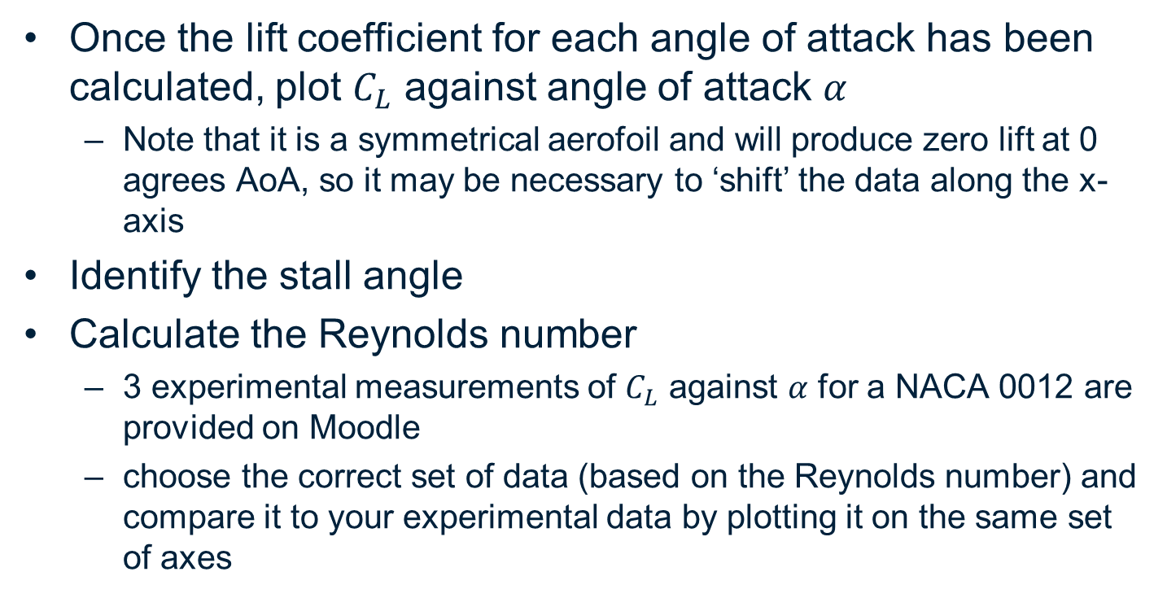
Hints for Processing the Data
Once the lift coefficient for each angle of attack has been calculated, plot $C_{L}$ against angle of attack $α$
Note that it is a symmetrical aerofoil and will produce zero lift at 0 agrees AoA, so it may be necessary to ‘shift’ the data along the x-axis
Identify the stall angle
Calculate the Reynolds number
3 experimental measurements of $C_{L}$ against $α$ for a NACA 0012 are provided on Moodle
choose the correct set of data (based on the Reynolds number) and compare it to your experimental data by plotting it on the same set of axes

Slide 17
Hints for Processing the Data
For three angles of attack, 0 degrees, pre-stall, and post-stall, draw the expected streamlines around the aerofoil and discuss them
The drag force cannot be obtained from this experiment, but explain what happens to the drag coefficient of an aerofoil with varying incidence, making reference to the stall angle

Slide 18
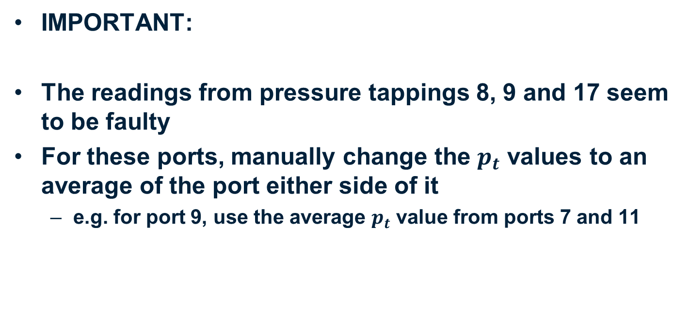
Hints for Processing the Data
IMPORTANT:
The readings from pressure tappings 8, 9 and 17 seem to be faulty
For these ports, manually change the $p_{t}$ values to an average of the port either side of it
e.g. for port 9, use the average $p_{t}$ value from ports 7 and 11

Slide 19
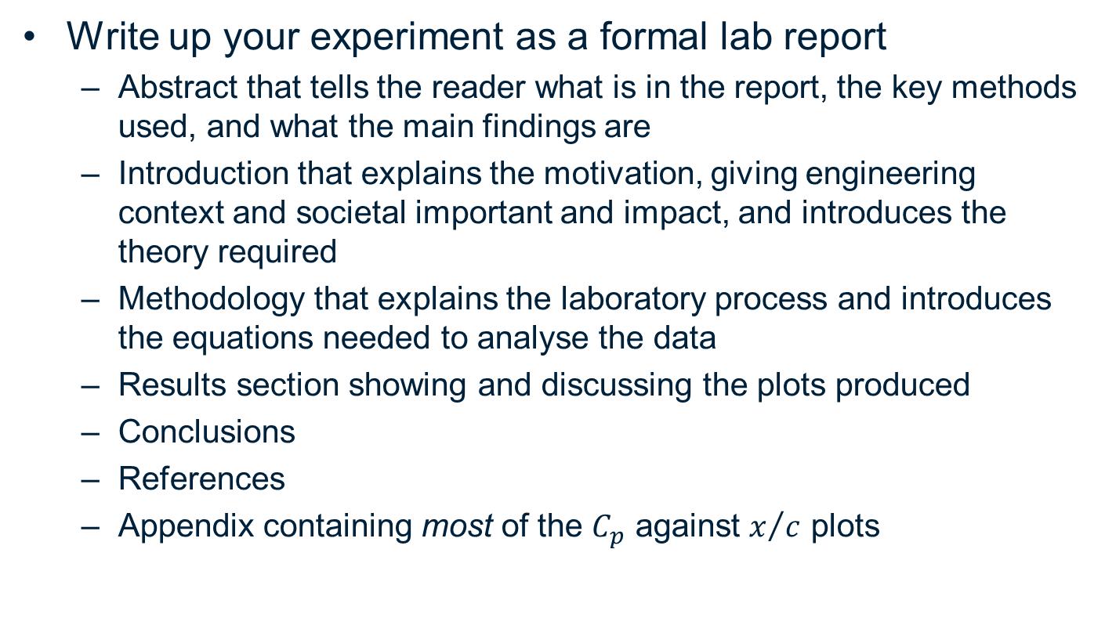
Lab Report
Write up your experiment as a formal lab report
Abstract that tells the reader what is in the report, the key methods used, and what the main findings are
Introduction that explains the motivation, giving engineering context and societal important and impact, and introduces the theory required
Methodology that explains the laboratory process and introduces the equations needed to analyse the data
Results section showing and discussing the plots produced
Conclusions
References
Appendix containing most of the $C_{p}$ against $x/c$ plots

Slide 20
Lab Report
Information on writing a lab report is included on Moodle under the Aero lab section
Maximum 8 sides of A4 (including figures and references, but not including Appendix)
Moodle submission, no need for title pages
Assessment is based on report presentation as well as technical content
Use figure captions and numbers, refer to figures by their numbers in the text

Slide 21
Lab Report Submission
Plot titles are not required, your captions should be descriptive enough to help readers understand what the figure shows
Due 2 weeks after your individual lab session, but can be uploaded to Moodle any time before then

