Slide 1
Bayesian Optimization
Caglar Demir
Department of Computer Science
Paderborn University

Slide 2
Outline
Bayes’ Theorem
Frequentism vs Bayesianism
Gaussians
Gaussian distribution
Gaussian process
Bayesian Optimization
Multi-armed bandit problem
Exploration vs Exploitation
Acquisition Function

Slide 3
Bayes’ Theorem

Slide 4
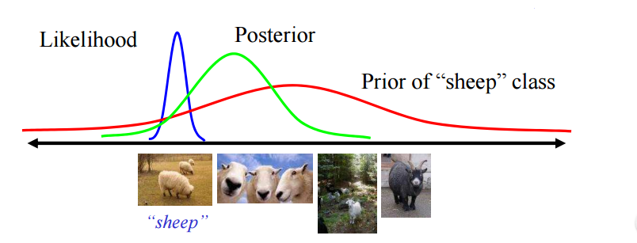
Bayes’ Theorem
Source
- CPSC 540 Machine Learning in 2013 at UBC by Nando de Freitas

Slide 5
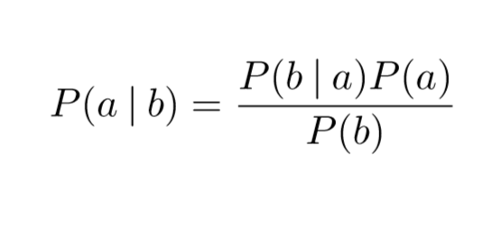
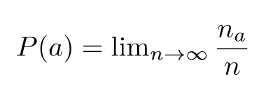
Bayes’ Theorem
Bayesianism vs Frequentism
Source
- CM Bishop. Bishop pattern recognition and machine learning, 2001

Slide 6
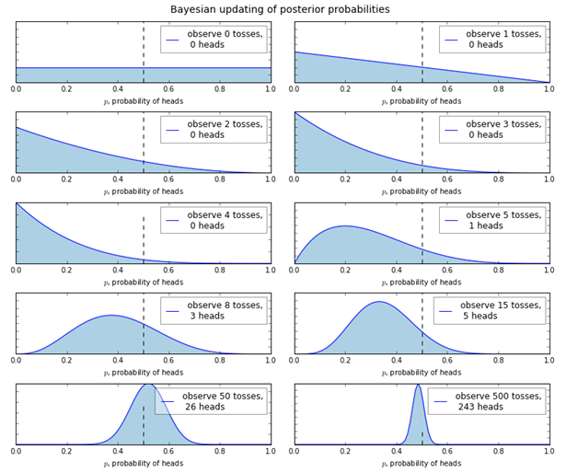
Bayes’ Theorem
Tossing with a fair coin
Source
- Cameron Davidson-Pilon, Probabilistic Programming and Bayesian Inference, 2015

Slide 7
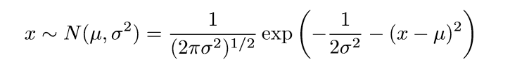
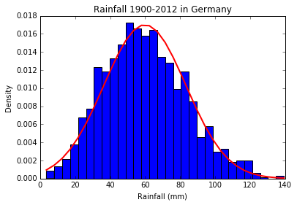
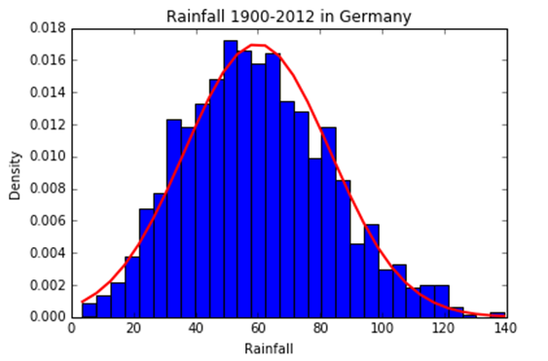
Gaussians
Gaussian Distribution
Source
- The World Bank Group, Climate Change Knowledge Portal

Slide 8


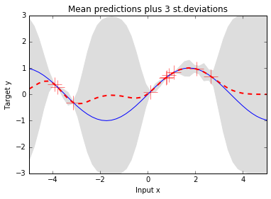
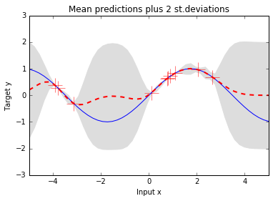
Gaussians
Gaussian Process
Source
- CPSC 540 Machine Learning in 2013 at UBC by Nando de Freitas

Slide 9
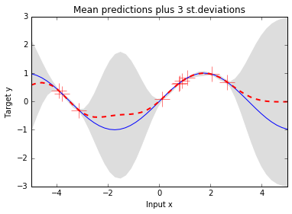
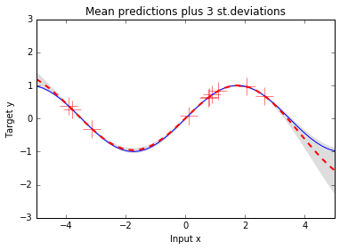
Gaussians
Gaussian Process
Kernel Parameter = 1
Kernel Parameter = 10
Source
- CPSC 540 Machine Learning in 2013 at UBC by Nando de Freitas

Slide 10

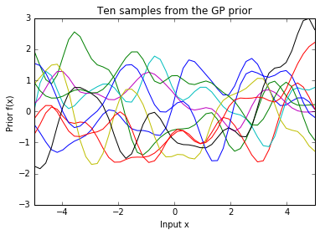
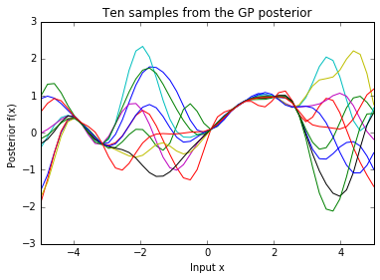
Gaussians
Gaussian Process
Source
- CPSC 540 Machine Learning in 2013 at UBC by Nando de Freitas
- E. Brochu, V. Cora and Nando de Freitas, A Tutorial on Bayesian Optimization of Expensive Cost Functions

Slide 11
Bayesian Optimization
Powerful technique for finding the extrema of objective function, when
Evaluations of objective function are costly.
A closed-form expression is not available for objective function.
Estimating the objective function
with the posterior mean function of a Gaussian process

Slide 12

Bayesian Optimization
Multi-armed bandit problem
Which slot machine to start ?
How many trials ?
Time or Budget ?
Exploration vs Exploitation
Regret = Player reward – Reward of best action

Slide 13
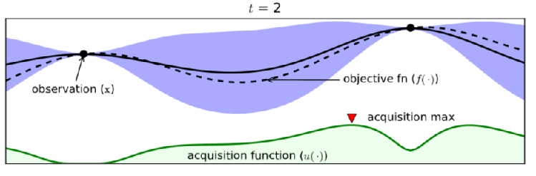
Bayesian Optimization
Source
- E. Brochu, V. Cora and Nando de Freitas, A Tutorial on Bayesian Optimization of Expensive Cost Functions

Slide 14
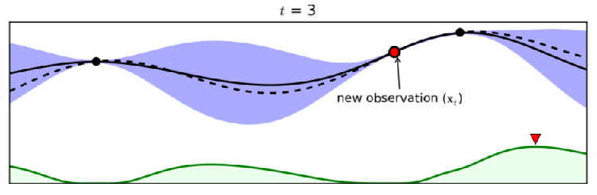
Bayesian Optimization
Source
- E. Brochu, V. Cora and Nando de Freitas, A Tutorial on Bayesian Optimization of Expensive Cost Functions

Slide 15
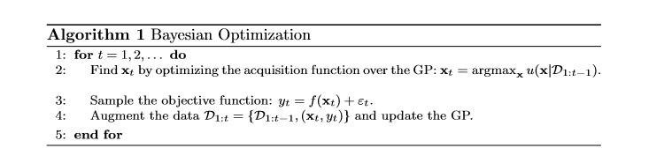
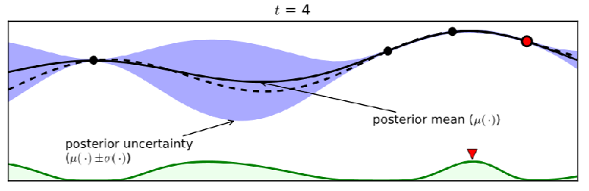
Bayesian Optimization
Source
- E. Brochu, V. Cora and Nando de Freitas, A Tutorial on Bayesian Optimization of Expensive Cost Functions

Slide 16
Bayesian Optimization
Acquisition functions

Slide 17
Bayesian Optimization
Acquisition functions
An optimization problem in an optimization problem ?
The expected improvement
Confidence bound Criteria

Slide 18

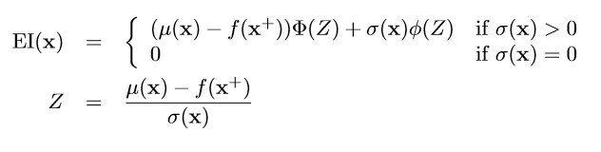
Bayesian Optimization
Acquisition function: The expected improvement
Source
- J. Mockus, V. Tiesis, and A. Zilinskas. Toward Global Optimization
- E. Brochu, V. Cora and Nando de Freitas, A Tutorial on Bayesian Optimization of Expensive Cost Functions

Slide 19




Bayesian Optimization
Acquisition function: Confidence bound Criteria
Source
- E. Brochu, V. Cora and Nando de Freitas, A Tutorial on Bayesian Optimization of Expensive Cost Functions
- D. R. Jones. A taxonomy of global optimization methods based on response surfaces. J. Global Optimization

Slide 20
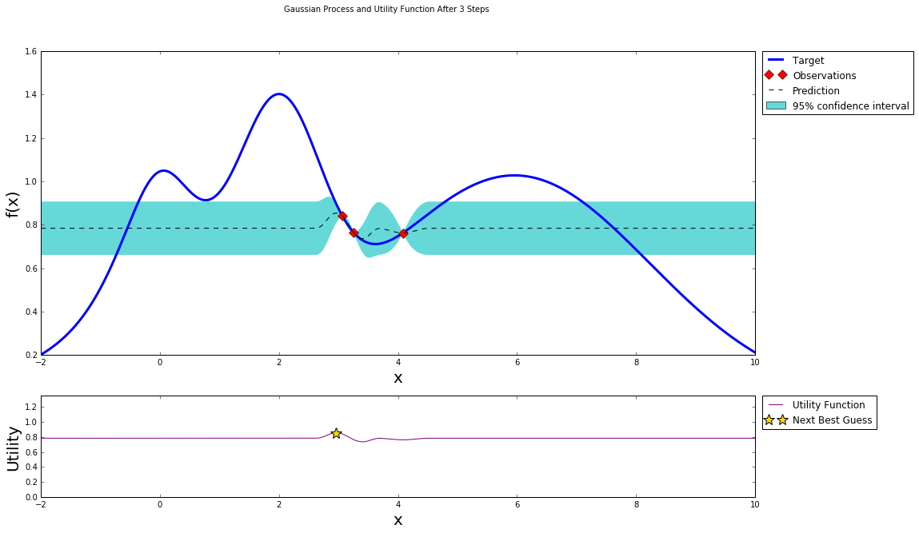
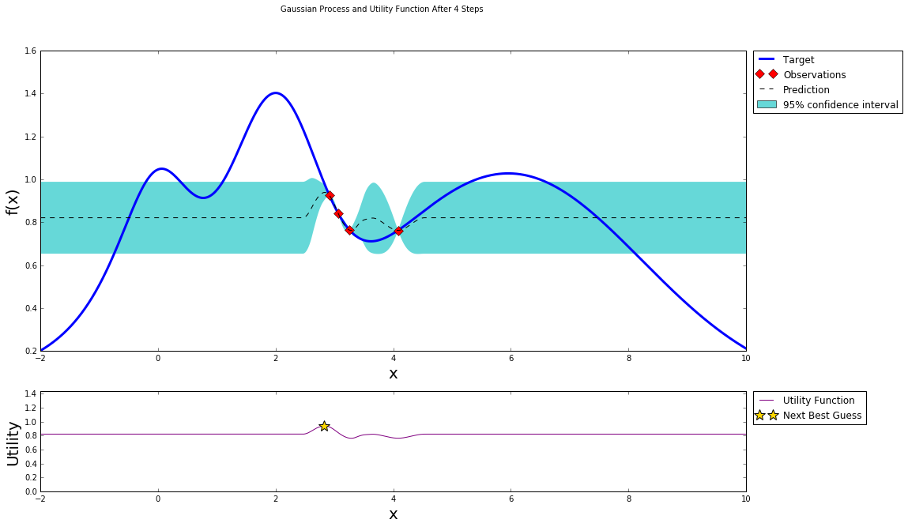
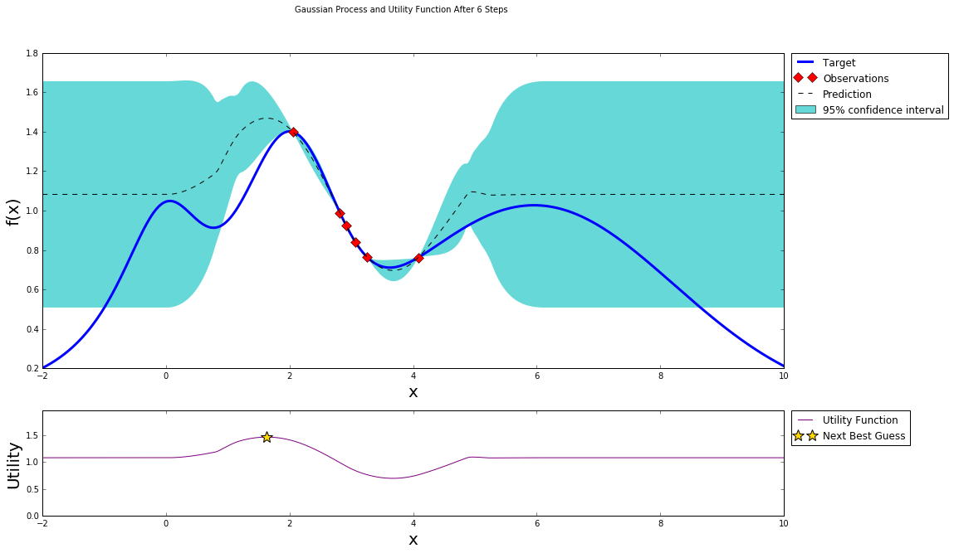
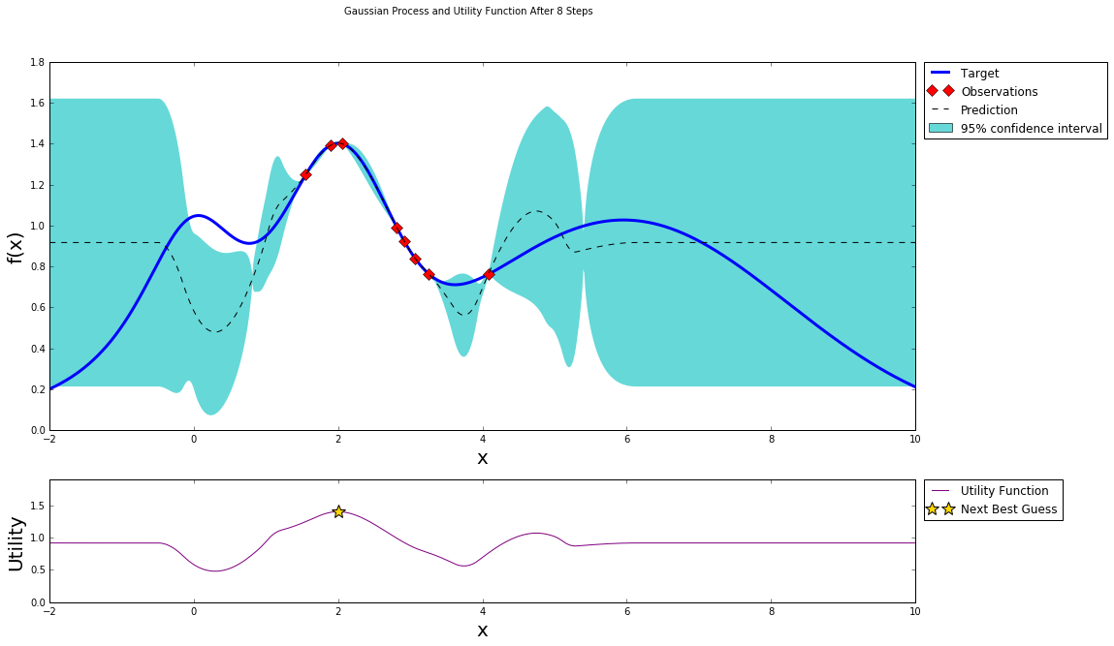
Bayesian Optimization
Source
Implementation of BO by PhD.Fernando Nougeira

Slide 21
Bayesian Optimization
THANK YOU !

