Slide 1
Demix BASE Tools - Benchmark Appraisal Support Environment Tools – Version 04
Pieter van Zyl, Jared Twigg
13 Feb 2021

Slide 2
Copyright (c) 2020-2021, Demix (Pty) Ltd, All rights reserved
http://www.demix.org
Permission is hereby granted, free of charge, to any person obtaining a copy
of this software and associated documentation files (the "Software"), to deal
in the Software without restriction, including without limitation the rights
to use, copy, modify, merge, publish, distribute, sublicense, and/or sell
copies of the Software, and to permit persons to whom the Software is
furnished to do so, subject to the following conditions:
The above copyright notice and this permission notice shall be included in all
copies or substantial portions of the Software. Email your acceptance of the license agreement to request@demix.org
THE SOFTWARE IS PROVIDED "AS IS", WITHOUT WARRANTY OF ANY KIND, EXPRESS OR
IMPLIED, INCLUDING BUT NOT LIMITED TO THE WARRANTIES OF MERCHANTABILITY,
FITNESS FOR A PARTICULAR PURPOSE AND NONINFRINGEMENT. IN NO EVENT SHALL THE
AUTHORS OR COPYRIGHT HOLDERS BE LIABLE FOR ANY CLAIM, DAMAGES OR OTHER
LIABILITY, WHETHER IN AN ACTION OF CONTRACT, TORT OR OTHERWISE, ARISING FROM,
OUT OF OR IN CONNECTION WITH THE SOFTWARE OR THE USE OR OTHER DEALINGS IN THE
SOFTWARE.
More information at https://demix.org/tools
Enhancement suggestions email request@demix.org

Slide 3
List of tools
Software tool and documentation | Short description
00_Data_Reference.xlsm | Copy of 01_rrVaa_CompanyName_CAS_Plan.xlsm and provides source data for the presentations: Technology Test, Opening Briefing, Preliminary Findings and Final Findings
10_rrVaa_CompanyName_CAS_Plan.xlsm | Main planning workbook. rr is the latest release, Vaa is the latest document version number. Update Vaa when content changes. Demix will update rr when a new release is made of the workbook. The workbook is built on the principle of primary/single source. It is copied over 00_Data_Reference (see above) is the primary source of information for CAS provides data for the BASE software
11_03v02_CompanyName_TechnologyTest | Presentation (can be a participants briefing) but is used the week before phase 2 starts to test the technology. Plan data is linked to 00_Data_Reference

Slide 4
List of tools
Software tool and documentation | Short description
20_rrVaa_CompanyName_OpeningBriefing.pptx | Opening briefing presentation. Plan data is linked to 00_Data_Reference
21_rrVaa_CompanyName_PreliminaryFindings.pptx | Preliminay findings presentation. Plan data is linked to 00_Data_Reference
30_rrVaa_CompanyName_FinalFindings.pptx | Final findings presentation. Plan data is linked to 00_Data_Reference

Slide 5
List of tools
Software tool and documentation | Short description
BASEfiles\50_rrVaa_50_09v01_BASE_OEdbATL_template.xlsx | A template used to create the BASE OEdb for the ATL. A 3 in 1. It is a compact OE database that is 1) generated from the random generated sample list of projects/support functions in the 01_rrVaa_CompanyName_CAS_Plan.xlsm , 2) contains the scripted questions 3) can be used for OE collection by linking the documents to the projects/support functions 4) used by ATMs to testing document sufficiency, 5) used by ATMs to collect affirmations 6) used by ATMs to document strength, weaknesses and notes 7) used by the appraisal team to perform characterisation
BASEfiles\60_05v01_BASE_QuestionsAndModel.xlsx | A template that contains scripted questions. This can be updated and is injected into the BASE OEdb when it is generated.

Slide 6
BASE plan, CAS, presentation workflow
Update CAS from BASE plan
Do all planning here in the BASE plan
10_rrVaa_CompanyName_CAS_Plan.xlsm
CAS
00_Data_Reference.xlsm
BASE Software
See next slides for BASE software features
Save to here when needing to update presentations
11_03v02_CompanyName_TechnologyTest
20_rrVaa_CompanyName_OpeningBriefing.pptx
21_rrVaa_CompanyName_PreliminaryFindings.pptx
30_rrVaa_CompanyName_FinalFindings.pptx
Open presentations with 00_Data_Reference open and update links
CMMI institute toolkit
Copact BASE_OEdb
Principle of primary source / single source

Slide 7
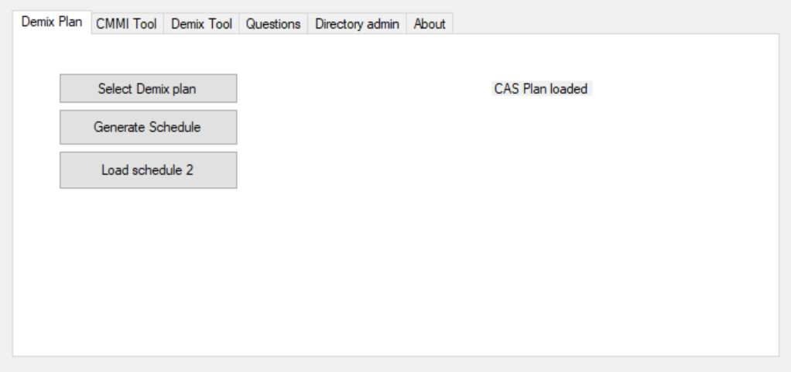
After random sample, uploads 01_rrVaa_CompanyName_CAS_Plan.xlsm
Load: Project and support function info
Load: Staff info
Load: Process info
Use 1,2 and 3 above to generate the full project/support function – staff – pa list.
A recommended list is presented (include=x) with duplicates excluded (include= “ “)
A subset of this list can be selected for interviews by removing duplicate staff, for example extra developers for the same project
Ignore

Slide 8
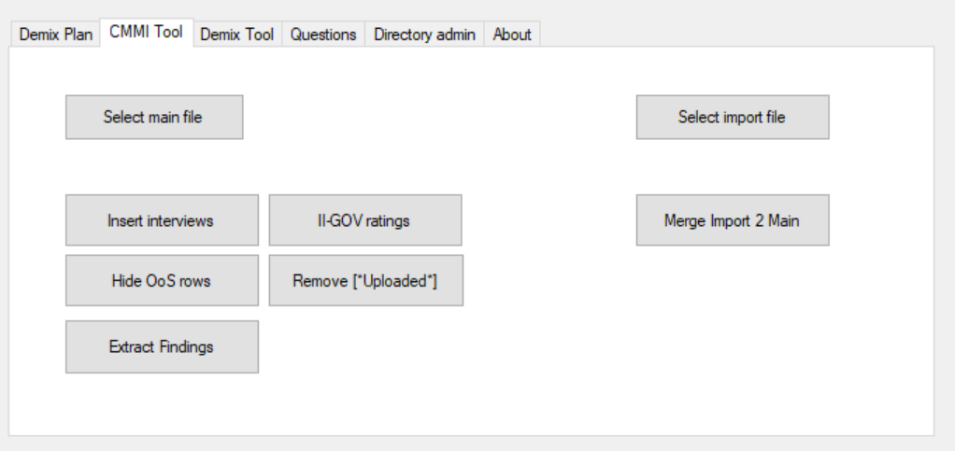
Used with the CMMI institute’s MDD-Toolkit-Appraisal Tool features
Select ATM MDD-Toolkit-Appraisal Tool version to upload
Select LA’s main MDD-Toolkit-Appraisal Tool
Extract II-GOV ratings
Inert interviewees from the plan
Merge ATM updates into the LA’s main version.
Insert [UPLOAD] into Column “RFIs, Questions, Information Needed”
Hide all unneeded OoS rows
Remove [“Uploaded”] notifications from notes
Extract findings, strengths, weakness, recommendations

Slide 9
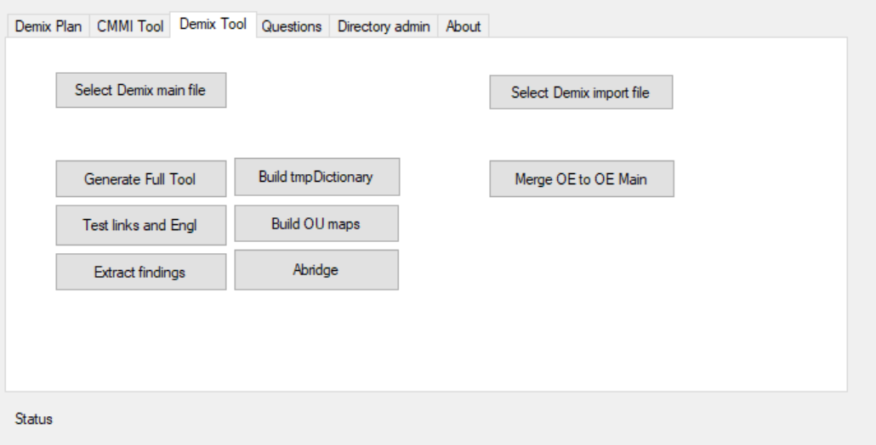
Select a ATM’s compact db with his/her change
Used with the CAS_Plan.xlsm to generate a compact OE database.
Select a BASE OEdb to create (template)
Merge the ATMs changes on the compact OE db with the LAs main compact OE db
Generate a BASE OEdb for this appraisal based on 01_rrVaa_CompanyName_CAS_Plan.xlsm
Run Build tmpDictionary first
Then build an OU maps
Note: does not build all yet. Needs enhancement
Test the links in the BASE OEdb. Test if English translation of documents are present (-engl) and add ‘n link to the enlsih version
Extract findings from the BASE OEdb
Remove project specific info for C&NA purpuses

