Slide 1



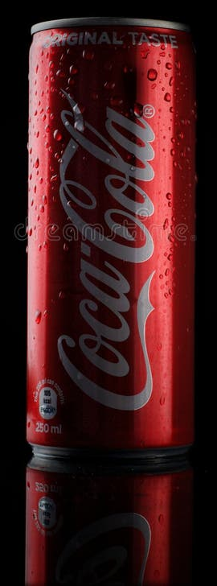





Slide 2
EVER

Slide 3
THOUGHT

Slide 4
WHY

Slide 5
ALL

Slide 6
GOOD

Slide 7

THINGS

Slide 8
ARE

Slide 9
RED
RED
RED
&
BLACK
BLACK
BLACK

Slide 10
RED
RED
RED
&
BLACK
BLACK
BLACK

Slide 11
?

Slide 12
?

Slide 13
T

Slide 14
T

Slide 15
E

Slide 16
E

Slide 17
D

Slide 18
D

Slide 19
TEDx

