Slide 1


Team Name: TEAM(SC1)_09
LEARNATHON 4.0
Problem Statement: Use of technology to test adulteration of fresh produce
Team Members:
Abhisekh Pattnaik (Roll no.-24CSEAIML218)
Ansuman Dash (Roll no.-24CSEAIML059)
Debashis Panda (Roll no.-24CSEAIML001)
MD Arshyan Ahmad (Roll no.-24CSE376)

Slide 2
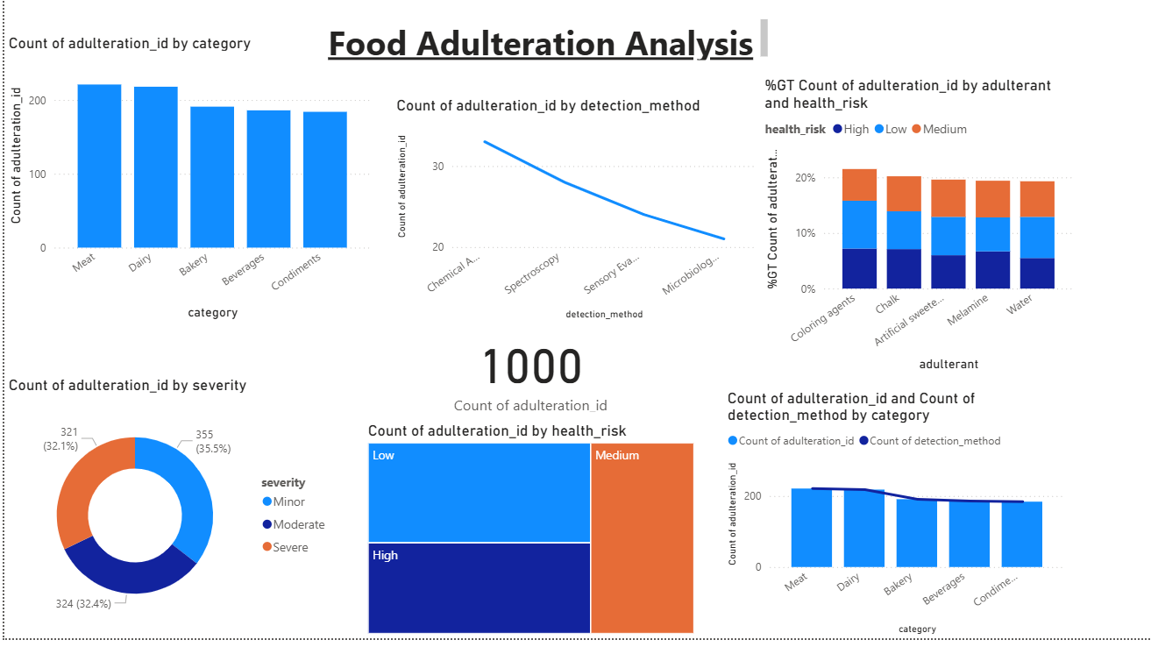
“Uncovering the Truth Behind Food Adulteration”
1,000 cases analyzed – key adulterants: coloring agents & sweeteners.
Meat & dairy are the most impacted categories.
36% cases are severe, posing major health risks.
Chemical analysis is the most effective detection method.

Slide 3
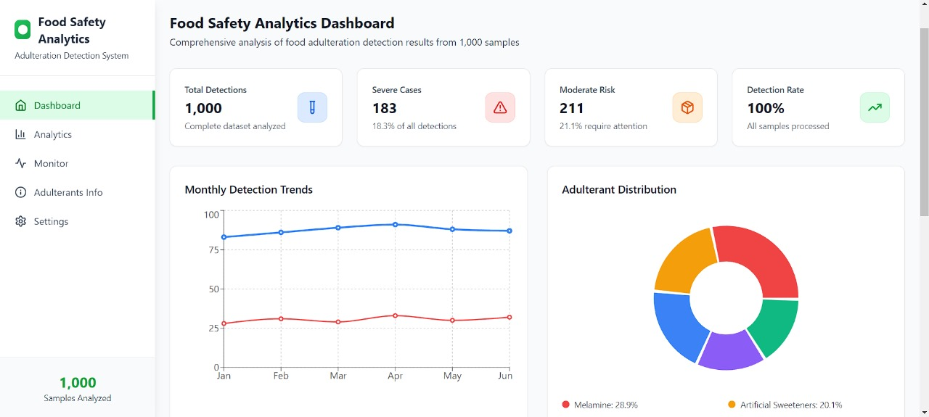
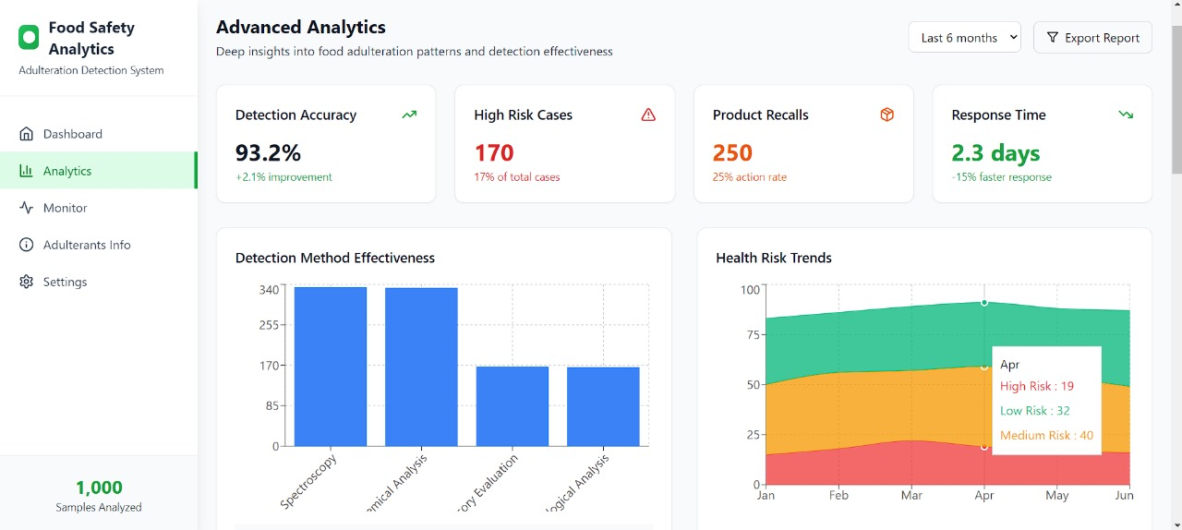
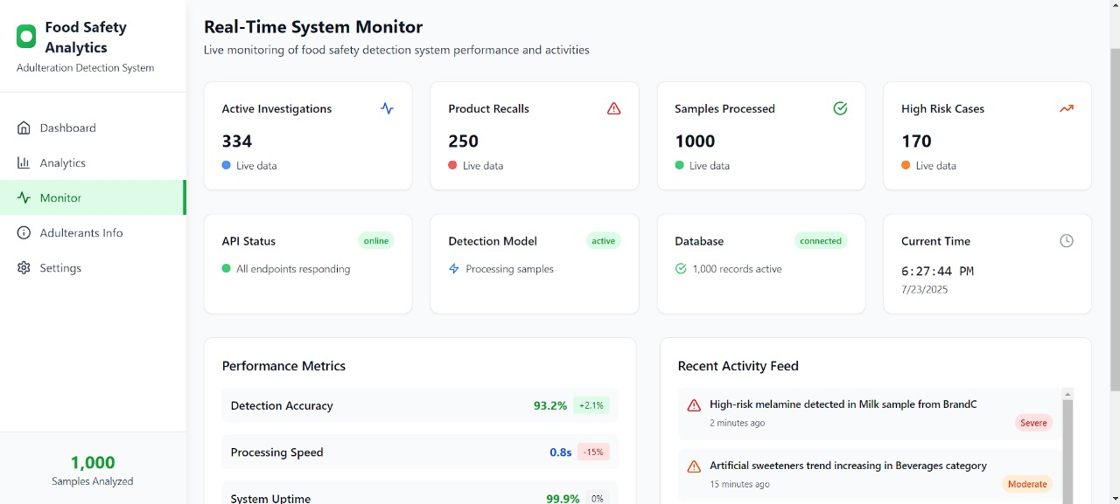
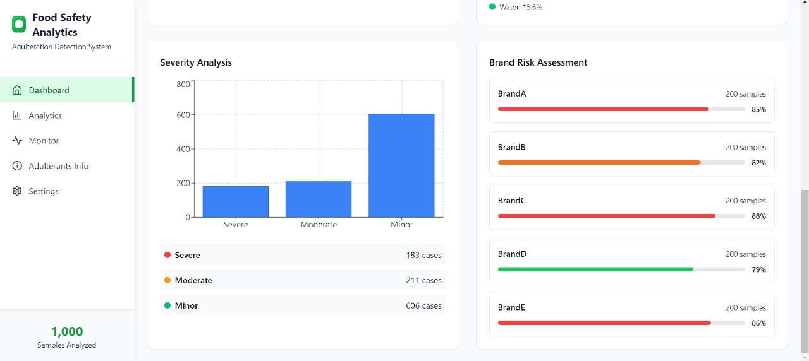
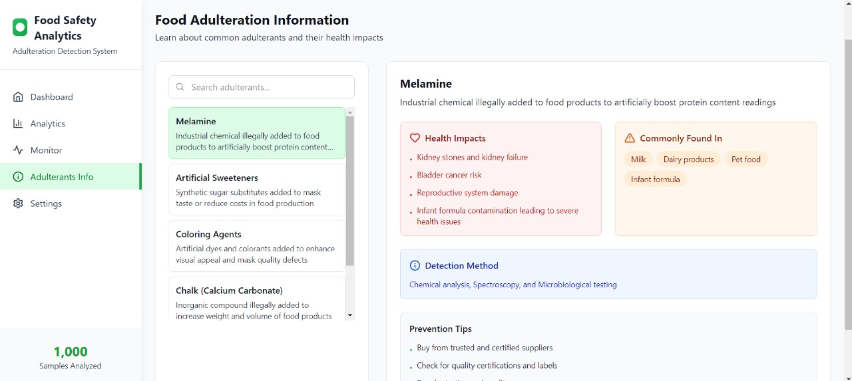
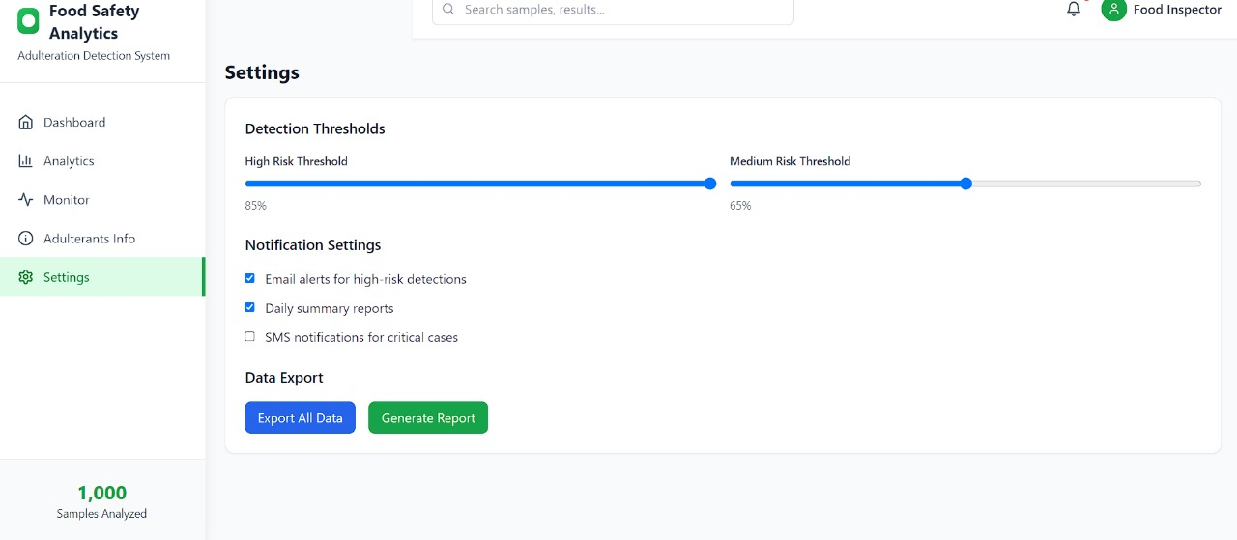
UI Interface

Slide 4
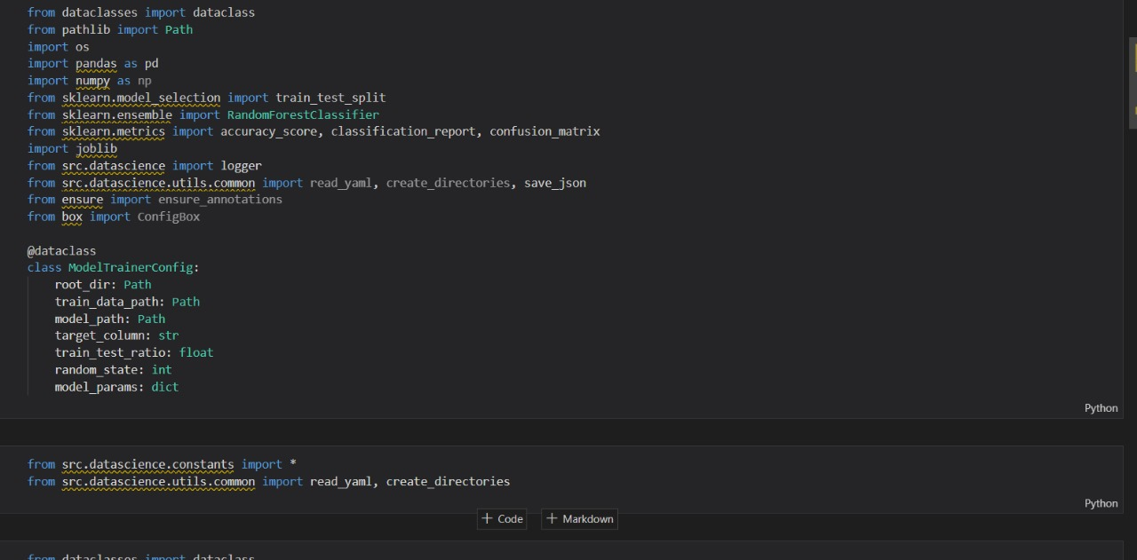
Machine Learning Model Used:
Random Forest Classifier. This is a powerful and popular machine learning model well-suited for classification tasks. Our Goal: The model's primary job is to analyze various details about a food adulteration incident and predict the associated health risk level (e.g., Low, Medium, or High).
It works like a committee of experts by building hundreds of decision trees. Each tree votes on the outcome, and the majority vote becomes the final prediction. This "wisdom of the crowd" approach ensures high accuracy.

Slide 5
Impact and Benefit:
The potential of this project is to create an automated, data-driven system for monitoring food safety. The primary benefit is a significant improvement in public health protection by enabling proactive and targeted interventions against harmful food adulteration.
Predictive Risk Assessment
Automated Monitoring System
Enhanced Public Safety: By quickly identifying high-risk products, the model enables faster recalls and public warnings.
Data-Driven Policy Making: The model's ability to identify key risk factors provides concrete evidence to support stronger food safety policies and regulations.

Slide 6
Actionable Recommendation:
Check food more often – regular testing, especially for meat and dairy.
Use smart tools – modern sensors and AI can catch adulteration quickly.
Teach people – show consumers simple ways to spot bad food.
Stricter rules – surprise checks and stronger action on offenders.
Track trends – keep using data and dashboards to stay ahead.

