Slide 1
Software Release Year Quiz
Fun Friday: Tech Timeline Challenge
Tech History Quiz • Let's Test Your Knowledge!

Slide 2
Instructions
- Each question will be displayed on screen.
- Answer aloud or type your answer in the chat.
- Click to reveal the correct answer.
- Points are awarded for each correct answer.
- Let's have fun and brush up on our tech history!

Slide 3
Windows 95
What year was Windows 95 released?
A) 1993
B) 1995
C) 1997
D) 1999

Slide 4
Windows 95 - Answer
The correct answer is: 1995

Slide 5
iPhone Introduction
When was the iPhone first introduced by Apple?
A) 2005
B) 2006
C) 2007
D) 2008

Slide 6
iPhone Introduction - Answer
The correct answer is: 2007

Slide 7
Google Founded
What year was Google officially founded?
A) 1997
B) 1998
C) 1999
D) 2000

Slide 8
Google Founded - Answer
The correct answer is: 1998

Slide 9
Java Release
When was the first version of Java released?
A) 1994
B) 1995
C) 1996
D) 1997

Slide 10
Java Release - Answer
The correct answer is: 1995

Slide 11
Facebook Launch
When did Facebook launch?
A) 2003
B) 2004
C) 2005
D) 2006

Slide 12
Facebook Launch - Answer
The correct answer is: 2004

Slide 13
YouTube Launch
When did YouTube launch?
A) 2004
B) 2005
C) 2006
D) 2007

Slide 14
YouTube Launch - Answer
The correct answer is: 2005

Slide 15
Android Release
When was the first version of Android released?
A) 2007
B) 2008
C) 2009
D) 2010

Slide 16
Android Release - Answer
The correct answer is: 2008

Slide 17
Operating Systems History
Which operating system came first?
A) MS-DOS
B) Unix
C) Windows
D) Mac OS

Slide 18
Operating Systems History - Answer
The correct answer is: Unix (1969)

Slide 19
Programming History – B Starts
What was the original name of JavaScript when it was first introduced?

Slide 20
Programming History - Answer
The correct answer is: LiveScript

Slide 21
Web Development
In web development, what does AJAX stand for?

Slide 22
Web Development - Answer
The correct answer is: Asynchronous JavaScript And XML

Slide 23
GUI History
Which company introduced the first commercial GUI OS, popularizing the mouse?

Slide 24
GUI History - Answer
The correct answer is: Xerox

Slide 25
Search Engine History
Before Google, name some popular search engines from the 1990s.

Slide 26
Search Engine History - Answer
The correct answer is: AltaVista, Yahoo, Lycos, WebCrawler, Excite, InfoSeek, Ask Jeeves, HotBot, Dogpile, MetaCrawler

Slide 27
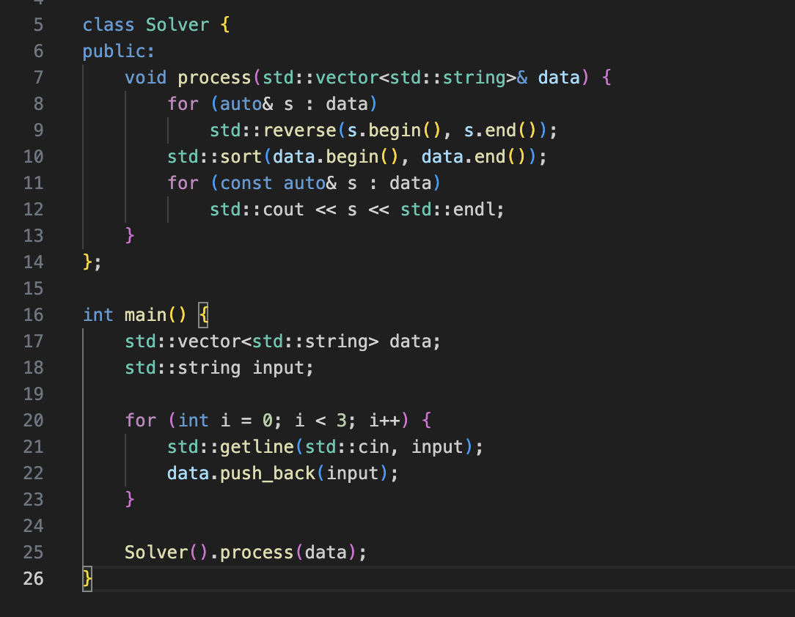
Which Programming Language is this?

Slide 28
C++

Slide 29
NetWeb Softwares
When was NetWeb First Started? Or you can say when is NetWeb’s Birthday?

Slide 30
NetWeb Softwares
Answer Need to find

Slide 31
Thanks for Playing!

