Slide 1
RNA-Seq data analysis
Qi Liu
Department of Biomedical Informatics
Vanderbilt University School of Medicine
qi.liu@vanderbilt.edu
Office hours: Thursday 2:00-4:00pm, 497A PRB

Slide 2
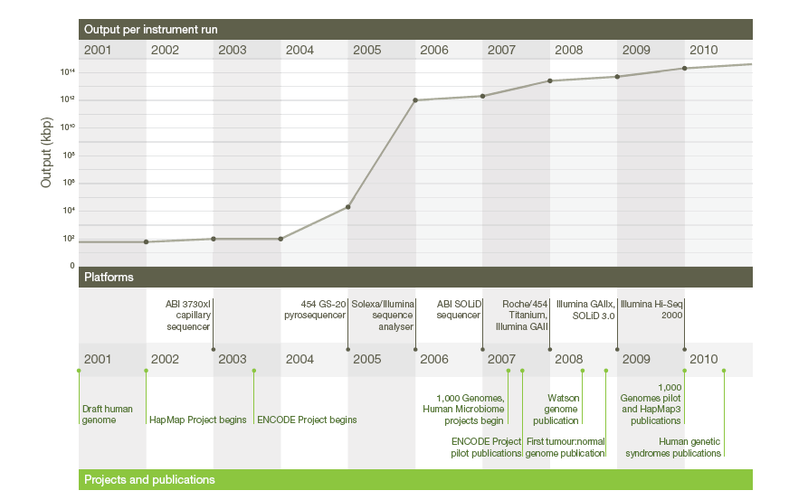
A decade’s perspective on DNA sequencing technology
Elaine R. Mardis, Nature(2011) 470, 198-203

Slide 3
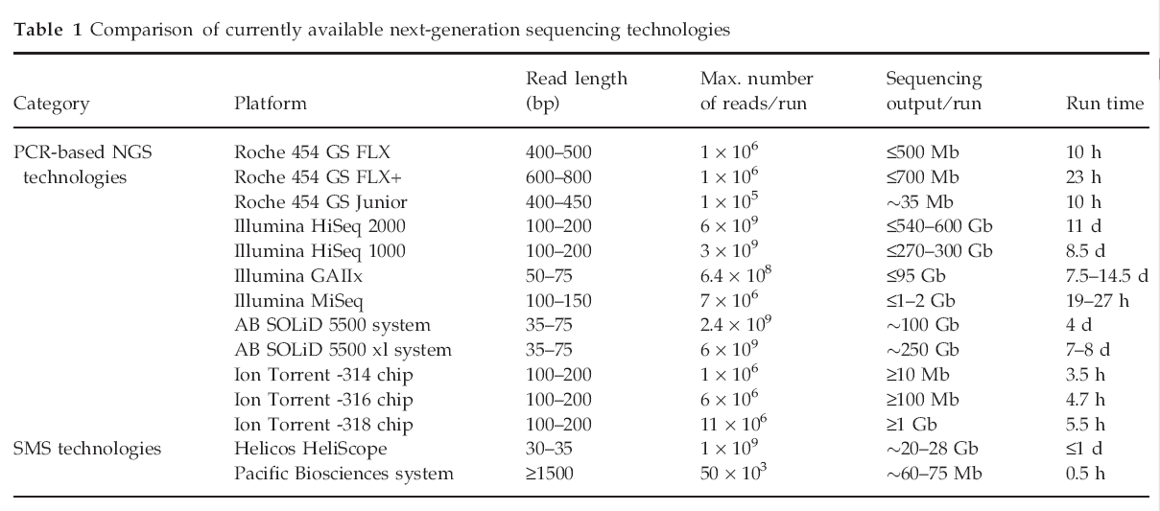
NGS technologies
S Shokralla et al., Molecular Ecology (2012) 21, 1794–1805

Slide 4
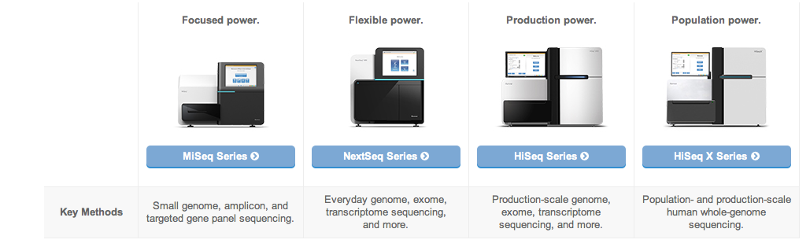
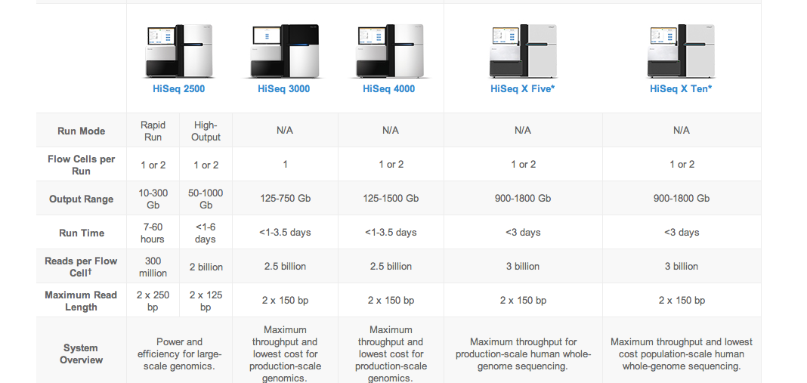

Slide 5
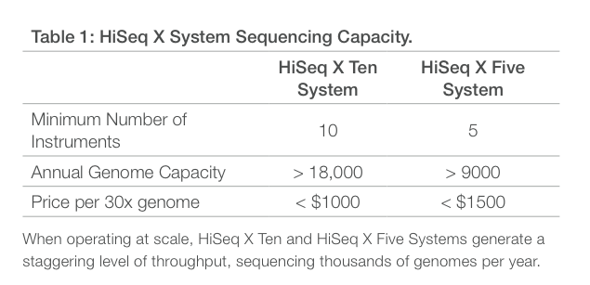
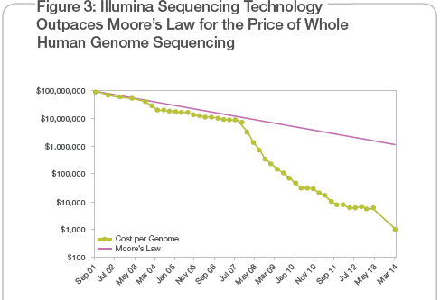

Slide 6
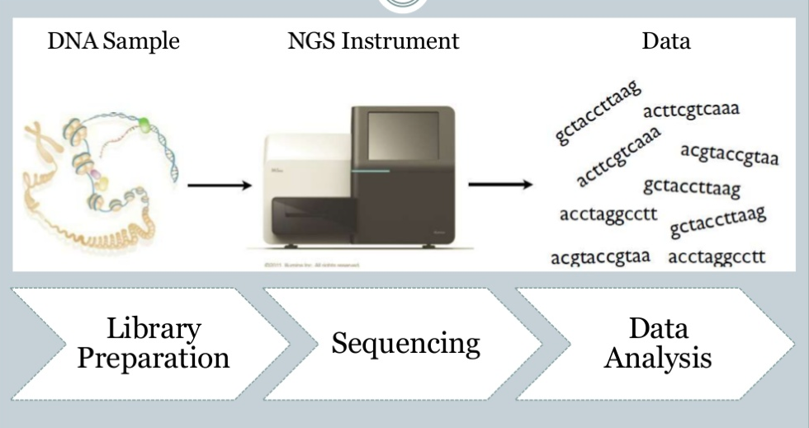
NGS sequencing pipeline
http://www.slideshare.net/mkim8/a-comparison-of-ngs-platforms

Slide 7
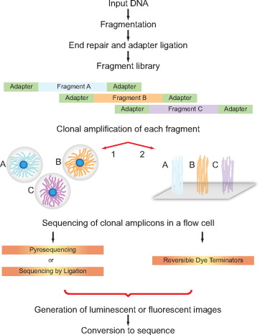
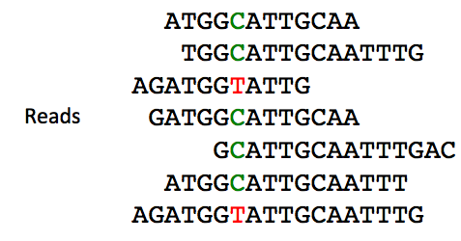
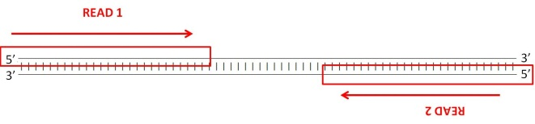
Sequencing steps
Library preparation
Library amplification
Parallel sequencing
Voelkerding KV et al., J Mol Diagn (2010) 12,539-51.

Slide 8
NGS Application
Whole genome sequencing
Whole exome sequencing
RNA sequencing
ChIP-seq/ChIP-exo
CLIP-seq
GRO-seq/PRO-seq
Bisulfite-Seq

Slide 9

Patient
Technologies
Data Analysis
Integration and interpretation
point mutation
Small indels
Further understanding of cancer and clinical applications
Genomics
WGS, WES
Copy number variation
Functional effect of mutation
Structural variation
Differential expression
Transcriptomics
RNA-Seq
Network and pathway analysis
Gene fusion
Alternative splicing
RNA editing
Integrative analysis
Epigenomics
Bisulfite-Seq
ChIP-Seq
Methylation
Histone modification
Transcription Factor binding
Shyr D, Liu Q. Biol Proced Online. (2013)15,4

Slide 10
Recent NGS-based studies in cancer
Cancer | Experiment Design | Description
Colon cancer | 72 WES, 68 RNA-seq 2 WGS | Identify multiple gene fusions such as RSPO2 and RSPO3 from RNA-seq that may function in tumorigenesis
Breast cancer | 65 WGS/WES, 80 RNA-seq | 36% of the mutations found in the study were expressed. Identify the abundance of clonal frequencies in an epithelial tumor subtype
Hepatocellular carcinoma | 1 WGS, 1 WES | Identify TSC1 nonsense substitution in subpopulation of tumor cells, intra-tumor heterogeneity, several chromosomal rearrangements, and patterns in somatic substitutions
Breast cancer | 510 WES | Identify two novel protein-expression-defined subgroups and novel subtype-associated mutations
Colon and rectal cancer | 224 WES, 97 WGS | 24 genes were found to be significantly mutated in both cancers. Similar patterns in genomic alterations were found in colon and rectum cancers
squamous cell lung cancer | 178 WES, 19 WGS, 178 RNA-seq, 158 miRNA-seq | Identify significantly altered pathways including NFE2L2 and KEAP1 and potential therapeutic targets
Ovarian carcinoma | 316 WES | Discover that most high-grade serous ovarian cancer contain TP53 mutations and recurrent somatic mutations in 9 genes
Melanoma | 25 WGS | Identify a significantly mutated gene, PREX2 and obtain a comprehensive genomic view of melanoma
Acute myeloid leukemia | 8 WGS | Identify mutations in relapsed genome and compare it to primary tumor. Discover two major clonal evolution patterns
Breast cancer | 24 WGS | Highlights the diversity of somatic rearrangements and analyzes rearrangement patterns related to DNA maintenance
Breast cancer | 31 WES, 46 WGS | Identify eighteen significant mutated genes and correlate clinical features of oestrogen-receptor-positive breast cancer with somatic alterations
Breast cancer | 103 WES, 17 WGS | Identify recurrent mutation in CBFB transcription factor gene and deletion of RUNX1. Also found recurrent MAGI3-AKT3 fusion in triple-negative breast cancer
Breast cancer | 100 WES | Identify somatic copy number changes and mutations in the coding exons. Found new driver mutations in a few cancer genes
Acute myeloid leukemia | 24 WGS | Discover that most mutations in AML genomes are caused by random events in hematopoietic stem/progenitor cells and not by an initiating mutation
Breast cancer | 21 WGS | Depict the life history of breast cancer using algorithms and sequencing technologies to analyze subclonal diversification
Head and neck squamous cell carcinoma | 32 WES | Identify mutation in NOTCH1 that may function as an oncogene
Renal carcinoma | 30 WES | Examine intra-tumor heterogeneity reveal branch evolutionary tumor growth

Slide 11
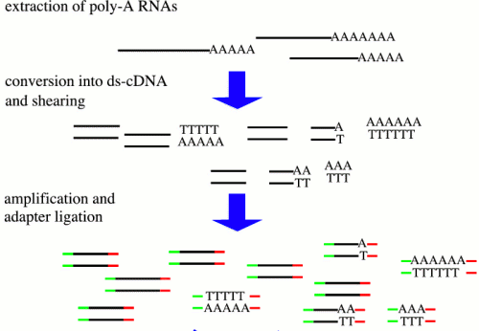



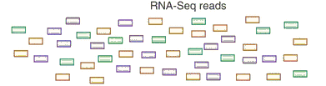
Overview of RNA-Seq
Transcriptome profiling using NGS

Slide 12
Application
Differential expression
Gene fusion
Alternative splicing
Novel transcribed regions
Allele-specific expression
RNA editing
Transcriptome for non-model organisms

Slide 13
Benefits & Challenge
Benefits:
Independence on prior knowledge
High resolution, sensitivity and large dynamic range
Unravel previously inaccessible complexities
Challenge:
Interpretation is not straightforward
Procedures continue to evolve

Slide 14
From reads to differential expression
Raw Sequence Data
FASTQ Files
QC by
FastQC/R
Reads Mapping
Unspliced Mapping
BWA, Bowtie
Spliced mapping
TopHat, MapSplice
Mapped Reads
SAM/BAM Files
Expression Quantification
Summarize read counts
FPKM/RPKM
Cufflinks
QC by
RNA-SeQC
DE testing
DEseq, edgeR, etc
Cuffdiff
List of DE
Functional Interpretation
Function enrichment
Infer networks
Integrate with other data
Biological Insights & hypothesis

Slide 15
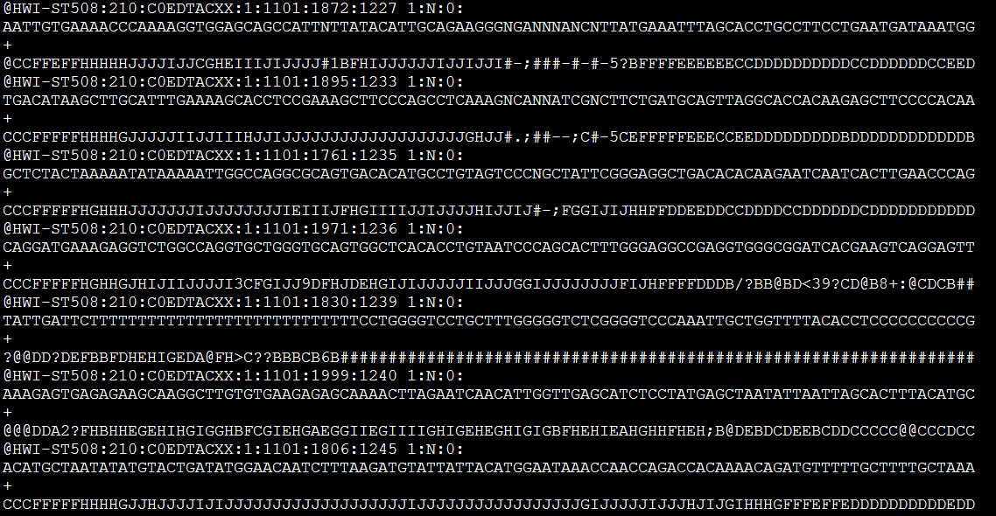
FASTQ files
Line1: Sequence identifier
Line2: Raw sequence
Line3: meaningless
Line4: quality values for the sequence

Slide 16
Sequencing QC
Information we need to check
Basic information( total reads, sequence length, etc.)
Per base sequence quality
Overrepresented sequences
GC content
Duplication level
Etc.

Slide 17
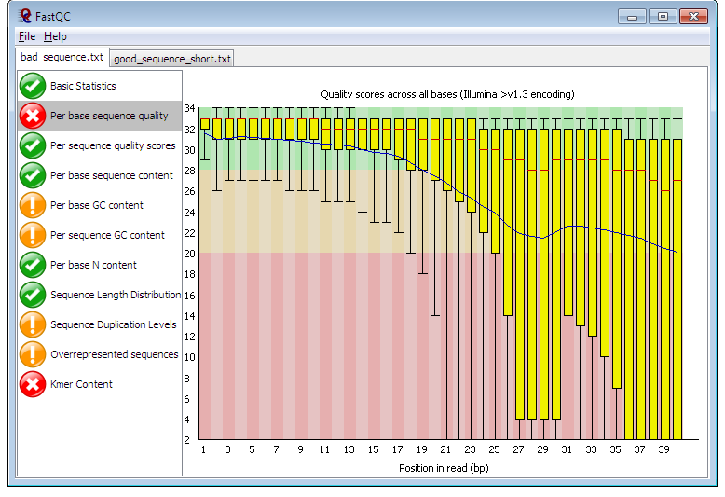
FastQC
http://www.bioinformatics.babraham.ac.uk/projects/fastqc/

Slide 18


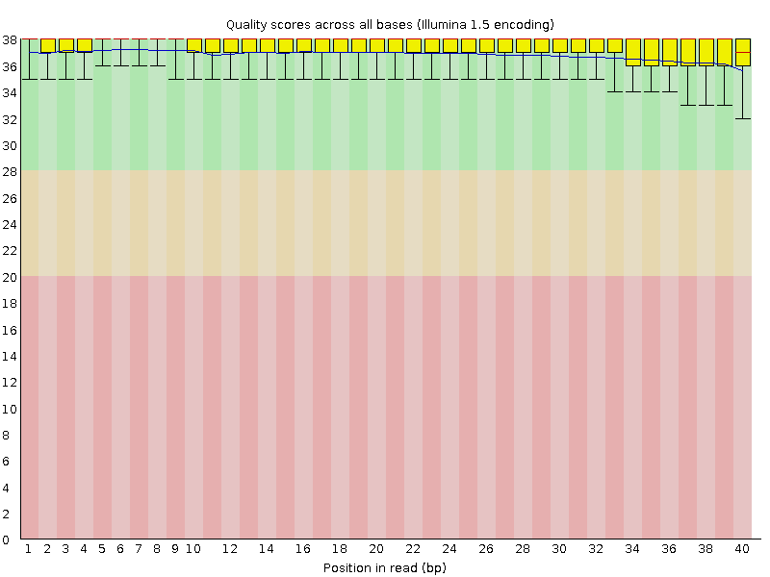
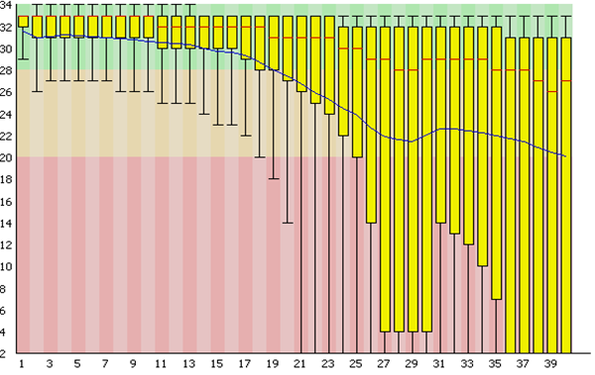
Per base sequence quality

Slide 19
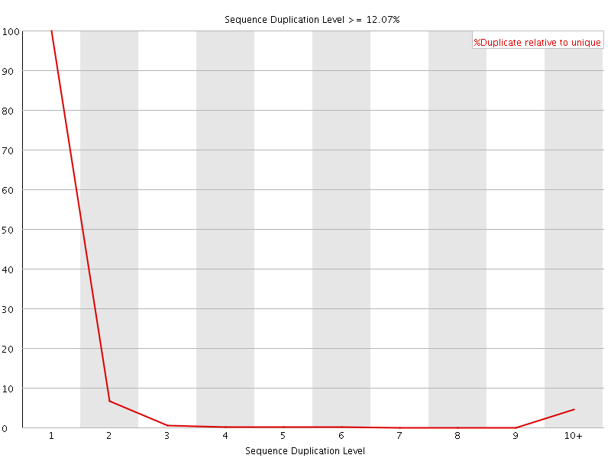
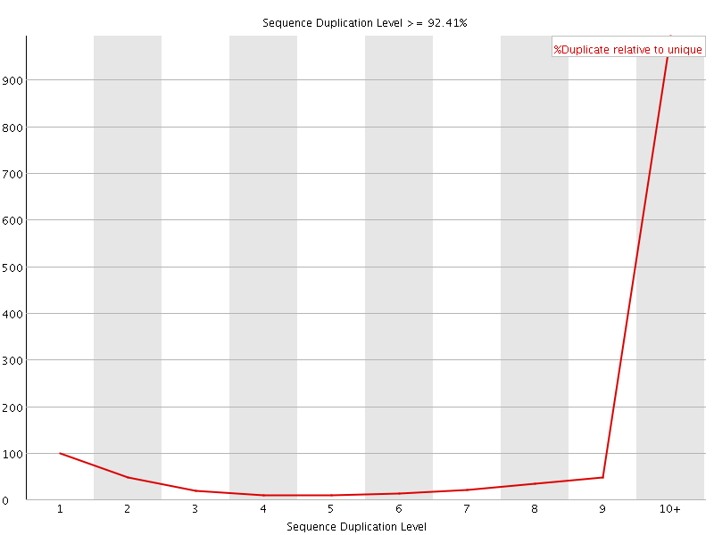
Duplication level

Slide 20
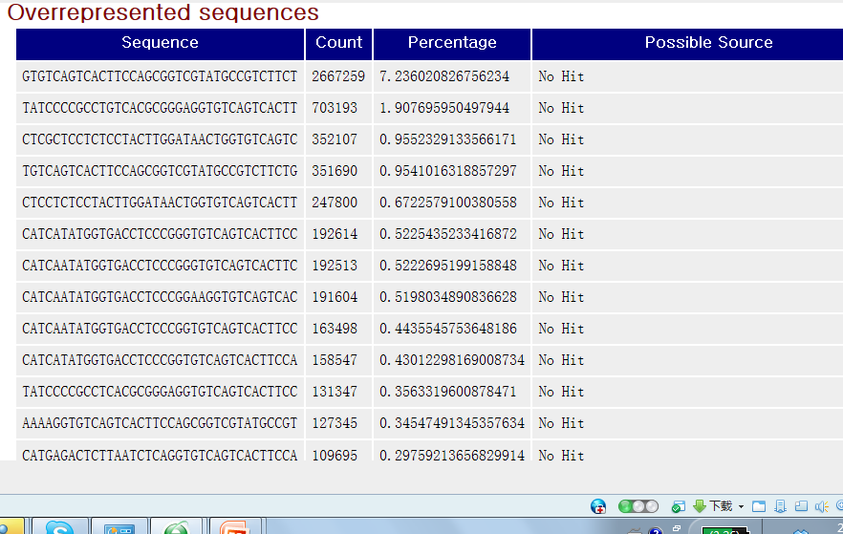
Overrepresented Sequences
Adapter

Slide 21
From reads to differential expression
Raw Sequence Data
FASTQ Files
QC by
FastQC/R
Reads Mapping
Unspliced Mapping
BWA, Bowtie
Spliced mapping
TopHat, MapSplice
Mapped Reads
SAM/BAM Files
Expression Quantification
Summarize read counts
FPKM/RPKM
Cufflinks
QC by
RNA-SeQC
DE testing
DEseq, edgeR, etc
Cuffdiff
List of DE
Functional Interpretation
Function enrichment
Infer networks
Integrate with other data
Biological Insights & hypothesis

Slide 22
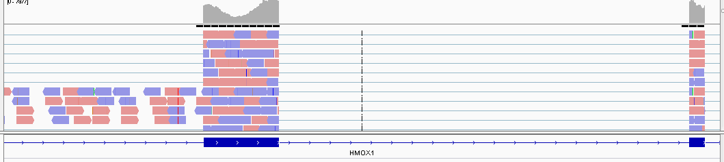
Read mapping
exon mapping
exon-exon junction
Unlike DNA-Seq, when mapping RNA-Seq reads back to reference genome, we need to pay attention to exon-exon junction reads

Slide 23
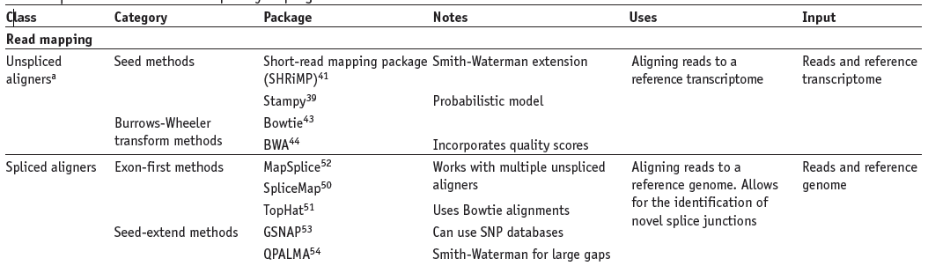
List of mapping methods

Slide 24
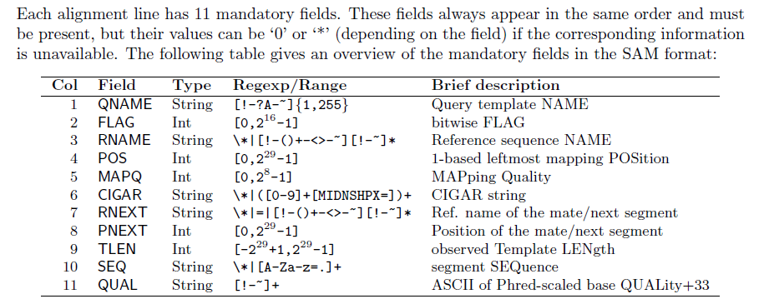
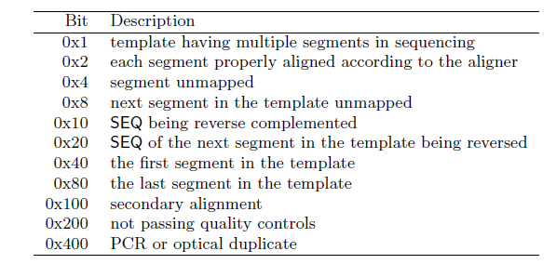
SAM/BAM format
Two section: header section, alignment section
http://samtools.sourceforge.net/SAM1.pdf

Slide 25
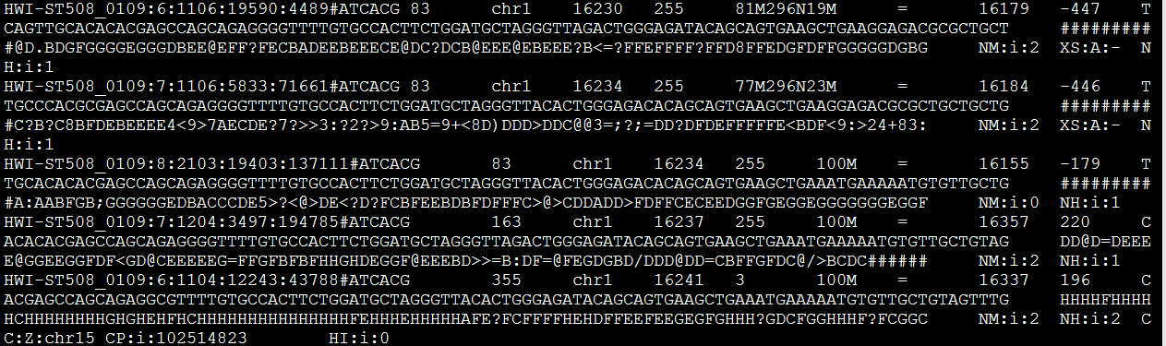
One example: SAM file
Read ID
Flag
pos
MQ
83= 1+2+16+64
read paired; read mapped in proper pair; read reverse strand; first in pair

Slide 26
Mapping QC
Information we need to check
Percentage of reads properly mapped or uniquely mapped
Among the mapped reads, the percentage of reads in exon, intron, and intergenic regions.
5' or 3' bias
The percentage of expressed genes

Slide 27
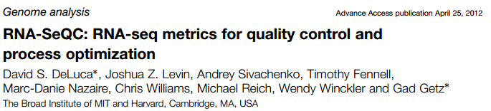
2012, Bioinformatics
Read Metrics
Total, unique, duplicate reads
Alternative alignment reads
Read Length
Fragment Length mean and standard deviation
Read pairs: number aligned, unpaired reads, base mismatch rate for each pair mate, chimeric pairs
Vendor Failed Reads
Mapped reads and mapped unique reads
rRNA reads
Transcript-annotated reads (intragenic, intergenic, exonic, intronic)
Expression profiling efficiency (ratio of exon-derived reads to total reads sequenced)
Strand specificity
Coverage
Mean coverage (reads per base)
Mean coefficient of variation
5'/3' bias
Coverage gaps: count, length
Coverage Plots
Downsampling
GC Bias
Correlation:
Between sample(s) and a reference expression profile
When run with multiple samples, the correlation between every sample pair is reported
https://confluence.broadinstitute.org/display/CGATools/RNA-SeQC

Slide 28
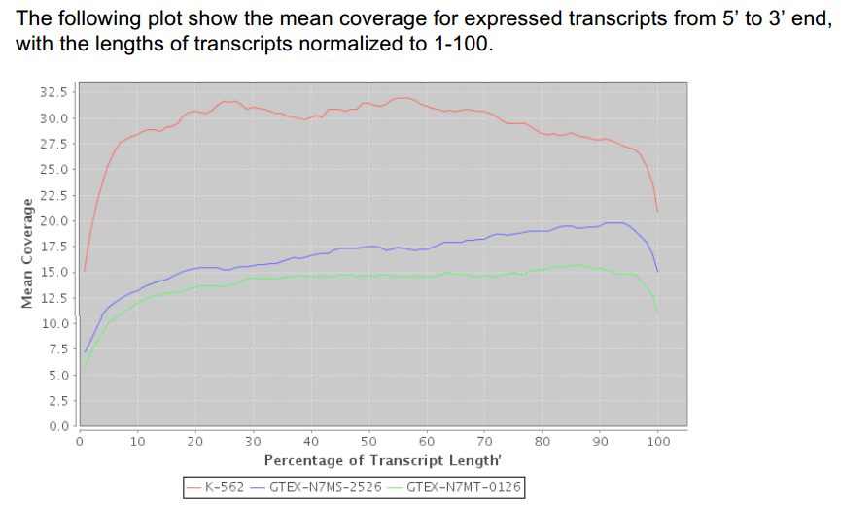
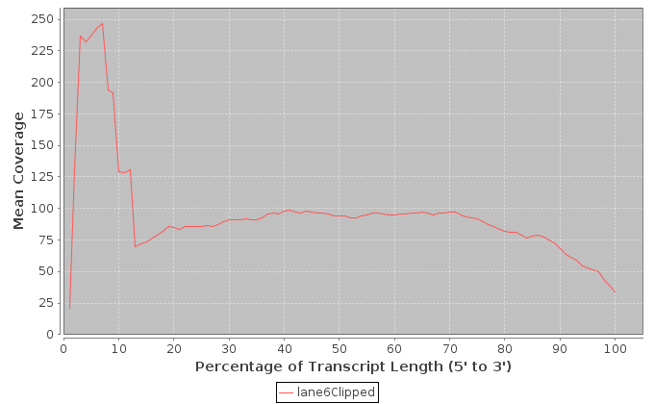
No 5' or 3' bias
5' bias

Slide 29
From reads to differential expression
Raw Sequence Data
FASTQ Files
QC by
FastQC/R
Reads Mapping
Unspliced Mapping
BWA, Bowtie
Spliced mapping
TopHat, MapSplice
Mapped Reads
SAM/BAM Files
Expression Quantification
Summarize read counts
FPKM/RPKM
Cufflinks
QC by
RNA-SeQC
DE testing
DEseq, edgeR, etc
Cuffdiff
List of DE
Functional Interpretation
Function enrichment
Infer networks
Integrate with other data
Biological Insights & hypothesis

Slide 30
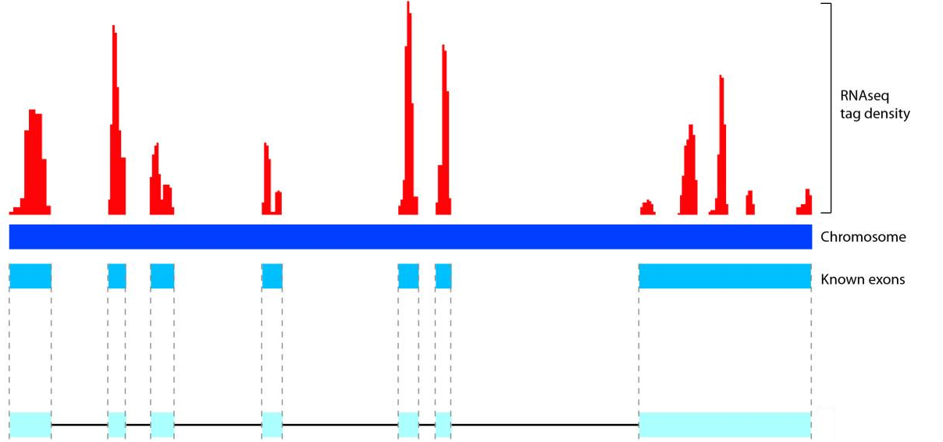
Expression quantification
Count data
Summarized mapped reads to CDS, gene or exon level
Notes:
tables of counts, showing how may reads are in coding region, exon, gene or junction)

Slide 31
Expression quantification
The number of reads is roughly proportional to
the length of the gene
the total number of reads in the library
Question:
Gene A: 200
Gene B: 300
Expression of Gene A < Expression of Gene B?

Slide 32

Expression quantification
FPKM /RPKM
Cufflinks & Cuffdiff
Notes:
tables of counts, showing how may reads are in coding region, exon, gene or junction)

Slide 33
From reads to differential expression
Raw Sequence Data
FASTQ Files
QC by
FastQC/R
Reads Mapping
Unspliced Mapping
BWA, Bowtie
Spliced mapping
TopHat, MapSplice
Mapped Reads
SAM/BAM Files
Expression Quantification
Summarize read counts
FPKM/RPKM
Cufflinks
QC by
RNA-SeQC
DE testing
DEseq, edgeR, etc
Cuffdiff
List of DE
Functional Interpretation
Function enrichment
Infer networks
Integrate with other data
Biological Insights & hypothesis

Slide 34
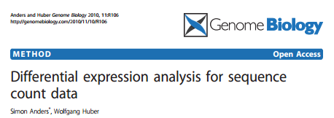
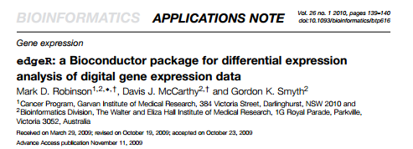
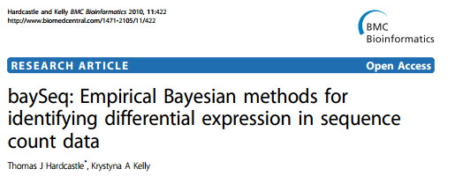
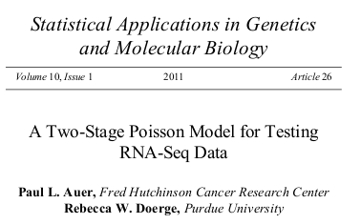
Count-based methods (R packages)
DESeq -- based on negative binomial distribution
edgeR -- use an overdispersed Poisson model
baySeq -- use an empirical Bayes approach
TSPM -- use a two-stage poisson model

Slide 35
RPKM/FPKM-based methods
Cufflinks & Cuffdiff
Other differential analysis methods for microarray data
t-test, limma etc.

Slide 36
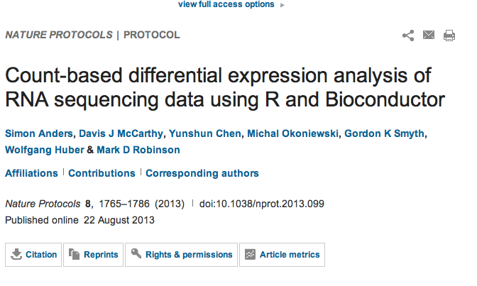
Count-based

Slide 37

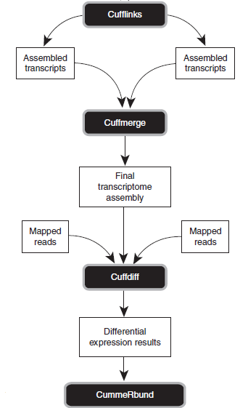
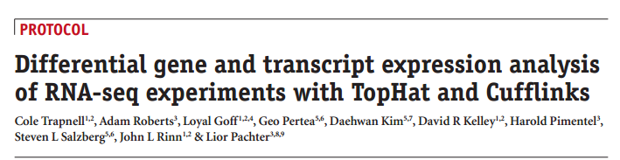
Cufflinks & Cuffdiff
Nature Protocols 7, 562-578 (2012)
http://cufflinks.cbcb.umd.edu/manual.html

Slide 38
Procedures
Step 1: Align the RNA-seq reads to the genome
Map the reads for each sample to the reference genome:
$ tophat -p 8 -G genes.gtf -o C1_R1_thout genome C1_R1_1.fq C1_R1_2.fq
$ tophat -p 8 -G genes.gtf -o C1_R2_thout genome C1_R2_1.fq C1_R2_2.fq
$ tophat -p 8 -G genes.gtf -o C1_R3_thout genome C1_R3_1.fq C1_R3_2.fq
$ tophat -p 8 -G genes.gtf -o C2_R1_thout genome C2_R1_1.fq C1_R1_2.fq
$ tophat -p 8 -G genes.gtf -o C2_R2_thout genome C2_R2_1.fq C1_R2_2.fq
$ tophat -p 8 -G genes.gtf -o C2_R3_thout genome C2_R3_1.fq C1_R3_2.fq
Steps 2 - 4: Assemble expressed genes and transcripts
Assemble transcripts for each sample:
$ cufflinks -p 8 -o C1_R1_clout C1_R1_thout/accepted_hits.bam
$ cufflinks -p 8 -o C1_R2_clout C1_R2_thout/accepted_hits.bam
$ cufflinks -p 8 -o C1_R3_clout C1_R3_thout/accepted_hits.bam
$ cufflinks -p 8 -o C2_R1_clout C2_R1_thout/accepted_hits.bam
$ cufflinks -p 8 -o C2_R2_clout C2_R2_thout/accepted_hits.bam
$ cufflinks -p 8 -o C2_R3_clout C2_R3_thout/accepted_hits.bam
Create a file called assemblies.txt that lists the assembly file for each sample. The file should contain the following lines:
./C1_R1_clout/transcripts.gtf
./C2_R2_clout/transcripts.gtf
./C1_R2_clout/transcripts.gtf
./C2_R1_clout/transcripts.gtf
./C1_R3_clout/transcripts.gtf
./C2_R3_clout/transcripts.gtf
Run Cuffmerge on all your assemblies to create a single merged transcriptome annotation:
cuffmerge -g genes.gtf -s genome.fa -p 8 assemblies.txt
Step 5: Identify differentially expressed genes and transcripts
Run Cuffdiff by using the merged transcriptome assembly along with the BAM files from TopHat for each replicate:
$ cuffdiff -o diff_out -b genome.fa -p 8 –L C1,C2 -u merged_asm/merged.gtf \
./C1_R1_thout/accepted_hits.bam,./C1_R2_thout/accepted_hits.bam,./C1_R3_thout/accepted_hits.bam \
./C2_R1_thout/accepted_hits.bam,./C2_R3_thout/accepted_hits.bam,./C2_R2_thout/accepted_hits.bam

Slide 39
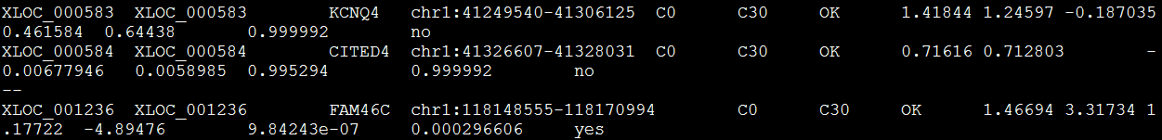
Cuffdiff Results
isoform_exp.diff
gene_exp.diff
tss_group_exp.diff
cds_exp.diff

Slide 40
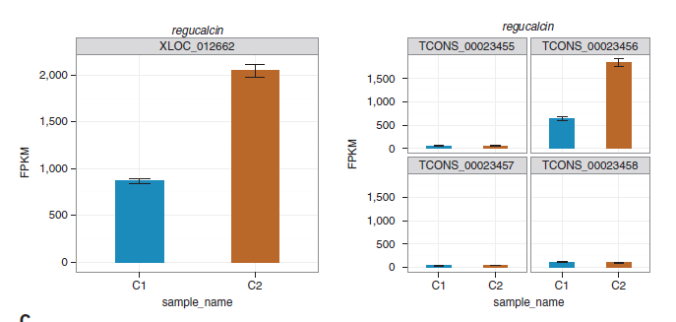
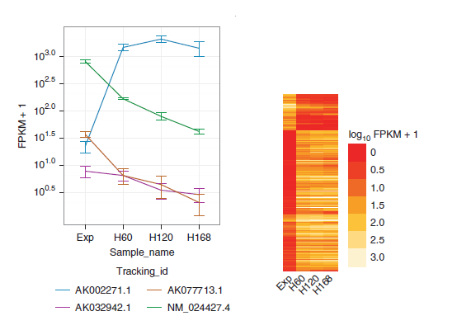
CummeRbund

Slide 41
References
Garber M, Grabherr MG, Guttman M, Trapnell C. Computational methods for transcriptome annotation and quantification using RNA-seq. Nat Methods. 2011;8(6):469-77.
Oshlack A, Robinson MD, Young MD. From RNA-seq reads to differential expression results. Genome Biol. 2010;11(12):220.
Ozsolak F, Milos PM. RNA sequencing: advances, challenges and opportunities. Nat Rev Genet. 2011;12(2):87-98.
Pepke S, Wold B, Mortazavi A. Computation for ChIP-seq and RNA-seq studies. Nat Methods. 2009 ;6(11 Suppl):S22-32.
Wang Z, Gerstein M, Snyder M. RNA-Seq: a revolutionary tool for transcriptomics. Nat Rev Genet. 2009;10(1):57-63.

Slide 42
Resources
http://seqanswers.com/forums/showthread.php?t=43
List software packages for next generation sequence analysis
http://manuals.bioinformatics.ucr.edu/home/ht-seq
Give examples of R codes to deal with next generation sequence data
http://www.rna-seqblog.com/
A blog publishes news related to RNA-Seq analysis.
http://www.bioconductor.org/help/workflows/high-throughput-sequencing Give examples using bioconductor for sequence data analysis
http://www.bioconductor.org/help/workflows/high-throughput-sequencing walk you through an end-to-end RNA-Seq differential expression workflow, using DESeq2 along with other Bioconductor packages.

Slide 43
HOMEWORK
https://www.youtube.com/watch?v=PMIF6zUeKko
Next-Generation Sequencing Technologies - Elaine Mardis
http://en.wikipedia.org/wiki/FASTQ_format
FASTQ format
http://samtools.github.io/hts-specs/SAMv1.pdf
SAM format
http://www.nature.com/nprot/journal/v8/n9/full/nprot.2013.099.html
Count-based differential expression analysis
http://www.nature.com/nprot/journal/v7/n3/full/nprot.2012.016.html
Differential expression analysis with TopHat and Cufflinks
http://www.bioconductor.org/help/workflows/high-throughput-sequencing walk you through an end-to-end RNA-Seq differential expression workflow, using DESeq2 along with other Bioconductor packages.

