Slide 1
Using CI / CD technology for web application development
Korchovyi Yurii

Slide 2






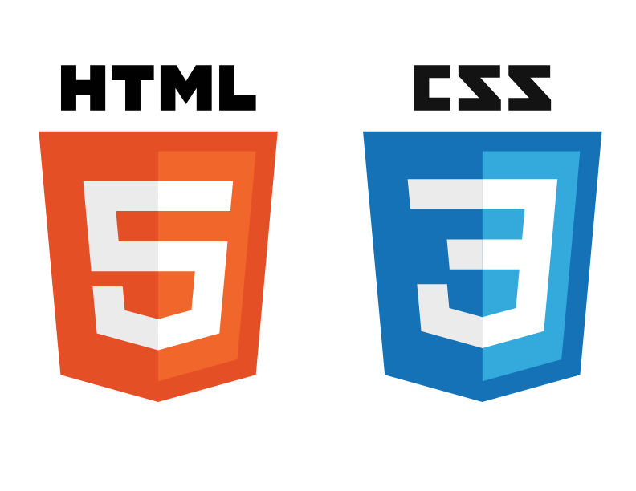

Used tools

Slide 3
Completed steps
1. TF files are written for two instances of their group security, user templates with the installation of Jenkins and Apache2-server.
2. Settings Jenkins.
3. Created Pipeline in Jenkins.
4. Settings Pipeline and push web-page to Apache-server.
5. Created repository in GitHub

Slide 4

Our Infrastructure
Local host
Install aws_instance and security groups
ec2(1)
Build and run
container
Pipeline
ec2(2)
Local host
http://18.222.249.167/

Slide 5
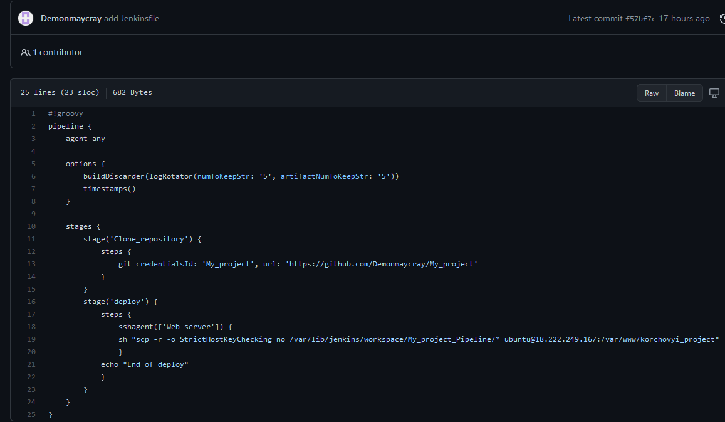
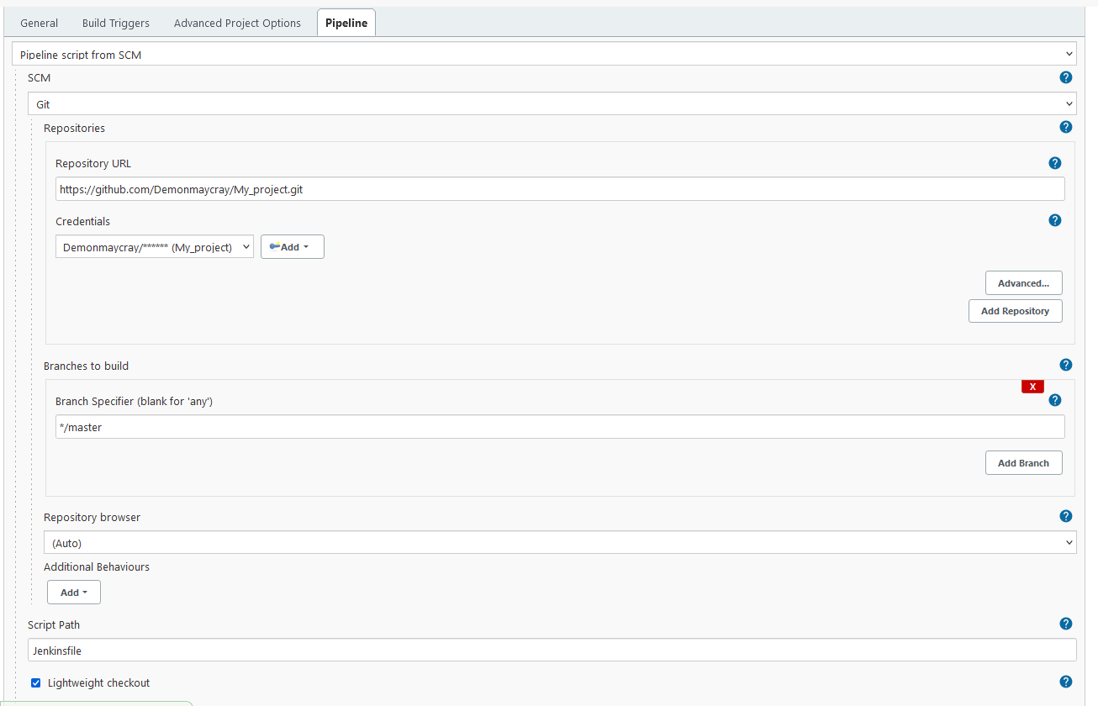
Pipeline

Slide 6
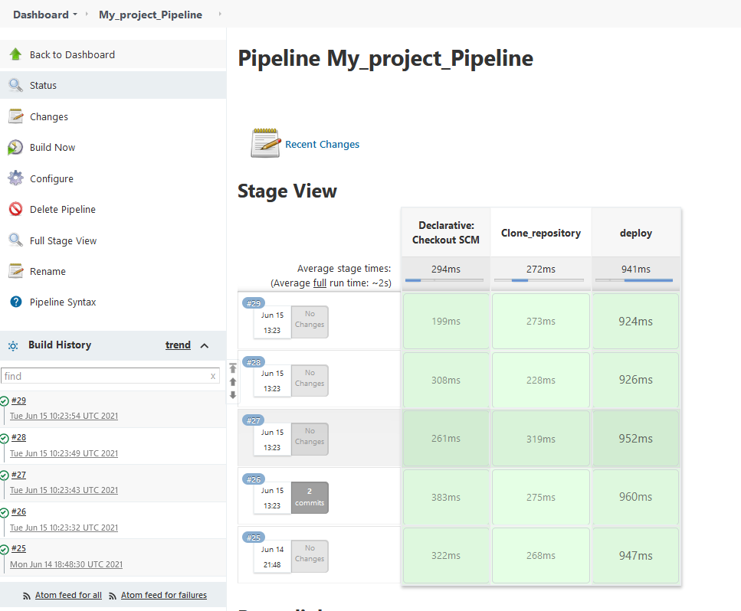
Pipeline

Slide 7
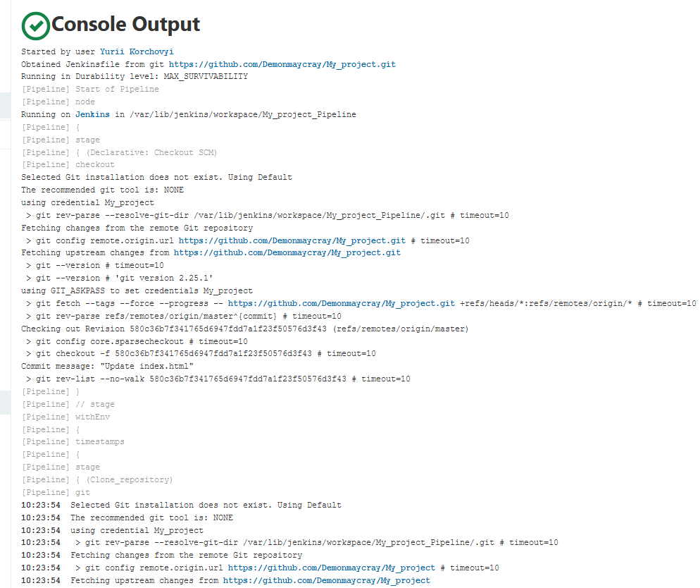
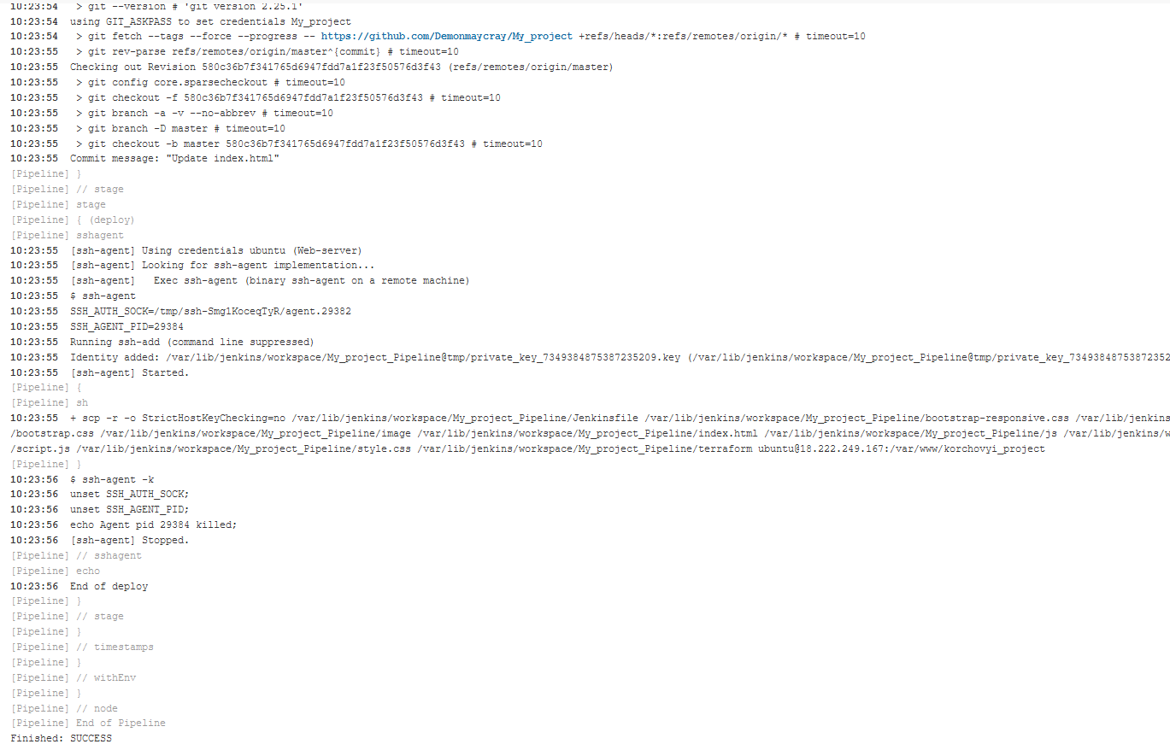
Pipeline

Slide 8
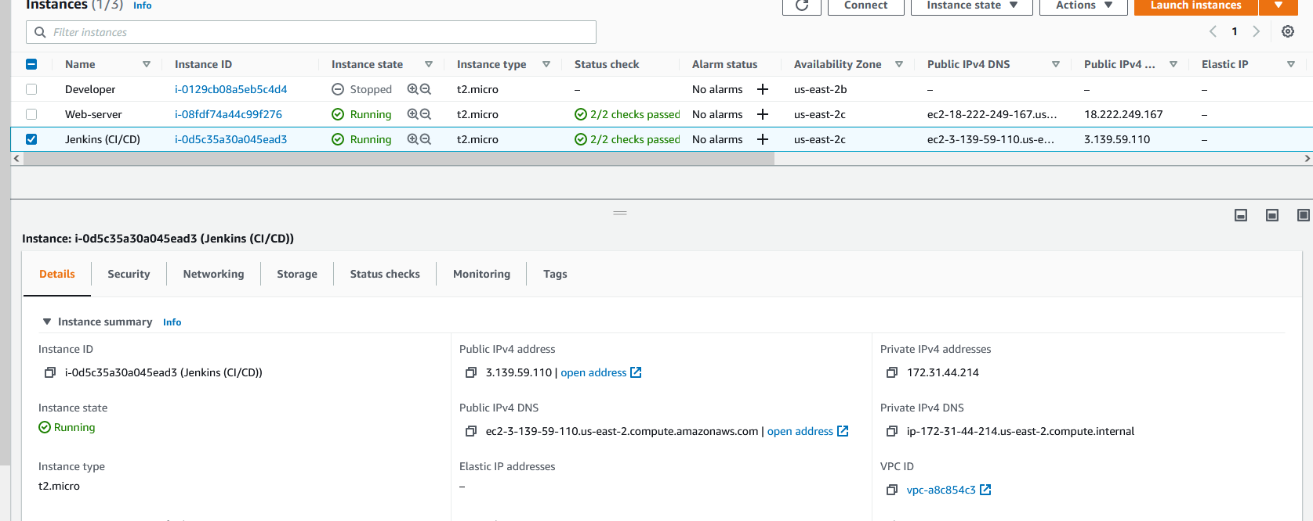
Amazon Web Service

Slide 9
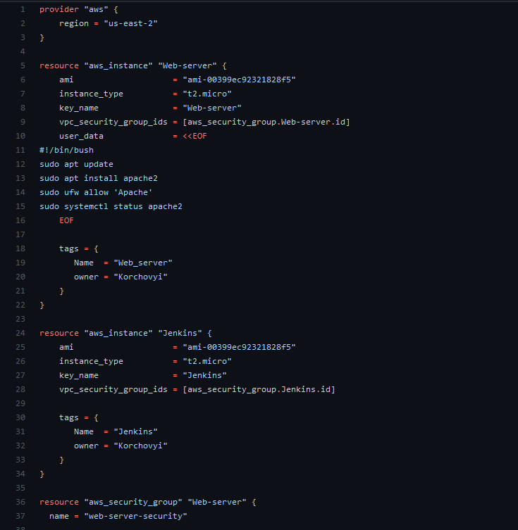
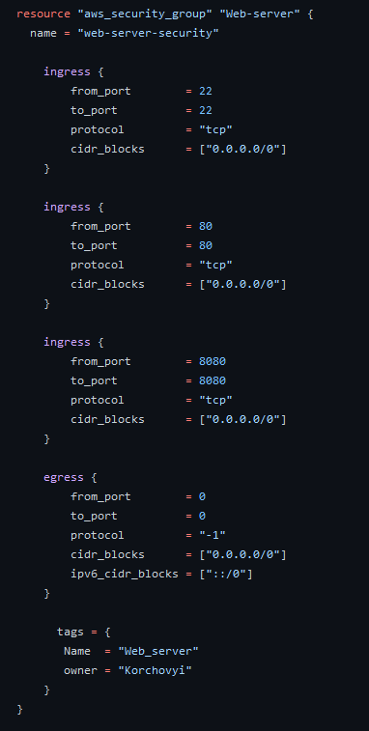
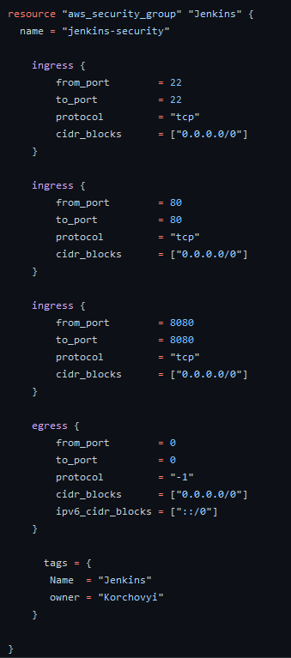
Terraform (main.tf)

Slide 10
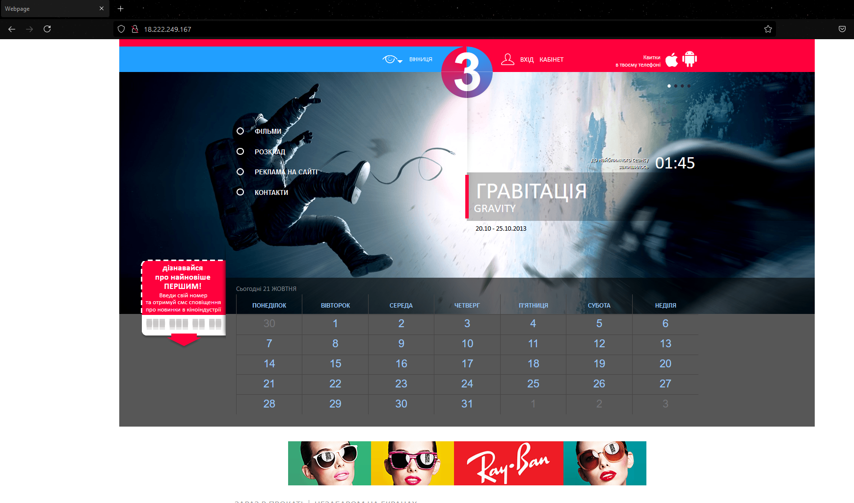
Result

