Slide 1
Design Procedure
Obtain specifications (goals) for the circuit
Define the inputs and outputs
Derive the truth table
Develop the simplified Boolean equation for each output (usually K-maps)
Draw the logic circuit diagram
Implement (physically or with a simulator)

Slide 2
Specification
Step 1
Design a circuit that can covert between binary and Gray code
We need more specifics:
Convert in either direction? No, go binary -> Gray
How many bits? 3
Step 2
Inputs: 3 bits (x,y,z) that together represent an unsigned binary number (with x being the MSB)
Outputs: 3 bits (G,H,I) that together represent a number in Gray code (with G being the MSB)

Slide 3
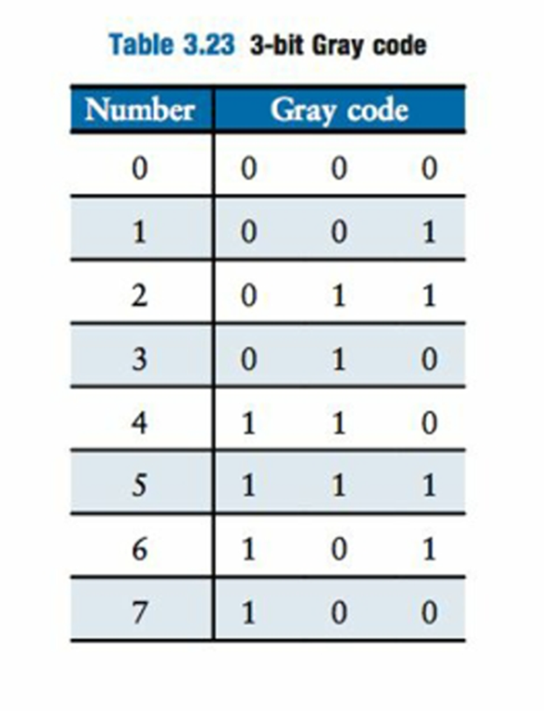
3-bit Gray Code

Slide 4
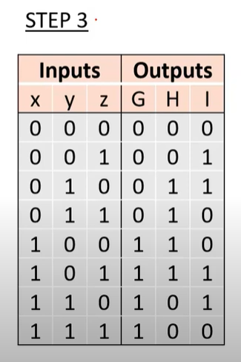
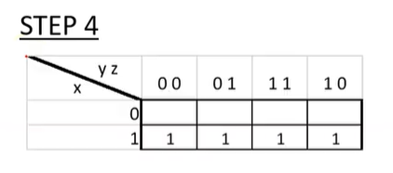
Gray Code Converter (1)
G = X

Slide 5
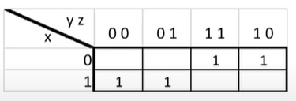
Gray Code Converter (2)
G = X
H = x’y + xy’

Slide 6
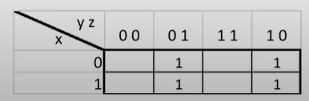
Gray Code Converter (3)
G = X
H = x’y + xy’
I = y’z + yz’

Slide 7
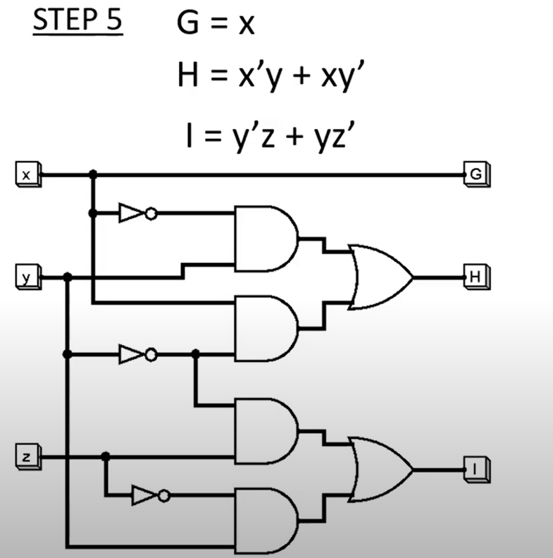
Gray Code Converter (4)

